Slide 1
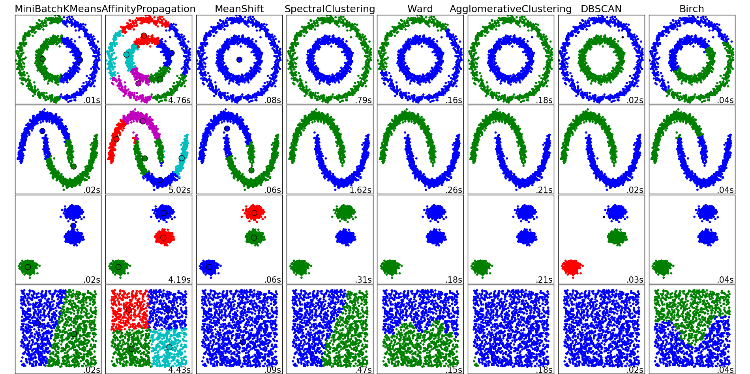
http://scikit-learn.org/stable/auto_examples/cluster/plot_cluster_comparison.html

Slide 2
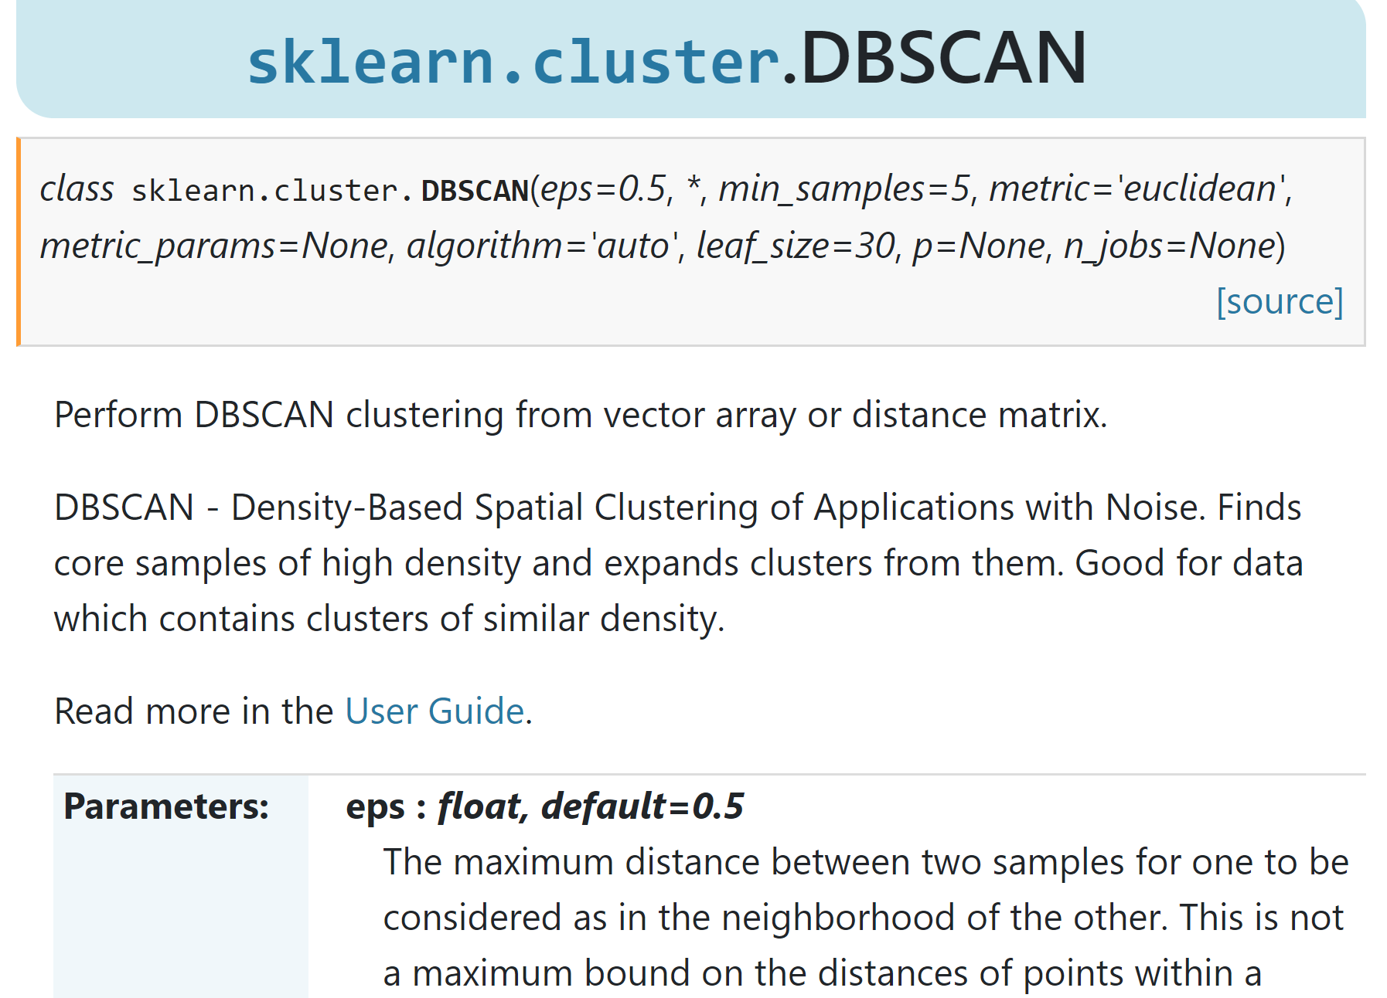

Slide 3
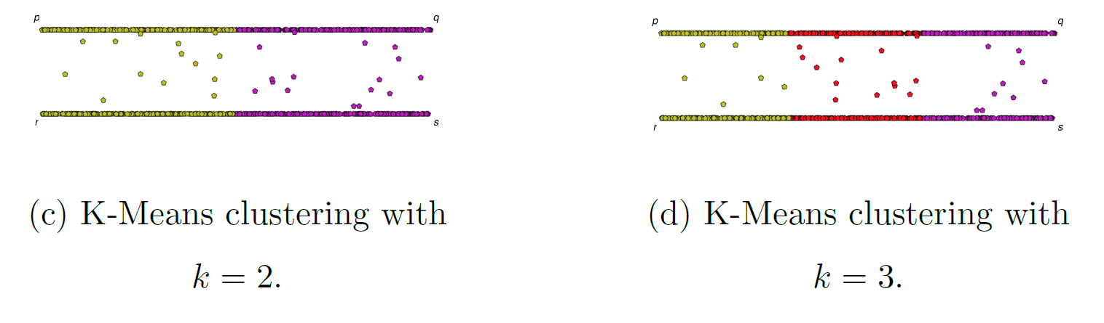
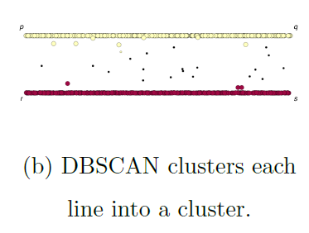
If you care about closeness:
Complete linkage
Average linkage
Ward’s linkage
K-means
If you care about connected components:
  Single linkage
  DBscan
Figures courtesy of Wako Bungula

Slide 4
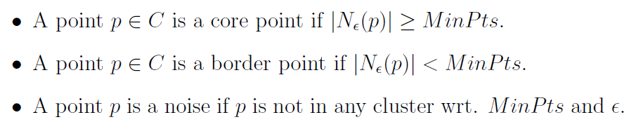
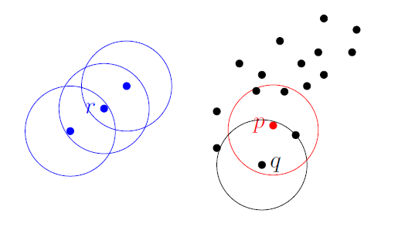
Dbscan (Density-based spatial clustering of applications with noise )
Figures courtesy of Wako Bungula

Slide 5
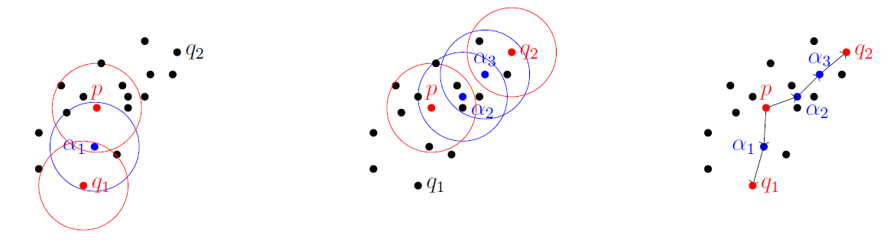
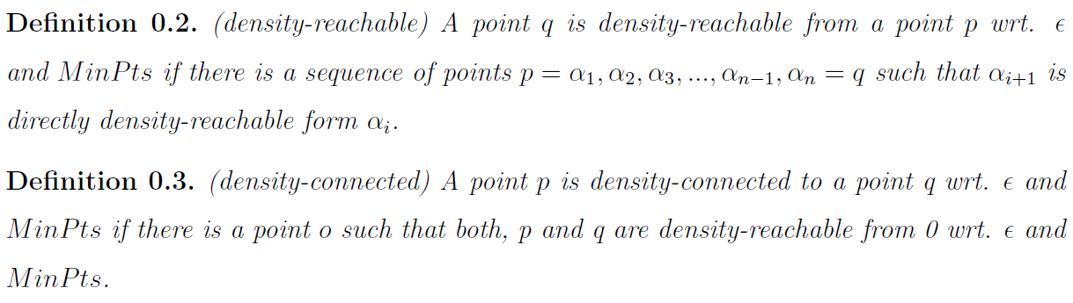
Figures courtesy of Wako Bungula

Slide 6
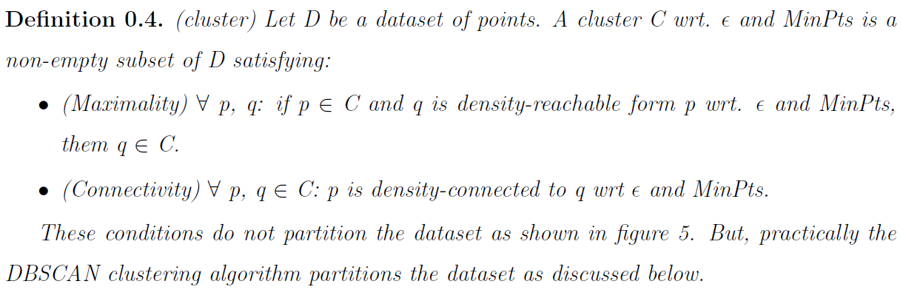
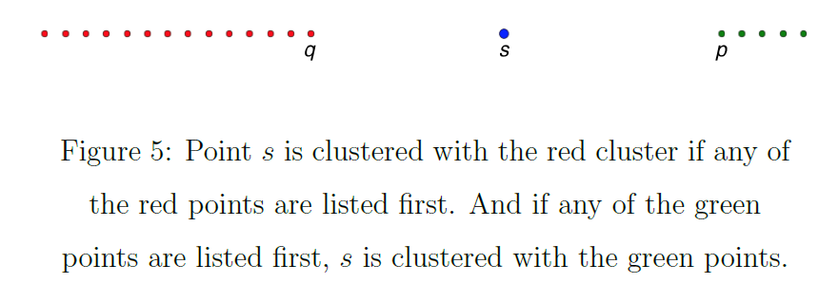
Figures courtesy of Wako Bungula

Slide 7
Figures courtesy of Wako Bungula

Slide 8
http://scikit-learn.org/stable/auto_examples/cluster/plot_cluster_comparison.html

Slide 9
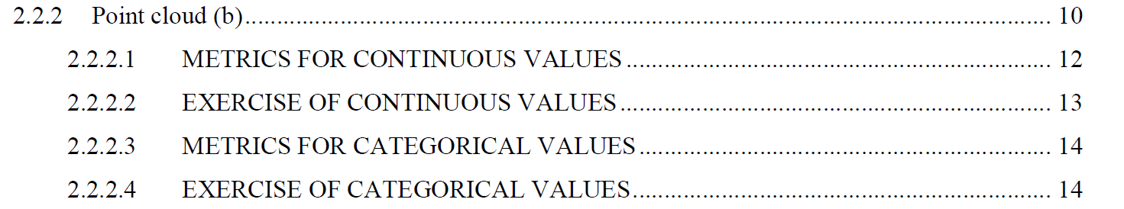
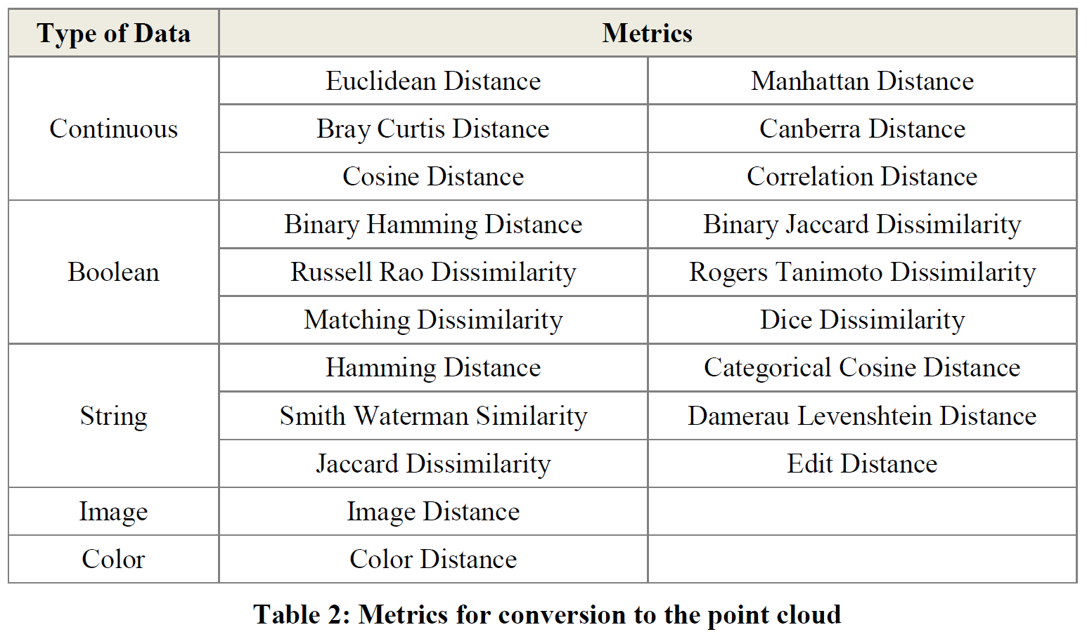
Section 2.2.2: Distances
http://www.bigdata.uni-frankfurt.de/wp-content/uploads/2015/10/
Evaluating-Ayasdi’s-Topological-Data-Analysis-For-Big-Data_HKim2015.pdf

Slide 10
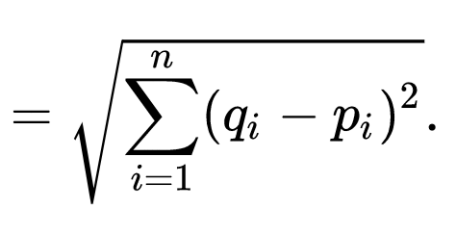

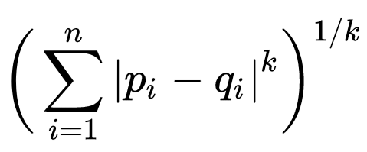

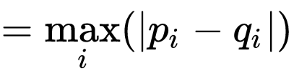
q
d(p, q) = ??
Euclidean
Minkowski distance
Chebyshev distance
5
4
p
3

Slide 11
q
d(p, q) = ??
Euclidean
5
Minkowski distance (k = 1)
7
Chebyshev distance
4
5
4
p
3

Slide 12
Application 3 (in paper): Basketball
Data: rates (per minute played) of rebounds, assists, turnovers, steals, blocked shots, personal fouls, and points scored for 452 players.
➔ Input: 452 points in R⁷
For each player, we have a vector
= (r, a, t, s, b, f, p) in R⁷
Distance: variance normalized Euclidean distance.
Clustering: Single linkage.
( min , min , min , min , min , min , min )
rebounds assists turnovers steals blocked shots personal fouls points scored
http://www.nature.com/srep/2013/130207/srep01236/full/srep01236.html

Slide 13
Distance: variance normalized Euclidean distance.
( min , min , min , min , min , min , min )
rebounds assists turnovers steals blocked shots personal fouls points scored

Slide 14
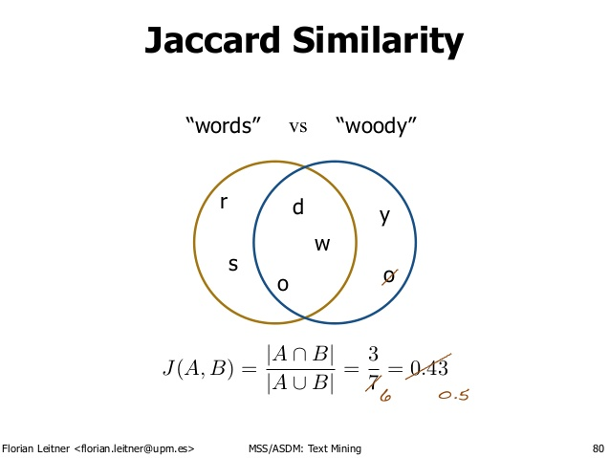
http://d-roger.com/2016/09/07/finding-similar-items-查找相似项/
Jacard Distance = 1 – J(A, B)

Slide 15
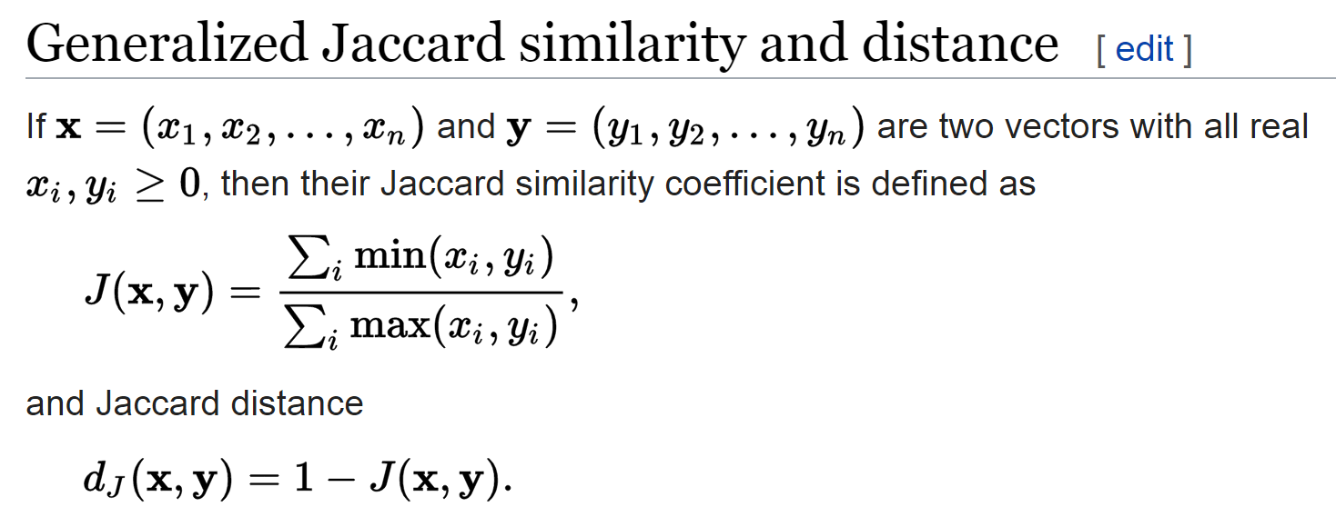
https://en.wikipedia.org/wiki/Jaccard_index

Slide 16
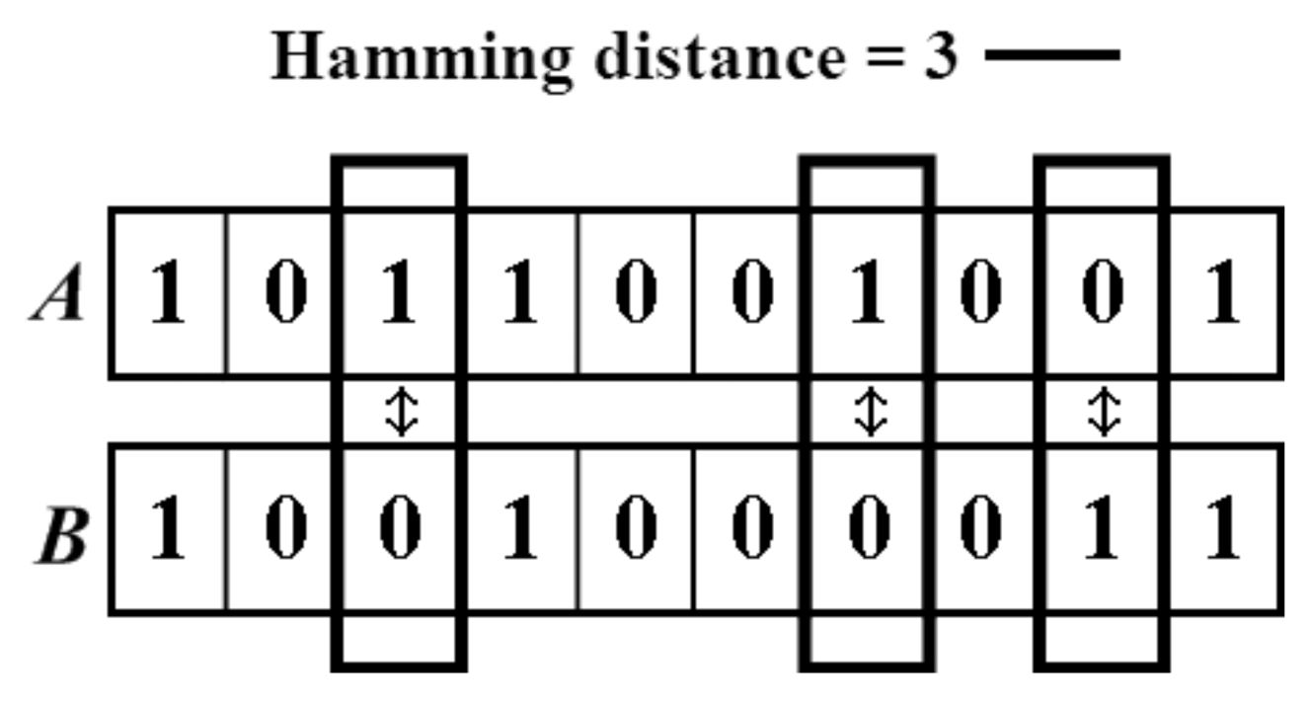

https://people.rit.edu/rmb5229/320/project3/hamming.html
http://rosalind.info/glossary/hamming-distance/
Hamming Distance = 7

Slide 17
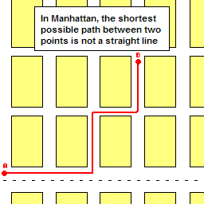
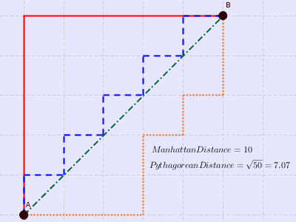

http://www.joachimdespland.com/mammoth.html
http://bloggity.nurdz.com/gamedev-math/manhattan/
http://www.improvedoutcomes.com/docs/WebSiteDocs/Clustering/Clustering_Parameters/Manhattan_Distance_Metric.htm

Slide 18
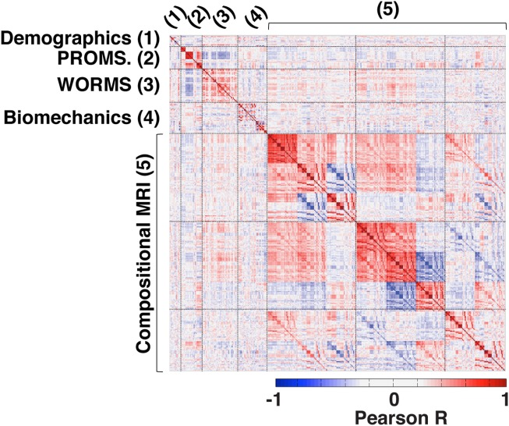
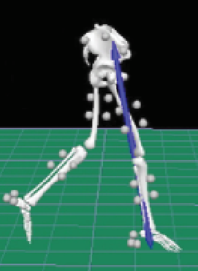
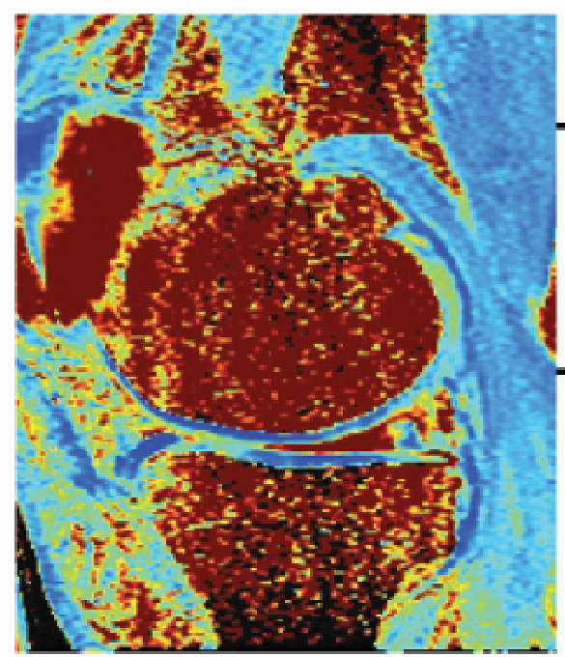
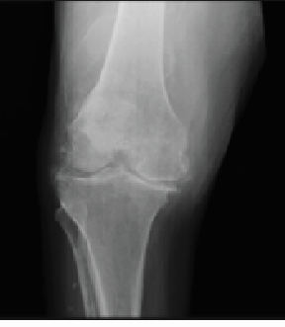

https://onlinelibrary.wiley.com/doi/full/10.1002/jmri.25750

Slide 19
In R^{n}
If n small, Euclidean distance often makes sense
If n is large, consider Chebyshev distance or
performing PCA first to project data into R^{d}, for small d
and then using Euclidean distance
Chebyshev distance:

Slide 20
Dimensionality Reduction: Given dataset D R^{N}
Want: embedding f: D → R^{n} where n << N
    which “preserves” the structure of the data.
Many reduction methods:
f₁: D → R, f₂: D → R, … f_{n}: D → R
(f₁, f₂, … f_{n}): D → R^{n}
Many are linear, M: R^{N} → R^{n}, Mx = y
But there are also non-linear dimensionality reduction algorithms.
U

Slide 21
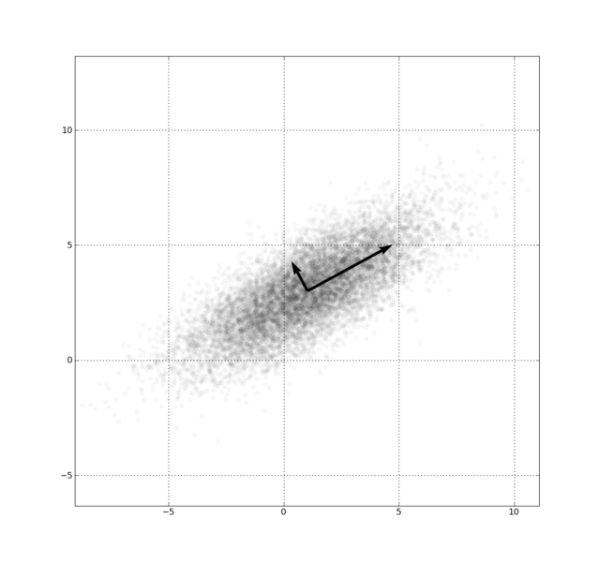
Example: Principle component analysis (PCA)
http://en.wikipedia.org/wiki/File:GaussianScatterPCA.png

Slide 22
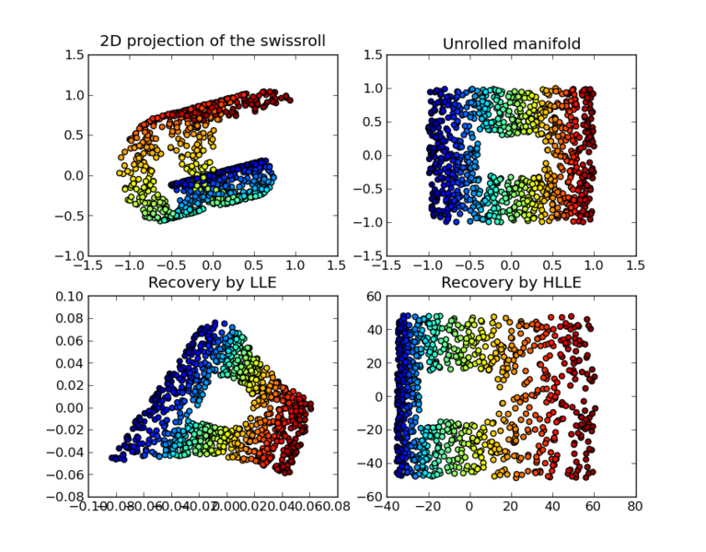
https://en.wikipedia.org/wiki/Nonlinear_dimensionality_reduction

Slide 23
Why use PCA in data analysis?
Consider the points (0, 0, …, 0), (1, 0, …, 0), (10, 0, …, 0)
Add noise to first point (0, 0, …, 0) → (0, 1, …, 1)
In R¹⁰⁰, d((0, 1, …, 1), (1, 0, …, 0)) = 10 > 9.
Add small noise to first point (0, 0, …, 0) → (0, 0.1, …, 0.1)
In R^{39,900}, d((0, 0.1, …, 0.1), (1, 0, …, 0)) = 20 > 9.
0 1 10

