Slide 1
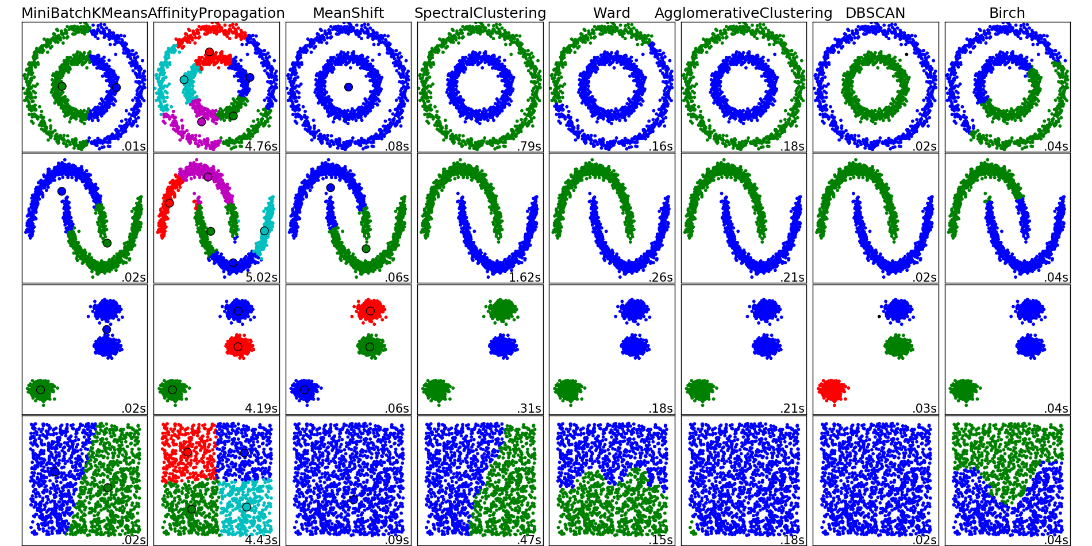
http://scikit-learn.org/stable/auto_examples/cluster/plot_cluster_comparison.html

Slide 2
ICON Anouncement:
Module 6 website + office hours
Our course website is at https://homepage.divms.uiowa.edu/~idarcy/COURSES/MB/SPRING21/5760.html
Links to slides are available at this website. See UICapture on ICON for zoom recordings. See ICON for the most updated list of assignments.
Zoom link for office hours:
MWF
11:20 - 11:45am+ : https://uiowa.zoom.us/j/9
2:20-2:55pm+ : https://uiowa.zoom.us/j/9
Note: + means I will be also available directly after the office hour, normally for as long as needed. You are also welcome to ask questions and make appointments via e-mail, etc.

Slide 3
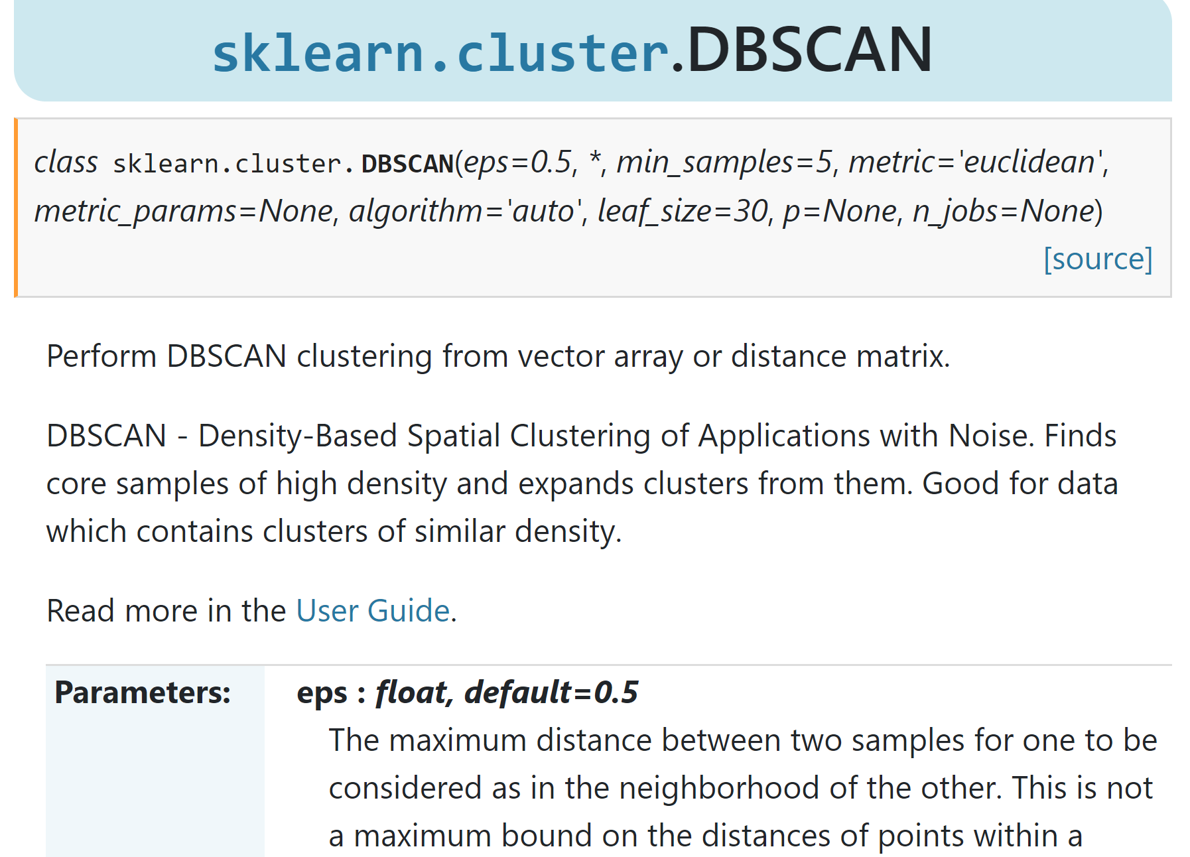

Slide 4
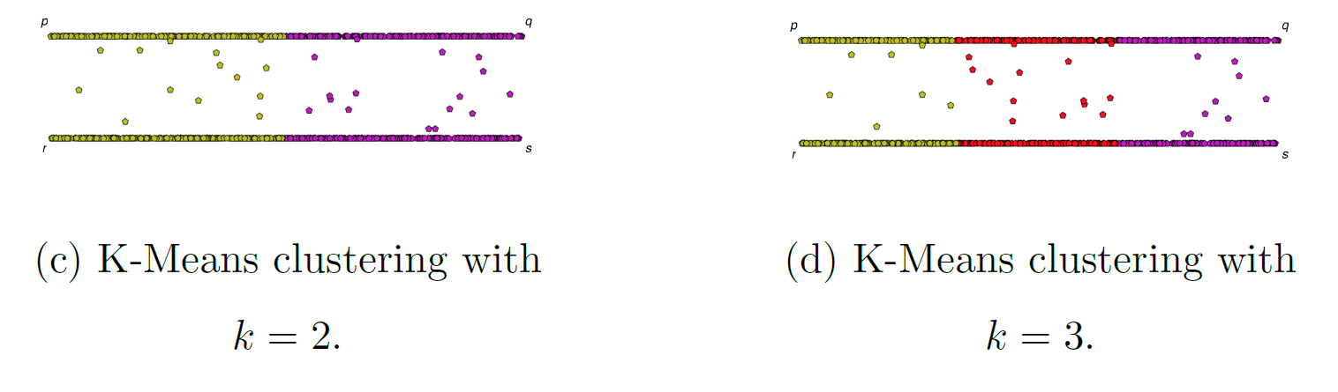
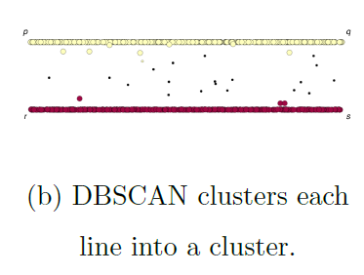
If you care about closeness:
Complete linkage
Average linkage
Ward’s linkage
K-means
If you care about connected components:
  Single linkage
  DBscan
Figures courtesy of Wako Bungula

Slide 5
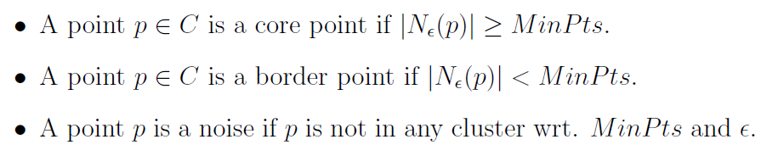
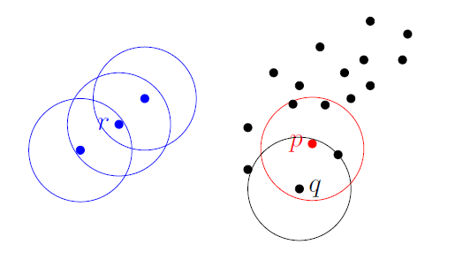
Dbscan (Density-based spatial clustering of applications with noise )
Figures courtesy of Wako Bungula

Slide 6
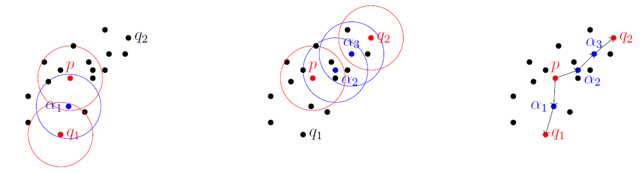
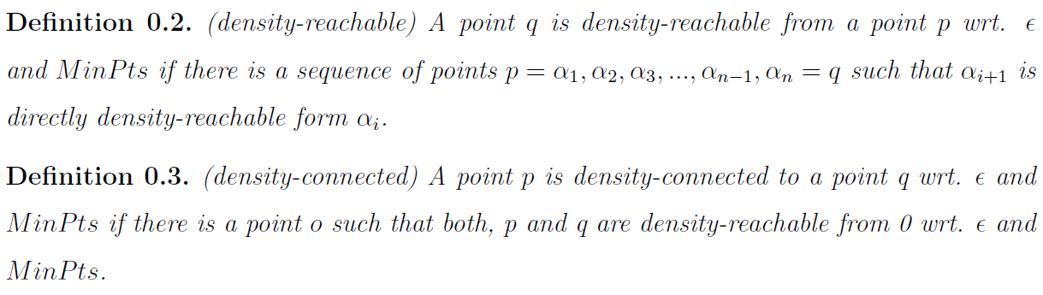
Figures courtesy of Wako Bungula

Slide 7
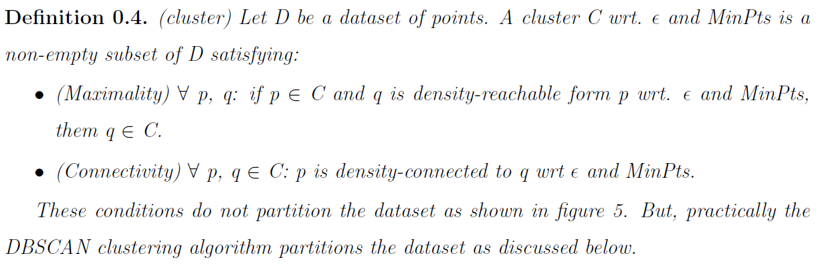
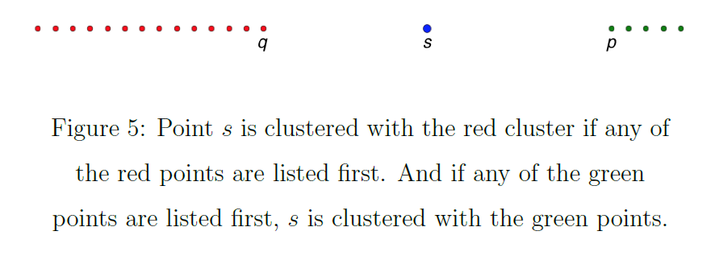
Figures courtesy of Wako Bungula

Slide 8
Figures courtesy of Wako Bungula

Slide 9
http://scikit-learn.org/stable/auto_examples/cluster/plot_cluster_comparison.html

Slide 10
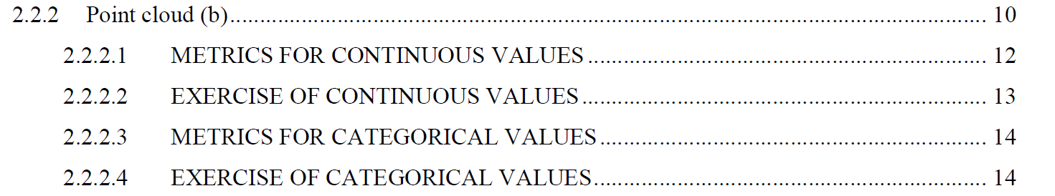
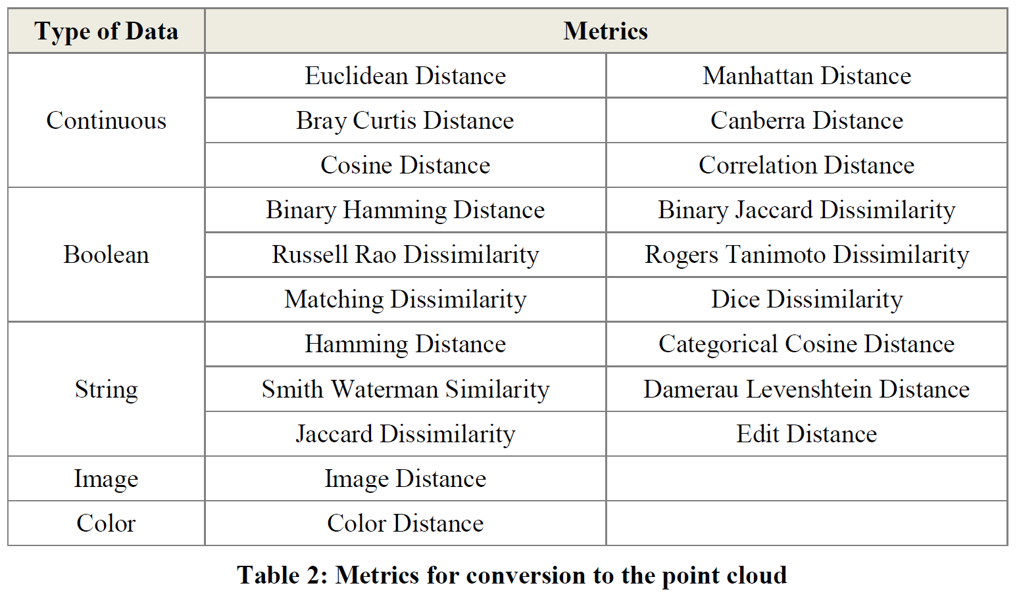
Section 2.2.2: Distances
http://www.bigdata.uni-frankfurt.de/wp-content/uploads/2015/10/
Evaluating-Ayasdi’s-Topological-Data-Analysis-For-Big-Data_HKim2015.pdf

Slide 11
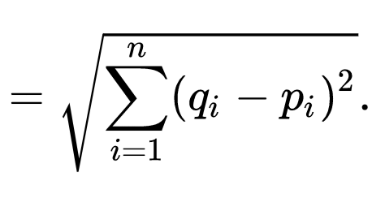

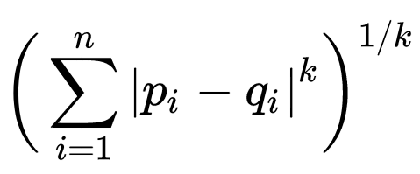

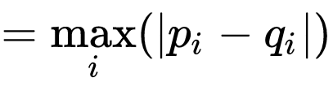
q
d(p, q) = ??
Euclidean
Minkowski distance
Chebyshev distance
5
4
p
3

Slide 12
q
d(p, q) = ??
Euclidean
5
Minkowski distance (k = 1)
7
Chebyshev distance
4
5
4
p
3

Slide 13
Application 3 (in paper): Basketball
Data: rates (per minute played) of rebounds, assists, turnovers, steals, blocked shots, personal fouls, and points scored for 452 players.
➔ Input: 452 points in R⁷
For each player, we have a vector
= (r, a, t, s, b, f, p) in R⁷
Distance: variance normalized Euclidean distance.
Clustering: Single linkage.
( min , min , min , min , min , min , min )
rebounds assists turnovers steals blocked shots personal fouls points scored
http://www.nature.com/srep/2013/130207/srep01236/full/srep01236.html

Slide 14
Distance: variance normalized Euclidean distance.
( min , min , min , min , min , min , min )
rebounds assists turnovers steals blocked shots personal fouls points scored

Slide 15
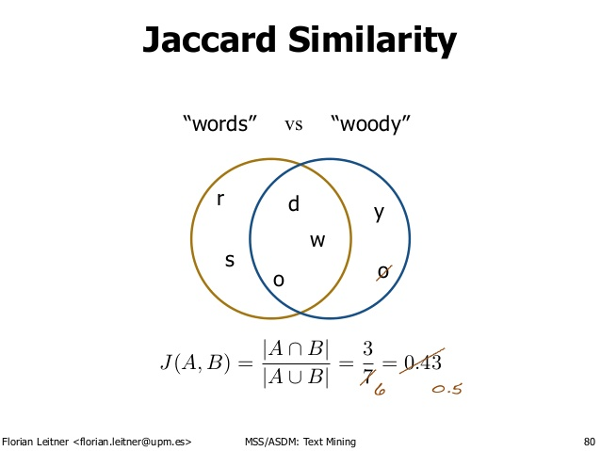
http://d-roger.com/2016/09/07/finding-similar-items-查找相似项/
Jacard Distance = 1 – J(A, B)

Slide 16
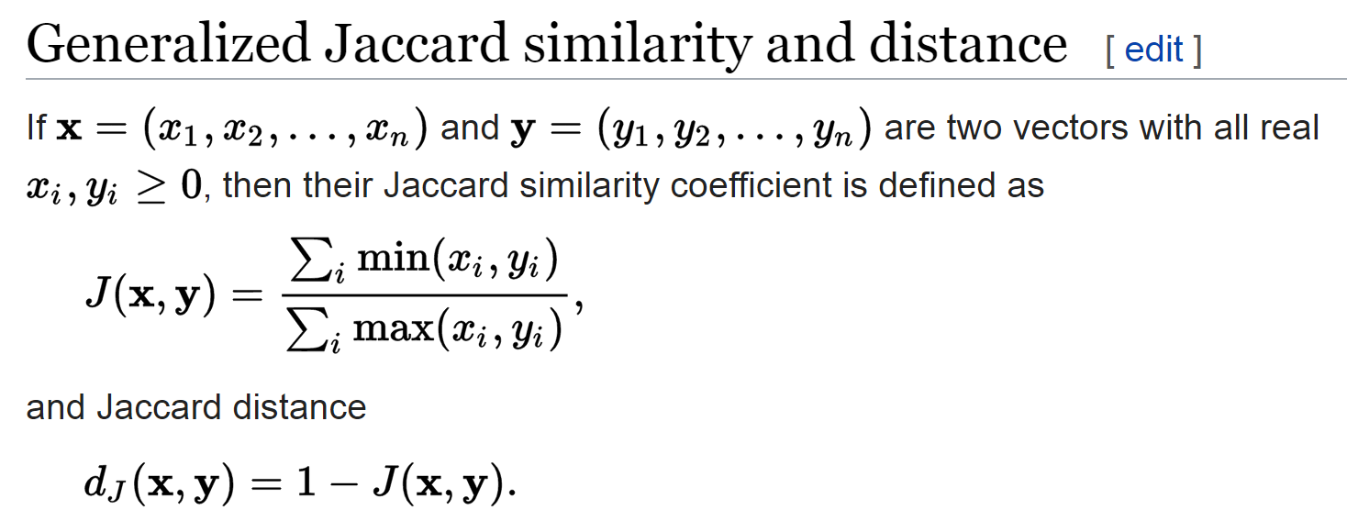
https://en.wikipedia.org/wiki/Jaccard_index

Slide 17
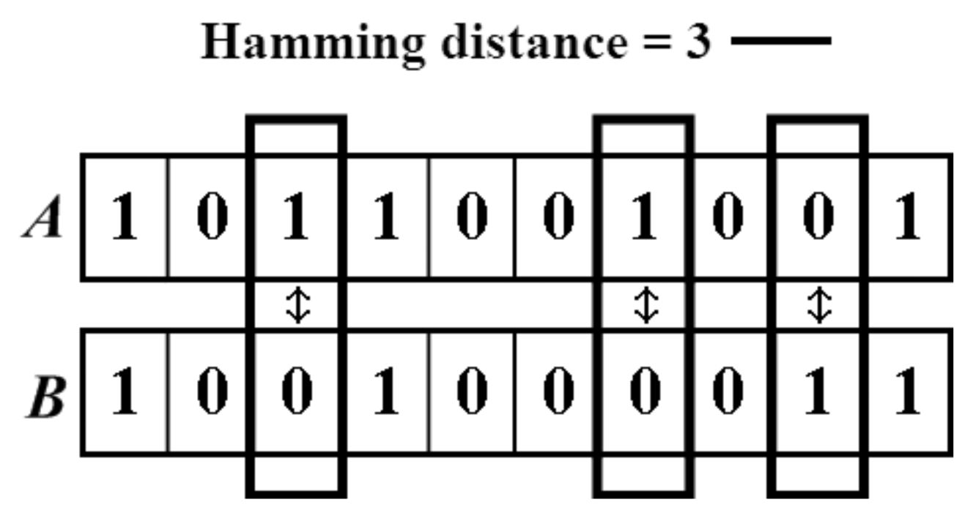

https://people.rit.edu/rmb5229/320/project3/hamming.html
http://rosalind.info/glossary/hamming-distance/
Hamming Distance = 7

Slide 18
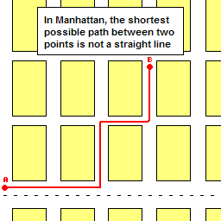
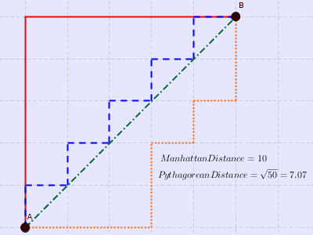

http://www.joachimdespland.com/mammoth.html
http://bloggity.nurdz.com/gamedev-math/manhattan/
http://www.improvedoutcomes.com/docs/WebSiteDocs/Clustering/Clustering_Parameters/Manhattan_Distance_Metric.htm

Slide 19
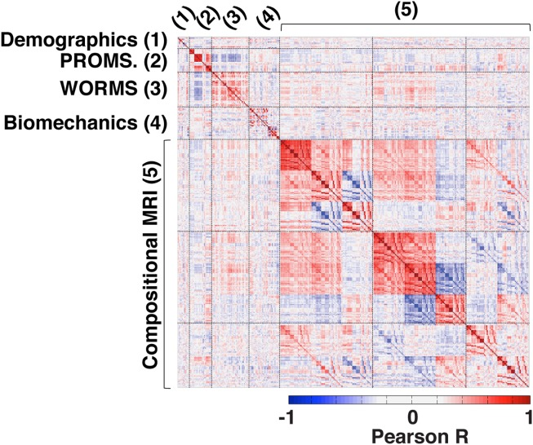
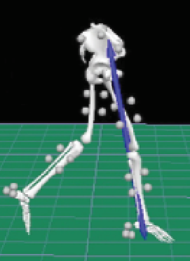
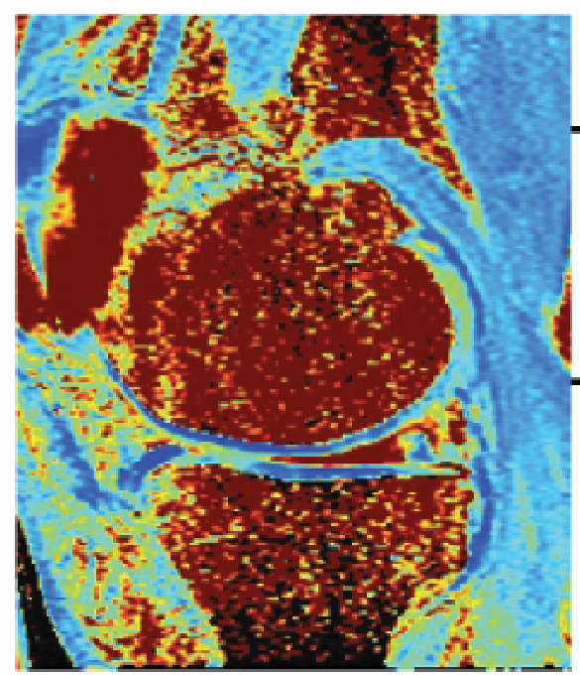
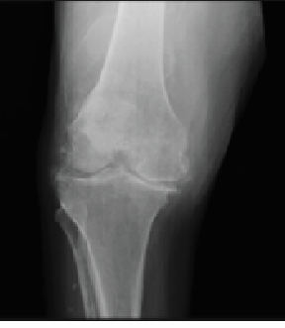

https://onlinelibrary.wiley.com/doi/full/10.1002/jmri.25750

Slide 20
In R^{n}
If n small, Euclidean distance often makes sense
If n is large, consider Chebyshev distance or
performing PCA first to project data into R^{d}, for small d
and then using Euclidean distance
Chebyshev distance:

Slide 21
Dimensionality Reduction: Given dataset D R^{N}
Want: embedding f: D → R^{n} where n << N
    which “preserves” the structure of the data.
Many reduction methods:
f₁: D → R, f₂: D → R, … f_{n}: D → R
(f₁, f₂, … f_{n}): D → R^{n}
Many are linear, M: R^{N} → R^{n}, Mx = y
But there are also non-linear dimensionality reduction algorithms.
U

Slide 22
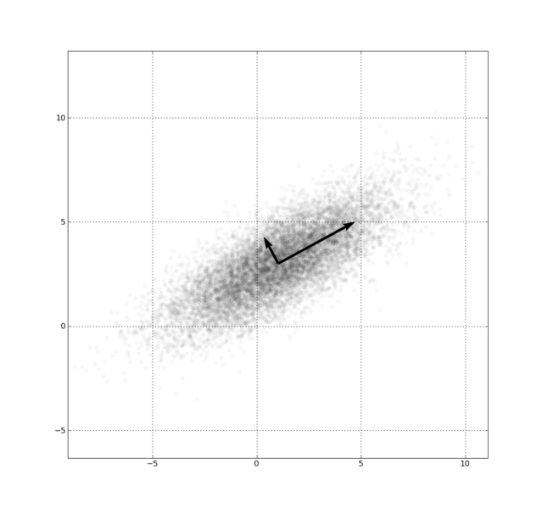
Example: Principle component analysis (PCA)
http://en.wikipedia.org/wiki/File:GaussianScatterPCA.png

Slide 23
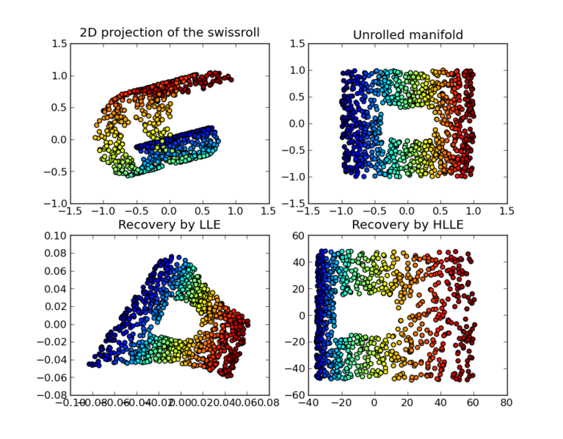
https://en.wikipedia.org/wiki/Nonlinear_dimensionality_reduction

Slide 24
Why use PCA in data analysis?
Consider the points (0, 0, …, 0), (1, 0, …, 0), (10, 0, …, 0)
Add noise to first point (0, 0, …, 0) → (0, 1, …, 1)
In R¹⁰⁰, d((0, 1, …, 1), (1, 0, …, 0)) = 10 > 9.
Add small noise to first point (0, 0, …, 0) → (0, 0.1, …, 0.1)
In R^{39,900}, d((0, 0.1, …, 0.1), (1, 0, …, 0)) = 20 > 9.
0 1 10

