Slide 1
Diagonalization Revisted
Isabel K. Darcy
Mathematics Department
Applied Math and Computational Sciences
University of Iowa
Fig from
knotplot.com

Slide 3
A is diagonalizable if there exists an invertible matrix P such that P⁻¹AP = D where D is a diagonal matrix.
Diagonalization has many important applications
It allows one to convert a more complicated problem into
a simpler problem.
Example: Calculating A^{k} when A is diagonalizable.

Slide 4
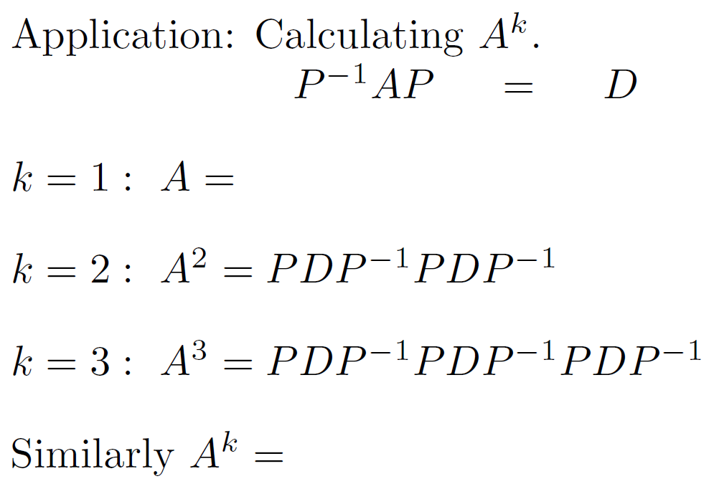

Slide 5
3
3

Slide 6
3
3
3
3
3

Slide 7
More diagonalization background:
I.e., we are assuming A is diagonalizable since
implies

Slide 11
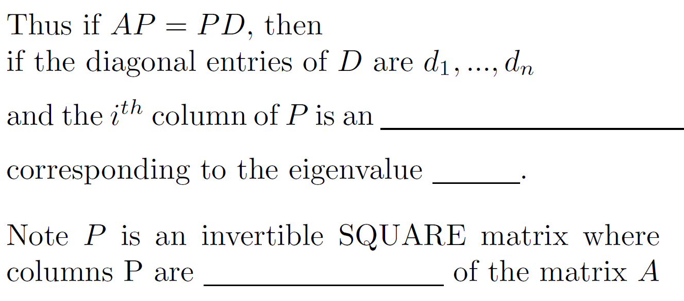

Slide 15
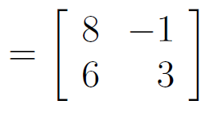

Slide 16
Check answer:

Slide 17
To diagonalize a matrix A:
Step 1: Find eigenvalues: Solve the equation: det (A – λΙ) = 0
for λ.
Step 2: For each eigenvalue, find its corresponding eigenvectors by solving the homogeneous system of equations: (A – λΙ)x = 0
for x.
Case 3a.) IF the geometric multiplicity is LESS then the algebraic multiplicity for at least ONE eigenvalue of A, then A is NOT diagonalizable. (Cannot find square matrix P).
Matrix defective = NOT diagonalizable.

Slide 18
Case 3b.) A is diagonalizable if and only if
geometric multiplicity = algebraic multiplicity
for ALL the eigenvalues of A.
Use the eigenvalues of A to construct the diagonal matrix D
Use the basis of the corresponding eigenspaces for the
corresponding columns of P. (NOTE: P is a SQUARE matrix).
NOTE: ORDER MATTERS.

Slide 19
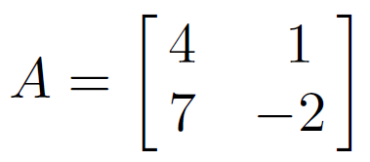
For more complicated example, see video 4: Eigenvalue/Eigenvector Example
& video 5: Diagonalization
Step 1: Find eigenvalues: Solve the equation: det (A – λI) = 0
for λ.

Slide 20
characteristic equation:
λ = -3 : algebraic multiplicity =
geometric multiplicity =
dimension of eigenspace =
λ = 5 : algebraic multiplicity
geometric multiplicity
dimension of eigenspace
1 ≤ geometric multiplicity ≤ algebraic multiplicity

Slide 21
characteristic equation:
λ = -3 : algebraic multiplicity = 1
geometric multiplicity = 1
dimension of eigenspace = 1
λ = 5 : algebraic multiplicity = 1
geometric multiplicity = 1
dimension of eigenspace = 1
1 ≤ geometric multiplicity ≤ algebraic multiplicity
Matrix is not defective.

Slide 22
characteristic equation:
λ = -3 : algebraic multiplicity = 1
geometric multiplicity = 1
dimension of eigenspace = 1
λ = 5 : algebraic multiplicity = 1
geometric multiplicity = 1
dimension of eigenspace = 1
1 ≤ geometric multiplicity ≤ algebraic multiplicity
Matrix is not defective.
Thus A is diagonalizable

Slide 23
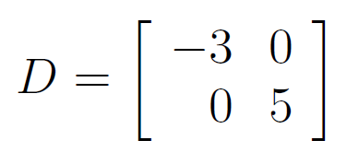
characteristic equation:
λ = -3 : algebraic multiplicity = 1
geometric multiplicity = 1
dimension of eigenspace = 1
λ = 5 : algebraic multiplicity = 1
geometric multiplicity = 1
dimension of eigenspace = 1
1 ≤ geometric multiplicity ≤ algebraic multiplicity
Matrix is not defective.
Thus A is diagonalizable

Slide 24
Find eigenvectors to create P
Nul(A + 3Ι) = eigenspace corresponding to eigenvalue λ = -3 of A

Slide 25
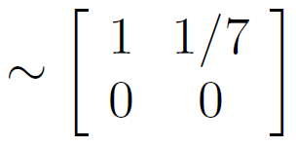

Slide 26
Basis for eigenspace corresponding to λ = -3:

Slide 27
Basis for eigenspace corresponding to λ = -3:

Slide 28
Find eigenvectors to create P
Nul(A - 5Ι) = eigenspace corresponding to eigenvalue λ = 5 of A
Basis for eigenspace corresponding to λ = 5:

Slide 29
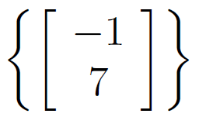
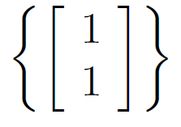
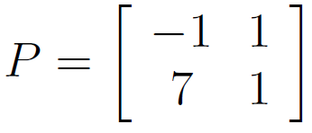
Basis for eigenspace corresponding to λ = -3:
Basis for eigenspace corresponding to λ = 5:

Slide 30
Basis for eigenspace corresponding to λ = -3:
Basis for eigenspace corresponding to λ = 5:

Slide 31
Note we want to be invertible.
Note P is invertible if and only if
the columns of P are linearly independent.
We get this for FREE!!!!!

Slide 32
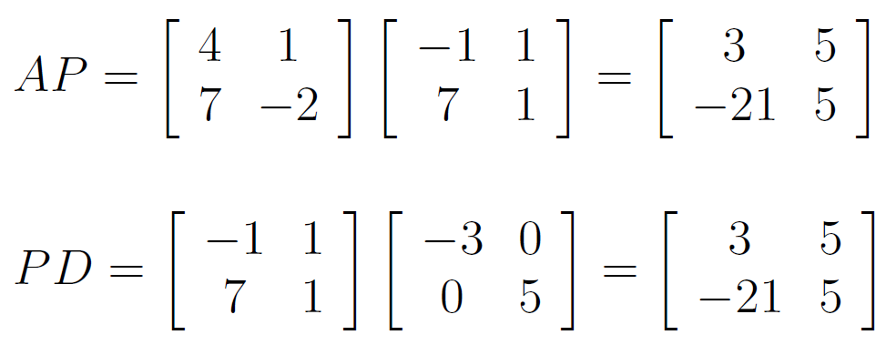
Note: You can easily check your answer.

Slide 33
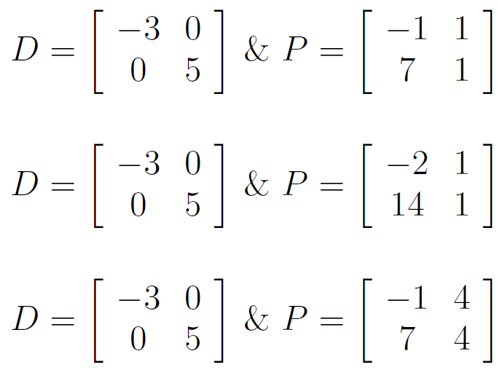
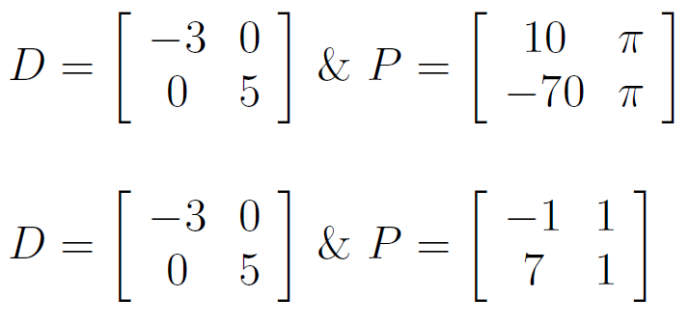
Note there are many correct answers.
Diagonalize

Slide 34
Note there are many correct answers.
Diagonalize
ORDER MATTERS!!!

