Slide 1
A quick example calculating the column space and the nullspace of a matrix.
Isabel K. Darcy
Mathematics Department
Applied Math and Computational Sciences
University of Iowa
Fig from
knotplot.com

Slide 2
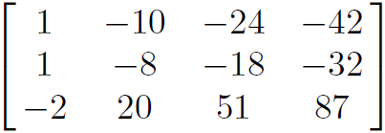
=
Determine the column space of A

Slide 3
Column space of A
= span of the columns of A
= set of all linear combinations
of the columns of A

Slide 4
=
Determine the column space of A
Column space of A = col A =
col A = span , , ,
{
}

Slide 5
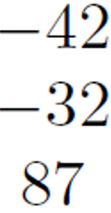
=
Determine the column space of A
Column space of A = col A =
col A = span , , ,
= c₁ + c₂ + c₃ + c₄ c_{i} in R
{
}
{
}

Slide 6
=
Determine the column space of A
Column space of A = col A =
col A = span , , ,
= c₁ + c₂ + c₃ + c₄ c_{i} in R
{
}
Want simpler answer
{
}

Slide 7
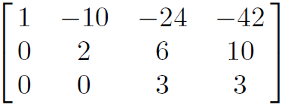
=
Determine the column space of A
Put A into echelon form:
R₂ – R₁ → R₂
R₃ + 2R₁ → R₃

Slide 8
=
Determine the column space of A
Put A into echelon form:
And determine the pivot columns
R₂ – R₁ → R₂
R₃ + 2R₁ → R₃

Slide 9
=
Determine the column space of A
Put A into echelon form:
And determine the pivot columns
R₂ – R₁ → R₂
R₃ + 2R₁ → R₃

Slide 10
=
Determine the column space of A
Put A into echelon form:
And determine the pivot columns
R₂ – R₁ → R₂
R₃ + 2R₁ → R₃

Slide 11
=
Determine the column space of A
Put A into echelon form:
A basis for col A consists of the 3 pivot columns from the
original matrix A.
Thus basis for col A =
R₂ – R₁ → R₂
R₃ + 2R₁ → R₃
{
}

Slide 12
=
Determine the column space of A
A basis for col A consists of the 3 pivot columns from the
original matrix A.
Thus basis for col A =
Note the basis for col A consists of exactly 3 vectors.
{
}

Slide 13
=
Determine the column space of A
A basis for col A consists of the 3 pivot columns from the
original matrix A.
Thus basis for col A =
Note the basis for col A consists of exactly 3 vectors.
Thus col A is 3-dimensional.
{
}

Slide 14
=
Determine the column space of A
col A contains all linear combinations of the 3 basis vectors:
col A = c₁ + c₂ + c₃ c_{i} in R
{
}

Slide 15
=
Determine the column space of A
col A contains all linear combinations of the 3 basis vectors:
col A = c₁ + c₂ + c₃ c_{i} in R
= span , ,
{
}
{
}

Slide 16
=
Determine the column space of A
col A contains all linear combinations of the 3 basis vectors:
col A = c₁ + c₂ + c₃ c_{i} in R
= span , ,
{
}
{
}
Can you identify
col A?

Slide 17
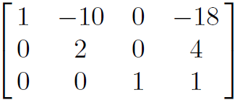
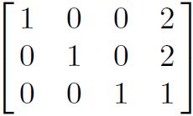
=
Determine the nullspace of A
Put A into echelon form and then into reduced echelon form:
R₂ – R₁ → R₂
R₃ + 2R₁ → R₃
R₁ + 8R₃ → R₁
R₁ - 2R₃ → R₁
R₃/3 → R₃
R₁ + 5R₂ → R₁
R₂/2 → R₂

Slide 18
Nullspace of A = solution set of
Ax = 0

Slide 19
=
Solve: A x = 0 where A
Put A into echelon form and then into reduced echelon form:
R₂ – R₁ → R₂
R₃ + 2R₁ → R₃
R₁ + 8R₃ → R₁
R₁ - 2R₃ → R₁
R₃/3 → R₃
R₁ + 5R₂ → R₁
R₂/2 → R₂

Slide 20
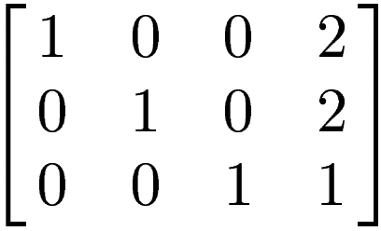
0
0
0
~
Solve: A x = 0 where A
x₁ x₂ x₃ x₄
x₁ -2 x₄ -2
x₂ -2 x₄ -2
x₃ - x₄ -1
x₄ x₄ 1
=
=
x₄

Slide 21
0
0
0
~
Solve: A x = 0 where A
x₁ x₂ x₃ x₄
x₁ -2 x₄ -2
x₂ -2 x₄ -2
x₃ - x₄ -1
x₄ x₄ 1
=
=
{
Thus Nullspace of A =
Nul A = x₄ x₄ in R
x₄
}

Slide 22
0
0
0
~
Solve: A x = 0 where A
x₁ x₂ x₃ x₄
Thus Nullspace of A =
Nul A = x₄ x₄ in R = span
{
}
{
}

