Slide 1
QR decomposition:
A = QR
Q is orthonormal
R is upper triangular
To find QR decomposition:
1.) Q: Use Gram-Schmidt to find orthonormal basis for column space of A
2.) Let R = Q^{T}A

Slide 2
Find the QR decomposition of
A =
4
3
1.) Use Gram-Schmidt to find orthonormal basis for column space of A

Slide 3
Find the QR decomposition of
A =
4
3
1.) Use Gram-Schmidt to find orthonormal basis for column space of A
col(A) = span ,
{
}
4
3

Slide 4
Find the QR decomposition of
A =
4
3
1.) Use Gram-Schmidt to find orthogonal basis for column space of A
col(A) = span ,
{
}
4
3

Slide 5
Find the QR decomposition of
A =
4
3
1.) Use Gram-Schmidt to find orthogonal basis for column space of A
col(A) = span , = span ,
{
}
{
?}
4
3

Slide 6
4
3

Slide 7
Find orthogonal projection
of onto
4
3
4
3

Slide 8
Find orthogonal projection
of onto
4
3
4
3
4
3
(1, 2) • (4, 3)
(1, 2) • (1, 2)
proj =
1(4) + 2(3) 4 + 6
1² + 2² 1 + 4
= =

Slide 9
Find orthogonal projection
of onto
4
3
4
3
4
3
(1, 2) • (4, 3)
(1, 2) • (1, 2)
proj =
1(4) + 2(3) 10
1² + 2² 5
= =

Slide 10
Find orthogonal projection
of onto
2
4
4
3
4
3
4
3
(1, 2) • (4, 3)
(1, 2) • (1, 2)
proj =
2
4
1(4) + 2(3)
1² + 2²
= = 2 =

Slide 11
Find orthogonal projection
of onto
2
4
4
3
4
3
4
3
(1, 2) • (4, 3)
(1, 2) • (1, 2)
2
4
proj = =

Slide 12
Find the component
of orthogonal to
2
4
4
3
4
3

Slide 13
Find the component
of orthogonal to
2
4
2
-1
4
3
4
3
4
3
2
4
2
-1
− =

Slide 14
Short-cut for R² case:
4
3

Slide 15
Find the QR decomposition of
A =
4
3
1.) Use Gram-Schmidt to find orthogonal basis for column space of A
col(A) = span , = span ,
{
}
{
}
4
3
2
-1

Slide 16
Find the length of each vector:
= √ 1² + 2² = √ 5
2
-1
= √ (-1)² + 2² = √ 5

Slide 17
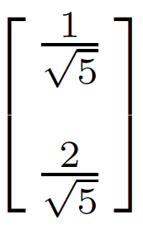
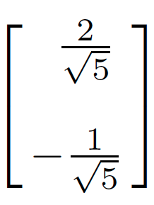
Divide each vector by its length:
col(A) = span , = span ,
= span ,
{
}
{
}
4
3
2
-1
{
}

Slide 18
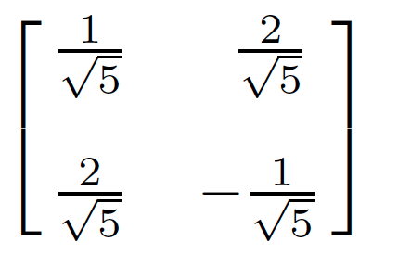
col(A) = span ,
Q =
A = QR
{
}

Slide 19
A = QR
A = QR
Q⁻¹A = Q⁻¹QR
Q⁻¹A = R
Q has orthonormal columns:
Thus Q⁻¹ = Q^{T}
Thus R = Q⁻¹A = Q^{T}A

Slide 20
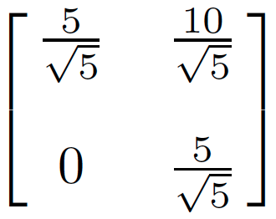
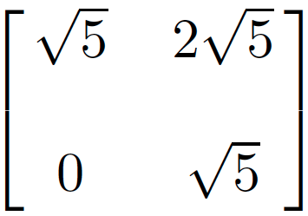
Find the QR decomposition of
A = = QR
R = Q⁻¹A = Q^{T}A =
= =
4
3
4
3

