Slide 1
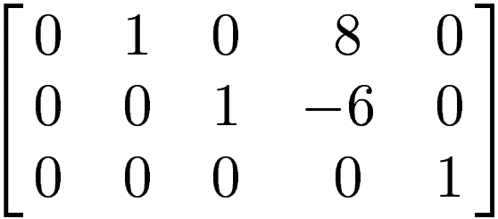
~
Determine the nullspace of B where B
x₁ x₂ x₃ x₄ x₅

Slide 2
0
0
0
~
Solve: B x = 0 where B
x₁ x₂ x₃ x₄ x₅
x₁ x₁ x₁ 0 1 0
x₂ -8 x₄ 0 -8 x₄ 0 -8
x₃ -6 x₄ 0 -6 x₄ 0 -6
x₄ x₄ 0 x₄ 0 1
x₅ 0 0 0 0 0
=
= + = +
x₁
x₄

Slide 3
0
0
0
~
Solve: B x = 0 where B
x₁ x₂ x₃ x₄ x₅
x₁ 1 0
x₂ 0 -8
x₃ 0 -6
x₄ 0 1
x₅ 0 0
= +
x₁
x₄

Slide 4
0
0
0
~
Solve: B x = 0 where B
x₁ x₂ x₃ x₄ x₅
{ | }
x₁ 1 0
x₂ 0 -8
x₃ 0 -6
x₄ 0 1
x₅ 0 0
Nul B
= +
x₁
x₄
x₁, x₄ in R

Slide 5
0
0
0
~
Solve: B x = 0 where B
x₁ x₂ x₃ x₄ x₅
{ | }
1 0
0 -8
0 -6
0 1
0 0
Nul B
= +
x₁
x₄
x₁, x₄ in R

Slide 6
0
0
0
~
Solve: B x = 0 where B
x₁ x₂ x₃ x₄ x₅
{ }
1 0
0 -8
0 -6
0 1
0 0
Nul B
= span ,

Slide 7
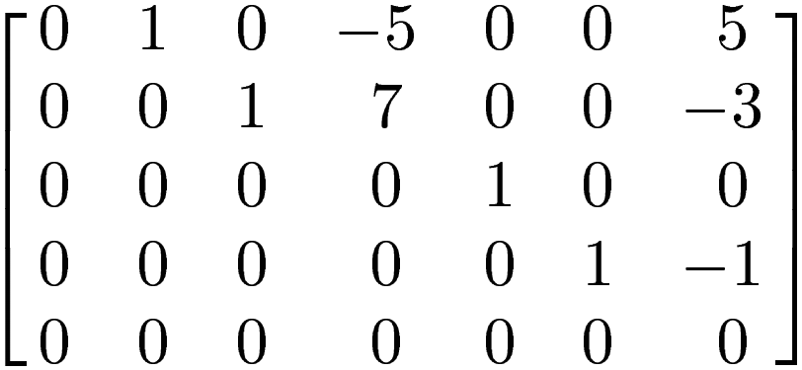
~
Solve: E x = 0 where E
x₁ x₂ x₃ x₄ x₅ x₆ x₇
x₁ x₁ 1 0 0
x₂ 5x₄ - 5x₇ 0 5 -5
x₃ -7x₄ + 3x₇ 0 -7 3 x₄ x₄ 0 1 0
x₅ 0 0 0 0
x₆ x₇ 0 0 1
x₇ x₇ 0 0 1
=
= + +
x₁
x₄
x₇

Slide 8
Nul E =

Slide 9
Determine the column space of E
where E
IF POSSIBLE
~
x₁ x₂ x₃ x₄ x₅ x₆ x₇
Note: We don’t know the original matrix E. We only know REF of E.

Slide 10
Determine the column space of B
where B
IF POSSIBLE
~
x₁ x₂ x₃ x₄ x₅
Note: We don’t know the original matrix B. We only know REF of B.
But

Slide 11
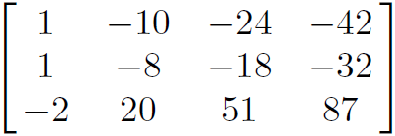



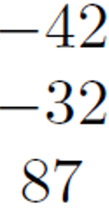

=
Determine the column space of A
Column space of A = col A =
col A = span , , ,
= c₁ + c₂ + c₃ + c₄ c_{i} in R
{
}
{
}

Slide 12
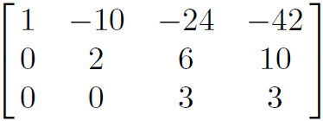
=
Determine the column space of A
Put A into echelon form:
A basis for col A consists of the 3 pivot columns from the
original matrix A.
Thus basis for col A =
R₂ – R₁ → R₂
R₃ + 2R₁ → R₃
{
}

