Slide 1
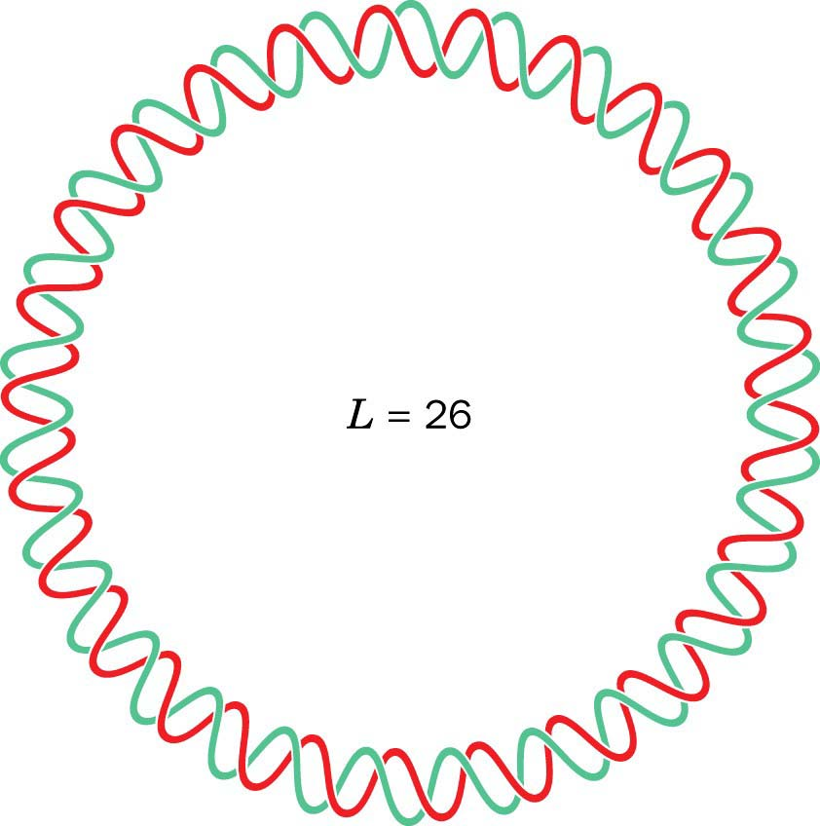
http://www.siumed.edu/~bbartholomew/images/chapter29/F29-18.jpg

Slide 2
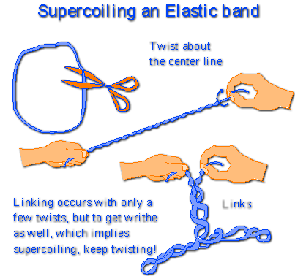
http://www.maths.uq.edu.au/~infinity/Infinity7/supercoiling.gif

Slide 3
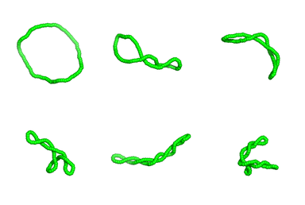
http://www.stanford.edu/~ajspakow/figures/TWsnap.png
http://cmgm.stanford.edu/biochem/biochem201/Slides/DNA%20Topology/065%20Supercoiled%20DNA%20jpeg.JPG

Slide 4
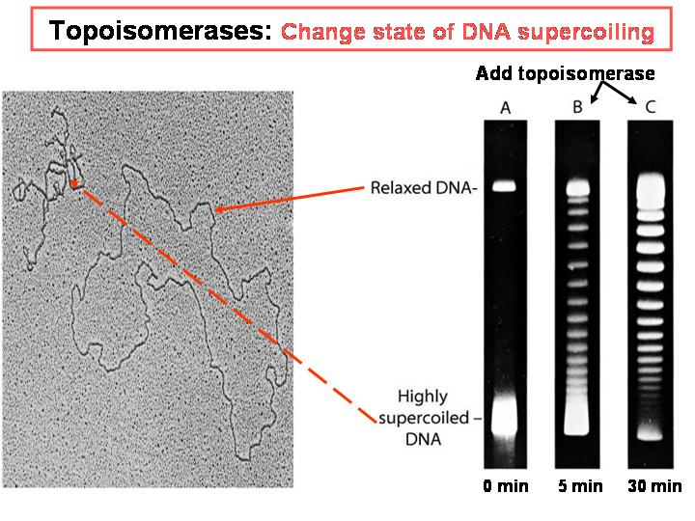
http://www.biochem.arizona.edu/classes/bioc461/GRAPHICS/Chapter27/Slide23.JPG

Slide 5
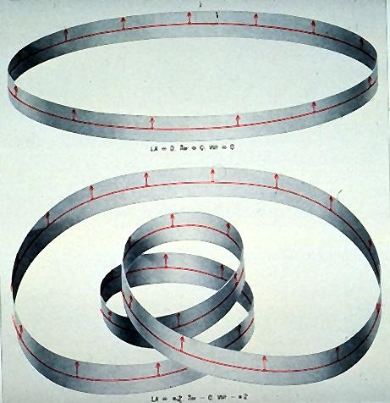
http://cmgm.stanford.edu/biochem201/Slides/DNA%20Topology/069%20Writhe%20Defined%20jpeg.JPG

Slide 6
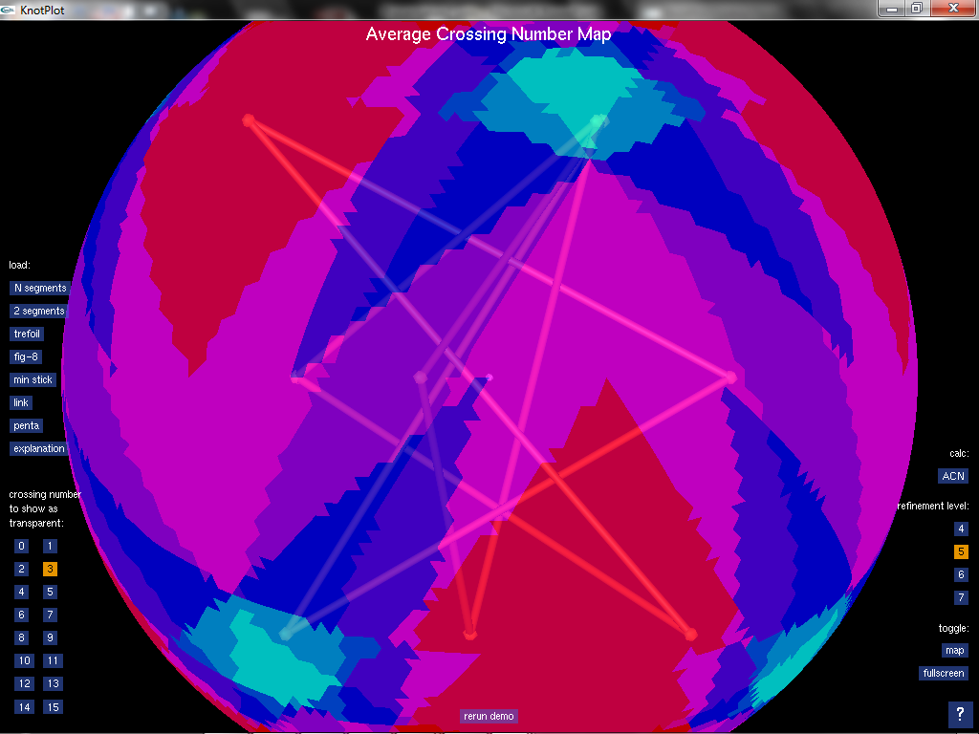

Slide 7
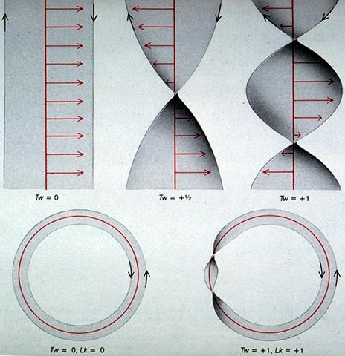
http://cmgm.stanford.edu/biochem/biochem201/Slides/DNA%20Topology/067%20Twist%20Defined%20jpeg.JPG

Slide 8
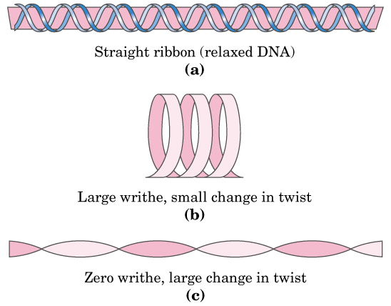
http://www.biochem.arizona.edu/classes/bioc462/462a/NOTES/Nucleic_Acids/Fig24_17TwistWrithe.GIF

Slide 9
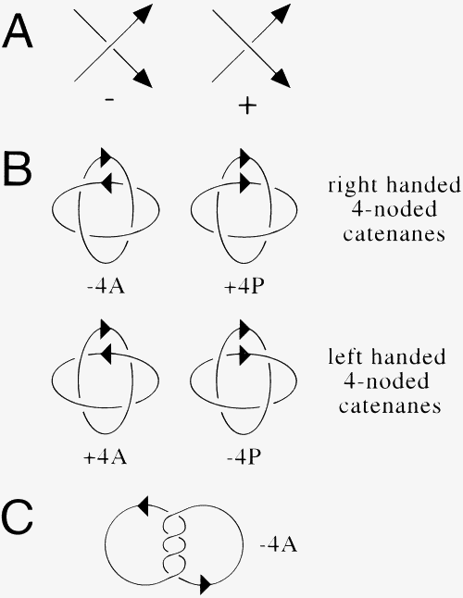
Topological Selectivity in Xer Site-Specific Recombination
Sean D. Colloms , Jonathan Bath and David J. Sherrat
Cell, Volume 88, Issue 6, 21 March 1997, Pages 855-864

Slide 11
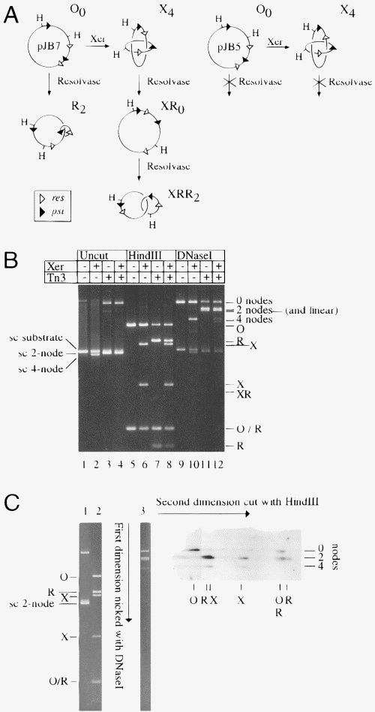

Slide 12
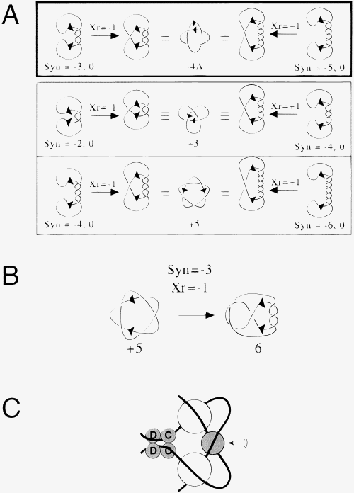
Figure 7. Topological Outcomes of Different Reaction Mechanisms(A) A −4A catenane can be produced using a −3 synapse and a strand exchange mechanism that introduces a negative node between the crossover sites (Syn = −3, 0; Xr = −1), or a −5 synapse and strand exchange that introduces a positive node (Syn = −5, 0; Xr = +1). Inversion with Syn = −2, 0; Xr = −1 and Syn = −4, 0; Xr = −1 yields the observed +3 and +5 knots, as would inversion with Syn = −4, 0; Xr = +1 and Syn = −6, 0; Xr = +1. In order to simplify topological analysis, we arbitrarily chose to draw reactions in a projection where the recombination cores are aligned in parallel. Although strictly parallel alignment in space is unlikely, it is almost always possible to choose a projection in which sites appear parallel.(B) Possible second round inversion pathway. If normally Syn = −3, 0; Xr = −1, then a +5 torus knot can invert to form a 6-noded knot.(C) A model showing how interwrapping of cer accessory sequences around ArgR and PepA could trap three negative supercoils. The structure has a 2-fold axis of symmetry (arrow). One hexamer of ArgR ( 100 kDa; shaded circle) binds to ARG boxes located centrally in the accessory sequences of each cer site. Two hexamers of PepA ( 330 kDa; open circles) are shown binding to the accessory sequences on either side of each ARG box. The recombinases XerC (C) and XerD (D) bind to the recombination cores. It is possible to construct a similar model containing only one hexamer of PepA, with one of its 2-fold axes of symmetry lying on the symmetry axis of the synaptic complex. We do not rule out the possibility that there are protein–protein interactions between ArgR and PepA and the recombinases.

