Slide 1
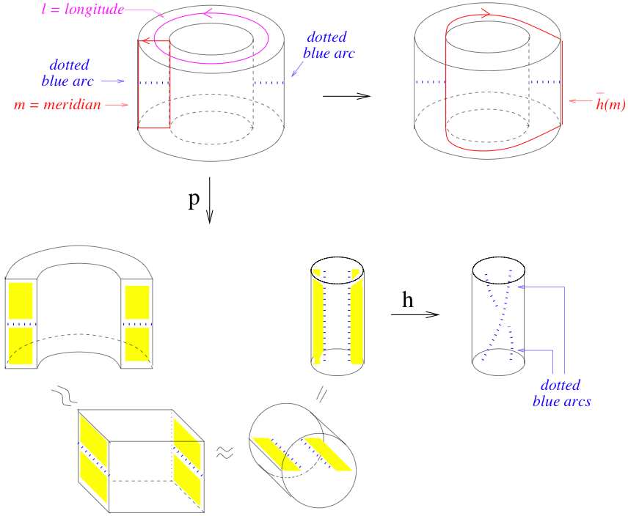

Slide 2
Motivation:
Classification of rational tangles.
Dehn surgery.
Solving tangle equations.
Visualization of double branch covers of knots/links/tangles via Dehn surgery.
Seifert-fibered spaces.
Theorem: [Lickorish, Wallace] Any closed orientable
3-manifold is obtained by Dehn surgery on some link in S^{3.}

Slide 3
Classification of rational tangles:
1.) Can convert any rational tangle into an alternating tangle.
Thus if 2 tangles have same fraction, they are equivalent.

