Slide 1
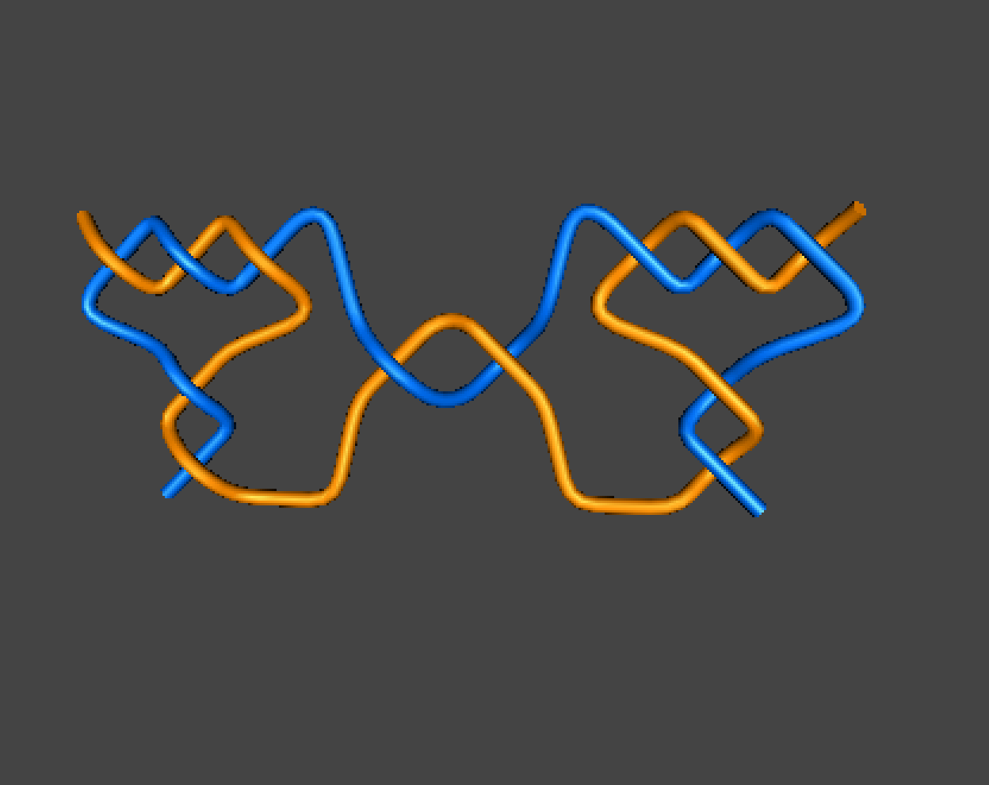


$$\left(c_{1},…,c_{n−1},c_{n}+d_{k},d_{k−1},…,d_{1}\right)$$
(3, 2, 1 + 1, 2, 3)

Slide 2


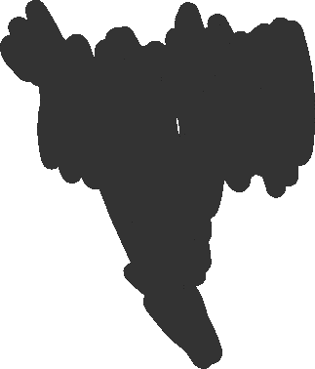




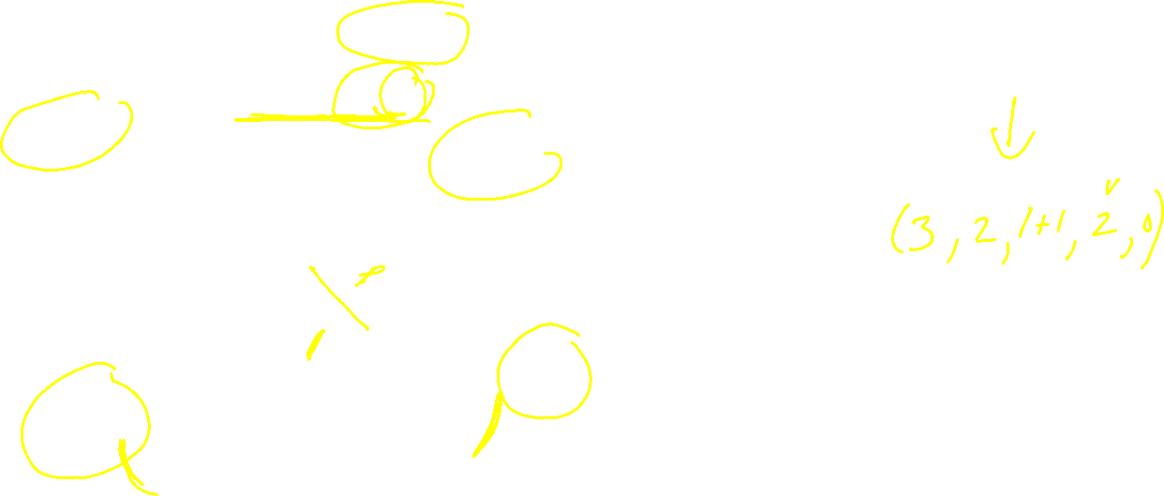





$$\left(c_{1},…,c_{n−1},c_{n}+d_{k},d_{k−1},…,d_{1}\right)$$
(3, 2, 1 + 1, 2, 3)

Slide 3





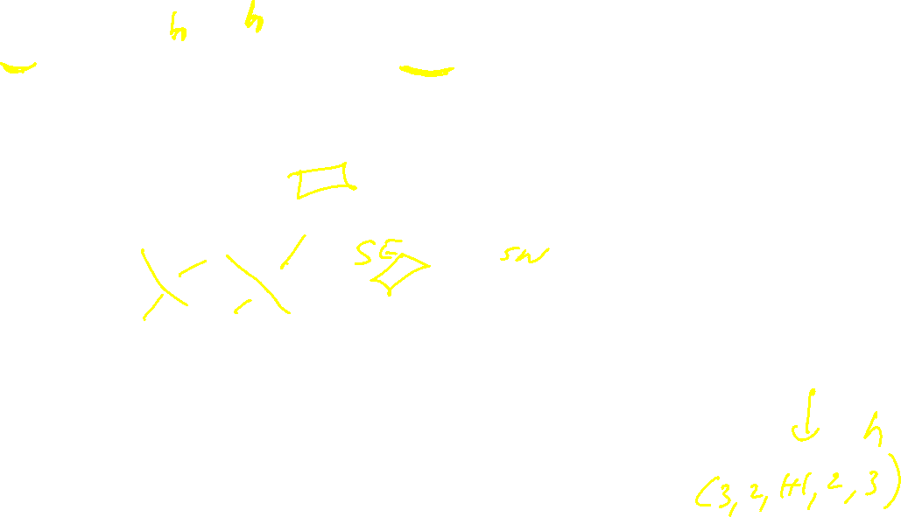









$$\left(c_{1},…,c_{n−1},c_{n}+d_{k},d_{k−1},…,d_{1}\right)$$
(3, 2, 1 + 1, 2, 3)

Slide 4


$$\left(c_{1},…,c_{n−1},c_{n}+d_{k},d_{k−1},…,d_{1}\right)$$
(3, 2, 1 + 1, 2, 3)

Slide 5






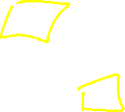


$$\left(c_{1},…,c_{n−1},c_{n}+d_{k},d_{k−1},…,d_{1}\right)$$
(3, 2, 1 + 1, 2, 3)

Slide 6


$$\left(c_{1},…,c_{n−1},c_{n}+d_{k},d_{k−1},…,d_{1}\right)$$
(3, 2, 1 + 1, 2, 3)

Slide 7
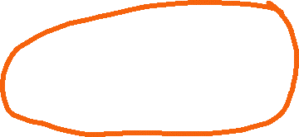





$$\left(c_{1},…,c_{n−1},c_{n}+d_{k},d_{k−1},…,d_{1}\right)$$
(3, 2, 1 + 1, 2, 3)

Slide 8
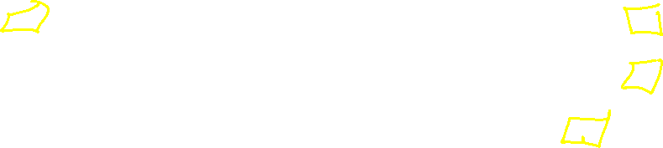

$$\left(c_{1},…,c_{n−1},c_{n}+d_{k},d_{k−1},…,d_{1}\right)$$
(3, 2, 1 + 1, 2, 3)

Slide 9




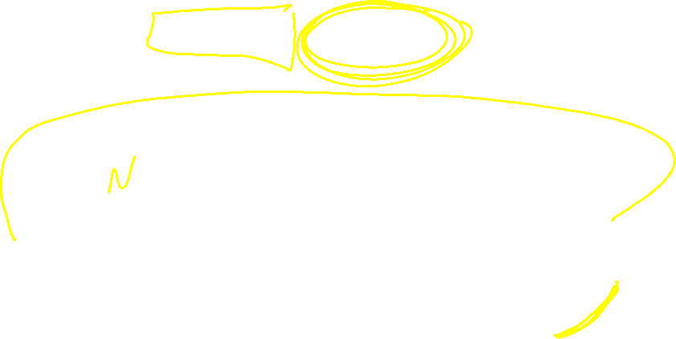
$$\left(c_{1},…,c_{n−1},c_{n}+d_{k},d_{k−1},…,d_{1}\right)$$
(3, 2, 1 + 1, 2, 3)

Slide 10



$$\left(c_{1},…,c_{n−1},c_{n}+d_{k},d_{k−1},…,d_{1}\right)$$
(3, 2, 1 + 1, 2, 3)

Slide 11



$$\left(c_{1},…,c_{n−1},c_{n}+d_{k},d_{k−1},…,d_{1}\right)$$
(3, 2, 1 + 1, 2, 3)

Slide 12
$$\left(c_{1},…,c_{n−1},c_{n}+d_{k},d_{k−1},…,d_{1}\right)$$
(3, 2, 1 + 1, 2, 3)

Slide 13
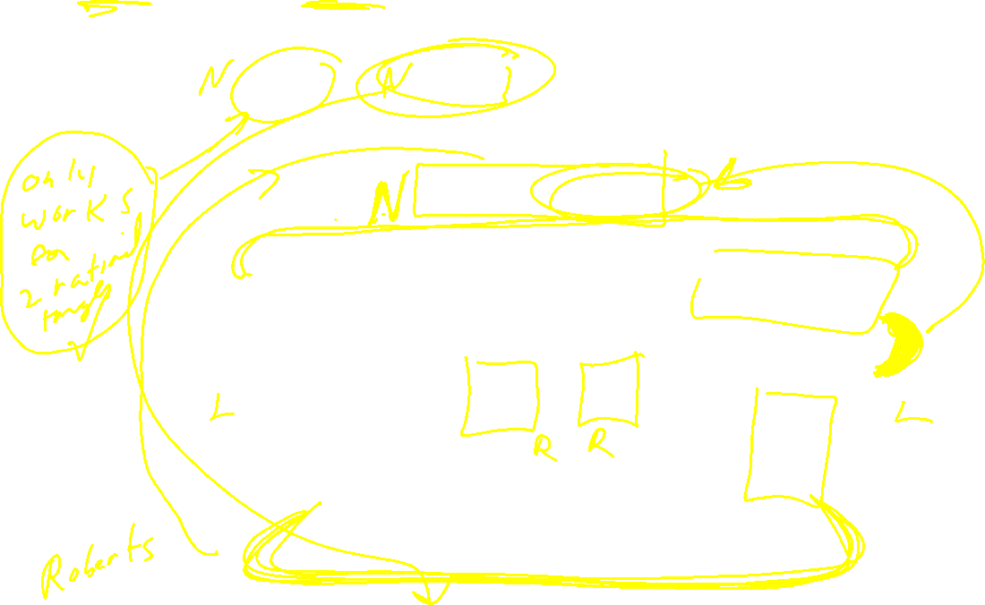

$$\left(c_{1},…,c_{n−1},c_{n}+d_{k},d_{k−1},…,d_{1}\right)$$
(3, 2, 1 + 1, 2, 3)

Slide 14
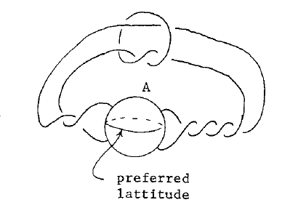
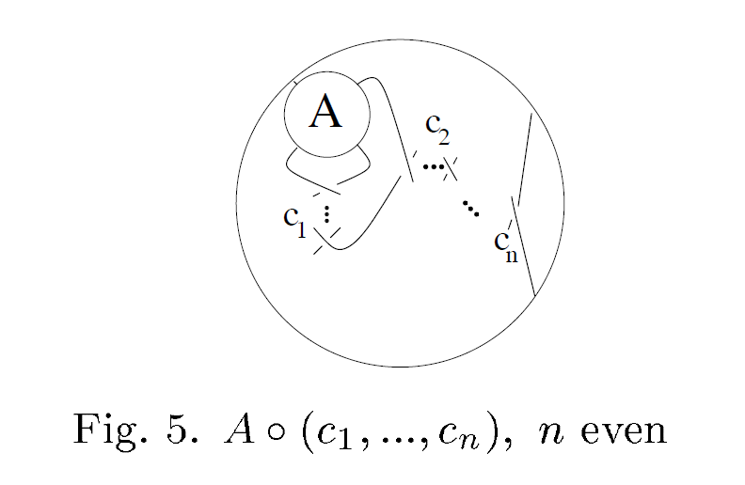



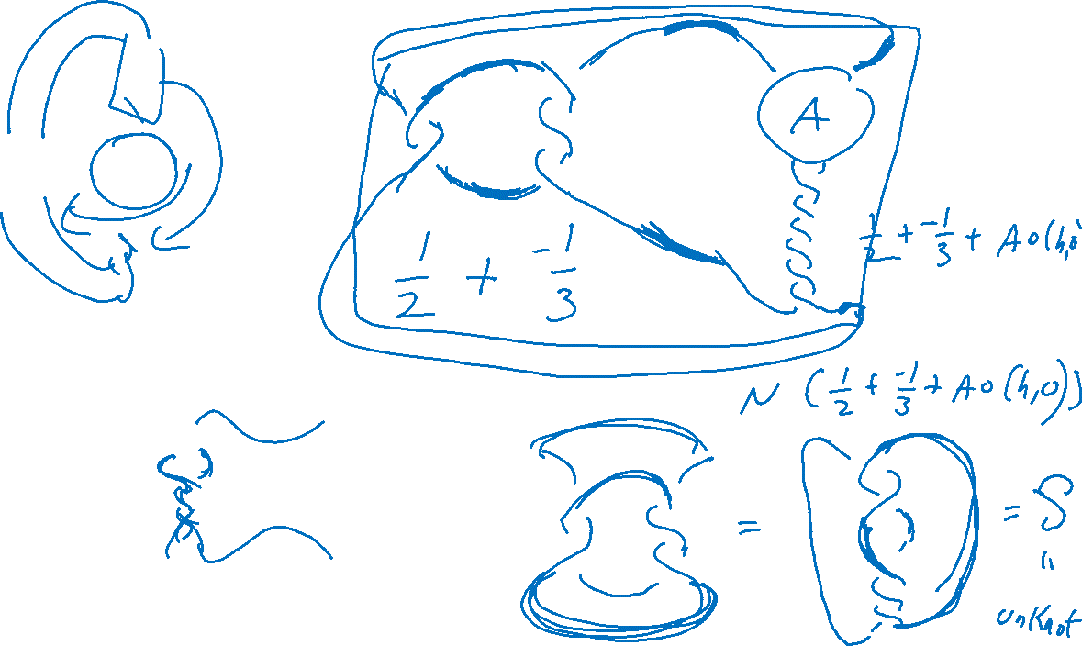




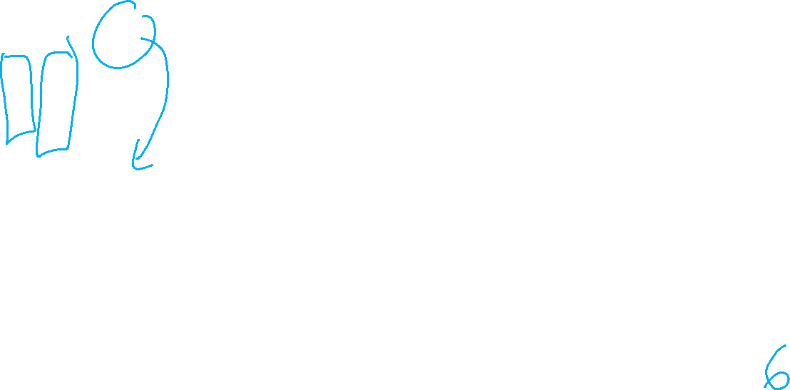

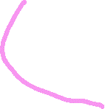


Slide 15
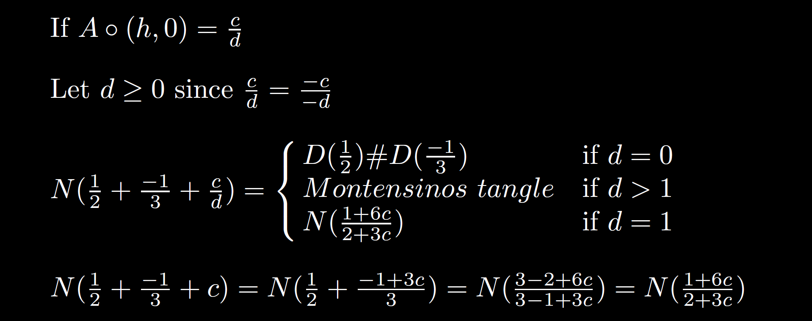
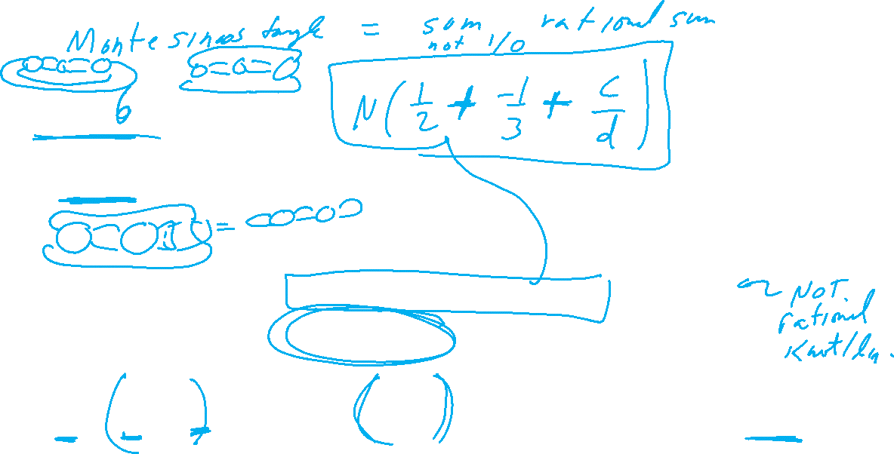

Slide 16
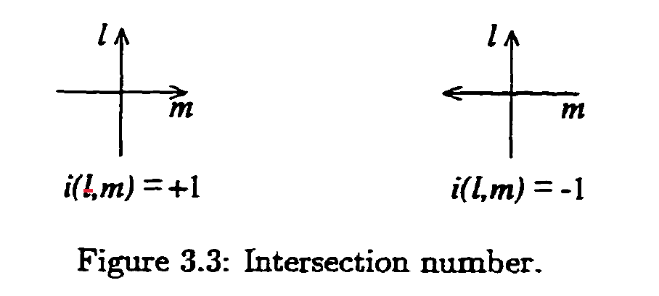
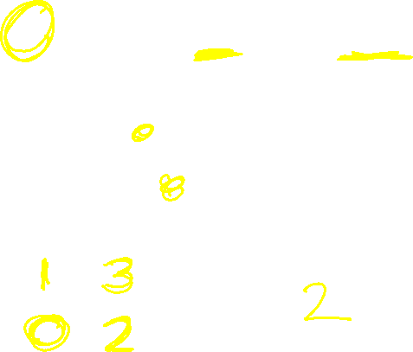
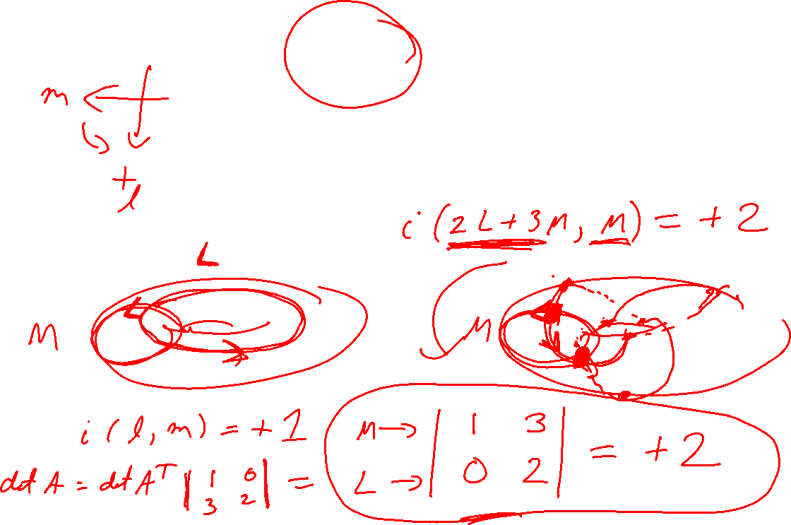
Intersection Number

Slide 17
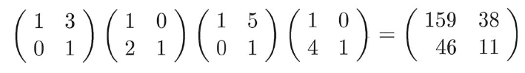
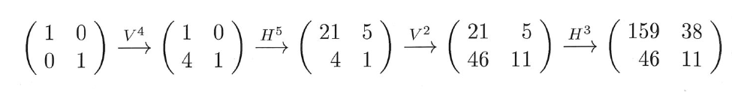
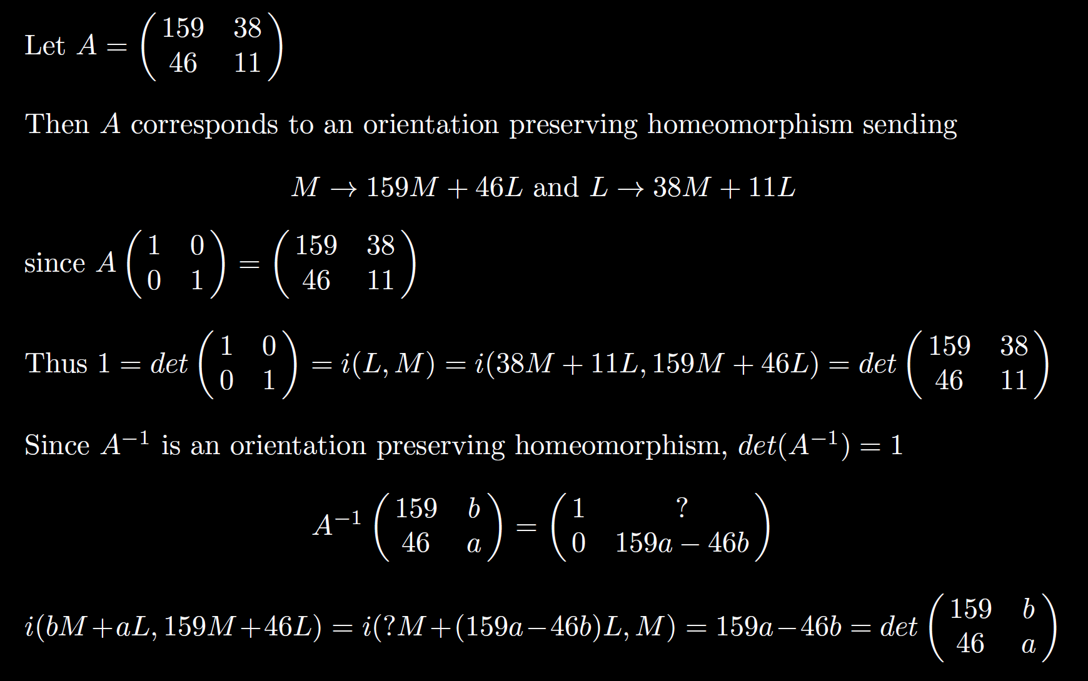
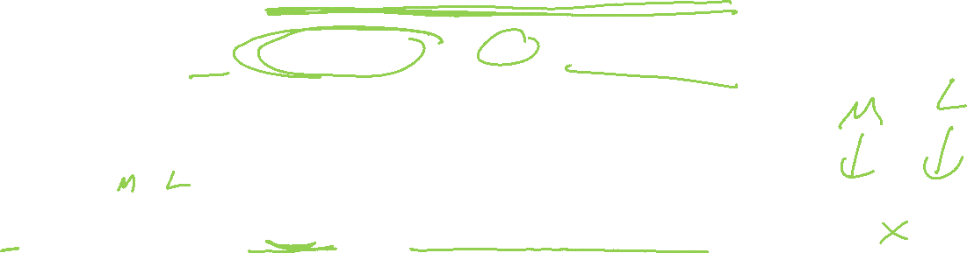

Slide 18
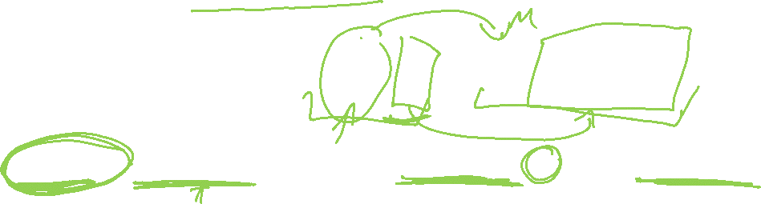

Slide 19
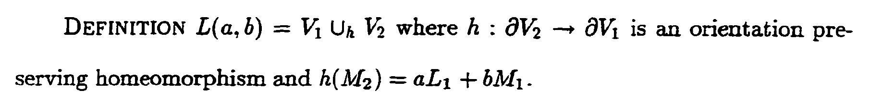
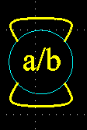
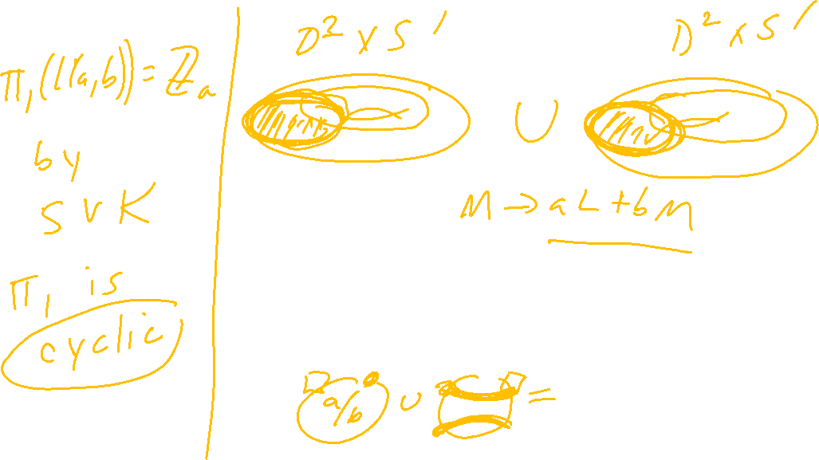

Slide 20
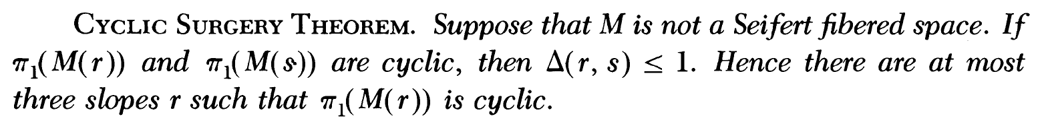
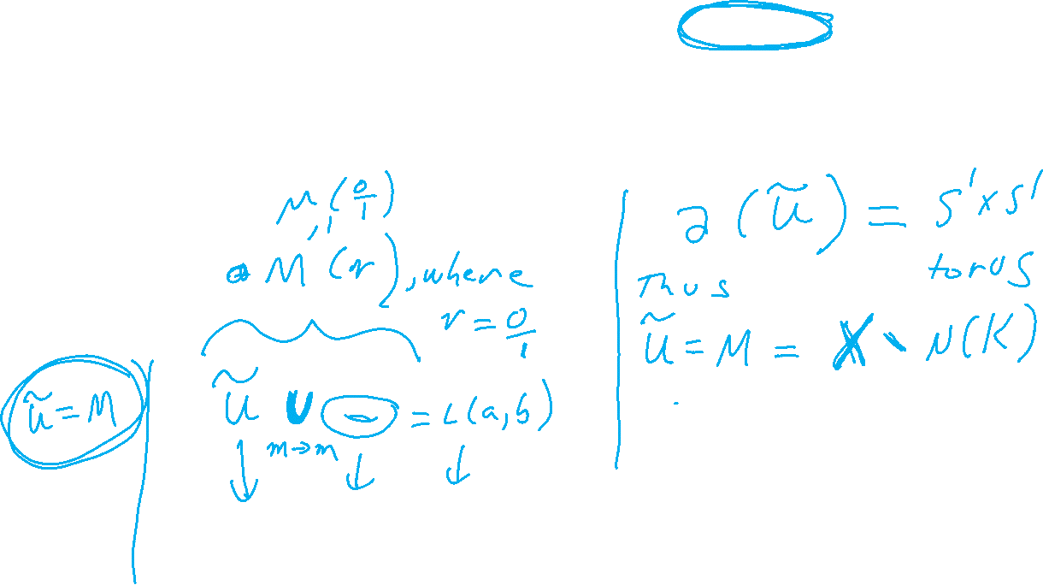
M. Culler, C. Gordon, J. Luecke, P. Shalen (1987). Dehn surgery on knots. The Annals of Mathematics 125 (2): 237-300.
https://marc-culler.info/static/home/papers/CyclicSurgery.pdf
f(m’) = curve of slope r ~ pl + qm; r = q/p ,
in terms of a bases: l = longitude and m = meridian of boundary of N(K)

Slide 21
M. Culler, C. Gordon, J. Luecke, P. Shalen (1987). Dehn surgery on knots. The Annals of Mathematics 125 (2): 237-300.
https://marc-culler.info/static/home/papers/CyclicSurgery.pdf

Slide 22

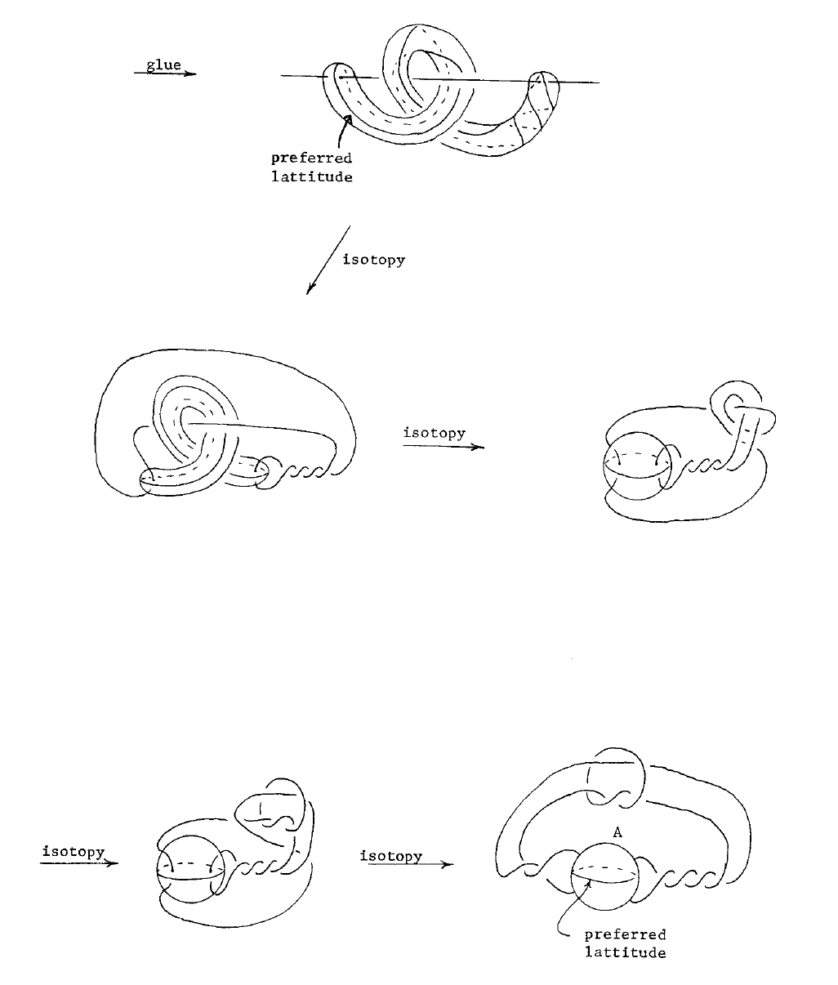

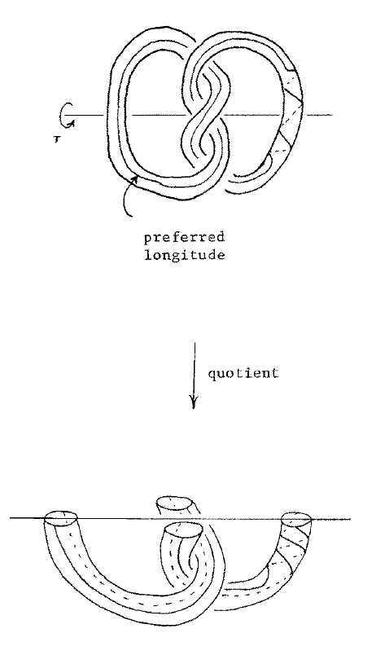
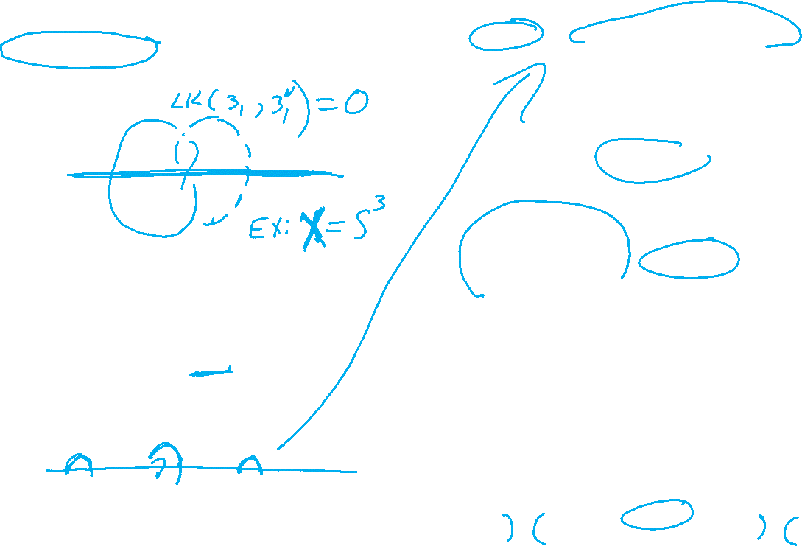

Slide 23
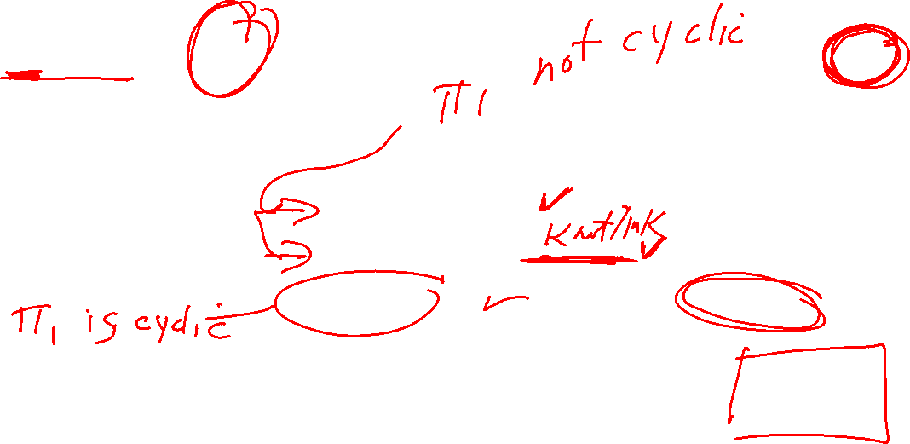

Slide 24

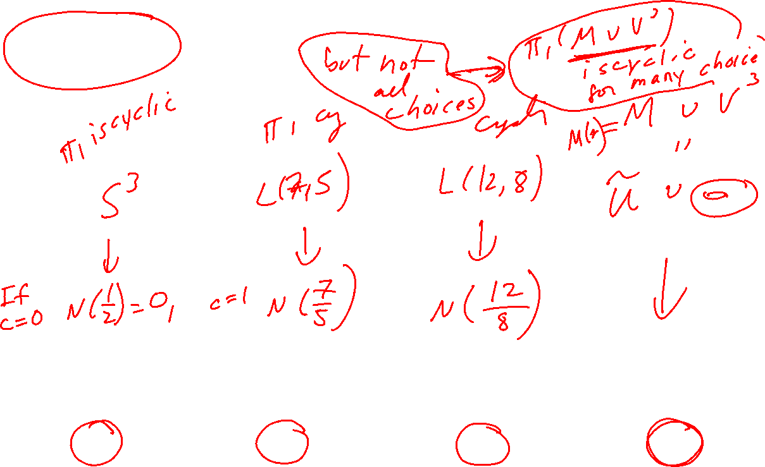

Slide 25
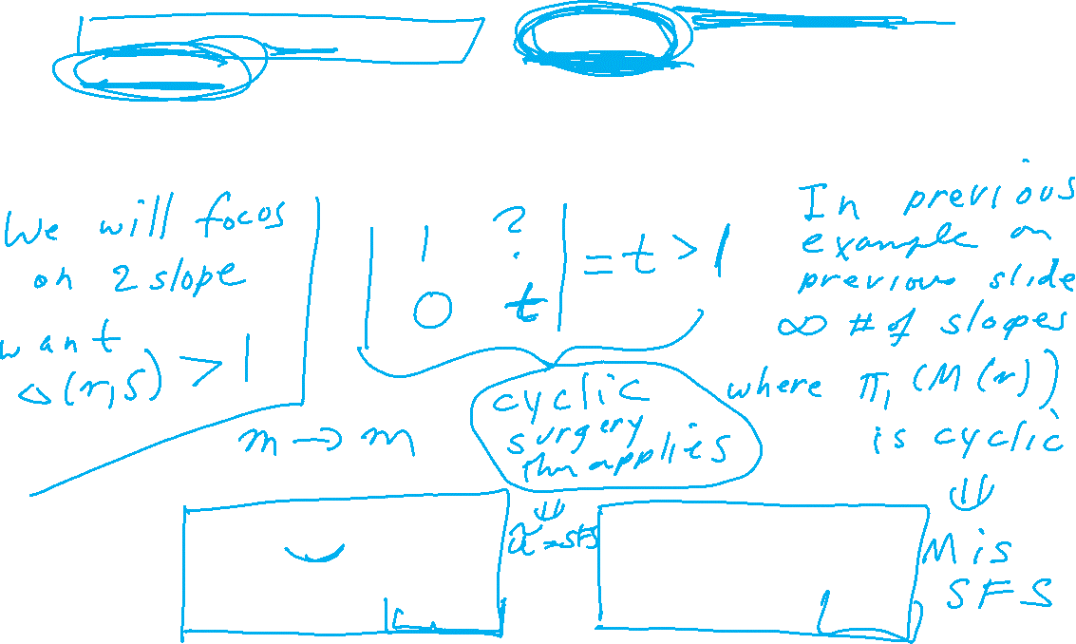
M. Culler, C. Gordon, J. Luecke, P. Shalen (1987). Dehn surgery on knots. The Annals of Mathematics 125 (2): 237-300.
https://marc-culler.info/static/home/papers/CyclicSurgery.pdf
f(m’) = curve of slope r ~ pl + qm; r = q/p ,
in terms of a bases: l = longitude and m = meridian of boundary of N(K)

Slide 27

M. Culler, C. Gordon, J. Luecke, P. Shalen (1987). Dehn surgery on knots. The Annals of Mathematics 125 (2): 237-300.
https://marc-culler.info/static/home/papers/CyclicSurgery.pdf
f(m’) = curve of slope r ~ pl + qm; r = q/p ,
in terms of a bases: l = longitude and m = meridian of boundary of N(K)

Slide 28
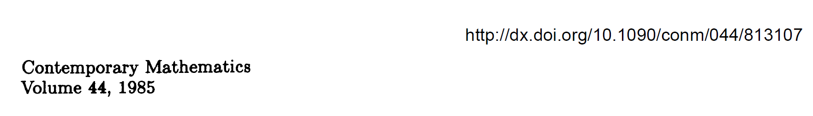

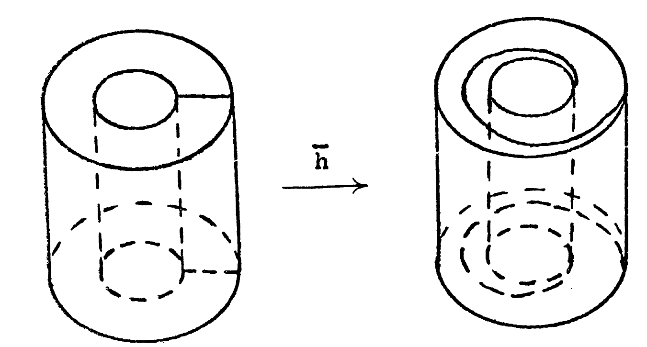
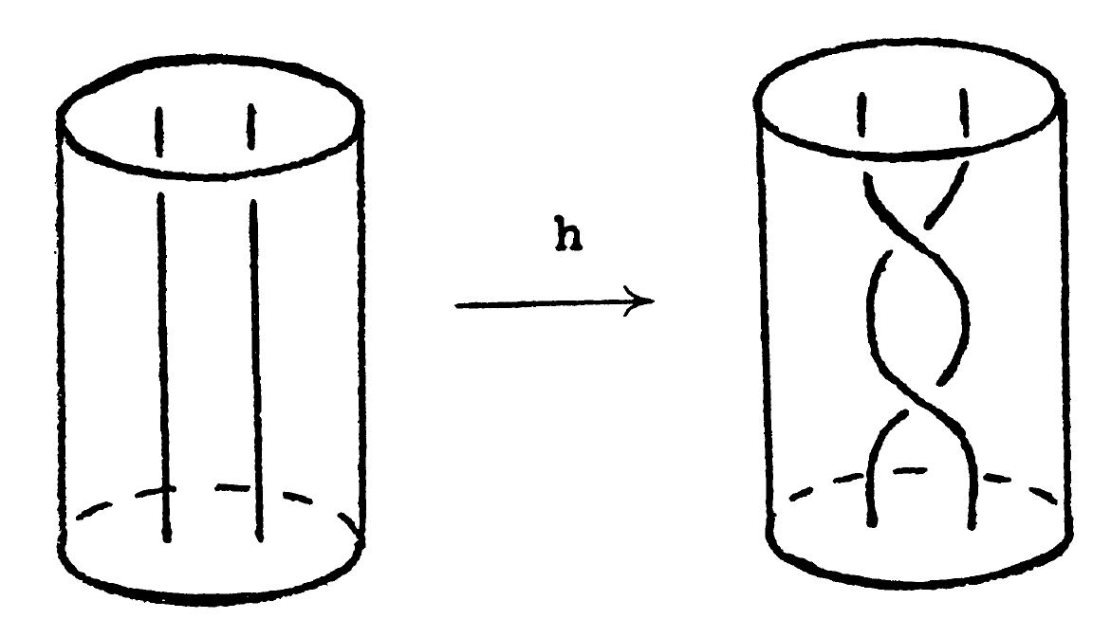
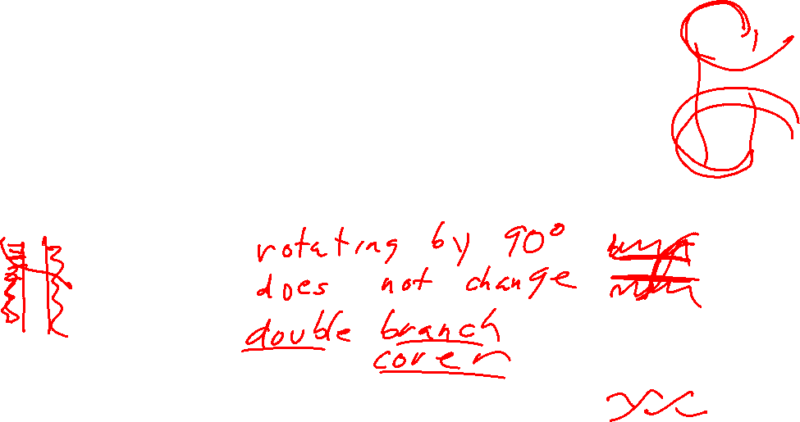

Slide 29
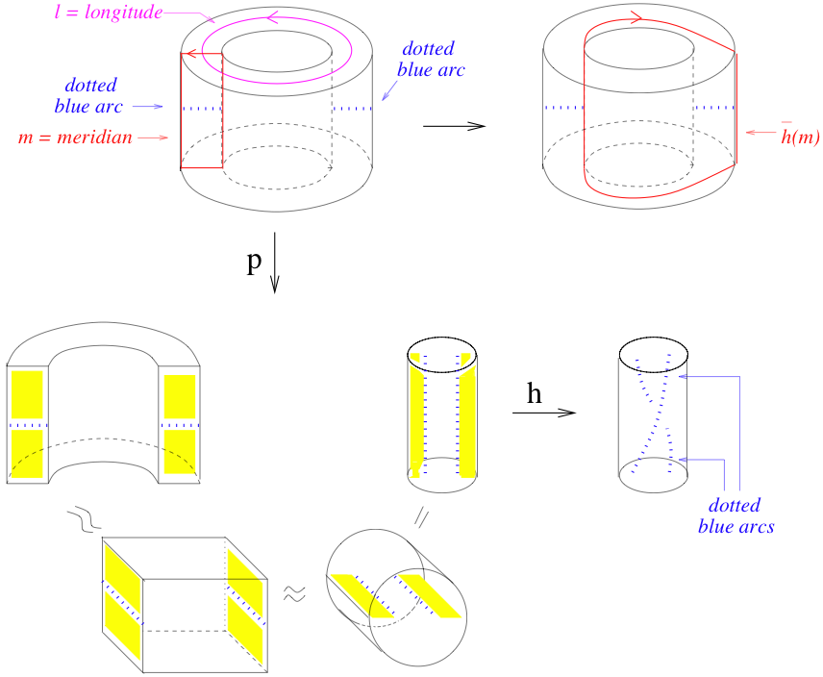
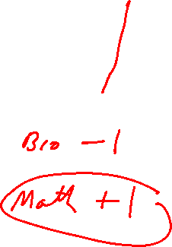

Slide 30
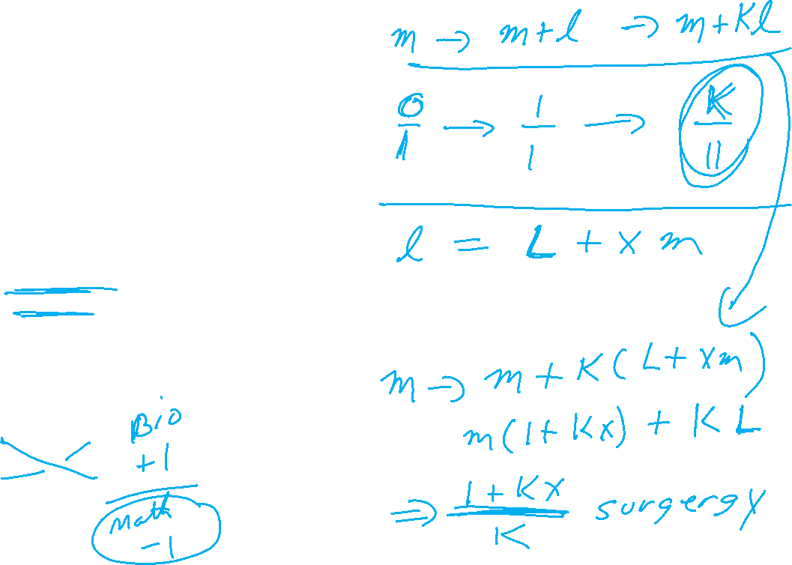

Slide 31
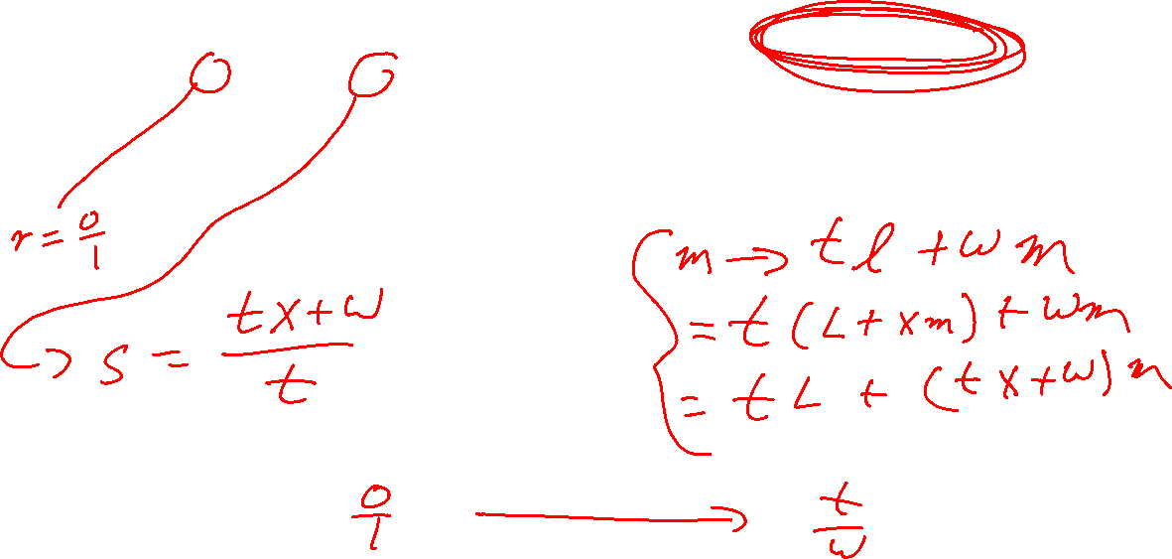
M. Culler, C. Gordon, J. Luecke, P. Shalen (1987). Dehn surgery on knots. The Annals of Mathematics 125 (2): 237-300.
https://marc-culler.info/static/home/papers/CyclicSurgery.pdf
f(m’) = curve of slope r ~ pl + qm; r = q/p ,
in terms of a bases: l = longitude and m = meridian of boundary of N(K)

Slide 32
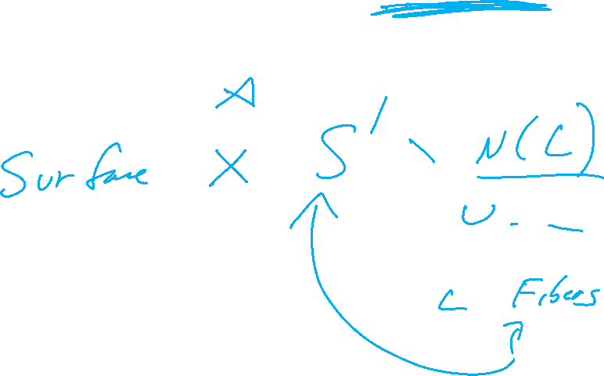
M. Culler, C. Gordon, J. Luecke, P. Shalen (1987). Dehn surgery on knots. The Annals of Mathematics 125 (2): 237-300.
https://marc-culler.info/static/home/papers/CyclicSurgery.pdf

Slide 33
