Slide 1
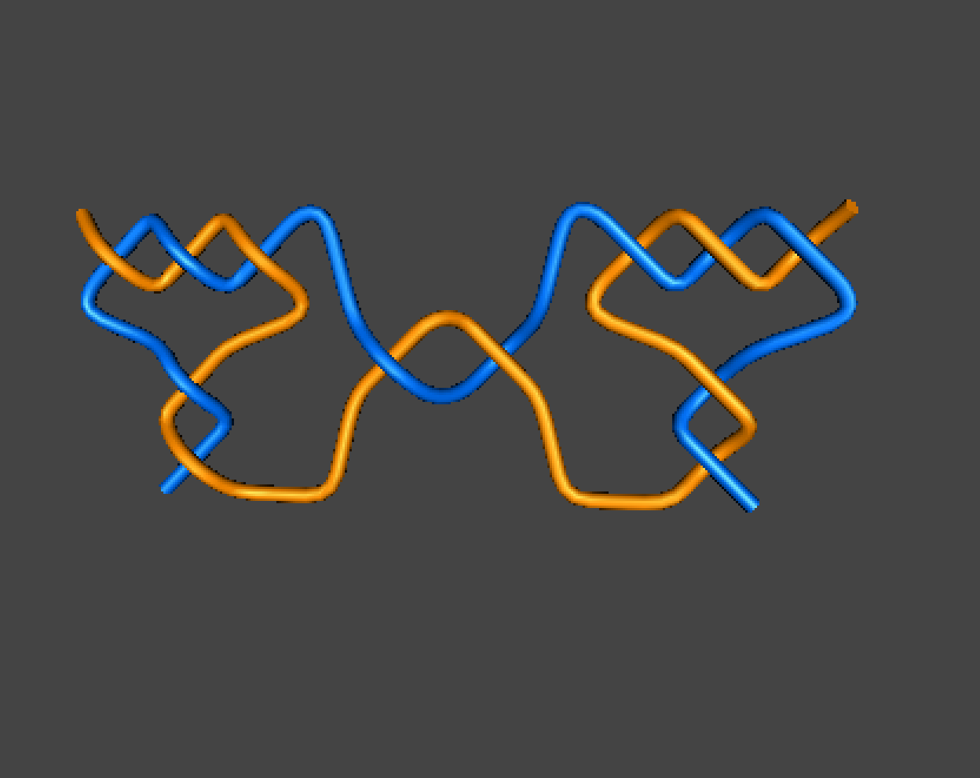

$$\left(c_{1},…,c_{n−1},c_{n}+d_{k},d_{k−1},…,d_{1}\right)$$
(3, 2, 1 + 1, 2, 3)

Slide 2


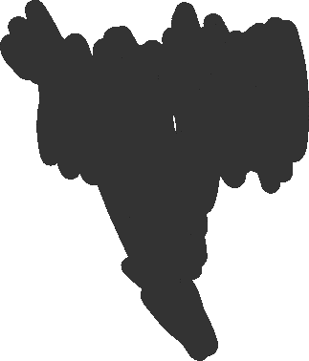









$$\left(c_{1},…,c_{n−1},c_{n}+d_{k},d_{k−1},…,d_{1}\right)$$
(3, 2, 1 + 1, 2, 3)

Slide 3














$$\left(c_{1},…,c_{n−1},c_{n}+d_{k},d_{k−1},…,d_{1}\right)$$
(3, 2, 1 + 1, 2, 3)

Slide 4


$$\left(c_{1},…,c_{n−1},c_{n}+d_{k},d_{k−1},…,d_{1}\right)$$
(3, 2, 1 + 1, 2, 3)

Slide 5








$$\left(c_{1},…,c_{n−1},c_{n}+d_{k},d_{k−1},…,d_{1}\right)$$
(3, 2, 1 + 1, 2, 3)

Slide 6


$$\left(c_{1},…,c_{n−1},c_{n}+d_{k},d_{k−1},…,d_{1}\right)$$
(3, 2, 1 + 1, 2, 3)

Slide 7
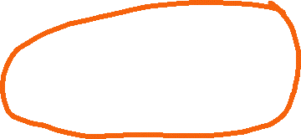





$$\left(c_{1},…,c_{n−1},c_{n}+d_{k},d_{k−1},…,d_{1}\right)$$
(3, 2, 1 + 1, 2, 3)

Slide 8

$$\left(c_{1},…,c_{n−1},c_{n}+d_{k},d_{k−1},…,d_{1}\right)$$
(3, 2, 1 + 1, 2, 3)

Slide 9




$$\left(c_{1},…,c_{n−1},c_{n}+d_{k},d_{k−1},…,d_{1}\right)$$
(3, 2, 1 + 1, 2, 3)

Slide 10



$$\left(c_{1},…,c_{n−1},c_{n}+d_{k},d_{k−1},…,d_{1}\right)$$
(3, 2, 1 + 1, 2, 3)

Slide 11



$$\left(c_{1},…,c_{n−1},c_{n}+d_{k},d_{k−1},…,d_{1}\right)$$
(3, 2, 1 + 1, 2, 3)

Slide 12
$$\left(c_{1},…,c_{n−1},c_{n}+d_{k},d_{k−1},…,d_{1}\right)$$
(3, 2, 1 + 1, 2, 3)

Slide 13

$$\left(c_{1},…,c_{n−1},c_{n}+d_{k},d_{k−1},…,d_{1}\right)$$
(3, 2, 1 + 1, 2, 3)

Slide 14
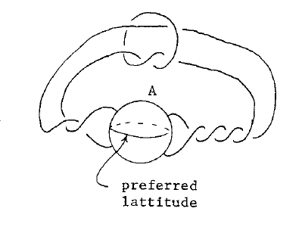
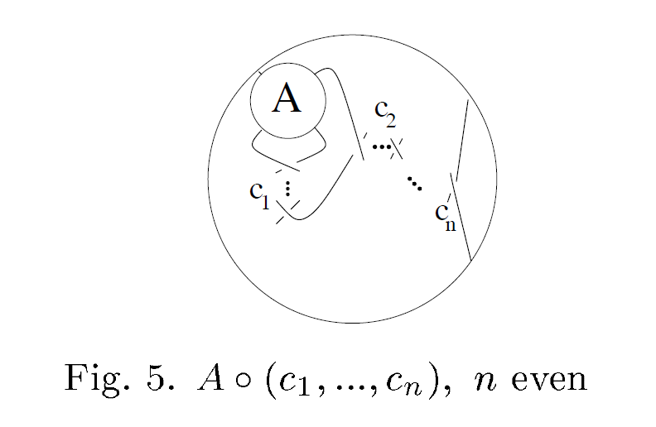



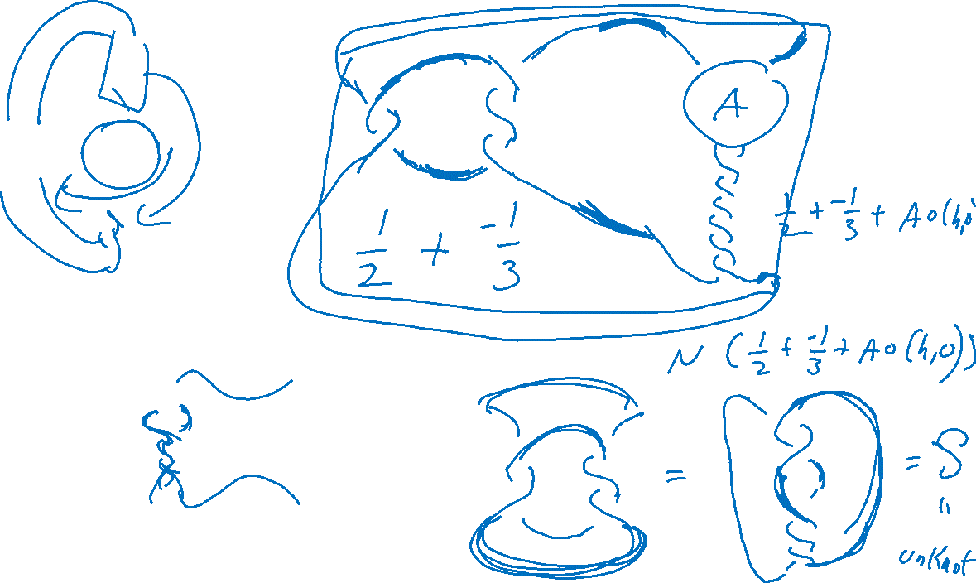





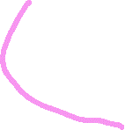


Slide 15
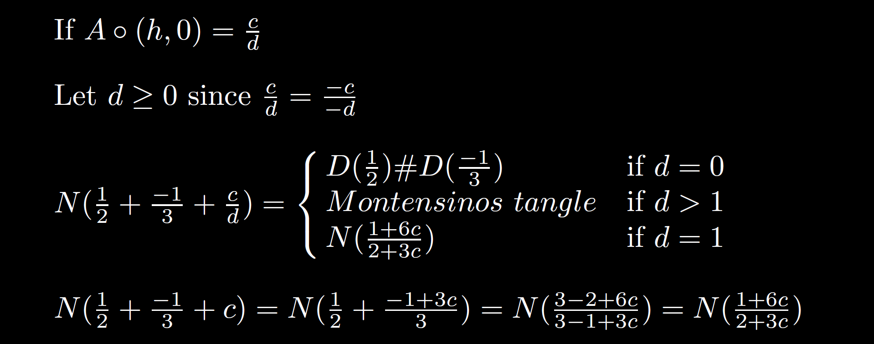

Slide 16
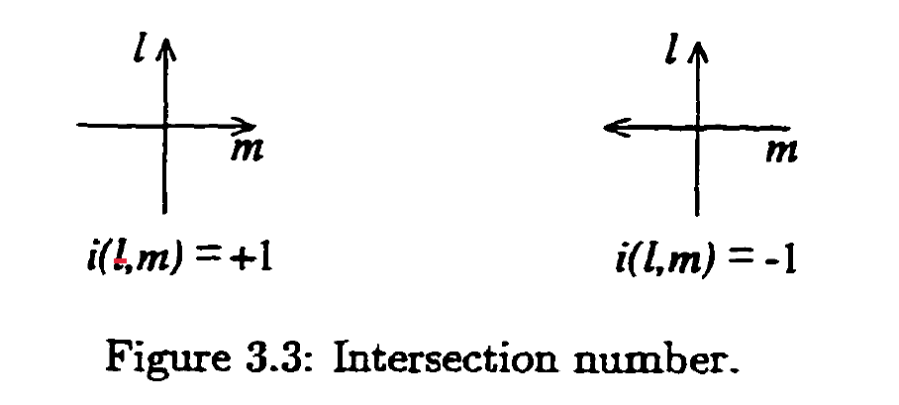
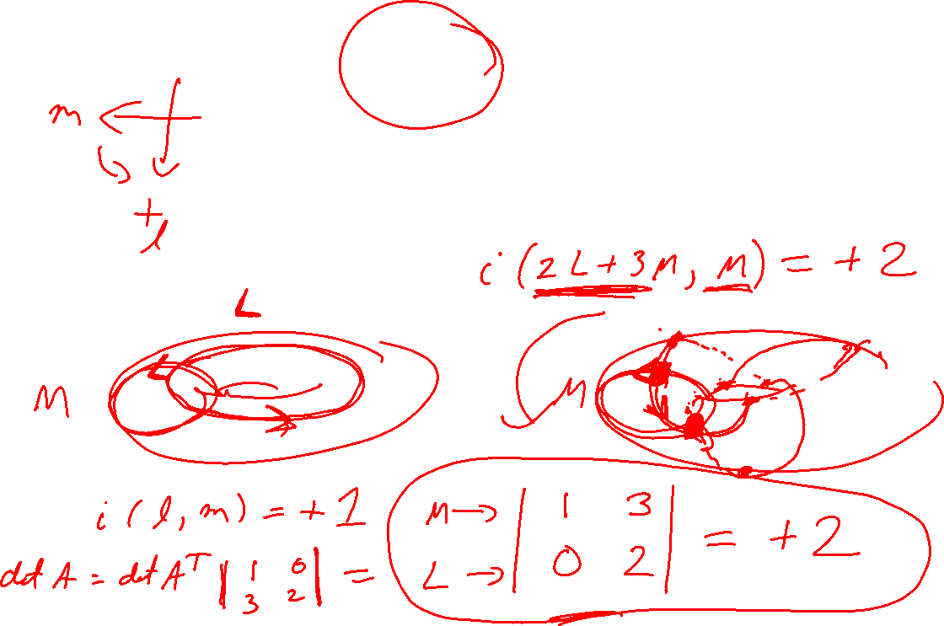
Intersection Number

Slide 17
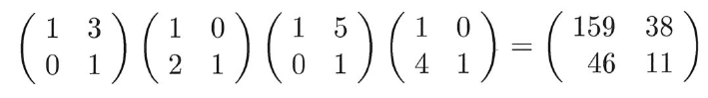
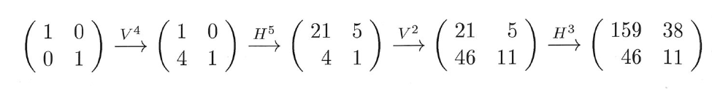
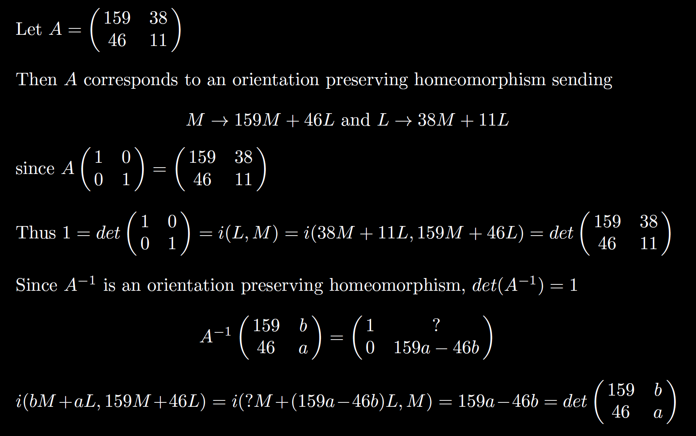

Slide 19
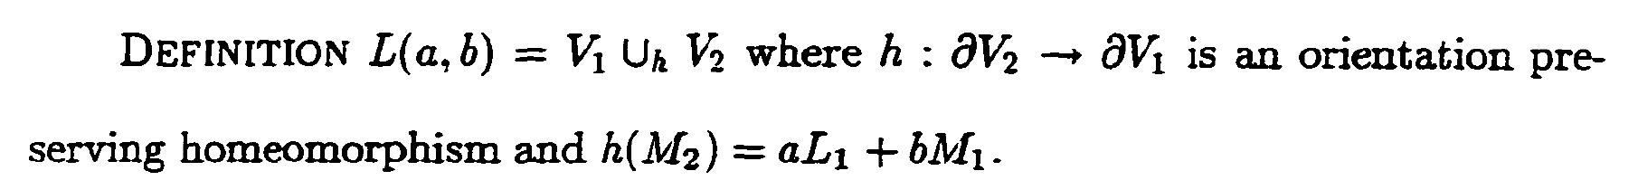
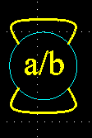

Slide 20
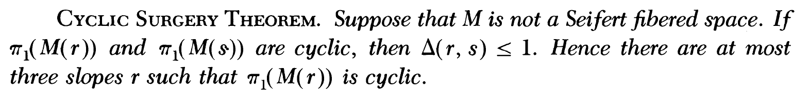
M. Culler, C. Gordon, J. Luecke, P. Shalen (1987). Dehn surgery on knots. The Annals of Mathematics 125 (2): 237-300.
https://marc-culler.info/static/home/papers/CyclicSurgery.pdf
f(m’) = curve of slope r ~ pl + qm; r = q/p ,
in terms of a bases: l = longitude and m = meridian of boundary of N(K)

Slide 21
M. Culler, C. Gordon, J. Luecke, P. Shalen (1987). Dehn surgery on knots. The Annals of Mathematics 125 (2): 237-300.
https://marc-culler.info/static/home/papers/CyclicSurgery.pdf

Slide 22

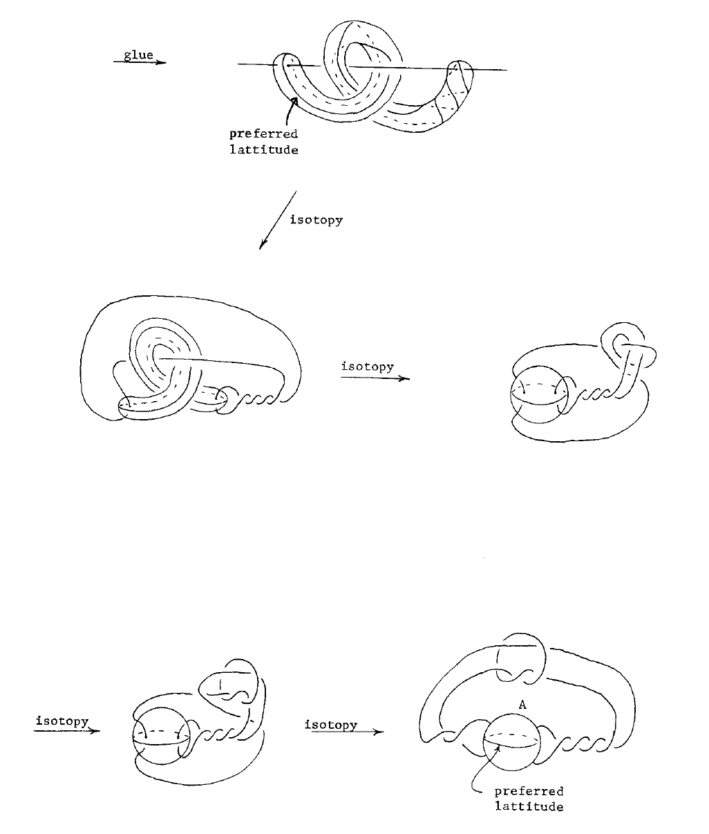

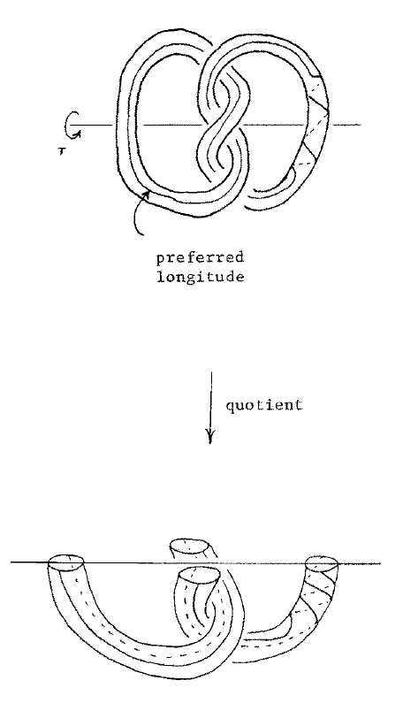

Slide 24


Slide 25
M. Culler, C. Gordon, J. Luecke, P. Shalen (1987). Dehn surgery on knots. The Annals of Mathematics 125 (2): 237-300.
https://marc-culler.info/static/home/papers/CyclicSurgery.pdf
f(m’) = curve of slope r ~ pl + qm; r = q/p ,
in terms of a bases: l = longitude and m = meridian of boundary of N(K)

Slide 27
M. Culler, C. Gordon, J. Luecke, P. Shalen (1987). Dehn surgery on knots. The Annals of Mathematics 125 (2): 237-300.
https://marc-culler.info/static/home/papers/CyclicSurgery.pdf
f(m’) = curve of slope r ~ pl + qm; r = q/p ,
in terms of a bases: l = longitude and m = meridian of boundary of N(K)

Slide 28
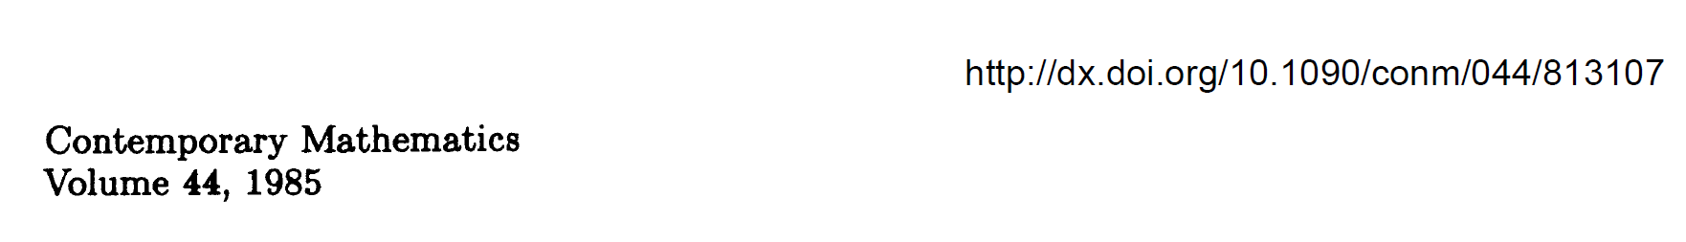

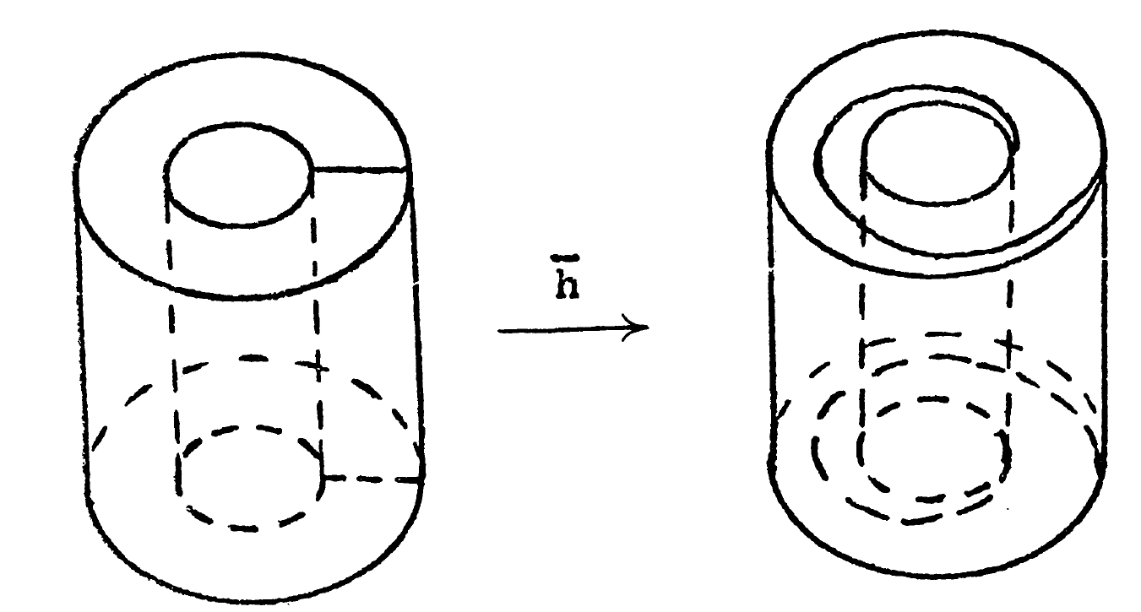
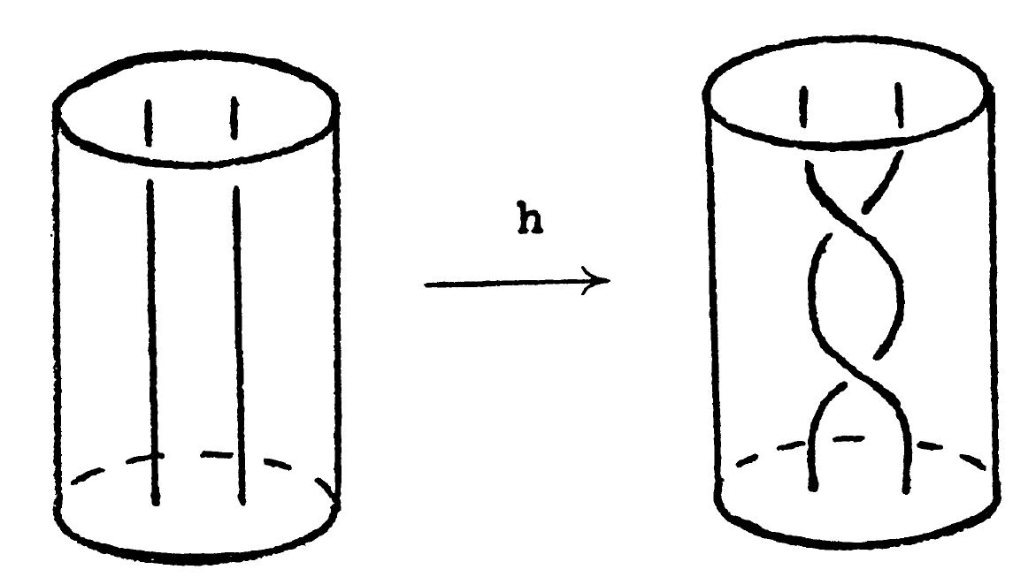

Slide 29
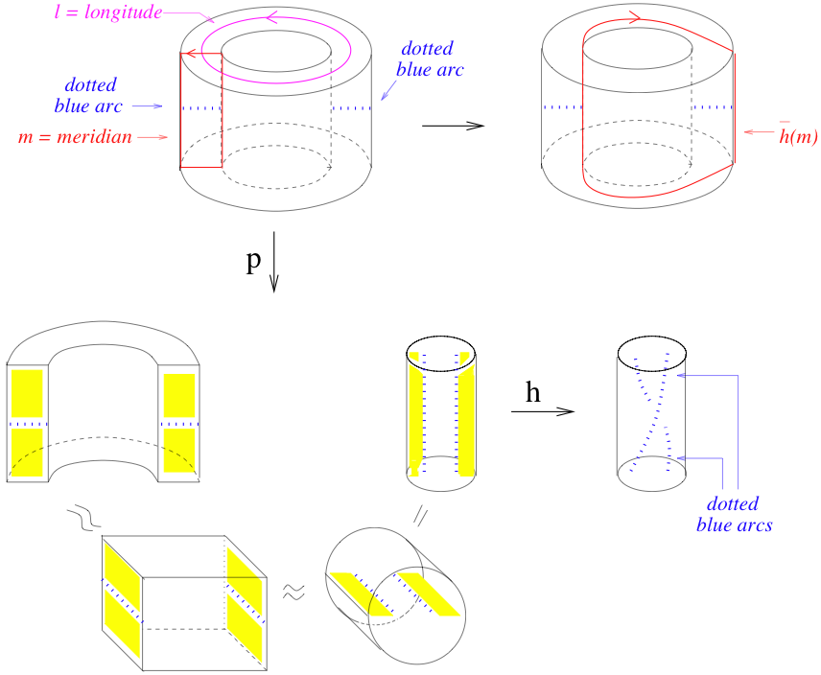

Slide 31
M. Culler, C. Gordon, J. Luecke, P. Shalen (1987). Dehn surgery on knots. The Annals of Mathematics 125 (2): 237-300.
https://marc-culler.info/static/home/papers/CyclicSurgery.pdf
f(m’) = curve of slope r ~ pl + qm; r = q/p ,
in terms of a bases: l = longitude and m = meridian of boundary of N(K)

Slide 32
M. Culler, C. Gordon, J. Luecke, P. Shalen (1987). Dehn surgery on knots. The Annals of Mathematics 125 (2): 237-300.
https://marc-culler.info/static/home/papers/CyclicSurgery.pdf

Slide 33
