Slide 1
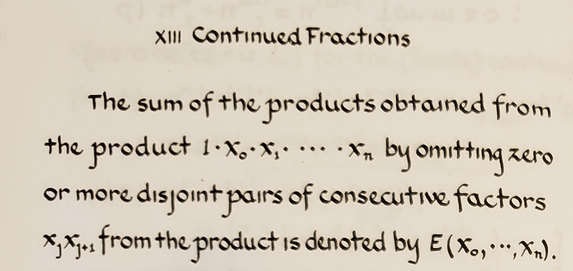
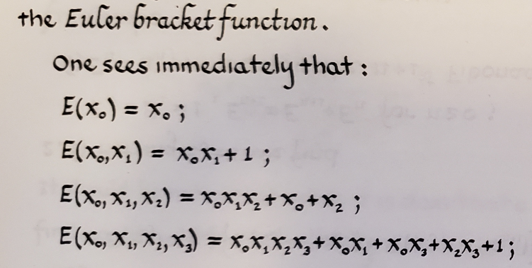

Slide 4

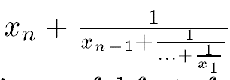
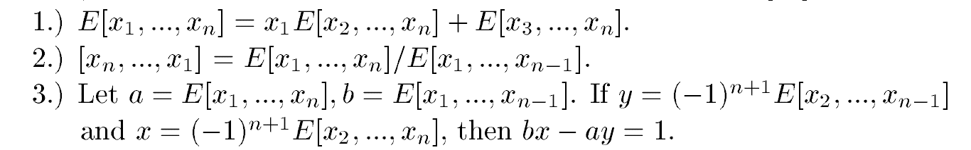

Slide 5
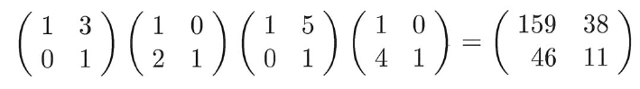
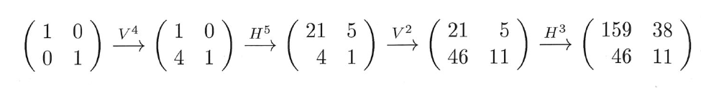

Slide 6


















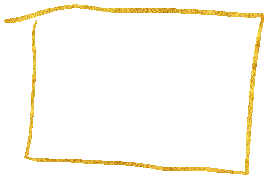
















Slide 7
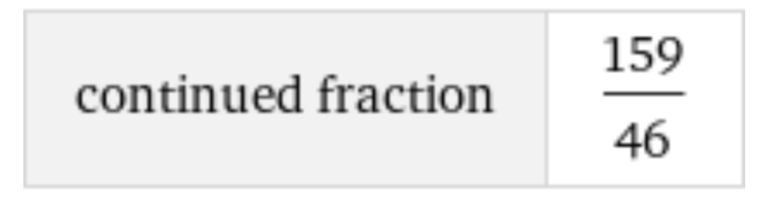
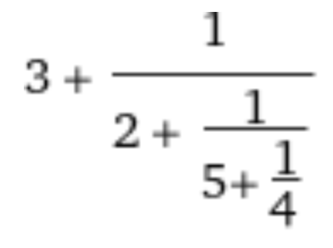
https://www.wolframalpha.com/input/?i=continued+fraction+159%2F46

Slide 9
|t| > 1

Slide 10
|t| > 1

Slide 12
|t| > 1

Slide 13
|t| > 1

Slide 14
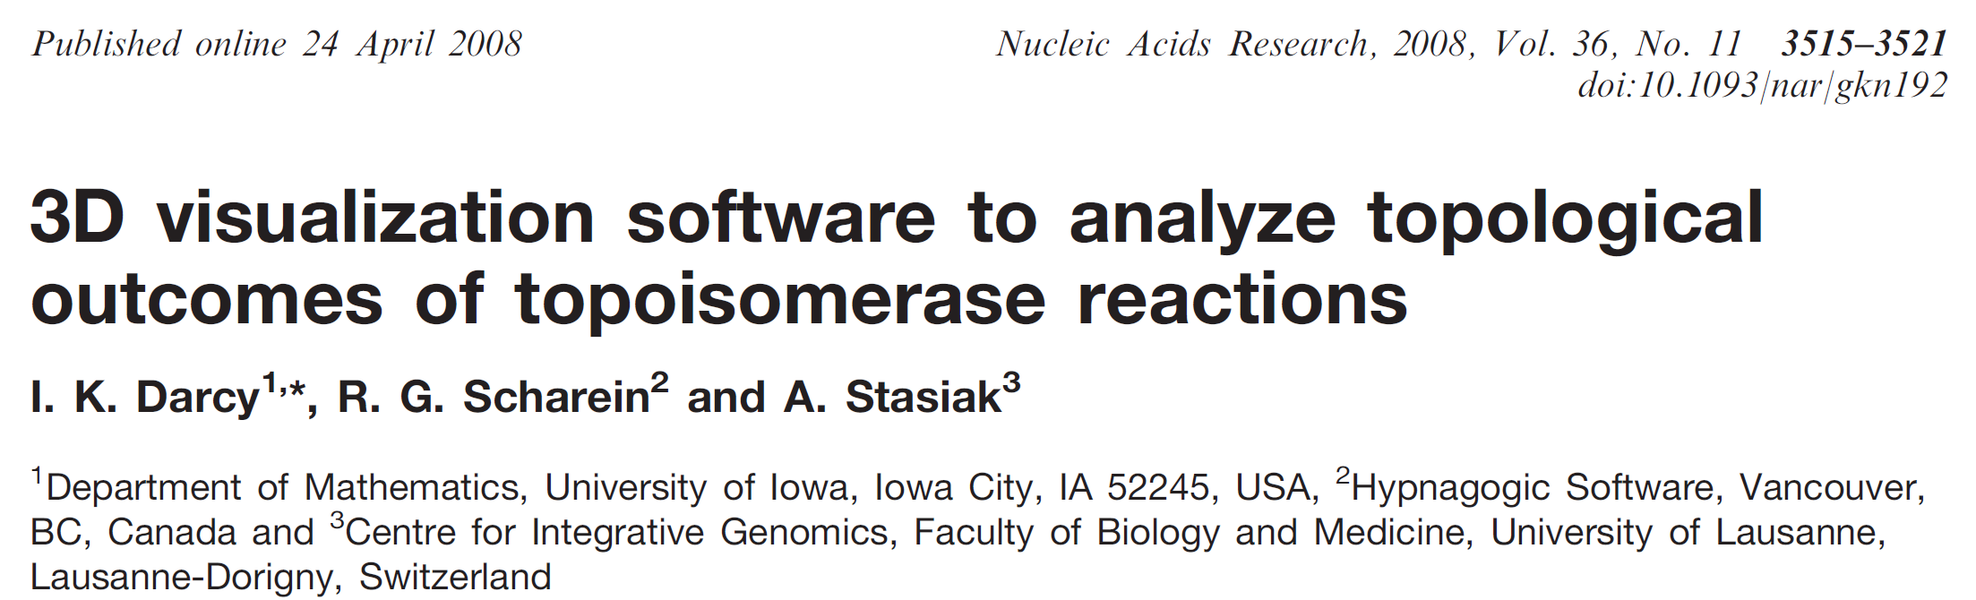

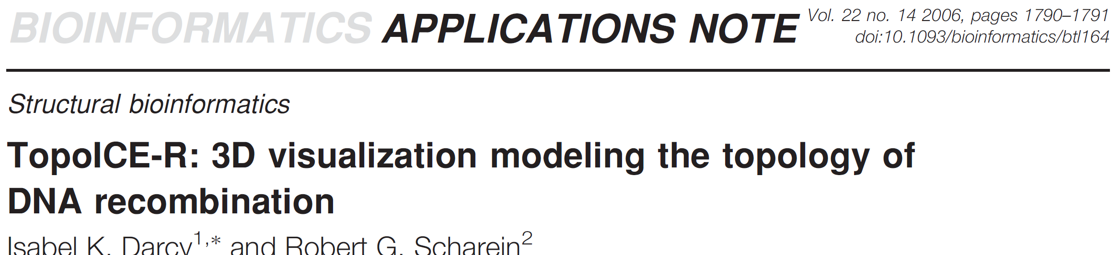
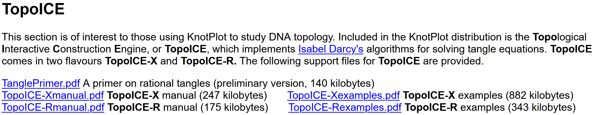
https://academic.oup.com/nar/article/36/11/3515/2410103
https://academic.oup.com/bioinformatics/article/22/14/1790/227088
https://knotplot.com/download/

Slide 16
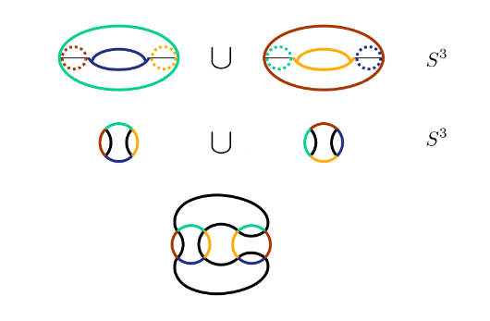

Slide 17

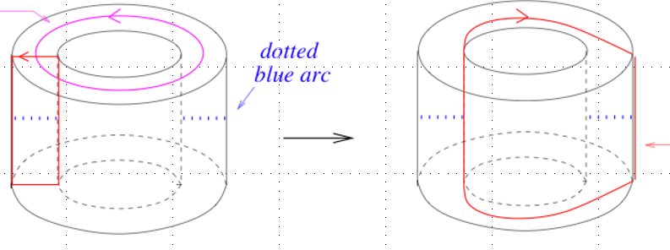
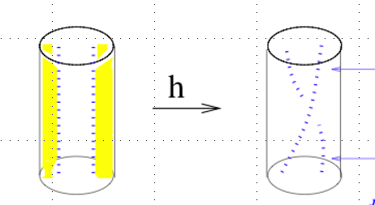

Slide 18
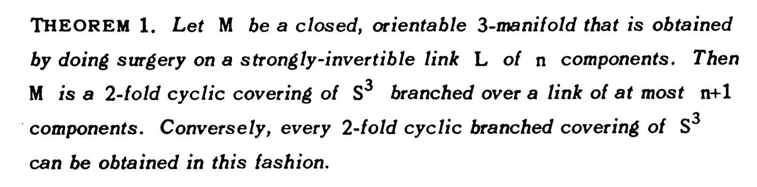
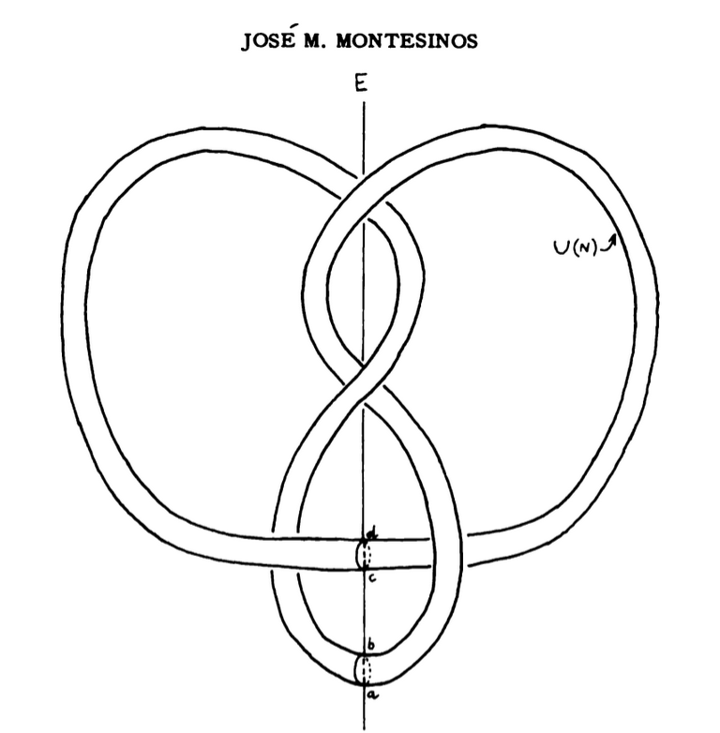
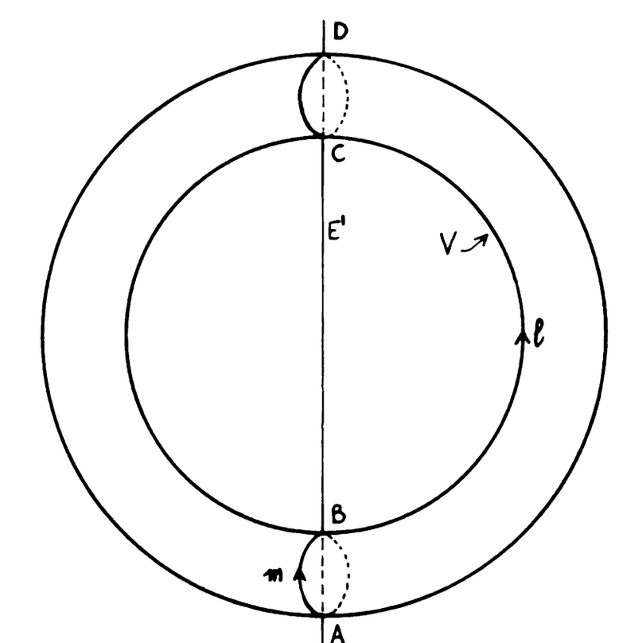







Slide 19
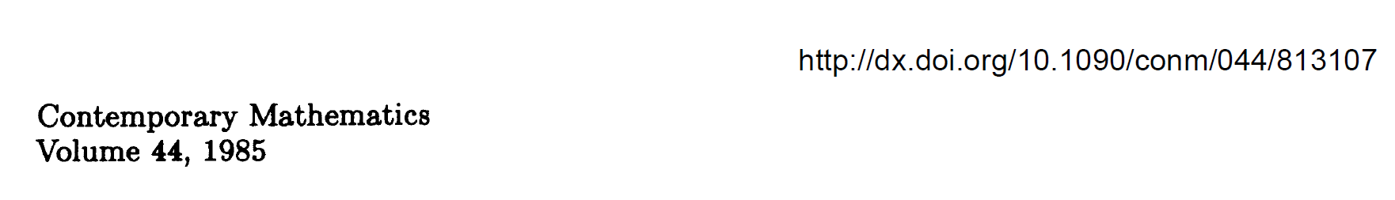

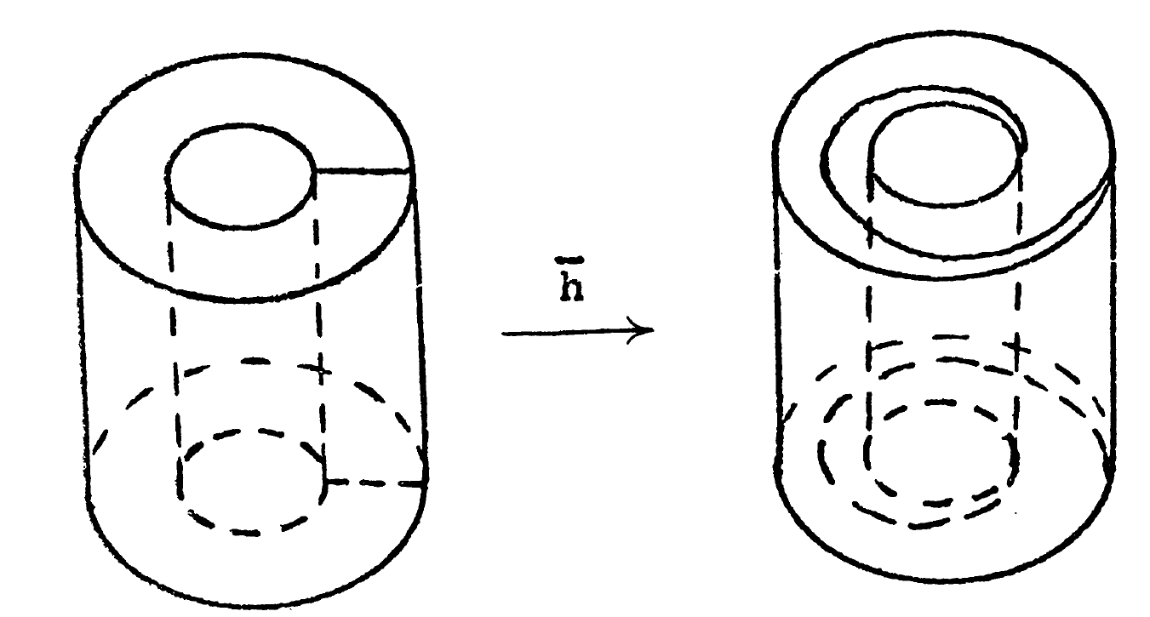
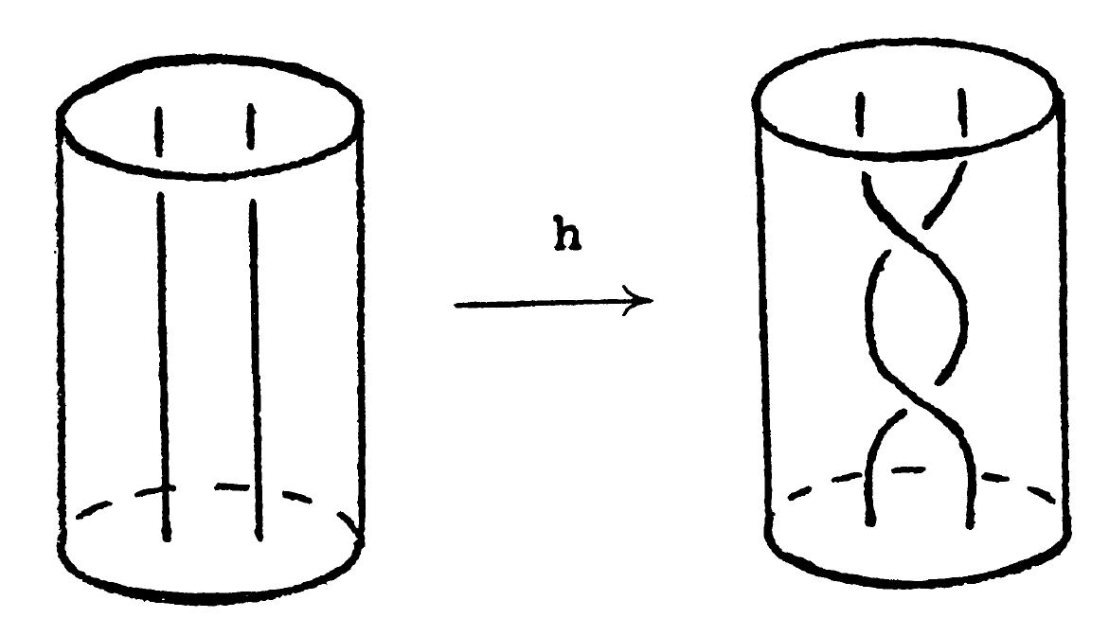







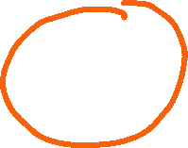





Slide 20
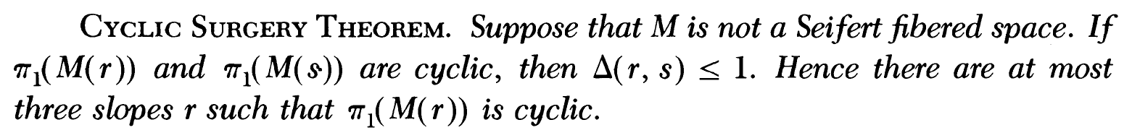
M. Culler, C. Gordon, J. Luecke, P. Shalen (1987). Dehn surgery on knots. The Annals of Mathematics (Annals of Mathematics) 125 (2): 237-300.
https://marc-culler.info/static/home/papers/CyclicSurgery.pdf

Slide 21
M. Culler, C. Gordon, J. Luecke, P. Shalen (1987). Dehn surgery on knots. The Annals of Mathematics (Annals of Mathematics) 125 (2): 237-300.
https://marc-culler.info/static/home/papers/CyclicSurgery.pdf

Slide 22
M. Culler, C. Gordon, J. Luecke, P. Shalen (1987). Dehn surgery on knots. The Annals of Mathematics (Annals of Mathematics) 125 (2): 237-300.
https://marc-culler.info/static/home/papers/CyclicSurgery.pdf

Slide 23
