Slide 1



















Slide 2









Slide 3









Slide 4








Slide 5




Slide 6














Slide 7


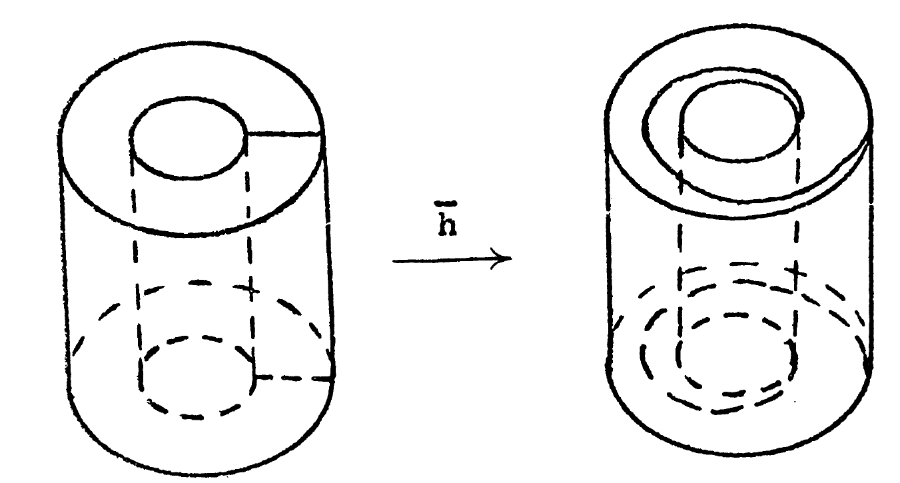
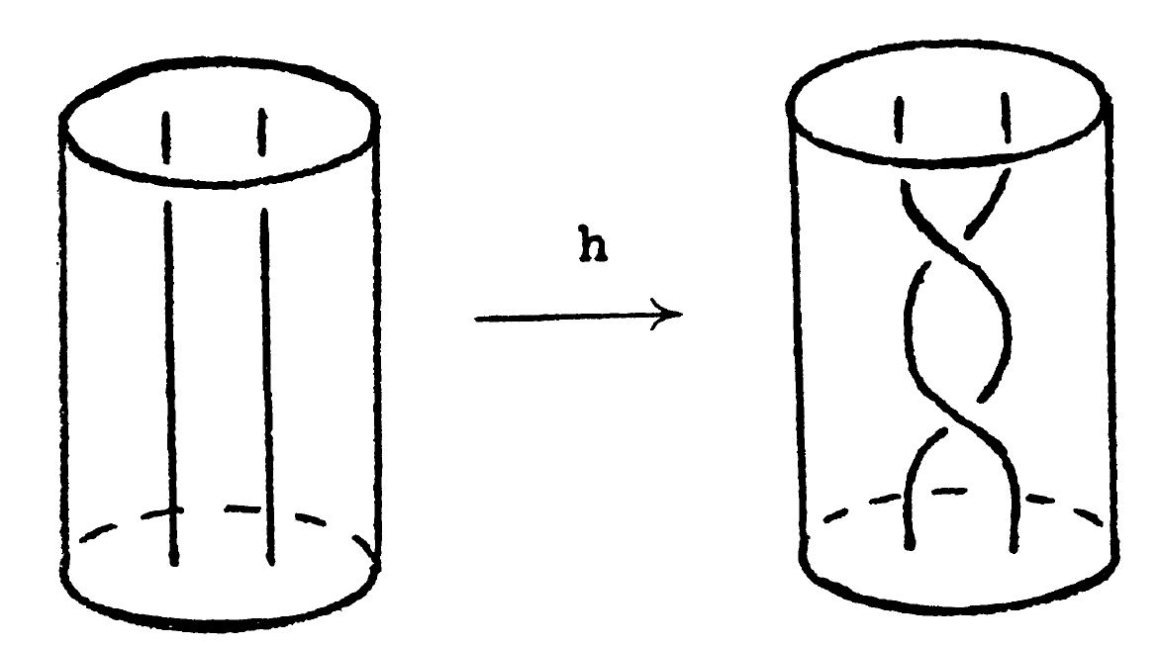

Slide 8
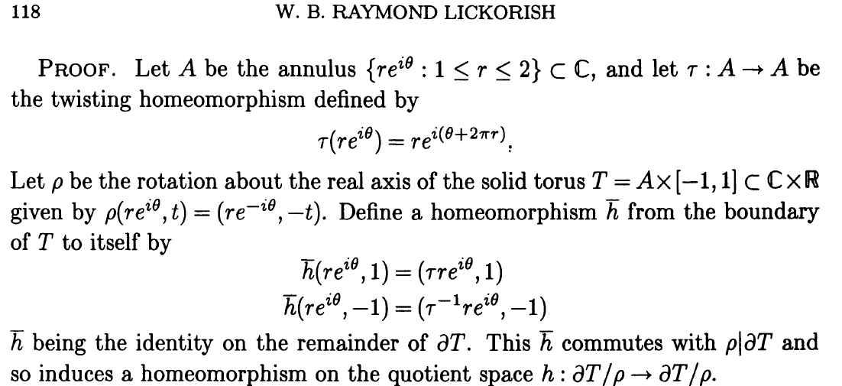


Slide 9
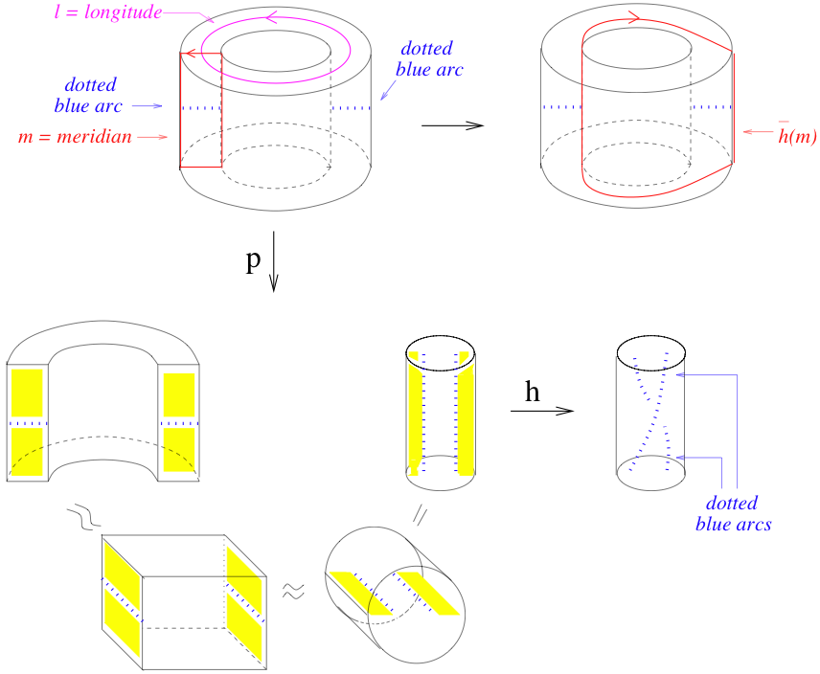

Slide 10

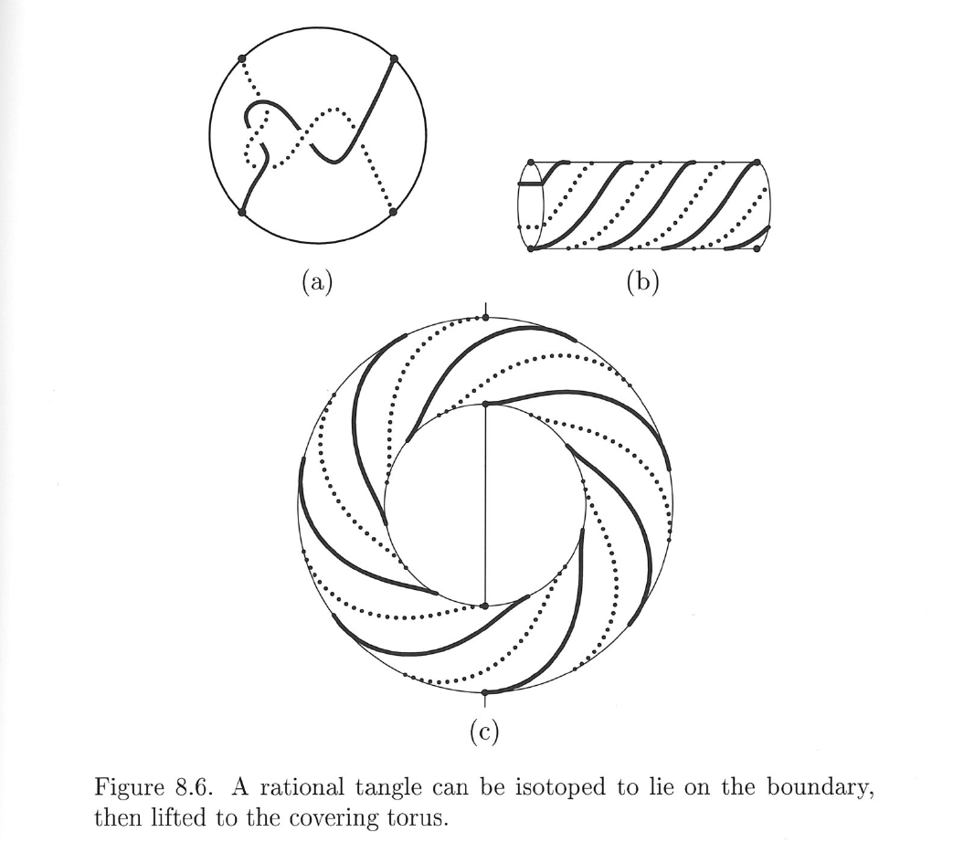
Classification of rational tangles is simpler:

Slide 11











Slide 12
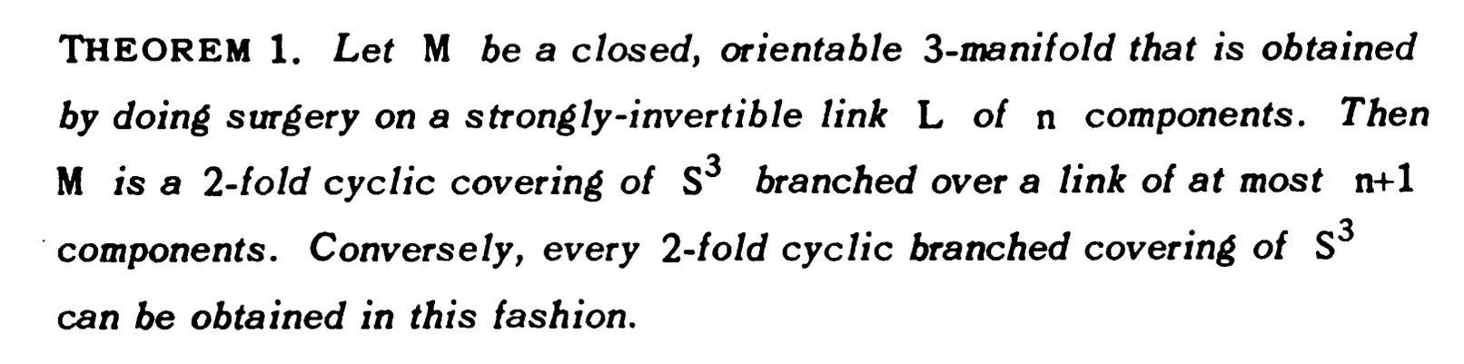
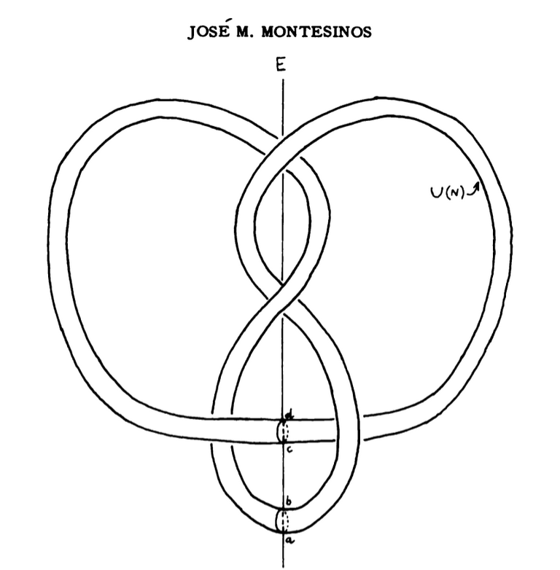
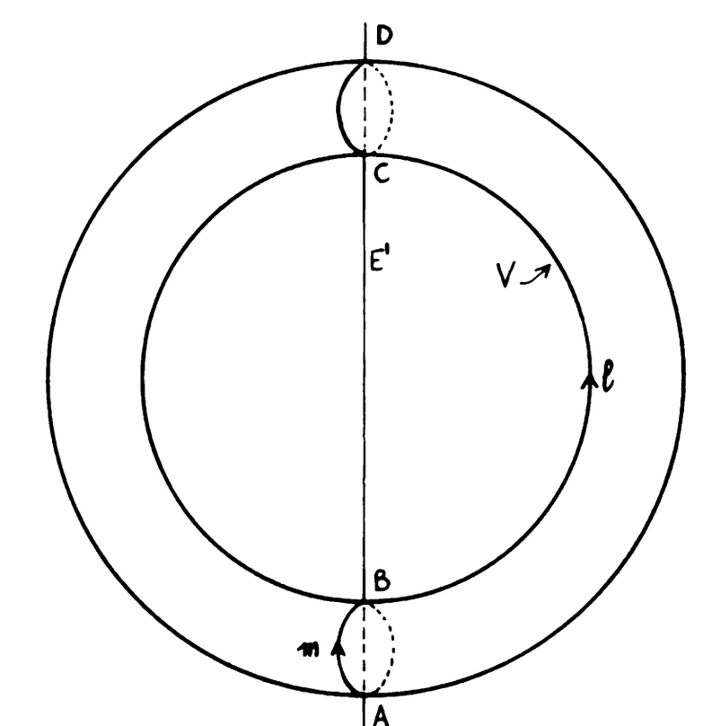







Slide 15













Slide 16





















Slide 17









HW 2: Choose 1 problem
Option 2: Relate tangle equations on previous slide to double branch cover.
Hint:

