Slide 1
Exam 2: Monday (Oct 26th)
Presentation: Choose a day(s) before Thanksgiving break (Nov 21) so you have time to incorporate feedback.

Slide 2
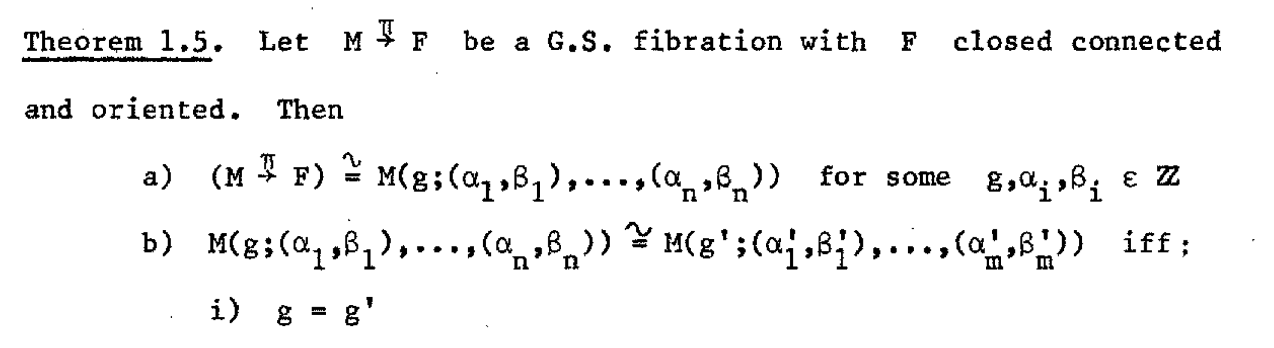






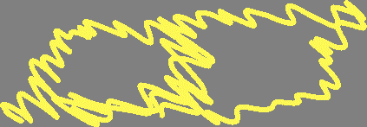












Slide 3
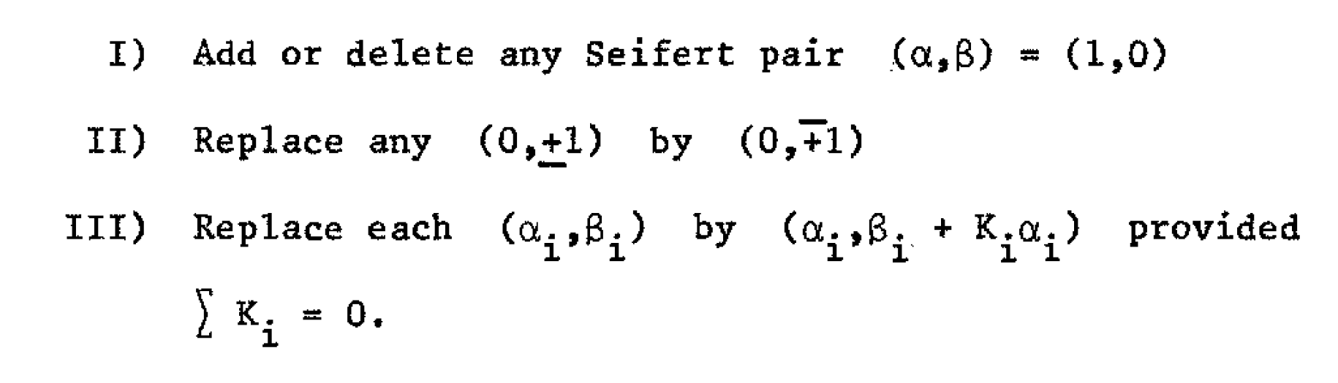

Slide 4

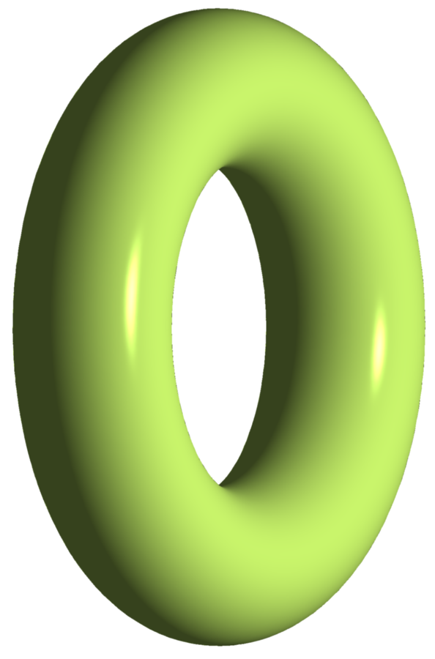

Slide 6
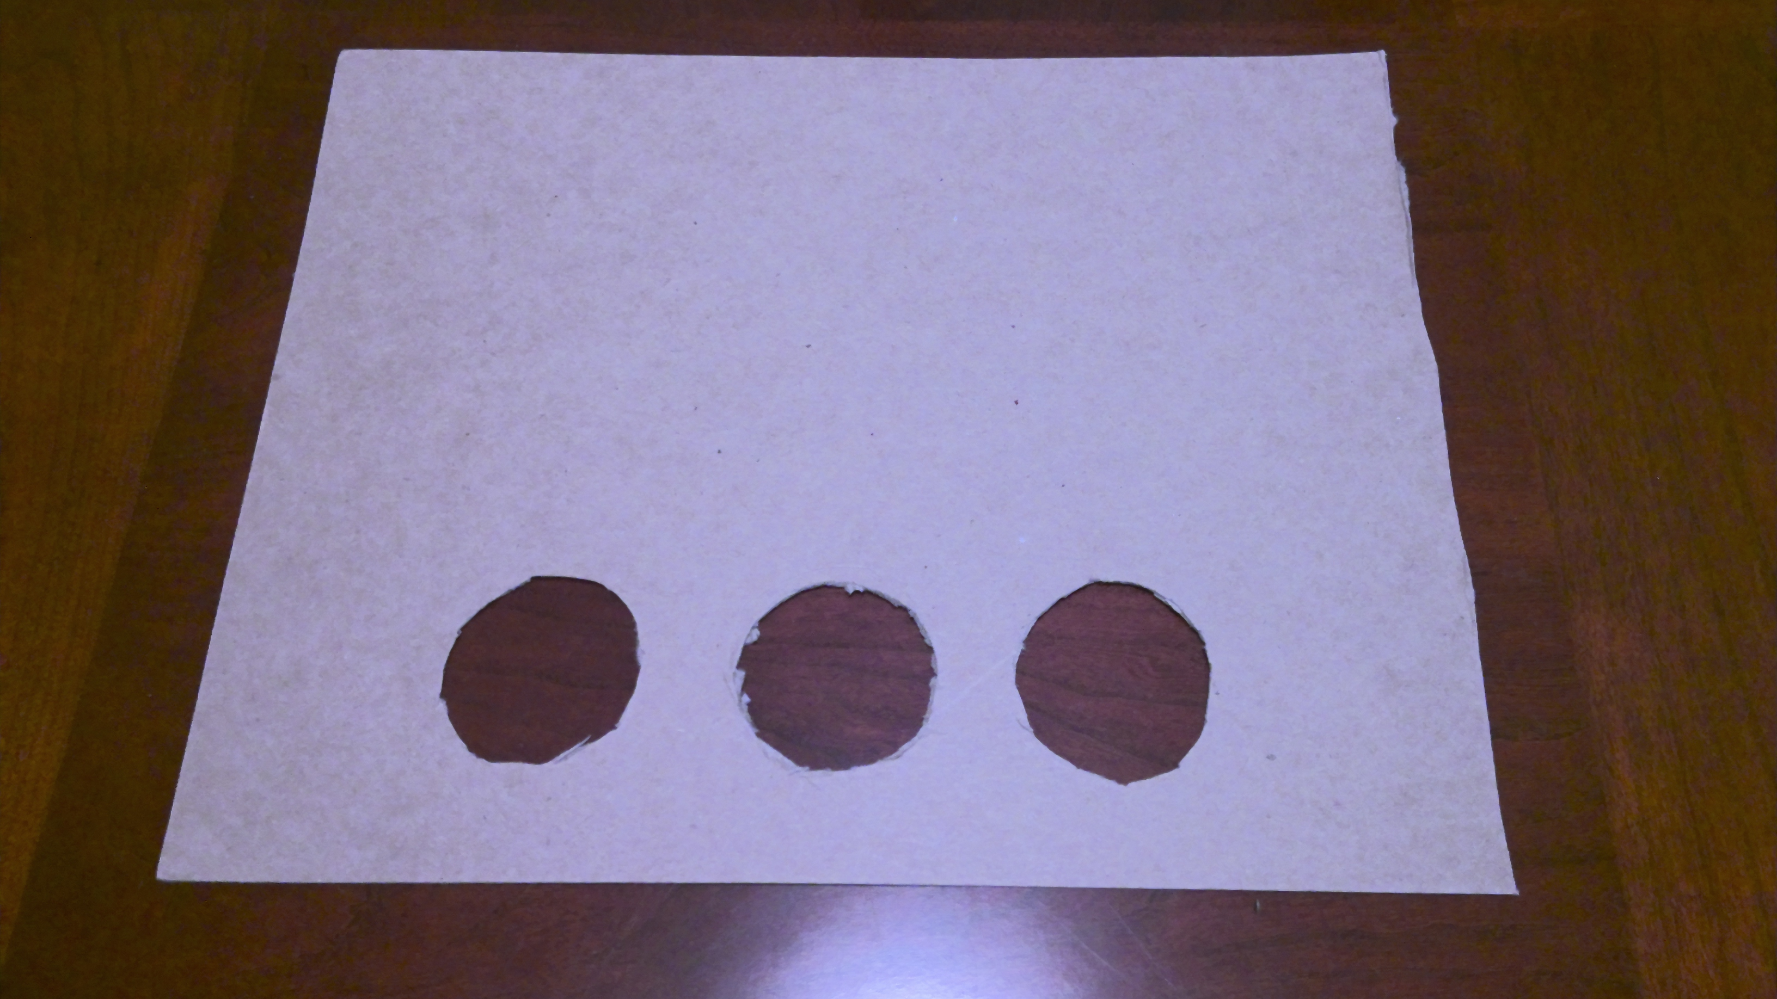
Remove exceptional fibers and create new cross section:

Slide 7
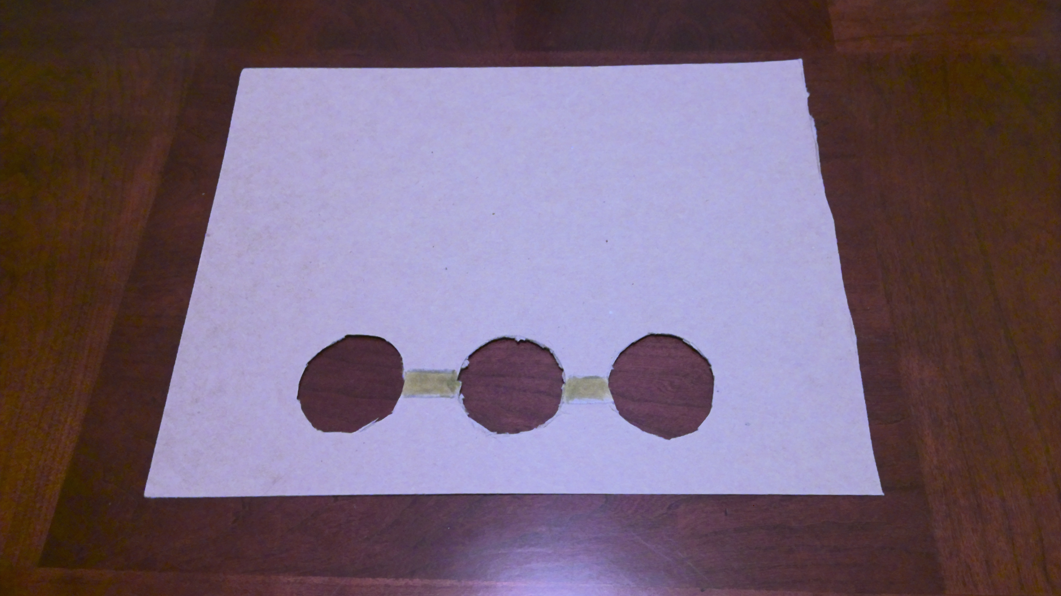

Slide 8
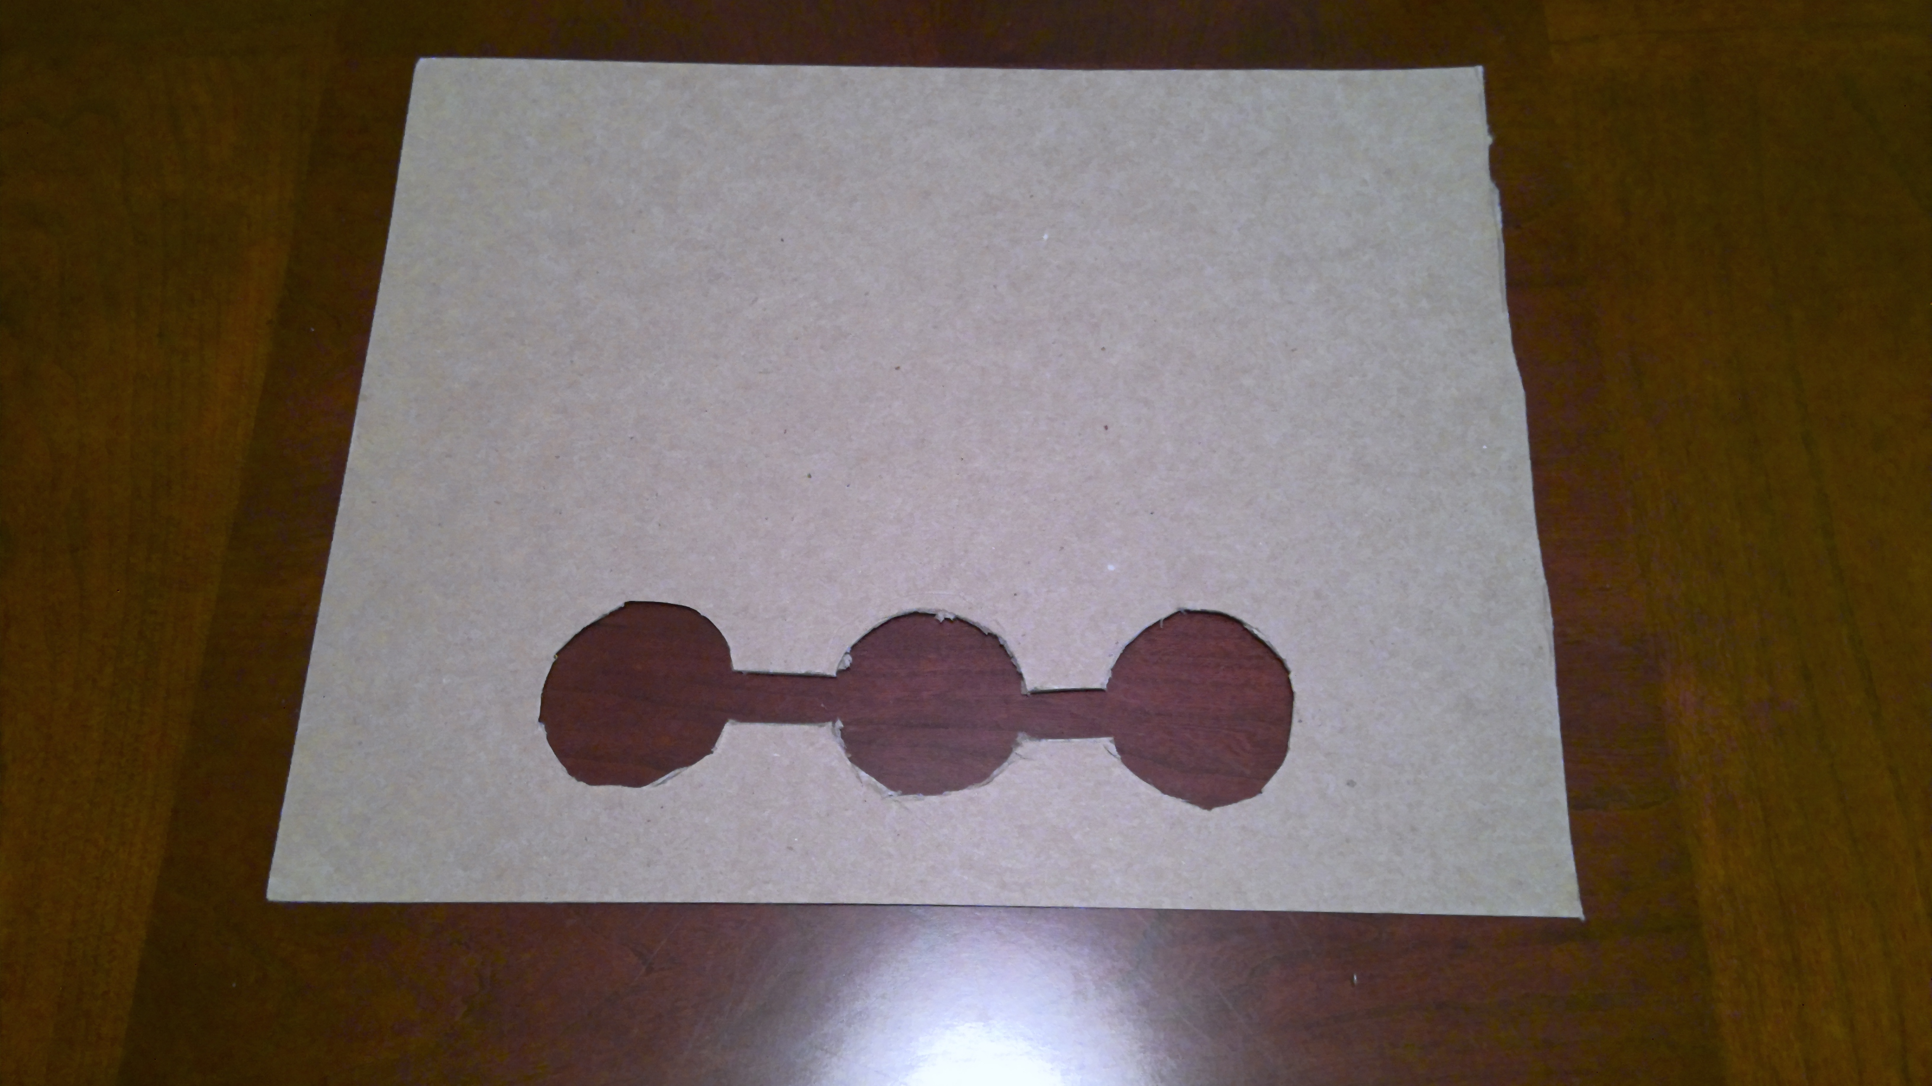

Slide 9
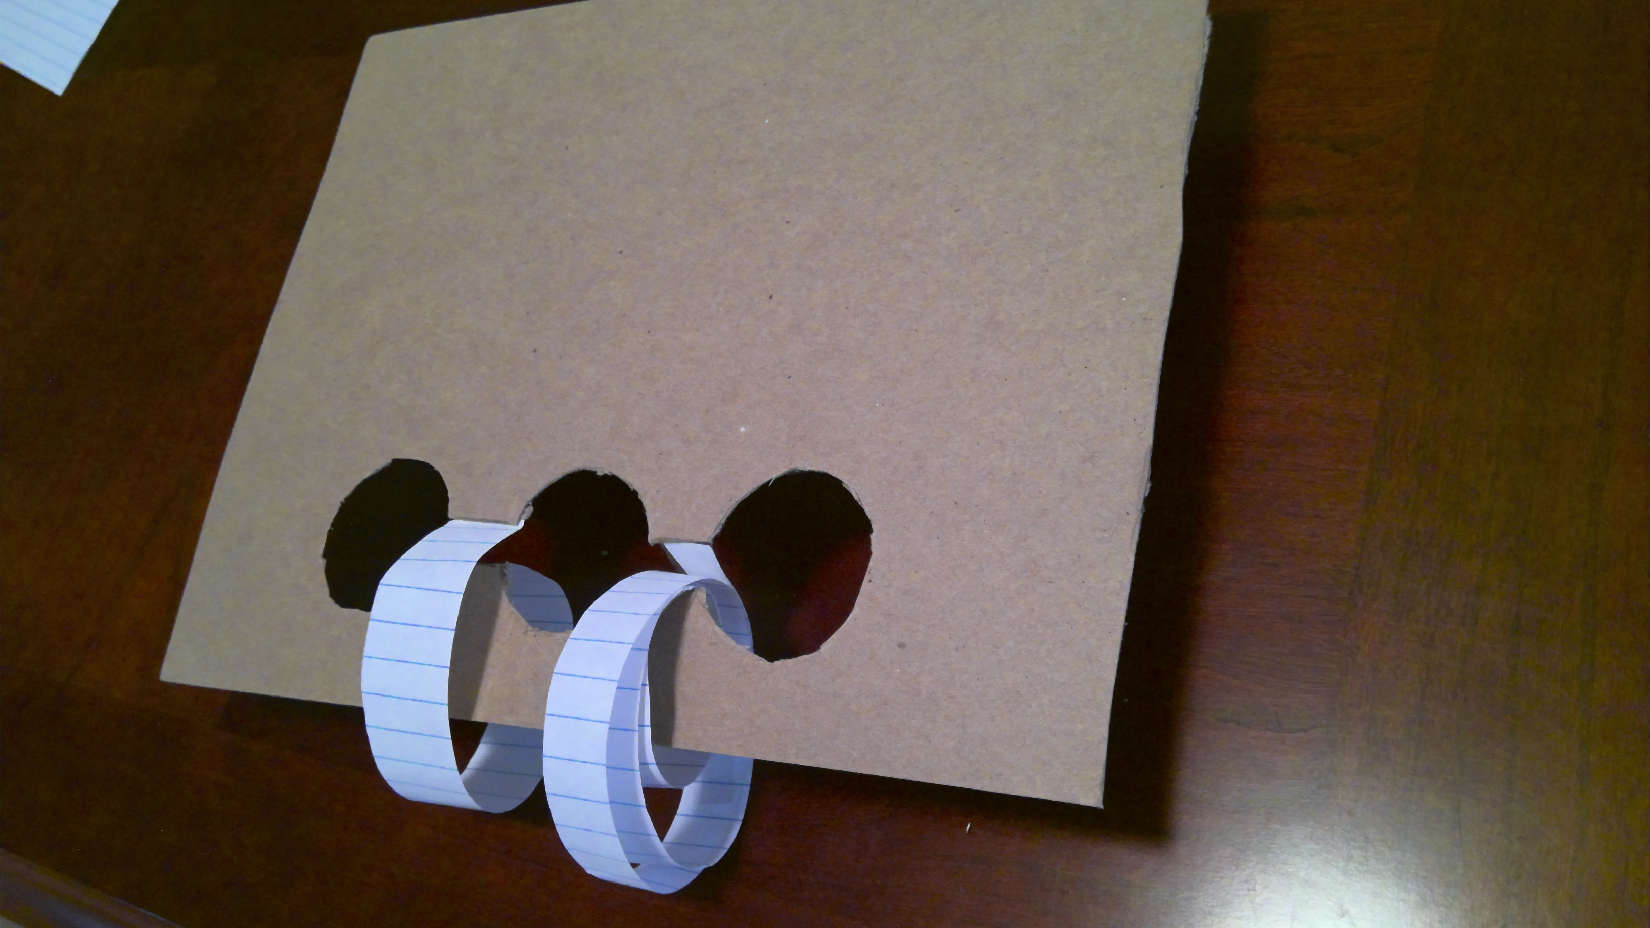

Slide 10






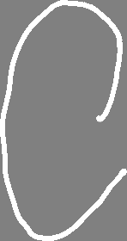





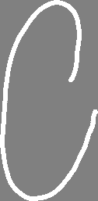

































Remove exceptional fibers and create new cross section:

Slide 12



Slide 13










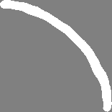




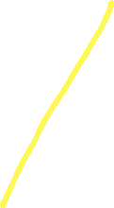


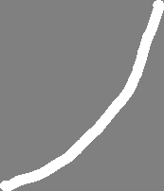








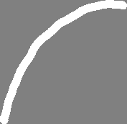



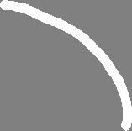

Slide 15



Slide 18
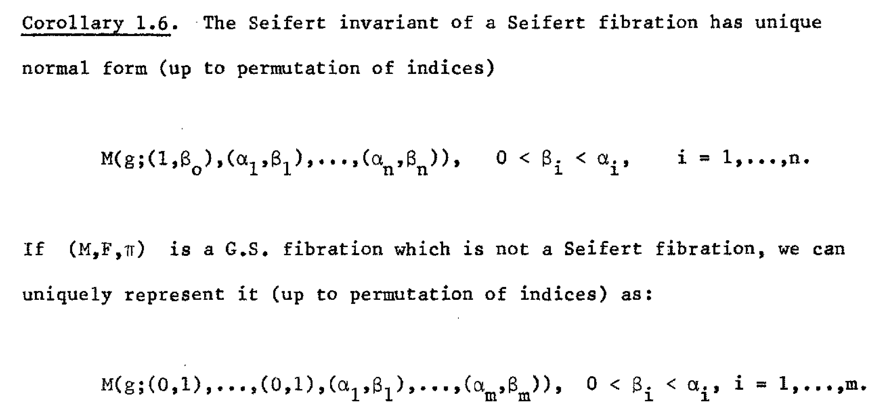

Slide 19
Identify M(0; (5, 12))

Slide 20
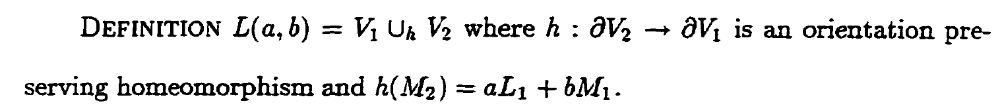
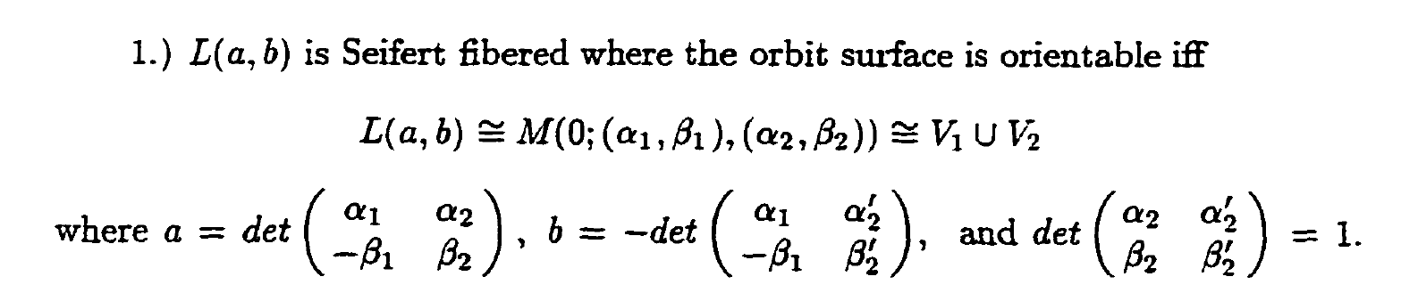

Slide 21
Identify M(0; (5, 12))

Slide 22
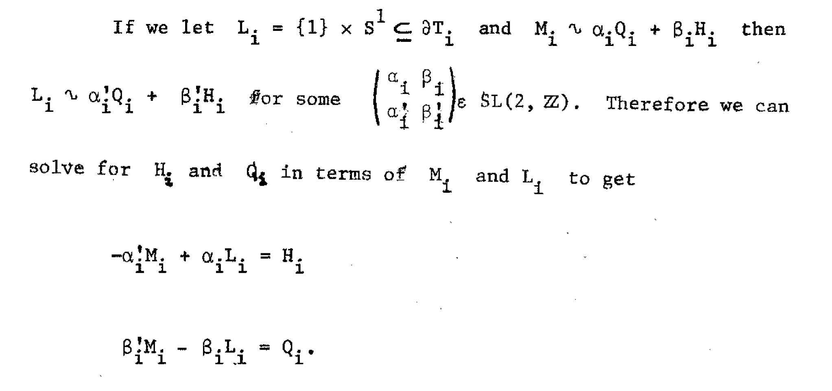
F
F
F
F

Slide 23
Identify M(0; (5, 12))

Slide 24
Identify M(0; (1, 3), (1, -3), (5, 12))

Slide 25
Identify M(0; (0, 1), (5, 12))

Slide 26
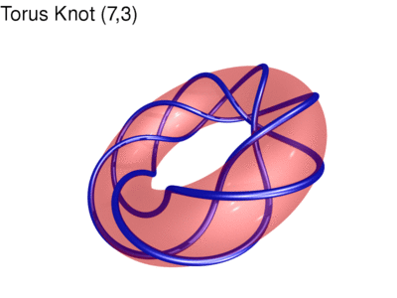
Identify this manifold:

Slide 27
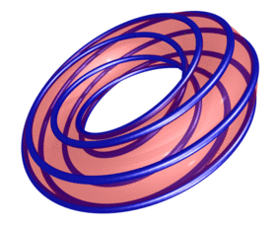
Identify this manifold:
http://www.mitchr.me/SS/torusKnots/index.html

Slide 29
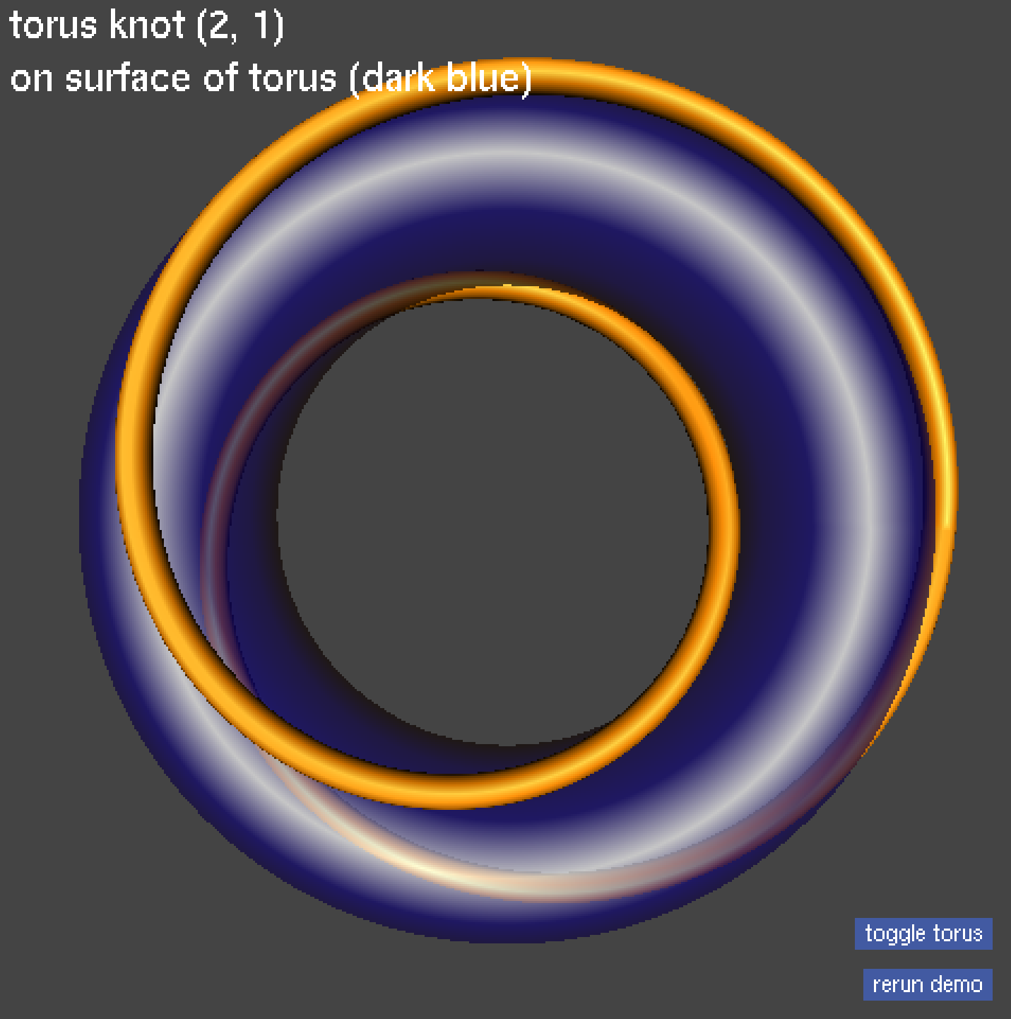
Identify this manifold

Slide 30

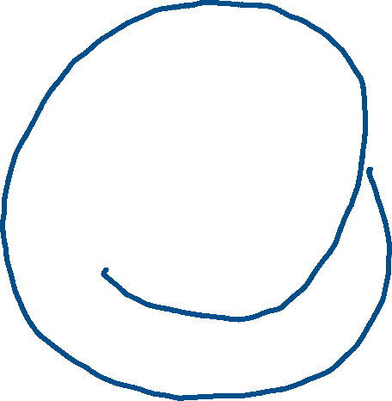




Slide 31
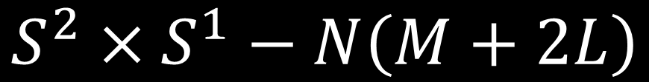
$$S^{2}×S^{1}−N\left(M+2L\right)$$

Slide 32
















$$S^{2}×S^{1}−N\left(M+2L\right)$$

Slide 33





$$S^{2}×S^{1}−N\left(M+2L\right)$$

Slide 34
$$S^{2}×S^{1}−N\left(M+2L\right)$$

Slide 38
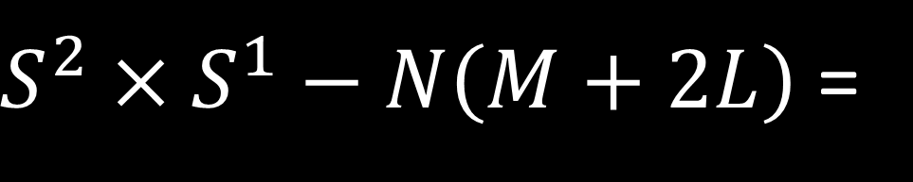
$S^{2}×S^{1}−N\left(M+2L\right)$ =

Slide 39
