Slide 1
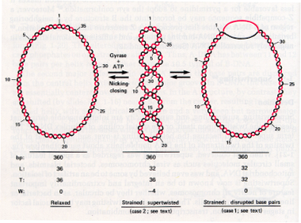
http://www.personal.psu.edu/rch8/workmg/Struc_Nucleic_Acids_Chpt2.htm

Slide 2
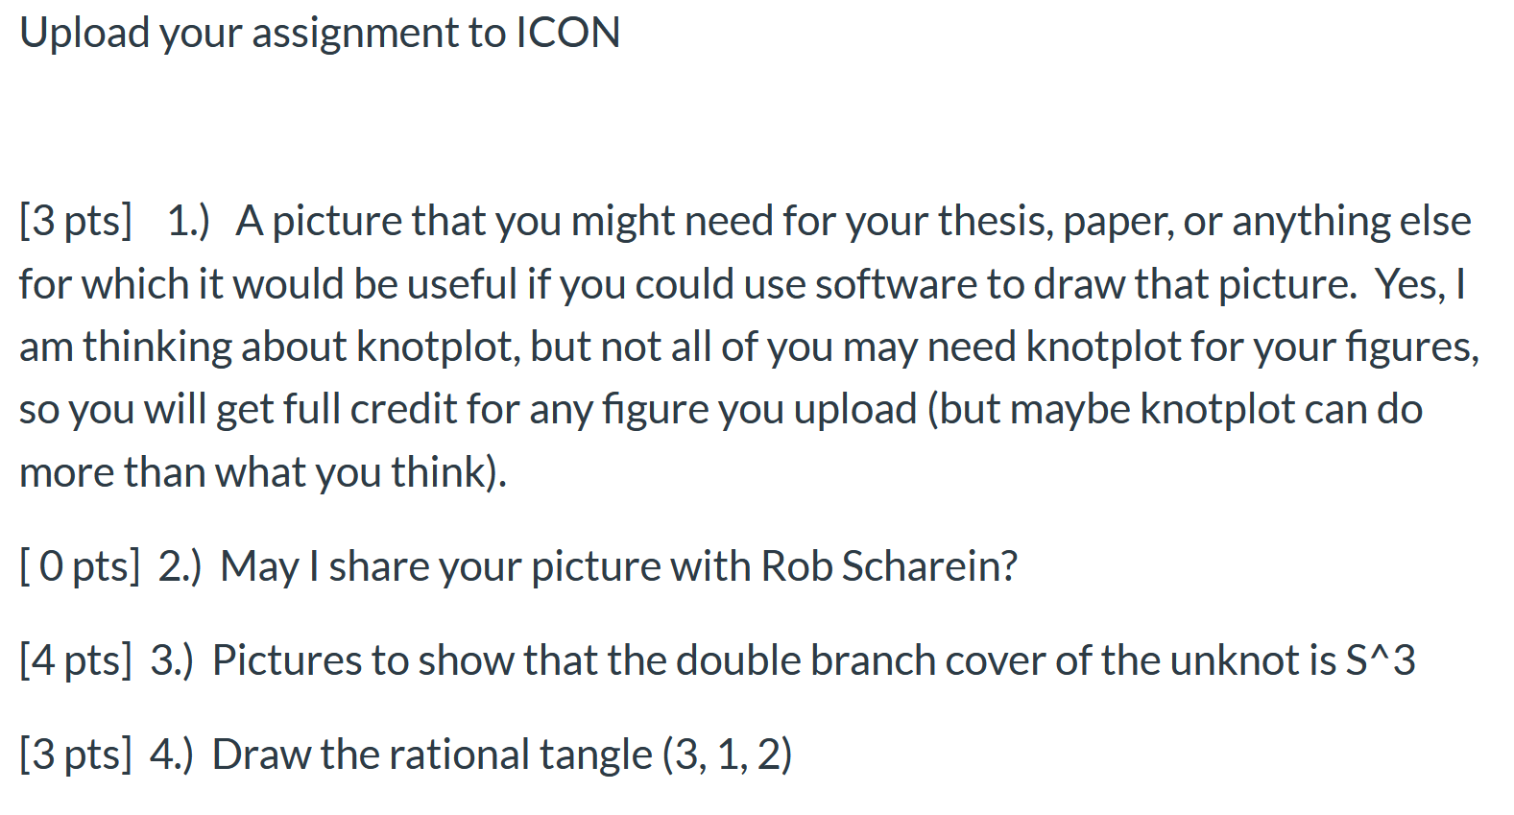
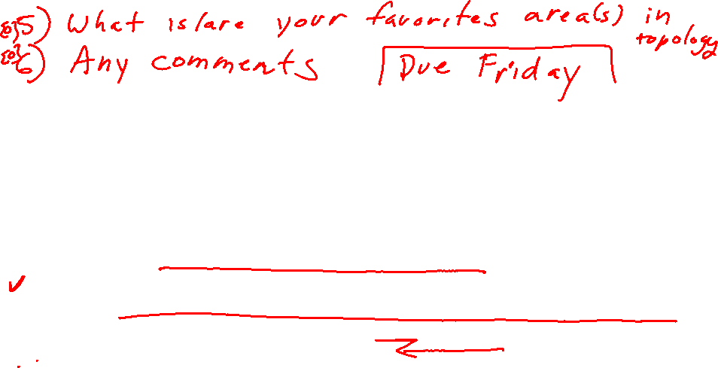

Slide 3
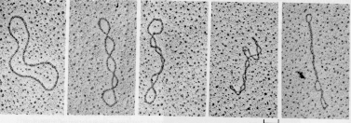
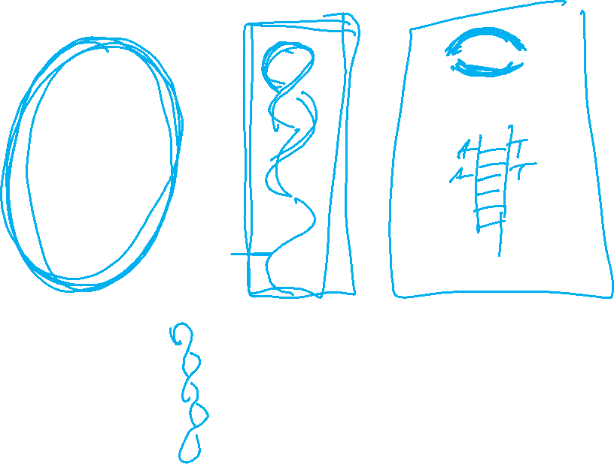
http://www.personal.psu.edu/rch8/workmg/Struc_Nucleic_Acids_Chpt2.htm

Slide 4
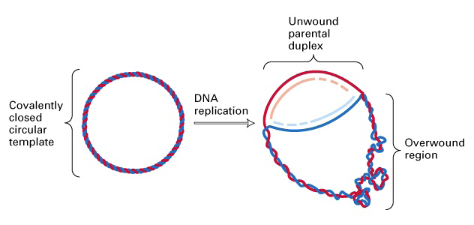
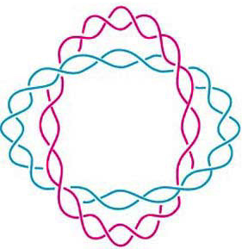
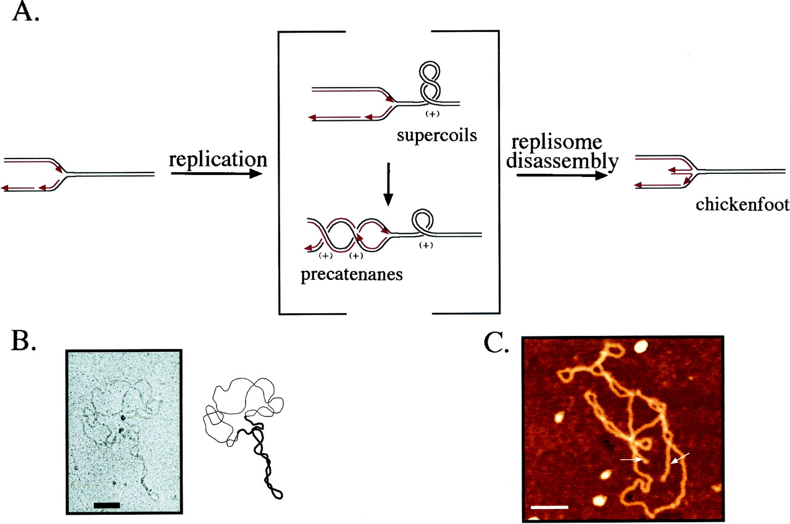
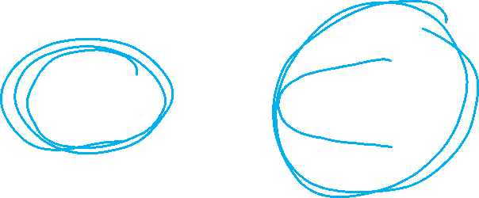
(J. Mann) http://www.sbs.utexas.edu/herrin/bio344/
Postow L. et.al. PNAS;2001;98:8219-8226

Slide 5
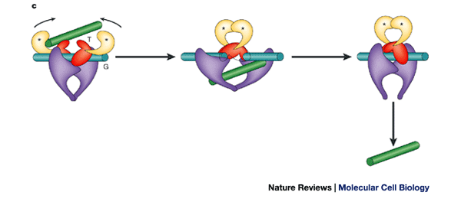
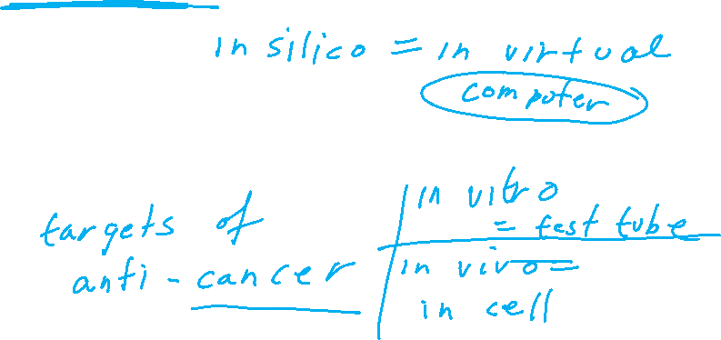
Topoisomerase II performing a crossing change on DNA:
Cellular roles of DNA topoisomerases: a molecular perspective, James C. Wang, Nature Reviews Molecular Cell Biology 3, 430-440 (June 2002)

Slide 6

Topoisomerases are proteins which cut one segment of DNA allowing a second DNA segment to pass through before resealing the break.

Slide 7
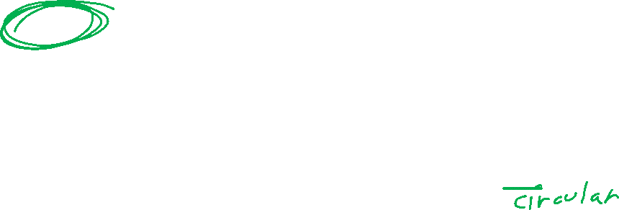
DNA substrate = starting conformation of DNA before protein action
Usually unkotted, and
supercoiled
http://www.personal.psu.edu/rch8/workmg/Struc_Nucleic_Acids_Chpt2.htm

Slide 8
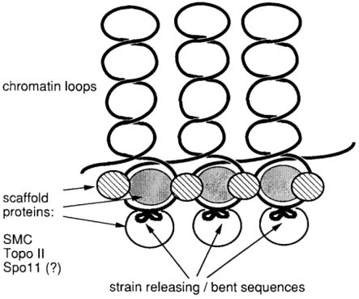
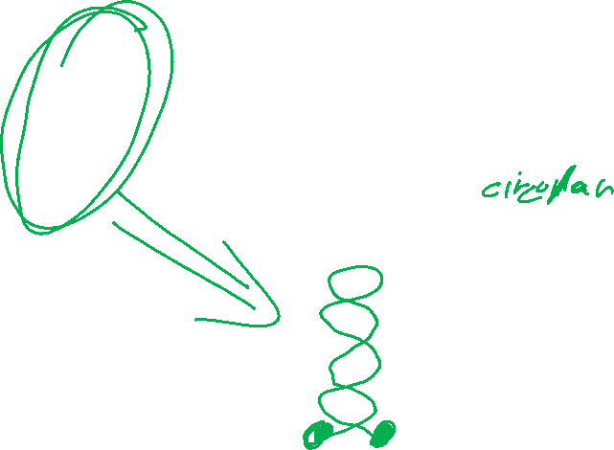
DNA substrate = starting conformation of DNA before protein action
Usually unkotted, and
supercoiled
http://www.personal.psu.edu/rch8/workmg/Struc_Nucleic_Acids_Chpt2.htm
Meiotic double-strand breaks in yeast artificial chromosomes containing human DNA
Grzegorz Ira, Ekaterina Svetlova, Jan Filipski
Nucl. Acids Res. (1998) 26 (10):2415-2419

Slide 9
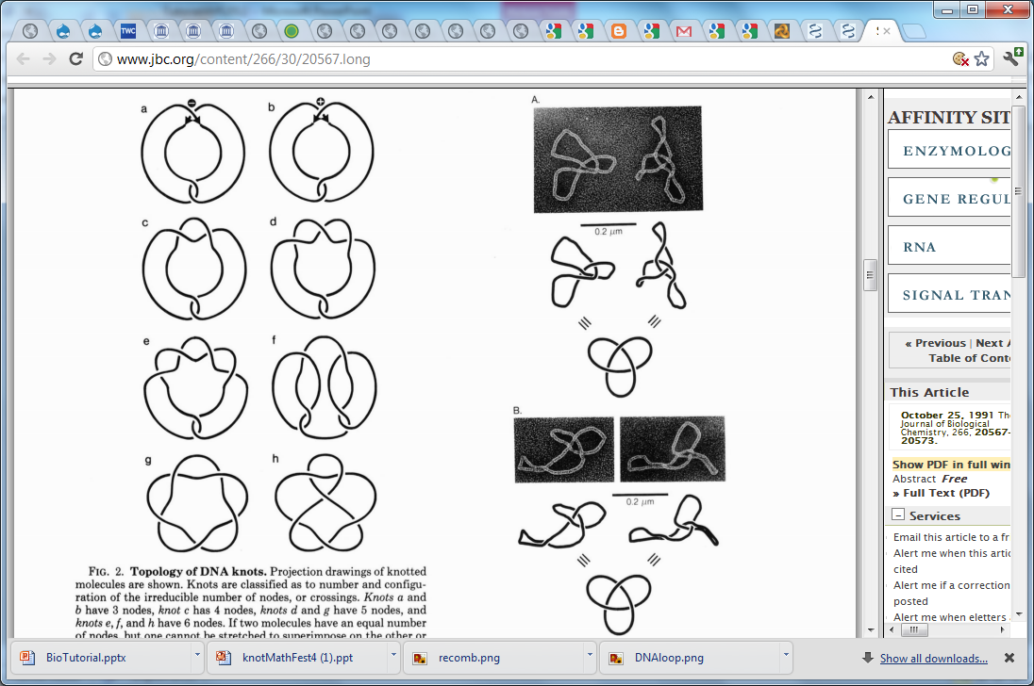
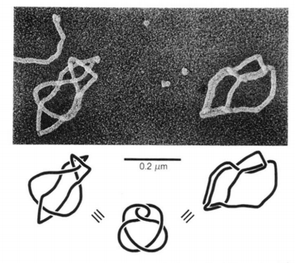
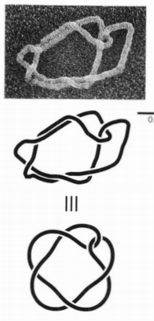
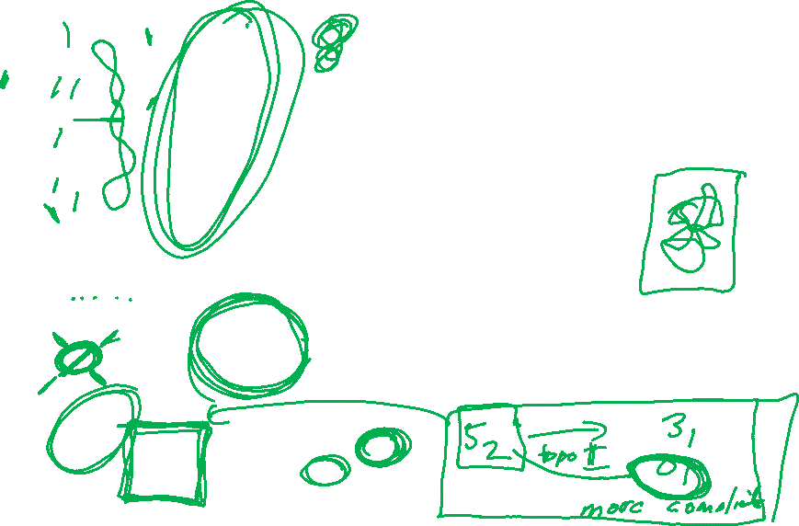
DNA substrate = starting conformation of DNA before protein action
Usually unkotted, and
supercoiled
http://www.personal.psu.edu/rch8/workmg/Struc_Nucleic_Acids_Chpt2.htm
But can be knotted
Eg: Twist knots
(or torus knots/links)
Supercoiled DNA-directed knotting by T4 topoisomerase.
Wasserman SA, Cozzarelli NR. J Biol Chem. 1991

Slide 10
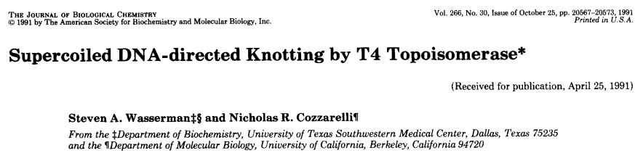
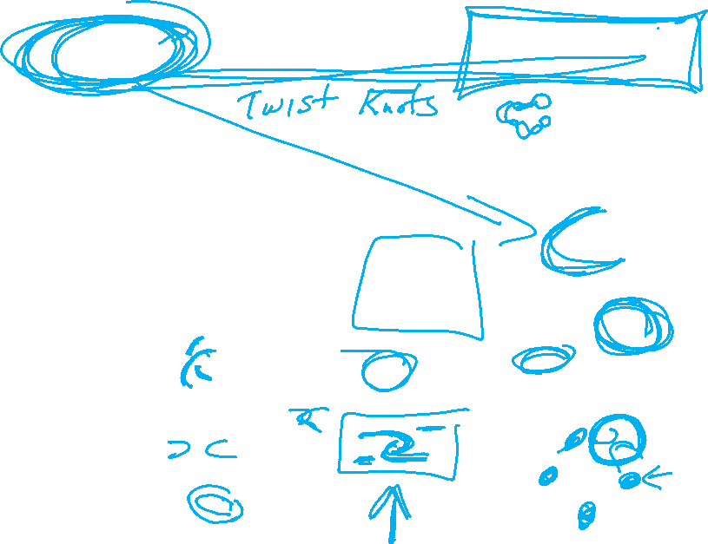

Slide 11
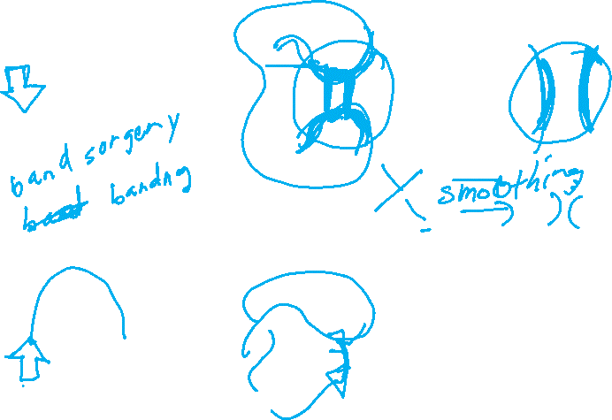
Recombination:

Slide 12
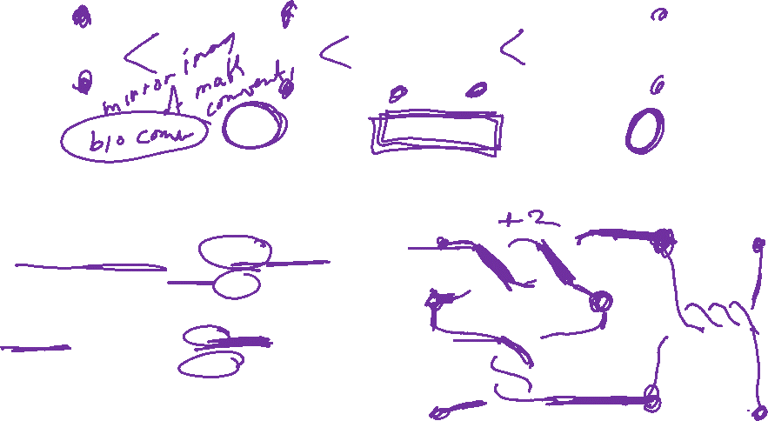
Rational Tangles
Rational tangles alternate between vertical crossings & horizontal crossings.
k horizontal crossings are right-handed if k > 0
k horizontal crossings are left-handed if k < 0
k vertical crossings are left-handed if k > 0
k vertical crossings are right-handed if k < 0
Note that if k > 0, then the slope of the overcrossing strand is negative,
while if k < 0, then the slope of the overcrossing strand is positive.
By convention, the rational tangle notation always ends with the number of horizontal crossings.

Slide 13
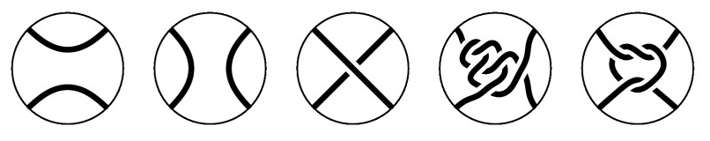
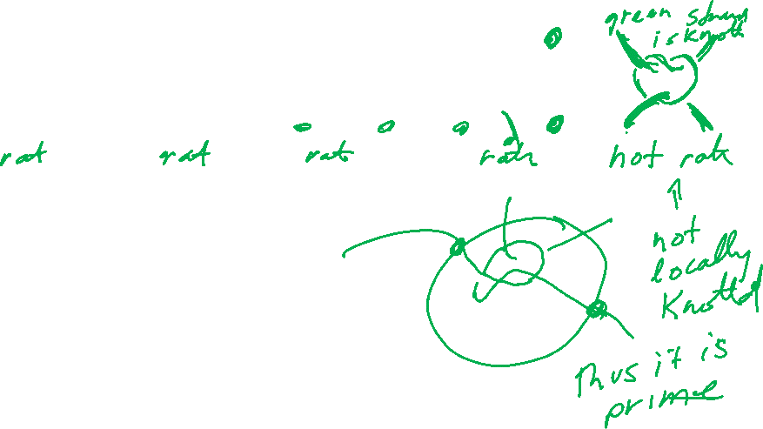
Tangles

Slide 14
Which tangles are rational?
This one is not rational.
The others are all rational

