Slide 1
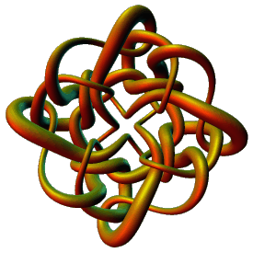
Modeling Protein-DNA Complexes Using Tangles
Isabel K. Darcy
Mathematics Department
Applied Mathematical and Computational Sciences (AMCS)
University of Iowa
http://www.math.uiowa.edu/~idarcy
This work was partially supported by the Joint DMS/NIGMS Initiative to Support Research in the Area of Mathematical Biology (NSF 0800285).
©2008 I.K. Darcy. All rights reserved

Slide 2
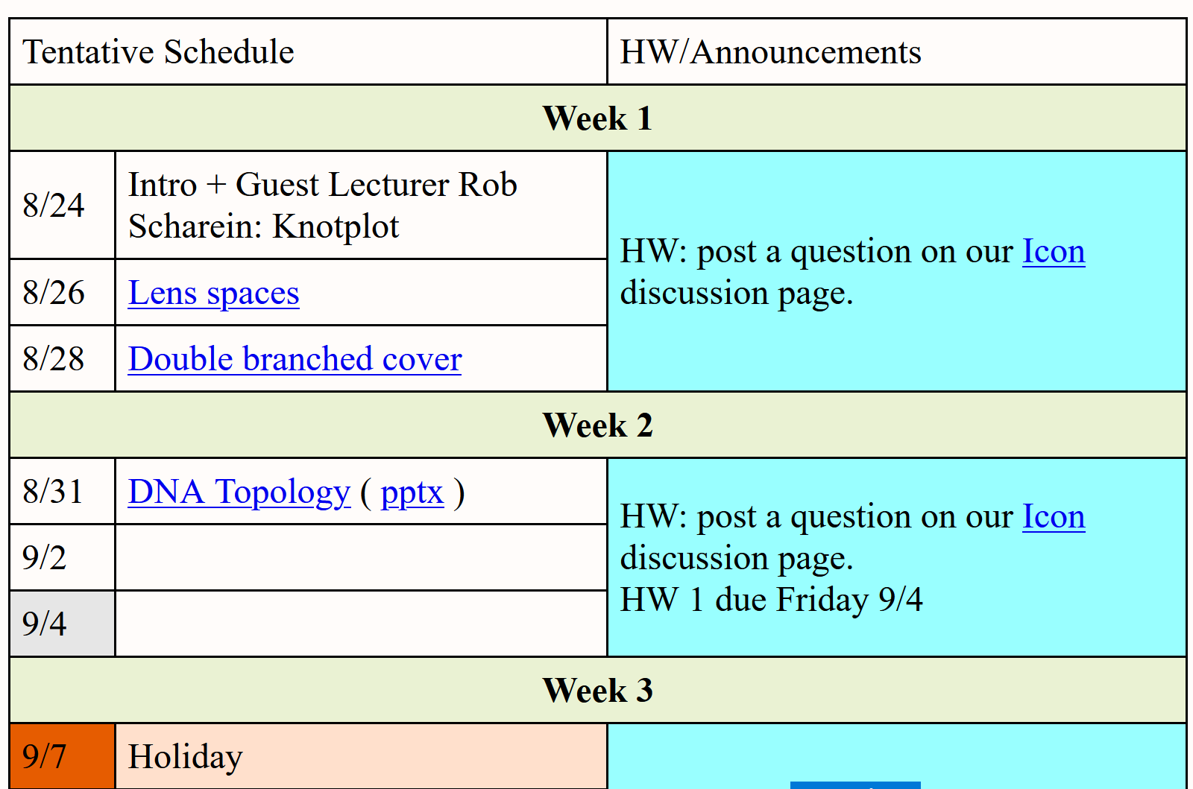
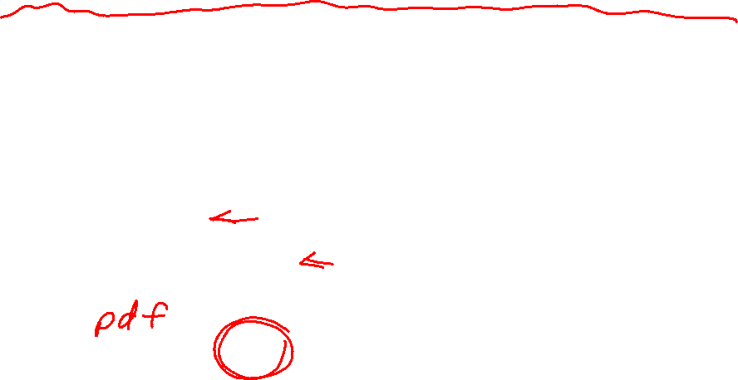
http://homepage.divms.uiowa.edu/~idarcy/COURSES/7400/FALL20/7400.html

Slide 3
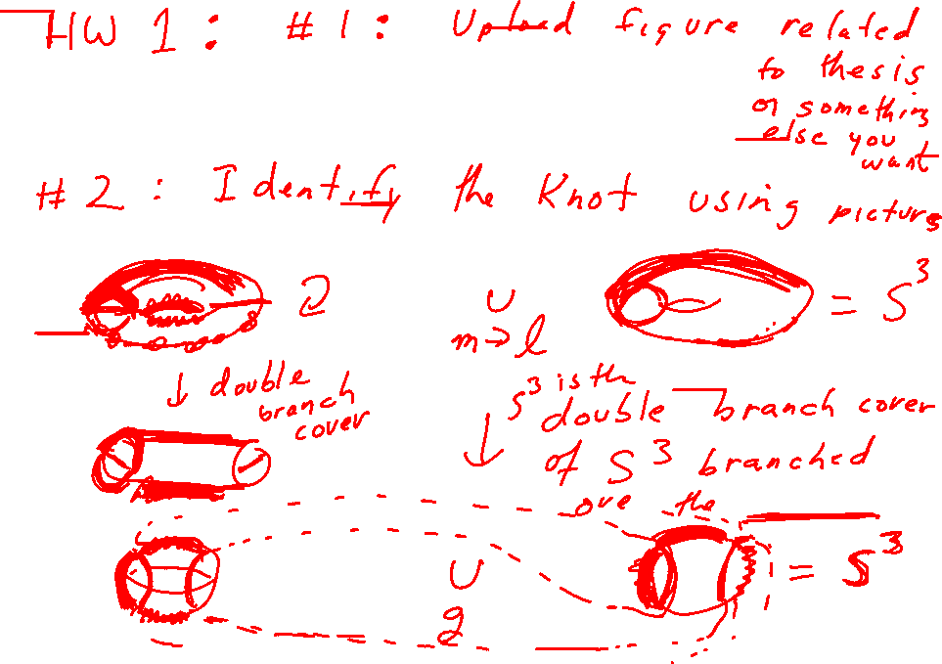

Slide 4
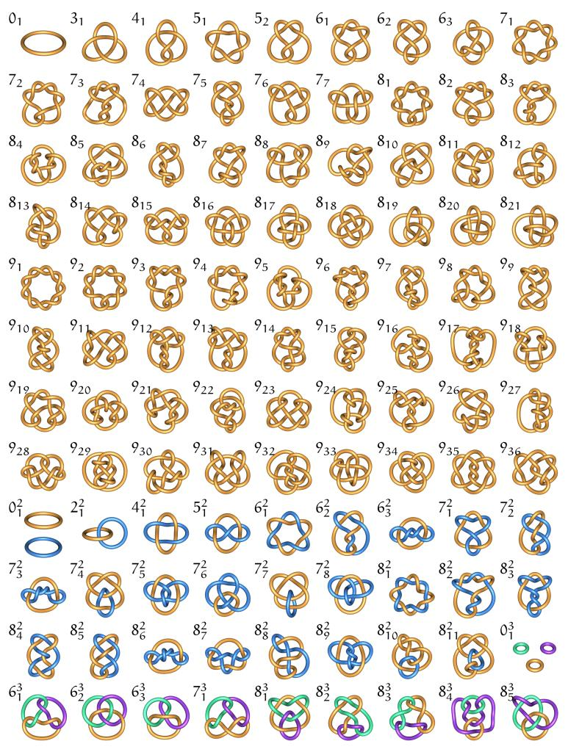
Unknot
Figure 8
Trefoil
Pentafoil
9 crossing knot,
7th in the list of 9 crossing knots
http://knotplot.com/zoo: Minimal diagrams of knots (knot with fewest number of crossings)

Slide 5
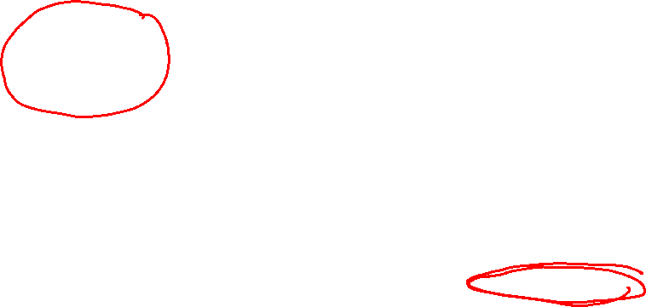
Duplex DNA knots produced by Escherichia coli topoisomerase I. Dean FB, Stasiak A, Koller T, Cozzarelli NR., J Biol Chem. 1985 Apr 25;260(8):4975-83.

Slide 6
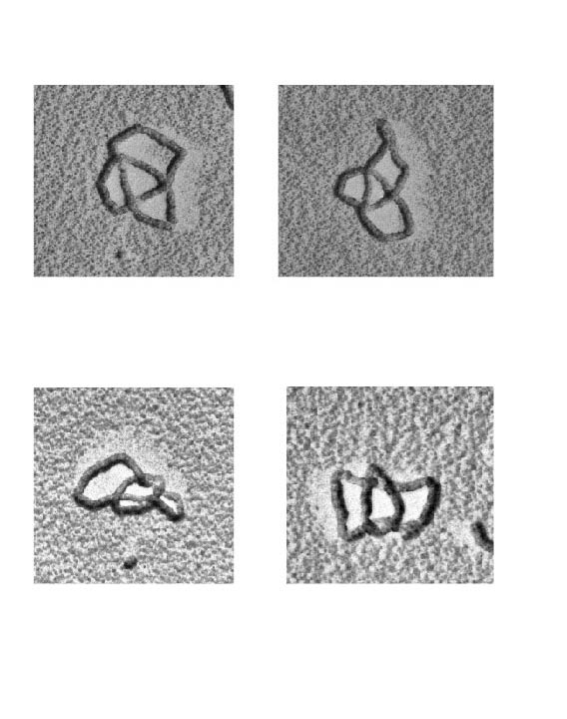

Links (math) = catenanes (biology)
Hopf link or 2-cat
2 component link
Unlink
4-cat
6-cat
8-cat
3 component link

Slide 7
A mathematician’s introduction to a simplified view of the biology behind DNA topology

Slide 8
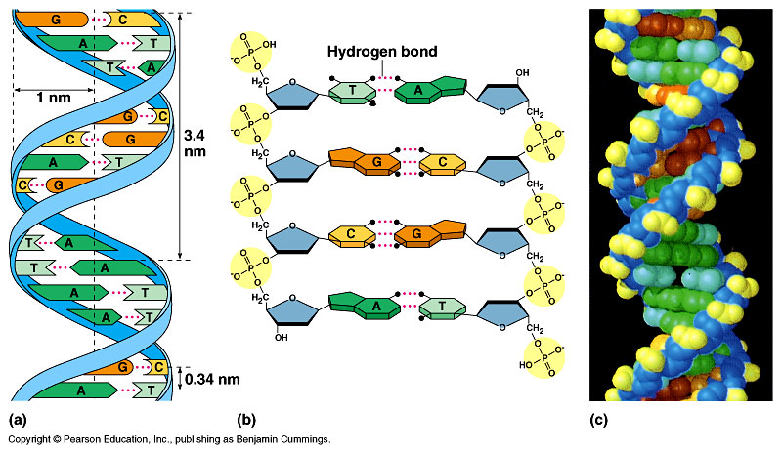
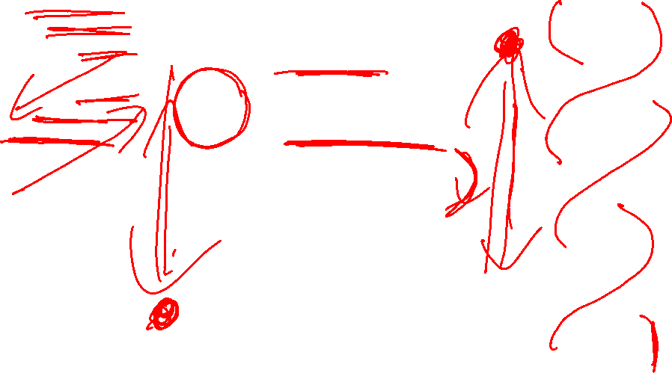
DNA – The Double Helix
DNA – The twisted annulus

Slide 9
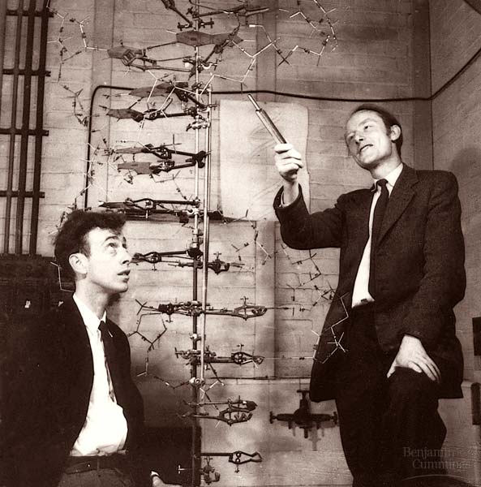
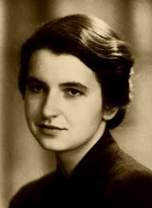
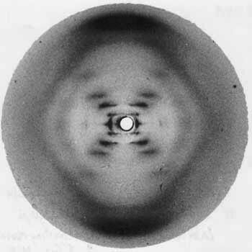
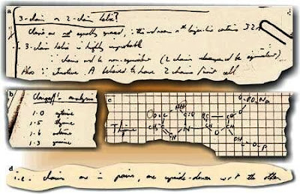
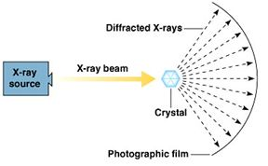
James Watson, Francis Crick and Rosalind Franklin
Rosalind Franklin: DNA is a double helix with antiparallel strands
http://philosophyofscienceportal.blogspot.com/2008/04/rosalind-franklin-double-helix.html

Slide 10
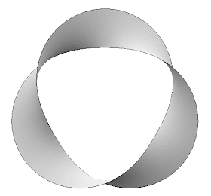
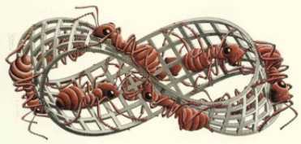
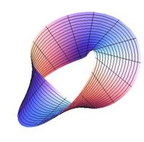
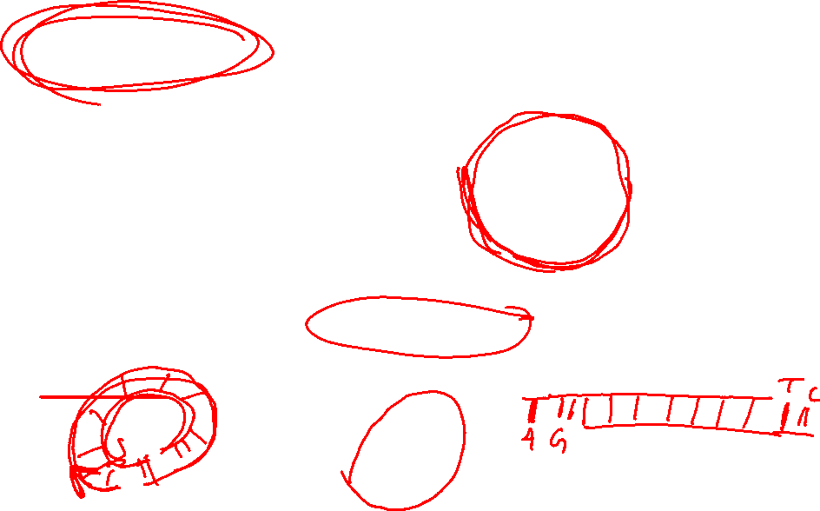
Anti-parallel strands means DNA does not (normally) form a mobius band
http://www.susqu.edu/brakke/knots/knot32mh.gif
http://plus.maths.org/issue18/puzzle/mobiusII.jpg
Circular DNA normally forms a twisted annulus
http://mathforum.org/mathimages/imgUpload/thumb/Full_twist.jpg/200px-Full_twist.jpg

Slide 11
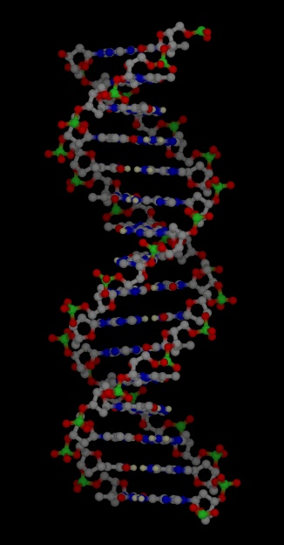
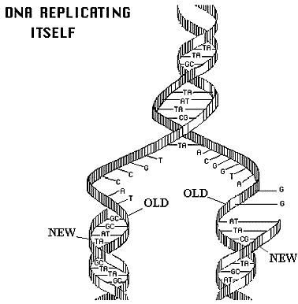
http://www.accessexcellence.org/RC/VL/GG/images/dna_replicating.gif
http://www.ch.cam.ac.uk/magnus/molecules/nucleic/dna1.jpg

Slide 12
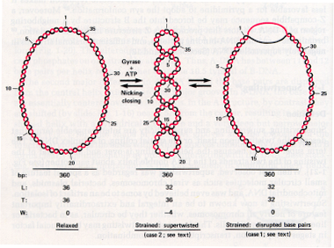
http://www.personal.psu.edu/rch8/workmg/Struc_Nucleic_Acids_Chpt2.htm

Slide 13
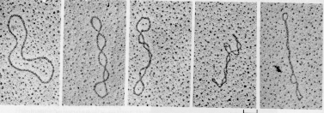
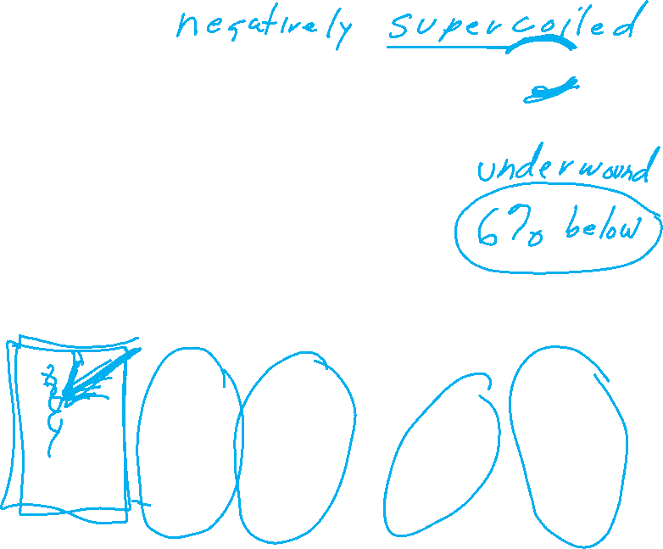
http://www.personal.psu.edu/rch8/workmg/Struc_Nucleic_Acids_Chpt2.htm

Slide 14
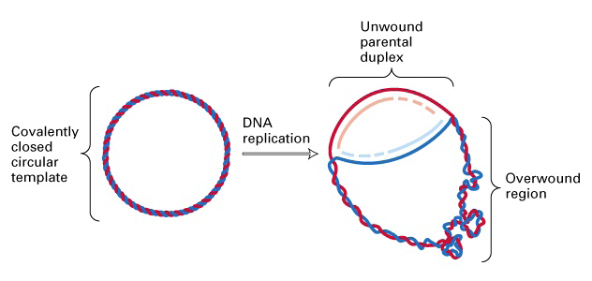
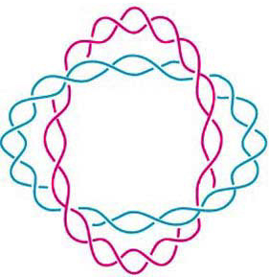
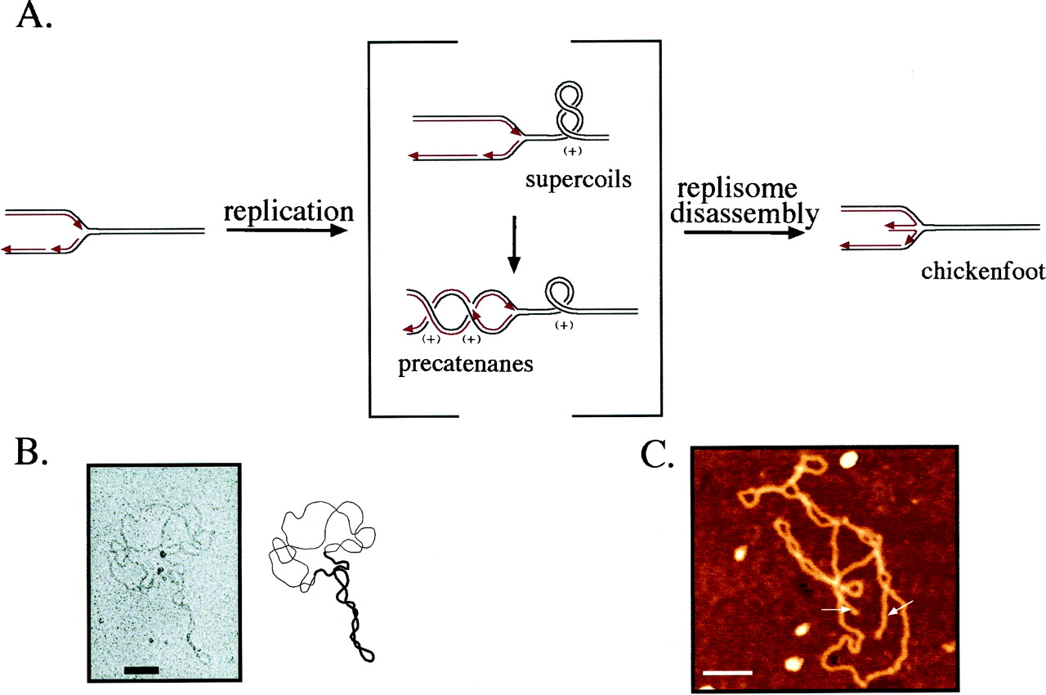
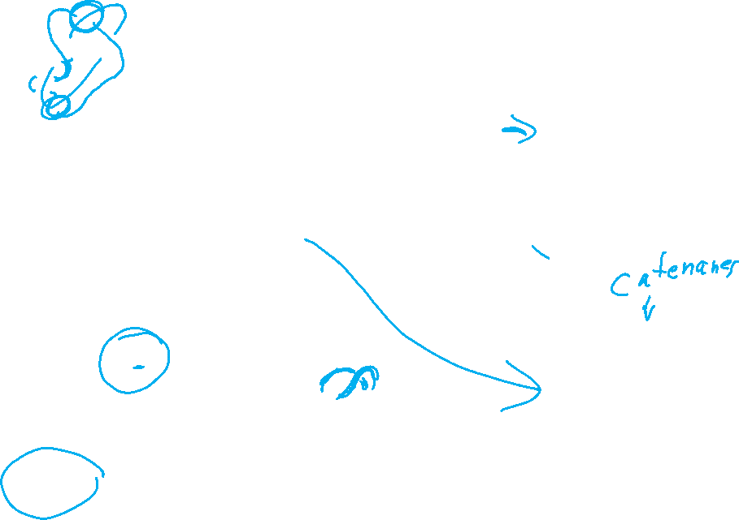
(J. Mann) http://www.sbs.utexas.edu/herrin/bio344/
Postow L. et.al. PNAS;2001;98:8219-8226

Slide 15
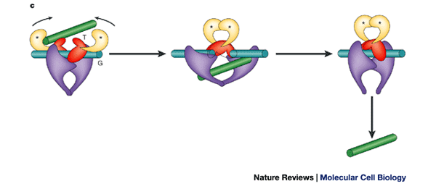
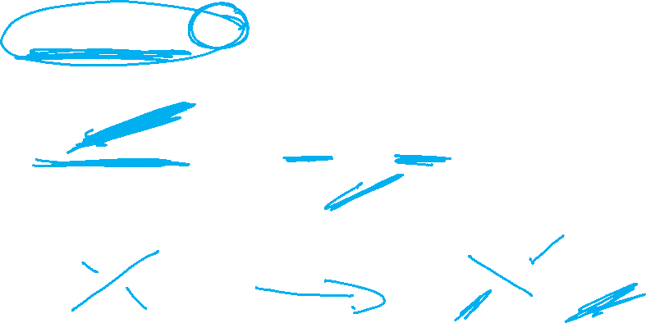
Topoisomerase II performing a crossing change on DNA:
Cellular roles of DNA topoisomerases: a molecular perspective, James C. Wang, Nature Reviews Molecular Cell Biology 3, 430-440 (June 2002)

Slide 16
Topoisomerases are proteins which cut one segment of DNA allowing a second DNA segment to pass through before resealing the break.

Slide 17
DNA substrate = starting conformation of DNA before protein action
Usually unkotted, and
supercoiled
http://www.personal.psu.edu/rch8/workmg/Struc_Nucleic_Acids_Chpt2.htm

Slide 18
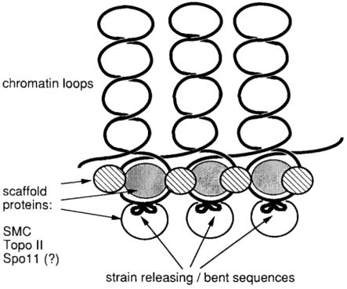
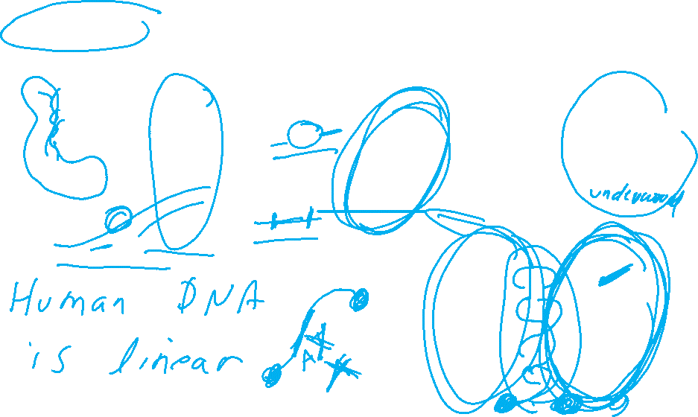
DNA substrate = starting conformation of DNA before protein action
Usually unkotted, and
supercoiled
http://www.personal.psu.edu/rch8/workmg/Struc_Nucleic_Acids_Chpt2.htm
Meiotic double-strand breaks in yeast artificial chromosomes containing human DNA
Grzegorz Ira, Ekaterina Svetlova, Jan Filipski
Nucl. Acids Res. (1998) 26 (10):2415-2419

Slide 19
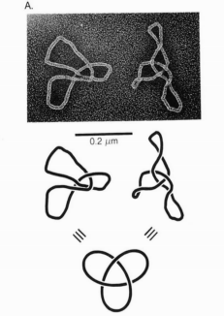
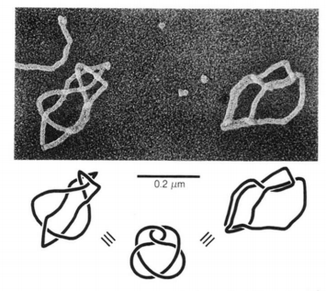
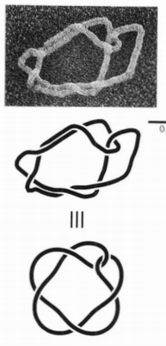
DNA substrate = starting conformation of DNA before protein action
Usually unkotted, and
supercoiled
http://www.personal.psu.edu/rch8/workmg/Struc_Nucleic_Acids_Chpt2.htm
But can be knotted
Eg: Twist knots
(or torus knots/links)
Supercoiled DNA-directed knotting by T4 topoisomerase.
Wasserman SA, Cozzarelli NR. J Biol Chem. 1991

