Slide 1
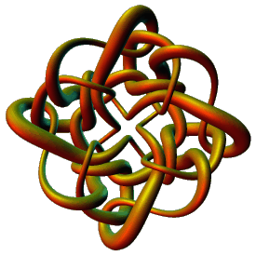
Modeling Protein-DNA Complexes Using Tangles
Isabel K. Darcy
Mathematics Department
Applied Mathematical and Computational Sciences (AMCS)
University of Iowa
http://www.math.uiowa.edu/~idarcy
This work was partially supported by the Joint DMS/NIGMS Initiative to Support Research in the Area of Mathematical Biology (NSF 0800285).
©2008 I.K. Darcy. All rights reserved

Slide 2
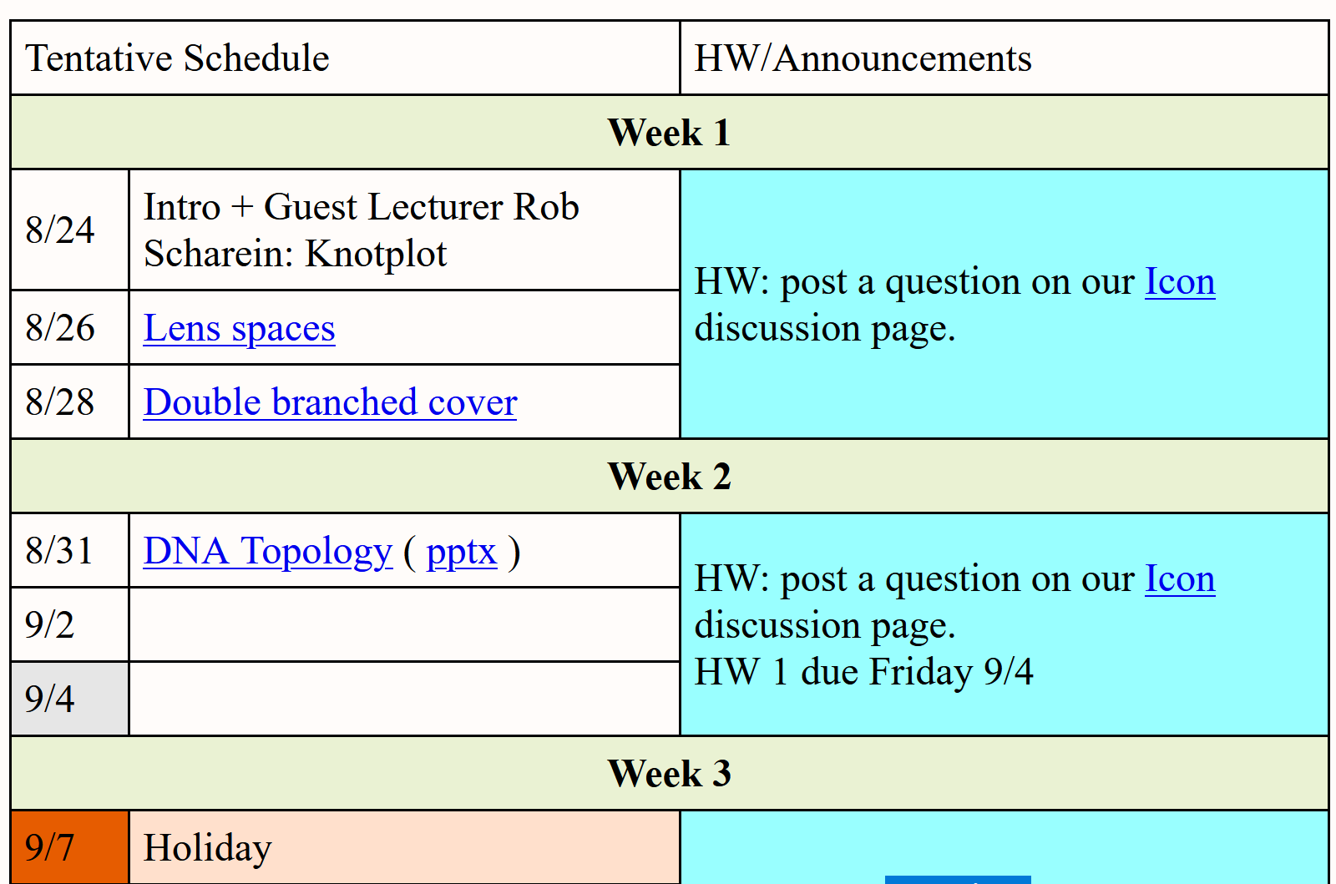
http://homepage.divms.uiowa.edu/~idarcy/COURSES/7400/FALL20/7400.html

Slide 4
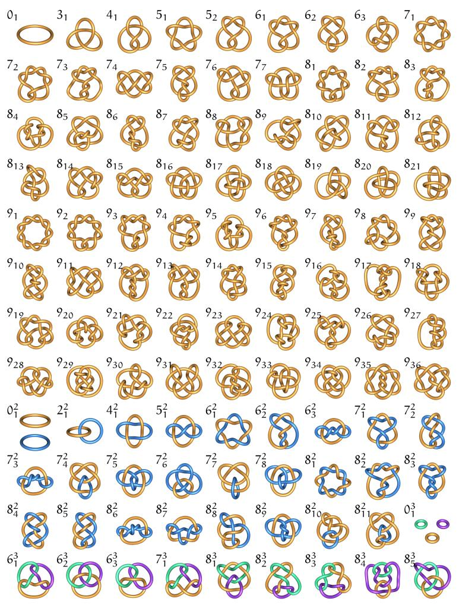
Unknot
Figure 8
Trefoil
Pentafoil
9 crossing knot,
7th in the list of 9 crossing knots
http://knotplot.com/zoo: Minimal diagrams of knots (knot with fewest number of crossings)

Slide 5
Duplex DNA knots produced by Escherichia coli topoisomerase I. Dean FB, Stasiak A, Koller T, Cozzarelli NR., J Biol Chem. 1985 Apr 25;260(8):4975-83.

Slide 6
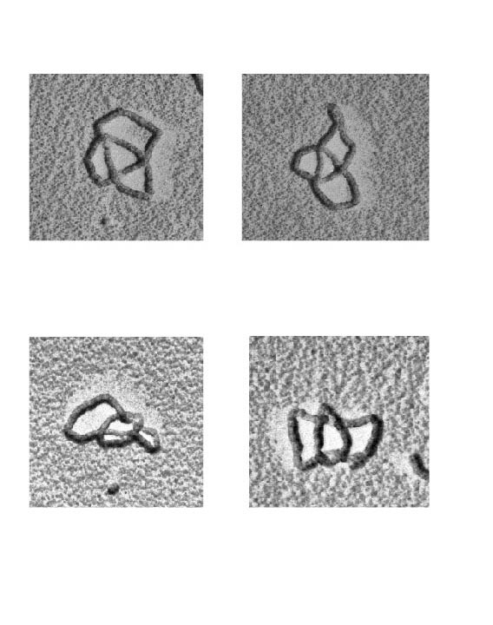
Links (math) = catenanes (biology)
Hopf link or 2-cat
2 component link
Unlink
4-cat
6-cat
8-cat
3 component link

Slide 7
A mathematician’s introduction to a simplified view of the biology behind DNA topology

Slide 8
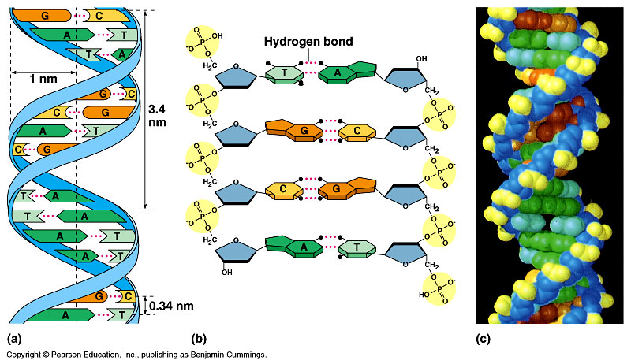
DNA – The Double Helix
DNA – The twisted annulus

Slide 9
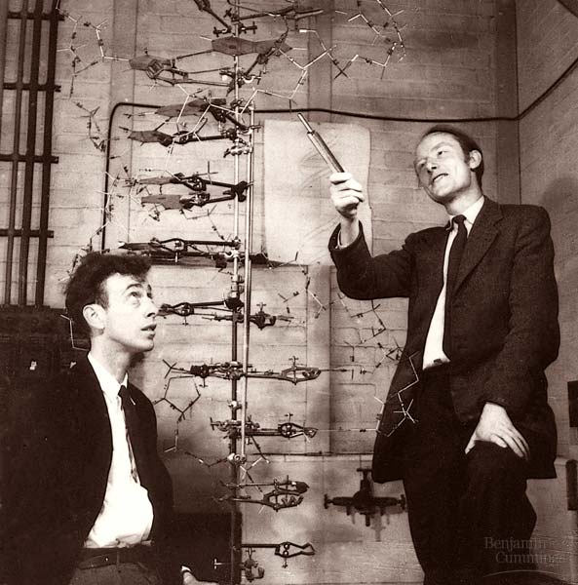
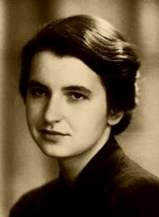
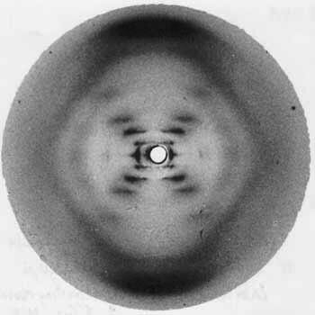
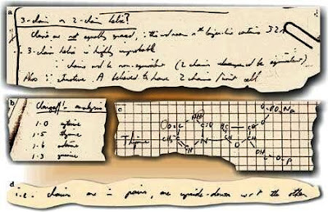
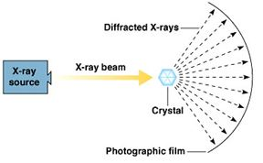
James Watson, Francis Crick and Rosalind Franklin
Rosalind Franklin: DNA is a double helix with antiparallel strands
http://philosophyofscienceportal.blogspot.com/2008/04/rosalind-franklin-double-helix.html

Slide 10
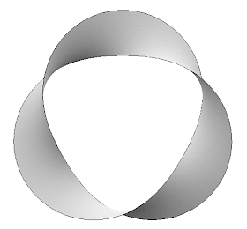
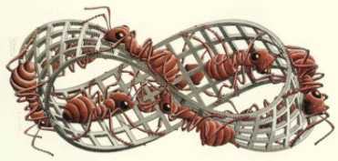
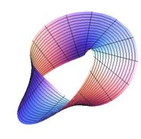
Anti-parallel strands means DNA does not (normally) form a mobius band
http://www.susqu.edu/brakke/knots/knot32mh.gif
http://plus.maths.org/issue18/puzzle/mobiusII.jpg
Circular DNA normally forms a twisted annulus
http://mathforum.org/mathimages/imgUpload/thumb/Full_twist.jpg/200px-Full_twist.jpg

Slide 11
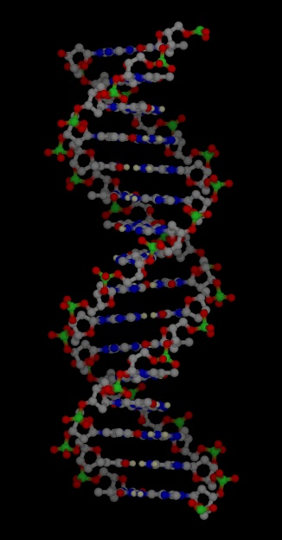
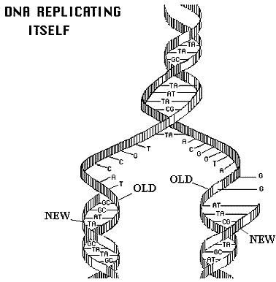
http://www.accessexcellence.org/RC/VL/GG/images/dna_replicating.gif
http://www.ch.cam.ac.uk/magnus/molecules/nucleic/dna1.jpg

Slide 12
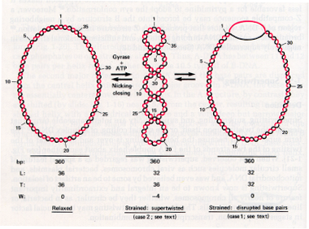
http://www.personal.psu.edu/rch8/workmg/Struc_Nucleic_Acids_Chpt2.htm

Slide 13
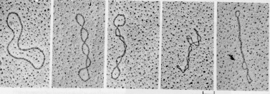
http://www.personal.psu.edu/rch8/workmg/Struc_Nucleic_Acids_Chpt2.htm

Slide 14
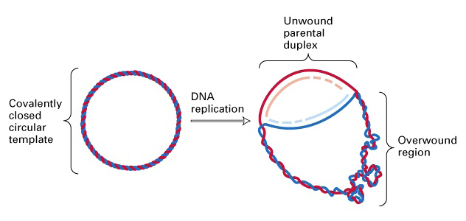
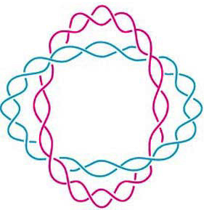
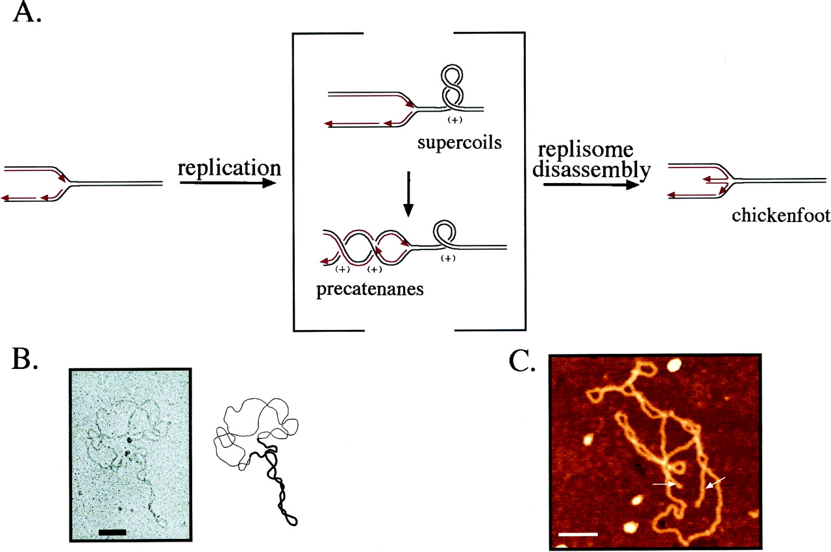
(J. Mann) http://www.sbs.utexas.edu/herrin/bio344/
Postow L. et.al. PNAS;2001;98:8219-8226

Slide 15
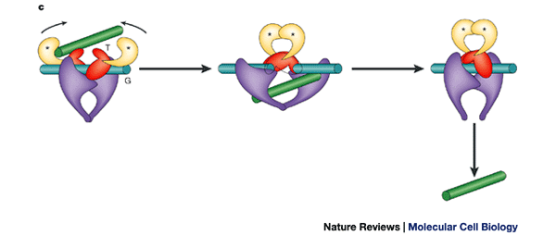
Topoisomerase II performing a crossing change on DNA:
Cellular roles of DNA topoisomerases: a molecular perspective, James C. Wang, Nature Reviews Molecular Cell Biology 3, 430-440 (June 2002)

Slide 16
Topoisomerases are proteins which cut one segment of DNA allowing a second DNA segment to pass through before resealing the break.

Slide 17
DNA substrate = starting conformation of DNA before protein action
Usually unkotted, and
supercoiled
http://www.personal.psu.edu/rch8/workmg/Struc_Nucleic_Acids_Chpt2.htm

Slide 18
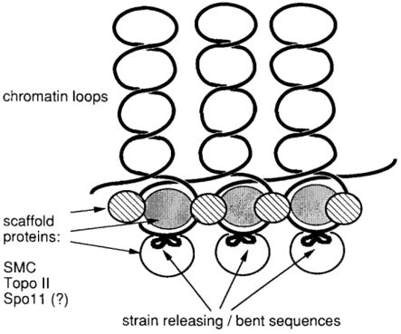
DNA substrate = starting conformation of DNA before protein action
Usually unkotted, and
supercoiled
http://www.personal.psu.edu/rch8/workmg/Struc_Nucleic_Acids_Chpt2.htm
Meiotic double-strand breaks in yeast artificial chromosomes containing human DNA
Grzegorz Ira, Ekaterina Svetlova, Jan Filipski
Nucl. Acids Res. (1998) 26 (10):2415-2419

Slide 19
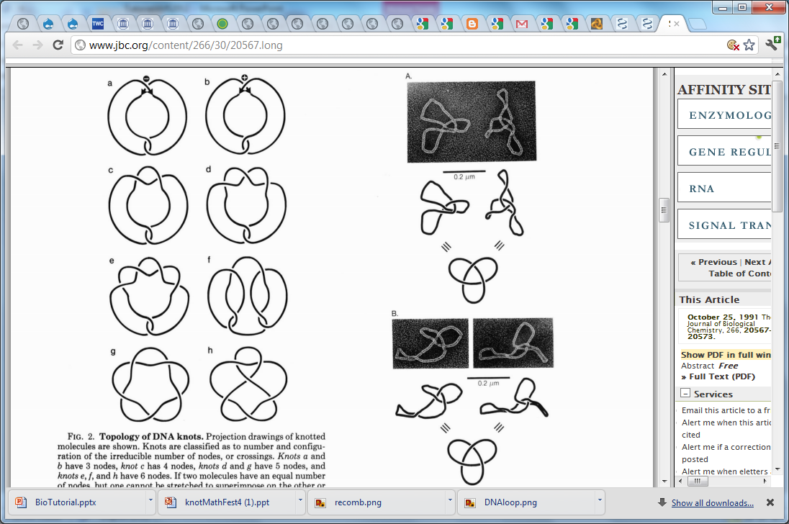
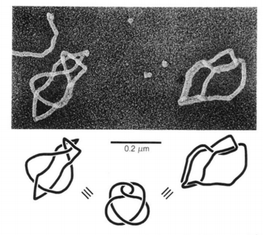
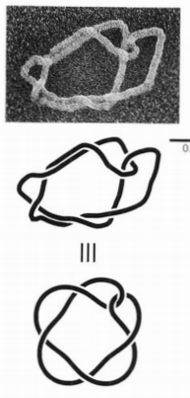
DNA substrate = starting conformation of DNA before protein action
Usually unkotted, and
supercoiled
http://www.personal.psu.edu/rch8/workmg/Struc_Nucleic_Acids_Chpt2.htm
But can be knotted
Eg: Twist knots
(or torus knots/links)
Supercoiled DNA-directed knotting by T4 topoisomerase.
Wasserman SA, Cozzarelli NR. J Biol Chem. 1991

Slide 20
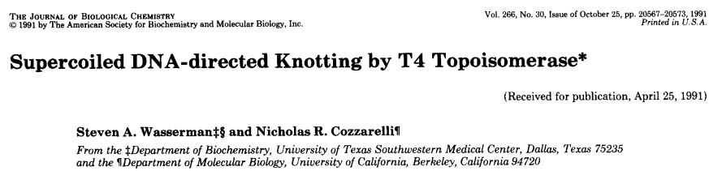

Slide 21
Recombination:

Slide 22
An introduction to the tangle model for protein-bound DNA

Slide 23
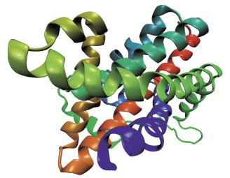
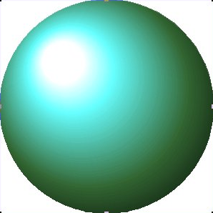
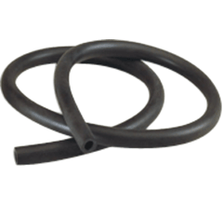
Mathematical Model
Protein =
=
=
=
DNA =

Slide 24
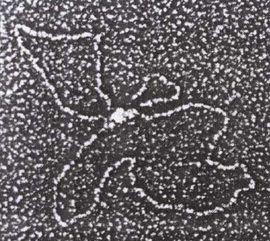
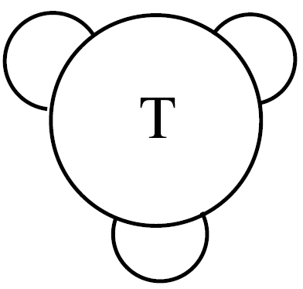
C. Ernst, D. W. Sumners, A calculus for rational tangles: applications to DNA recombination, Math. Proc. Camb. Phil. Soc. 108 (1990), 489-515.
protein = three dimensional ball
protein-bound DNA = strings.
Protein-DNA complex
Heichman and Johnson
Slide (modified) from Soojeong Kim

Slide 25

Tangle = 3-dimensional ball containing strings where the endpoints of the strings are fixed on the boundary of the ball.
=
≠
Protein = 3-dimensional ball
DNA = strings

Slide 26
Tangle = 3-dimensional ball containing strings where the endpoints of the strings are fixed on the boundary of the ball.
=
≠
Protein = 3-dimensional ball
DNA = strings

Slide 27
Rational Tangles
Rational tangles alternate between vertical crossings & horizontal crossings.
k horizontal crossings are right-handed if k > 0
k horizontal crossings are left-handed if k < 0
k vertical crossings are left-handed if k > 0
k vertical crossings are right-handed if k < 0
Note that if k > 0, then the slope of the overcrossing strand is negative,
while if k < 0, then the slope of the overcrossing strand is positive.
By convention, the rational tangle notation always ends with the number of horizontal crossings.

Slide 28
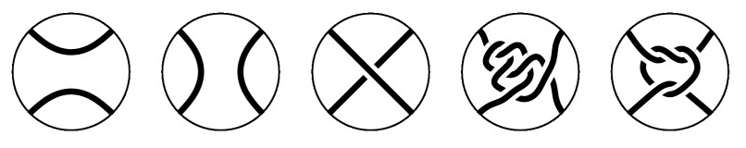
Tangles

Slide 29
Which tangles are rational?
This one is not rational.
The others are all rational

Slide 30
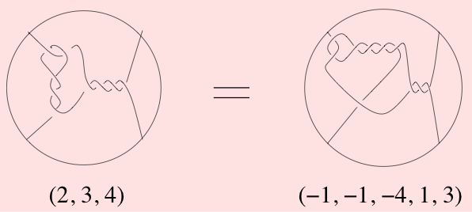
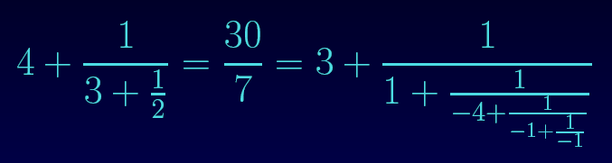
Rational tangles can be classified with fractions.

Slide 31
Why are we interested in rational tangles?
1.) Rational tangles are simple
simplest
non-rational
tangles:

Slide 32
Why are we interested in rational tangles?
1.) Rational tangles are simple
simplest
non-rational
tangles:
2.) Rational tangles are
formed by adding twists.
Think supercoils:
EM courtesy of Andrzej Stasiak

Slide 33
Why are we interested in rational tangles?
1.) Rational tangles are simple
simplest
non-rational
tangles:
2.) Rational tangles are
formed by adding twists.
Think supercoils:
EM courtesy of Andrzej Stasiak
3.) A tangle is rational if and only if one can push the strings to lie on the boundary of the 3-ball so that the strings do not cross themselves on 3-ball

Slide 34
A knot/link is rational if it can be formed from a rational tangle via numerator closure.
N(2/7) = N(2/1)
Note 7 – 1 = 6 = 2(3)

Slide 35
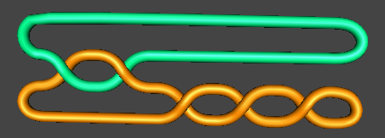
A knot/link is rational if it can be formed from a rational tangle via numerator closure.
A rational knot/link is also called a
2-bridge knot/link
or 4-plat

Slide 36
A knot/link is rational if it can be formed from a rational tangle via numerator closure.
N(2/7) = N(2/1)
Note 7 – 1 = 6 = 2(3)

Slide 37
a = c
and
b – d is a multiple of a or
bd – 1 is a multiple of a.

Slide 38
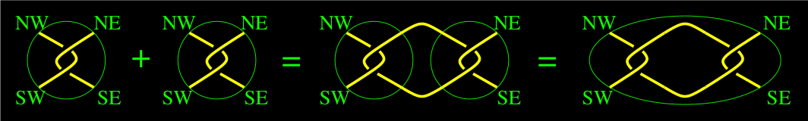
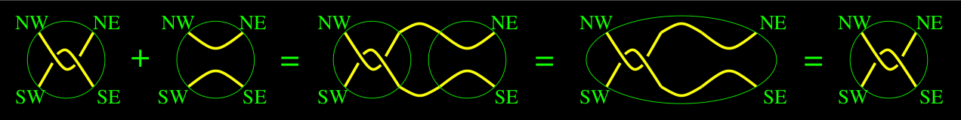
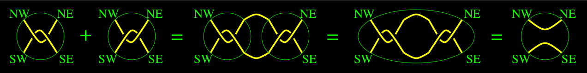
A + B = C
2 + 0 = 2
2 + -2 = 0
Most tangles don’t have inverses

Slide 42
The tangle equations corresponding to an electron micrograph:

Slide 43
Different recombinases have different topological mechanisms:

Slide 44
Different recombinases have different topological mechanisms:
Ex: Cre recombinase can act on both directly and inversely repeated sites.
Xer recombinase on psi.
Unique product
Uses topological filter to only perform deletions, not inversions

Slide 45
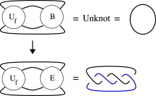
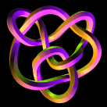
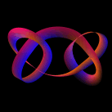
There are an infinite number of solutions to
Can solve by using
TopoICE in Rob Scharein’s KnotPlot.com

Slide 49
How to solve tangle equations
1.) Brute force
Ex: solve x + 3 = 5
0 + 3 = 5, 1 + 3 = 5, 2 + 3 = 5

Slide 50
How to solve tangle equations
1.) Brute force
Ex: solve x + 3 = 5
0 + 3 = 5, 1 + 3 = 5, 2 + 3 = 5

Slide 51
How to solve tangle equations
1.) Brute force
Ex: solve x + 3 = 5
0 + 3 = 5, 1 + 3 = 5, 2 + 3 = 5
2.) Make simplifying assumptions

Slide 52
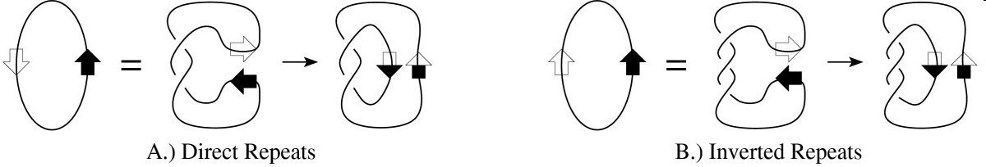
How to solve tangle equations
1.) Brute force
Ex: solve x + 3 = 5
0 + 3 = 5, 1 + 3 = 5, 2 + 3 = 5
2.) Make simplifying assumptions

Slide 53
How to solve tangle equations
1.) Brute force
Ex: solve x + 3 = 5
1 + 3 = 5, 1 + 3 = 5, 2 + 3 = 5
2.) Make simplifying assumptions
3.) Use mathematics

Slide 54
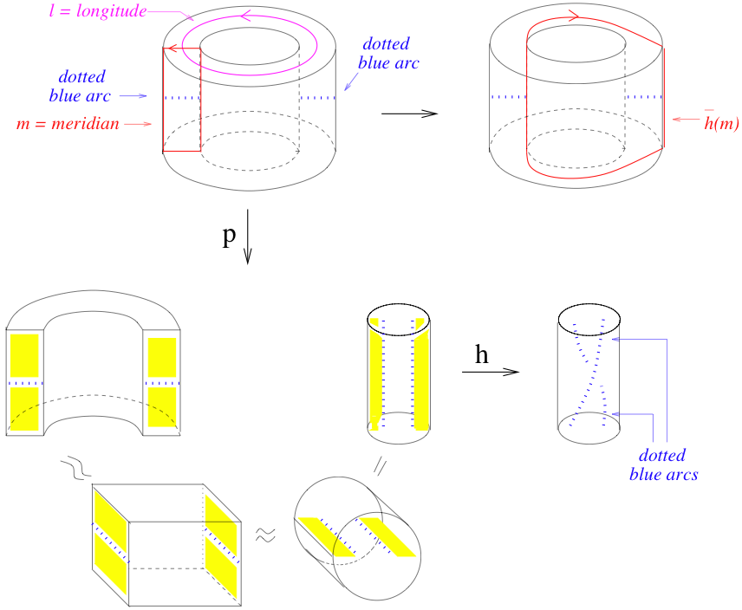

Slide 55
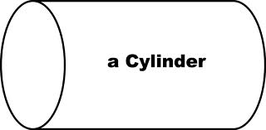
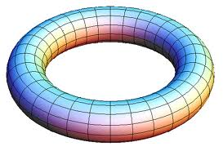
[0, 1] x [0, 1]
[0, 1] x circle
circle x circle

Slide 56
[0, 1] x [0, 1]
[0, 1] x circle
circle x circle

Slide 57
A.)

Slide 58
Sphere x [0, 1]
Sphere x Circle

Slide 59
A.)
B.)

Slide 60
A.)
B.)
A
C.)

Slide 61
A.)
B.)
A
C.)
D.)

Slide 62
There exists an algebraic formula for converting solutions:

Slide 63

Protein-bound DNA vs Local Action

Slide 64
Protein-bound DNA vs Local Action

Slide 65
Protein-bound DNA vs Local Action

Slide 66
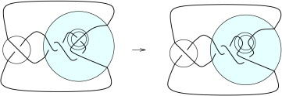
Protein-bound DNA vs Local Action

Slide 67
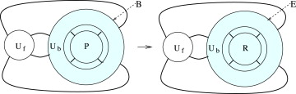
Protein-bound DNA vs Local Action
More general model:

Slide 68
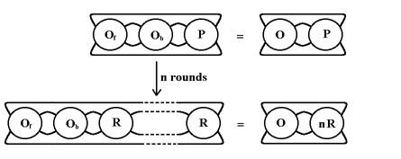
Processive Recombination (multiple reactions while protein remains bound to DNA).

Slide 69
Processive Recombination (multiple reactions per one encounter):
Distributive Recombination (multiple encounters and one reaction per encounter):

