Slide 1
g₂
U V
g₃
g₁
g₄
g = g₁g₂g₃g₄

Slide 2
U V
g₂
g₃
g₁
g₄
g = (α₀g₁α₁)(α₁g₂α₂)(α₂g₃α₃)(α₃g₄α₄)
where α₀ and α₄ are constant maps.

Slide 3
U V
g₂
g₃
g₁
g₄
g = (α₀g₁α₁)(α₁g₂α₂)(α₂g₃α₃)(α₃g₄α₄)
where (α₀g₁α₁), (α₁g₂α₂) in π₁(U) and
(α₂g₃α₃), (α₃g₄α₄) in π₁(V)

Slide 4
U V
g₂
g₃
g₁
g₄
g = (α₀g₁α₁)(α₁g₂α₂)(α₂g₃α₃)(α₃g₄α₄)
where (α₀g₁α₁) in π₁(U) and
(α₁g₂α₂), (α₂g₃α₃), (α₃g₄α₄) in π₁(V)

Slide 5
U V
g₂
g₃
g₁
g₄
g = (α₀g₁α₁)(α₁g₂α₂)(α₂g₃α₃)(α₃g₄α₄)
where (α₀g₁α₁α₁g₂α₂) = (α₀g₁g₂α₂) in π₁(U) and (α₂g₃g₄α₄) in π₁(V)

Slide 6
U V
g₂
g₃
g₁
g₄
g = (α₀g₁α₁)(α₁g₂α₂)(α₂g₃α₃)(α₃g₄α₄)
where (α₀g₁α₁) in π₁(U) and
(α₁g₂g₃g₄α₄) in π₁(V)

Slide 7
U V
g₂
g₃
g₁
g₄
g = (α₀g₁β₁)(β₁g₂α₂)(α₂g₃α₃)(α₃g₄α₄)
where (α₀g₁β₁) in π₁(U) and
(β₁g₂g₃g₄α₄) in π₁(V)

Slide 8
U V
g
π₁(U) = <a, b> [g]_{U} = b
π₁(V) = {e} [g]_{v} = e [g]_{U U V} = e
π₁(U V) = <b> [g]_{U V} = b
U
U

Slide 9
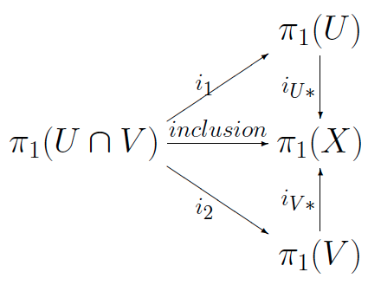
U V
g
[g]_{U} = b
[g]_{v} = e [g]_{U U V} = e
[g]_{U V} = b
U

