Slide 1

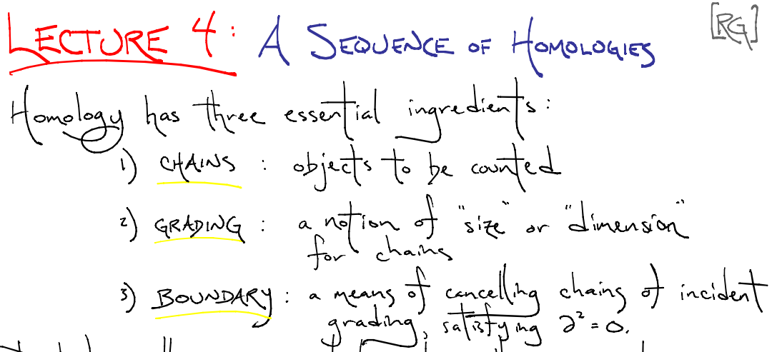

http://www.ima.umn.edu/2008-2009/ND6.15-26.09/

Slide 2
Create your own homology
3 ingredients:
1.) Objects
2.) Grading
3.) Boundary map

Slide 3
Building blocks for a simplicial homology
0-simplex = vertex = v
1-simplex = edge
v₁
v₂
e
2-simplex = triangle
v₂
e₁
e₂
v₁
v₃
e₃
Notes:
The building blocks for a simplicial complex consist of zero simplices which are zero dimensional vertices, one simplices which are one-dimensional edges, and 2-simplices which are two dimensional triangles,

Slide 4
Grading
Grading: Each object is assigned a unique grade
Grading = Partition of R[x]
Ex: Grade = dimension
Grade 0: 0-simplex = vertex = v
v₁
v₂
e
Grade 1: 1-simplex = edge = {v₁, v₂}
v₂
Grade 2: 2-simplex = triangle = {v₁, v₂, v₃}
e₁
e₂
v₁
v₃
e₃

Slide 5

Boundary Map
_{n} : C_{n} → C_{n-1} such that ² = 0
v₁
v₂
→
v₁
v₂
→ 0
e
v₂
v₂
→
→ 0
e₁
e₂
e₁
e₂
v₁
v₃
v₁
v₃
e₃
e₃

Slide 6
_{n+1}
_{n}
₂
₁
₀
C_{n+1} → C_{n} → C_{n-1} →. . . → C₂ → C₁ → C₀ → 0
H_{n} = Z_{n}/B_{n} = (kernel of )/ (image of )
cycles
boundaries
_{n}
_{n+1}
=
v₂
e₁
e₂
v₁
v₃
e₃

