Slide 1
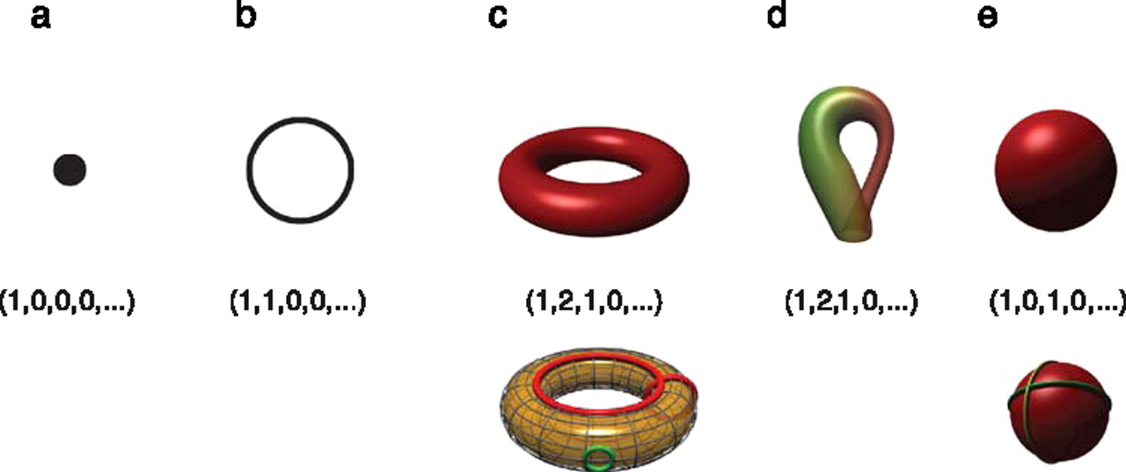
Betti numbers provide a signature of the underlying topology.
Using Z₂ coefficients
Singh G et al. J Vis 2008;8:11
©2008 by Association for Research in Vision and Ophthalmology
Notes:
Betti numbers provide a signature of the underlying topology. Illustrated in the figure are five simple objects (topological spaces) together with their Betti number signatures: (a) a point, (b) a circle, (c) a hollow torus, (d) a Klein bottle, and (e) a hollow sphere. For the case of the torus (c), the figure shows three loops on its surface. The red loops are “essential” in that they cannot be shrunk to a point, nor can they be deformed one into the other without tearing the loop. The green loop, on the other hand, can be deformed to a point without any obstruction. For the torus, therefore, we have b 1 = 2. For the case of the sphere, the loops shown (and actually all loops on the sphere) can be contracted to points, which is reflected by the fact that b 1 = 0. Both the sphere and the torus have b 2 = 1, this is due to the fact both surfaces enclose a part of space (a void).

Slide 2
How many connected components?

Slide 3
Counting number of connected components using homology
v₂
v₅
e₁
e₂
e₃
e₄
v₁
v₃
v₄
v₆
e₅
C₀ = Z₂[v₁, v₂, v₃, v₄, v₅, v₆] = set of 0-chains
C₁ = Z₂[e₁, e₂, e₃, e₄, e₅] = set of 1-chains

Slide 4
Counting number of connected components using homology
v₂
v₅
e₁
e₂
e₃
e₄
v₁
v₃
v₄
v₆
e₅
(e₁) = v₁ + v₂
o
Components are
{v₁, v₂, v₃} and
{v₄, v₅, v₆}
(e₂) = v₂ + v₃
o
(e₃) = v₄ + v₅
o
(e₄) = v₅ + v₆
o
(e₅) = v₄ + v₆
o

Slide 5
Counting number of connected components using homology
v₂
v₅
e₁
e₂
e₃
e₄
v₁
v₃
v₄
v₆
e₅
C₀ = Z₂[v₁, v₂, v₃, v₄, v₅, v₆] = set of 0-chains
C₁ = Z₂[e₁, e₂, e₃, e₄, e₅] = set of 1-chains
: C₁ → C₀
o

Slide 6
Counting number of connected components using homology
v₂
v₅
e₁
e₂
e₃
e₄
v₁
v₃
v₄
v₆
e₅
: C₁ → C₀
o
(e₁) = v₁ + v₂
o
(e₂) = v₂ + v₃
o
(e₃) = v₄ + v₅
o
(e₄) = v₅ + v₆
o
(e₅) = v₄ + v₆
o

Slide 7
Counting number of connected components using homology
v₂
v₅
e₁
e₂
e₃
e₄
v₁
v₃
v₄
v₆
e₅
: C₁ → C₀
o
(e₁) = v₁ + v₂
Extend linearly:
o
(e₂) = v₂ + v₃
o
(e₃) = v₄ + v₅
o
(e₄) = v₅ + v₆
o
(e₅) = v₄ + v₆
o

Slide 8
Counting number of connected components using homology
v₂
v₅
e₁
e₂
e₃
e₄
v₁
v₃
v₄
v₆
e₅
: C₁ → C₀
o
(e₁) = v₁ + v₂
o
(e₂) = v₂ + v₃
o
Extend linearly:
(e₃) = v₄ + v₅
o
(Σn_{i}e_{i}) = n_{i} Σ (e_{i})
o
o
(e₄) = v₅ + v₆
o
(e₅) = v₄ + v₆
o

Slide 9
Counting number of connected components using homology
v₂
v₅
e₁
e₂
e₃
e₄
v₁
v₃
v₄
v₆
e₅
o₁
o₀
C₁ → C₀ → 0
Z₀ = kernal of
= {x : (x) = 0}
o₀
o₀

Slide 10
Counting number of connected components using homology
v₂
v₅
e₁
e₂
e₃
e₄
v₁
v₃
v₄
v₆
e₅
o₁
o₀
C₁ → C₀ → 0
Z₀ = kernal of
= {x : (x) = 0}
= C₀ = Z₂[v₁, v₂, v₃, v₄, v₅, v₆]
o₀
o₀

Slide 11
Counting number of connected components using homology
v₂
v₅
e₁
e₂
e₃
e₄
v₁
v₃
v₄
v₆
e₅
o₁
o₀
(e₁) = v₁ + v₂
C₁ → C₀ → 0
Z₀ = Z₂[v₁, v₂, v₃, v₄, v₅, v₆]
B₀ = image of
o
(e₂) = v₂ + v₃
o
(e₃) = v₄ + v₅
o
(e₄) = v₅ + v₆
o
o₁
(e₅) = v₄ + v₆
o

Slide 12
Counting number of connected components using homology
v₂
v₅
e₁
e₂
e₃
e₄
v₁
v₃
v₄
v₆
e₅
H₀ = Z₀/B₀ = <v₁, v₂, v₃, v₄, v₅, v₆ :
v₁ + v₂ = 0,
v₂ + v₃ = 0,
v₄ + v₅ = 0,
v₅ + v₆ = 0,
v₄ + v₆ = 0>

Slide 13
Counting number of connected components using homology
v₂
v₅
e₁
e₂
e₃
e₄
v₁
v₃
v₄
v₆
e₅
Z₀/B₀ = <v₁, v₂, v₃, v₄, v₅, v₆ : v₁ + v₂ = 0, v₂ + v₃ = 0,
v₄ + v₅ = 0, v₅ + v₆ = 0, v₄ + v₆ = 0>

Slide 14
Counting number of connected components using homology
v₂
v₅
e₁
e₂
e₃
e₄
v₁
v₃
v₄
v₆
e₅
Z₀/B₀ = <v₁, v₂, v₃, v₄, v₅, v₆ : v₁ + v₂ = 0, v₂ + v₃ = 0,
v₄ + v₅ = 0, v₅ + v₆ = 0, v₄ + v₆ = 0>
= <v₁, v₂, v₃, v₄, v₅, v₆ : v₁ + v₂ , v₂ + v₃ , v₄ + v₅ , v₅ + v₆ ,
v₄ + v₆ >

Slide 15
Counting number of connected components using homology
v₂
v₅
e₁
e₂
e₃
e₄
v₁
v₃
v₄
v₆
e₅
Z₀/B₀ = <v₁, v₂, v₃, v₄, v₅, v₆ : v₁ + v₂ = 0, v₂ + v₃ = 0,
v₄ + v₅ = 0, v₅ + v₆ = 0, v₄ + v₆ = 0>
v₁ + v₂ = 0 implies v₁ = v₂
Z₀/B₀ = <v₁, v₃, v₄, v₅, v₆ : v₂ + v₃ = 0, v₄ + v₅ = 0,
v₅ + v₆ = 0, v₄ + v₆ = 0>

Slide 16
Counting number of connected components using homology
v₂
v₅
e₁
e₂
e₃
e₄
v₁
v₃
v₄
v₆
e₅
Z₀/B₀ = <v₁, v₂, v₃, v₄, v₅, v₆ : v₁ + v₂ = 0, v₂ + v₃ = 0,
v₄ + v₅ = 0, v₅ + v₆ = 0, v₄ + v₆ = 0>
Z₀/B₀ = <[v₁], [v₄]> where [v₁] = {v₁, v₂, v₃}
and [v₄] = {v₄, v₅, v₆}

Slide 17
Counting number of connected components using homology
Z₀/B₀ = <v₁, v₂, v₃, v₄, v₅, v₆ : v₁ + v₂ = 0, v₂ + v₃ = 0,
v₄ + v₅ = 0, v₅ + v₆ = 0, v₄ + v₆ = 0>
Use matrices:
See Computing Persistent Homology by Afra Zomorodian, Gunnar Carlsson

Slide 18
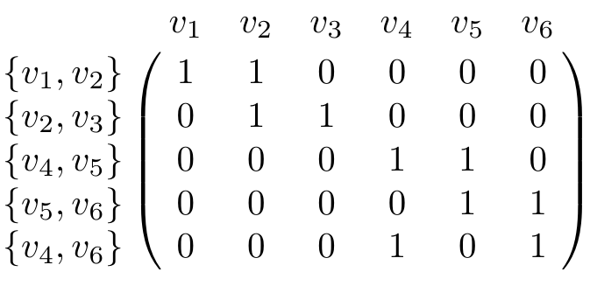
Counting number of connected components using homology
Z₀/B₀ = <v₁, v₂, v₃, v₄, v₅, v₆ : v₁ + v₂ = 0, v₂ + v₃ = 0,
v₄ + v₅ = 0, v₅ + v₆ = 0, v₄ + v₆ = 0>
Use matrices:
See Computing Persistent Homology by Afra Zomorodian, Gunnar Carlsson

Slide 19
Counting number of connected components using homology
v₂
v₅
e₁
e₂
e₃
e₄
v₁
v₃
v₄
v₆
e₅
: C₁ → C₀
o
(e₁) = v₁ + v₂
o
(e₂) = v₂ + v₃
o
Extend linearly:
(e₃) = v₄ + v₅
o
(Σn_{i}e_{i}) = n_{i} Σ (e_{i})
o
o
(e₄) = v₅ + v₆
o
(e₅) = v₄ + v₆
o

Slide 20
Counting number of connected components using homology
Z₀/B₀ = <v₁, v₂, v₃, v₄, v₅, v₆ : v₁ + v₂ = 0, v₂ + v₃ = 0,
v₄ + v₅ = 0, v₅ + v₆ = 0, v₄ + v₆ = 0>
Use matrices:
See Computing Persistent Homology by Afra Zomorodian, Gunnar Carlsson
T

Slide 21
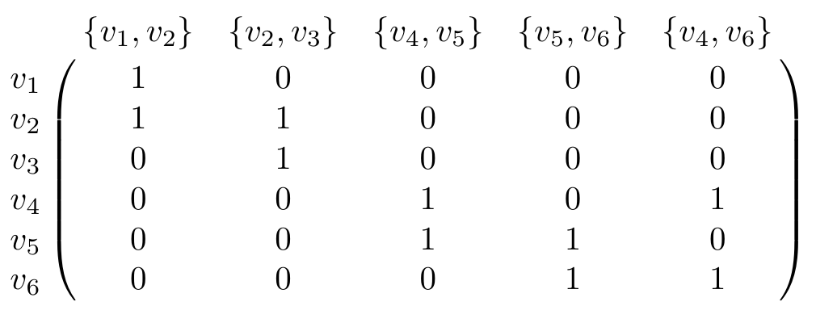
Counting number of connected components using homology
Z₀/B₀ = <v₁, v₂, v₃, v₄, v₅, v₆ : v₁ + v₂ = 0, v₂ + v₃ = 0,
v₄ + v₅ = 0, v₅ + v₆ = 0, v₄ + v₆ = 0>
Use matrices:
See Computing Persistent Homology by Afra Zomorodian, Gunnar Carlsson

Slide 22
Let e₁ = {v₁, v₂} =
Let e₂ = {v₂, v₃} =
Let e₃ =
{v₄, v₅} =
Let e₄ =
{v₅, v₆} =
Let e₅ =
{v₄, v₆} =

Slide 23
v₁ =
, v₂ =
, v₃ =
, v₄ =
, v₅ =
v₆ =

Slide 24
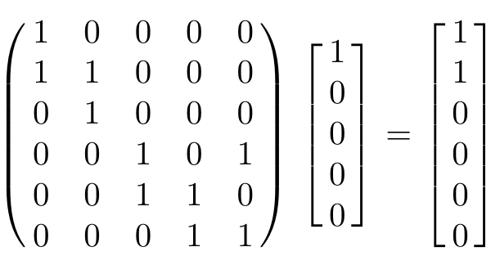
v₂
v₅
(e₁) = v₁ + v₂
e₁
e₂
e₃
e₄
o
v₁
v₃
v₄
v₆
e₅

Slide 25
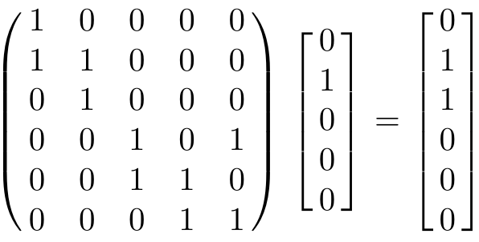
v₂
v₅
(e₂) = v₂ + v₃
e₁
e₂
e₃
e₄
o
v₁
v₃
v₄
v₆
e₅

Slide 26
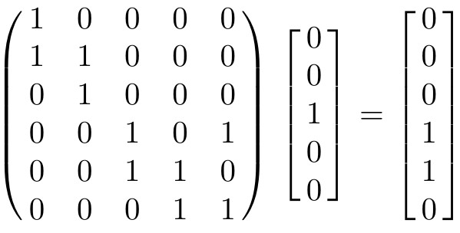
v₂
v₅
(e₃) = v₄ + v₅
e₁
e₂
e₃
e₄
o
v₁
v₃
v₄
v₆
e₅

Slide 27
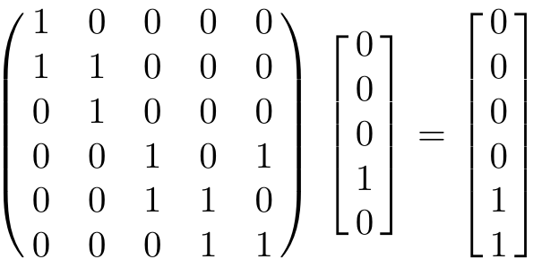
v₂
v₅
(e₄) = v₅ + v₆
e₁
e₂
e₃
e₄
o
v₁
v₃
v₄
v₆
e₅

Slide 28
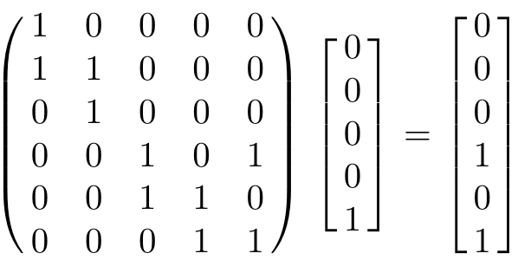
v₂
v₅
(e₅) = v₄ + v₆
e₁
e₂
e₃
e₄
o
v₁
v₃
v₄
v₆
e₅

Slide 29
Counting number of connected components using homology
v₂
v₅
e₁
e₂
e₃
e₄
v₁
v₃
v₄
v₆
e₅
: C₁ → C₀
o
(e₁) = v₁ + v₂
o
Extend linearly:
(e₂) = v₂ + v₃
o
(Σn_{i}e_{i}) = n_{i} Σ (e_{i})
o
o
(e₃) = v₄ + v₅
o
(e₄) = v₅ + v₆
o
(e₅) = v₄ + v₆
o

Slide 30
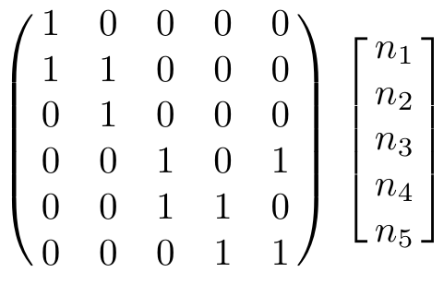

Slide 31
=

Slide 32
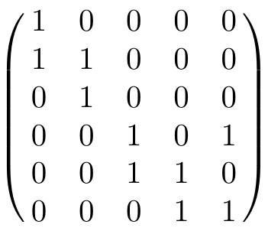
B₀ = Image of = column space of
o₁

Slide 33
v₂
v₅
e₁
e₂
e₃
e₄
v₁
v₃
v₄
v₆
e₅

Slide 34
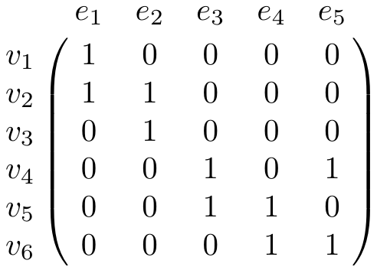
v₂
v₅
e₁
e₂
e₃
e₄
v₁
v₃
v₄
v₆
e₅

Slide 35
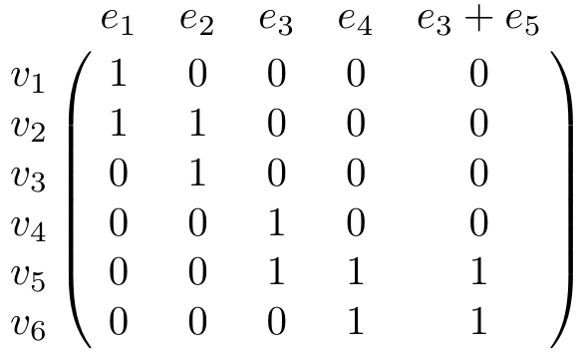
v₂
v₅
e₁
e₂
e₃
e₄
v₁
v₃
v₄
v₆
e₅

Slide 36
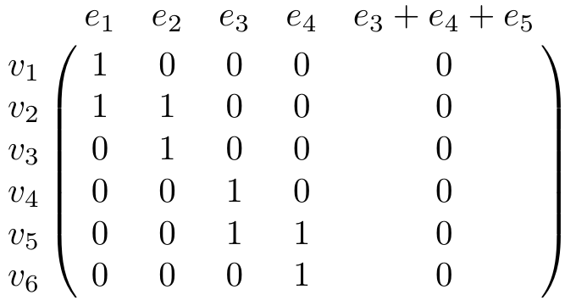
v₂
v₅
e₁
e₂
e₃
e₄
v₁
v₃
v₄
v₆
e₅

Slide 37
Counting number of connected components using homology
v₂
v₅
e₁
e₂
e₃
e₄
v₁
v₃
v₄
v₆
e₅
H₀ = Z₀/B₀ = <v₁, v₂, v₃, v₄, v₅, v₆ : v₁ + v₂ = 0, v₂ + v₃ = 0,
v₄ + v₅ = 0, v₅ + v₆ = 0, v₄ + v₆ = 0>
H₀ = Z₀/B₀ = <[v₁], [v₄]> where [v₁] = {v₁, v₂, v₃}
and [v₄] = {v₄, v₅, v₆}

Slide 38
v₂
v₅
e₁
e₂
e₃
e₄
v₁
v₃
v₄
v₆
e₅

Slide 39
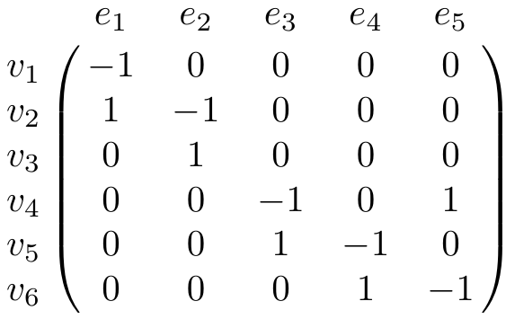
v₂
v₅
Using arbitrary coefficients
e₁
e₂
e₃
e₄
v₁
v₃
v₄
v₆
e₅

Slide 40
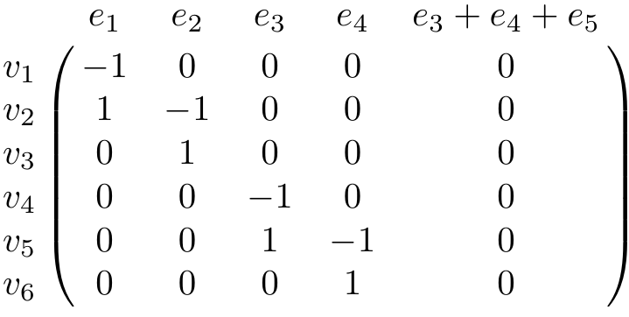
v₂
v₅
Using arbitrary coefficients
e₁
e₂
e₃
e₄
v₁
v₃
v₄
v₆
e₅

Slide 41
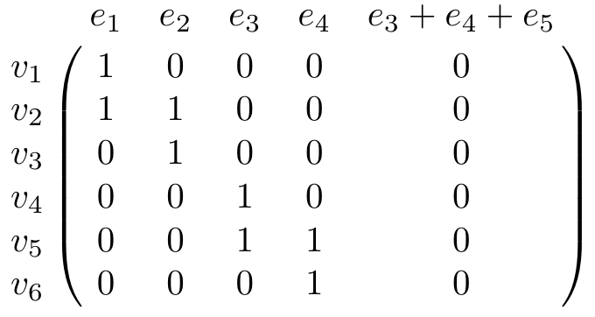
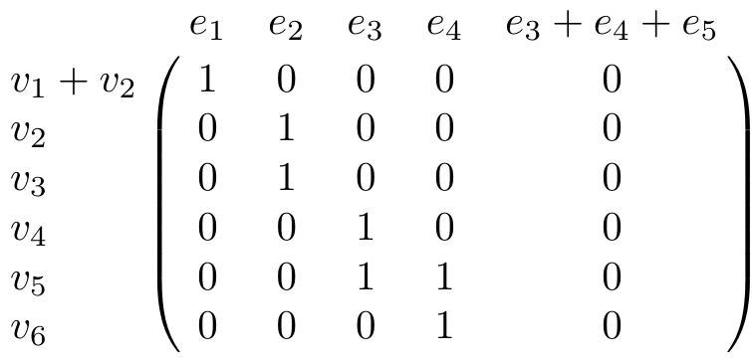
Row operations
v₂
e₁
e₂
v₁
v₃
v₅
e₃
e₄
v₄
v₆
e₅

Slide 42
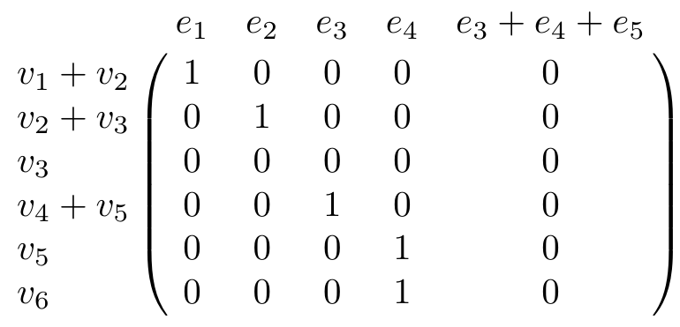
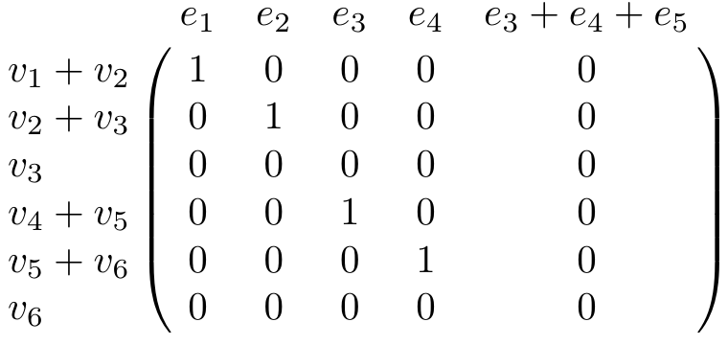
Row operations
v₂
v₅
e₁
e₂
e₃
e₄
v₁
v₃
v₄
e₅
v₆

Slide 43
Counting number of connected components using homology
v₂
v₅
e₁
e₂
e₃
e₄
v₁
v₃
v₄
v₆
e₅
H₀ = Z₀/B₀ = <v₁+v₂, v₂+v₃, v₃, v₄+v₅, v₅+v₆, v₆ :
v₁ + v₂ = 0, v₂ + v₃ = 0,
v₄ + v₅ = 0, v₅ + v₆ = 0, v₄ + v₆ = 0>
H₀ = Z₀/B₀ = <[v₃], [v₆]> where [v₃] = {v₁, v₂, v₃}
and [v₆] = {v₄, v₅, v₆}

Slide 44
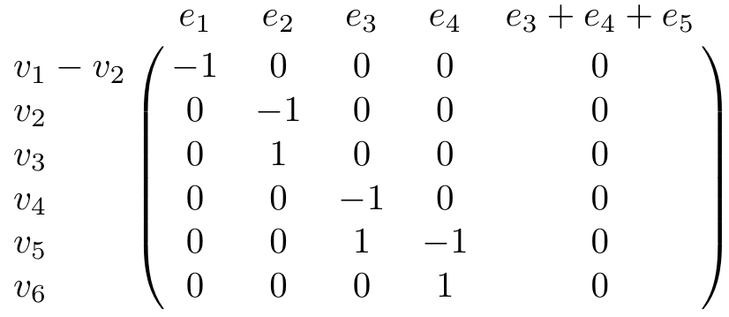
Row operations using arbitrary coefficients
v₂
e₁
e₂
v₁
v₃
v₅
e₃
e₄
v₄
v₆
e₅

Slide 45
Counting number of connected components using homology
v₂
v₅
e₁
e₂
e₃
e₄
v₁
v₃
v₄
v₆
e₅
o₁
o₀
C₁ → C₀ → 0
Z₀ = kernel of
= {x : (x) = 0}
= C₀ = Z₂[v₁, v₂, v₃, v₄, v₅, v₆]
o₀
o₀

Slide 46
Counting number of connected components using homology
v₂
v₅
e₁
e₂
e₃
e₄
v₁
v₃
v₄
v₆
e₅
o₁
o₀
C₁ → C₀ → 0
Z₀ = kernel of = null space of M₀ =
= {x : (x) = 0}
= C₀ = Z₂[v₁, v₂, v₃, v₄, v₅, v₆]
o₀
o₀

Slide 47
Counting number of connected components using homology
v₂
v₅
e₁
e₂
e₃
e₄
v₁
v₃
v₄
v₆
e₅
o₁
o₀
C₁ → C₀ → 0
Z₀ = kernel of = null space of M₀ = [0 0 0 0 0 0]
= {x : (x) = 0}
= C₀ = Z₂[v₁, v₂, v₃, v₄, v₅, v₆]
o₀
o₀

Slide 48
Counting number of connected components using homology
v₂
v₅
e₁
e₂
e₃
e₄
v₁
v₃
v₄
v₆
e₅
H₀ = Z₀/B₀ = <v₁, v₂, v₃, v₄, v₅, v₆ : v₁ + v₂ = 0, v₂ + v₃ = 0,
v₄ + v₅ = 0, v₅ + v₆ = 0, v₄ + v₆ = 0>
H₀ = Z₀/B₀ = <[v₁], [v₄]> where [v₁] = {v₁, v₂, v₃}
and [v₄] = {v₄, v₅, v₆}

Slide 49
o₁
o₀
C₁ → C₀ → 0
H₀ = Z₀/B₀ = (kernel of )/ (image of )
null space of M₀
column space of M₁
Rank H₀ = Rank Z₀ – Rank B₀
Z₀ = null space of [0 0 0 0 0 0]
B₀ = column space of
o₀
o₁
=

Slide 50
Counting number of connected components using homology
v₂
v₅
e₁
e₂
e₃
e₄
v₁
v₃
v₄
v₆
e₅
H₀ = Z₀/B₀ = <v₁, v₂, v₃, v₄, v₅, v₆ : v₁ + v₂ = 0, v₂ + v₃ = 0,
v₄ + v₅ = 0, v₅ + v₆ = 0, v₄ + v₆ = 0>
H₀ = Z₀/B₀ = <[v₁], [v₄]> where [v₁] = {v₁, v₂, v₃}
and [v₄] = {v₄, v₅, v₆}

Slide 51
Counting number of connected components using homology
v₂
v₅
e₁
e₂
e₃
e₄
v₁
v₃
v₄
v₆
e₅
H₀ = Z₀/B₀ = <v₁+v₂, v₂+v₃, v₃, v₄+v₅, v₅+v₆, v₆ :
v₁ + v₂ = 0, v₂ + v₃ = 0,
v₄ + v₅ = 0, v₅ + v₆ = 0, v₄ + v₆ = 0>
H₀ = Z₀/B₀ = <[v₃], [v₆]> where [v₃] = {v₁, v₂, v₃}
and [v₆] = {v₄, v₅, v₆}

Slide 52
o_{n+1}
o_{n}
o₂
o₁
o₀
C_{n+1} → C_{n} → C_{n-1} →. . . → C₂ → C₁ → C₀ → 0
H_{n} = Z_{n}/B_{n} = (kernel of )/ (image of )
null space of M_{n}
column space of M_{n+1}
Rank H_{n} = Rank Z_{n} – Rank B_{n}
o_{n}
o_{n+1}
=

Slide 53
o₂
o₁
C₂ → C₁ → C₀
H₁ = Z₁/B₁ = (kernel of )/ (image of )
null space of M₁
column space of M₂
Rank H₁ = Rank Z₁ – Rank B₁
o₁
o₂
=

Slide 54
H₀ = Z₀/B₀ = # of connected components
Z₀ = 0-dim cycles = vertices.
B₀ = boundaries of 1-dim edges.
Betti numbers provide a signature of the underlying topology.
Using Z₂ coefficients
Singh G et al. J Vis 2008;8:11
©2008 by Association for Research in Vision and Ophthalmology
Notes:
Betti numbers provide a signature of the underlying topology. Illustrated in the figure are five simple objects (topological spaces) together with their Betti number signatures: (a) a point, (b) a circle, (c) a hollow torus, (d) a Klein bottle, and (e) a hollow sphere. For the case of the torus (c), the figure shows three loops on its surface. The red loops are “essential” in that they cannot be shrunk to a point, nor can they be deformed one into the other without tearing the loop. The green loop, on the other hand, can be deformed to a point without any obstruction. For the torus, therefore, we have b 1 = 2. For the case of the sphere, the loops shown (and actually all loops on the sphere) can be contracted to points, which is reflected by the fact that b 1 = 0. Both the sphere and the torus have b 2 = 1, this is due to the fact both surfaces enclose a part of space (a void).

Slide 55
H₁ = Z₁/B₁ = # of loops that aren’t a boundary
Z₁ = 1-dim cycles = loops.
B₁ = boundaries of 2-dim surfaces.
Betti numbers provide a signature of the underlying topology.
Using Z₂ coefficients
Singh G et al. J Vis 2008;8:11
©2008 by Association for Research in Vision and Ophthalmology
Notes:
Betti numbers provide a signature of the underlying topology. Illustrated in the figure are five simple objects (topological spaces) together with their Betti number signatures: (a) a point, (b) a circle, (c) a hollow torus, (d) a Klein bottle, and (e) a hollow sphere. For the case of the torus (c), the figure shows three loops on its surface. The red loops are “essential” in that they cannot be shrunk to a point, nor can they be deformed one into the other without tearing the loop. The green loop, on the other hand, can be deformed to a point without any obstruction. For the torus, therefore, we have b 1 = 2. For the case of the sphere, the loops shown (and actually all loops on the sphere) can be contracted to points, which is reflected by the fact that b 1 = 0. Both the sphere and the torus have b 2 = 1, this is due to the fact both surfaces enclose a part of space (a void).

Slide 56
v₂
o₂
o₁
C₂ → C₁ → C₀
e₁
e₂
v₁
v₃
v₅
e₃
e₄
v₄
v₆
e₅
Z₁ = kernel of = null space of M₁
o₁

Slide 57
o₂
o₁
C₂ → C₁ → C₀
Z₁ = kernel of = null space of M₁
o₁

Slide 58
o₂
o₁
C₂ → C₁ → C₀
Z₁ = kernel of = null space of M₁
o₁

Slide 59
o₂
o₁
C₂ → C₁ → C₀
Z₁ = kernel of = null space of M₁
= <e₃ + e₄ + e₅>
o₁

Slide 60
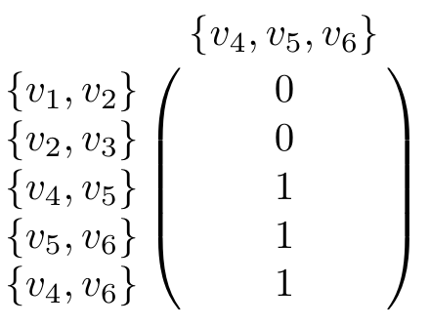
o₂
o₁
v₂
C₂ → C₁ → C₀
e₁
e₂
v₁
v₃
v₅
e₃
e₄
v₄
v₆
e₅
B₁ = image of = column space of M₂
o₂

Slide 61
o₂
o₁
v₂
C₂ → C₁ → C₀
e₁
e₂
v₁
v₃
v₅
e₃
e₄
v₄
v₆
e₅
B₁ = image of = column space of M₂
= <{v₄, v₅} + {v₅, v₆} + {v₄, v₆}> = <e₃ + e₄ + e₅>
o₂

Slide 62
v₂
v₅
o₂
o₁
e₁
e₂
e₃
e₄
C₂ → C₁ → C₀
v₁
v₃
v₄
e₅
v₆
H₁ = Z₁/B₁ = (kernel of )/ (image of )
null space of M₁
column space of M₂
<e₃ + e₄ + e₅>
<e₃ + e₄ + e₅>
Rank H₁ = Rank Z₁ – Rank B₁ = 1 – 1 = 0
o₁
o₂
=
=

Slide 63
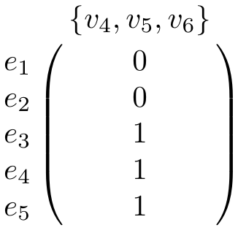
o₂
o₁
v₂
C₂ → C₁ → C₀
e₁
e₂
v₁
v₃
v₅
e₃
e₄
v₄
v₆
e₅
B₁ = image of = column space of M₂
= <{v₄, v₅} + {v₅, v₆} + {v₄, v₆}> = <e₃ + e₄ + e₅>
o₂

Slide 64
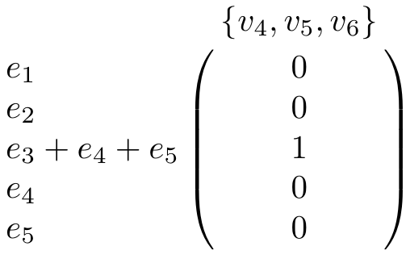
o₂
o₁
v₂
C₂ → C₁ → C₀
e₁
e₂
v₁
v₃
v₅
e₃
e₄
v₄
v₆
e₅
B₁ = image of = column space of M₂
= <{v₄, v₅} + {v₅, v₆} + {v₄, v₆}> = <e₃ + e₄ + e₅>
o₂

Slide 65
v₂
v₅
o₂
o₁
e₁
e₂
e₃
e₄
C₂ → C₁ → C₀
v₁
v₃
v₄
e₅
v₆
H₁ = Z₁/B₁ = (kernel of )/ (image of )
null space of M₁
column space of M₂
<e₃ + e₄ + e₅>
<e₃ + e₄ + e₅>
Rank H₁ = Rank Z₁ – Rank B₁ = 1 – 1 = 0
o₁
o₂
=
=

Slide 66
o₃
o₂
v₂
C₂₃ → C₂ → C₁
e₁
e₂
v₁
v₃
v₅
e₃
e₄
v₄
v₆
e₅
H₂ = ker of /image of
= nullspace of M₂/column space of M₃
=
o₂
o₃

