Slide 1
Euler characteristic (simple form):
= number of vertices – number of edges + number of faces
Or in short-hand,
= |V| - |E| + |F|
where V = set of vertices
E = set of edges
F = set of faces
& the notation |X| = the number of elements in the set X.

Slide 2
= |V| – |E| + |F|
= 3 – 1 = 2

Slide 3
= |V| – |E| + |F|
= 3 – 2 = 1

Slide 4
= |V| – |E| + |F|
= 4 – 3 = 1

Slide 5
= |V| – |E| + |F|
= 4 – 4 = 0

Slide 6
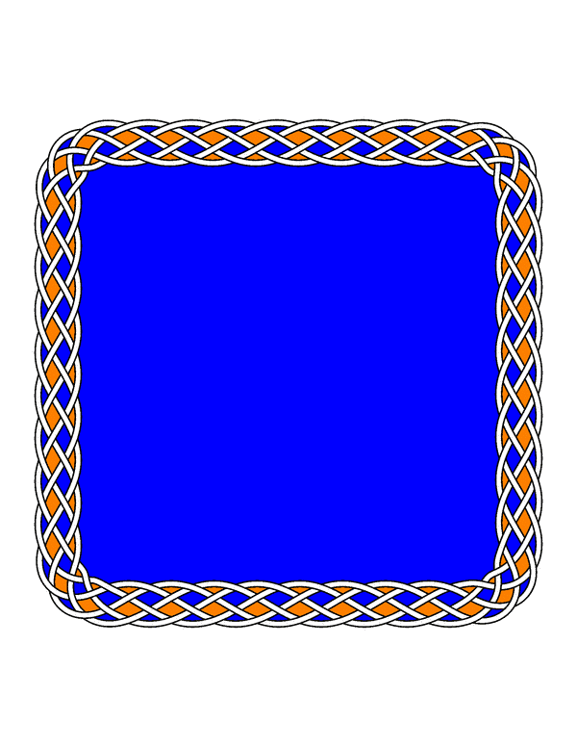
The Euler characteristic is a topological invariant
That means that if two objects are topologically the same, they have the same Euler characteristic.
Example:
= 1
= 1

Slide 7
Euler characteristic
sphere
= { x in R³ : ||x || = 1 }
2
1
ball
= { x in R³ : ||x || ≤ 1 }
disk
= { x in R² : ||x || ≤ 1 }
closed interval
= { x in R : ||x || ≤ 1 }

Slide 8
The Euler characteristic is a topological invariant
That means that if two objects are topologically the same, they have the same Euler characteristic.
But objects with the same Euler characteristic need not be topologically equivalent.
≠
≠
= 1

Slide 9
Let R be a subset of X
A deformation retract of X onto R is a continuous map F: X × [0, 1] → X, F(x, t) = f_{t}(x) such that
f₀ is the identity map,
f₁(X) = R, and
f_{t}(r) = r for all r in R.
If R is a deformation retract of X, then (R) = (X).

Slide 10
Let R be a subset of X
A deformation retract of X onto R is a continuous map F: X × [0, 1] → X, F(x, t) = f_{t}(x) such that f₀ is the identity map,
f₁(X) = R, and
f_{t}(r) = r for all r in R.
If R is a deformation retract of X, then (R) = (X).

Slide 11
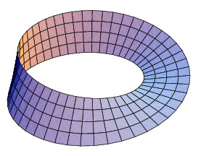
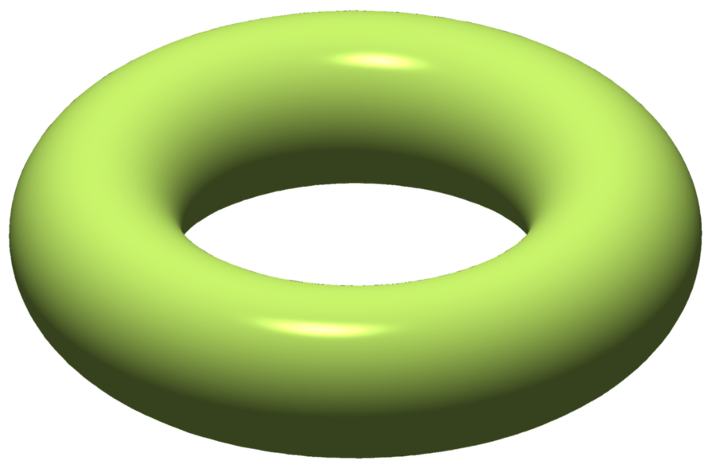
Euler characteristic
S¹ = circle
= { x in R² : ||x || = 1 }
Annulus
Mobius band
Solid torus = S¹ x disk
Torus = S¹ x S¹
0
Mobius band and torus images from https://en.wikipedia.org/wiki/Euler_characteristic

Slide 12
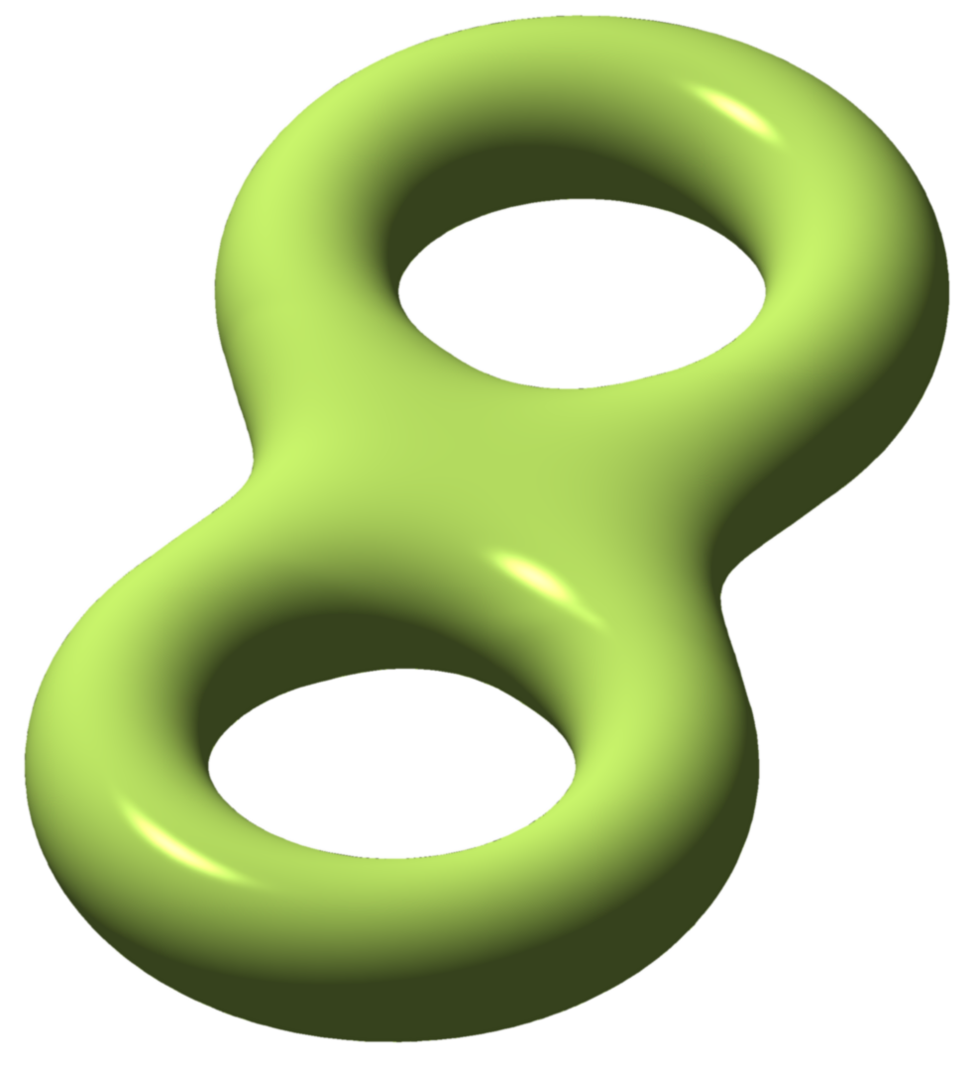
Euler characteristic
-1
-2
Solid double torus
The graph:
Double torus =
genus 2 torus =
boundary of solid
double torus
Genus n tori images from https://en.wikipedia.org/wiki/Euler_characteristic

Slide 13
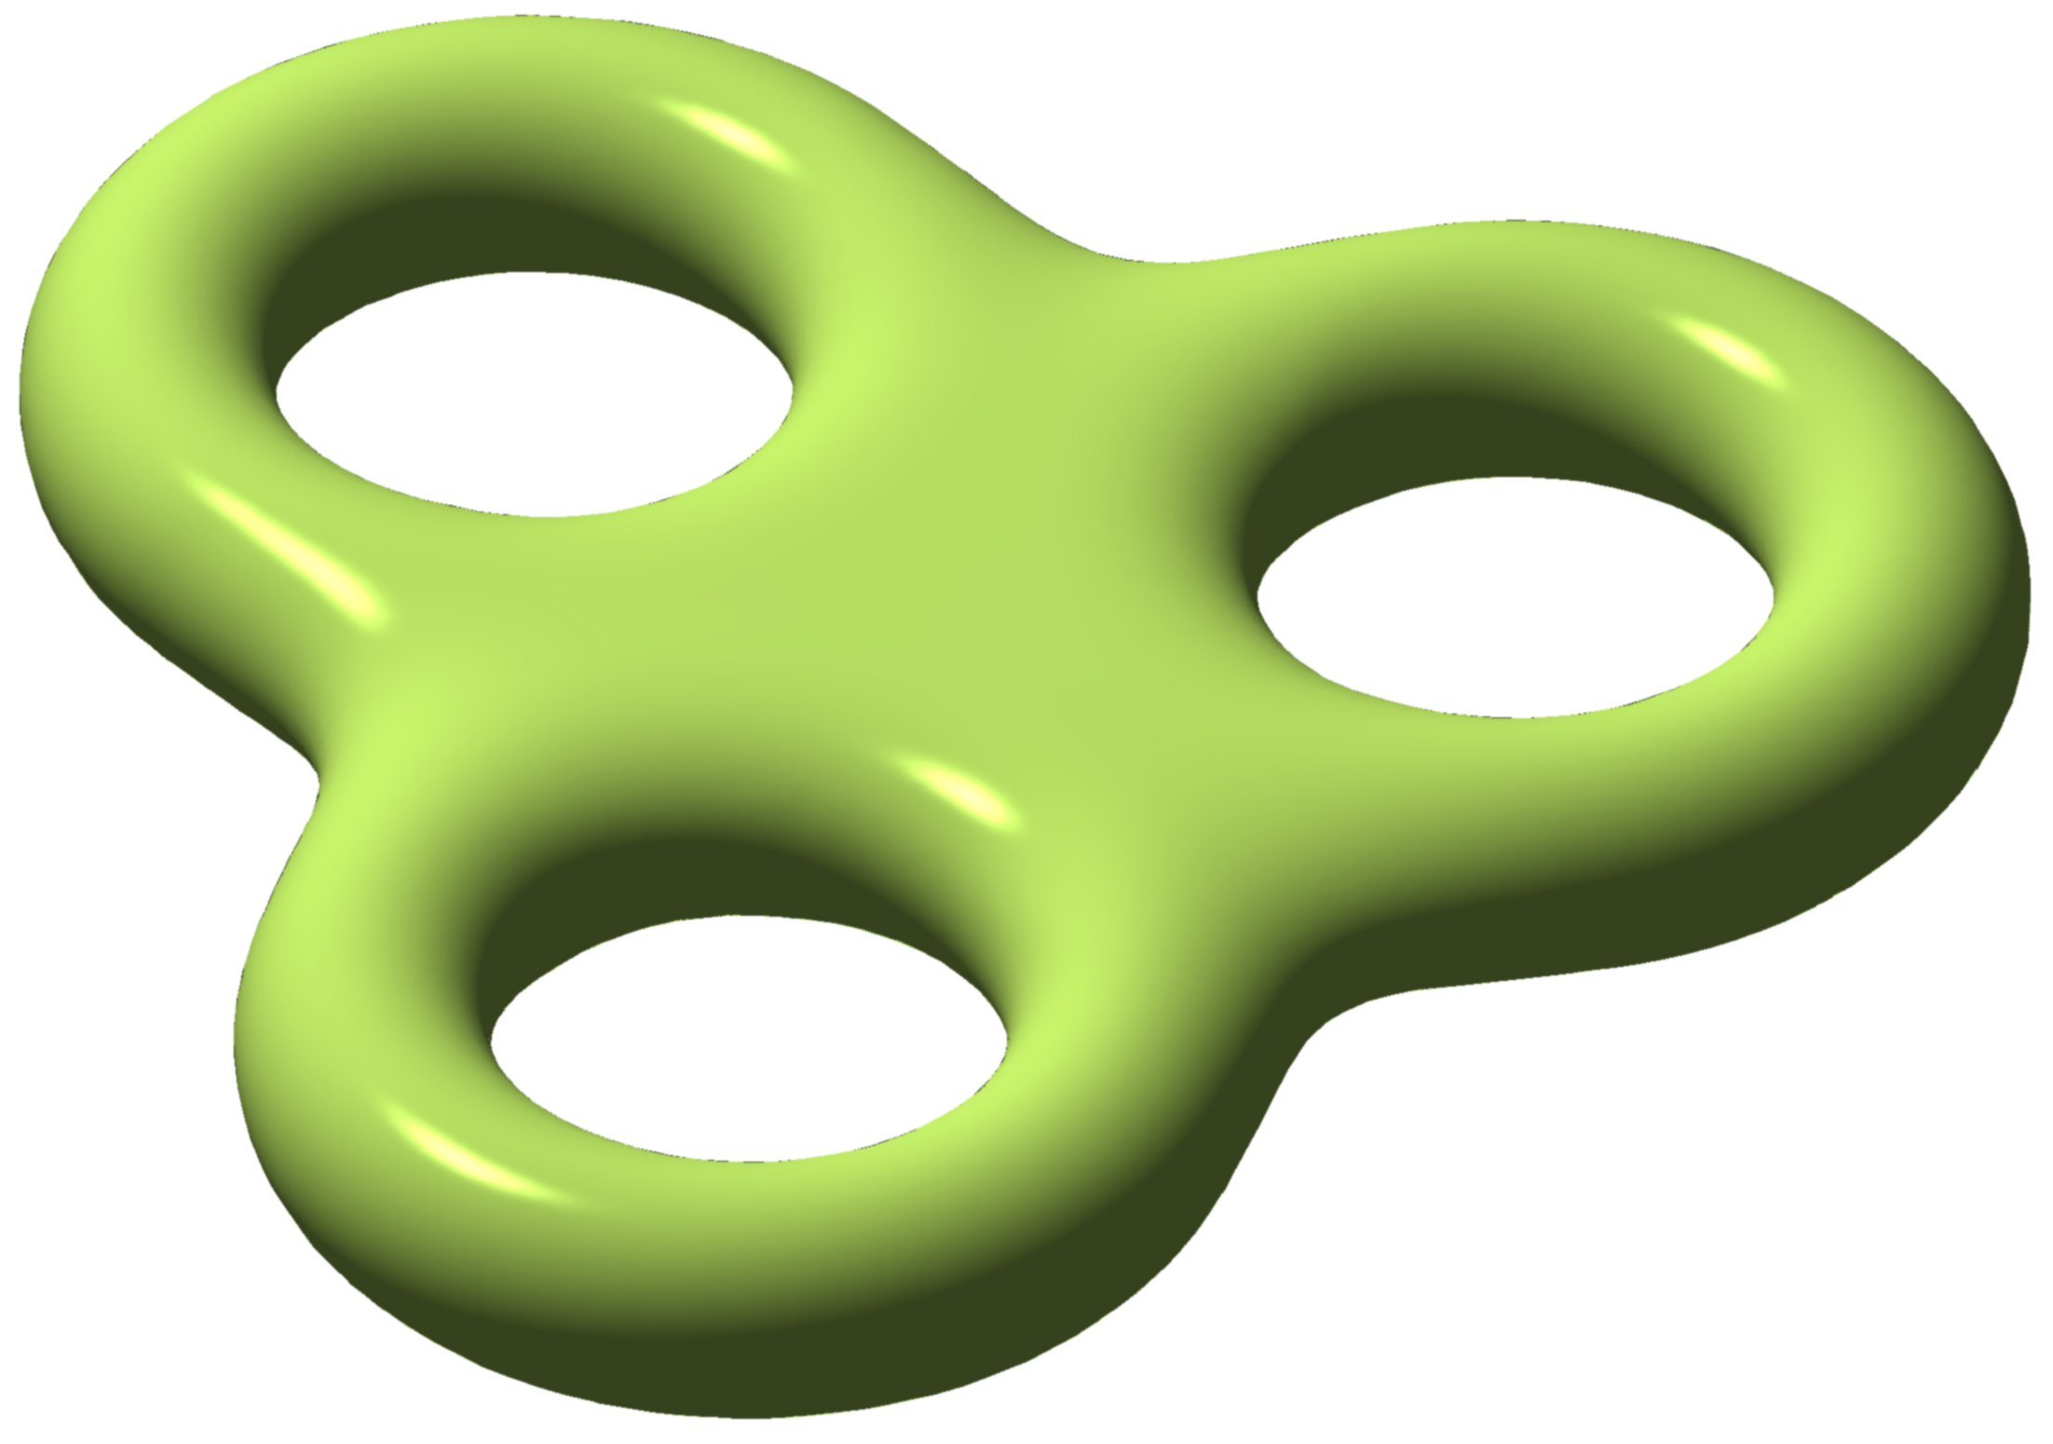
Euler 2-dimensional orientable surface characteristic without boundary
2
0
-2
-4
sphere
S¹ x S¹ = torus
genus 2 torus
genus 3 torus
Genus n tori images from https://en.wikipedia.org/wiki/Euler_characteristic

