Slide 1
Creating a cell complex = CW complex
Building block: n-cells = { x in R^{n} : || x || ≤ 1 }
Examples: 0-cell = { x in R⁰ : ||x || < 1 }
1-cell =open interval ={ x in R : ||x || < 1 } ( )
2-cell = open disk = { x in R² : ||x || < 1 }
3-cell = open ball = { x in R³ : ||x || < 1 }
Notes:
To distinguish cell complexes from simplicial complexes, I’ll now color my 2-dimensional faces, light brown instead of blue since one can use any color one wants.

Slide 2

Cell complex = CW complex
Building block: n-cells = { x in R^{n} : || x || < 1 }
Examples: 0-cell = { x in R⁰ : ||x || < 1 }
1-cell =open interval ={ x in R : ||x || < 1 } ( )
2-cell = open disk = { x in R² : ||x || < 1 }
Grading = dimension
(n-cells) = { x in R^{n} : || x || = 1 }
_{n}
Notes:
Thus the building blocks are basically the same for both simplicial and cell complexes. But the rules for building cell complexes are much more lax than those for building simplicial complexes. We will illustrate with a couple of examples

Slide 3
Example: disk = { x in R² : ||x || ≤ 1 }
Simplicial complex
3 vertices, 3 edges, 1 triangle
=
Cell complex
1 vertex, 1 edge, 1 disk.
=
U U
( )
U
[ ]
=
=
U
Notes:
For example,
For the simplicial complex of a disk we have three vertices -3 edges plus s one 2-dimensional equals to one, so the euler characteristic of a disk is one. We also get an Euler characteristic of one for the cell complex of a disk one vertex -1 edge plus one 2-dimensional equals to 1.

Slide 4
Cell complex = CW complex
Building block: n-cells = { x in R^{n} : || x || < 1 }
Examples: 0-cell = { x in R⁰ : ||x || < 1 }
1-cell =open interval ={ x in R : ||x || < 1 } ( )
2-cell = open disk = { x in R² : ||x || < 1 }
X⁰ = set of points with discrete topology.
Given the (n-1)-skeleton X^{n-1}, form the
n-skeleton, X_{n}, by attaching n-cells via
maps σ_{α}: ∂D^{n} → X^{n-1},
I.e., X^{n} = X^{n-1} D^{n} / ~ where x ~ σ_{α}(x) for all x in ∂D^{n}
Π
α
α
α
Notes:
Thus the building blocks are basically the same for both simplicial and cell complexes. But the rules for building cell complexes are much more lax than those for building simplicial complexes. We will illustrate with a couple of examples

Slide 5
Example: disk = { x in R² : ||x || ≤ 1 }
Simplicial complex
3 vertices, 3 edges, 1 triangle
=
Cell complex
1 vertex, 1 edge, 1 disk.
=
U U
( )
U
[ ]
=
=
U
Notes:
For example,
For the simplicial complex of a disk we have three vertices -3 edges plus s one 2-dimensional equals to one, so the euler characteristic of a disk is one. We also get an Euler characteristic of one for the cell complex of a disk one vertex -1 edge plus one 2-dimensional equals to 1.

Slide 6

Example: sphere = { x in R³ : ||x || = 1 }
Simplicial complex
=
Cell
complex
=
U
U
=
Fist image from http://openclipart.org/detail/1000/a-raised-fist-by-liftarn
Notes:
That is we hit this disk so hard that it forms almost the entire two sphere except for this one vertex. Note that the sphere minus a vertex is topologically equivalent to an open disk. I can topologically deform the sphere minus the vertex by increasing the size of the hole created by removing the vertex.
This cell complex is not a simplicial complex but the simplicial complex above is also a cell complex.
We created it by

Slide 7
Example: constant, identity, constant maps
Cell complex
1 vertex, 1 edge, 2 disks.
U U U
( )
U
[ ]
=
=
U
=
U
Notes:
For example,
For the simplicial complex of a disk we have three vertices -3 edges plus s one 2-dimensional equals to one, so the euler characteristic of a disk is one. We also get an Euler characteristic of one for the cell complex of a disk one vertex -1 edge plus one 2-dimensional equals to 1.

Slide 8
Let X be a CW complex.
X⁰ = set of points with discrete topology.
Given the (n-1)-skeleton X^{n-1}, form the
n-skeleton, X_{n}, by attaching n-cells via
attaching maps σ_{α}: ∂D^{n} → X^{n-1},
I.e., X^{n} = X^{n-1} D^{n} / ~ where x ~ σ_{α}(x) for all x in ∂D^{n}
The characteristic map Φ_{α}: D^{n} → X is the map that extends the attaching map σ_{α}: ∂D^{n} → X^{n-1}
and Φ_{α}|D^{n} onto its image is a homeomorphism.
Φ_{α} is the composition D^{n} → X^{n-1} D^{n} → X^{n} → X
α
Π
α
α
α
α
α
o
α
α
Π
β
β
Notes:
Thus the building blocks are basically the same for both simplicial and cell complexes. But the rules for building cell complexes are much more lax than those for building simplicial complexes. We will illustrate with a couple of examples

Slide 9
Your name homology
3 ingredients:
1.) Objects
2.) Grading
3.) Boundary map

Slide 10
Grading
Grading: Each object is assigned a unique grade.
Let X_{n} = {x₁, …, x_{k}} = generators of grade n.
Extend grading on the set of generators to the set of n-chains: C_{n} = set of n-chains = R[X_{n}]
Normally n-chains in C_{n} are assigned to the grade n.
Notes:
Vi t^2vi 1t^2vi

Slide 11
_{n} : C_{n} → C_{n-1} such that ² = 0
_{n+1}
_{n}
₂
₁
₀
C_{n+1} → C_{n} → C_{n-1} →. . . → C₂ → C₁ → C₀ → 0
H_{n} = Z_{n}/B_{n} = (kernel of )/ (image of )
null space of M_{n}
column space of M_{n+1}
Rank H_{n} = Rank Z_{n} – Rank B_{n}
_{n}
_{n+1}
=

Slide 12
Čech homology
Given U V_{α} where V_{α} open for all α in A.
Objects = finite intersections = { V_{α} : α_{i} in A }
Grading = n = depth of intersection.
( V_{α} ) = Σ V_{α}
Ex: (V_{α}) = 0, (V_{α} V_{β}) = V_{α} + V_{β}
(V_{α} V_{β} V_{γ}) = (V_{α} V_{β}) + (V_{α} V_{γ}) + (V_{β} V_{γ})
α in A
n
U
i = 1
i
( )
n
n
n
U
_{n+1}
U
i = 1
i
j = 1
i = 1
i ≠ j
i
U
₀
₁
U
U
U
U
U
₂

Slide 13
Creating the Čech simplicial complex
1.) B₁ … B_{k+1} ≠ ⁄ , create k-simplex {v₁, ... , v_{k+1}}.
U
U
0
Notes:
Thus we now have the Vietoris Rips simplicial complex. Note we get the same simplex by adding one dimension at a time

Slide 14
Unoriented simplicial complex using Z₂ coefficients
Grading = dimension
0-simplex = vertex = v
1-simplex = edge = {v₁, v₂}
Note that the boundary of this edge is v₂ + v₁
v₁
v₂
e
2-simplex = face = {v₁, v₂, v₃}
v₂
Note that the boundary
of this face is the cycle
e₁ + e₂ + e₃
= {v₁, v₂} + {v₂, v₃} + {v₁, v₃}
e₁
e₂
v₁
v₃
e₃
Notes:
If I use Z₂ coefficients, the Building blocks for a simplicial complex using are unoriented
Since my complexes are unoriented, we now use set notation to indicate our complexes. So an edge can be denoted by the unordered set v1v2, while a face is denoted by the unordered set v1v2v3. Since orientation doesn’t matter with Z2 coefficients, the order of the vertices in my set also does not matter.
Since 1 = -1 mod 2, I don’t need minus signs and thus we can calculate boundary using only addition and no subtraction. Thus to calculate the boundary of a face, I can remove v3 to get the boundary edge v1v2, remove v1 to get
The sum of these 3 edges is the boundary of this face. I don’t have alternating signs since 1 = -1.
Similarly the boundary of an edge, remove v1, I get v2, remove v2, I get v1 so the boundary of the edge v1v2 is the sum v2 + v1
As before the boundary of a vertex is 0 since if I remove the vertex, I have the empty set.

Slide 15
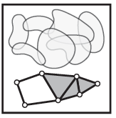
Nerve Lemma: If V is a finite collection of subsets of X with all non-empty intersections of subcollections of V contractible, then N(V) is homotopic to the union of elements of V.
http://www.math.upenn.edu/~ghrist/EAT/EATchapter2.pdf

Slide 16
Theorem: The choice of triangulation does not affect the homology.
_{n} : C_{n} → C_{n-1} such that ² = 0
_{n+1}
_{n}
₂
₁
₀
C_{n+1} → C_{n} → C_{n-1} →. . . → C₂ → C₁ → C₀ → 0
H_{n} = Z_{n}/B_{n} = (kernel of )/ (image of )
null space of M_{n}
column space of M_{n+1}
Rank H_{n} = Rank Z_{n} – Rank B_{n}
_{n}
_{n+1}
=

Slide 17
Building blocks for oriented simplicial complex
3-simplex =
σ = (v₁, v₂, v₃, v₄) = (v₂, v₃, v₁, v₄) = (v₃, v₁, v_{2,} v₄)
= (v₂, v₁, v₄, v₃) = (v₃, v₂, v₄, v₁) = (v₁, v₃, v₄, v₂)
= (v₄, v₂, v₁, v₃) = (v₄, v₃, v₂, v₁) = (v₄, v₁, v₃, v₂)
= (v₁, v₄, v₂, v₃) = (v₂, v₄, v₃, v₁) = (v₃, v₄, v₁, v₂)
– σ = (v₂, v₁, v₃, v₄) = (v₃, v₂, v₁, v₄) = (v₁, v₃, v₂, v₄)
= (v₂, v₄, v₁, v₃) = (v₃, v₄, v₂, v₁) = (v₁, v₄,v₃, v₂)
= (v₁, v₂, v₄, v₃) = (v₂, v₃, v₄, v₁) = (v₃, v₁, v₄, v₂)
= (v₄, v₁, v₂, v₃) = (v₄, v₂, v₃, v₁) = (v₄, v₃, v₁, v₂)
v₂
v₄
v₁
v₃
Notes:
While 12 different ordered quadruples represent a three simplex

Slide 18
Čech homology
Given U V_{α} where V_{α} open for all α in A.
Objects = finite intersections = { V_{α} : α_{i} in A }
Grading = n = depth of intersection.
( V_{α} ) = Σ V_{α}
Ex: (V_{α}) = 0, (V_{α} V_{β}) = V_{α} + V_{β}
(V_{α} V_{β} V_{γ}) = (V_{α} V_{β}) + (V_{α} V_{γ}) + (V_{β} V_{γ})
α in A
n
U
i = 1
i
( )
n
n
n
U
_{n+1}
U
i = 1
i
j = 1
i = 1
i ≠ j
i
U
₀
₁
U
U
U
U
U
₂

Slide 19
Oriented simplicial complex
0-simplex = vertex = v
Grading = dimension
1-simplex = oriented edge = (v₁, v₂)
Note that the boundary of this edge is v₂ – v₁
v₁
v₂
e
2-simplex = oriented face = (v₁, v₂, v₃)
v₂
Note that the boundary
of this face is the cycle
e₁ + e₂ + e₃
= (v₁, v₂) + (v₂, v₃) – (v₁, v₃)
= (v₁, v₂) – (v₁, v₃) + (v₂, v₃)
e₁
e₂
v₁
v₃
e₃
Notes:
Note that the boundary of the 2-dimensional face is the 1-dimensional cycle e₁ + e₂ + e₃. While the boundary of the 1-dimensional edge is the difference between it 0-dimensional boundary vertices v₂ – v₁ . A zero dimensional vertex does not have boundary. Boundary v = 0.
Note that when we use an ordered triple to represent a face, we can calculate its boundary via an alternating sum of its two dimensional boundary edges.
If I remove vertex v3, I get the edge v1v2. If I remove the edge v2, I get the edge minus v1 v3. removing the vertex v1, I get the edge V2 V3
Note that when I remove a vertex with an odd subscript, the resulting edge is added, while if I remove a vertex with an even subscript we subtract the resulting edge.
1 and 3 are both odd, so Removing v3 results in plus v1 v2, and removing v1 results in plus v2 v3
while removing v2 results in minus v1 v3 since 2 is even
Similarly when calculating the boundary of the edge v1v2, removing v1 results in plus v2 since 1 is odd while removing v2 results in minus v1 since 2 is even.
The boundary of a vertex is zero since if we remove the vertex we have nothing, zero
Note this also means that the dimension of the boundary of an object is 1 less than that of the original object.
The boundary of the 2dim face is a 1 dimensional cycle, while the boundary of 1 dimensional edge is 0-dimensional. The boundary of a 0 dimensional vertex is empty.

Slide 20
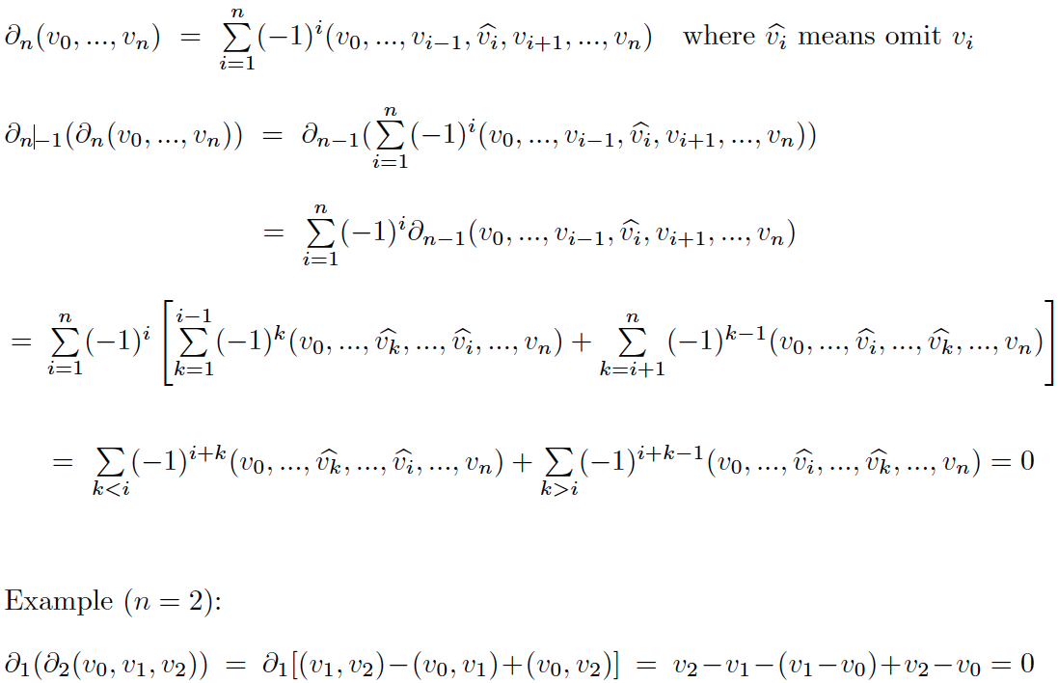

Slide 21
Building blocks for a simplicial complex
0-simplex = vertex = v
Grading = dimension
1-simplex = oriented edge = (v₀, v₁)
Note that the boundary of this edge is v₁ – v₀
v₀
v₁
e
2-simplex = oriented face = (v₀, v₁, v₂)
v₁
Note that the boundary
of this face is the cycle
e₁ + e₂ + e₃
= (v₀, v₁) + (v₁, v₂) – (v₀, v₂)
= (v₁, v₂) – (v₀, v₂) + (v₀, v₁)
e₁
e₂
v₀
v₂
e₃
Notes:
Note that the boundary of the 2-dimensional face is the 1-dimensional cycle e₁ + e₂ + e₃. While the boundary of the 1-dimensional edge is the difference between it 0-dimensional boundary vertices v₂ – v₁ . A zero dimensional vertex does not have boundary. Boundary v = 0.
Note that when we use an ordered triple to represent a face, we can calculate its boundary via an alternating sum of its two dimensional boundary edges.
If I remove vertex v3, I get the edge v1v2. If I remove the edge v2, I get the edge minus v1 v3. removing the vertex v1, I get the edge V2 V3
Note that when I remove a vertex with an odd subscript, the resulting edge is added, while if I remove a vertex with an even subscript we subtract the resulting edge.
1 and 3 are both odd, so Removing v3 results in plus v1 v2, and removing v1 results in plus v2 v3
while removing v2 results in minus v1 v3 since 2 is even
Similarly when calculating the boundary of the edge v1v2, removing v1 results in plus v2 since 1 is odd while removing v2 results in minus v1 since 2 is even.
The boundary of a vertex is zero since if we remove the vertex we have nothing, zero
Note this also means that the dimension of the boundary of an object is 1 less than that of the original object.
The boundary of the 2dim face is a 1 dimensional cycle, while the boundary of 1 dimensional edge is 0-dimensional. The boundary of a 0 dimensional vertex is empty.

Slide 22
Building blocks for a Δ-complex
0-simplex = vertex = v
Grading = dimension
1-simplex = oriented edge = [v₀, v₁]
Note that the boundary of this edge is v₁ – v₀
v₀
v₁
e
2-simplex = oriented face = [v₀, v₁, v₂]
v₁
Note that the boundary
of this face is the cycle
e₁ + e₂ - e₃
= [v₀, v₁] + [v₁, v₂] – [v₀, v₂]
= [v₁, v₂] – [v₀, v₂] + [v₀, v₁]
e₁
e₂
v₀
v₂
e₃
Notes:
Note that the boundary of the 2-dimensional face is the 1-dimensional cycle e₁ + e₂ + e₃. While the boundary of the 1-dimensional edge is the difference between it 0-dimensional boundary vertices v₂ – v₁ . A zero dimensional vertex does not have boundary. Boundary v = 0.
Note that when we use an ordered triple to represent a face, we can calculate its boundary via an alternating sum of its two dimensional boundary edges.
If I remove vertex v3, I get the edge v1v2. If I remove the edge v2, I get the edge minus v1 v3. removing the vertex v1, I get the edge V2 V3
Note that when I remove a vertex with an odd subscript, the resulting edge is added, while if I remove a vertex with an even subscript we subtract the resulting edge.
1 and 3 are both odd, so Removing v3 results in plus v1 v2, and removing v1 results in plus v2 v3
while removing v2 results in minus v1 v3 since 2 is even
Similarly when calculating the boundary of the edge v1v2, removing v1 results in plus v2 since 1 is odd while removing v2 results in minus v1 since 2 is even.
The boundary of a vertex is zero since if we remove the vertex we have nothing, zero
Note this also means that the dimension of the boundary of an object is 1 less than that of the original object.
The boundary of the 2dim face is a 1 dimensional cycle, while the boundary of 1 dimensional edge is 0-dimensional. The boundary of a 0 dimensional vertex is empty.

Slide 23
Creating a simplicial complex
0-skeleton
0.) Start by adding 0-dimensional vertices
(0-simplices)
Notes:
To create a simplicial complex, we start by adding 0-simplices (ie 0-dimensional vertices). So our step zero will be to add 0-simplices.

Slide 24
Creating a simplicial complex
1-skeleton
1.) Next add 1-dimensional edges (1-simplices).
Note: These edges must connect two vertices.
I.e., the boundary of an edge is two vertices

Slide 25
Creating a simplicial complex
1-skeleton = graph
no loops
1.) Next add 1-dimensional edges (1-simplices).
Note: These edges must connect two vertices.
I.e., the boundary of an edge is two vertices

Slide 26
Creating a simplicial complex
1-skeleton = graph
1.) Next add 1-dimensional edges (1-simplices).
Note: These edges must connect two vertices.
I.e., the boundary of an edge is two vertices

Slide 27
Creating a simplicial complex
2-skeleton
2.) Add 2-dimensional triangles (2-simplices).
Boundary of a triangle = a cycle consisting of 3 edges.
Notes:
Step 2.) Add 2-dimensional triangles (2-simplices). But we can only add a triangle where 3 edges form a triangle since the Boundary of a triangle is a cycle consisting of 3 edges.
The boundary of a simplex must exist before we can add that simplex.
Note we can also use n set of three vertices to identify a 2-simplex. But to add a 2-simplex, we must have its three boundary edges in the complex.

Slide 28
Creating a simplicial complex
3-skeleton
3.) Add 3-dimensional tetrahedrons (3-simplices).
Boundary of a 3-simplex
= a cycle consisting of its four 2-dimensional faces.
Notes:
Continuing to increase in dimension, in step 3, we Add 3-dimensional tetrahedrons (3-simplices). But we can only add the tetrahedron if it’s faces are already part of the simplicial complex that we have created so far. That is we can only add a 3-simplex if there are 4 2-dimensionals that form the boundary of a tetrahedron, then we can add a 3-simplex by filling it in.
I can identify a 3-simples with four vertices.
Note all the 2-dimensionals must be triangles. Thus I cannot fill in this pyramid because it has a square base.

Slide 29
Creating a simplicial complex
n-skeleton
n.) Add n-dimensional n-simplices, {v₁, v₂, …, v_{n+1}}.
Boundary of a n-simplex
= a cycle consisting of (n-1)-simplices.
Notes:
In step n, we can add n-simplices, but only if its boundary, a sum of (n-1) dimensional simplices was created in the previous step, the n-1 step where we added n-1 - simplices.
In our example, the highest dimensional simplex is a 3-simplex, this solid tetrahedron, so we have a 3-dimensional simplicial complex.
This partitioning of an object into 0-simplices, 1-simplices, 2-simplices, etc. is called a triangulation of the object. An object is called a simplicial complex if it has a triangulation.
Let us now triangulate a couple of familiar examples.

Slide 30
n-skeleton = U k-simplices
k ≤ n
n.) Add n-dimensional n-simplices, {v₁, v₂, …, v_{n+1}}.
Boundary of a n-simplex
= a cycle consisting of (n-1)-simplices.
Notes:
In step n, we can add n-simplices, but only if its boundary, a sum of (n-1) dimensional simplices was created in the previous step, the n-1 step where we added n-1 - simplices.
In our example, the highest dimensional simplex is a 3-simplex, this solid tetrahedron, so we have a 3-dimensional simplicial complex.
This partitioning of an object into 0-simplices, 1-simplices, 2-simplices, etc. is called a triangulation of the object. An object is called a simplicial complex if it has a triangulation.
Let us now triangulate a couple of familiar examples.

Slide 31
Let {v₀, v₁, …, v_{n}} be a simplex.
A subset of {v₀, v₁, …, v_{n}} is called a face of this simplex.
Ex: The faces of
are {v₁, v₂}, {v₂, v₃}, {v₁, v₃}, {v₁}, {v₂}, {v₃}
v₂
e₁
e₂
v₁
v₃
e₃

Slide 32
A simplicial complex K is a set of simplices that satisfies the following conditions:
1. Any face of a simplex from K is also in K.
2. The intersection of any two simplices in K is either empty or a face of both the simplices.

Slide 33
A simplicial complex K is a set of simplices that satisfies the following conditions:
1. Any face of a simplex from K is also in K.
2. The intersection of any two simplices in K is either empty or a face of both the simplices.
simplex = convex hull

Slide 34
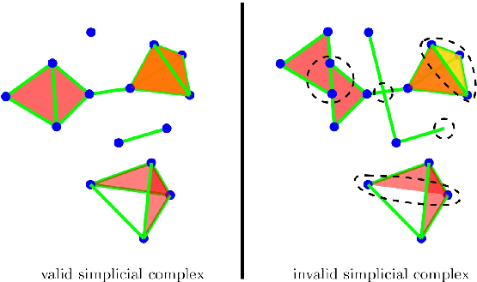
The persistent cosmic web and its filamentary structure I: Theory and implementation - Sousbie, Thierry http://inspirehep.net/record/870503/plots

Slide 35
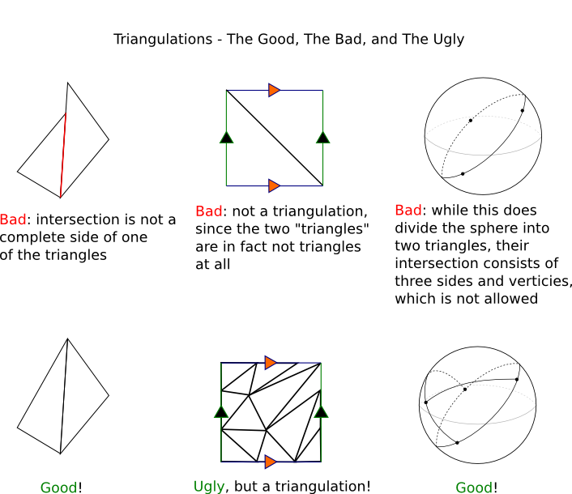
http://www.math.cornell.edu/~mec/Winter2009/Victor/part5.htm

Slide 36
How many vertices?
http://www.math.cornell.edu/~mec/Winter2009/Victor/part5.htm

Slide 37
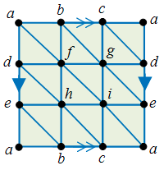
Standard triangulation of the torus:
https://simomaths.wordpress.com/2013/12/05/from-euler-characteristics-to-cohomology-ii/

Slide 38
A simplicial complex K is a set of simplices that satisfies the following conditions:
1. Any face of a simplex from K is also in K.
2. The intersection of any two simplices in K is either empty or a face of both the simplices.

Slide 39
Building blocks for an abstract simplicial complex
0-simplex = vertex = {v}
1-simplex = edge = {v₁, v₂}
n-simplex = {v₀, v₁, …, v_{n}}
Let V be a finite set.
A finite abstract simplicial complex is
a subset A of P(V) such that
1.) v in V implies {v} in A, then
2.) if X is in A and if Y X, then Y is in A
U
Notes:
The building blocks for a simplicial complex consist of zero simplices which are zero dimensional vertices, one simplices which are one-dimensional edges, and 2-simplices which are two dimensional triangles,

Slide 40
Building blocks for oriented simplicial complex
3-simplex =
σ = (v₁, v₂, v₃, v₄) = (v₂, v₃, v₁, v₄) = (v₃, v₁, v_{2,} v₄)
= (v₂, v₁, v₄, v₃) = (v₃, v₂, v₄, v₁) = (v₁, v₃, v₄, v₂)
= (v₄, v₂, v₁, v₃) = (v₄, v₃, v₂, v₁) = (v₄, v₁, v₃, v₂)
= (v₁, v₄, v₂, v₃) = (v₂, v₄, v₃, v₁) = (v₃, v₄, v₁, v₂)
– σ = (v₂, v₁, v₃, v₄) = (v₃, v₂, v₁, v₄) = (v₁, v₃, v₂, v₄)
= (v₂, v₄, v₁, v₃) = (v₃, v₄, v₂, v₁) = (v₁, v₄,v₃, v₂)
= (v₁, v₂, v₄, v₃) = (v₂, v₃, v₄, v₁) = (v₃, v₁, v₄, v₂)
= (v₄, v₁, v₂, v₃) = (v₄, v₂, v₃, v₁) = (v₄, v₃, v₁, v₂)
v₂
v₄
v₁
v₃
Notes:
While 12 different ordered quadruples represent a three simplex

Slide 41
Building blocks for a Δ-complex
3-simplex =
σ = [v₁, v₂, v₃, v₄]
v₂
v₄
v₁
v₃
Notes:
While 12 different ordered quadruples represent a three simplex

Slide 42
Building blocks for a simplicial complex
0-simplex = vertex = v
Grading = dimension
1-simplex = oriented edge = (v₀, v₁)
Note that the boundary of this edge is v₁ – v₀
v₀
v₁
e
2-simplex = oriented face = (v₀, v₁, v₂)
v₁
Note that the boundary
of this face is the cycle
e₁ + e₂ + e₃
= (v₀, v₁) + (v₁, v₂) – (v₀, v₂)
= (v₁, v₂) – (v₀, v₂) + (v₀, v₁)
e₁
e₂
v₀
v₂
e₃
Notes:
Note that the boundary of the 2-dimensional face is the 1-dimensional cycle e₁ + e₂ + e₃. While the boundary of the 1-dimensional edge is the difference between it 0-dimensional boundary vertices v₂ – v₁ . A zero dimensional vertex does not have boundary. Boundary v = 0.
Note that when we use an ordered triple to represent a face, we can calculate its boundary via an alternating sum of its two dimensional boundary edges.
If I remove vertex v3, I get the edge v1v2. If I remove the edge v2, I get the edge minus v1 v3. removing the vertex v1, I get the edge V2 V3
Note that when I remove a vertex with an odd subscript, the resulting edge is added, while if I remove a vertex with an even subscript we subtract the resulting edge.
1 and 3 are both odd, so Removing v3 results in plus v1 v2, and removing v1 results in plus v2 v3
while removing v2 results in minus v1 v3 since 2 is even
Similarly when calculating the boundary of the edge v1v2, removing v1 results in plus v2 since 1 is odd while removing v2 results in minus v1 since 2 is even.
The boundary of a vertex is zero since if we remove the vertex we have nothing, zero
Note this also means that the dimension of the boundary of an object is 1 less than that of the original object.
The boundary of the 2dim face is a 1 dimensional cycle, while the boundary of 1 dimensional edge is 0-dimensional. The boundary of a 0 dimensional vertex is empty.

Slide 43
Building blocks for a Δ-complex
0-simplex = vertex = v
Grading = dimension
1-simplex = oriented edge = [v₀, v₁]
Note that the boundary of this edge is v₁ – v₀
v₀
v₁
e
2-simplex = oriented face = [v₀, v₁, v₂]
v₁
Note that the boundary
of this face is the cycle
e₁ + e₂ - e₃
= [v₀, v₁] + [v₁, v₂] – [v₀, v₂]
= [v₁, v₂] – [v₀, v₂] + [v₀, v₁]
e₁
e₂
v₀
v₂
e₃
Notes:
Note that the boundary of the 2-dimensional face is the 1-dimensional cycle e₁ + e₂ + e₃. While the boundary of the 1-dimensional edge is the difference between it 0-dimensional boundary vertices v₂ – v₁ . A zero dimensional vertex does not have boundary. Boundary v = 0.
Note that when we use an ordered triple to represent a face, we can calculate its boundary via an alternating sum of its two dimensional boundary edges.
If I remove vertex v3, I get the edge v1v2. If I remove the edge v2, I get the edge minus v1 v3. removing the vertex v1, I get the edge V2 V3
Note that when I remove a vertex with an odd subscript, the resulting edge is added, while if I remove a vertex with an even subscript we subtract the resulting edge.
1 and 3 are both odd, so Removing v3 results in plus v1 v2, and removing v1 results in plus v2 v3
while removing v2 results in minus v1 v3 since 2 is even
Similarly when calculating the boundary of the edge v1v2, removing v1 results in plus v2 since 1 is odd while removing v2 results in minus v1 since 2 is even.
The boundary of a vertex is zero since if we remove the vertex we have nothing, zero
Note this also means that the dimension of the boundary of an object is 1 less than that of the original object.
The boundary of the 2dim face is a 1 dimensional cycle, while the boundary of 1 dimensional edge is 0-dimensional. The boundary of a 0 dimensional vertex is empty.

Slide 44
o
Δ^{n} = [v₀, v₁, …, v_{n}], Δ^{n} = interior of Δ^{n}
A Δ-complex structure on a space X is a collection of maps
ϕ_{α}: Δ^{n} → X, with n depending on the index α, such that:
(i) The restriction ϕ_{α}|Δ^{n} is injective, and each point of X is in
the image of exactly one such restriction ϕ_{α}|Δ^{n}.
Each restriction of ϕ_{α} to an n-1 face of Δ^{n} is one of the maps
ϕ_{β}: Δ^{n−1} → X.
Here we identify the face of Δ^{n} with Δ^{n−1} by the canonical linear homeomorphism between them that preserves the ordering of the vertices.
(iii) A set A ⊂ X is open iff ϕ_{α}⁻¹(A) is open in Δ^{n} for each ϕ_{α}.
o
o

Slide 45
Let X be a CW complex.
X⁰ = set of points with discrete topology.
Given the (n-1)-skeleton X^{n-1}, form the
n-skeleton, X_{n}, by attaching n-cells via
attaching maps σ_{α}: ∂D^{n} → X^{n-1},
I.e., X^{n} = X^{n-1} D^{n} / ~ where x ~ σ_{α}(x) for all x in ∂D^{n}
The characteristic map Φ_{α}: D^{n} → X is the map that extends the attaching map σ_{α}: ∂D^{n} → X^{n-1}
and Φ_{α}|D^{n} onto its image is a homeomorphism.
Φ_{α} is the composition D^{n} → X^{n-1} D^{n} → X^{n} → X
α
Π
α
α
α
α
α
o
α
α
Π
β
β
Notes:
Thus the building blocks are basically the same for both simplicial and cell complexes. But the rules for building cell complexes are much more lax than those for building simplicial complexes. We will illustrate with a couple of examples

Slide 46
Building blocks for a Δ-complex
X⁰ = set of points with discrete topology.
Given the (n-1)-skeleton X^{n-1}, form the n-skeleton, X_{n}, by attaching n-cells via their (n-1)-faces via
attaching maps σ_{β}: D^{n-1} → X^{n-1} such that
σ_{β}|D^{n-1} is a homeomorphism.
o
Notes:
Thus the building blocks are basically the same for both simplicial and cell complexes. But the rules for building cell complexes are much more lax than those for building simplicial complexes. We will illustrate with a couple of examples

Slide 47
Building blocks for a Δ-complex
X⁰ = set of points with discrete topology.
Given the (n-1)-skeleton X^{n-1}, form the n-skeleton, X_{n}, by attaching n-cells via their (n-1)-faces via
attaching maps σ_{β}: D^{n-1} → X^{n-1} such that
σ_{β}|D^{n-1} is a homeomorphism.
o
Thus a Δ-complex is a special type of CW complex
The simplices are oriented via the increasing ordering of their vertices.
Notes:
Thus the building blocks are basically the same for both simplicial and cell complexes. But the rules for building cell complexes are much more lax than those for building simplicial complexes. We will illustrate with a couple of examples

Slide 48
Example: sphere = { x in R³ : ||x || = 1 }
Δ-complex
=
₃
₂
₁
₀
C₃ → C₂ → C₁ → C₀ → 0
0 → R² → R³ → R³ → 0
Notes:
That is we hit this disk so hard that it forms almost the entire two sphere except for this one vertex. Note that the sphere minus a vertex is topologically equivalent to an open disk. I can topologically deform the sphere minus the vertex by increasing the size of the hole created by removing the vertex.
This cell complex is not a simplicial complex but the simplicial complex above is also a cell complex.
We created it by

Slide 49
Example: sphere = { x in R³ : ||x || = 1 }
Δ-complex
=
₃
₂
₁
₀
C₃ → C₂ → C₁ → C₀ → 0
0 → R² → R³ → R³ → 0
H₀ = Z₀/B₀ = R³/R² = R
Notes:
That is we hit this disk so hard that it forms almost the entire two sphere except for this one vertex. Note that the sphere minus a vertex is topologically equivalent to an open disk. I can topologically deform the sphere minus the vertex by increasing the size of the hole created by removing the vertex.
This cell complex is not a simplicial complex but the simplicial complex above is also a cell complex.
We created it by

Slide 50
Example: sphere = { x in R³ : ||x || = 1 }
Δ-complex
=
₃
₂
₁
₀
C₃ → C₂ → C₁ → C₀ → 0
0 → R² → R³ → R³ → 0
H₁ = Z₁/B₁ = R/R = 0
Notes:
That is we hit this disk so hard that it forms almost the entire two sphere except for this one vertex. Note that the sphere minus a vertex is topologically equivalent to an open disk. I can topologically deform the sphere minus the vertex by increasing the size of the hole created by removing the vertex.
This cell complex is not a simplicial complex but the simplicial complex above is also a cell complex.
We created it by

Slide 51
Example: sphere = { x in R³ : ||x || = 1 }
Δ-complex
=
₃
₂
₁
₀
C₃ → C₂ → C₁ → C₀ → 0
0 → R² → R³ → R³ → 0
H₂ = Z₂/B₂ = R/0 = R
Notes:
That is we hit this disk so hard that it forms almost the entire two sphere except for this one vertex. Note that the sphere minus a vertex is topologically equivalent to an open disk. I can topologically deform the sphere minus the vertex by increasing the size of the hole created by removing the vertex.
This cell complex is not a simplicial complex but the simplicial complex above is also a cell complex.
We created it by

Slide 52
Example: sphere = { x in R³ : ||x || = 1 }
₃
₂
₁
₀
C₃ → C₂ → C₁ → C₀ → 0
Cell
complex
=
U
Fist image from http://openclipart.org/detail/1000/a-raised-fist-by-liftarn
Notes:
That is we hit this disk so hard that it forms almost the entire two sphere except for this one vertex. Note that the sphere minus a vertex is topologically equivalent to an open disk. I can topologically deform the sphere minus the vertex by increasing the size of the hole created by removing the vertex.
This cell complex is not a simplicial complex but the simplicial complex above is also a cell complex.
We created it by

Slide 53
Example: sphere = { x in R³ : ||x || = 1 }
₃
₂
₁
₀
C₃ → C₂ → C₁ → C₀ → 0
0 → R → 0 → R → 0
Cell
complex
=
U
Fist image from http://openclipart.org/detail/1000/a-raised-fist-by-liftarn
Notes:
That is we hit this disk so hard that it forms almost the entire two sphere except for this one vertex. Note that the sphere minus a vertex is topologically equivalent to an open disk. I can topologically deform the sphere minus the vertex by increasing the size of the hole created by removing the vertex.
This cell complex is not a simplicial complex but the simplicial complex above is also a cell complex.
We created it by

Slide 54
Example: sphere = { x in R³ : ||x || = 1 }
₃
₂
₁
₀
C₃ → C₂ → C₁ → C₀ → 0
0 → R → 0 → R → 0
H_{i} = Z_{i}/B_{i} = R/0 = R for i = 0
Cell
complex
=
U
Fist image from http://openclipart.org/detail/1000/a-raised-fist-by-liftarn
Notes:
That is we hit this disk so hard that it forms almost the entire two sphere except for this one vertex. Note that the sphere minus a vertex is topologically equivalent to an open disk. I can topologically deform the sphere minus the vertex by increasing the size of the hole created by removing the vertex.
This cell complex is not a simplicial complex but the simplicial complex above is also a cell complex.
We created it by

Slide 55
Example: sphere = { x in R³ : ||x || = 1 }
₃
₂
₁
₀
C₃ → C₂ → C₁ → C₀ → 0
0 → R → 0 → R → 0
H_{i} = Z_{i}/B_{i} = R/0 = R for i = 0, 2
Cell
complex
=
U
Fist image from http://openclipart.org/detail/1000/a-raised-fist-by-liftarn
Notes:
That is we hit this disk so hard that it forms almost the entire two sphere except for this one vertex. Note that the sphere minus a vertex is topologically equivalent to an open disk. I can topologically deform the sphere minus the vertex by increasing the size of the hole created by removing the vertex.
This cell complex is not a simplicial complex but the simplicial complex above is also a cell complex.
We created it by

Slide 56
Example: sphere = { x in R³ : ||x || = 1 }
₃
₂
₁
₀
C₃ → C₂ → C₁ → C₀ → 0
0 → R → 0 → R → 0
H_{i} = Z_{i}/B_{i} = R/0 = R for i = 0, 2
H_{i} = Z_{i}/B_{i} = 0/0 = R for i = 1, 3, 4, 5, …
Cell
complex
=
U
Fist image from http://openclipart.org/detail/1000/a-raised-fist-by-liftarn
Notes:
That is we hit this disk so hard that it forms almost the entire two sphere except for this one vertex. Note that the sphere minus a vertex is topologically equivalent to an open disk. I can topologically deform the sphere minus the vertex by increasing the size of the hole created by removing the vertex.
This cell complex is not a simplicial complex but the simplicial complex above is also a cell complex.
We created it by

Slide 57
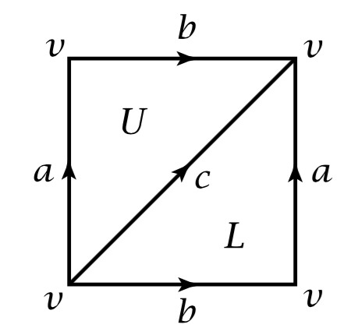
Example: Δ-complex of a Torus
Note the required orientation of edge c for the above complex to be a Δ-complex.
Simplices are oriented via the increasing sequence of their vertices.

Slide 58
Singular homology
A singular n-simplex in a space X is a map
σ: Δ^{n} → X
These n-simplices form a basis for C_{n}(X).
∂_{n}(σ) = Σ(−1)^{i}σ|[v₀, ... , v_{i}, ... ,v_{n}]
Note if X and Y are homeomorphic, then
H_{n}(X) = H_{n}(Y)

