Slide 1
Breadth-First Search (BFS)
http://cs.jhu.edu/~arjuna/files/BFS_n_DFS.pptx

Slide 2
Depth-First Search (DFS)
http://cs.jhu.edu/~arjuna/files/BFS_n_DFS.pptx

Slide 3
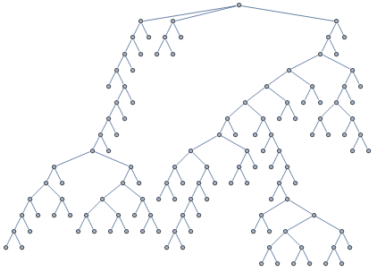
BFS vs. DFS
slazebni.cs.illinois.edu/fall17/lec05_uninformed_search.pptx

Slide 4
BFS vs. DFS
slazebni.cs.illinois.edu/fall17/lec05_uninformed_search.pptx

Slide 5
BFS vs. DFS
slazebni.cs.illinois.edu/fall17/lec05_uninformed_search.pptx

Slide 6
BFS vs. DFS
slazebni.cs.illinois.edu/fall17/lec05_uninformed_search.pptx

Slide 7
BFS vs. DFS
slazebni.cs.illinois.edu/fall17/lec05_uninformed_search.pptx

Slide 8
BFS vs. DFS
slazebni.cs.illinois.edu/fall17/lec05_uninformed_search.pptx

Slide 9
BFS vs. DFS
slazebni.cs.illinois.edu/fall17/lec05_uninformed_search.pptx

Slide 10
BFS vs. DFS
slazebni.cs.illinois.edu/fall17/lec05_uninformed_search.pptx

Slide 11
BFS vs. DFS
slazebni.cs.illinois.edu/fall17/lec05_uninformed_search.pptx

Slide 12
BFS vs. DFS
slazebni.cs.illinois.edu/fall17/lec05_uninformed_search.pptx

Slide 13
BFS vs. DFS
slazebni.cs.illinois.edu/fall17/lec05_uninformed_search.pptx

Slide 14
BFS vs. DFS
slazebni.cs.illinois.edu/fall17/lec05_uninformed_search.pptx

Slide 15
BFS vs. DFS
slazebni.cs.illinois.edu/fall17/lec05_uninformed_search.pptx

Slide 16
BFS vs. DFS
slazebni.cs.illinois.edu/fall17/lec05_uninformed_search.pptx

Slide 17
BFS vs. DFS
slazebni.cs.illinois.edu/fall17/lec05_uninformed_search.pptx

Slide 18
BFS vs. DFS
slazebni.cs.illinois.edu/fall17/lec05_uninformed_search.pptx

Slide 19
BFS vs. DFS
slazebni.cs.illinois.edu/fall17/lec05_uninformed_search.pptx

Slide 20
BFS vs. DFS
slazebni.cs.illinois.edu/fall17/lec05_uninformed_search.pptx

Slide 21
BFS vs. DFS
slazebni.cs.illinois.edu/fall17/lec05_uninformed_search.pptx

Slide 22
BFS vs. DFS
slazebni.cs.illinois.edu/fall17/lec05_uninformed_search.pptx

Slide 23
BFS vs. DFS
slazebni.cs.illinois.edu/fall17/lec05_uninformed_search.pptx

Slide 24
BFS vs. DFS
slazebni.cs.illinois.edu/fall17/lec05_uninformed_search.pptx

Slide 25
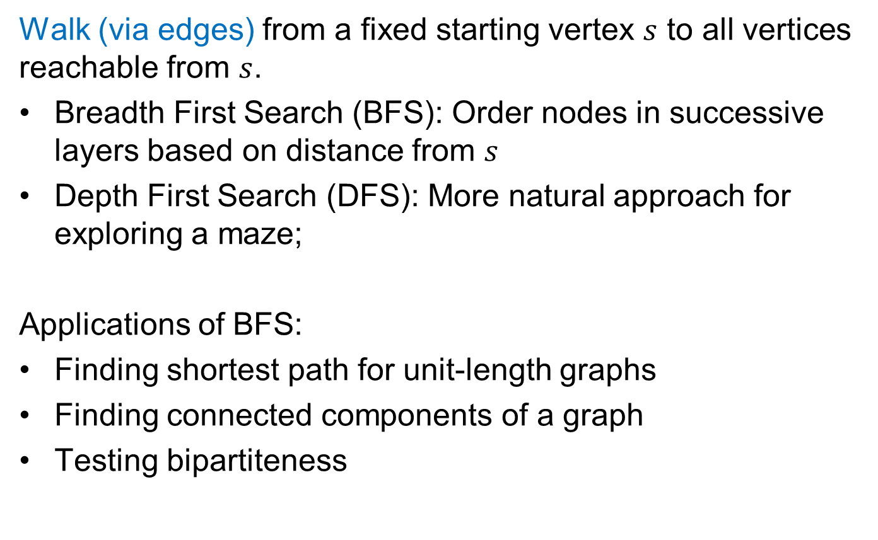
Graph Traversal
Walk (via edges) from a fixed starting vertex $s$ to all vertices reachable from $s$.
Breadth First Search (BFS): Order nodes in successive layers based on distance from $s$
Depth First Search (DFS): More natural approach for exploring a maze;
Applications of BFS:
Finding shortest path for unit-length graphs
Finding connected components of a graph
Testing bipartiteness
https://courses.cs.washington.edu/courses/cse421/18sp/lecture-4.pptx

Slide 26
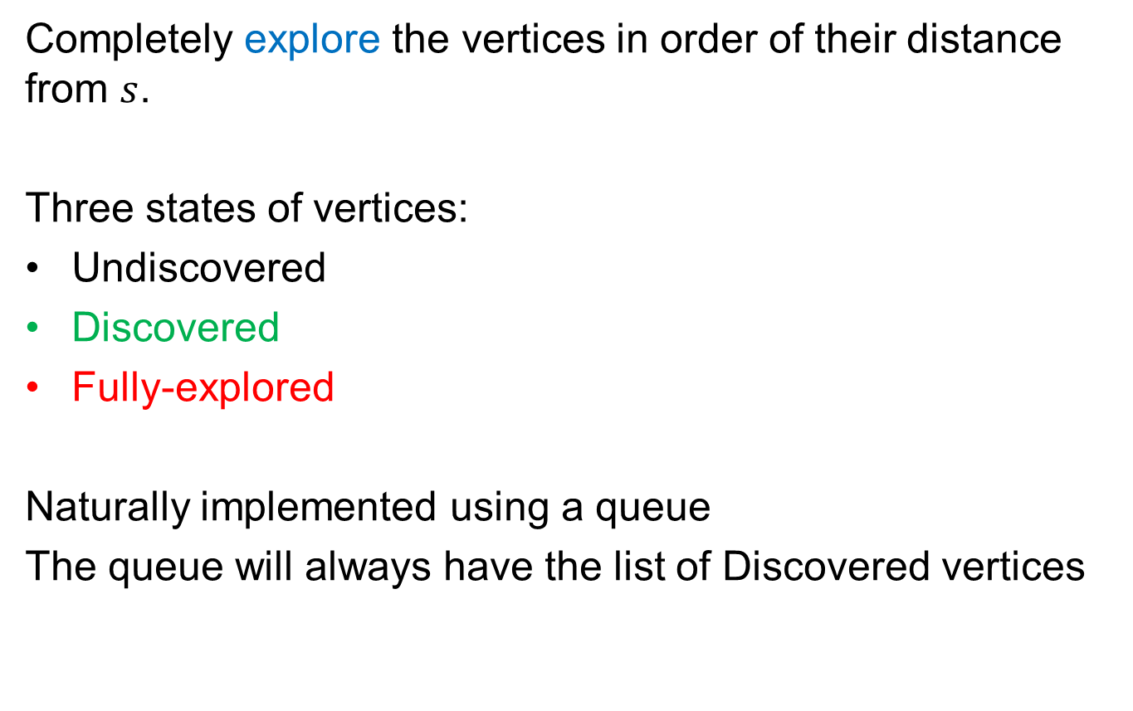
Breadth First Search (BFS)
Completely explore the vertices in order of their distance from $s$.
Three states of vertices:
Undiscovered
Discovered
Fully-explored
Naturally implemented using a queue
The queue will always have the list of Discovered vertices
https://courses.cs.washington.edu/courses/cse421/18sp/lecture-4.pptx

Slide 27
BFS(1)
1
Queue:
1
2
3
4
6
7
9
5
11
12
10
8
13
https://courses.cs.washington.edu/courses/cse421/18sp/lecture-4.pptx
Notes:
mark s "discovered"
queue = { s }
while queue not empty
u = remove_first(queue)
for each edge {u,x}
if (x is undiscovered)
mark x discovered
append x on queue
mark u fully explore

Slide 28
BFS(1)
1
Queue:
2 3
2
3
4
6
7
9
5
11
12
10
8
13
https://courses.cs.washington.edu/courses/cse421/18sp/lecture-4.pptx
Notes:
mark s "discovered"
queue = { s }
while queue not empty
u = remove_first(queue)
for each edge {u,x}
if (x is undiscovered)
mark x discovered
append x on queue
mark u fully explore

Slide 29
BFS(1)
1
Queue:
3 4
2
3
4
6
7
9
5
11
12
10
8
13
https://courses.cs.washington.edu/courses/cse421/18sp/lecture-4.pptx
Notes:
mark s "discovered"
queue = { s }
while queue not empty
u = remove_first(queue)
for each edge {u,x}
if (x is undiscovered)
mark x discovered
append x on queue
mark u fully explore

Slide 30
BFS(1)
1
Queue:
4 5 6 7
2
3
4
6
7
9
5
11
12
10
8
13
https://courses.cs.washington.edu/courses/cse421/18sp/lecture-4.pptx
Notes:
mark s "discovered"
queue = { s }
while queue not empty
u = remove_first(queue)
for each edge {u,x}
if (x is undiscovered)
mark x discovered
append x on queue
mark u fully explore

Slide 31
BFS(1)
1
Queue:
5 6 7 8 9
2
3
4
6
7
9
5
11
12
10
8
13
https://courses.cs.washington.edu/courses/cse421/18sp/lecture-4.pptx
Notes:
mark s "discovered"
queue = { s }
while queue not empty
u = remove_first(queue)
for each edge {u,x}
if (x is undiscovered)
mark x discovered
append x on queue
mark u fully explore

Slide 32
BFS(1)
1
Queue:
7 8 9 10
2
3
4
6
7
9
5
11
12
10
8
13
https://courses.cs.washington.edu/courses/cse421/18sp/lecture-4.pptx
Notes:
mark s "discovered"
queue = { s }
while queue not empty
u = remove_first(queue)
for each edge {u,x}
if (x is undiscovered)
mark x discovered
append x on queue
mark u fully explore

Slide 33
BFS(1)
1
Queue:
8 9 10 11
2
3
4
6
7
9
5
11
12
10
8
13
https://courses.cs.washington.edu/courses/cse421/18sp/lecture-4.pptx
Notes:
mark s "discovered"
queue = { s }
while queue not empty
u = remove_first(queue)
for each edge {u,x}
if (x is undiscovered)
mark x discovered
append x on queue
mark u fully explore

Slide 34
BFS(1)
1
Queue:
9 10 11 12 13
2
3
4
6
7
9
5
11
12
10
8
13
https://courses.cs.washington.edu/courses/cse421/18sp/lecture-4.pptx
Notes:
mark s "discovered"
queue = { s }
while queue not empty
u = remove_first(queue)
for each edge {u,x}
if (x is undiscovered)
mark x discovered
append x on queue
mark u fully explore

Slide 35
BFS(1)
1
Queue:
2
3
4
6
7
9
5
11
12
10
8
13
https://courses.cs.washington.edu/courses/cse421/18sp/lecture-4.pptx
Notes:
mark s "discovered"
queue = { s }
while queue not empty
u = remove_first(queue)
for each edge {u,x}
if (x is undiscovered)
mark x discovered
append x on queue
mark u fully explore

Slide 36
BFS Application: Shortest Paths
BFS Tree gives shortest
paths from 1 to all vertices
1
0
2
1
3
4
6
2
7
9
5
3
11
12
10
8
4
13
https://courses.cs.washington.edu/courses/cse421/18sp/lecture-4.pptx
Notes:
mark s "discovered"
queue = { s }
while queue not empty
u = remove_first(queue)
for each edge {u,x}
if (x is undiscovered)
mark x discovered
append x on queue
mark u fully explore

Slide 37
BFS Application: Shortest Paths
BFS Tree gives shortest
paths from 1 to all vertices
1
0
2
3
1
4
5
6
7
2
8
9
10
11
3
4
12
13
https://courses.cs.washington.edu/courses/cse421/18sp/lecture-4.pptx
Notes:
mark s "discovered"
queue = { s }
while queue not empty
u = remove_first(queue)
for each edge {u,x}
if (x is undiscovered)
mark x discovered
append x on queue
mark u fully explore

Slide 38
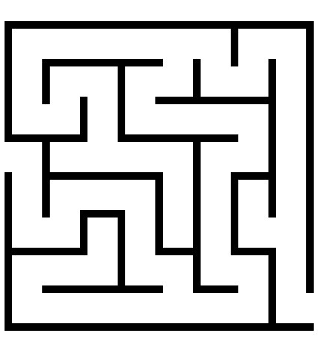
Depth First Search
Follow the first path you find
as far as you can go; back up
to last unexplored edge when
you reach a dead end,
then go as far you can
Naturally implemented using recursive calls or a stack
https://courses.cs.washington.edu/courses/cse421/18sp/lecture-5.pptx

Slide 39
DFS(A)
Color code:
undiscovered
discovered
fully-explored
A,1
Suppose edge lists
at each vertex are sorted alphabetically
Call Stack
(Edge list):
A (B,J)
B
J
C
G
H
K
L
D
F
I
M
st[] = {1}
E
https://courses.cs.washington.edu/courses/cse421/18sp/lecture-5.pptx

Slide 40
DFS(A)
Color code:
undiscovered
discovered
fully-explored
A,1
Call Stack:
(Edge list)
A (B,J)
B (A,C,J)
B,2
J
C
G
H
K
L
D
F
I
M
st[] = {1,2}
E
https://courses.cs.washington.edu/courses/cse421/18sp/lecture-5.pptx

Slide 41
DFS(A)
Color code:
undiscovered
discovered
fully-explored
A,1
Call Stack:
(Edge list)
A (B,J)
B (A,C,J)
C (B,D,G,H)
B,2
J
C,3
G
H
K
L
D
F
I
M
st[] = {1,2,3}
E
https://courses.cs.washington.edu/courses/cse421/18sp/lecture-5.pptx

Slide 42
DFS(A)
Color code:
undiscovered
discovered
fully-explored
A,1
Call Stack:
(Edge list)
A (B,J)
B (A,C,J)
C (B,D,G,H)
D (C,E,F)
B,2
J
C,3
G
H
K
L
D,4
F
I
M
st[] = {1,2,3,4}
E
https://courses.cs.washington.edu/courses/cse421/18sp/lecture-5.pptx

Slide 43
DFS(A)
Color code:
undiscovered
discovered
fully-explored
A,1
Call Stack:
(Edge list)
A (B,J)
B (A,C,J)
C (B,D,G,H)
D (C,E,F)
E (D,F)
B,2
J
C,3
G
H
K
L
D,4
F
I
M
st[] = {1,2,3,4,5}
E,5
https://courses.cs.washington.edu/courses/cse421/18sp/lecture-5.pptx

Slide 44
DFS(A)
Color code:
undiscovered
discovered
fully-explored
A,1
Call Stack:
(Edge list)
A (B,J)
B (A,C,J)
C (B,D,G,H)
D (C,E,F)
E (D,F)
F (D,E,G)
B,2
J
C,3
G
H
K
L
D,4
F,6
I
M
st[] = {1,2,3,4,5,6}
E,5
https://courses.cs.washington.edu/courses/cse421/18sp/lecture-5.pptx

Slide 45
DFS(A)
Color code:
undiscovered
discovered
fully-explored
A,1
Call Stack:
(Edge list)
A (B,J)
B (A,C,J)
C (B,D,G,H)
D (C,E,F)
E (D,F)
F (D,E,G)
G (C,F)
B,2
J
C,3
G,7
H
K
L
D,4
F,6
I
M
st[] = {1,2,3,4,5,6,7}
E,5
https://courses.cs.washington.edu/courses/cse421/18sp/lecture-5.pptx

Slide 46
DFS(A)
Color code:
undiscovered
discovered
fully-explored
A,1
Call Stack:
(Edge list)
A (B,J)
B (A,C,J)
C (B,D,G,H)
D (C,E,F)
E (D,F)
F (D,E,G)
G (C,F)
B,2
J
C,3
G,7
H
K
L
D,4
F,6
I
M
st[] = {1,2,3,4,5,6,7}
E,5
https://courses.cs.washington.edu/courses/cse421/18sp/lecture-5.pptx

Slide 47
DFS(A)
Color code:
undiscovered
discovered
fully-explored
A,1
Call Stack:
(Edge list)
A (B,J)
B (A,C,J)
C (B,D,G,H)
D (C,E,F)
E (D,F)
F (D,E,G)
B,2
J
C,3
G,7
H
K
L
D,4
F,6
I
M
st[] = {1,2,3,4,5,6}
E,5
https://courses.cs.washington.edu/courses/cse421/18sp/lecture-5.pptx

Slide 48
DFS(A)
Color code:
undiscovered
discovered
fully-explored
A,1
Call Stack:
(Edge list)
A (B,J)
B (A,C,J)
C (B,D,G,H)
D (C,E,F)
E (D,F)
B,2
J
C,3
G,7
H
K
L
D,4
F,6
I
M
st[] = {1,2,3,4,5}
E,5
https://courses.cs.washington.edu/courses/cse421/18sp/lecture-5.pptx

Slide 49
DFS(A)
Color code:
undiscovered
discovered
fully-explored
A,1
Call Stack:
(Edge list)
A (B,J)
B (A,C,J)
C (B,D,G,H)
D (C,E,F)
B,2
J
C,3
G,7
H
K
L
D,4
F,6
I
M
st[] = {1,2,3,4}
E,5
https://courses.cs.washington.edu/courses/cse421/18sp/lecture-5.pptx

Slide 50
DFS(A)
Color code:
undiscovered
discovered
fully-explored
A,1
Call Stack:
(Edge list)
A (B,J)
B (A,C,J)
C (B,D,G,H)
B,2
J
C,3
G,7
H
K
L
D,4
F,6
I
M
st[] = {1,2,3}
E,5
https://courses.cs.washington.edu/courses/cse421/18sp/lecture-5.pptx

Slide 51
DFS(A)
Color code:
undiscovered
discovered
fully-explored
A,1
Call Stack:
(Edge list)
A (B,J)
B (A,C,J)
C (B,D,G,H)
H (C,I,J)
B,2
J
C,3
G,7
H,8
K
L
D,4
F,6
I
M
st[] = {1,2,3,8}
E,5
https://courses.cs.washington.edu/courses/cse421/18sp/lecture-5.pptx

Slide 52
DFS(A)
Color code:
undiscovered
discovered
fully-explored
A,1
Call Stack:
(Edge list)
A (B,J)
B (A,C,J)
C (B,D,G,H)
H (C,I,J)
I (H)
B,2
J
C,3
G,7
H,8
K
L
D,4
F,6
I,9
M
st[] = {1,2,3,8,9}
E,5
https://courses.cs.washington.edu/courses/cse421/18sp/lecture-5.pptx

Slide 53
DFS(A)
Color code:
undiscovered
discovered
fully-explored
A,1
Call Stack:
(Edge list)
A (B,J)
B (A,C,J)
C (B,D,G,H)
H (C,I,J)
B,2
J
C,3
G,7
H,8
K
L
D,4
F,6
I,9
M
st[] = {1,2,3,8}
E,5
https://courses.cs.washington.edu/courses/cse421/18sp/lecture-5.pptx

Slide 54
DFS(A)
Color code:
undiscovered
discovered
fully-explored
A,1
Call Stack:
(Edge list)
A (B,J)
B (A,C,J)
C (B,D,G,H)
H (C,I,J)
J (A,B,H,K,L)
B,2
J,10
C,3
G,7
H,8
K
L
D,4
F,6
I,9
M
st[] = {1,2,3,8, 10}
E,5
https://courses.cs.washington.edu/courses/cse421/18sp/lecture-5.pptx

Slide 55
DFS(A)
Color code:
undiscovered
discovered
fully-explored
A,1
Call Stack:
(Edge list)
A (B,J)
B (A,C,J)
C (B,D,G,H)
H (C,I,J)
J (A,B,H,K,L)
K (J,L)
B,2
J,10
C,3
G,7
H,8
K,11
L
D,4
F,6
I,9
M
st[] = {1,2,3,8,10,11}
E,5
https://courses.cs.washington.edu/courses/cse421/18sp/lecture-5.pptx

Slide 56
DFS(A)
Color code:
undiscovered
discovered
fully-explored
A,1
Call Stack:
(Edge list)
A (B,J)
B (A,C,J)
C (B,D,G,H)
H (C,I,J)
J (A,B,H,K,L)
K (J,L)
L (J,K,M)
B,2
J,10
C,3
G,7
H,8
K,11
L,12
D,4
F,6
I,9
M
st[] = {1,2,3,8,10,11,12}
E,5
https://courses.cs.washington.edu/courses/cse421/18sp/lecture-5.pptx

Slide 57
DFS(A)
Color code:
undiscovered
discovered
fully-explored
A,1
Call Stack:
(Edge list)
A (B,J)
B (A,C,J)
C (B,D,G,H)
H (C,I,J)
J (A,B,H,K,L)
K (J,L)
L (J,K,M)
M (L)
B,2
J,10
C,3
G,7
H,8
K,11
L,12
D,4
F,6
I,9
M,13
st[] = {1,2,3,8,10,11,12,13}
E,5
https://courses.cs.washington.edu/courses/cse421/18sp/lecture-5.pptx

Slide 58
DFS(A)
Color code:
undiscovered
discovered
fully-explored
A,1
Call Stack:
(Edge list)
A (B,J)
B (A,C,J)
C (B,D,G,H)
H (C,I,J)
J (A,B,H,K,L)
K (J,L)
L (J,K,M)
B,2
J,10
C,3
G,7
H,8
K,11
L,12
D,4
F,6
I,9
M,13
st[] = {1,2,3,8,10,11,12}
E,5
https://courses.cs.washington.edu/courses/cse421/18sp/lecture-5.pptx

Slide 59
DFS(A)
Color code:
undiscovered
discovered
fully-explored
A,1
Call Stack:
(Edge list)
A (B,J)
B (A,C,J)
C (B,D,G,H)
H (C,I,J)
J (A,B,H,K,L)
K (J,L)
B,2
J,10
C,3
G,7
H,8
K,11
L,12
D,4
F,6
I,9
M,13
st[] = {1,2,3,8,10,11}
E,5
https://courses.cs.washington.edu/courses/cse421/18sp/lecture-5.pptx

Slide 60
DFS(A)
Color code:
undiscovered
discovered
fully-explored
A,1
Call Stack:
(Edge list)
A (B,J)
B (A,C,J)
C (B,D,G,H)
H (C,I,J)
J (A,B,H,K,L)
B,2
J,10
C,3
G,7
H,8
K,11
L,12
D,4
F,6
I,9
M,13
st[] = {1,2,3,8, 10}
E,5
https://courses.cs.washington.edu/courses/cse421/18sp/lecture-5.pptx

Slide 61
DFS(A)
Color code:
undiscovered
discovered
fully-explored
A,1
Call Stack:
(Edge list)
A (B,J)
B (A,C,J)
C (B,D,G,H)
H (C,I,J)
J (A,B,H,K,L)
B,2
J,10
C,3
G,7
H,8
K,11
L,12
D,4
F,6
I,9
M,13
st[] = {1,2,3,8, 10}
E,5
https://courses.cs.washington.edu/courses/cse421/18sp/lecture-5.pptx

Slide 62
DFS(A)
Color code:
undiscovered
discovered
fully-explored
A,1
Call Stack:
(Edge list)
A (B,J)
B (A,C,J)
C (B,D,G,H)
H (C,I,J)
B,2
J,10
C,3
G,7
H,8
K,11
L,12
D,4
F,6
I,9
M,13
st[] = {1,2,3,8}
E,5
https://courses.cs.washington.edu/courses/cse421/18sp/lecture-5.pptx

Slide 63
DFS(A)
Color code:
undiscovered
discovered
fully-explored
A,1
Call Stack:
(Edge list)
A (B,J)
B (A,C,J)
C (B,D,G,H)
B,2
J,10
C,3
G,7
H,8
K,11
L,12
D,4
F,6
I,9
M,13
st[] = {1,2,3}
E,5
https://courses.cs.washington.edu/courses/cse421/18sp/lecture-5.pptx

Slide 64
DFS(A)
Color code:
undiscovered
discovered
fully-explored
A,1
Call Stack:
(Edge list)
A (B,J)
B (A,C,J)
B,2
J,10
C,3
G,7
H,8
K,11
L,12
D,4
F,6
I,9
M,13
st[] = {1,2}
E,5
https://courses.cs.washington.edu/courses/cse421/18sp/lecture-5.pptx

Slide 65
DFS(A)
Color code:
undiscovered
discovered
fully-explored
A,1
Call Stack:
(Edge list)
A (B,J)
B (A,C,J)
B,2
J,10
C,3
G,7
H,8
K,11
L,12
D,4
F,6
I,9
M,13
st[] = {1,2}
E,5
https://courses.cs.washington.edu/courses/cse421/18sp/lecture-5.pptx

Slide 66
DFS(A)
Color code:
undiscovered
discovered
fully-explored
A,1
Call Stack:
(Edge list)
A (B,J)
B,2
J,10
C,3
G,7
H,8
K,11
L,12
D,4
F,6
I,9
M,13
st[] = {1}
E,5
https://courses.cs.washington.edu/courses/cse421/18sp/lecture-5.pptx

Slide 67
DFS(A)
Color code:
undiscovered
discovered
fully-explored
A,1
Call Stack:
(Edge list)
A (B,J)
B,2
J,10
C,3
G,7
H,8
K,11
L,12
D,4
F,6
I,9
M,13
st[] = {1}
E,5
https://courses.cs.washington.edu/courses/cse421/18sp/lecture-5.pptx

Slide 68
DFS(A)
Color code:
undiscovered
discovered
fully-explored
A,1
Call Stack:
(Edge list)
TA-DA!!
B,2
J,10
C,3
G,7
H,8
K,11
L,12
D,4
F,6
I,9
M,13
st[] = {}
E,5
https://courses.cs.washington.edu/courses/cse421/18sp/lecture-5.pptx

Slide 69
DFS(A)
Edge code:
Tree edge
Back edge
A,1
B,2
J,10
C,3
G,7
H,8
K,11
L,12
D,4
F,6
I,9
M,13
E,5
https://courses.cs.washington.edu/courses/cse421/18sp/lecture-5.pptx

Slide 70
DFS(A)
A,1
Edge code:
Tree edge
Back edge
B,2
C,3
H,8
D,4
J,10
E,5
I,9
K,11
F,6
L,12
G,7
M,13
https://courses.cs.washington.edu/courses/cse421/18sp/lecture-5.pptx
Notes:
By the way, suppose I’ve run dfs and each node has a dfs#
Suppose I then hand you an edge and tell you the dfs#’s of the two endpoints, how do you know which of the endpoints is the ancestor?

Slide 71
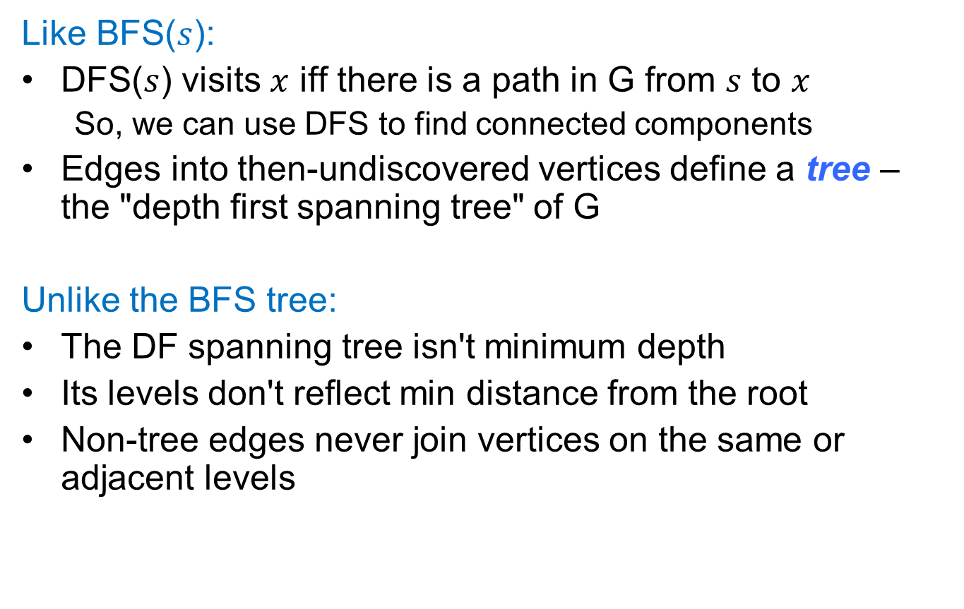
Properties of (undirected) DFS
Like BFS($s$):
DFS($s$) visits $x$ iff there is a path in G from $s$ to $x$
So, we can use DFS to find connected components
Edges into then-undiscovered vertices define a tree – the "depth first spanning tree" of G
Unlike the BFS tree:
The DF spanning tree isn't minimum depth
Its levels don't reflect min distance from the root
Non-tree edges never join vertices on the same or adjacent levels
https://courses.cs.washington.edu/courses/cse421/18sp/lecture-5.pptx

