Slide 1
Round-Robin Tournaments
A tournament where each team plays each other team exactly once is called a round-robin tournament.
In this case a directed graph is used.
Each team is represented by a vertex.
fd.valenciacollege.edu/file/dgil2/COT2104Class_Notes_Chapter_9_10.ppt

Slide 2
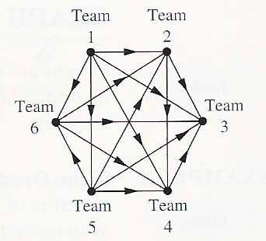
Round-Robin Tournaments
fd.valenciacollege.edu/file/dgil2/COT2104Class_Notes_Chapter_9_10.ppt
(a, b) is an edge if team a beats team b.
Team 1 is undefeated in this tournament
Team 3 is winless.
“Discrete Mathematics and its Applications.” Fifth Edition, by Kenneth H. Rosen. Mc Graw Hill, 2003. pag 542

Slide 3
Existence of a Hamilton path in K_{n}*
  Let K_{n}* be a complete directed graph. That is, K_{n}* has n vertices and for each distinct pair x,y of vertices, exactly one of the edges (x,y) or (y,x) is in K_{n}*.
  Such a graph (called a tournament ) always contains a (directed) Hamilton path.
K4*
K5*
Tournament is a directed graph obtained by choosing a direction for each edge in an undirected complete graph. The name tournament originates from such a graph's interpretation as the outcome of a round-robin tournament in which every player encounters every other player exactly once. [Wikipedia]
infosec.pusan.ac.kr/wp-content/uploads/2017/12/Graph-Theory4_last.ppt
Notes:
리그전(league 戰, 문화어: 련맹전)은 스포츠 경기에서 각 팀이 다른 팀과 모두 최소 한 번씩 경기를 치르는 경기 방식이다. 영어권에서 리그라는 표현은 일반적으로 대회라는 뜻으로 사용되므로 이 방식을 지칭할 경우 라운드 로빈 토너먼트(round-robin tournament) 또는 올 플레이 올 토너먼트(all-play-all tournament)라는 표현을 사용한다. 한국어에서 일반적으로 토너먼트가 싱글 엘리미네이션 토너먼트를 가리키는 것과는 상반된다.

Slide 4
Proof of Theorem 11.7
Complete directed graph에서의 vertex 수: n
Let P_{m} (m ≥ 2) a path containing the m-1 edges (v₁,v₂), (v₂,v₃),…,(v_{m-1}, v_{m}). If m=n, we are finished.
…
…
If not, let v be a vertex that doesn’t appear in P_{m}. If (v,v₁) is an edge in K_{n}*, we can extend P_{m} by adjoining this edge.
…
…
Exist
infosec.pusan.ac.kr/wp-content/uploads/2017/12/Graph-Theory4_last.ppt

Slide 5
Proof
(v,v1)아니면 (v1,v).둘중 하나. Complete graph 이므로.
If not, then (v₁,v) must be an edge. Now suppose that (v,v₂) is in the graph. Then we have the larger path: (v₁,v),(v,v₂),(v₂,v₃),…,(v_{m-1},v_{m}).
…
…
Ex)
infosec.pusan.ac.kr/wp-content/uploads/2017/12/Graph-Theory4_last.ppt

Slide 6
Proof of Theorem 11.7
If (v,v₂) is not an edge in K_{n}*, then (v₂,v) must be.
So, we can construct the path the way that we have described just before.
6
infosec.pusan.ac.kr/wp-content/uploads/2017/12/Graph-Theory4_last.ppt
Notes:
6

Slide 7
Proof of Theorem 11.7
As we continue this process there are only two possibilities:
(a) For some the edges (v_{k},v),(v,v_{k+1}) are in K_{n}* and we replace (v_{k},v_{k+1}) with this pair of edges:
or
(b) (v_{m},v) is in K_{n}* and we add this edge to p_{m}. Either case results in a path p_{m+1} that includes m+1 vertices and has m edges.
…
…
(a)
(b)
infosec.pusan.ac.kr/wp-content/uploads/2017/12/Graph-Theory4_last.ppt

Slide 8
Proof of Theorem 11.7
This process can be repeated until a Hamilton path is found.
infosec.pusan.ac.kr/wp-content/uploads/2017/12/Graph-Theory4_last.ppt

Slide 9
The Hamiltonian path can be used to determine who gets 1st prize, 2nd prize, 3rd prize, etc
EXCEPT
There can be multiple Hamiltonian paths.
How many Hamiltonian paths are in the digraph below?
a b
a b
c d
c d

Slide 10
Traveling Salesman Problem
The problem is: given a number of cities and the costs of travelling from any city to any other city, what is the least-cost round-trip route that visits each city exactly once and then returns to the starting city?
It is related to the search for Hamilton cycles in a graph. It is to find a minimum-cost Hamilton cycle in a complete graph whose edges are labeled with costs
infosec.pusan.ac.kr/wp-content/uploads/2017/12/Graph-Theory4_last.ppt

Slide 11
Traveling Salesman Problem
Greedy Algorithm (Nearest-Neighbor Algorithm)
  Starting at a given vertex, chooses the edge with the least weight to the next possible vertex, that is, to the “closest” vertex.
  This strategy is continued at each successive vertex until a Hamiltonian cycle is completed.
  It may not provide us the optimal solution.
K5
a
Greedy solution (40)
; a → d → b → c → e → a
7 6 8 5 14
7
14
12
10
e
b
9
5
6
Another solution (37)
; a → d → b → e → c → a
7 6 9 5 10
13
8
d
c
11
infosec.pusan.ac.kr/wp-content/uploads/2017/12/Graph-Theory4_last.ppt

Slide 12
Travelling salesman problem (TSP)
  Task: find the shortest path to visit all cities exactly once
  Hamiltonian cycle in a graph
  simplification: cities are points in 2D
https://project.inria.fr/2015ma2827/files/2016/05/Lecture05.pptx

Slide 13
Travelling salesman problem (TSP)
  Task: find the shortest path to visit all cities exactly once
  Hamiltonian cycle in a graph
  simplification: cities are points in 2D
https://project.inria.fr/2015ma2827/files/2016/05/Lecture05.pptx

Slide 14
Travelling salesman problem (TSP)
  Task: find the shortest path to visit all cities exactly once
  Hamiltonian cycle in a graph
  simplification: cities are points in 2D
https://project.inria.fr/2015ma2827/files/2016/05/Lecture05.pptx

Slide 15
Travelling salesman problem (TSP)
  Task: find the shortest path to visit all cities exactly once
  Hamiltonian cycle in a graph
  simplification: cities are points in 2D
  Decision variables:
  where to go next after every city
  TSP is probably the most well-studied combinatorial problem!
https://project.inria.fr/2015ma2827/files/2016/05/Lecture05.pptx

Slide 16
Local search for TSP: 2-OPT
  Task: find the shortest path to visit all cities exactly once
  Local move:
  select two edges and replace them by two other edges
https://project.inria.fr/2015ma2827/files/2016/05/Lecture05.pptx

Slide 17
Local search for TSP: 2-OPT
  Task: find the shortest path to visit all cities exactly once
  Local move:
  select two edges and replace them by two other edges
https://project.inria.fr/2015ma2827/files/2016/05/Lecture05.pptx

Slide 18
Local search for TSP: 2-OPT
  Task: find the shortest path to visit all cities exactly once
  Local move:
  select two edges and replace them by two other edges

Slide 19
Local search for TSP: 2-OPT
  Task: find the shortest path to visit all cities exactly once
  Local move:
  select two edges and replace them by two other edges

Slide 20
Local search for TSP: 3-OPT
  Task: find the shortest path to visit all cities exactly once
  Local move:
  select three edges and replace them by three other edges
https://project.inria.fr/2015ma2827/files/2016/05/Lecture05.pptx

Slide 21
Local search for TSP: 3-OPT
  Task: find the shortest path to visit all cities exactly once
  Local move:
  select three edges and replace them by three other edges
https://project.inria.fr/2015ma2827/files/2016/05/Lecture05.pptx

Slide 22
Local search for TSP: 3-OPT
  Task: find the shortest path to visit all cities exactly once
  Local move:
  select three edges and replace them by three other edges
https://project.inria.fr/2015ma2827/files/2016/05/Lecture05.pptx

Slide 23
Local search for TSP
  Task: find the shortest path to visit all cities exactly once
  2-OPT:
  the neighborhood is a set of all tours that can be reached by swapping two edges
  3-OPT:
  the neighborhood is a set of all tours that can be reached by swapping three edges
  much better than 2-OPT in quality but more expensive
  4-OPT?
  marginally better but even more expensive
https://project.inria.fr/2015ma2827/files/2016/05/Lecture05.pptx

Slide 24
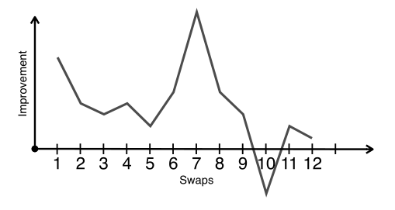
Local search for TSP: K-OPT
  Task: find the shortest path to visit all cities exactly once
  K-OPT:
  replace the notion of one favorable swap by a sequence of favorable swaps
  do not search for the entire set of sequences but build them incrementally
https://project.inria.fr/2015ma2827/files/2016/05/Lecture05.pptx

Slide 25
Local search for TSP: K-OPT
  Task: find the shortest path to visit all cities exactly once
  K-OPT:
  Choose a vertex t₁ and an edge (t₁, t₂)
  Choose a vertex t₃ with d(t₂, t₃) < d(t₁, t₂)
  If non exist, restart
  Consider solution by removing (t₃, t₄) and adding (t₁, t₄)
  Compute the cost but do not connect
https://project.inria.fr/2015ma2827/files/2016/05/Lecture05.pptx

Slide 26
Local search for TSP: K-OPT
  Task: find the shortest path to visit all cities exactly once
  K-OPT:
t₂
t₁
https://project.inria.fr/2015ma2827/files/2016/05/Lecture05.pptx

Slide 27
Local search for TSP: K-OPT
  Task: find the shortest path to visit all cities exactly once
  K-OPT:
t₂
t₁
t₃
t₄
https://project.inria.fr/2015ma2827/files/2016/05/Lecture05.pptx

Slide 28
Local search for TSP: K-OPT
  Task: find the shortest path to visit all cities exactly once
  K-OPT:
t₂
t₁
t₃
t₄
https://project.inria.fr/2015ma2827/files/2016/05/Lecture05.pptx

Slide 29
Local search for TSP: K-OPT
  Task: find the shortest path to visit all cities exactly once
  K-OPT:
t₂
t₁
t₃
t₄
https://project.inria.fr/2015ma2827/files/2016/05/Lecture05.pptx

Slide 30
Local search for TSP: K-OPT
  Task: find the shortest path to visit all cities exactly once
  K-OPT:
t₂
t₁
t₃
t₄
https://project.inria.fr/2015ma2827/files/2016/05/Lecture05.pptx

Slide 31
Local search for TSP: K-OPT
  Task: find the shortest path to visit all cities exactly once
  K-OPT:
  Choose a vertex t₁ and an edge (t₁, t₂)
  Choose a vertex t₃ with d(t₂, t₃) < d(t₁, t₂)
  If non exist, restart
  Consider solution by removing (t₃, t₄) and adding (t₁, t₄)
  Compute the cost but do not connect
  Restart with t₁ and edge (t₁, t₄)
https://project.inria.fr/2015ma2827/files/2016/05/Lecture05.pptx

Slide 32
Local search for TSP: K-OPT
  Task: find the shortest path to visit all cities exactly once
  K-OPT:
t₂
t₁
t₃
t₄
https://project.inria.fr/2015ma2827/files/2016/05/Lecture05.pptx

Slide 33
Local search for TSP: K-OPT
  Task: find the shortest path to visit all cities exactly once
  K-OPT:
t₂
t₁
t₆
t₃
t₄
t₅
https://project.inria.fr/2015ma2827/files/2016/05/Lecture05.pptx

Slide 34
Local search for TSP: K-OPT
  Task: find the shortest path to visit all cities exactly once
  K-OPT:
t₂
t₁
t₆
t₃
t₄
t₅
https://project.inria.fr/2015ma2827/files/2016/05/Lecture05.pptx

Slide 35
Local search for TSP: K-OPT
  Task: find the shortest path to visit all cities exactly once
  K-OPT:
t₂
t₁
t₆
t₃
t₄
t₅
https://project.inria.fr/2015ma2827/files/2016/05/Lecture05.pptx

Slide 36
Local search for TSP: K-OPT
  Task: find the shortest path to visit all cities exactly once
  K-OPT:
  Choose a vertex t₁ and an edge (t₁, t₄)
  Choose a vertex t₅ with d(t₄, t₅) < d(t₁, t₄)
  If non exist, restart
  Consider solution by removing (t₆, t₅) and adding (t₁, t₆)
  Compute the cost but do not connect
  Restart with t₁ and edge (t₁, t₆)
https://project.inria.fr/2015ma2827/files/2016/05/Lecture05.pptx

Slide 37
Local search for TSP: K-OPT
  Task: find the shortest path to visit all cities exactly once
  K-OPT:
t₂
t₁
t₆
t₃
t₄
t₅
https://project.inria.fr/2015ma2827/files/2016/05/Lecture05.pptx

Slide 38
Local search for TSP: K-OPT
  Task: find the shortest path to visit all cities exactly once
  K-OPT:
t₂
t₈
t₁
t₆
t₇
t₃
t₄
t₅
https://project.inria.fr/2015ma2827/files/2016/05/Lecture05.pptx

Slide 39
Local search for TSP: K-OPT
  Task: find the shortest path to visit all cities exactly once
  K-OPT:
t₂
t₈
t₁
t₆
t₇
t₃
t₄
t₅
https://project.inria.fr/2015ma2827/files/2016/05/Lecture05.pptx

Slide 40
Local search for TSP: K-OPT
  Task: find the shortest path to visit all cities exactly once
  K-OPT:
t₂
t₈
t₁
A good move!
t₆
t₇
t₃
t₄
t₅
https://project.inria.fr/2015ma2827/files/2016/05/Lecture05.pptx

Slide 41
Local search for TSP: hints
  Task: find the shortest path to visit all cities exactly once
  Start with simple ideas
  Use common sense
    Which moves are likely to be good?
    Which moves are likely to be bad?
    What connections do you need?
  Visualize the path
  Profile code before running for long
  Escape local minima
https://project.inria.fr/2015ma2827/files/2016/05/Lecture05.pptx

Slide 42
How to make local search work?
  Local search has no guarantees.
  How to make local search work well?
  Connectivity
  Escaping local minima
https://project.inria.fr/2015ma2827/files/2016/05/Lecture05.pptx

Slide 43
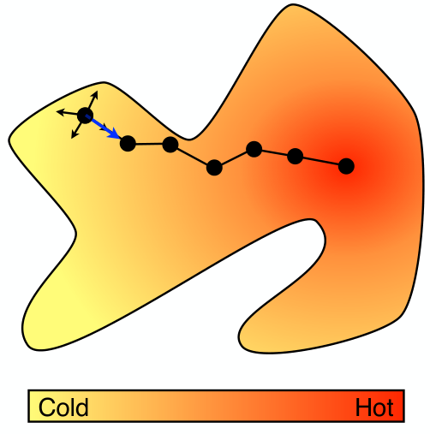
Local search
https://project.inria.fr/2015ma2827/files/2016/05/Lecture05.pptx

Slide 44
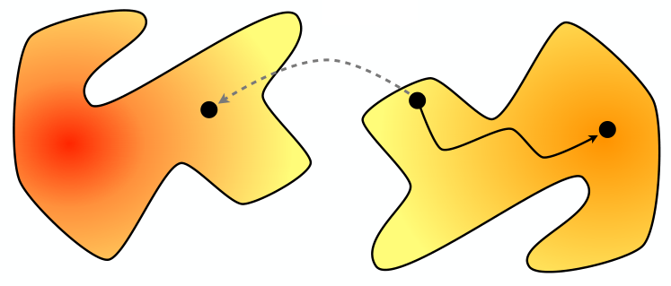
Connectivity
  Important property of local neighborhoods
  A neighborhood N is connected if, from every configuration S, some optimal solution O can be reached by a sequence of moves
https://project.inria.fr/2015ma2827/files/2016/05/Lecture05.pptx

Slide 45
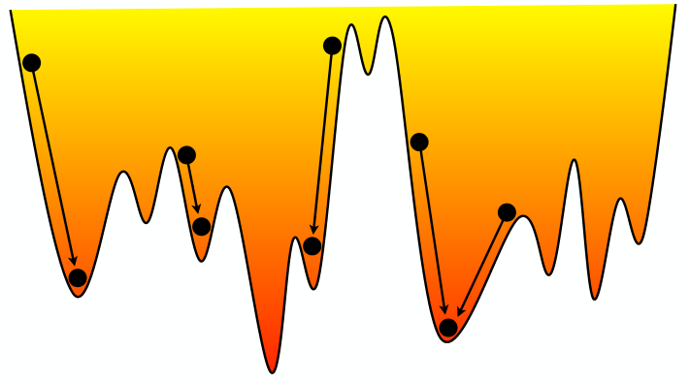
Connectivity
  Connectivity does not guarantee optimality
https://project.inria.fr/2015ma2827/files/2016/05/Lecture05.pptx

Slide 46
Connectivity of TSP
  Is 2-OPT connected?
  Simple algorithm:
  loop other the points along
  the optimal path and fix
  edges of the initial path
  one by one
https://project.inria.fr/2015ma2827/files/2016/05/Lecture05.pptx

Slide 47
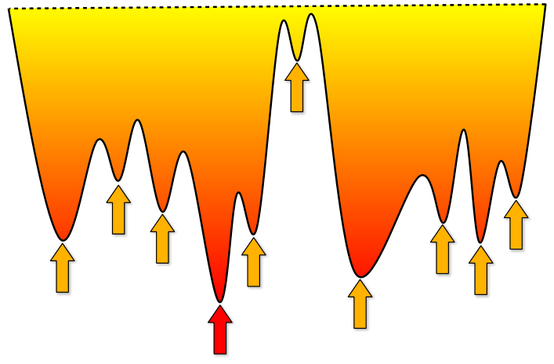
Local minima
  Greedy local search can easily get stuck in local minima.
  How to find a good one?
https://project.inria.fr/2015ma2827/files/2016/05/Lecture05.pptx

Slide 48
Escaping local minima
  Randomization
    Random restarts
      generic, can be always tried
    Metropolis scheme
    Simulated annealing
  Tabu search
https://project.inria.fr/2015ma2827/files/2016/05/Lecture05.pptx

Slide 49
Metropolis heuristics
  Basic idea
    accept a move if it improves the objective value
    accept “bad moves” as well with some probability
    the probability depends on how “bad” the move is
    inspired by statistical physics
  How to choose the probability?
    t is a scaling parameter (called temperature)
    Δ is the difference f(n) – f(s)
    a degrading move is accepted with probability
https://project.inria.fr/2015ma2827/files/2016/05/Lecture05.pptx

Slide 50
Metropolis heuristics
  What happens for a large t ?
    probability of accepting a degrading move is large
  What happens for a small t ?
    probability of accepting a degrading move is small
  Finding the correct temperature is hard
  Let us gradually change the temperature
    simulated annealing
https://project.inria.fr/2015ma2827/files/2016/05/Lecture05.pptx

Slide 51
Simulated annealing
  Based on statistical physics
    Heating and cooling schedules of crystals
  Key idea
    Use Metropolis algorithm but adjust the temperature dynamically
    Start with a high temperature (random moves)
    Decrease the temperature
    When the temperature is low becomes a local search
https://project.inria.fr/2015ma2827/files/2016/05/Lecture05.pptx

Slide 52
Simulated annealing
  Guaranteed to converge to a global optimum
    connected neighborhood
    slow cooling schedule
      slower than the exhaustive search
  In practice
    can give excellent results
    need to tune a temperature schedule
    default choice: t_{k+1} = α t_{k}
  Additional tools
    restarts
    reheats
https://project.inria.fr/2015ma2827/files/2016/05/Lecture05.pptx

