Slide 1
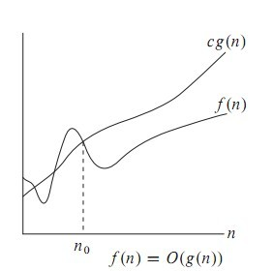
Big Oh (O)
https://www.seas.upenn.edu/~bhusnur4/cit596_spring2014/PNP.pptx
f(n)= O(g(n)) iff there exist positive constants c and n0 such that f(n) ≤ cg(n) for all n ≥ n0
O-notation to give an upper bound on a function

Slide 2
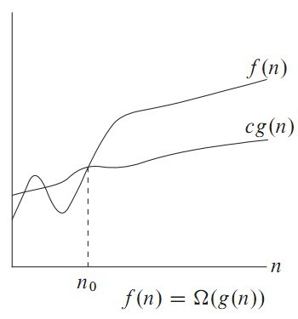
Omega Notation
https://www.seas.upenn.edu/~bhusnur4/cit596_spring2014/PNP.pptx
Big oh provides an asymptotic upper bound on a function.
Omega provides an asymptotic lower bound on a function.

Slide 3
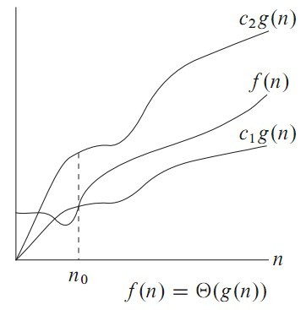
Theta Notation
https://www.seas.upenn.edu/~bhusnur4/cit596_spring2014/PNP.pptx
Theta notation is used when function f can be bounded both from above and below by the same function g

Slide 4
“Easy” Problems
https://www.cs.hmc.edu/~cs5grad/cs5/LectureSlides/class07-black-16-functional5.pptx
Sorting a list of n numbers: [42, 3, 17, 26, … , 100]
n log₂ n
Multiplying two n x n matrices:
(
)
(
)
(
)
3 5 2 7
1 6 8 9
2 4 6 10
9 3 2 12
1 5 5 4
5 12 8 6
7 6 1 5
9 23 5 8
n
=
n
n
n
n
Notes:
Naïve matrix multiplication is O(n**3), but best-known algorithm is n**2.373 (only works for square matrices).

Slide 5
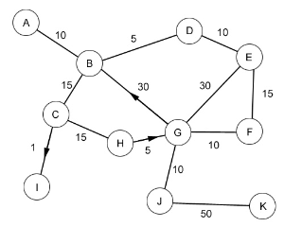
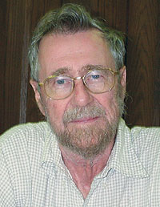
“Easy” Problems
https://www.cs.hmc.edu/~cs5grad/cs5/LectureSlides/class07-black-16-functional5.pptx
The Shortest Path Problem (i.e. “Google Maps”
Depending on implementation:
O(|V|²) or
O(|E| + |V|Log|V|)
Edsgar Dijkstra
https://www.cs.hmc.edu/~cs5grad/cs5/LectureSlides/class07-black-16-functional5.pptx

Slide 6
“Easy” Problems
https://www.cs.hmc.edu/~cs5grad/cs5/LectureSlides/class07-black-16-functional5.pptx
“Polynomial Time” = “Efficient”
n, n², n³, n⁴, n⁵,…
sorting
How about something like n log₂ n ?
matrix multiplication
shortest paths
The “class” P

Slide 7
“Hard” Problems
https://www.cs.hmc.edu/~cs5grad/cs5/LectureSlides/class07-black-16-functional5.pptx
The Travelling Salesperson Problem
New York
2566
4664
San Francisco
Moscow
5868
5563
2417
3627
366
1545
6060
Paris
Claremont
5625
Brute Force? Greed?

Slide 8
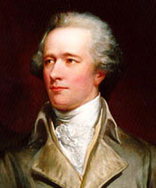
The Hamiltonian Path Problem
https://www.cs.hmc.edu/~cs5grad/cs5/LectureSlides/class07-black-16-functional5.pptx
Athens, GA
William Rowan
Hamilton
Homer, GA
Rome, GA
Damascus, GA
Bethlehem, GA
Those are some peachy names!
Notes:
A Hamiltonian path is a path that visits each vertex exactly once.
Sir William Rowan Hamilton, 1805-1865: Hamiltonian path problem

Slide 9
n² Versus 2^{n}
https://www.cs.hmc.edu/~cs5grad/cs5/LectureSlides/class07-black-16-functional5.pptx
Geoff-O-Matic
The Geoff-O-Matic performs 10⁹ operations/sec
n = 10 n = 30 n = 50 n = 70
n²
2^{n}
n!
100
< 1 sec
900
< 1 sec
2500
< 1 sec
4900
< 1 sec
1024
< 1 sec
10⁹
1 sec
10¹⁵
11.6 days
10²¹
31,688 years
< 1 sec
10¹⁶ years
10⁵⁷ years
10⁹³ years
Notes:
10! = 3628800. The other factorials are just silly.
The animations pop up the various answers one at a time.

Slide 10
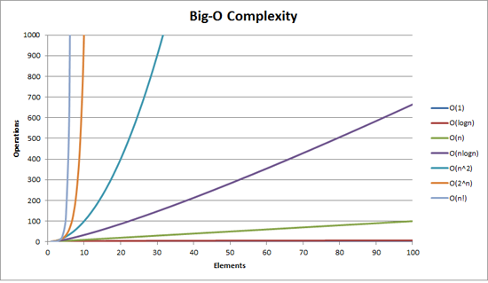
How bad is exponential complexity
https://www.seas.upenn.edu/~bhusnur4/cit596_spring2014/PNP.pptx
Fibonacci example – the recursive fib cannot even compute fib(50)

Slide 11
Tractability
Modified from http://cse.unl.edu/~ylu/raik283/notes/NP-Complete.ppt
Some problems are intractable: as they grow large, we are unable to solve them in reasonable time
Not in polynomial time: O(2^{n}), O(n!), O(n^{n}),
What constitutes reasonable time?
Standard working definition: polynomial time
On an input of size n the worst-case running time is O(n^{k}) for some constant k
Polynomial time: O(1), O(n lg n), O(n²), O(n³),

Slide 12
Optimization/Decision Problems
Modified from http://cse.unl.edu/~ylu/raik283/notes/NP-Complete.ppt
Optimization Problems
An optimization problem is one which asks, “What is the optimal solution to problem X?”
Examples:
Maximal Matching
Traveling Salesperson
Minimum Spanning Tree
Decision Problems
An decision problem is one with yes/no answer
Examples:
Does a graph G have a MST of weight ≤ W?

Slide 13
Optimization/Decision Problems
Modified from http://cse.unl.edu/~ylu/raik283/notes/NP-Complete.ppt
An optimization problem tries to find an optimal solution
A decision problem tries to answer a yes/no question
Many problems will have decision and optimization versions
Eg: Traveling salesman problem
optimization: find hamiltonian cycle of minimum weight
decision: is there a hamiltonian cycle of weight ≤ k
Some problems are decidable, but intractable: as they grow large, we are unable to solve them in reasonable time
Is there a polynomial-time algorithm that solves the problem?
Notes:
A Hamiltonian cycle (or Hamiltonian circuit) is a cycle in an undirected graph that visits each vertex exactly once and also returns to the starting vertex.

Slide 14
Decision and Optimization Problems
https://users.cs.duke.edu/~reif/courses/alglectures/pearsaul.lectures/NP.ppt
Decision Problem: computational problem with intended output of “yes” or “no”, 1 or 0
Optimization Problem: computational problem where we try to maximize or minimize some value
Introduce parameter k and ask if the optimal value for the problem is a most or at least k. Turn optimization into decision

Slide 15
The class P
https://www.seas.upenn.edu/~bhusnur4/cit596_spring2014/PNP.pptx
The class P consists of those problems that are solvable in polynomial time.
More specifically, they are problems that can be solved in time O(n^{k}) for some constant k, where n is the size of the input to the problem
The key is that n is the size of input
“Easy” Problems

Slide 16
The Class P
Modified from http://cse.unl.edu/~ylu/raik283/notes/NP-Complete.ppt
P: the class of decision problems that have polynomial-time deterministic algorithms.
That is, they are solvable in O(p(n)), where p(n) is a polynomial on n
A deterministic algorithm is (essentially) one that always computes the correct answer
Why polynomial?
if not, very inefficient
nice closure properties
the sum and composition of two polynomials are always polynomials too

Slide 17
Complexity Class P
https://users.cs.duke.edu/~reif/courses/alglectures/pearsaul.lectures/NP.ppt
Deterministic in nature
Solved by conventional computers in polynomial time
O(1) Constant
O(log n) Sub-linear
O(n) Linear
O(n log n) Nearly Linear
O(n²) Quadratic
Polynomial upper and lower bounds

Slide 18
Sample Problems in P
Modified from http://cse.unl.edu/~ylu/raik283/notes/NP-Complete.ppt
Dijkstra
MST
Merge Sort
Others?

Slide 19
NP
https://www.seas.upenn.edu/~bhusnur4/cit596_spring2014/PNP.pptx
NP is not the same as non-polynomial complexity/running time. NP does not stand for not polynomial.
NP = Non-Deterministic polynomial time
NP means verifiable in polynomial time
Verifiable?
If we are somehow given a ‘certificate’ of a solution we can verify the legitimacy in polynomial time

Slide 20
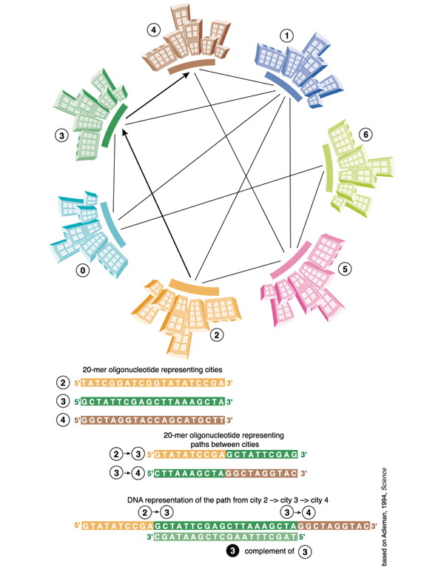
Computing with DNA
A nondeterministic computer
EMBO reports, Volume: 4, Issue: 1, Pages: 7-10, First published: 01 January 2003, DOI: (10.1038/sj.embor.embor719)
Notes:
The principle of Leonard Adleman's DNA computer to solve the ‘Travelling salesman’ problem.
IF THIS IMAGE HAS BEEN PROVIDED BY OR IS OWNED BY A THIRD PARTY, AS INDICATED IN THE CAPTION LINE, THEN FURTHER PERMISSION MAY BE NEEDED BEFORE ANY FURTHER USE. PLEASE CONTACT WILEY'S PERMISSIONS DEPARTMENT ON PERMISSIONS@WILEY.COM OR USE THE RIGHTSLINK SERVICE BY CLICKING ON THE 'REQUEST PERMISSIONS' LINK ACCOMPANYING THIS ARTICLE. WILEY OR AUTHOR OWNED IMAGES MAY BE USED FOR NON-COMMERCIAL PURPOSES, SUBJECT TO PROPER CITATION OF THE ARTICLE, AUTHOR, AND PUBLISHER.

Slide 21
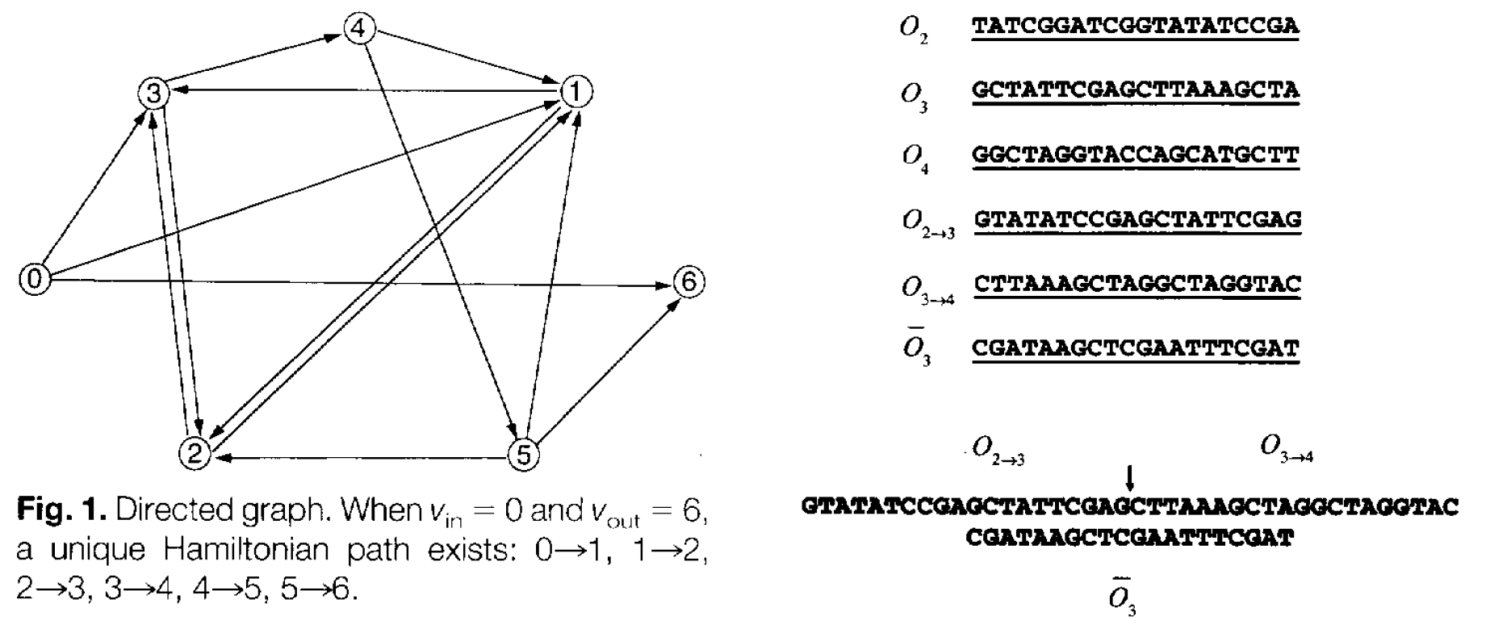

Slide 22
The class NP
Modified from http://cse.unl.edu/~ylu/raik283/notes/NP-Complete.ppt
NP: the class of decision problems that are solvable in polynomial time on a nondeterministic machine (or with a nondeterministic algorithm)
(A determinstic computer is what we know)
A nondeterministic computer is one that can “guess” the right answer or solution
Think of a nondeterministic computer as a parallel machine that can freely spawn an infinite number of processes
Examples
DNA computer
Quantum computer
Thus NP can also be thought of as the class of problems
whose solutions can be verified in polynomial time
Note that NP stands for “Nondeterministic Polynomial-time”

Slide 23
Sample Problems in NP
Modified from http://cse.unl.edu/~ylu/raik283/notes/NP-Complete.ppt
MST
Maximal matching
Hamiltonian Cycle (Traveling Salesman)
Graph Coloring

Slide 24
Hamiltonian cycles
https://www.seas.upenn.edu/~bhusnur4/cit596_spring2014/PNP.pptx
Determining whether a directed graph has a Hamiltonian cycle does not have a polynomial time algorithm (yet!)
However if someone was to give you a sequence of vertices, determining whether or not that sequence forms a Hamiltonian cycle can be done in polynomial time
Therefore Hamiltonian cycles are in NP
“Hard” Problem?

Slide 25
NP problems
https://www.seas.upenn.edu/~bhusnur4/cit596_spring2014/PNP.pptx
Graph theory has these fascinating(annoying?) pairs of problems
Shortest path algorithms?
Longest path is NP complete (we’ll define NP complete later)
Eulerian tours (visit every vertex but cover every edge only once, even degree etc). Solvable in polynomial time!
Hamiltonian tours (visit every vertex, no vertices can be repeated). NP complete

Slide 26
Review: P And NP Summary
Modified from http://cse.unl.edu/~ylu/raik283/notes/NP-Complete.ppt
P = set of problems that can be solved in polynomial time
NP = set of problems for which a solution can be verified in polynomial time
Clearly P ⊆ NP
Open question: Does P = NP?
Most suspect not
An August 2010 claim of proof that P ≠ NP, by Vinay Deolalikar, researcher at HP Labs, Palo Alto, has flaws
Notes:
a 3-CNF formula (i.e. with at most 3 variables per clause)

Slide 27
P is a subset of NP
https://www.seas.upenn.edu/~bhusnur4/cit596_spring2014/PNP.pptx
Since it takes polynomial time to run the program, just run the program and get a solution
But is NP a subset of P?
No one knows if P = NP or not
Solve for a million dollars!
http://www.claymath.org/millennium-problems
The Poincare conjecture is solved today

Slide 28
https://www.cs.hmc.edu/~cs5grad/cs5/LectureSlides/class07-black-16-functional5.pptx
$1 million
Vinay Deolalikar
Notes:
Deolalikar published an alleged proof in 2010. But it has flaws, and he has gone back to the drawing board.

Slide 29
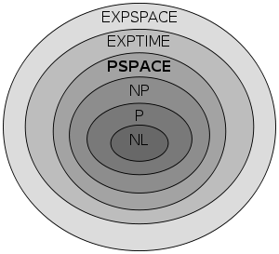
Are There Problems That Are Even Harder Than NP-Complete?
Kryptonite problems?
https://www.cs.hmc.edu/~cs5grad/cs5/LectureSlides/class07-black-16-functional5.pptx

Slide 30
https://www.cs.hmc.edu/~cs5grad/cs5/LectureSlides/class07-black-16-functional5.pptx
“I can’t find an efficient algorithm. I guess I’m too dumb.”
Cartoon courtesy of “Computers and Intractability: A Guide to the Theory of NP-Completeness” by M. Garey and D. Johnson

Slide 31
https://www.cs.hmc.edu/~cs5grad/cs5/LectureSlides/class07-black-16-functional5.pptx
Example: Exponential
“I can’t find an efficient algorithm because no such
algorithm is possible!”
Cartoon courtesy of “Computers and Intractability: A Guide to the Theory of NP-Completeness” by M. Garey and D. Johnson

Slide 32
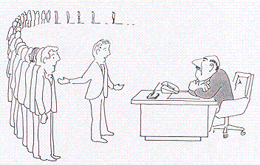
https://www.cs.hmc.edu/~cs5grad/cs5/LectureSlides/class07-black-16-functional5.pptx
NP-complete
“I can’t find an efficient algorithm, but neither
can all these famous people.”
Cartoon courtesy of “Computers and Intractability: A Guide to the Theory of NP-Completeness” by M. Garey and D. Johnson

Slide 33
NP-complete problems
Modified from http://cse.unl.edu/~ylu/raik283/notes/NP-Complete.ppt
A decision problem D is NP-complete iff
D ∈ NP
every problem in NP is polynomial-time reducible to D

Slide 34
Reducibility
https://www.seas.upenn.edu/~bhusnur4/cit596_spring2014/PNP.pptx
a problem Q can be reduced to another problem Q’ if any instance of Q can be “easily rephrased” as an instance of Q’, the solution to which provides a solution to the instance of Q
Is a linear equation reducible to a quadratic equation?
Sure! Let coefficient of the square term be 0

Slide 35
Reduction
Modified from http://cse.unl.edu/~ylu/raik283/notes/NP-Complete.ppt
A problem R can be reduced to another problem Q if any instance of R can be rephrased to an instance of Q, the solution to which provides a solution to the instance of R
This rephrasing is called a transformation
Intuitively: If R reduces in polynomial time to Q, R is “no harder to solve” than Q
Example: lcm(m, n) = m * n / gcd(m, n),
lcm(m,n) problem is reduced to gcd(m, n) problem

Slide 36
Polynomial-Time Reducibility
https://users.cs.duke.edu/~reif/courses/alglectures/pearsaul.lectures/NP.ppt
Language L is polynomial-time reducible to language M if there is a function computable in polynomial time that takes an input x of L and transforms it to an input f(x) of M, such that x is a member of L if and only if f(x) is a member of M.

Slide 37
NP-Hard and NP-Complete
Modified from http://cse.unl.edu/~ylu/raik283/notes/NP-Complete.ppt
If R is polynomial-time reducible to Q, we denote this R ≤_{p} Q
Definition of NP-Hard and NP-Complete:
If all problems R ∈ NP are polynomial-time reducible to Q, then Q is NP-Hard
Note: An NP-Hard problem need not be NP.
An NP-Hard problem is at least as hard as the NP-complete problems
We say Q is NP-Complete if Q is NP-Hard and Q ∈ NP
If R ≤_{p} Q and R is NP-Hard, Q is also NP-Hard (why?)
Notes:
P ⊆ NP ⊆ PSPACE ⊆ EXPTIME ⊆ NEXPTIME ⊆ EXPSPACE

Slide 38
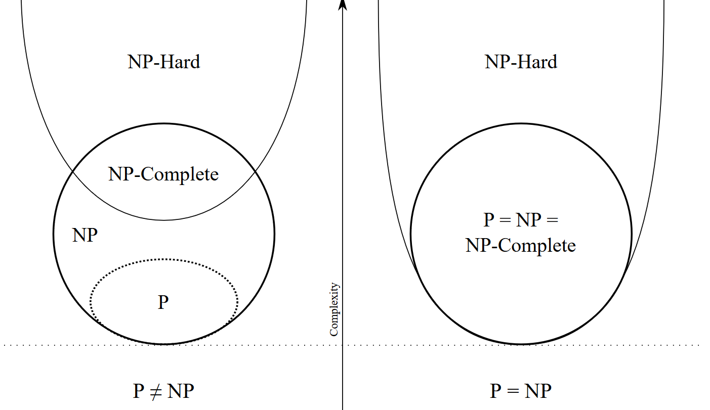
https://upload.wikimedia.org/wikipedia/commons/a/a0/P_np_np-complete_np-hard.svg

Slide 39
Not verifiable in polynomial time
Verifiable in polynomial time
https://upload.wikimedia.org/wikipedia/commons/a/a0/P_np_np-complete_np-hard.svg

Slide 40
The reducibility ‘tree’
https://www.seas.upenn.edu/~bhusnur4/cit596_spring2014/PNP.pptx
Richard Karp proved 21 problems to be NP complete in a seminal 1971 paper
Not that hard to read actually!
Definitely not hard to read it to the point of knowing what these problems are.
karp's paper

