Slide 1
Hamiltonian and Eulerian Graphs
Alan Cherne
Modified from https://web.eecs.utk.edu/~cphillip/cs594_spring2016/Hamiltonian_and_Eulerian_Graphs.pptx

Slide 2
DEFINITIONS
A Hamilton path is a path that contains all vertices of a graph
A Hamilton cycle is a cycle that contains all vertices of a graph
A Hamiltonian graph is a graph that contains a Hamilton cycle
An Eulerian trail is a walk that traverses each edge exactly once
An Eulerian cycle is a cycle that traverses each edge exactly once
An Eulerian graph is a graph that contains an Eulerian cycle

Slide 3
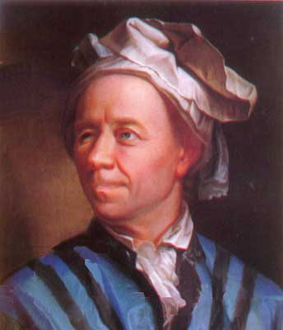
Leonard Euler
Born - April 15, 1707 in Basel, Switzerland
Died - September 18, 1783 in St. Petersburg, Russia
Pioneered many branches of mathematics and physics
Went blind in 1766 yet increased his rate of production to one paper a week by 1775.
Could repeat the Aeneid of Virgil from beginning to end without hesitation
Nicknamed “Cyclops” by Frederick the Great of Prussia

Slide 4
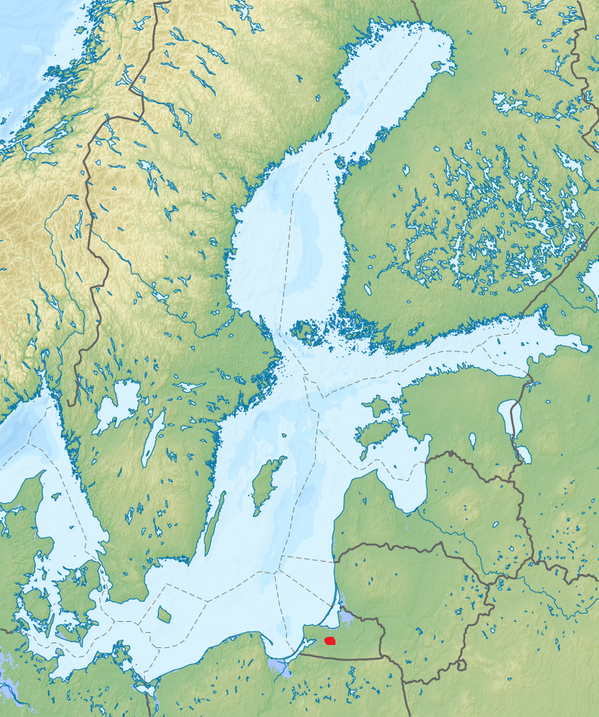
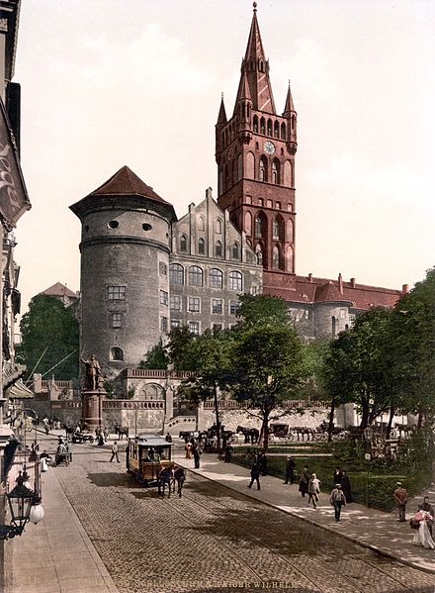
Königsberg, Prussia – Now Kaliningrad, Russia

Slide 5
History
Eulerian graphs were first studied by Leonard Euler when prompted by the mayor of Danzig to solve the Königsberg bridge problem. At first, Euler was not amused:
“Thus you see, most noble Sir, how this type of solution bears little relationship to mathematics, and I do not understand why you expect a mathematician to produce it, rather than anyone else, for the solution is based on reason alone, and its discovery does not depend on any mathematical principle. Because of this, I do not know why even questions which bear so little relationship to mathematics are solved more quickly by mathematicians than by others.”
He later changed his tune
“This question is so banal, but seemed to me worthy of attention in that neither geometry, nor algebra, nor even the art of counting was sufficient to solve it.”

Slide 6
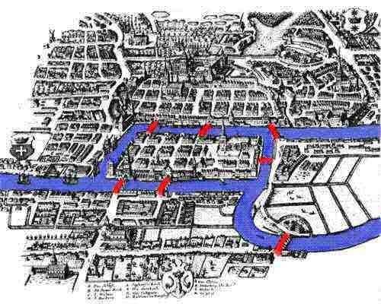
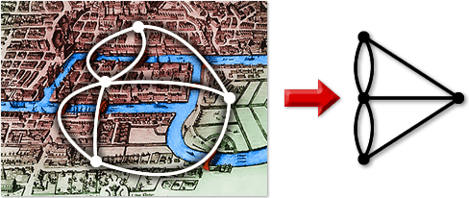
Königsberg Bridge

Slide 7
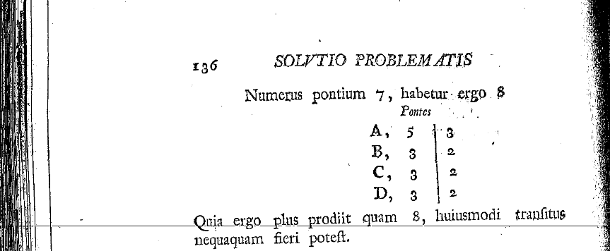
Euler’s Proof & Conclusions
If there are more than two areas to which an odd number of bridges lead, then such a journey is impossible
If, however, the number of bridges is odd for exactly two area, then the journey is possible if it starts in either of these two areas.
If, finally, there are no areas to which an odd number of bridges lead, then the required journey can be accomplished starting from any area. [1]

Slide 8
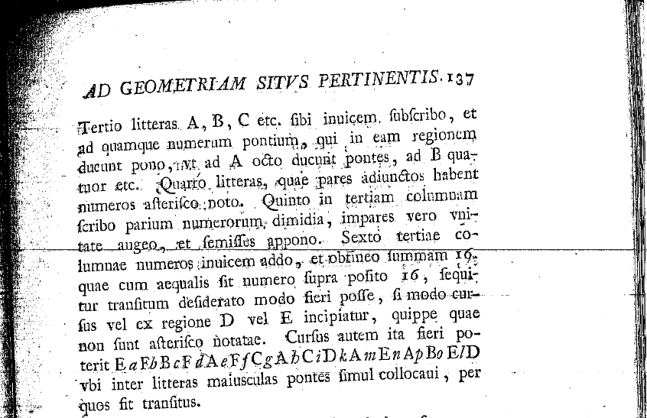
Cont.

Slide 9
Modern Theorems
A graph is Eulerian if and only if it is even, i.e. all it’s vertices have even degree
A graph is traversable if all but two vertices are even degree
Define a traversable graph as 1-traversable, and a graph where you must pick your pencil up once to draw it as 2-traversable, twice as 3-traversable, etc.
A 1-traversable graph is either an even graph, or contains 1 pair of odd vertices
A 2-traversable graph contains exactly two pairs of odd vertices
A 3-traversable graph contains three pairs of odd vertices
An n-traversable graph contains n pairs of odd vertices (n>1)
Vertices of odd degree come in pairs on connected graphs so this theorem covers all graphs

Slide 10
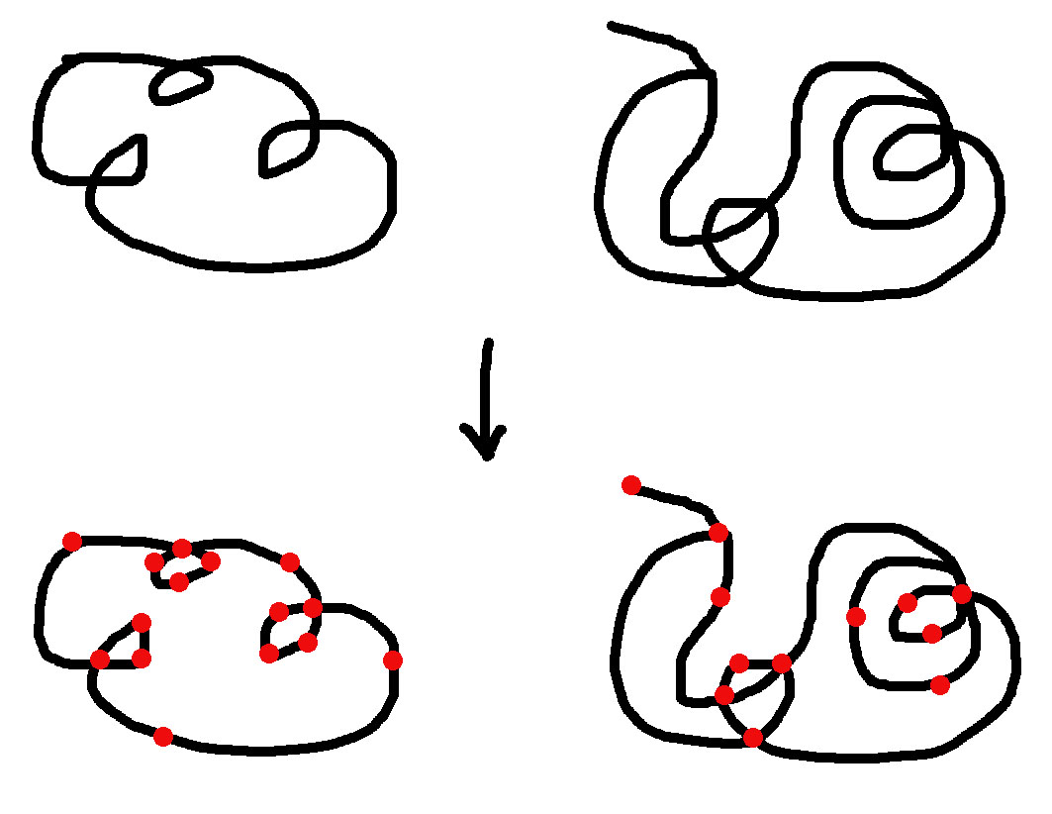
Drawing a graph with a pencil is just drawing a line

Slide 11
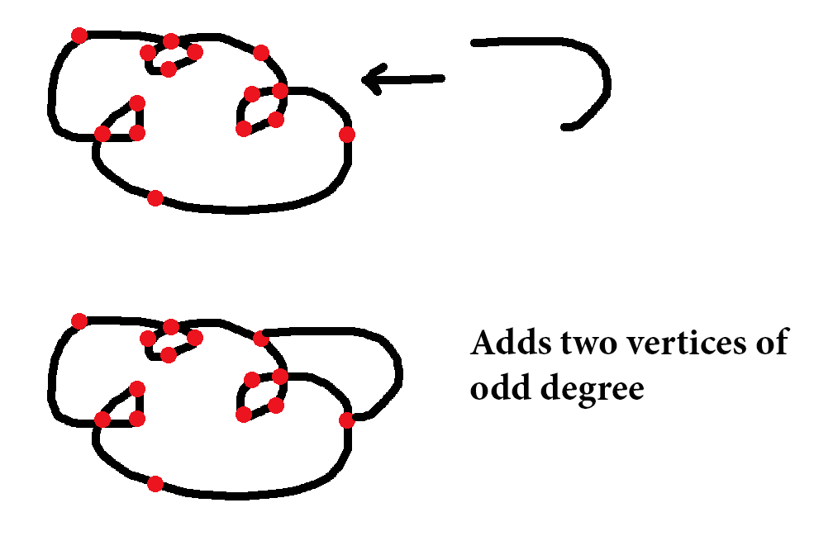
Lifting your pencil up is like attaching a new line

Slide 12
Lifting your pencil up is like attaching a new line
A new line doesn’t start or end on a vertex of odd degree

Slide 13
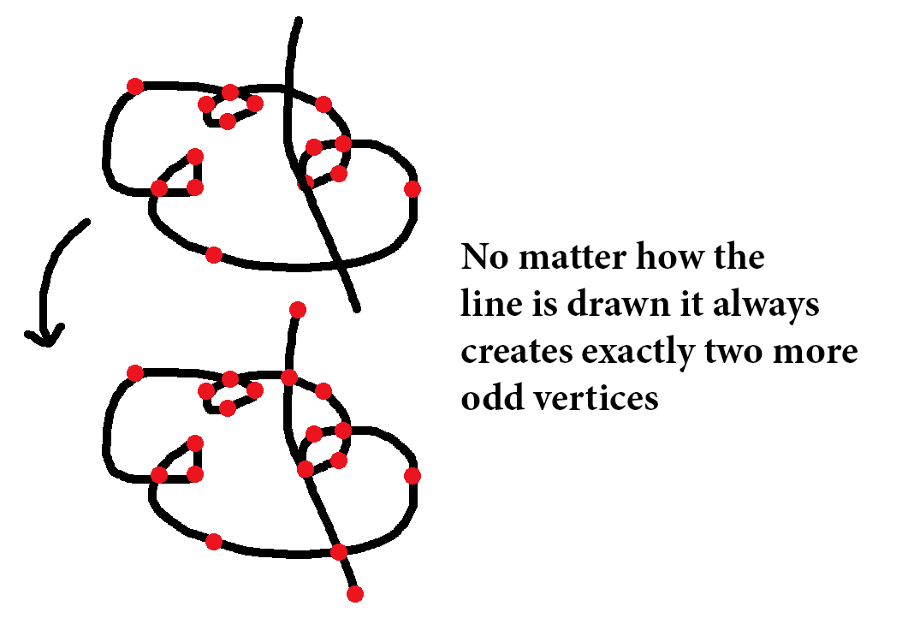
A 1-traversable, non-eulerian graph

Slide 14
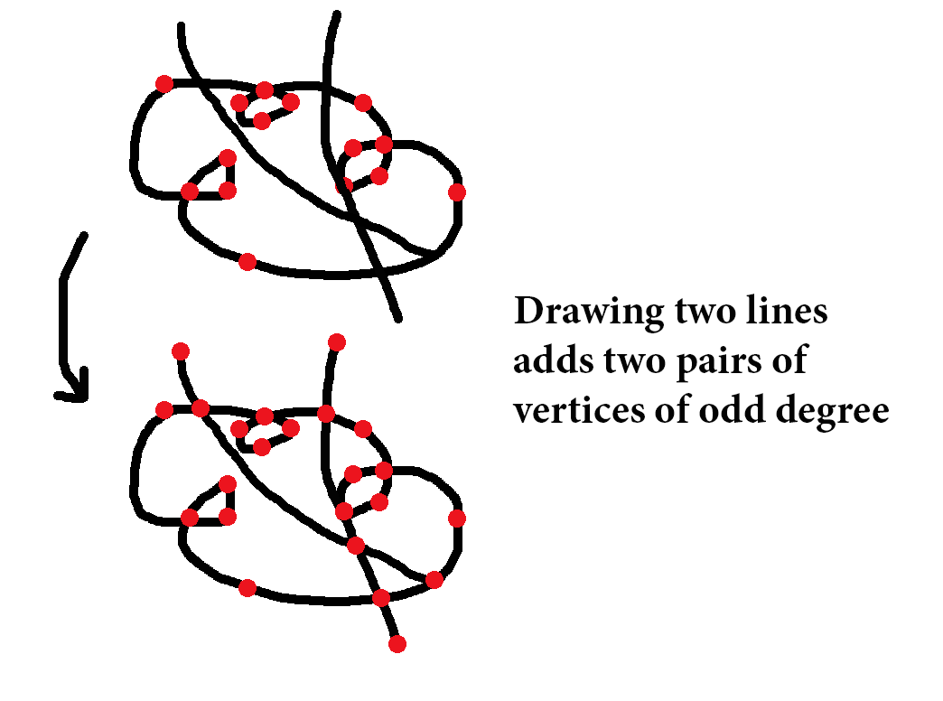
A 2-traversable graph

Slide 15
Traversability
From any degree sequence e.g. (4,3,3,3,3,3,2,1) we can know immediately how many pen-strokes it would take to draw the graph.
Traversability is a topological invariant, drawing on a torus doesn’t change anything
This doesn’t tell us how to draw it though…

Slide 16
Drawing Cliques
All cliques of odd order are even graphs, and Eulerian.
Every traversal is an Eulerian cycle – you must end where you started
It is possible to mess up…

Slide 17
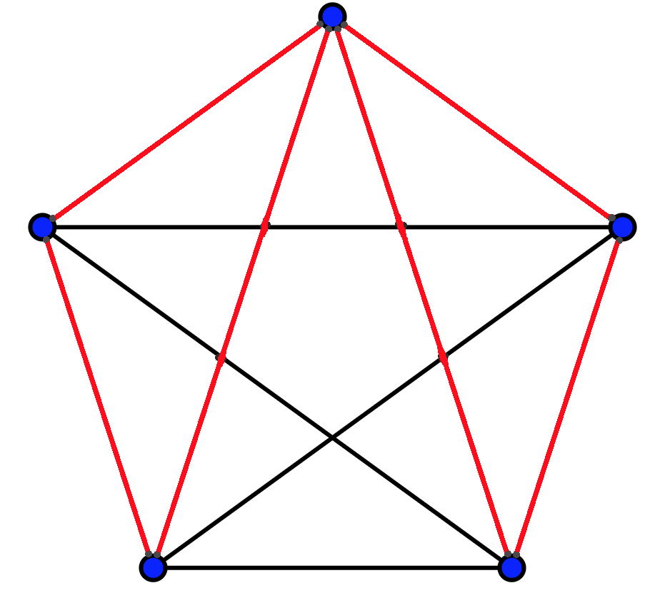
Drawing K₅ wrong

Slide 18
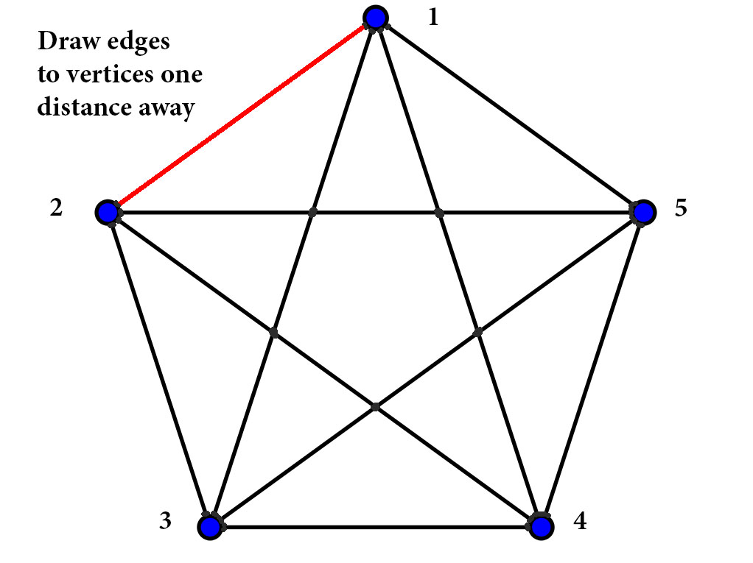
Drawing K₅ correctly

Slide 19
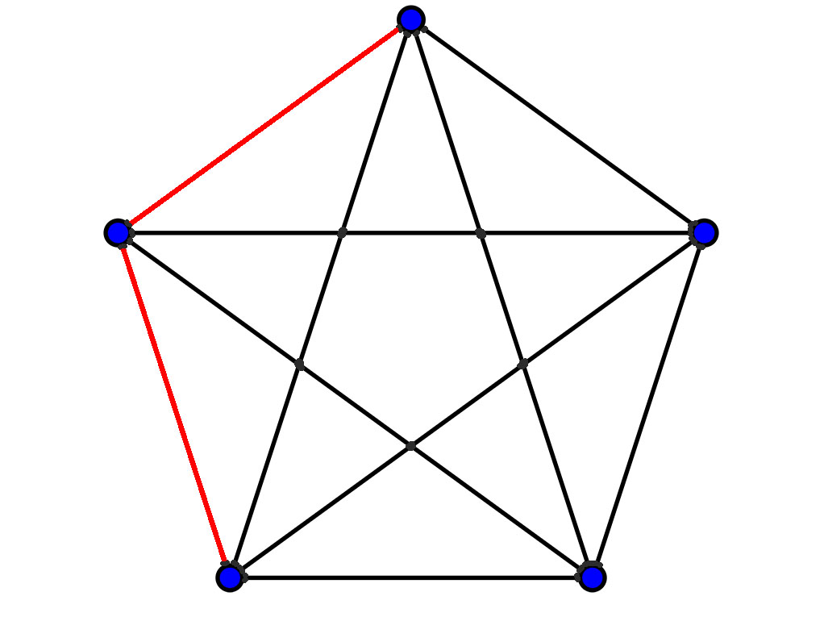
Drawing K₅ correctly

Slide 20
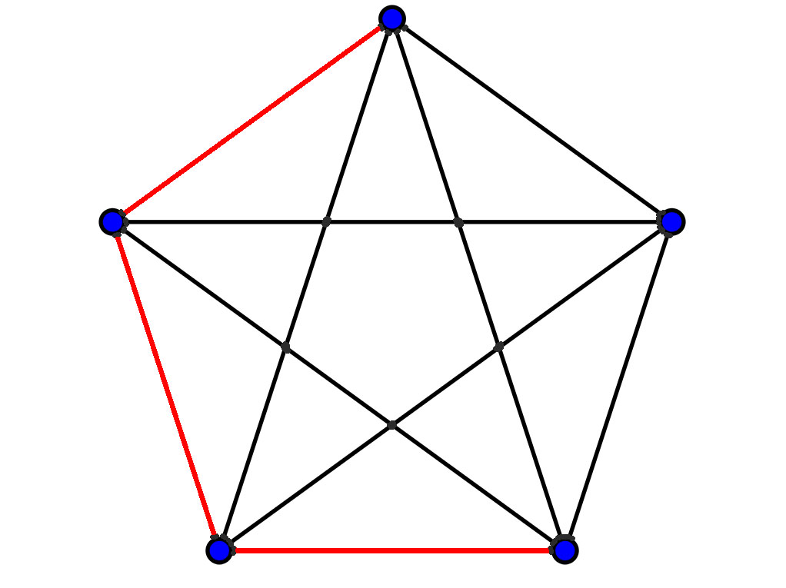
Drawing K₅ correctly

Slide 21
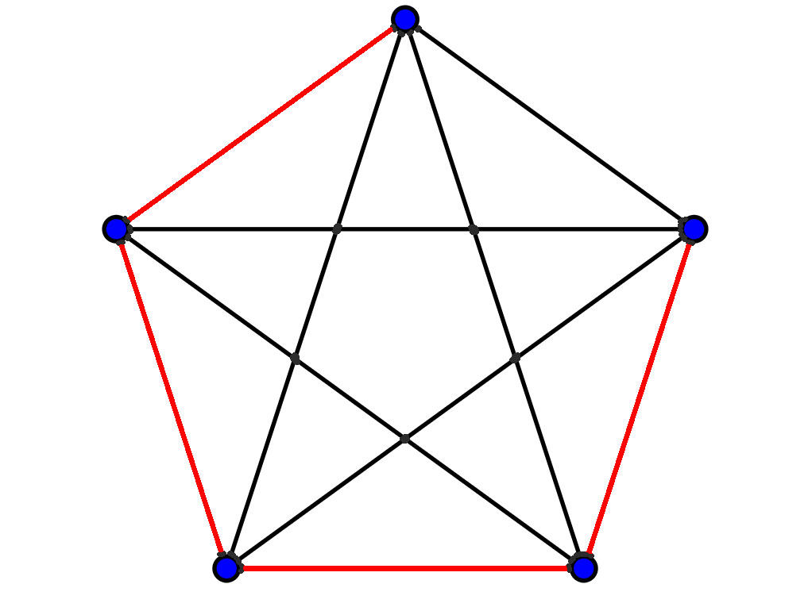
Drawing K₅ correctly

Slide 22
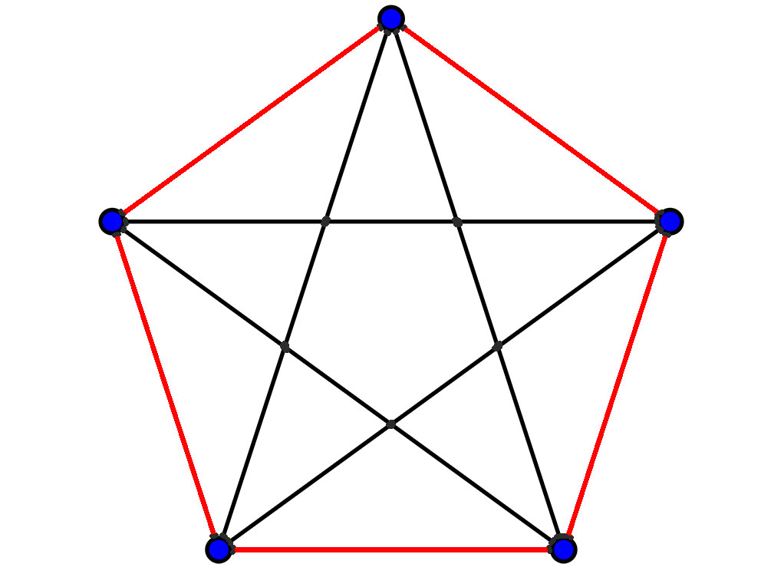
Drawing K₅ correctly

Slide 23
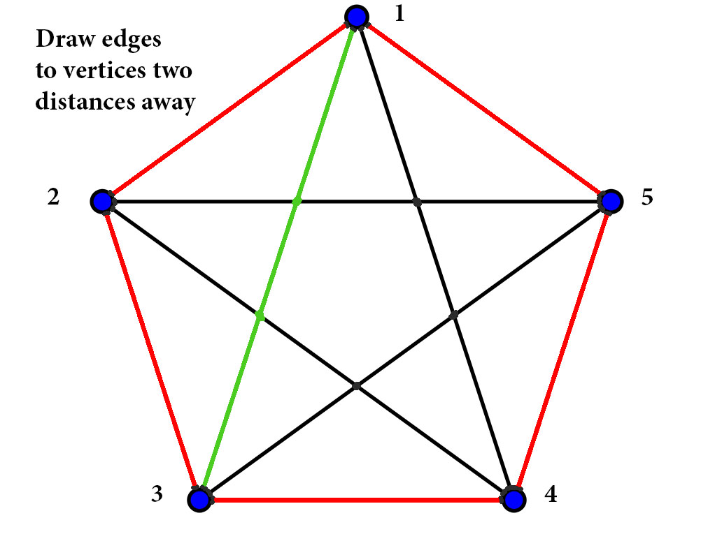
Drawing K₅ correctly

Slide 24
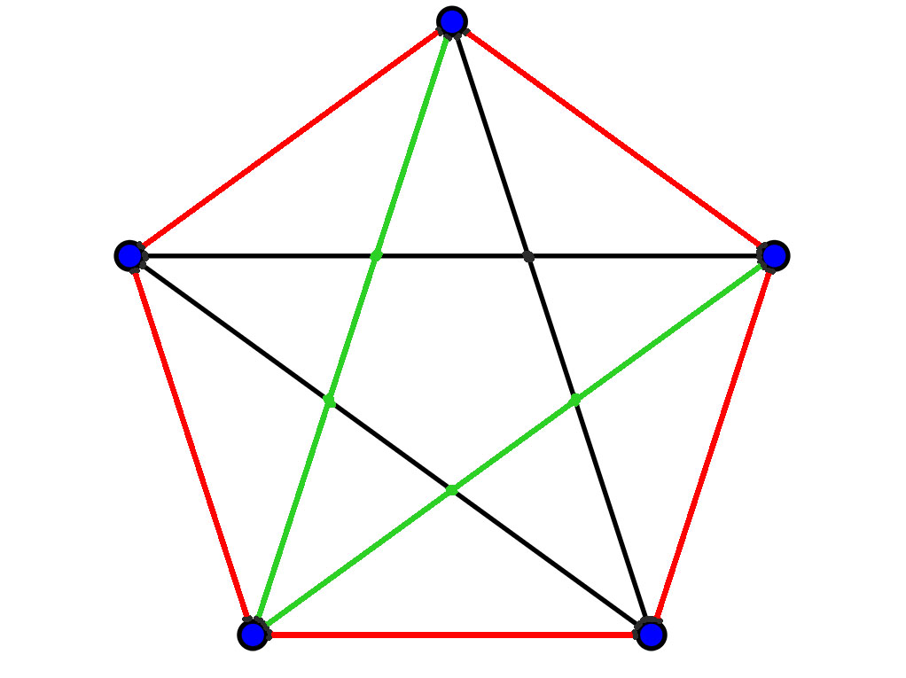
Drawing K₅ correctly

Slide 25
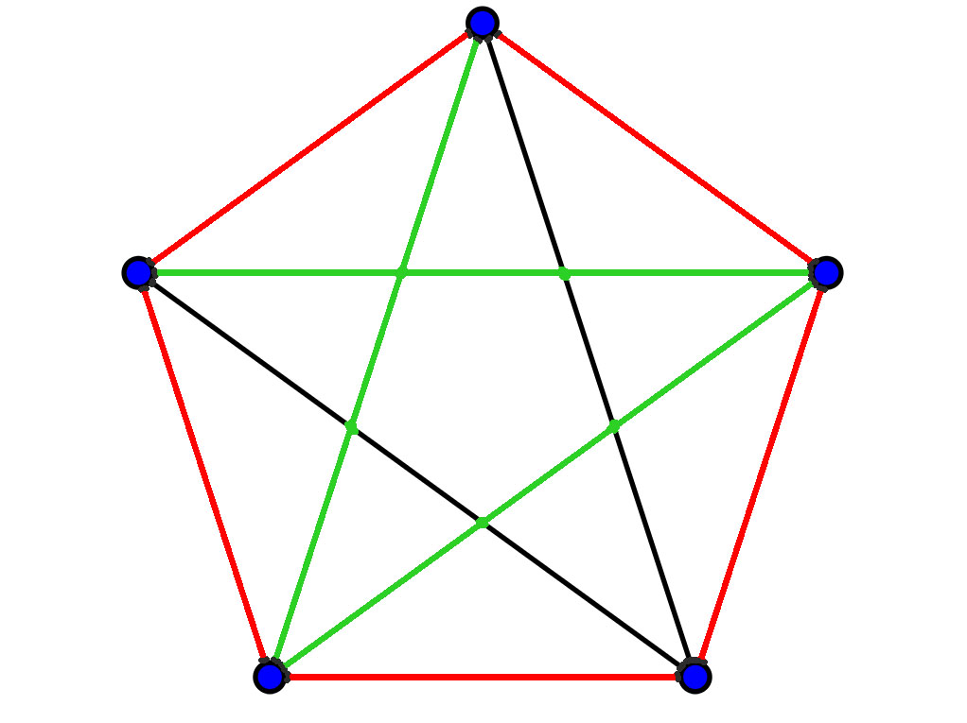
Drawing K₅ correctly

Slide 26
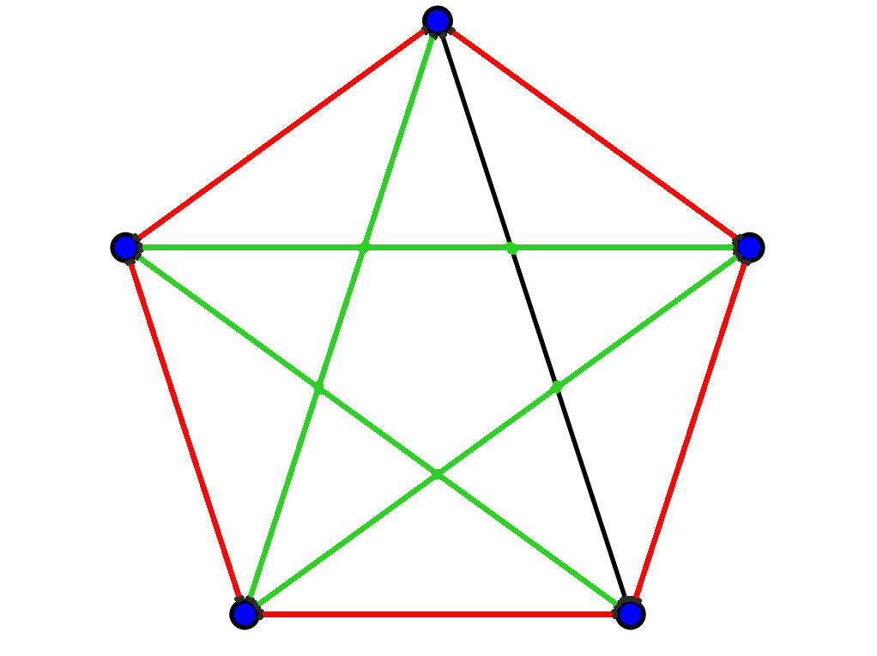
Drawing K₅ correctly

Slide 27
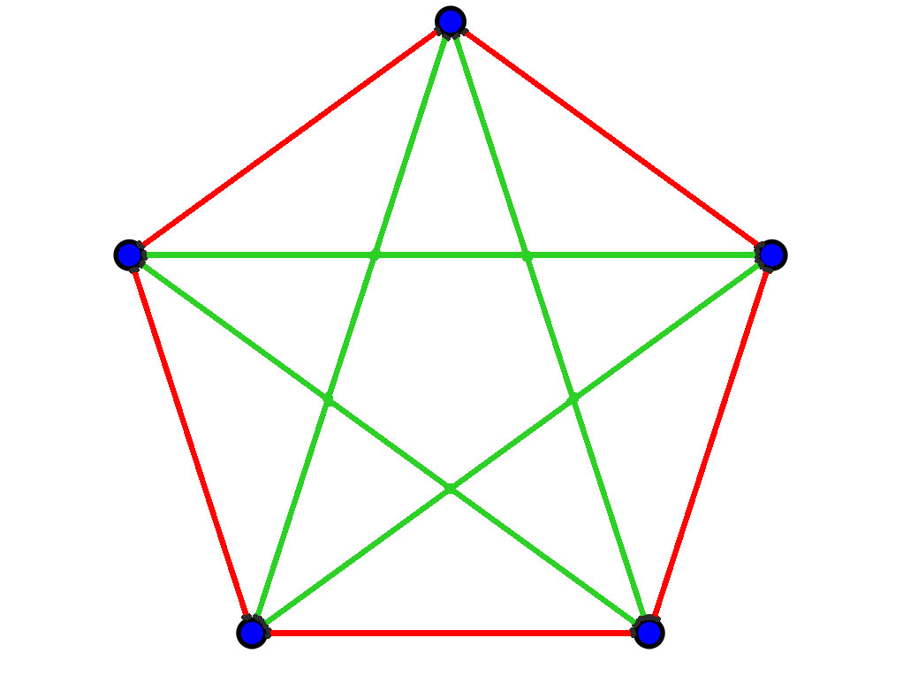
Drawing K₅ correctly

Slide 28
Why does this work?
The numbers 1 and 2 are relatively prime to 5, so drawing the edges one distance away cycles through 5 edges and drawing edges two distances away cycles through 5 edges as well
This is modular addition: 1, 1+1, 1+1+1, 1+1+1+1, 1+1+1+1+1 which gives the cycle (1,2,3,4,5) mod 5.
Similarly: 2, 2+2, 2+2+2, 2+2+2+2, 2+2+2+2+2 is the cycle (2,4,1,3,5) mod 5.
5+5 = 10, the number of edges in K₅

Slide 29
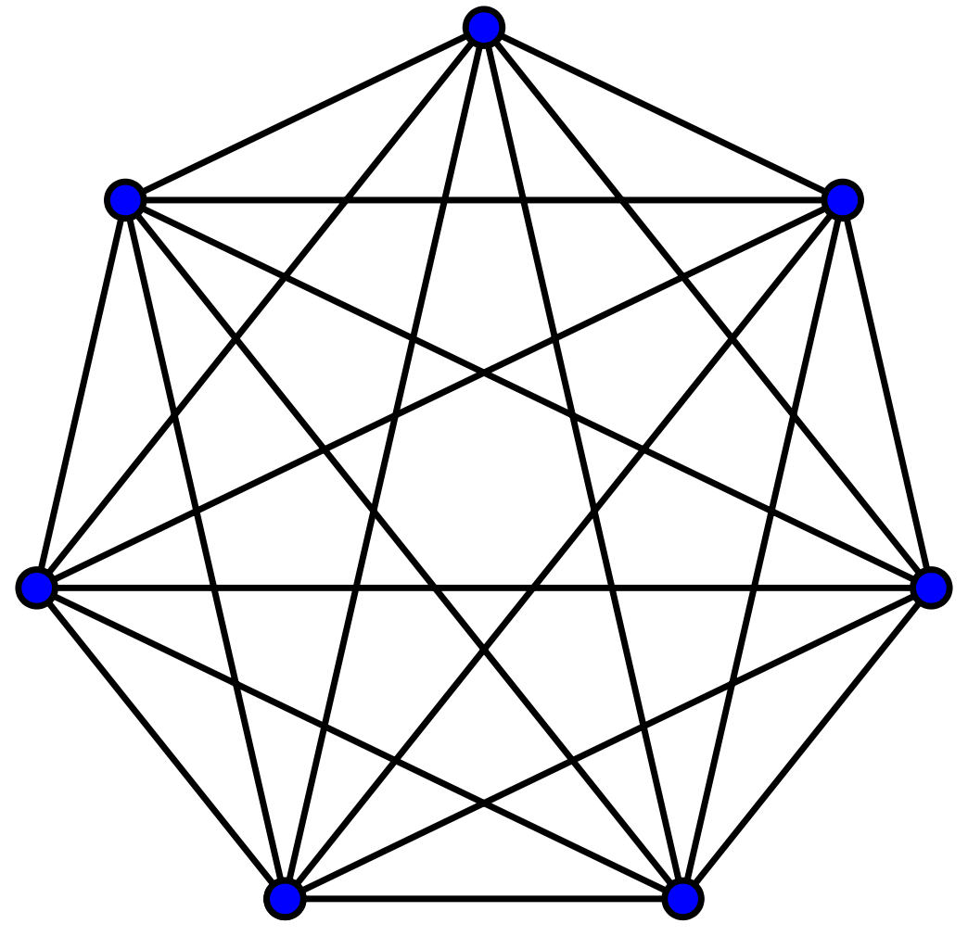
What about K₇?

Slide 30
This method works for K₇ as well
The numbers 1,2, and 3 are relatively prime to 7
One distance away: 1, 1+1, 1+1+1, 1+1+1+1, 1+1+1+1+1, 1+1+1+1+1+1, 1+1+1+1+1+1+1 is the cycle (1,2,3,4,5,6,7) mod 7
Two distances away: 2, 2+2, 2+2+2, 2+2+2+2, 2+2+2+2+2, 2+2+2+2+2+2, 2+2+2+2+2+2+2 is the cycle (2,4,6,1,3,5,6) mod 7
Three distances away: 3, 3+3, 3+3+3, 3+3+3+3, 3+3+3+3+3, 3+3+3+3+3+3, 3+3+3+3+3+3+3 is the cycle (3,6,2,5,1,4,7) mod 7
And 7+7+7 = 21, the number of edges in K₇

Slide 31
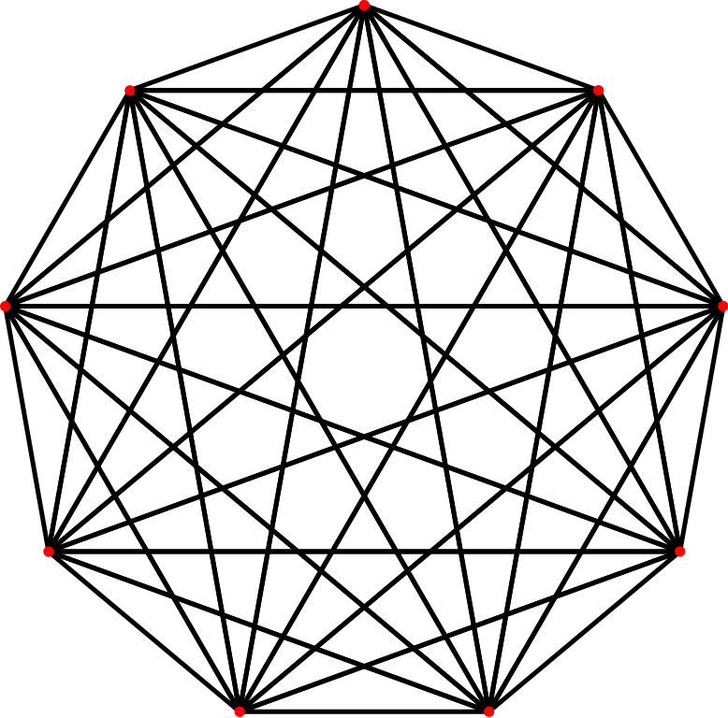
Something different happens for K₉

Slide 32
Drawing K₉
The numbers 1, 2 and 4 are relatively prime to 9 to 3 isn’t.
If you try to cycle through vertices 3 distances away from each other you end up with this cycle: 3, 3+3, 3+3+3, 3+3+3+3,… which is (3,6,9,3,6,9,3,6,9)
You end up drawing only three edges, a triangle
Drawing K₉ can still be drawn using this method, but with a modification. I leave this as homework

Slide 33
Hamiltonian Graphs
Hamiltonian graphs are graphs that contain a cycle that includes all vertices
Is the Königsberg bridge graph Hamiltonian?

Slide 34
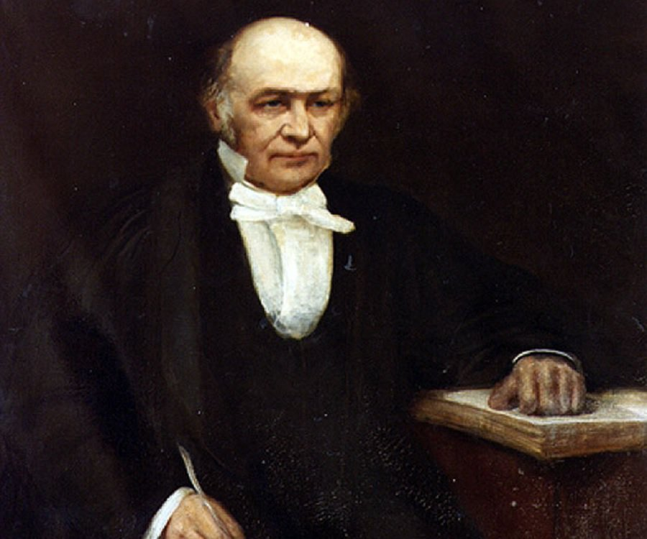
Sir William Rowan Hamilton
Born: August 4th, 1805 in Dublin, Ireland
Died: September 2nd, 1865 in Dublin, Ireland
Mathematician and physicist
Invented quaternions

Slide 35
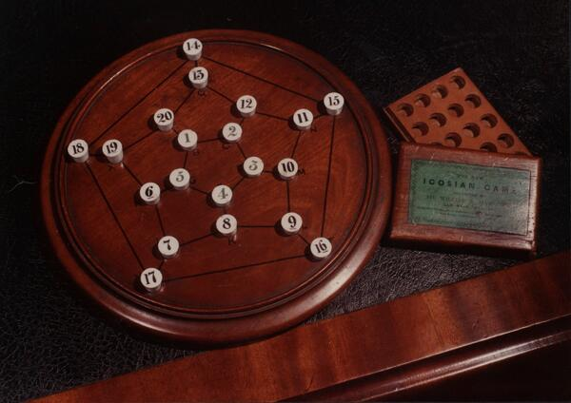
Hamilton’s Icosian Game
-Invented in 1857
-Based on the dodecahedron
a platonic solid
-Turns out all platonic solids are Hamiltonian, something that certainly interested 19th century mathematicians

Slide 36
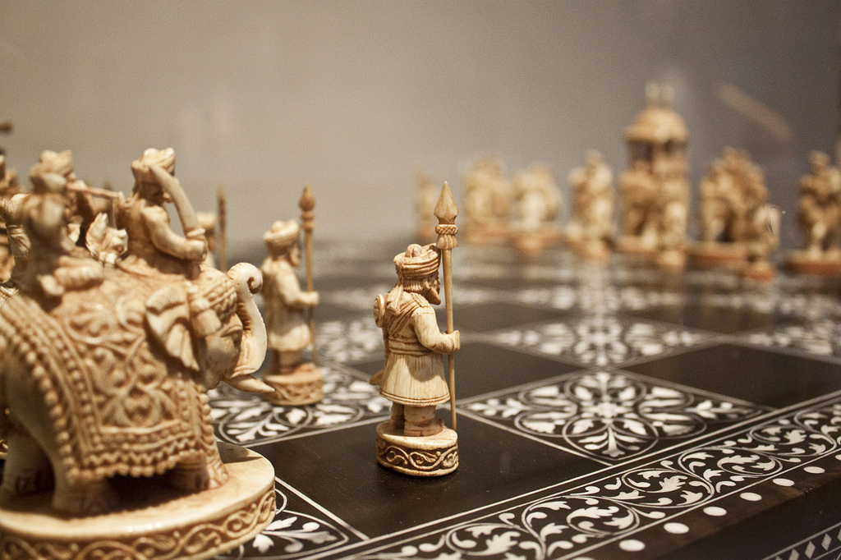
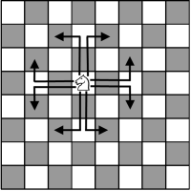
Knight’s Tour
The objective is to move the Knight and land on all squares of a chess board
Earliest known reference to the Knight’s Tour dates back to a 9th century Kashmiri poet named Rudrata
https://www.family-games-treasurehouse.com/images/xChess_Moves_Knight.gif.pagespeed.ic.biZfNgmowW.png

Slide 37
Knight’s Tour
The objective is to move the Knight and land on all squares of a chess board
Earliest known reference to the Knight’s Tour dates back to a 9th century Kashmiri poet named Rudrata
https://www.family-games-treasurehouse.com/images/xChess_Moves_Knight.gif.pagespeed.ic.biZfNgmowW.png

Slide 38
Knight’s Tour
The objective is to move the Knight and land on all squares of a chess board
Earliest known reference to the Knight’s Tour dates back to a 9th century Kashmiri poet named Rudrata
https://www.family-games-treasurehouse.com/images/xChess_Moves_Knight.gif.pagespeed.ic.biZfNgmowW.png

Slide 39
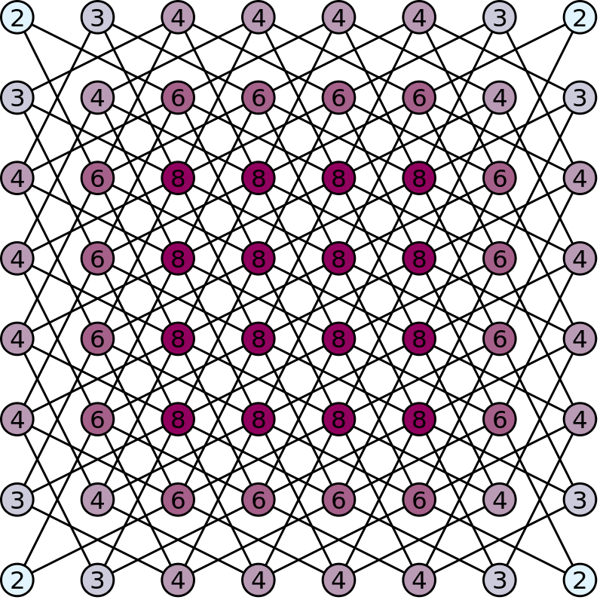
Knight’s Tour
In graph theoretic terms, a Knight’s Tour on a standard chess board is a Hamiltonian path on the graph to the right
The number on each node represents the degree of the vertex
First studied mathematically by Euler and later by Vandermonde and Warnsdorf

Slide 40
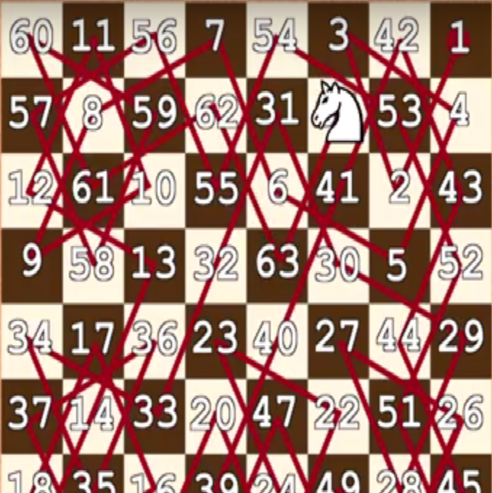
Knight’s Tour in general
Knight’s Tour on 8x8 board
An nxn chessboard has a closed knight’s tour iff n≥6 and n is even
There are 13,267,364,410,532 Hamiltonian cycles on the standard 8x8 Knight’s Graph
Knight’s Graphs are bipartite
Can almost make a magic square

Slide 41
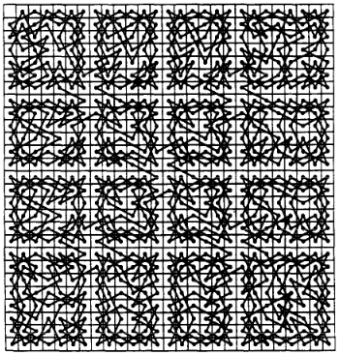
Hypohamiltonian
A graph is called Hypohamiltonian if the deletion of any one vertex allows there to be a Hamilton cycle
The 27x27 Knight’s Graph is (possibly) Hypohamiltonian – deleting one square allows a Hamiltonian cycle on the smaller board
The same is true for the 5x5, 7x7, 9x9, and 11x11 boards…

Slide 42
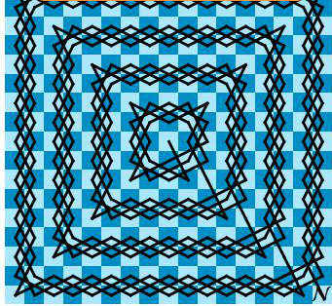
Infinite Knight’s Tour
An open Knight’s Tour exists on an infinite Knight’s Graph
Cantor could have proved that the integers have the same cardinality as the ZxZ grid by using the movement of a knight

Slide 43
Hamiltonian Graphs in general
Determining if a graph is Hamiltonian is NP-complete, so there is no easy necessary and sufficient condition.
Theorem: A necessary condition for a graph to be Hamiltonian is that it satisfies the following equation:
Let S be a set of vertices in a graph G and c(G) the amount of components in a graph. Then,
c(G-S)≤|S|
In words: If you delete S vertices you are left with S or less components
A graph that satisfies this condition for all sets S is called tough.

Slide 44
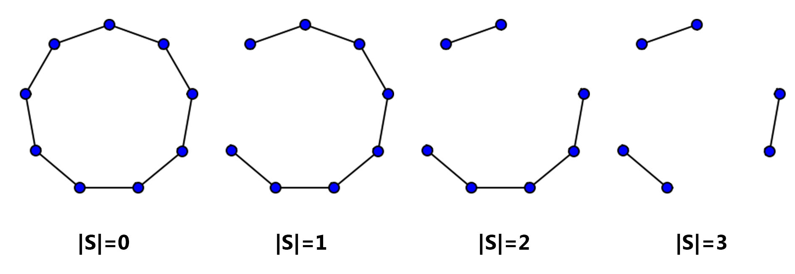
Why is this true?

Slide 45
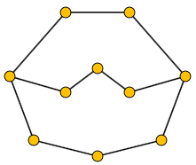
Toughness Test
If a graph is not tough it is not Hamiltonian
A simple test is to pick a set of vertices and see if it breaks the equation c(G-S)≤|S|
Is this graph tough?

Slide 46
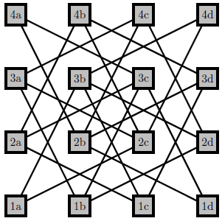
Is the 4x4 Knight’s Graph tough?

Slide 47
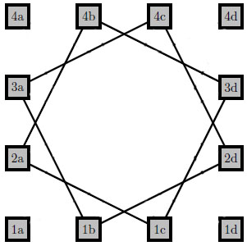
Not Tough

Slide 48
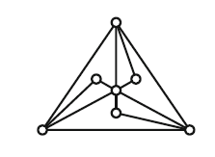
Tough, but not Hamiltonian

Slide 49
Tougher than Tough
We have seen that toughness is not a sufficient condition for Hamiltonicity, but what about making a stronger condition?
Definition: A graph G is said to be t-tough if for a given real number t and for every set of vertices |S|>1 the following equation is satisfied: c(G-S)≤ |S|/t
The toughness of a graph is the maximum t for which it is t-tough
It follows that a 1-tough graph is 2-connected, a 2-tough graph is 4-connected, a 3-tough graph is 6-connected, etc.
Testing whether a graph is t-tough is co-NP-complete, all tough graphs are tough computationally
Do 2-tough graphs all contain an essential subgraph similar to a cycle?

Slide 50
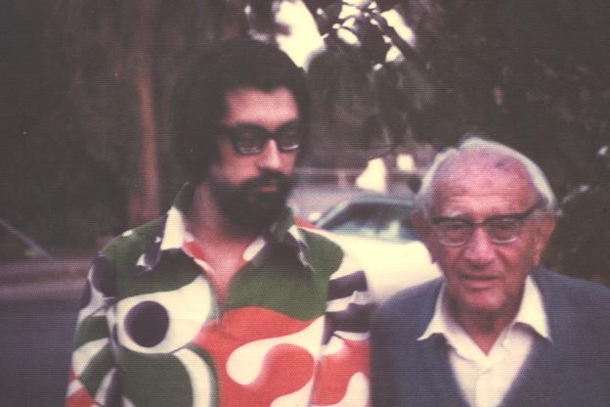
Václav (Vašek) Chvátal
Chvátal introduced the concept of t-toughness in 1973 and conjectured that every 2-tough graph was Hamiltonian
It was not until the year 2000 that Bauer, Broersma & Veldman found a counterexample
His conjecture that there is a constant t₀ such that every t₀-tough graph is Hamiltonian is still an open question (upper bound is currently 9/4)
Some progress has been made with this approach: every 18-tough (and above) chordal graph is Hamiltonian
Chvátal and Pólya

Slide 51
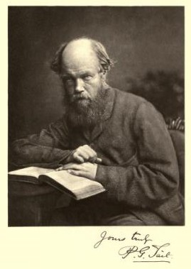
Nonhamiltonian Planar Graphs
Peter Guthrie Tait (1831-1901)
The study of Hamiltonian graphs has been important throughout the history of graph theory. One of the most notable instances is their connection with the Four-Color Conjecture
It was proven by Tait that the Four-Color Conjecture was equivalent to the statement that every 3-connected cubic planar graph was Hamiltonian
Tait thought that such graphs were all Hamiltonian and that he had proven the Four-Color Conjecture
A counterexample was provided in 1946 by W. T. Tutte

Slide 52
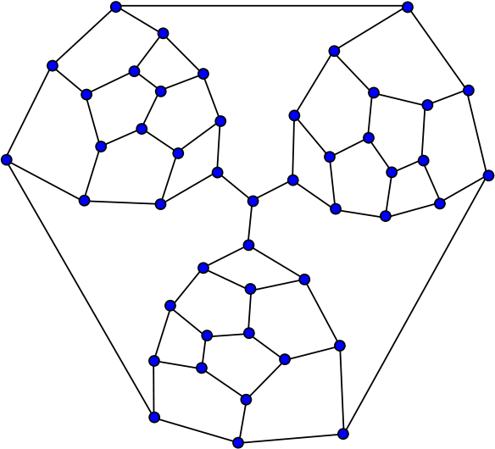
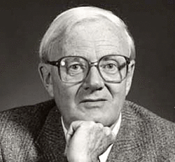
The Tutte Graph
Tutte constructed this Nonhamiltonian 3-connected cubic planar graph using ingenious ad hoc methods
Until 1968 no other examples were known
William Thomas Tutte (1917-2002)

Slide 53
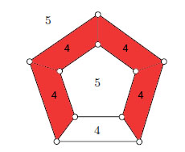

Ginberg’s Theorem
Using Euler’s identity for planar graphs V-E+F = 2, a necessary condition for Hamiltonicity can be constructed.
Let C be a Hamilton cycle of a planar graph G, f_{k} and g_{k} the number of faces of degree k contained in the interior of C and exterior of C respectively. Then,
In the example to the right, the equation is
(4-2)(4-1) + (5-2)(0-2) = (2)(3)+(3)(-2) = 6-6 = 0

Slide 54
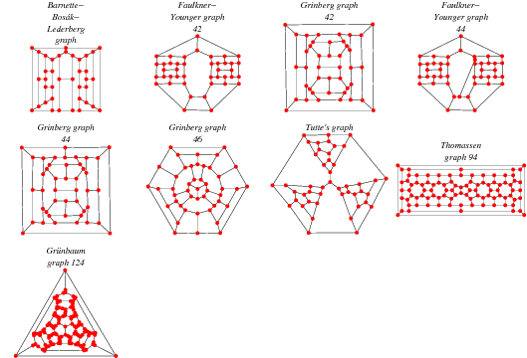
Application of Grinberg’s Theorem
Many graphs like Tutte’s can be made using Grinberg’s Theorem

Slide 55
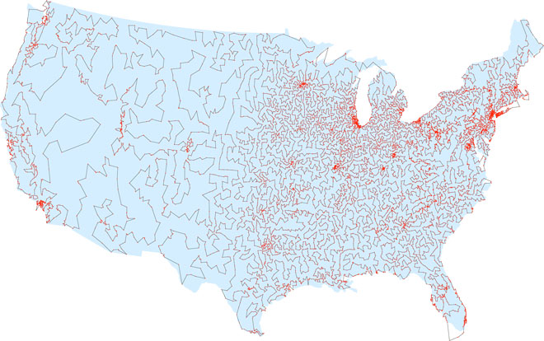
Traveling Salesman Problem
Finding a Hamilton cycle of shortest geographic distance is known as the Traveling Salesman Problem or TSP.
TSP is NP-Hard and algorithms are always being improved upon
In 1976 an algorithm was invented that guarantees an approximation at most 50% longer than the true shortest path
In 2011 this was improved to 49.99999999999999999999999999999999999999999999999996% [2]

Slide 56
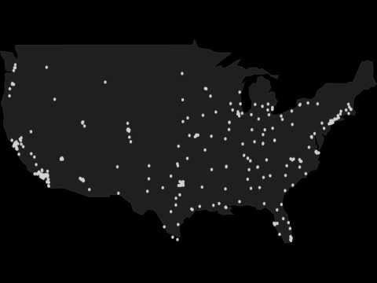
Traveling Salesman Algorithm

Slide 57
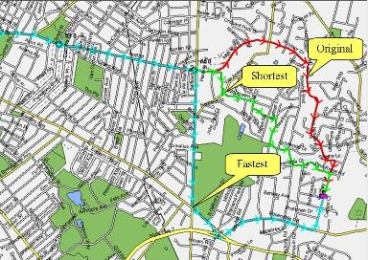
Applications of TSP
1) Drilling of printed circuit boards
2) Gas turbine engines
3) X-ray crystallography
4) Mission planning
5) Warehouses and post offices
6) Vehicle Routing
7) School bus routing [6]

Slide 58
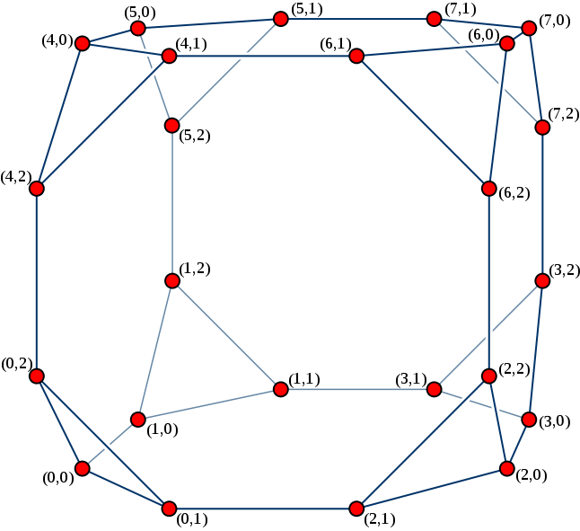
Open Problems
Every 3-connected cubic bipartite planar graph is Hamiltonian (1969)
Every Cayley graph is Hamiltonian (1984)
Is there a hypohamiltonian graph of minimum degree at east four? (1978)
All but a finite number of vertex-transitive connected graphs are Hamiltonian (1978) Coxeter
Every cubic planar graph with exactly three Hamilton cycles contains a triangle (1976)

Slide 59
Homework
1) Explain how to draw K₉ systematically without lifting your pencil up
2) How many times must you lift your pencil up to draw the Petersen Graph? K_{3,3}? K_{333,333}?
3) Deleting 4 vertices in the 4x4 Knight’s Graph leaves us with 6 components. Use the toughness equation to find an upper bound on the toughness of this graph (It will be less than one). Draw a 1/5-tough graph.

Slide 60
References
[1] http://eulerarchive.maa.org/docs/originals/E053.pdf
[2] http://www.wired.com/2013/01/traveling-salesman-problem/
[3] http://www.math.uwaterloo.ca/tsp/world/pictures.html
[4] http://www.mathematica-journal.com/issue/v11i3/contents/superhamilton/superhamilton.pdf
[5]https://pdfs.semanticscholar.org/927e/dbaa256301f500e8b3fcd52eaa6f0cc2c768.pdf
[6] http://www.intechopen.com/books/traveling-salesman-problem-theory-and-applications/traveling-salesman-problem-an-overview-of-applications-formulations-and-solution-approaches

