Slide 1
CS 581
Algorithmic Computational Genomics
http://tandy.cs.illinois.edu/CS581-firstday.pptx
Tandy Warnow
University of Illinois at Urbana-Champaign

Slide 2

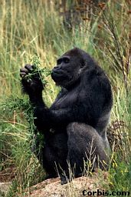
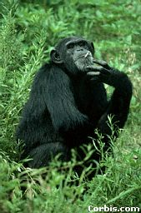
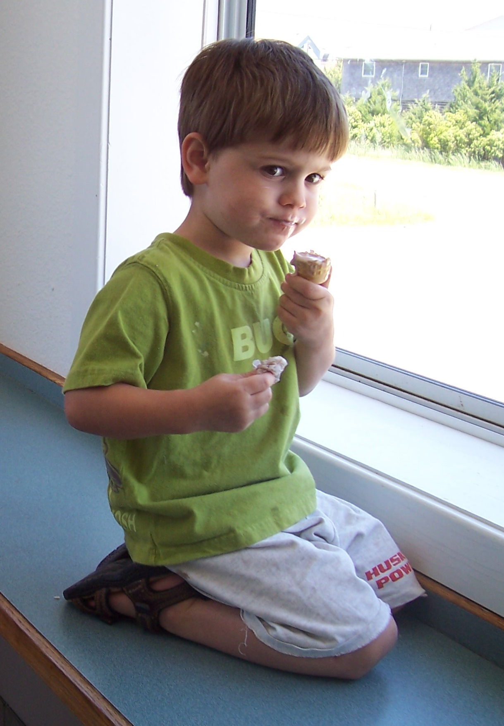
Phylogeny (evolutionary tree)
http://tandy.cs.illinois.edu/CS581-firstday.pptx
Orangutan
Gorilla
Chimpanzee
Human
From the Tree of the Life Website,
University of Arizona

Slide 3
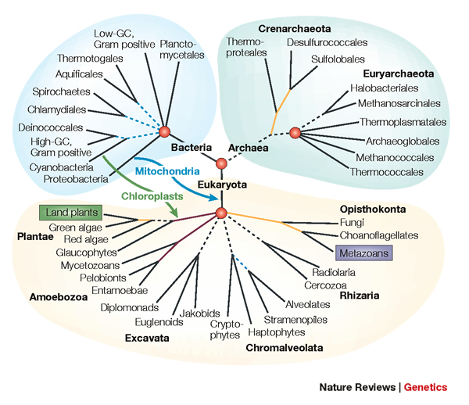
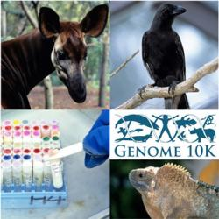
http://tandy.cs.illinois.edu/CS581-firstday.pptx
Phylogenomics
Phylogeny + genomics = genome-scale phylogeny estimation
.

Slide 4
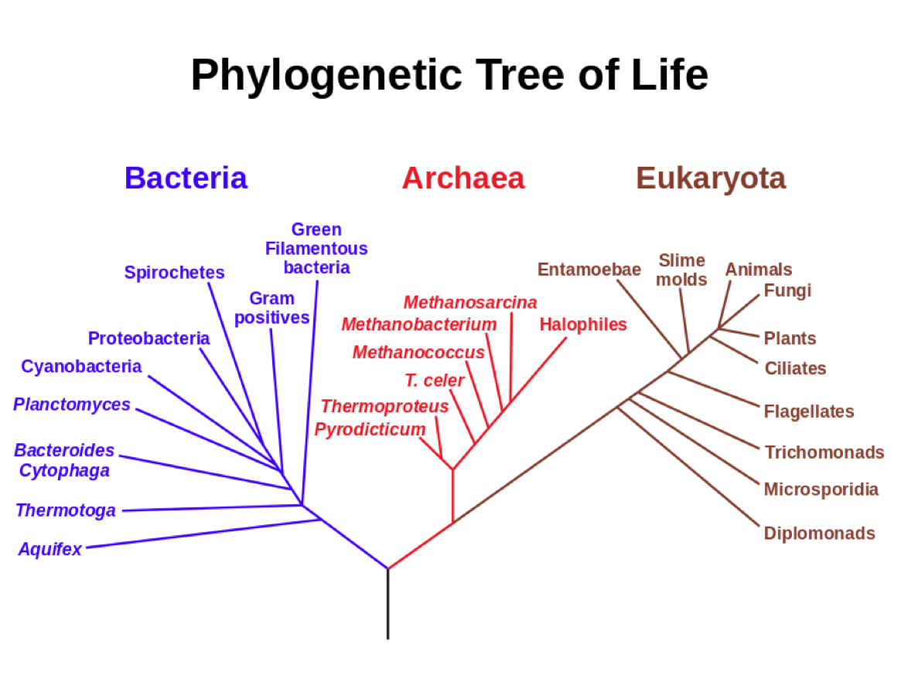
http://tandy.cs.illinois.edu/CS581-firstday.pptx
Estimating the Tree of Life
Basic Biology:
How did life evolve?
Applications of phylogenies to:
protein structure and function
population genetics
human migrations
metagenomics
Figure from
https://en.wikipedia.org/wiki/Common_descent

Slide 5
http://tandy.cs.illinois.edu/CS581-firstday.pptx
Estimating the Tree of Life
Large datasets!
Millions of species
thousands of genes
NP-hard optimization problems
Exact solutions infeasible
Approximation algorithms
Heuristics
Multiple optima
High Performance Computing:
necessary
but not sufficient
Figure from
https://en.wikipedia.org/wiki/Common_descent

Slide 6
http://tandy.cs.illinois.edu/CS581-firstday.pptx
Muir, 2016

Slide 7
Computer Science Solving Problems in Biology and Linguistics
Algorithm design using
  Divide-and-conquer
  Iteration
  Heuristic search
  Graph theory
Algorithm analysis using
  Probability Theory
  Graph Theory
Simulations and modelling
Collaborations with biologists and linguists and data analysis
Discoveries about how life evolved on earth (and how languages evolved, too)
http://tandy.cs.illinois.edu/CS581-firstday.pptx

Slide 8
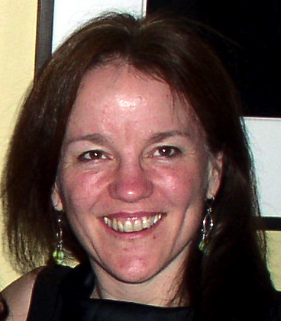
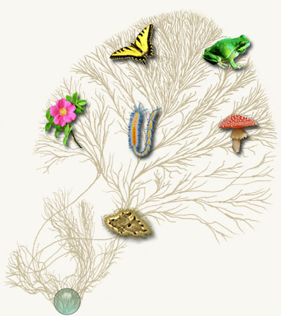
Computational Phylogenetics (2005)
http://tandy.cs.illinois.edu/CS581-firstday.pptx
Current methods can use months to
estimate trees on 1000 DNA sequences
Our objective:
More accurate trees and alignments
on 500,000 sequences in under a week
Courtesy of the Tree of Life web project, tolweb.org

Slide 9
Computational Phylogenetics (2018)
http://tandy.cs.illinois.edu/CS581-firstday.pptx
1997-2001: Distance-based phylogenetic tree estimation from polynomial length sequences
2012: Computing accurate trees (almost) without multiple sequence alignments
2009-2015: Co-estimation of multiple sequence alignments and gene trees, now on 1,000,000 sequences in under two weeks
2014-2015: Species tree estimation from whole genomes in the presence of massive gene tree heterogeneity
2016-2017: Scaling methods to very large heterogeneous datasets using novel machine learning and supertree methods.
Courtesy of the Tree of Life web project, tolweb.org

Slide 10
http://tandy.cs.illinois.edu/CS581-firstday.pptx c
The Tree of Life: Multiple Challenges
Scientific challenges:
Ultra-large multiple-sequence alignment
Gene tree estimation
Metagenomic classification
Alignment-free phylogeny estimation
Supertree estimation
Estimating species trees from many gene trees
Genome rearrangement phylogeny
Reticulate evolution
Visualization of large trees and alignments
Data mining techniques to explore multiple optima
Theoretical guarantees under Markov models of evolution
Techniques: applied probability theory, graph theory, supercomputing, and heuristics
Testing: simulations and real data

Slide 11
DNA Sequence Evolution
http://tandy.cs.illinois.edu/CS581-firstday.pptx
AAGACTT
-3 mil yrs
AAGACTT
-2 mil yrs
AAGGCCT
AAGGCCT
AAGGCCT
AAGGCCT
TGGACTT
TGGACTT
TGGACTT
TGGACTT
-1 mil yrs
AGGGCAT
AGGGCAT
AGGGCAT
TAGCCCT
TAGCCCT
TAGCCCT
AGCACTT
AGCACTT
AGCACTT
AGGGCAT
TAGCCCA
TAGACTT
AGCACAA
AGCGCTT
today
AGGGCAT
TAGCCCA
TAGACTT
AGCACAA
AGCGCTT

Slide 12
Gene Tree Estimation
http://tandy.cs.illinois.edu/CS581-firstday.pptx
U
V
W
X
Y
AGGGCAT
TAGCCCA
TAGACTT
TGCACAA
TGCGCTT
X
U
Y
V
W

Slide 13
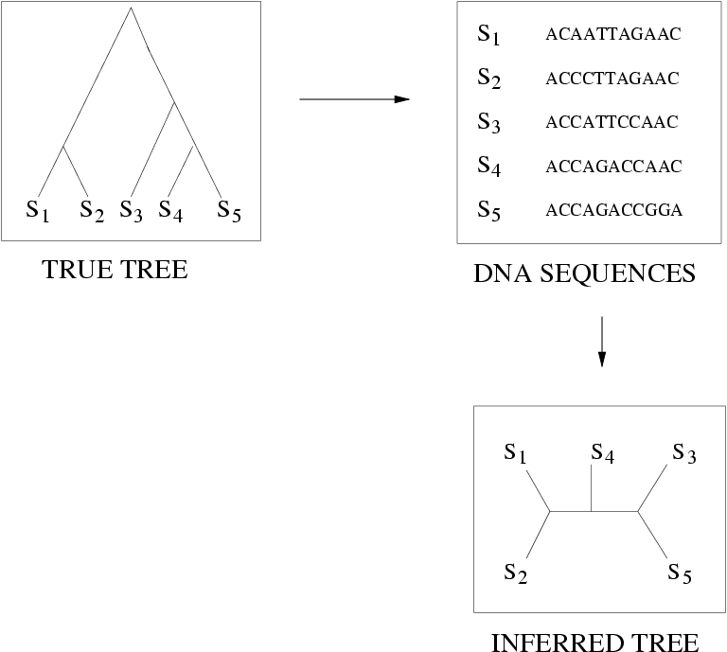
Quantifying Error
FN
FN: false negative
(missing edge)
FP: false positive
(incorrect edge)
FP
50% error rate
http://tandy.cs.illinois.edu/CS581-firstday.pptx

Slide 14
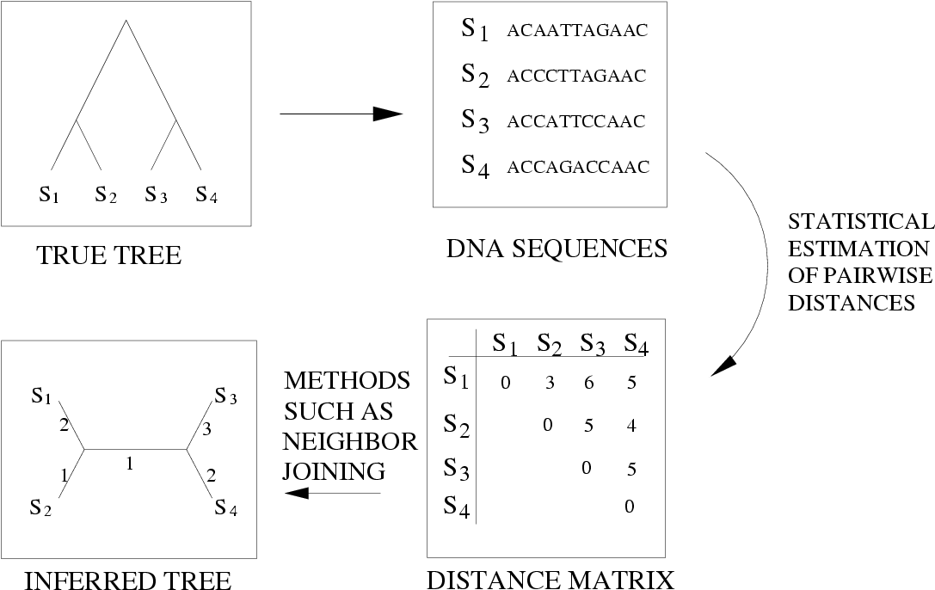
Distance-based estimation
http://tandy.cs.illinois.edu/CS581-firstday.pptx

Slide 15
Indels (insertions and deletions)
http://tandy.cs.illinois.edu/CS581-firstday.pptx
Deletion
Mutation
…ACGGTGCAGTTACCA…
…ACCAGTCACCA…
Notes:
15

Slide 16
Deletion
Substitution
…ACGGTGCAGTTACCA…
Insertion
…ACGGTGCAGTTACC-A…
…AC----CAGTCACCTA…
…ACCAGTCACCTA…
The true multiple alignment
  Reflects historical substitution, insertion, and deletion events
  Defined using transitive closure of pairwise alignments computed on edges of the true tree
http://tandy.cs.illinois.edu/CS581-firstday.pptx
Notes:
16
Homology = nucleotides lined up since they come from a common ancestor.
Indel = dash.

Slide 17
Gene Tree Estimation
http://tandy.cs.illinois.edu/CS581-firstday.pptx
S1 = AGGCTATCACCTGACCTCCA
S2 = TAGCTATCACGACCGC
S3 = TAGCTGACCGC
S4 = TCACGACCGACA

Slide 18
Input: unaligned sequences
http://tandy.cs.illinois.edu/CS581-firstday.pptx
S1 = AGGCTATCACCTGACCTCCA
S2 = TAGCTATCACGACCGC
S3 = TAGCTGACCGC
S4 = TCACGACCGACA

Slide 19
Phase 1: Alignment
http://tandy.cs.illinois.edu/CS581-firstday.pptx
S1 = AGGCTATCACCTGACCTCCA
S2 = TAGCTATCACGACCGC
S3 = TAGCTGACCGC
S4 = TCACGACCGACA
S1 = -AGGCTATCACCTGACCTCCA
S2 = TAG-CTATCAC--GACCGC--
S3 = TAG-CT-------GACCGC--
S4 = -------TCAC--GACCGACA

Slide 20
Phase 2: Construct tree
http://tandy.cs.illinois.edu/CS581-firstday.pptx
S1 = AGGCTATCACCTGACCTCCA
S2 = TAGCTATCACGACCGC
S3 = TAGCTGACCGC
S4 = TCACGACCGACA
S1 = -AGGCTATCACCTGACCTCCA
S2 = TAG-CTATCAC--GACCGC--
S3 = TAG-CT-------GACCGC--
S4 = -------TCAC--GACCGACA
S1
S2
S4
S3

Slide 21
The Tree of Life: Multiple Challenges
Scientific challenges:
Ultra-large multiple-sequence alignment
Gene tree estimation
Metagenomic classification
Alignment-free phylogeny estimation
Supertree estimation
Estimating species trees from many gene trees
Genome rearrangement phylogeny
Reticulate evolution
Visualization of large trees and alignments
Data mining techniques to explore multiple optima
Theoretical guarantees under Markov models of evolution
Techniques: applied probability theory, graph theory, supercomputing, and heuristics
Testing: simulations and real data
http://tandy.cs.illinois.edu/CS581-firstday.pptx

Slide 22
Combinatorial Optimization in Computational Biology: three topics that use Perfect Phylogeny
http://csiflabs.cs.ucdavis.edu/~gusfield/osb08.ppt
Dan Gusfield
OSB 2008, Lijiang, China,
November 1, 2008

Slide 23
Recombination: A richer model than Perfect Phylogeny
http://csiflabs.cs.ucdavis.edu/~gusfield/osb08.ppt
10100
10000
01011
01010
00010
10101 added
12345
00000
M
1
4
3
00010
2
10100
5
Pair 4, 5 fails the four
gamete-test. The sites 4, 5
are incompatible.
10000
01010
01011
Real sequence histories often involve recombination.

Slide 24
Sequence Recombination
10100
01011
P
S
5
Single crossover recombination
10101
A recombination of P and S at recombination point 5.
The first 4 sites come from P (Prefix) and the sites
from 5 onward come from S (Suffix).
http://csiflabs.cs.ucdavis.edu/~gusfield/osb08.ppt

Slide 25
Network with Recombination: ARG
http://csiflabs.cs.ucdavis.edu/~gusfield/osb08.ppt
10100
10000
01011
01010
00010
10101 new
12345
00000
M
1
4
3
00010
2
10100
5
P
10000
The previous tree with one
recombination event now derives
all the sequences.
01010
01011
5
S
10101

Slide 26
Chemistry
http://www.cri.haifa.ac.il/people/irith/lectures/Introduction%20to%20Graph-Theoryv2.pptx
Atom – vertex
Bond – edge
E.g. C3H7OH
Enumerating all isomers of a chemical compound.
Determining if two compounds with the same formula are identical.
H
H
H
H
C
C
C
O
H
H
H
H

Slide 27
Chemistry
http://www.cri.haifa.ac.il/people/irith/lectures/Introduction%20to%20Graph-Theoryv2.pptx
H
O
N
H
H
O
N
C
H
H
H
C
C
C
H
H
C
N
H
H
N
N
H
C
N
O
H
C3H7N2O2
H
H
O
Graph isomorphism problem

Slide 28
Chemistry
http://www.cri.haifa.ac.il/people/irith/lectures/Introduction%20to%20Graph-Theoryv2.pptx
Enumeration of isomers (graph enumeration)
Deciding whether two compounds are identical or not (graph isomorphism problem)

