Slide 1
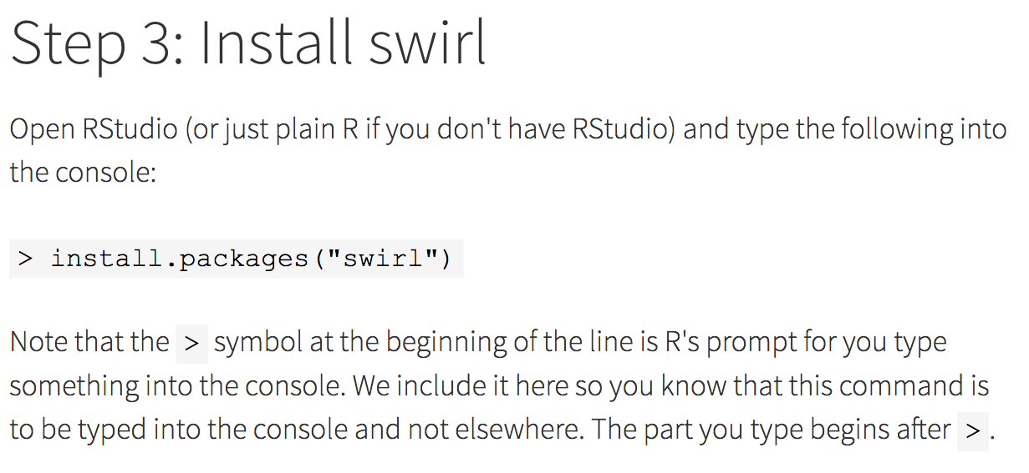
If you would like to learn R or statistics or data analysis via Swirl:
http://swirlstats.com/students.html

Slide 2
After you have installed a package using
> install.packages(“swirl”)
You can load the package using the library command:
> library(swirl)
Use the following to install Swirl courses:
> install_from_swirl("Course Name Here")
The following will start swirl:
> swirl()
For a list of courses:
http://swirlstats.com/scn/title.html
https://github.com/swirldev/swirl_courses#swirl-courses

Slide 3
Some notes:
1.) Normally you only need to install a package once.
e.g > install.packages(“TDAmapper”)
2.) If you want to use a package, you must load it
e.g > library(“TDAmapper”)
You only need to do this once per session.
3.) If you want to repeat a command, you can use the up-arrow on your keyboard to obtain previously typed commands in the console.
4.) When you start typing commands, R will show you some choices. You can click on the one you want.

Slide 4
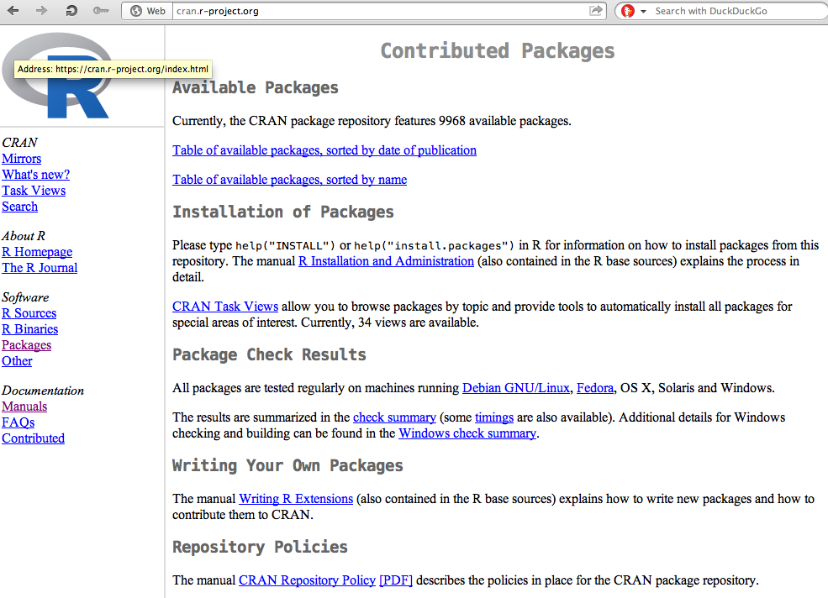
You can find R packates at
https://cran.r-project.org/
Packages

Slide 5
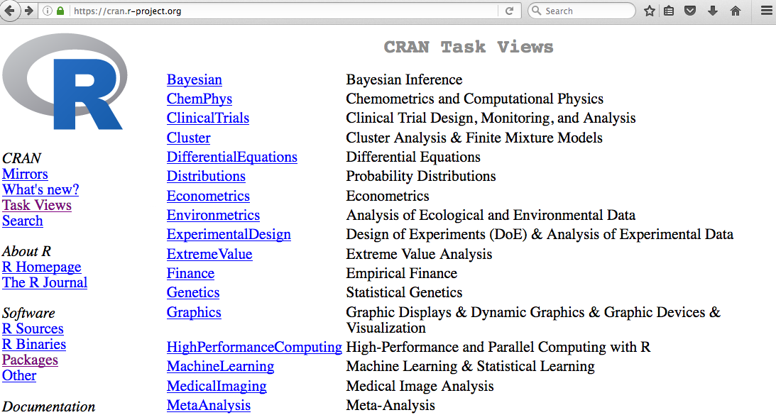

Slide 6
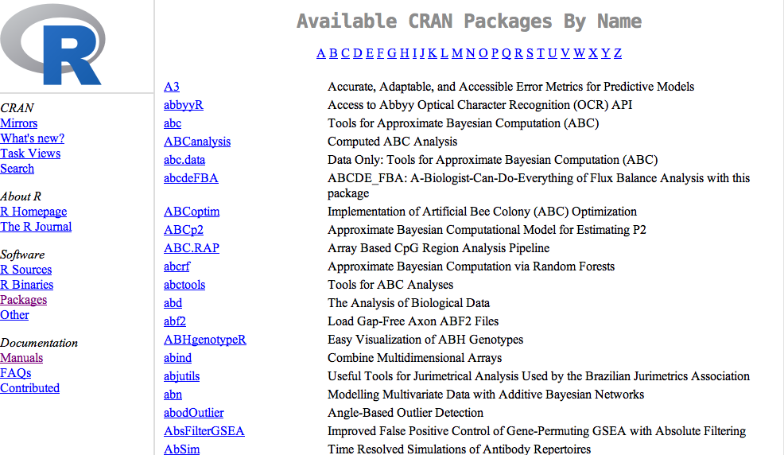

Slide 7
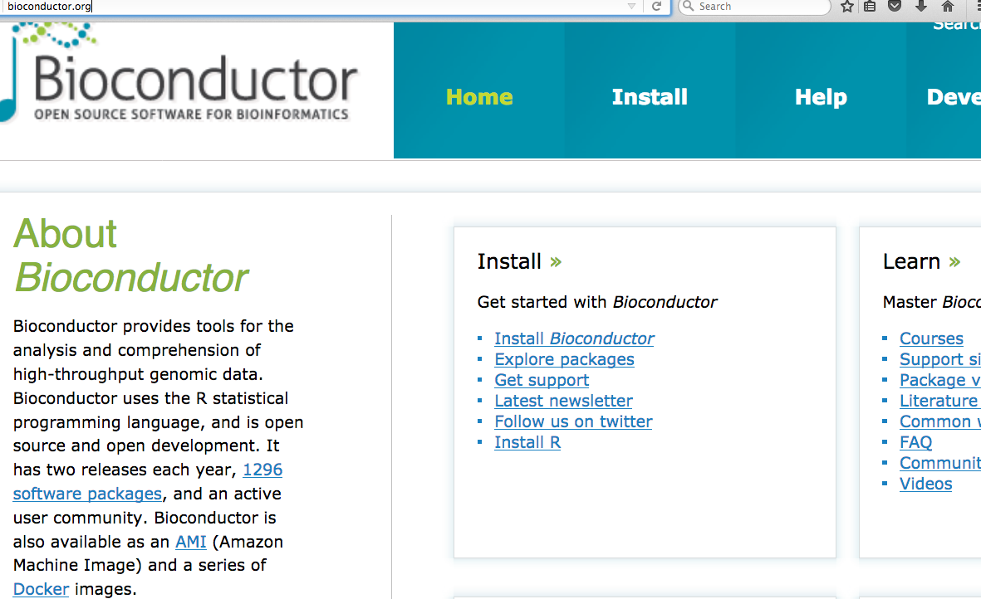
Additional packages can be found at other repositories such as http://bioconductor.org/

Slide 8
The TDAmapper package
Can download source code
useful info

Slide 9
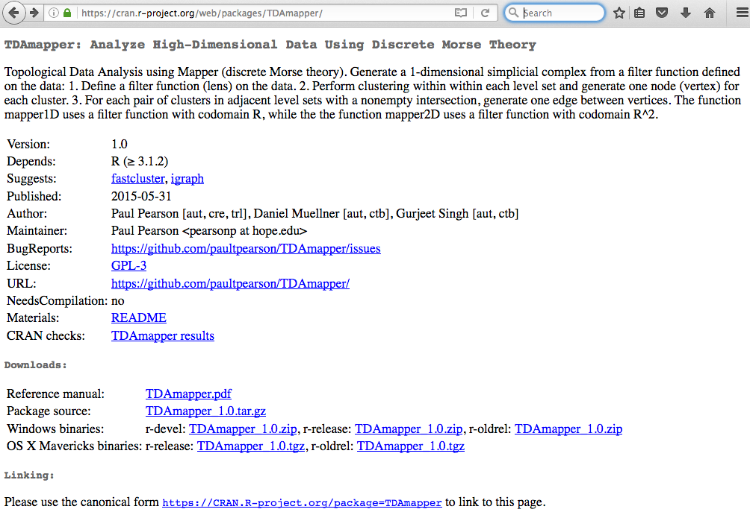
https://CRAN.R-project.org/package=TDAmapper
Click on README for info about package
Click on pdf for description of all TDAmapper commands

Slide 10
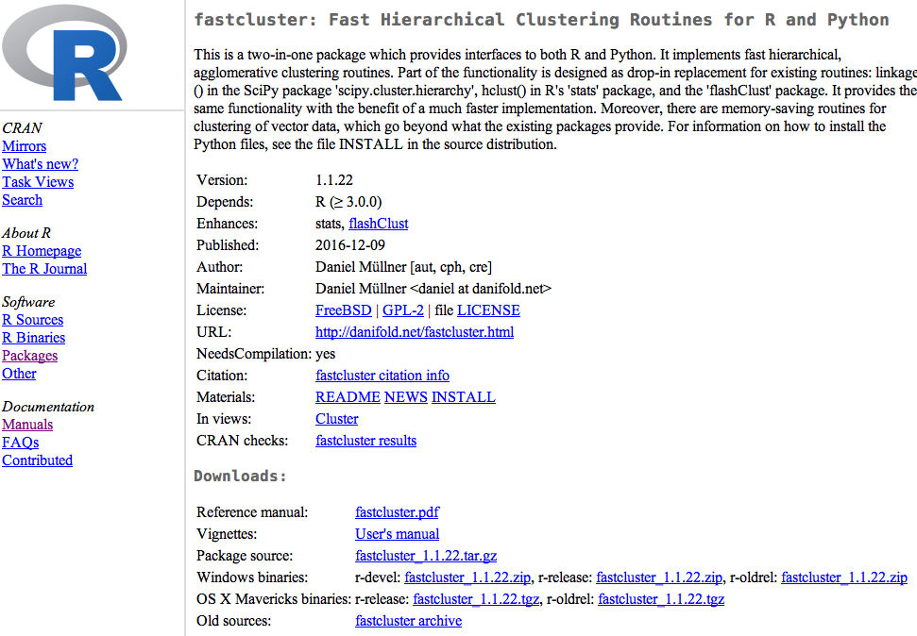
Vignettes are also useful

Slide 11
README
Do not install from GitHub unless you know what your are doing
Install in Rstudio
Examples are sometimes found in READMEs or Vignettes

Slide 12
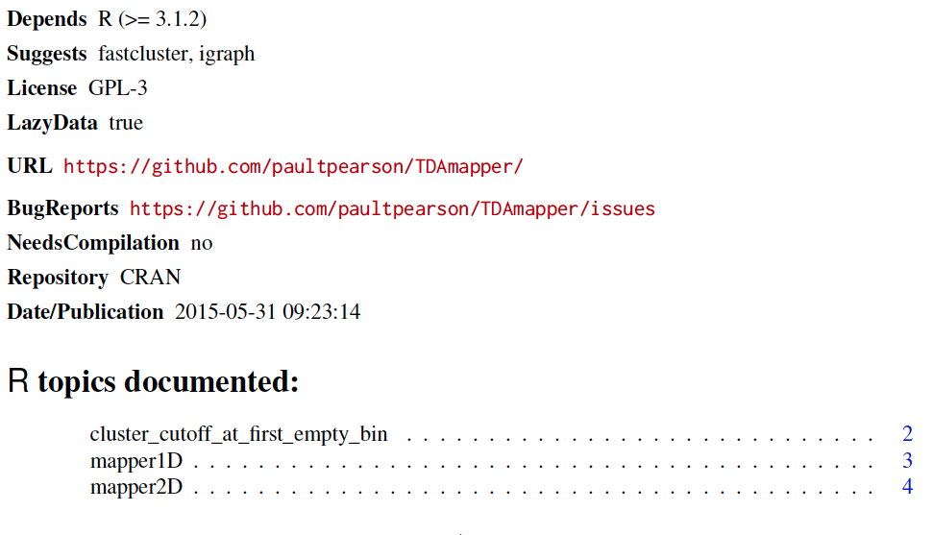
Reference manual:
The reference manual lists all commands contained in the package.

Slide 13
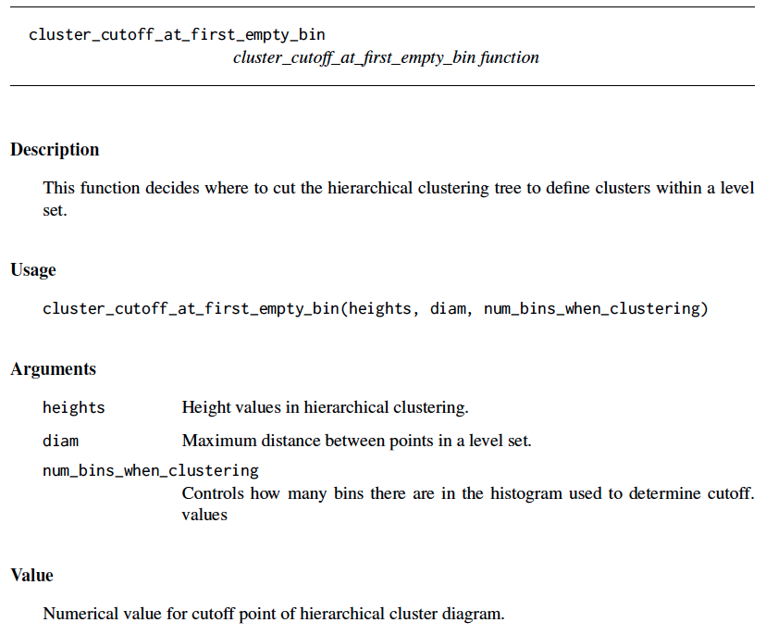
command name
All reference manuals follow same format.
Function inputs
Description of inputs
Description of output(s)

Slide 14
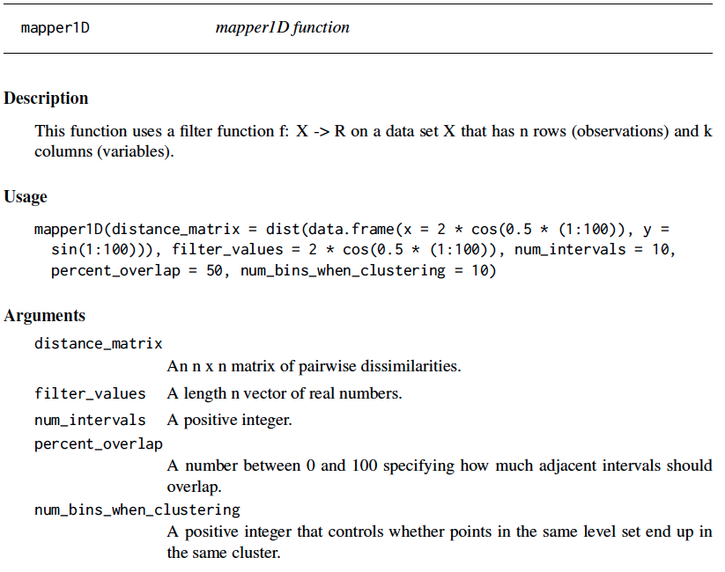

Slide 15
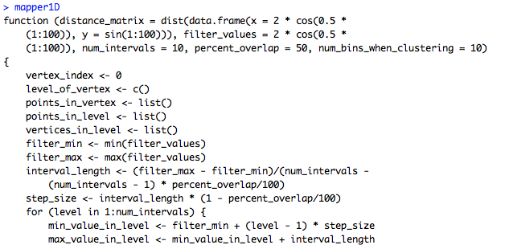
You can take a look at the code in Rstudio for any command just by typing the name of the command.
Note: mapper1d() calls this function
mapper1d allows you to view the code. Note no ()

Slide 16
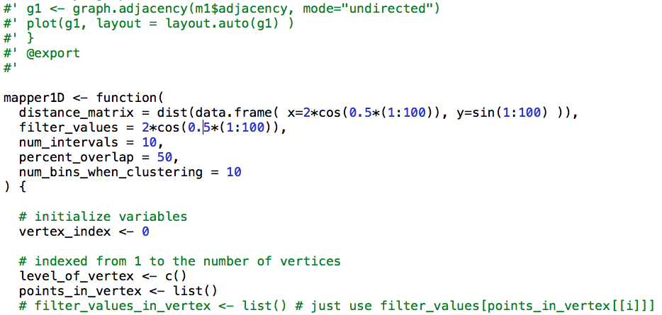
Note the version on GitHub contains commenting

Slide 17
