Slide 1
Graphs
Graph with 7 nodes and 16 edges
Nodes / Vertices
Undirected
Edges
Directed
https://www.csc2.ncsu.edu/faculty/nfsamato/practical-graph-mining-with-R/

Slide 2
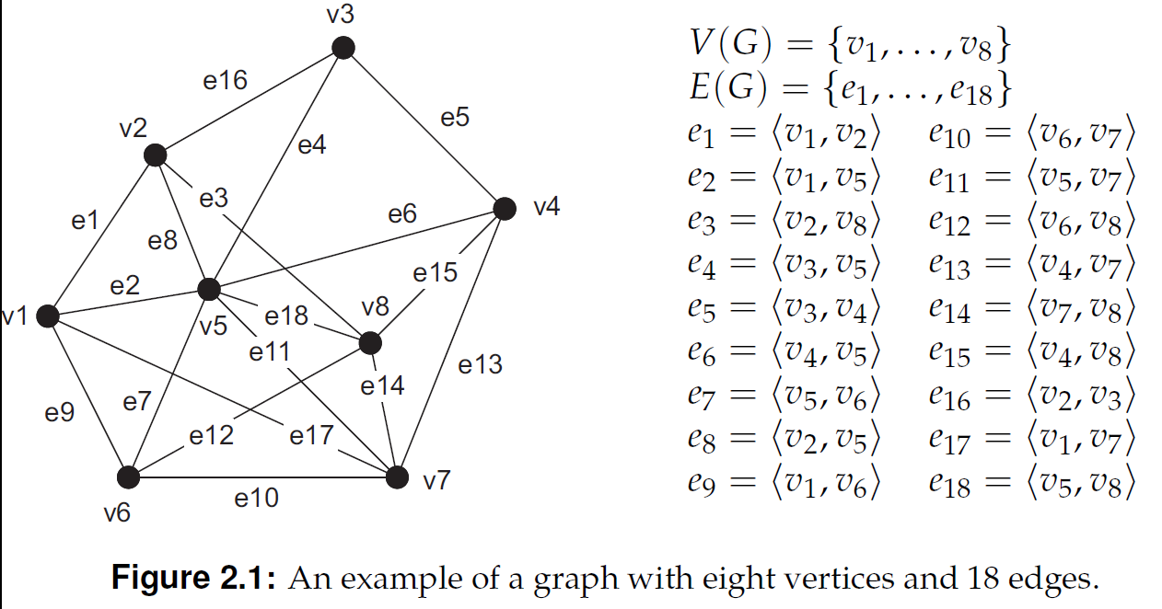

Slide 3
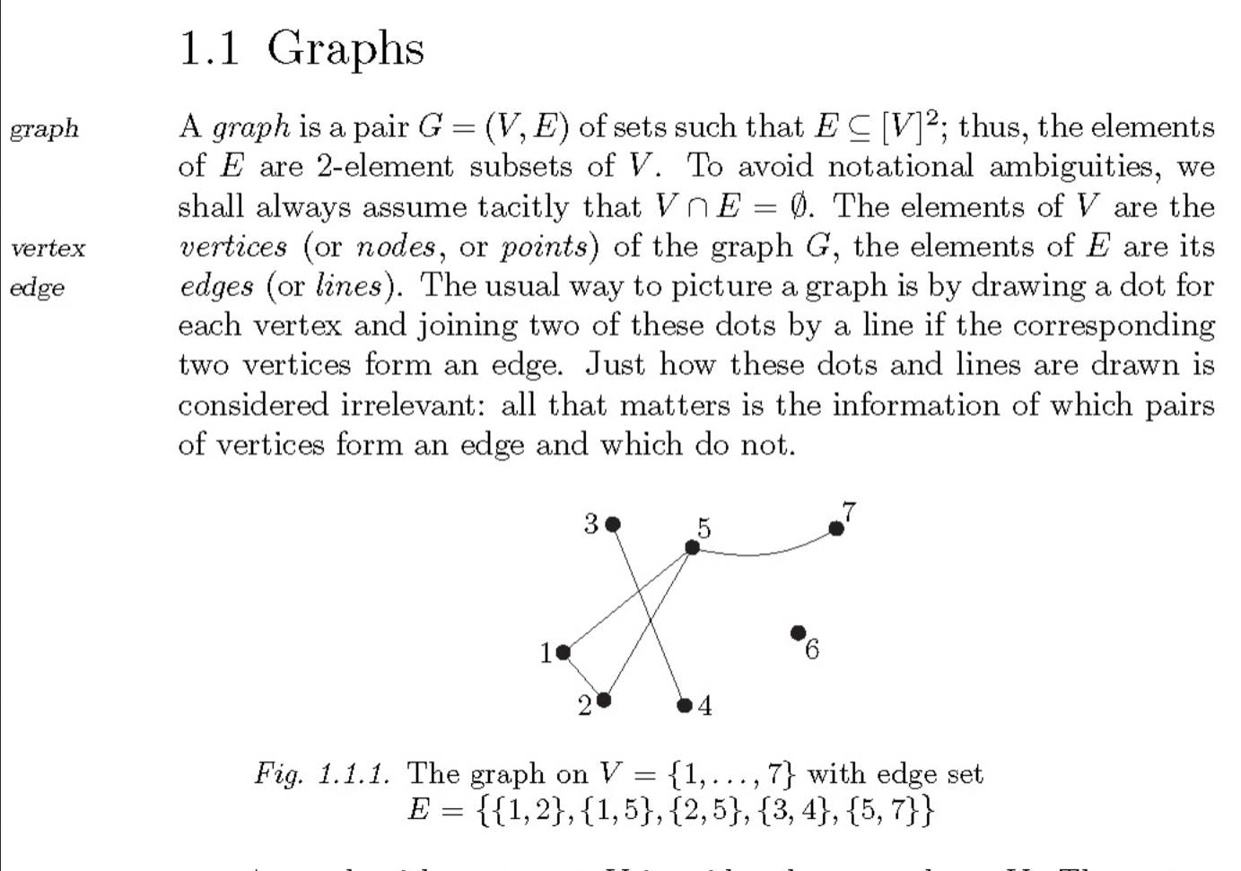
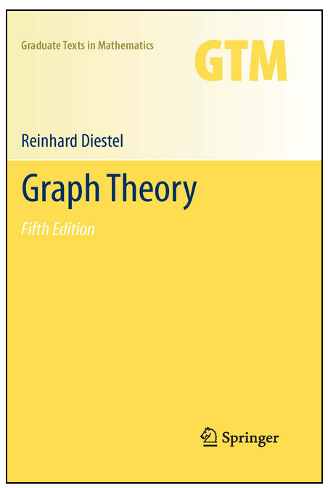
Reinhard Diestel, Graph Theory, Springer GTM 173, 5th edition 2016
http://diestel-graph-theory.com/basic.html

Slide 4
Definition 2.1: A graph G consists of a collection V of vertices and a collection
edges E, for which we write G = (V, E). Each edge e 2 E is said to join two vertices, which are called its end points. If e joins u, v 2 V, we write e = hu, vi.
Vertex u and v in this case are said to be adjacent. Edge e is said to be incident
with vertices u and v, respectively.
We will often write V(G) and E(G) to denote the set of vertices and edges
associated with graph G, respectively. It is important to realize that an edge
can actually be represented as an unordered tuple of two vertices, that is,
its end points. For this reason, we make no distinction between hv, ui and
hu, vi: they both represent the fact that vertex u and v are adjacent.

Slide 5
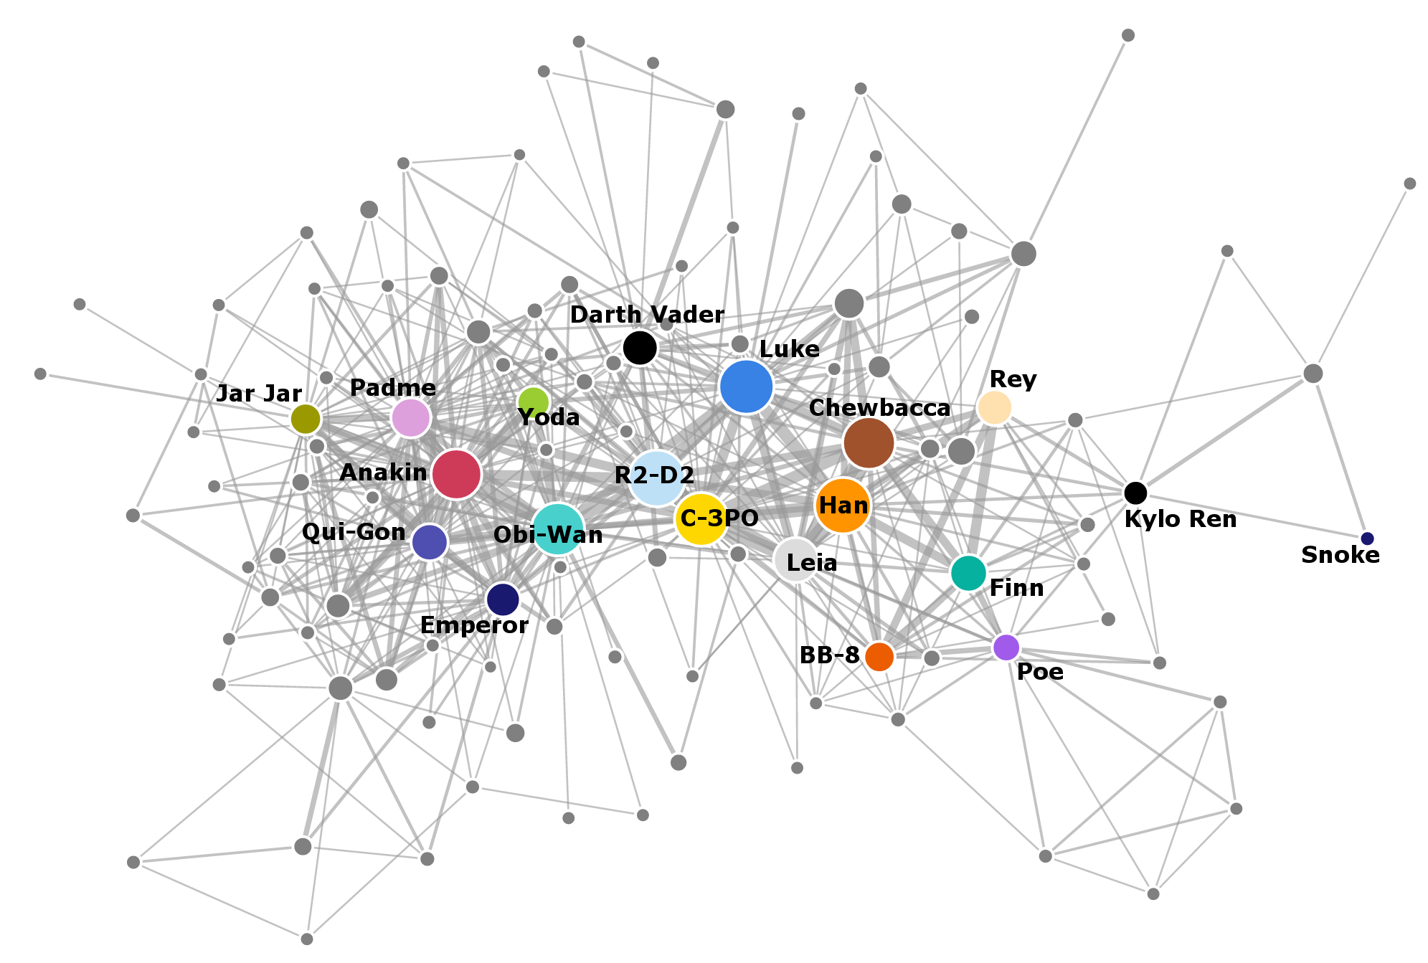
http://evelinag.com/blog/2016/01-25-social-network-force-awakens/
The nodes in the network represent
the individual characters, and they
are connected by a link if they both
speak within the
same scene.
The width of each link represents the frequency of co-occurrence of the two corresponding characters, and the size of each node represents the number of scenes where the character speaks.

Slide 6
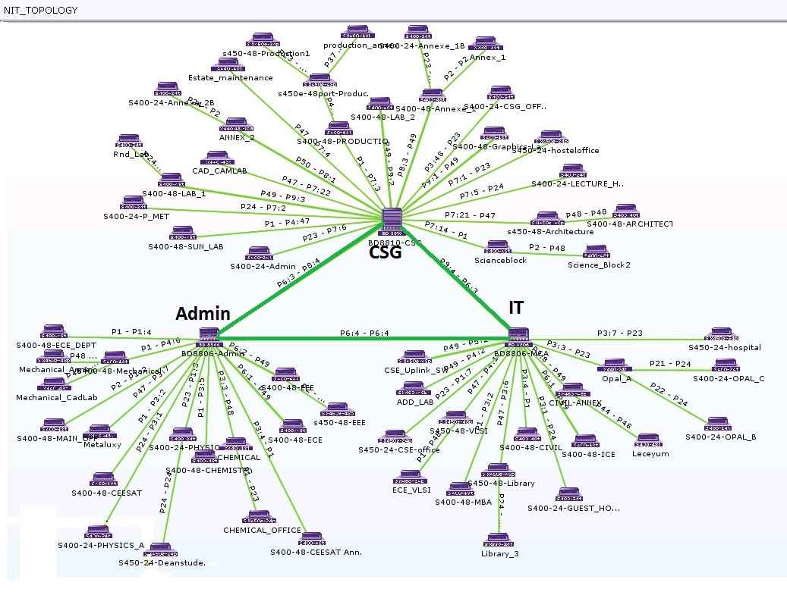
https://www.nitt.edu/home/students/facilitiesnservices/ComputerSupportGroup/cwn/

Slide 7
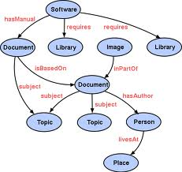
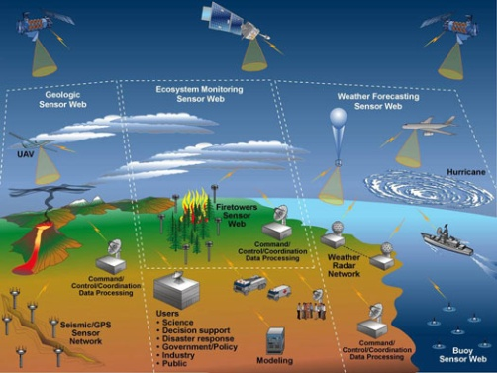
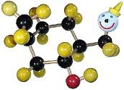
What apps naturally deal w/ graphs?
https://www.csc2.ncsu.edu/faculty/nfsamato/practical-graph-mining-with-R/PracticalGraphMiningWithR.html
Social Networks
Semantic Web
World Wide Web
Drug Design,
Chemical compounds
Computer networks
Sensor networks
Credit: Images are from Google images via search of keywords

Slide 8
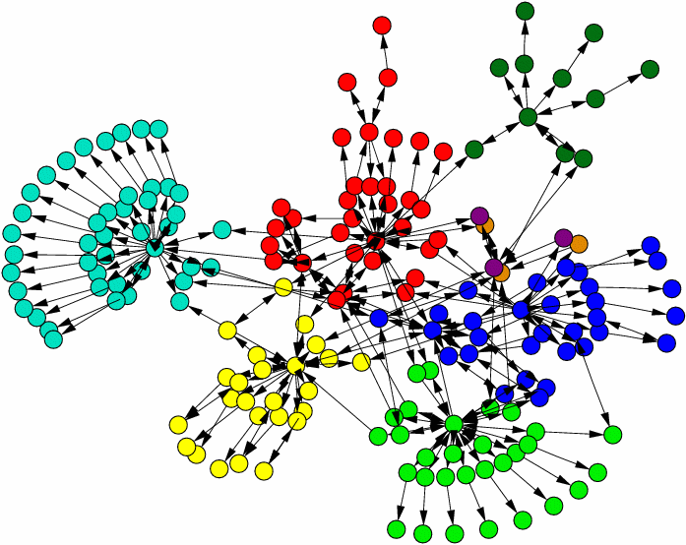
0r as networks, or graphs w/ nodes & links
https://www.csc2.ncsu.edu/faculty/nfsamato/practical-graph-mining-with-R/PracticalGraphMiningWithR.html
Nodes=Documents
Links=Document similarity (e.g., if document references another document )
president government party election political elected national districts held district independence vice minister parties
population area climate city miles province land topography total season 1999 square rate
economy million products 1996 growth copra economic 1997 food scale exports rice fish
Mining such data ~ studying graphs, or graph mining

Slide 9
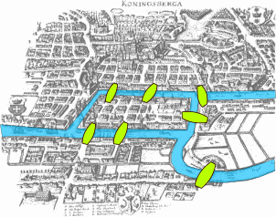
Classical graph theory problem
Seven Bridges of Königsberg: devise a walk through the city that would cross each of those bridges once and only once.
https://en.wikipedia.org/wiki/Seven_Bridges_of_K%C3%B6nigsberg

Slide 10
Seven Bridges of Königsberg: devise a walk through the city that would cross each of those bridges once and only once.
How do you model this as a graph:
What are the vertices?
What are the edges?
https://en.wikipedia.org/wiki/Seven_Bridges_of_K%C3%B6nigsberg

Slide 11
Seven Bridges of Königsberg: devise a walk through the city that would cross each of those bridges once and only once.
How do you model this as a graph:
What are the vertices?
What are the edges?
https://en.wikipedia.org/wiki/Seven_Bridges_of_K%C3%B6nigsberg

Slide 12
Seven Bridges of Königsberg: devise a walk through the city that would cross each of those bridges once and only once.
How do you model this as a graph:
What are the vertices?
What are the edges? Bridges
https://en.wikipedia.org/wiki/Seven_Bridges_of_K%C3%B6nigsberg

Slide 13
Seven Bridges of Königsberg: devise a walk through the city that would cross each of those bridges once and only once.
How do you model this as a graph:
What are the vertices? Disconnected land regions
What are the edges? Bridges
https://en.wikipedia.org/wiki/Seven_Bridges_of_K%C3%B6nigsberg

Slide 14
Seven Bridges of Königsberg: devise a walk through the city that would cross each of those bridges once and only once.
How do you model this as a graph:
What are the vertices? Disconnected land regions
What are the edges? Bridges
How do you word this problem as a graph theory problem?
How do you solve it? Can you solve it? Can you solve it efficiently?
What are some related applications?
https://en.wikipedia.org/wiki/Seven_Bridges_of_K%C3%B6nigsberg

Slide 15
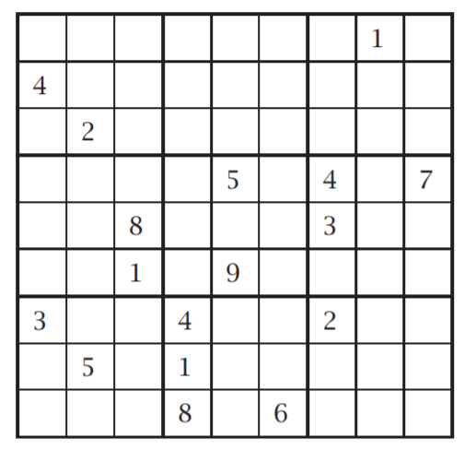
http://www.ams.org/notices/200706/tx070600708p.pdf

Slide 16
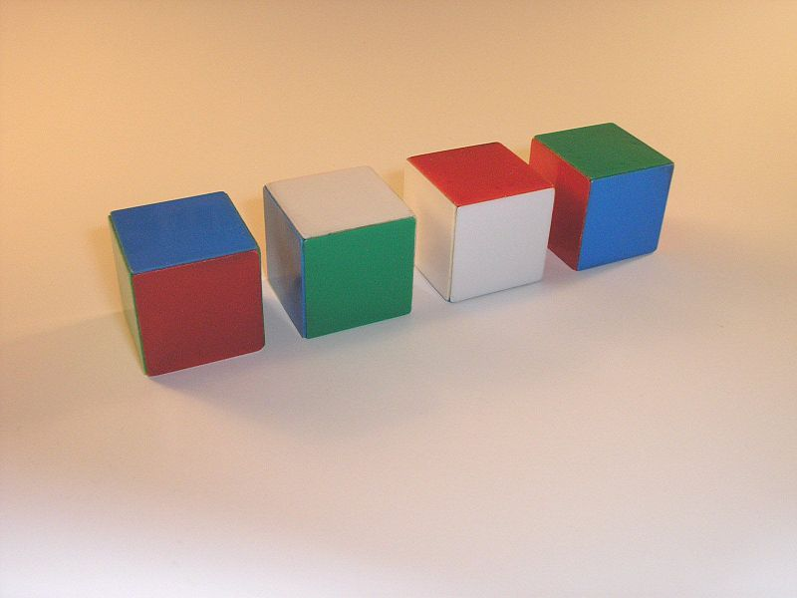
INSTANT INSANITY (1967)
http://ime.math.arizona.edu/circles/GraphsTC.pptx
A puzzle with 4 cubes. Each cubes face is one of 4 colors: red, blue, green, white
Stack the cubes in a column. So that each side of the column has all four colors showing.
Notes:
Give them about 20-30 minutes to try and solve the puzzle

Slide 17
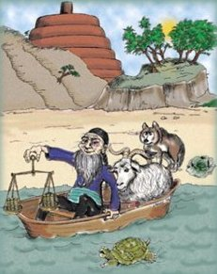
A graph theory problem that is more than a thousand years old from Africa, Europe, etc.
https://dilbert.com/ pballew.blogspot.com/2012/09/a-brief-history-of-river-crossing.html
https://pballew.blogspot.com/2012/09/a-brief-history-of-river-crossing.html
See also
https://www.maa.org/sites/default/files/Asher50650798.pdf

