Slide 1
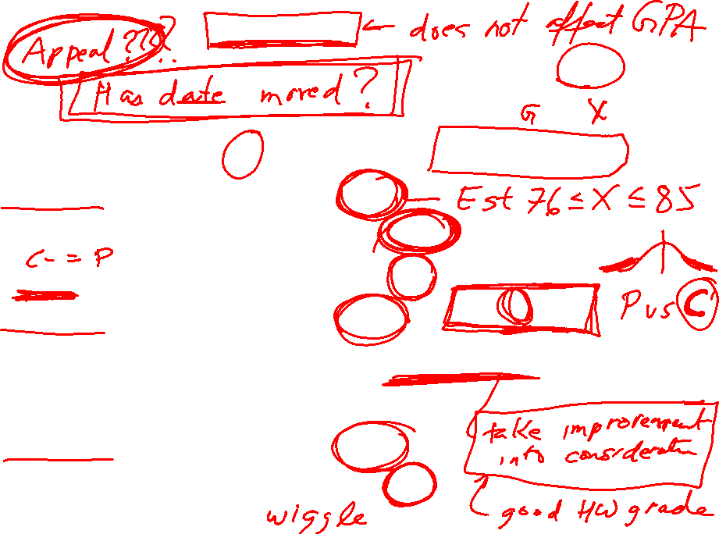
Should you take the P/NP option:
Suppose your current grade is G%. Final exam is worth 30%.
If you earn X% on final exam, then your grade is 0.7G + 0.3X
Thus if you want grade Y, you need to earn X = (Y – 0.7G)/0.3
Scenario 1: Your current grade is 83%.
If Y = 81, you need [81 - .7(83)]/(0.3) = 76.3 on the final exam.
If Y = 60, you need [60 - .7(83)]/(0.3) = 6.3 on the final exam.
Scenario 2: Your current grade is 79%.
If Y = 81, you need [81 - .7(79)]/(0.3) = 85.6 or lower on the final exam.
If Y = 60, you need [60 - .7(79)]/(0.3) = 15.7 on the final exam.
Scenario 3: Your current grade is 60%.
If Y = 60, you need [60 - .7(60)]/(0.3) = 60 on the final exam.
But B > P

Slide 2
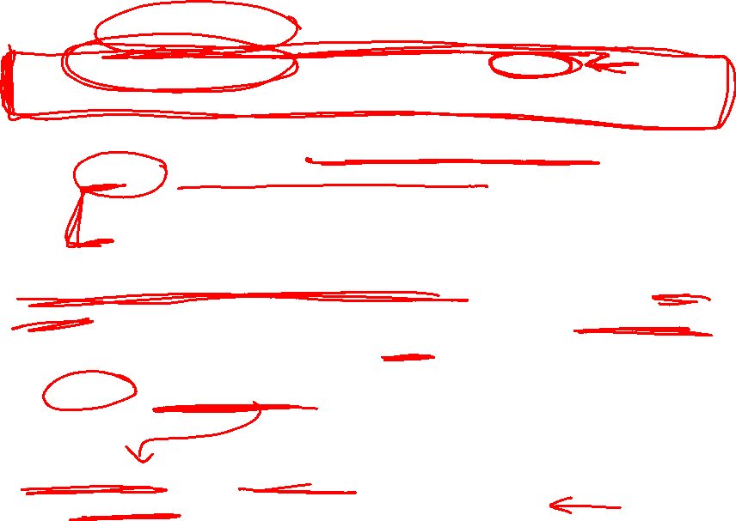
Timeline:
Tonight: Post-midterm 2 review webassign problems available.
More practice problems available at (check errata)
http://www-users.math.umn.edu/~tlawson/2374/exams.html
Saturday evening: More webassign review problems available
  1st set ordered according to sections.
  2nd set containing all webassign review problems in a mixed ordering.
Answers to webassign review problems are available after 3rd attempt. All other webassign answers available after due date. Webassign review problems are (semi-)optional.
By Sunday: First 3 versions of webassign part of Final exam will become available.
Thursday noon: First 3 versions of webassign part of Final exam are due. Answers to these exams will be available.

Slide 3
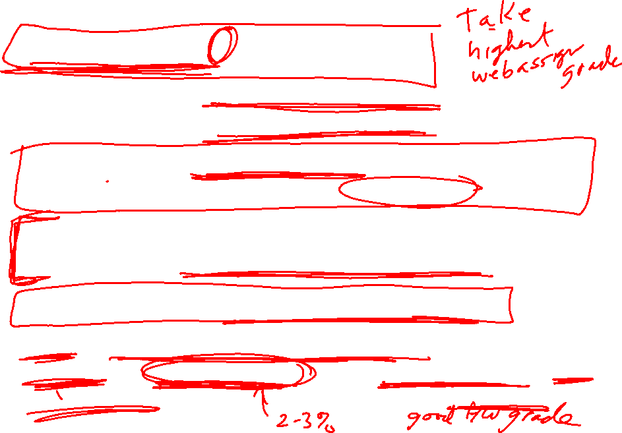
Timeline:
Thursday noon – 2pm? Zoom problem session.
Thursday afternoon. Webassign versions 4 and 5 become available. These versions will be due Saturday at 11:59pm.
Friday 05/15/2020 10:00AM - 12:00PM: In class portion of Final exam. E-mail me ASAP if you need a make-up time.
Friday afternoon: I will be grading exams. I hope to post Final exam grades along with tentative grades by Friday midnight.
Saturday at 11:59pm: Webassign versions 4 and 5 due.
Sunday: I will update Webassign final exam grades as well as grade for course. For borderline grades, I will take improvement (on both parts of final exam) into consideration as well as completion of optional assignments.

Slide 4
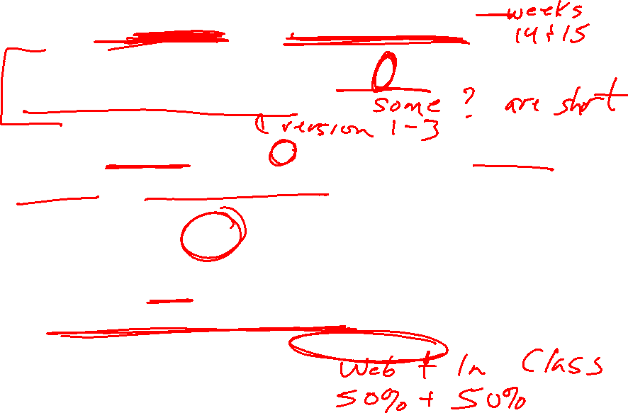
Final exam is cumulative with fairly even coverage.
For webassign part: 1 hour each, about 5 – 7 questions. Check ICON Sunday night for description.
Example: Version X contains n problems including one from section ?? and one from chapter ??.
Note the remaining n-2 problems can come from any section.
Some versions might be harder than other versions, but I will try to make them of comparable difficulty. E-mail me if you would like one Webassign version to be a paper version.
Webassign part worth 50 pts.
Webassign grade = highest of the 5 versions
In class part also worth 50 pts.

Slide 5
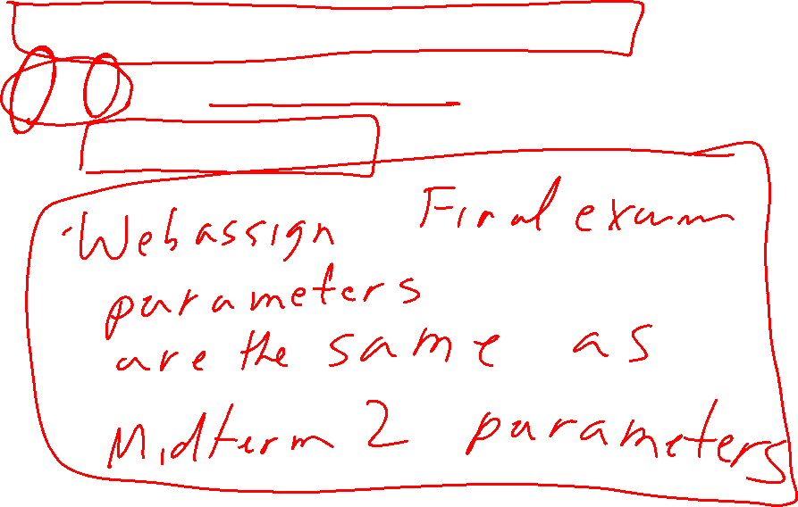
Webassign Midterm 2 version 3 problem 1
K vs k: If this affected your grade, please e-mail me.
Also, check my addition.

Slide 6
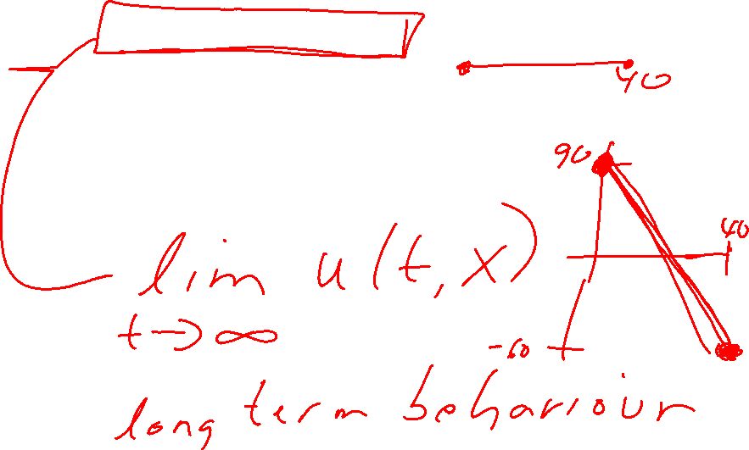
Find the steady-state solution of the heat conduction equation α²u_{xx} = u_{t}
that satisfies the given set of boundary conditions. u(0, t) = 90,
u(40, t) = −60

Slide 7
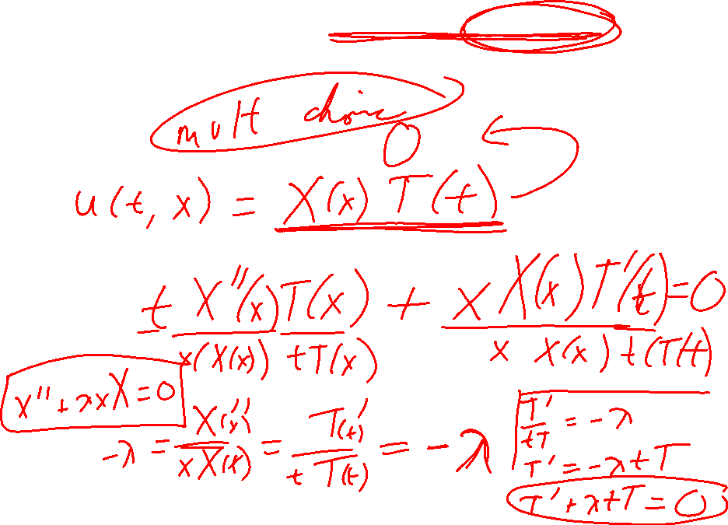
Determine whether the method of separation of variables can be used to replace the given partial differential equation by a pair of ordinary differential equations.
tu_{xx} + xu_{t} = 0

Slide 8
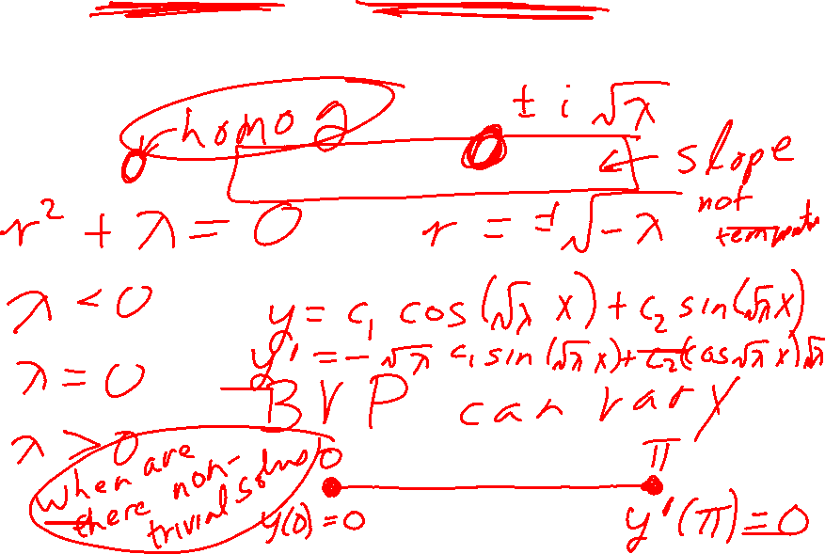
Find the eigenvalues and eigenfunctions of the given boundary value problem. Assume that all eigenvalues are real. (Let n represent an arbitrary positive number.)
y'' + λy = 0, y(0) = 0, y'(π) = 0

Slide 9
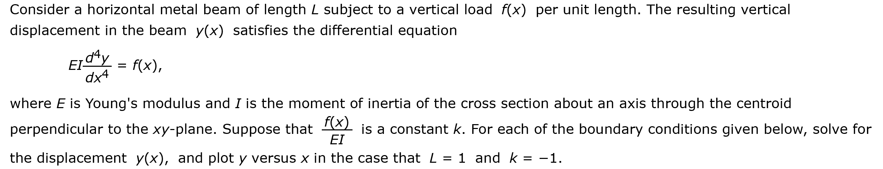
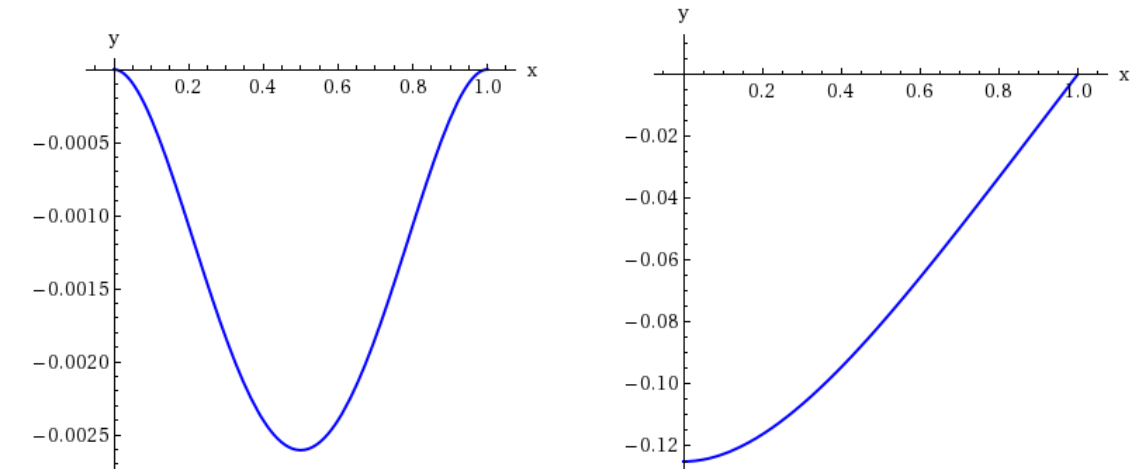
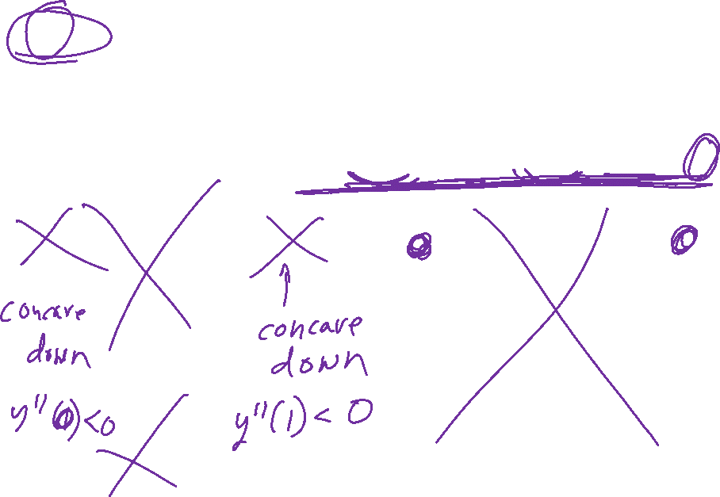
(a) simply supported at both ends: y(0) = y''(0) = y(L) = y''(L) = 0

Slide 10
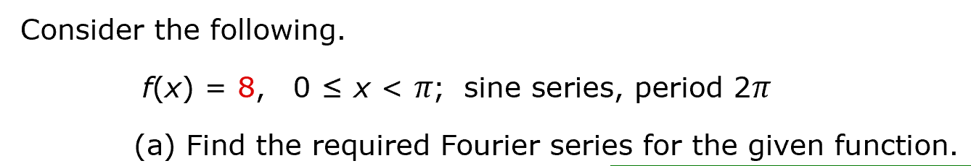
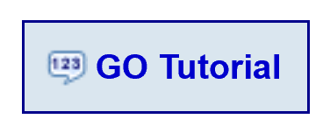
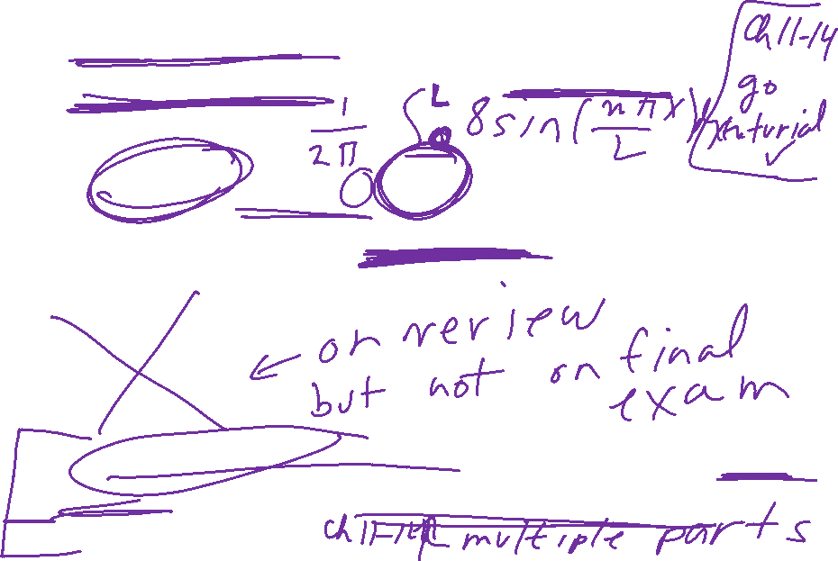
See webassign post-midterm 2 review problems for sample webassign final exam problems for post-midterm 2 material. Note in-class final exam problems can be more interesting.
Note chapter 10 Boyce and DiPrima final exam problems will not be go tutorial problems (but Multivariable calculus problems can be go tutorial problems)

Slide 11
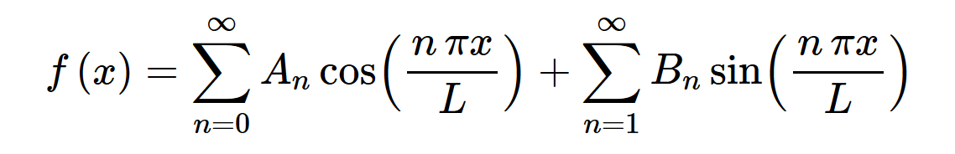
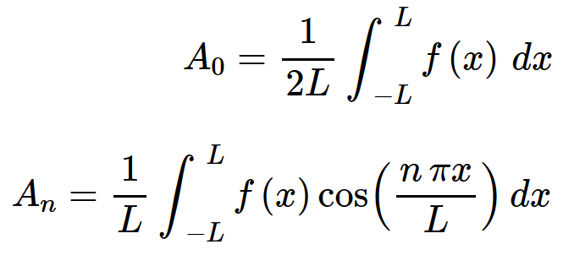
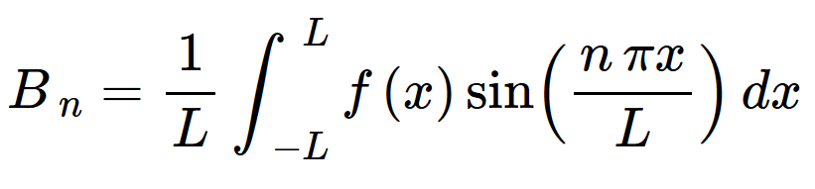
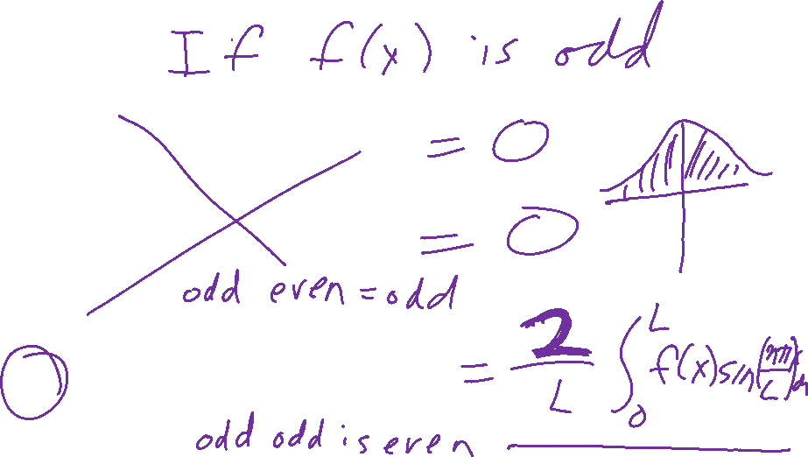
http://tutorial.math.lamar.edu/Classes/DE/FourierSeries.aspx
Find A_{n} and B_{n} if

Slide 12
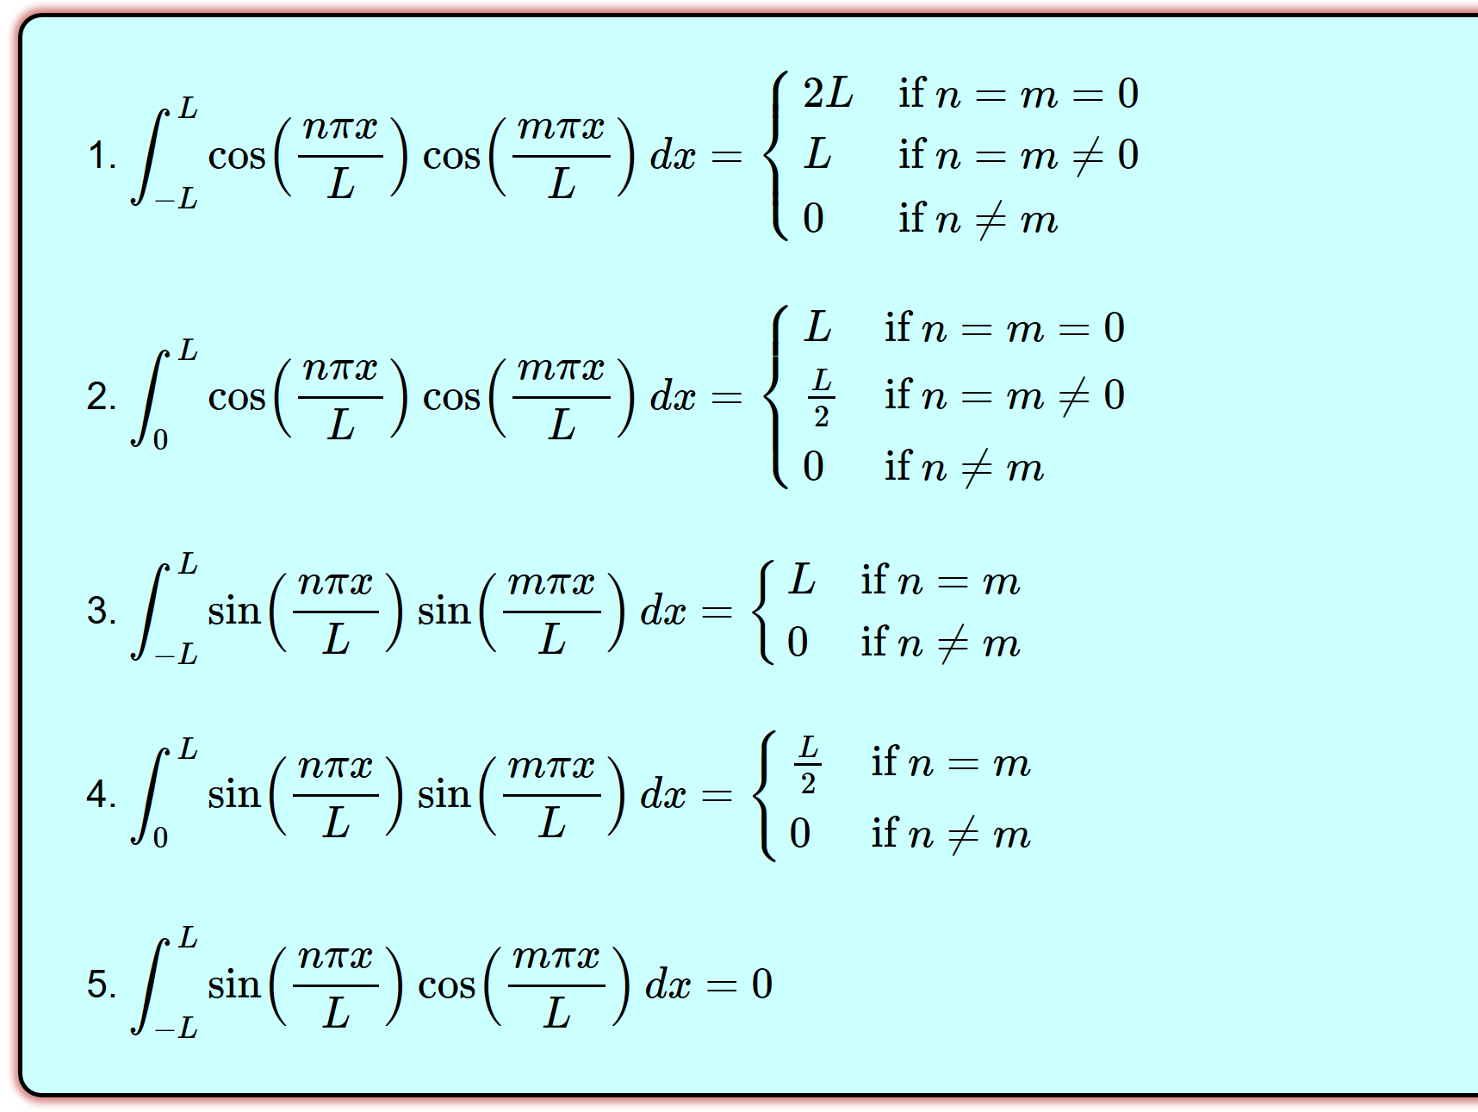
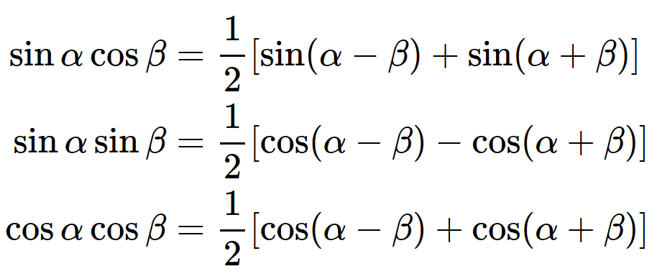
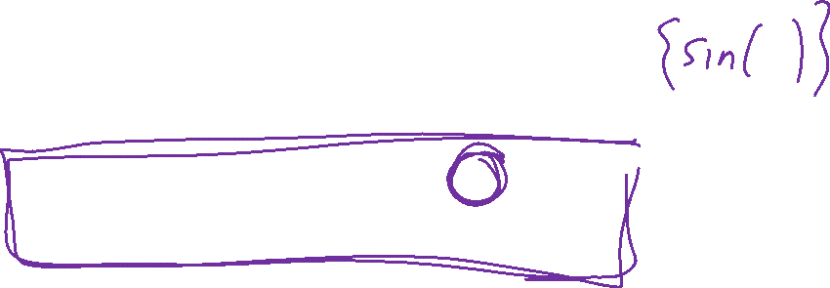
http://tutorial.math.lamar.edu/Classes/DE/PeriodicOrthogonal.aspx

Slide 13
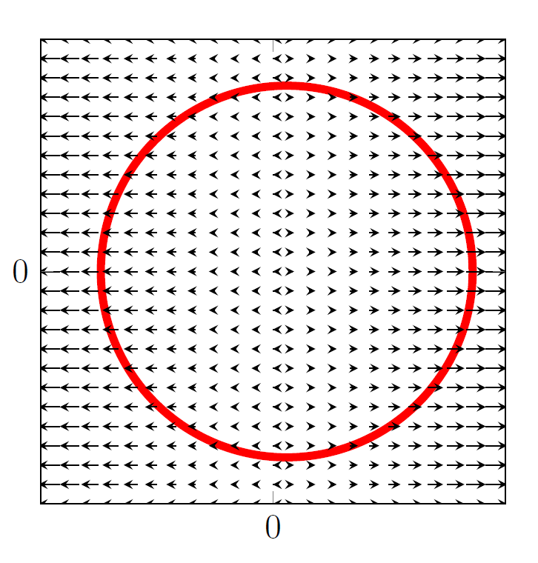
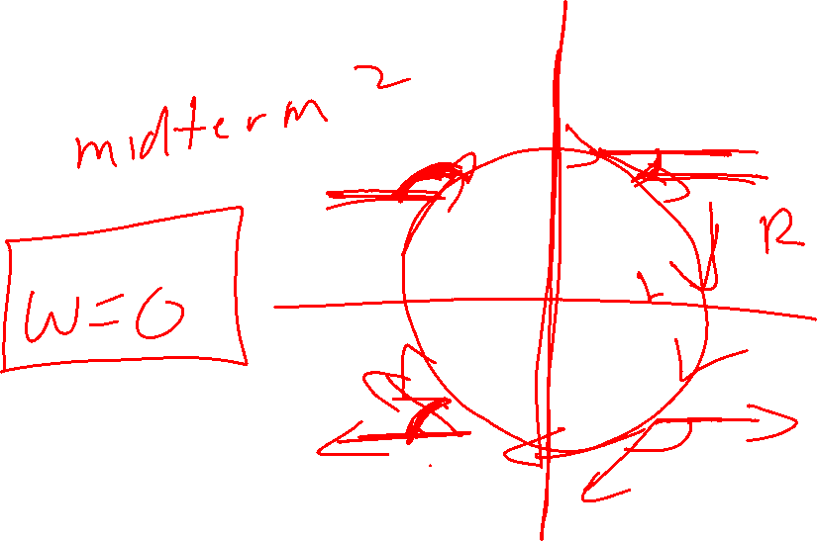
[2] (e) What is the work done by force field F(x, y) =< x, 0 > on a particle that moves once around the circle oriented in the clockwise direction. Briefly explain your answer without using integration or Green's theorem.

Slide 14
