Slide 1

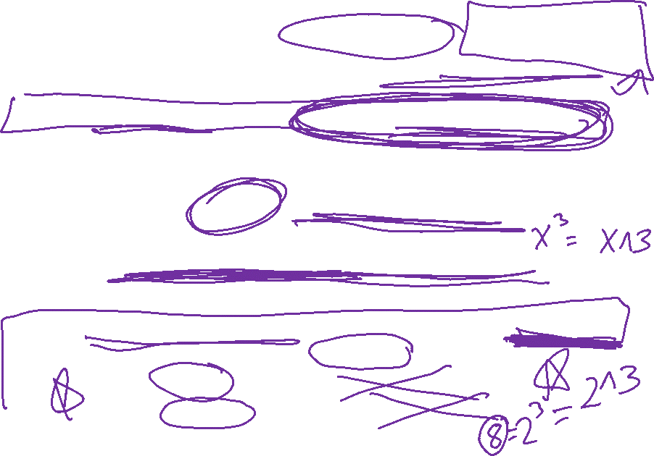
Midterm 2 will cover 13.6 – 14.5
Webassign portion
3 different timed versions (45 minutes each).
Click on ask your teacher if you have questions or problems. Include your answer or any other useful info in your e-mail.
Version 1 available now. Due Monday Apr 20 at 9:00am.
Versions 2 and 3 available this afternoon and due Tuesday April 21 at 4pm.
All 3 version are different, covering different sections, but with some overlap.
Grade on webassign will be highest of your 3 attempts.
will include multiple part webassign problems.
NOTE: unless stated otherwise, webassign requires exact answers, so 1/2 or 0.5 are both fine since 1/2 = 0.5, but
1/3 does not equal 0.3333333 and
sqrt(2) does not equal 1.1415927,
so you canNOT use decimals for 1/3, sqrt(2), etc.

Slide 2

Note both parts of exam are open book/open notes
You may look up integral formulas and trig identities.
You may use WolframAlpha to draw graphs.
Please do the problems yourself.
Create your own review sheet(s) including all formulas you might need for quick reference.
If you need an extension on HW/quizzes, ask and it shall be granted. If you need an extension on midterm 2,
it may or may not be granted, so ask early.
Click on ask your teacher if you have questions or problems. Include your answer or any other useful info in your e-mail.

Slide 3

Webassign midterm is set up in same format as webassign quiz, except that for multipart problems, you will be given the highest grade on each part (so if you change right answer to wrong answer, you will still be given full credit).
You have 2 submissions for each part.
Webassign portion may be curved.
Watch your time: 45 minutes from when you open – NO BREAKS
Webassign part: 3 – 5 problems, worth 60% of midterm 2.
Written upload to ICON part: 2 main problems plus possibly shorter problems, worth 40% of midterm 2

Slide 4
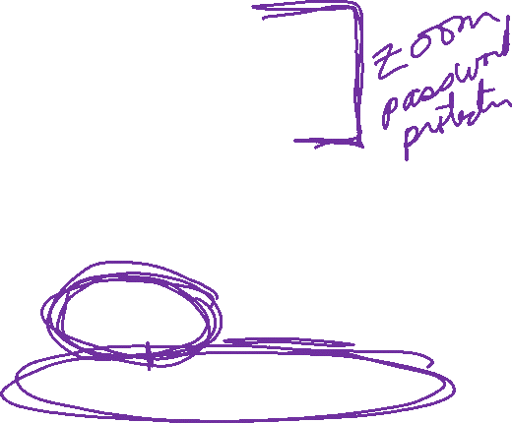
Midterm 2 will cover 13.6 – 14.5
For written portion to be uploaded to ICON, choose ONE of the following times:
Tuesday April 21 at 6:30pm in the evening
Wednesday April 22 at 9:30am in the morning
Wednesday April 22 at 1:30pm in the afternoon
Log into zoom and upload to ICON. You will have 30 minutes for this written portion of the exam plus 20 minute to upload to ICON.
NOTE zoom class on Monday, Tuesday, and Wednesday will be password protected. Look for e-mail over this weekend.

Slide 5
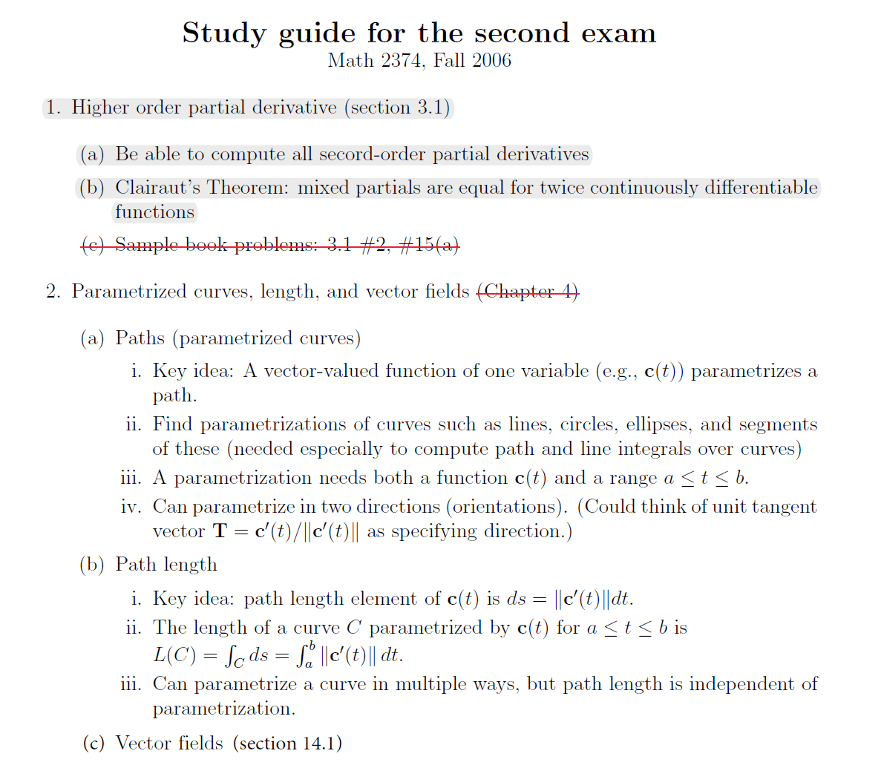
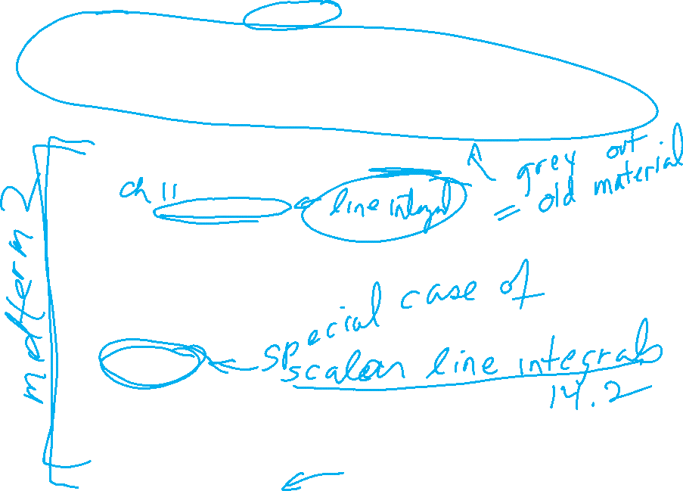

Slide 6
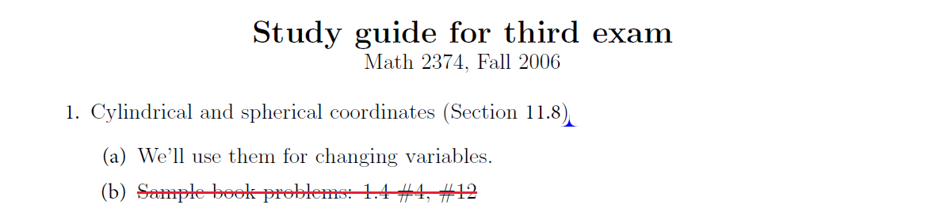
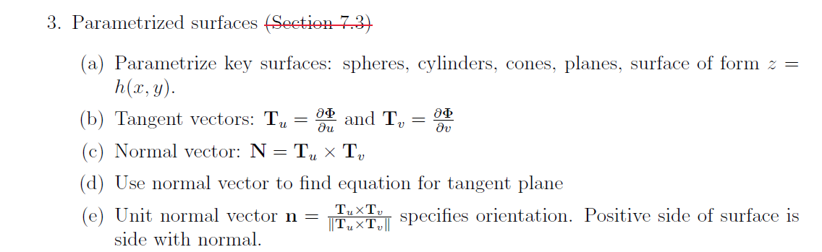
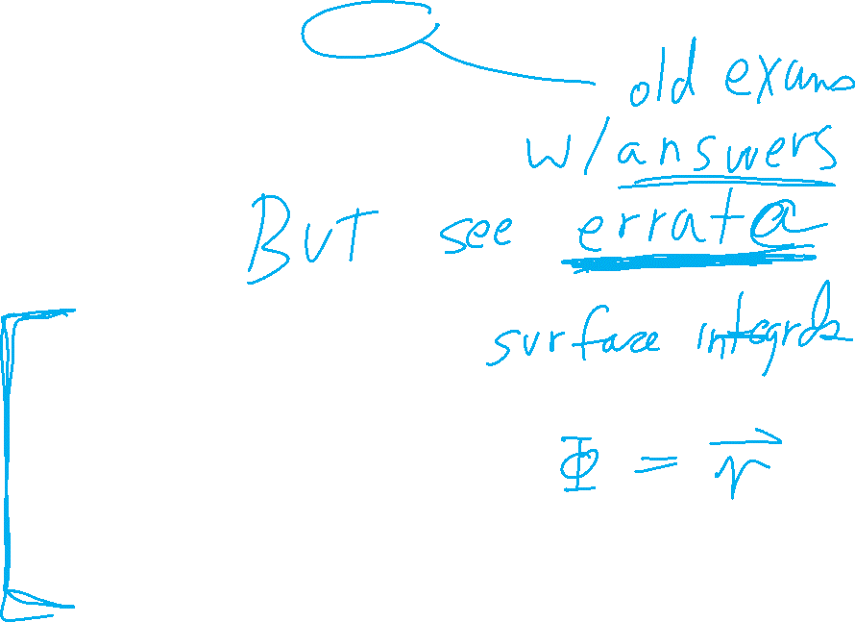

Slide 7
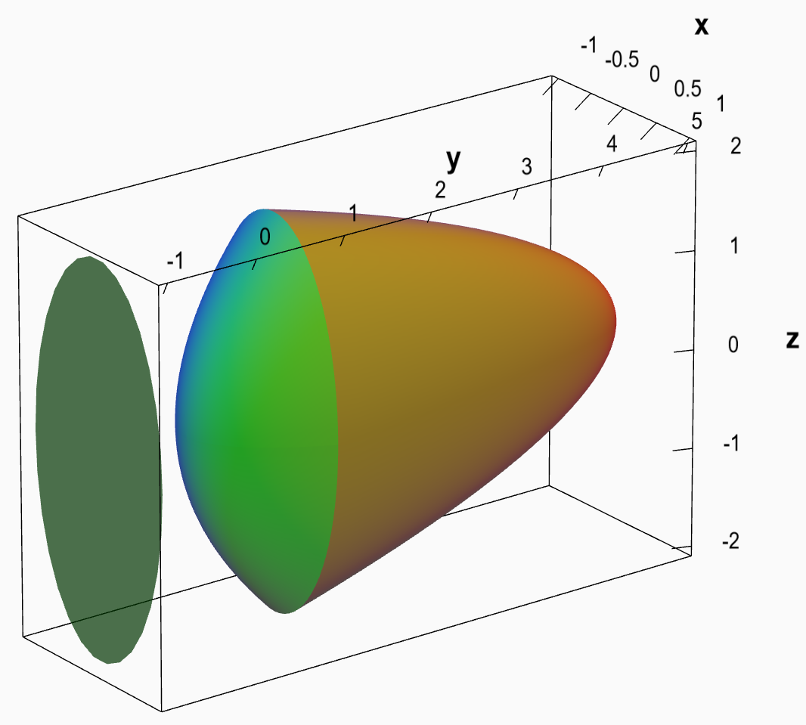
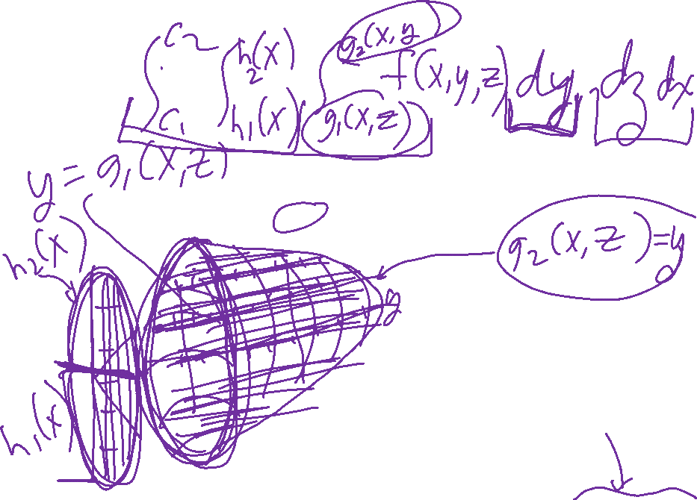
13.6: Triple integrals and 13.7 Cylindrical and Spherical
https://mathinsight.org/triple_integral_shadow_method

Slide 8
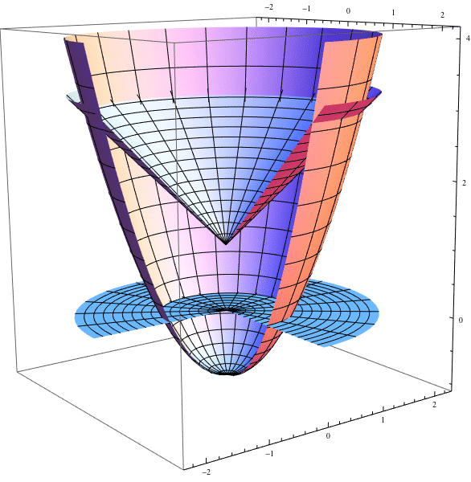
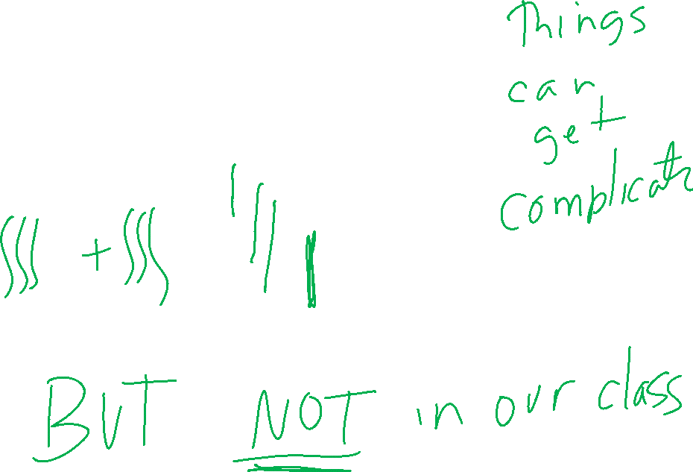
https://math.stackexchange.com/questions/850677/triple-integral-calculation-gone-wrong

Slide 9
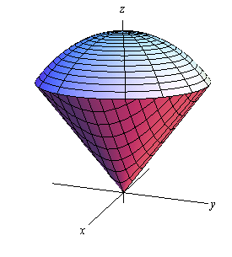
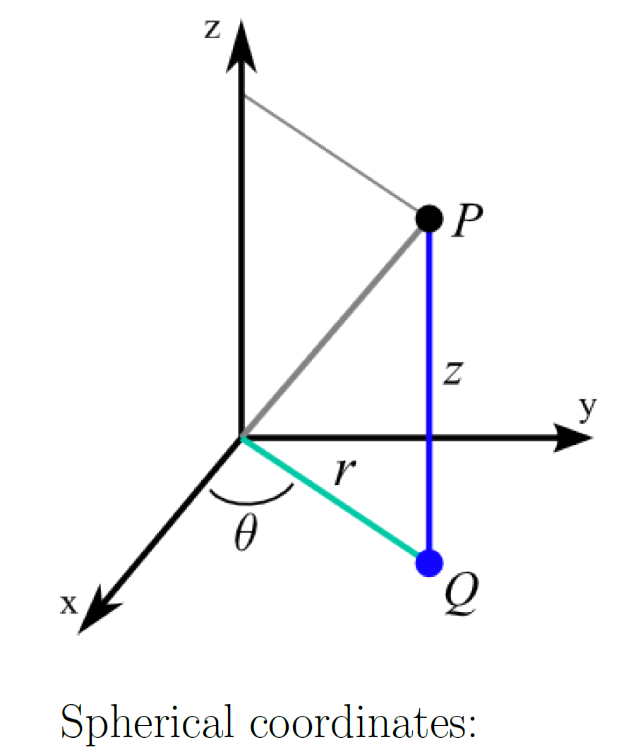
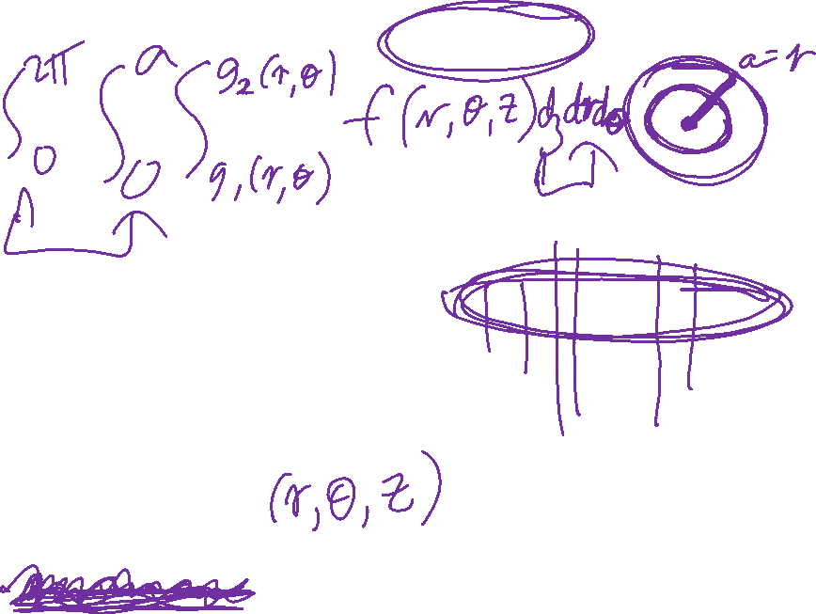
13.6: Triple integrals and 13.7 Cylindrical and Spherical

Slide 10
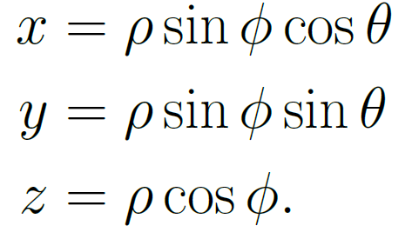
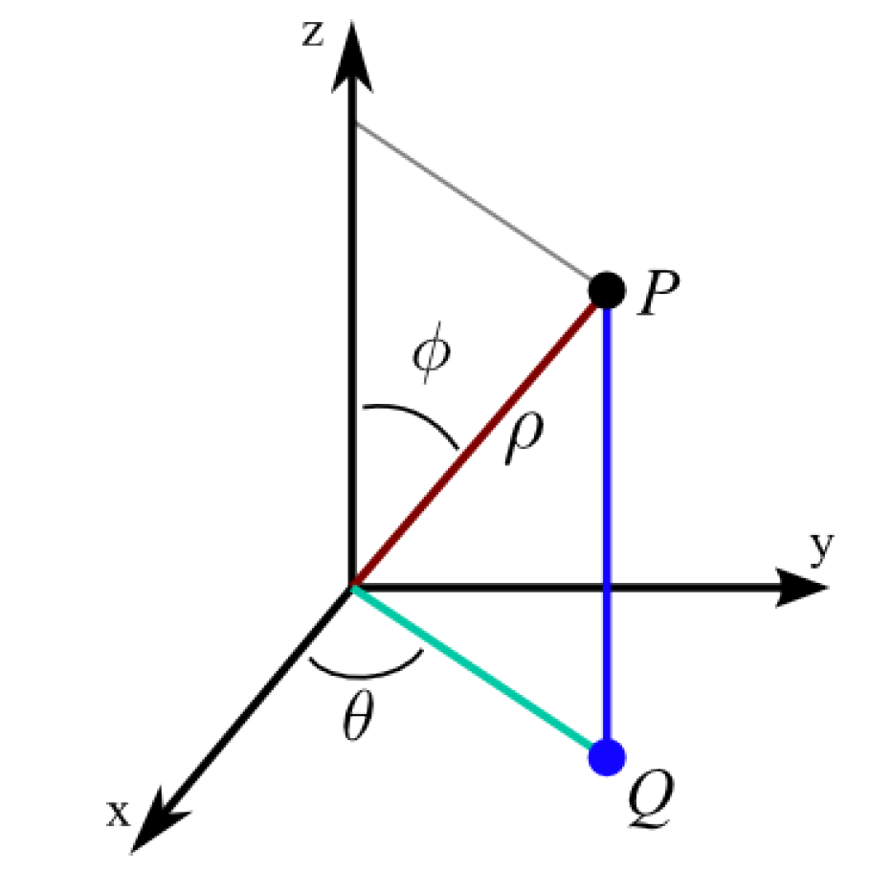
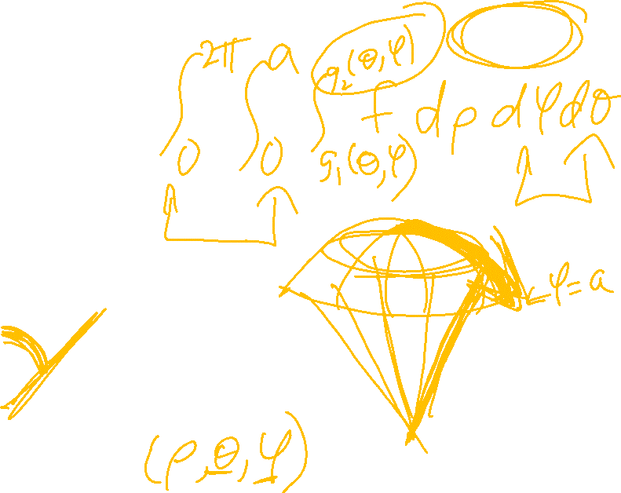
13.6: Triple integrals and 13.7 Cylindrical and Spherical
https://math.stackexchange.com/questions/2680630/find-the-volume-of-the-region-inside-both-the-sphere-x2y2z2-4-and-the-cyl

Slide 11

13.6: Triple integrals and 13.7 Cylindrical and Spherical
Be able to change the order of integration.

Slide 12
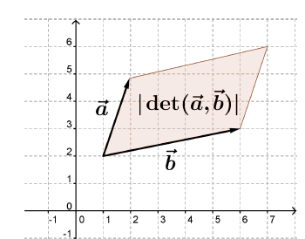

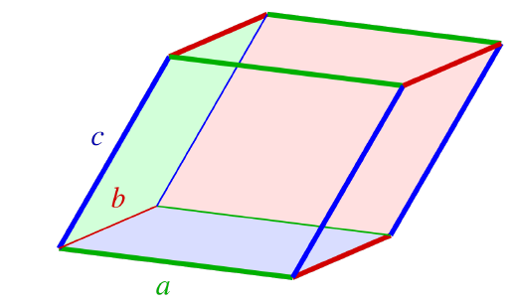
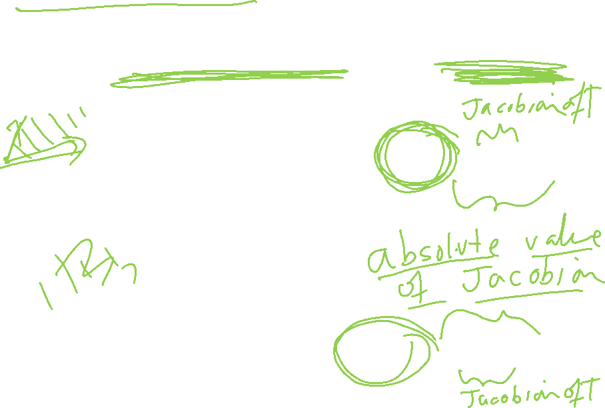
13.9: Change of variable
Examples: Cylindrical, spherical, as well as more general

Slide 13
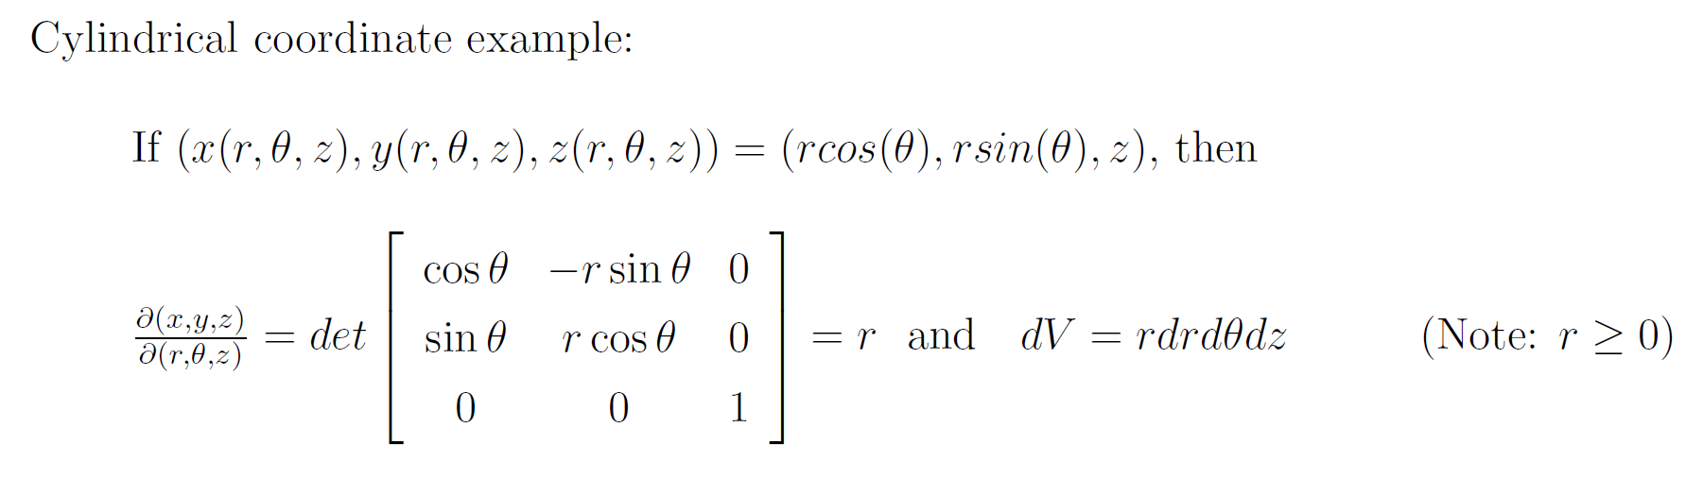
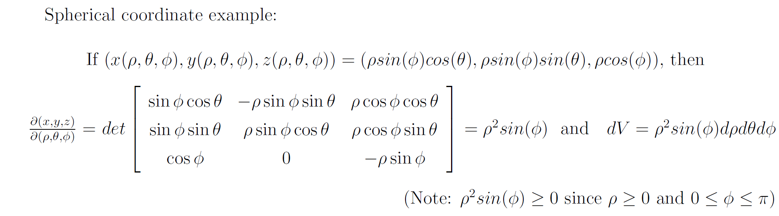
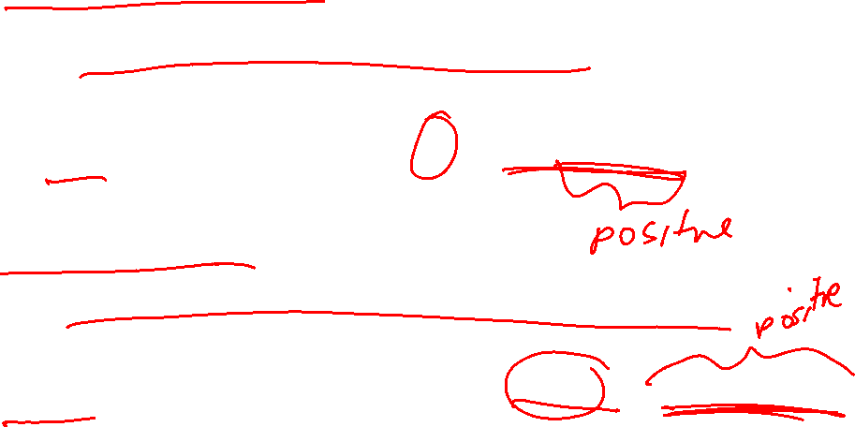
13.9: Change of variable
Examples: Cylindrical, spherical, as well as more general

Slide 14
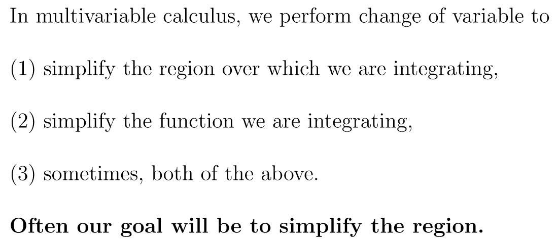
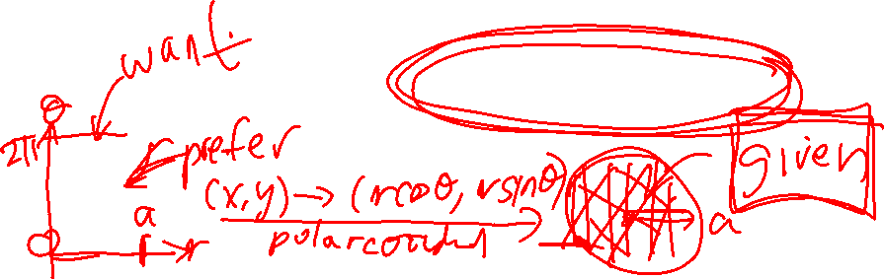
13.9: Change of variable
Examples: Cylindrical, spherical, as well as more general

Slide 15
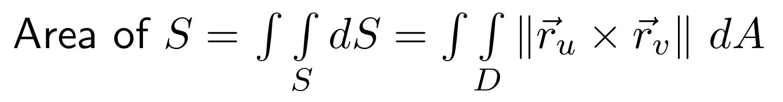
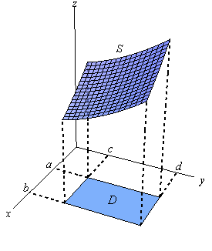
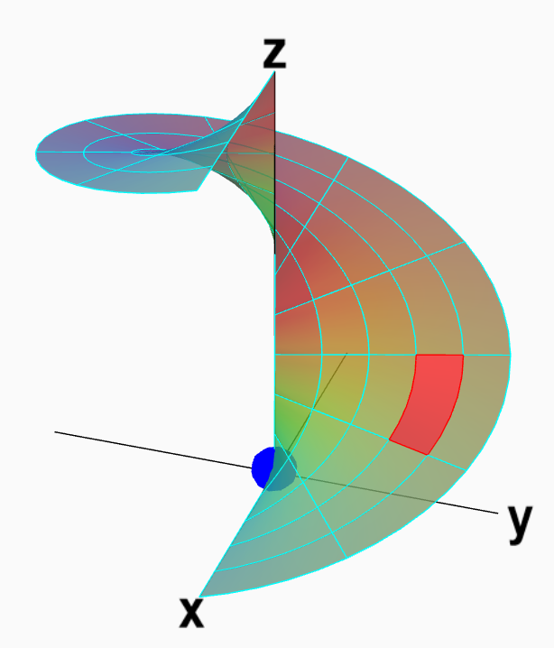
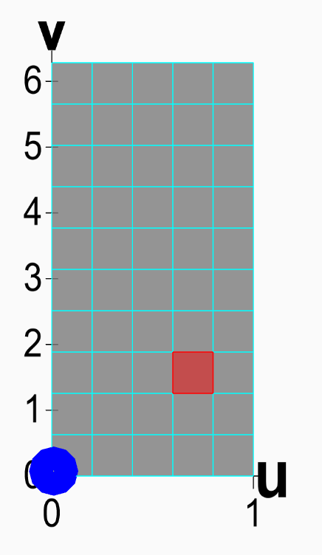
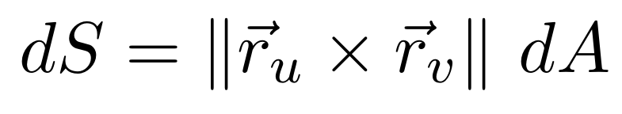
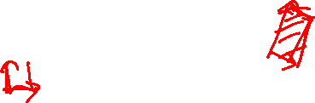
Section 13.8 Surface area
http://tutorial.math.lamar.edu/Classes/CalcIII/SurfaceIntegrals.aspx
http://tutorial.math.lamar.edu/Classes/CalcIII/SurfaceIntegrals.aspx
https://mathinsight.org/parametrized_surface_area

Slide 16
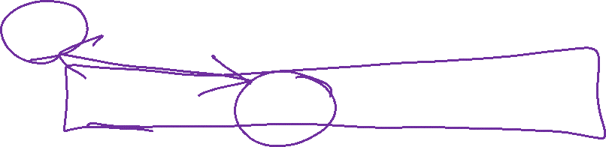
13.8: Surface Integrals
Special case of 14.5: scalar surface integral

Slide 17

Section 13.8 Surface area
http://tutorial.math.lamar.edu/Classes/CalcIII/SurfaceIntegrals.aspx
http://tutorial.math.lamar.edu/Classes/CalcIII/SurfaceIntegrals.aspx
https://mathinsight.org/parametrized_surface_area

Slide 18
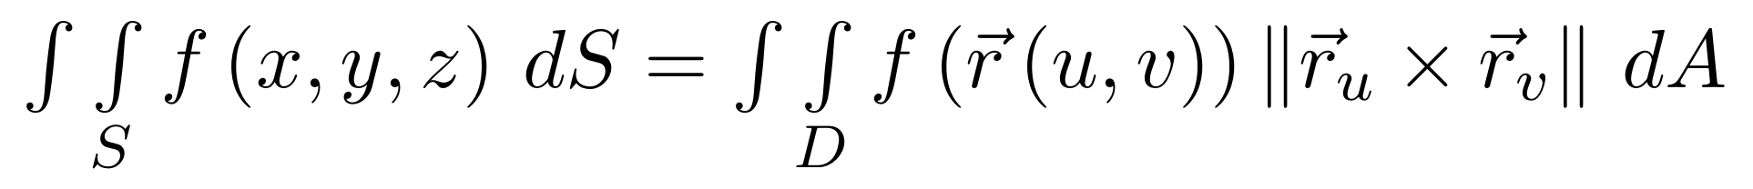
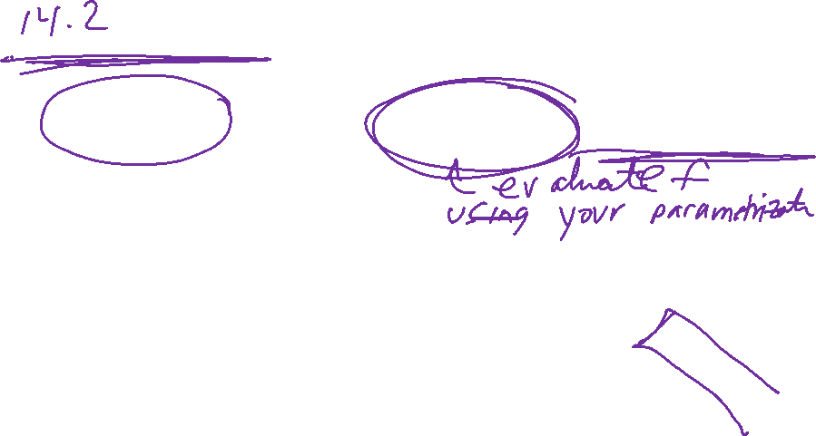
Scalar surface integral of a function z = f(x, y) over a surface S
http://tutorial.math.lamar.edu/Classes/CalcIII/SurfaceIntegrals.aspx
https://mathinsight.org/parametrized_surface_area

Slide 19

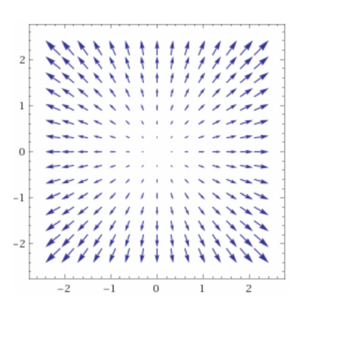
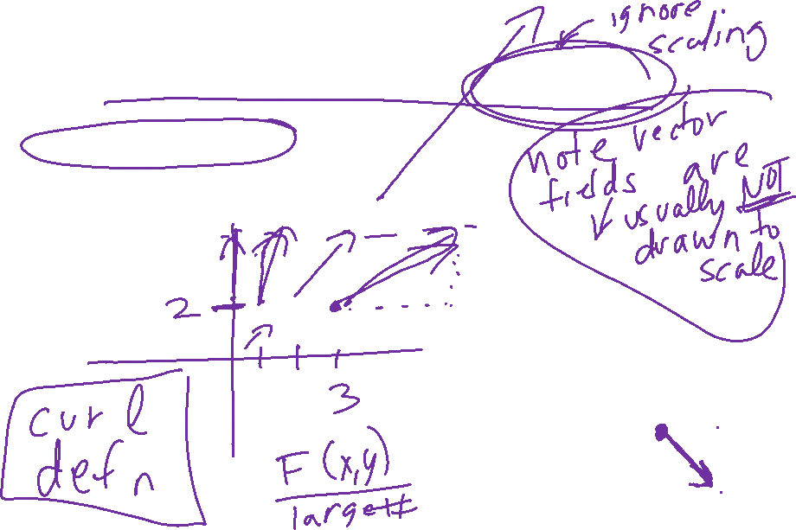
14.1: Vector Fields
Be able to draw them and/or identify them

Slide 20
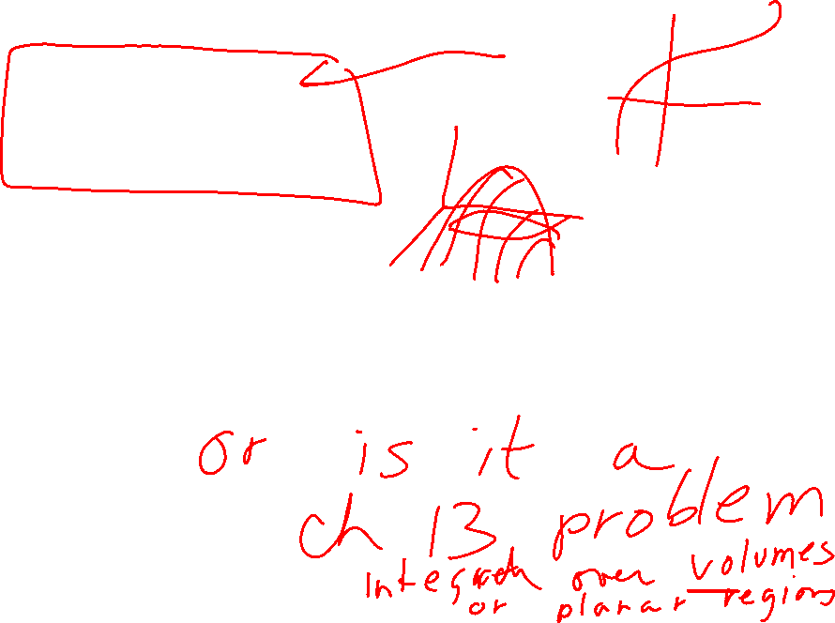
14.2 Line integrals
14.5 Surface integrals
Are you integrating over a scalar field or a vector field?

Slide 21

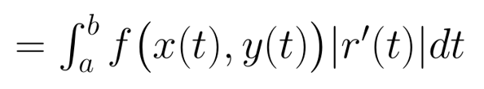
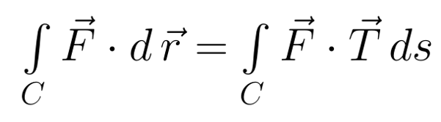
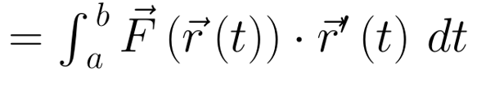
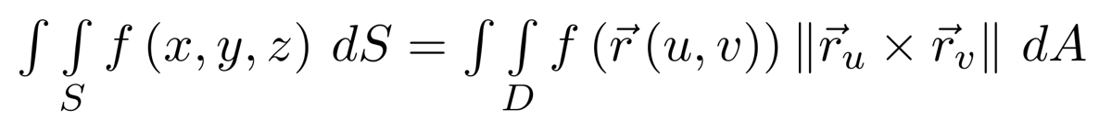
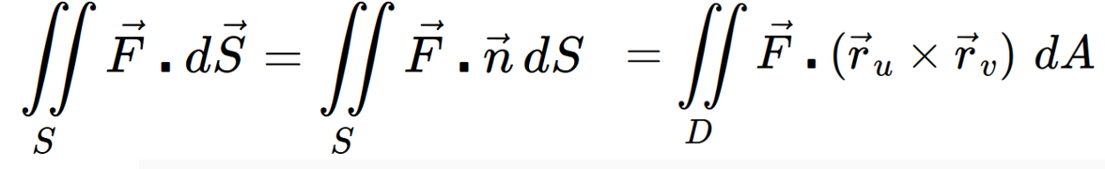
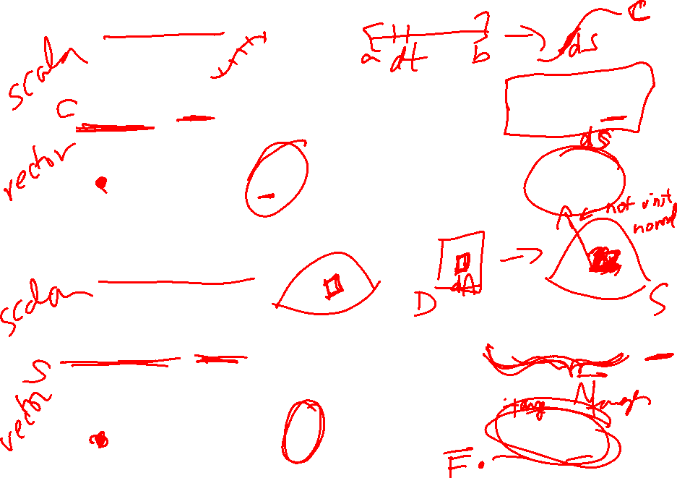
14.2 Line integrals
14.5 Surface integrals

Slide 22
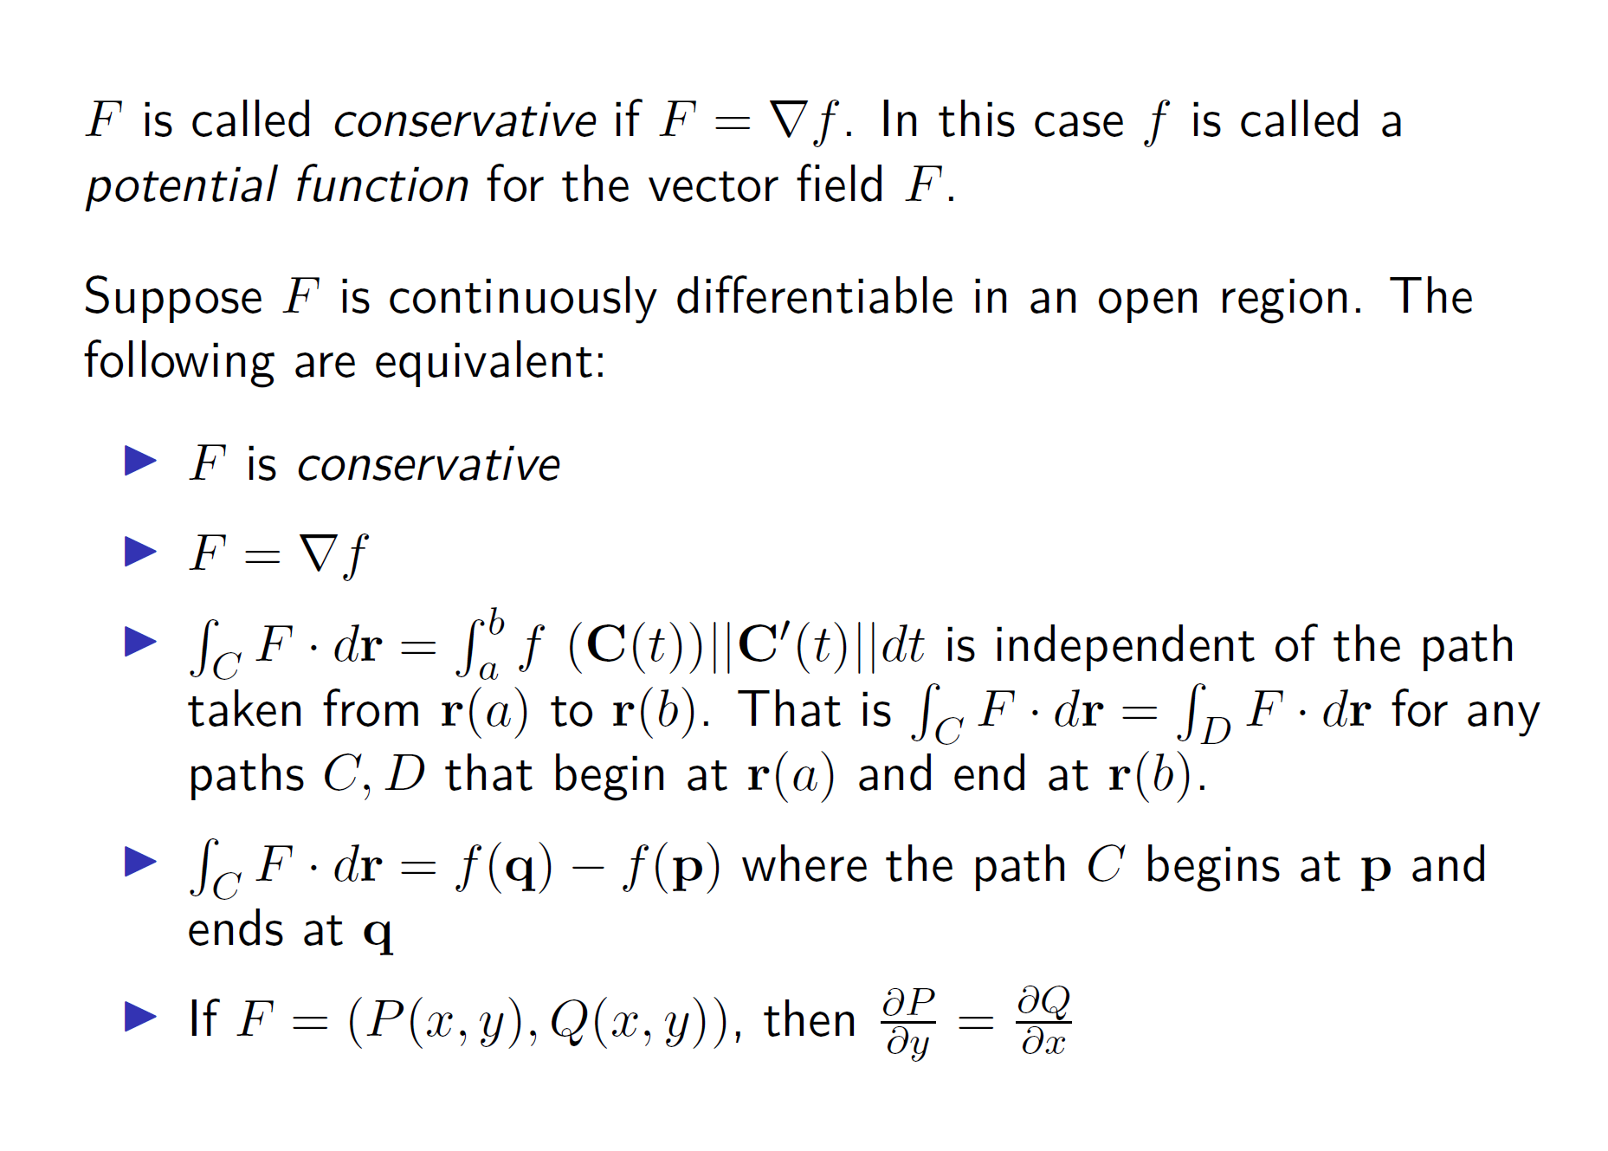
Section 14.3: Path Independence

Slide 23
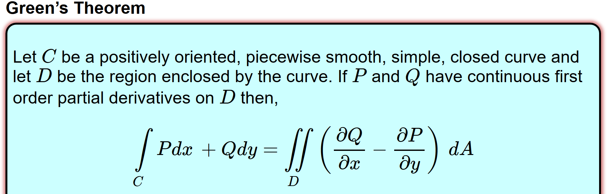
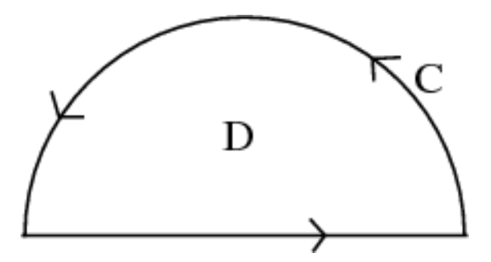
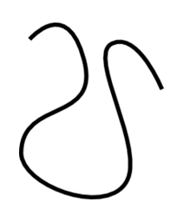

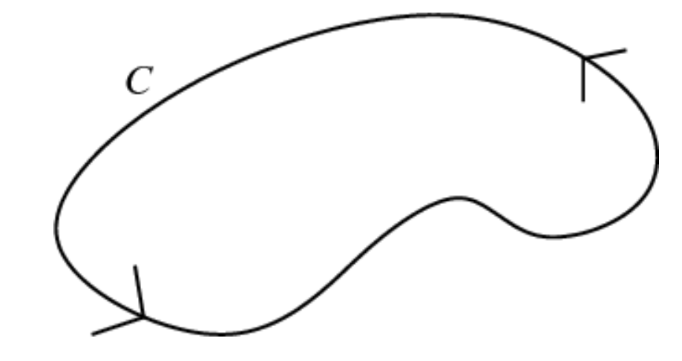

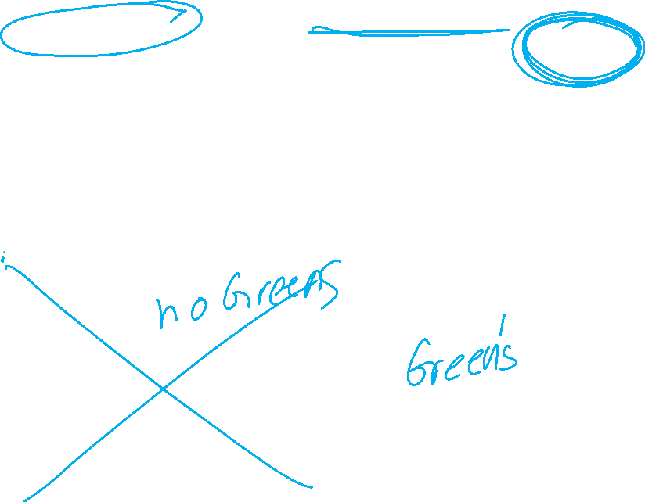
14.4: Alternate method for calculating vector line integral over a closed curve.
http://tutorial.math.lamar.edu/Classes/CalcIII/GreensTheorem.aspx
NOT closed
closed
https://mathinsight.org/

Slide 24
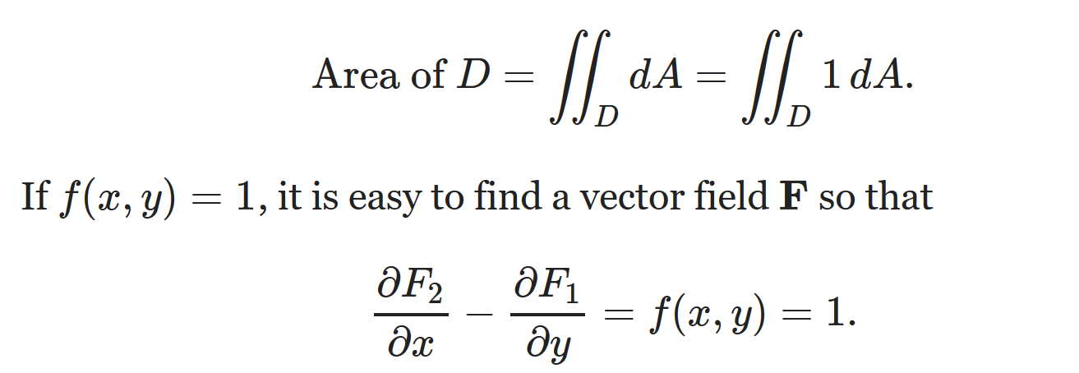





Can also use Green’s theorem to calculate double integrals.
Example: Find area of a region.

Slide 25


Vector surface integral
https://mathinsight.org/surface_integral_vector_field_introduction

Slide 26

Vector surface integral
https://mathinsight.org/surface_integral_vector_field_introduction

Slide 27




Note surface must be orientable: Surfaces must have 2 sides
Not orientable Orientable
Mobius band
Sphere
https://math.libretexts.org/Bookshelves/Calculus/Book%3A_Calculus_(Guichard)/16%3A_Vector_Calculus/16.07%3A_Surface_Integrals
Klein bottle
Torus
en.wikipedia.org
en.wikipedia.org

Slide 28
Not orientable
https://physics.stackexchange.com/questions/262362/what-is-the-direction-of-area-vector

Slide 29
Vector surface integral
https://mathinsight.org/surface_integral_vector_field_introduction

Slide 30

A surface is closed if it has no boundary
Not closed Closed surface
Sphere
Torus
The tube = cylinder
Cylinder with top and bottom
en.wikipedia.org

Slide 31

http://tutorial.math.lamar.edu/Classes/CalcIII/GreensTheorem.aspx
http://ltcconline.net/greenl/courses/202/vectorIntegration/greensTheorem.htm

Slide 32
For a closed surface, outward normal = positive orientation
en.wikipedia.org

Slide 33

https://math.libretexts.org/Bookshelves/Calculus/Book%3A_Calculus_(OpenStax)/16%3A_Vector_Calculus/16.6%3A_Surface_Integrals

Slide 34


Slide 35



Slide 36
See example Example 16.6.15: Calculating Heat Flow at
Https://math.libretexts.org/Bookshelves/Calculus/Book%3A_Calculus_(OpenStax)/16%3A_Vector_Calculus/16.6%3A_Surface_Integrals

