Slide 1
Midterm 2 part 2: Name: E-mail address

Slide 8
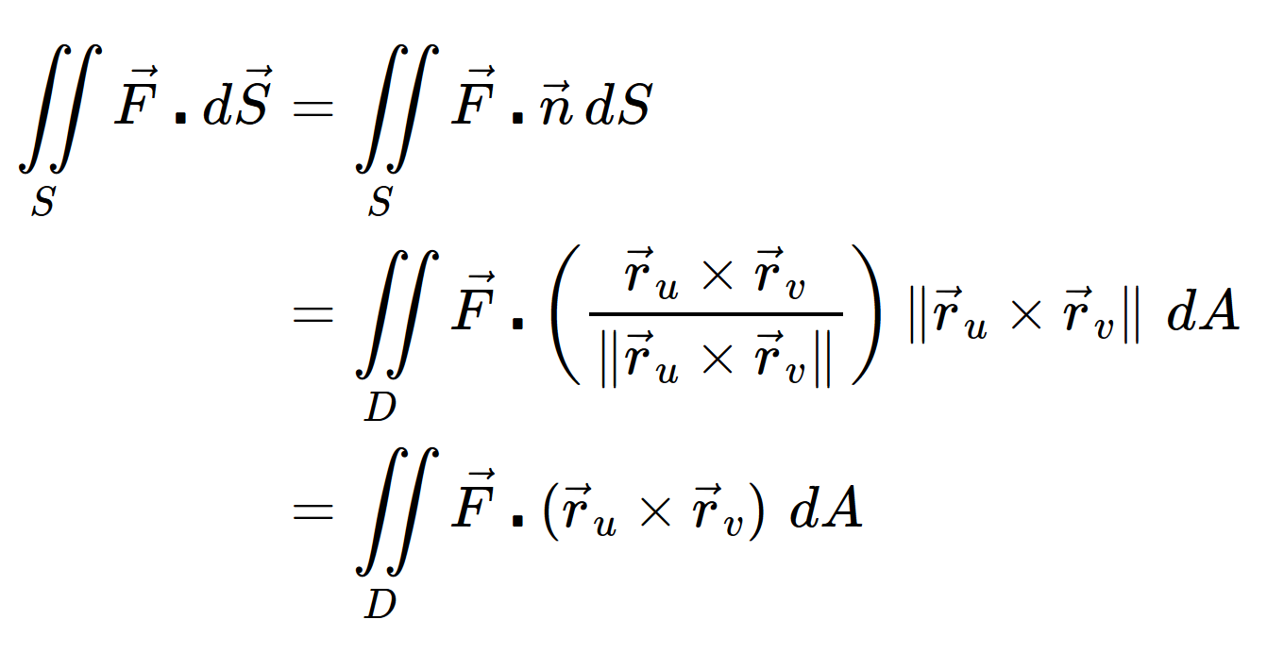
Vector surface integral

