Slide 1
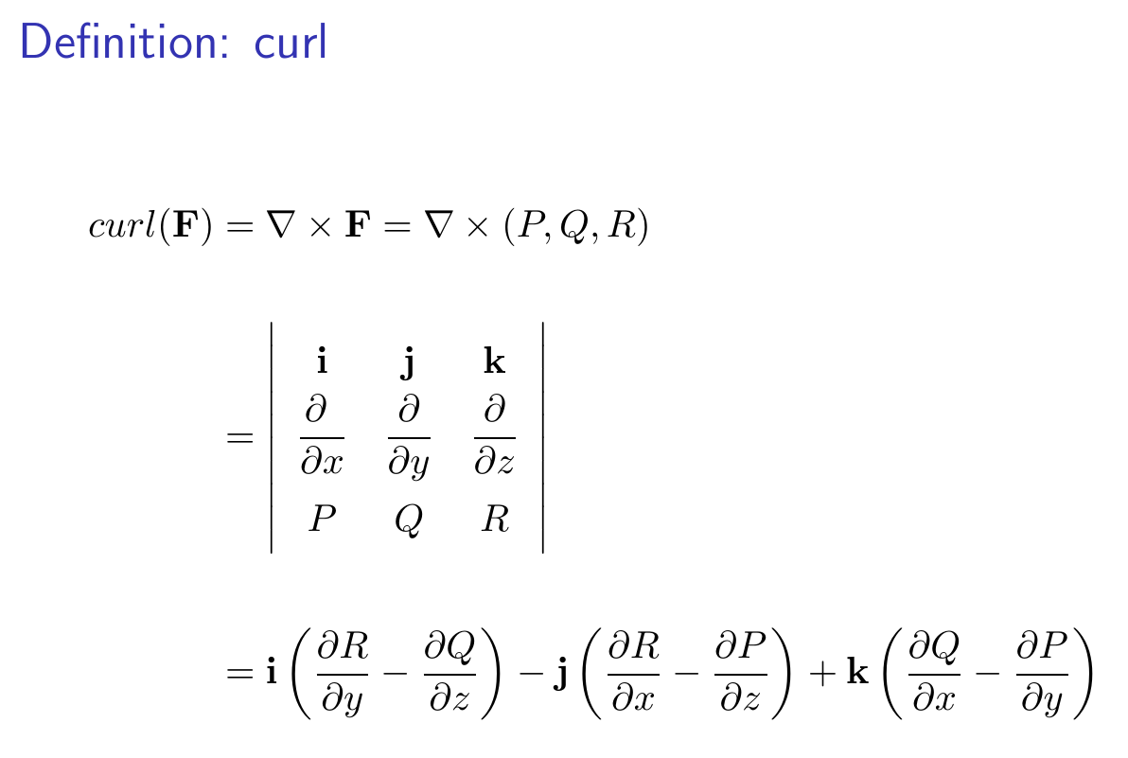
14.7 Stoke’s Theorem

Slide 2
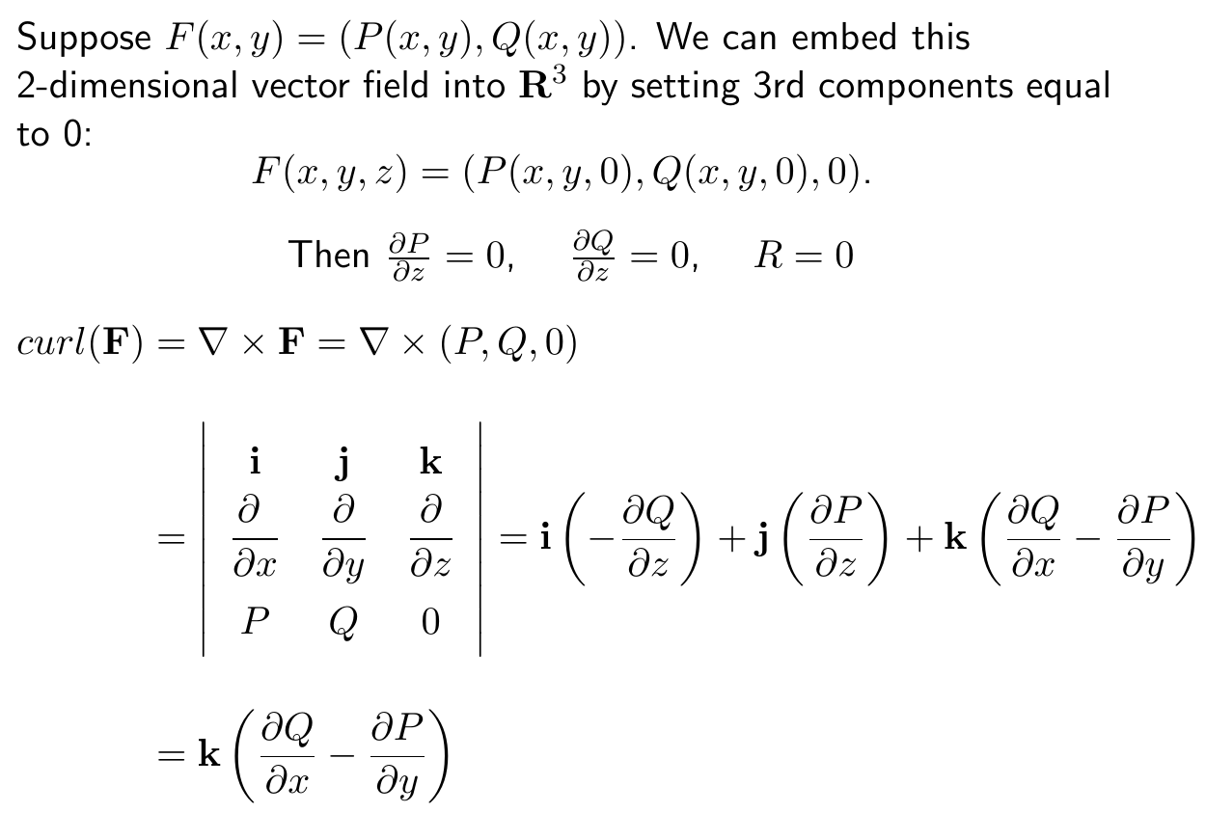

Slide 3
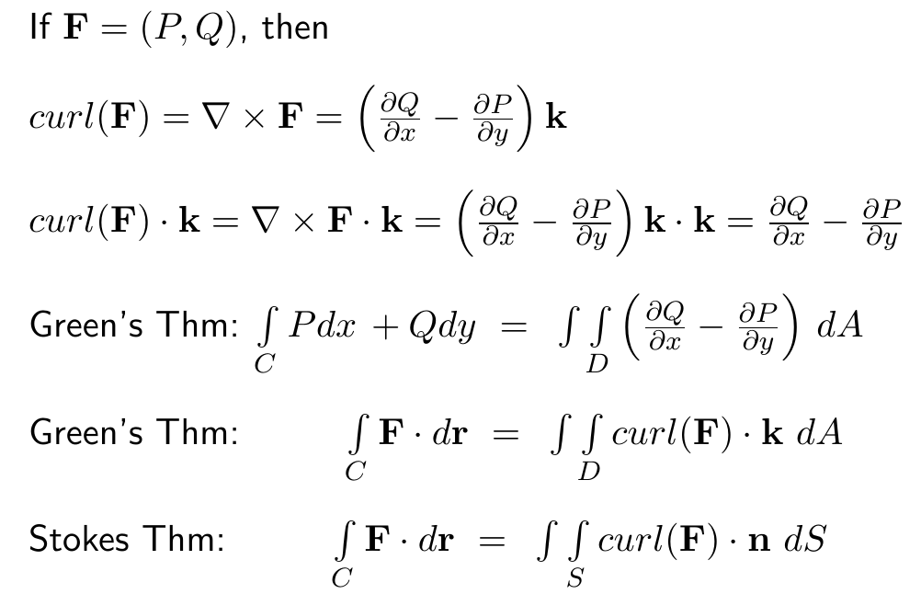

Slide 4
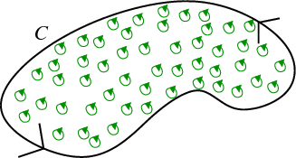
https://mathinsight.org/greens_theorem_idea

Slide 5
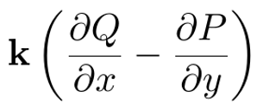
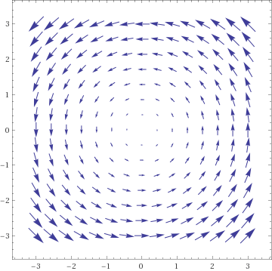

Slide 6
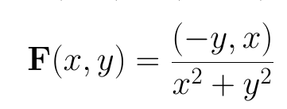
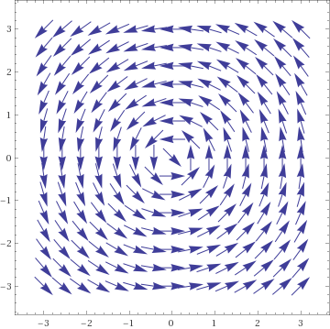

Slide 8
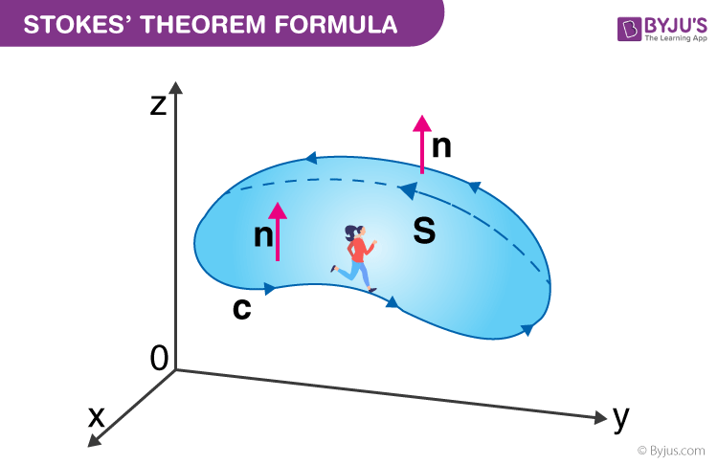
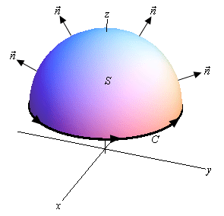
https://byjus.com/maths/stokes-theorem/
http://tutorial.math.lamar.edu/Classes/CalcIII/StokesTheorem.aspx
Green’s Theorem is a special case of Stoke’s theorem when your surface lies in the xy plane

Slide 9
https://byjus.com/maths/stokes-theorem/
http://tutorial.math.lamar.edu/Classes/CalcIII/StokesTheorem.aspx
whose components have continuous first order partial derivatives.

Slide 10
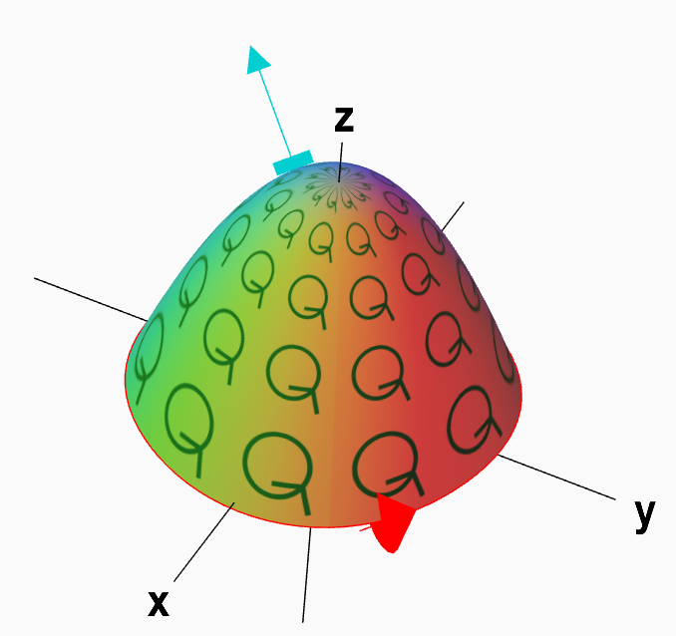
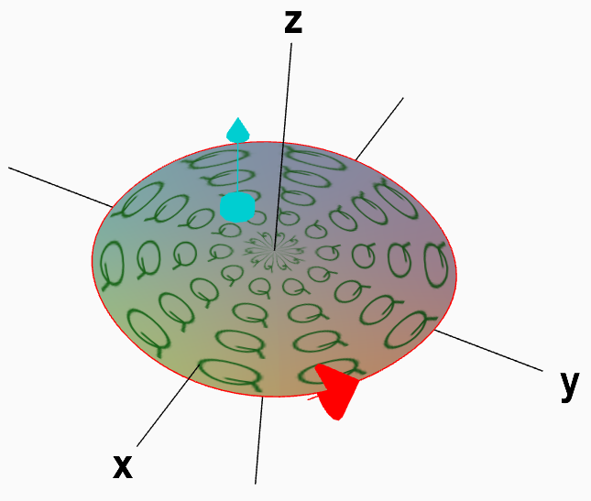
https://mathinsight.org/stokes_theorem_idea

Slide 11
https://mathinsight.org/stokes_theorem_idea

Slide 12
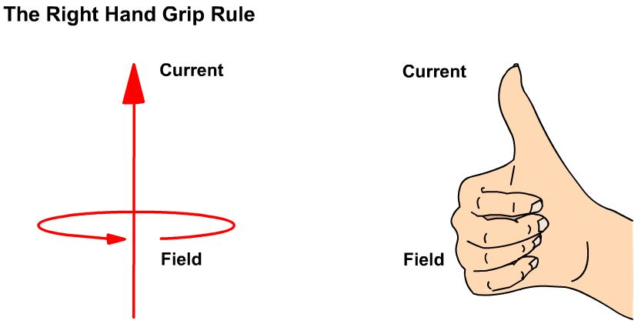
http://iamtechnical.com/right-hand-grip-rule
https://mathinsight.org/stokes_theorem_idea

Slide 13
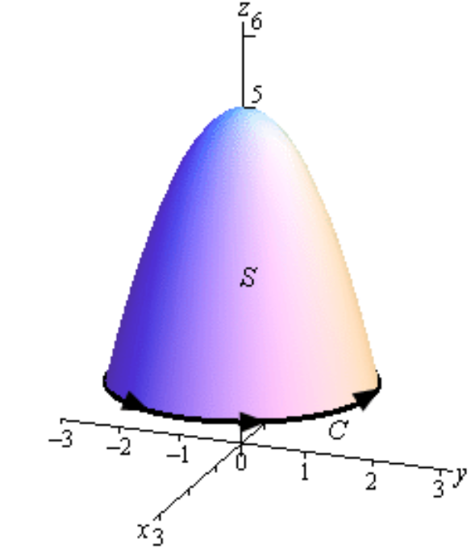
http://tutorial.math.lamar.edu/Classes/CalcIII/StokesTheorem.aspx
S = piecewise smooth positively oriented surface.
C = boundary of S
= simple closed positively oriented curve.
F = vector field whose components have continuous first order partial derivatives.

Slide 14
http://tutorial.math.lamar.edu/Classes/CalcIII/StokesTheorem.aspx
Find C:

Slide 15
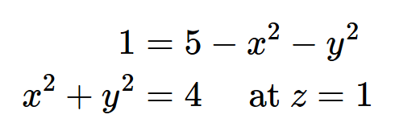
http://tutorial.math.lamar.edu/Classes/CalcIII/StokesTheorem.aspx
Find C:
Parametrize C:

Slide 16
http://tutorial.math.lamar.edu/Classes/CalcIII/StokesTheorem.aspx
Parametrize C:

Slide 17
http://tutorial.math.lamar.edu/Classes/CalcIII/StokesTheorem.aspx

Slide 18
http://tutorial.math.lamar.edu/Classes/CalcIII/StokesTheorem.aspx

Slide 19
http://tutorial.math.lamar.edu/Classes/CalcIII/StokesTheorem.aspx

Slide 20
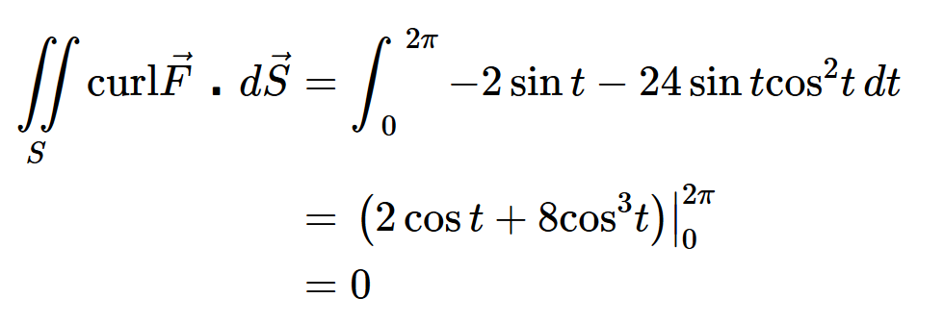
http://tutorial.math.lamar.edu/Classes/CalcIII/StokesTheorem.aspx

Slide 21
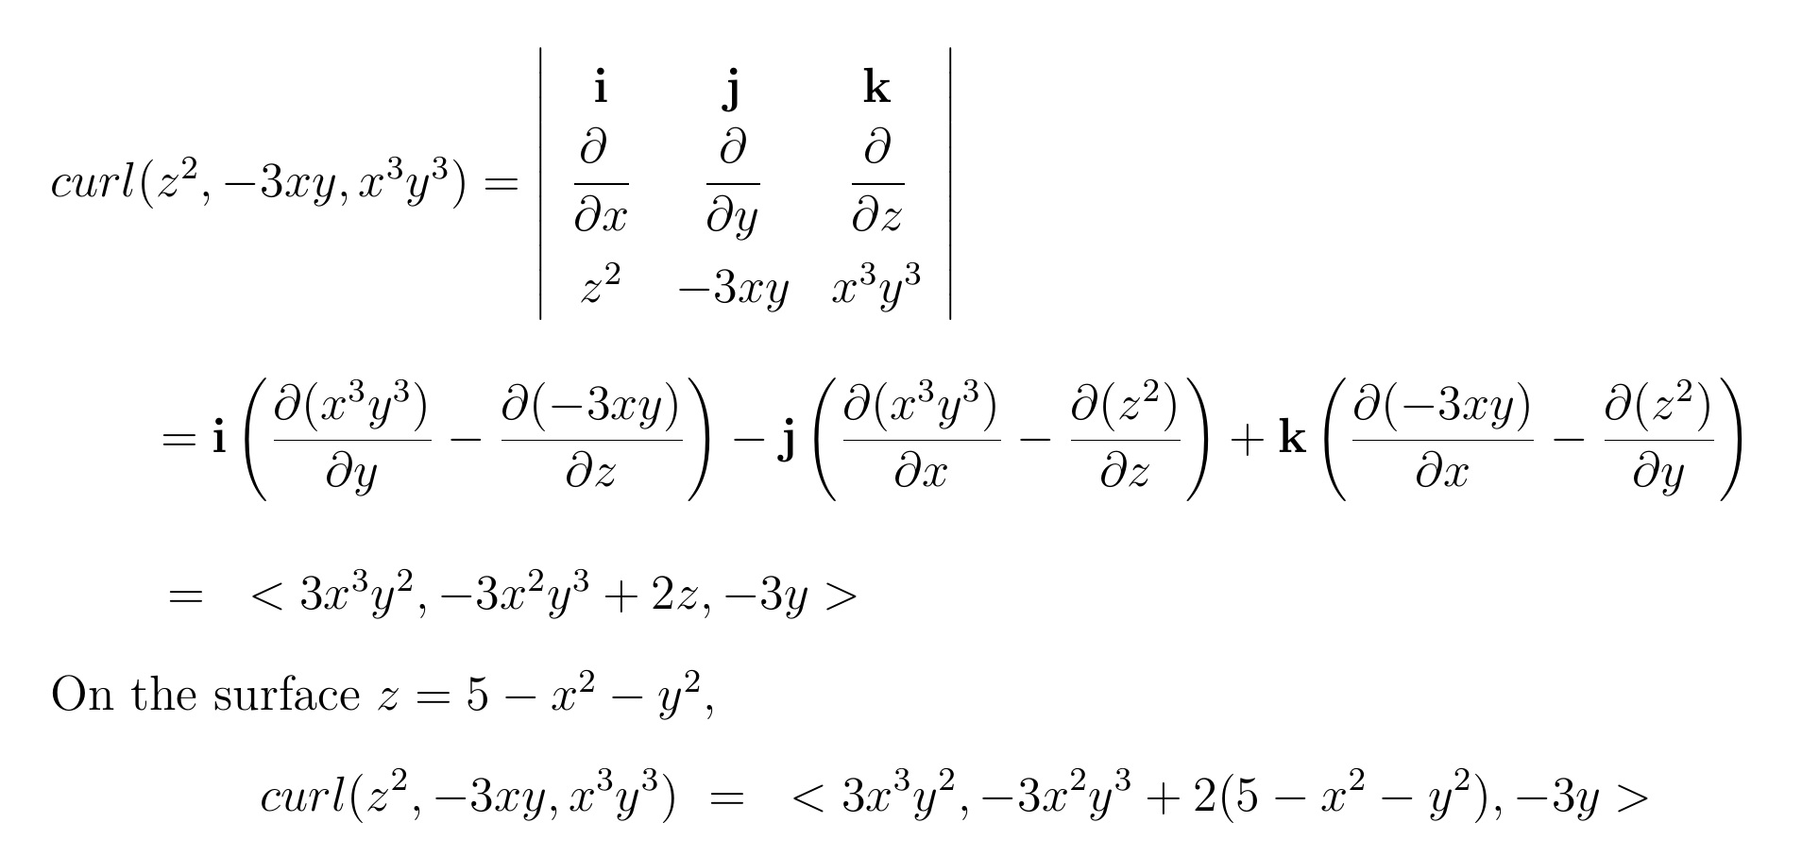

Slide 23
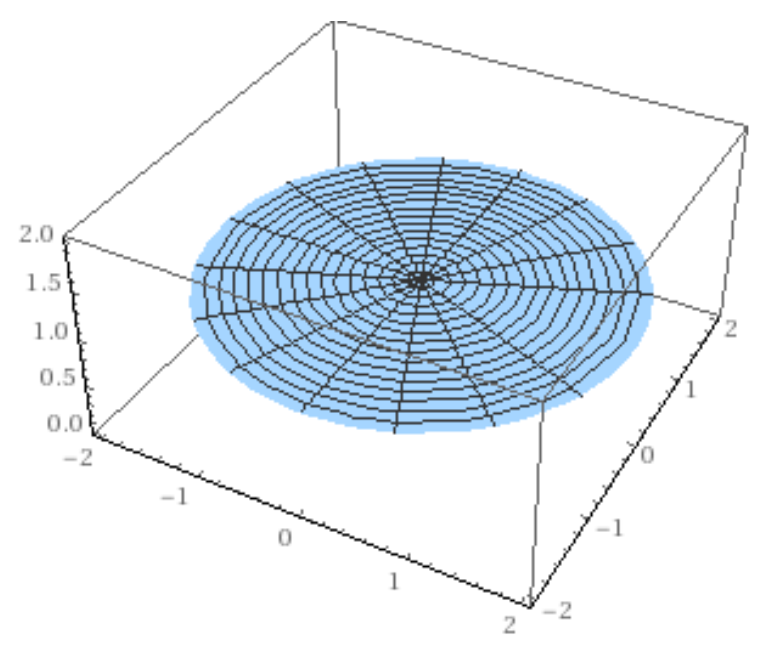

Slide 24
https://mathinsight.org/stokes_theorem_idea

Slide 25
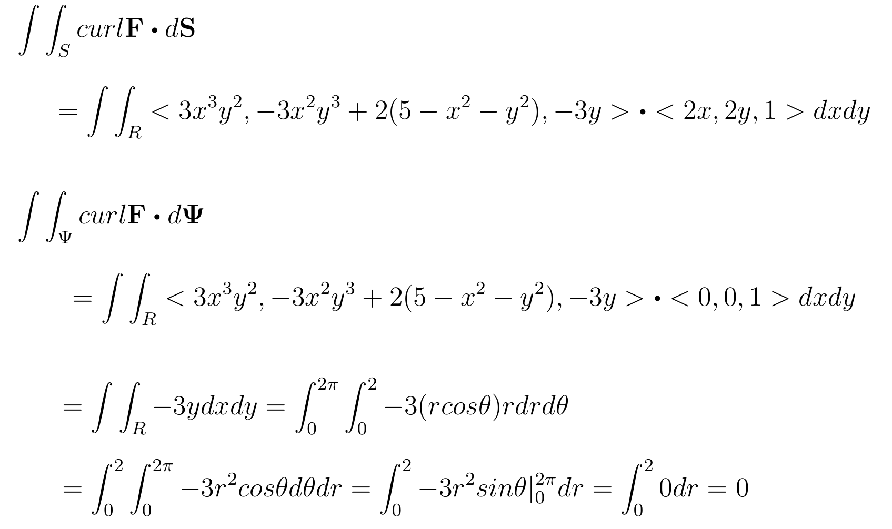

Slide 26
http://tutorial.math.lamar.edu/Classes/CalcIII/StokesTheorem.aspx

Slide 27
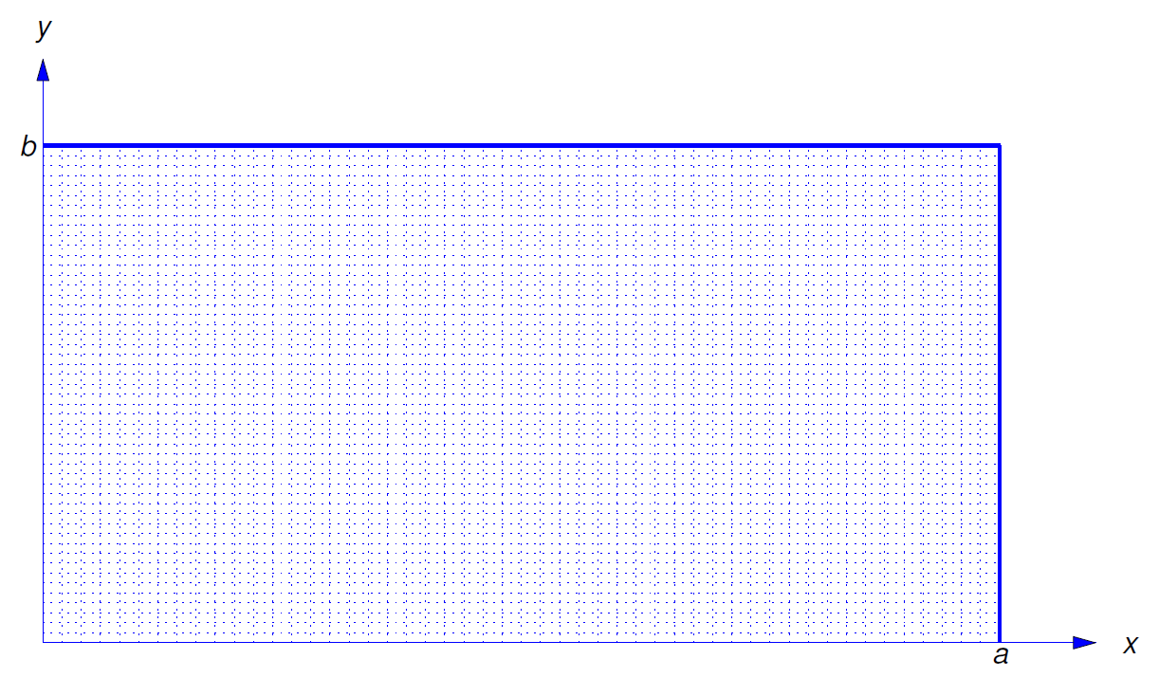
Ch 10 Boundary Value Problems
10.5 and 10.6 Heat Equation
10.7 Wave Equation
10.8 LaPlace Equation

Slide 28
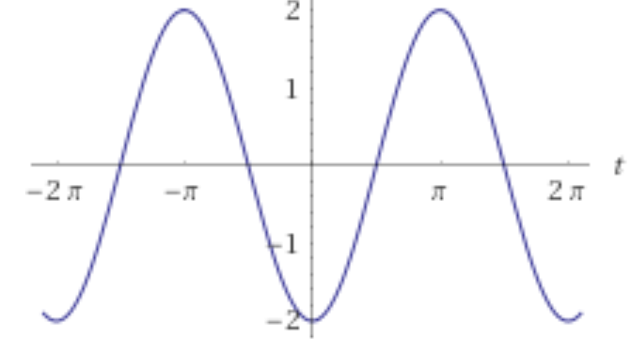
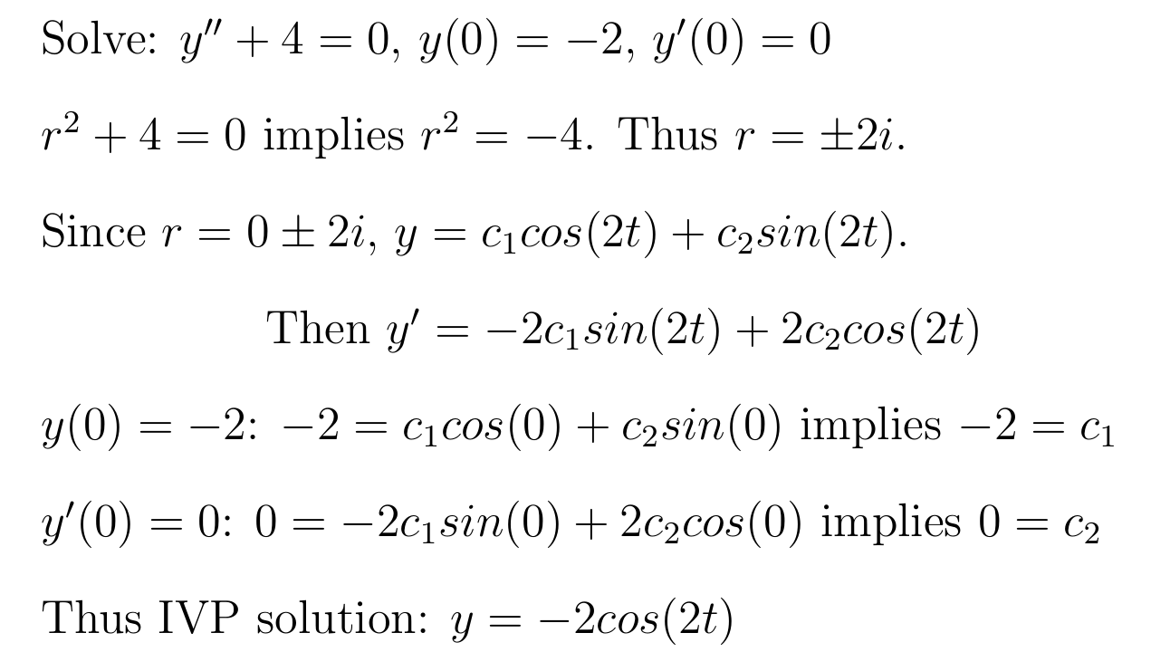
Boundary Value Problem vs Initial Value Problem
In Math IV, you solved DE equations involving initial values:

Slide 29
Boundary Value Problem vs Initial Value Problem
In Math IV, you solved DE equations involving initial values:

Slide 30
For boundary value problems:
Solutions may not be unique.
Solutions may not exist.

Slide 31
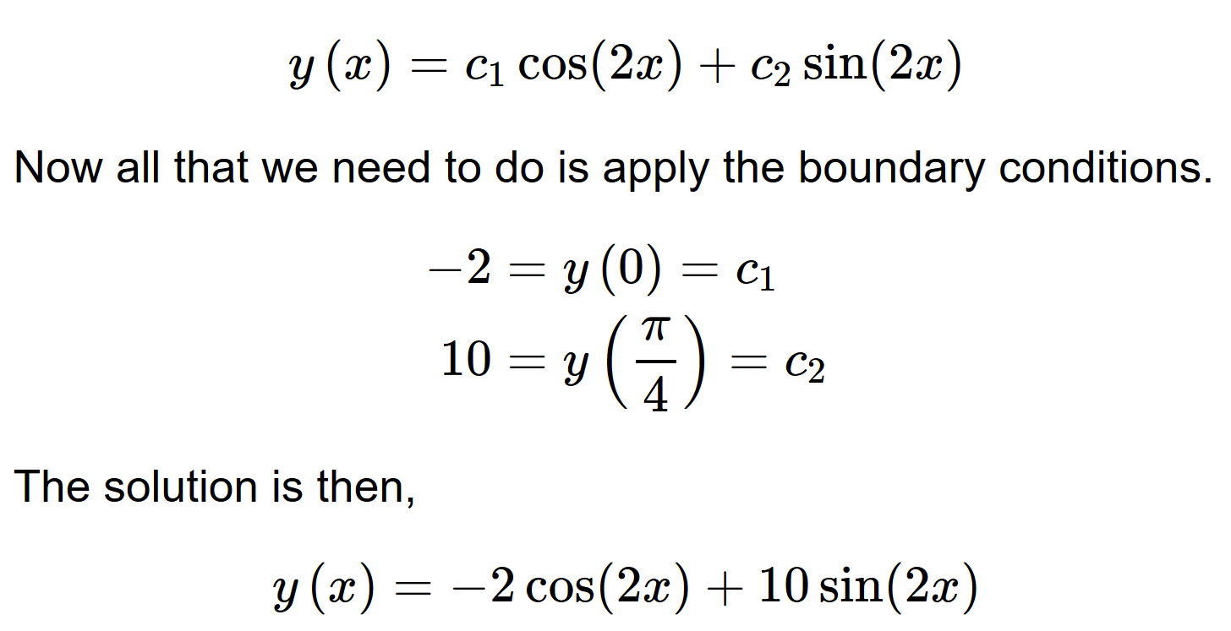
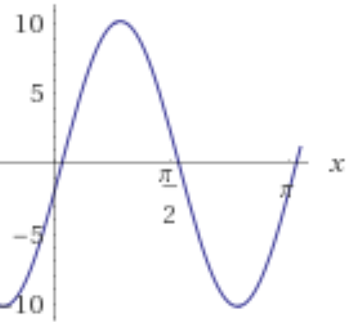
http://tutorial.math.lamar.edu/Classes/DE/BoundaryValueProblem.aspx

Slide 32
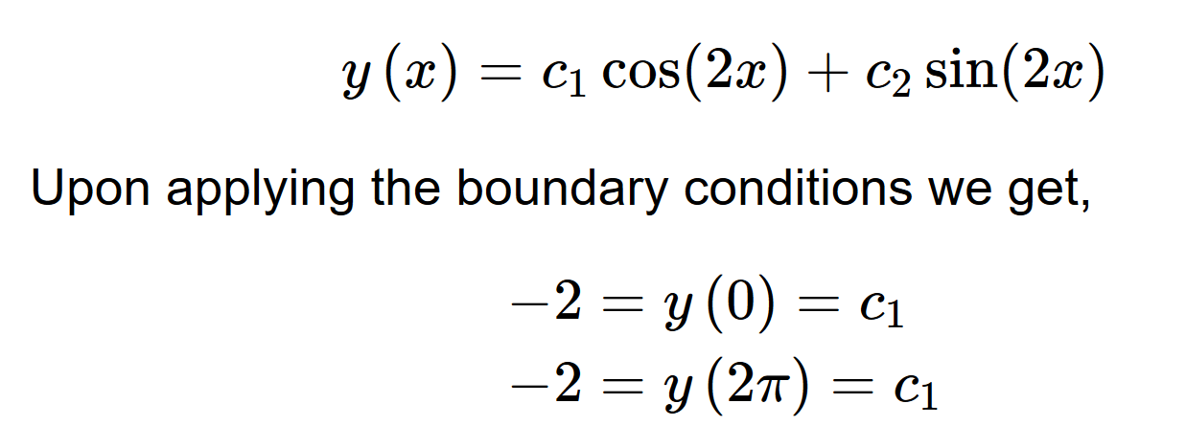
http://tutorial.math.lamar.edu/Classes/DE/BoundaryValueProblem.aspx

Slide 33
http://tutorial.math.lamar.edu/Classes/DE/BoundaryValueProblem.aspx

Slide 34
http://tutorial.math.lamar.edu/Classes/DE/FourierSeries.aspx
10.2

Slide 35
http://tutorial.math.lamar.edu/Classes/DE/PeriodicOrthogonal.aspx
Periodic Function
A function is said to be periodic with period T if f(x+T) = f(x) for all x
The smallest value of T satisfying the above is called the fundamental period.

Slide 36
http://tutorial.math.lamar.edu/Classes/DE/PeriodicOrthogonal.aspx
A function is said to be even if f(−x) = f(x)
A function is said to be odd if f(−x) = −f(x)

Slide 37
http://tutorial.math.lamar.edu/Classes/DE/PeriodicOrthogonal.aspx

Slide 38
http://tutorial.math.lamar.edu/Classes/DE/PeriodicOrthogonal.aspx

Slide 39
http://tutorial.math.lamar.edu/Classes/DE/PeriodicOrthogonal.aspx

Slide 40
http://tutorial.math.lamar.edu/Classes/DE/PeriodicOrthogonal.aspx

Slide 41
http://tutorial.math.lamar.edu/Classes/DE/PeriodicOrthogonal.aspx

Slide 42
http://tutorial.math.lamar.edu/Classes/DE/PeriodicOrthogonal.aspx

Slide 43
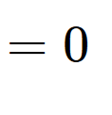
http://tutorial.math.lamar.edu/Classes/DE/PeriodicOrthogonal.aspx
Since

Slide 44
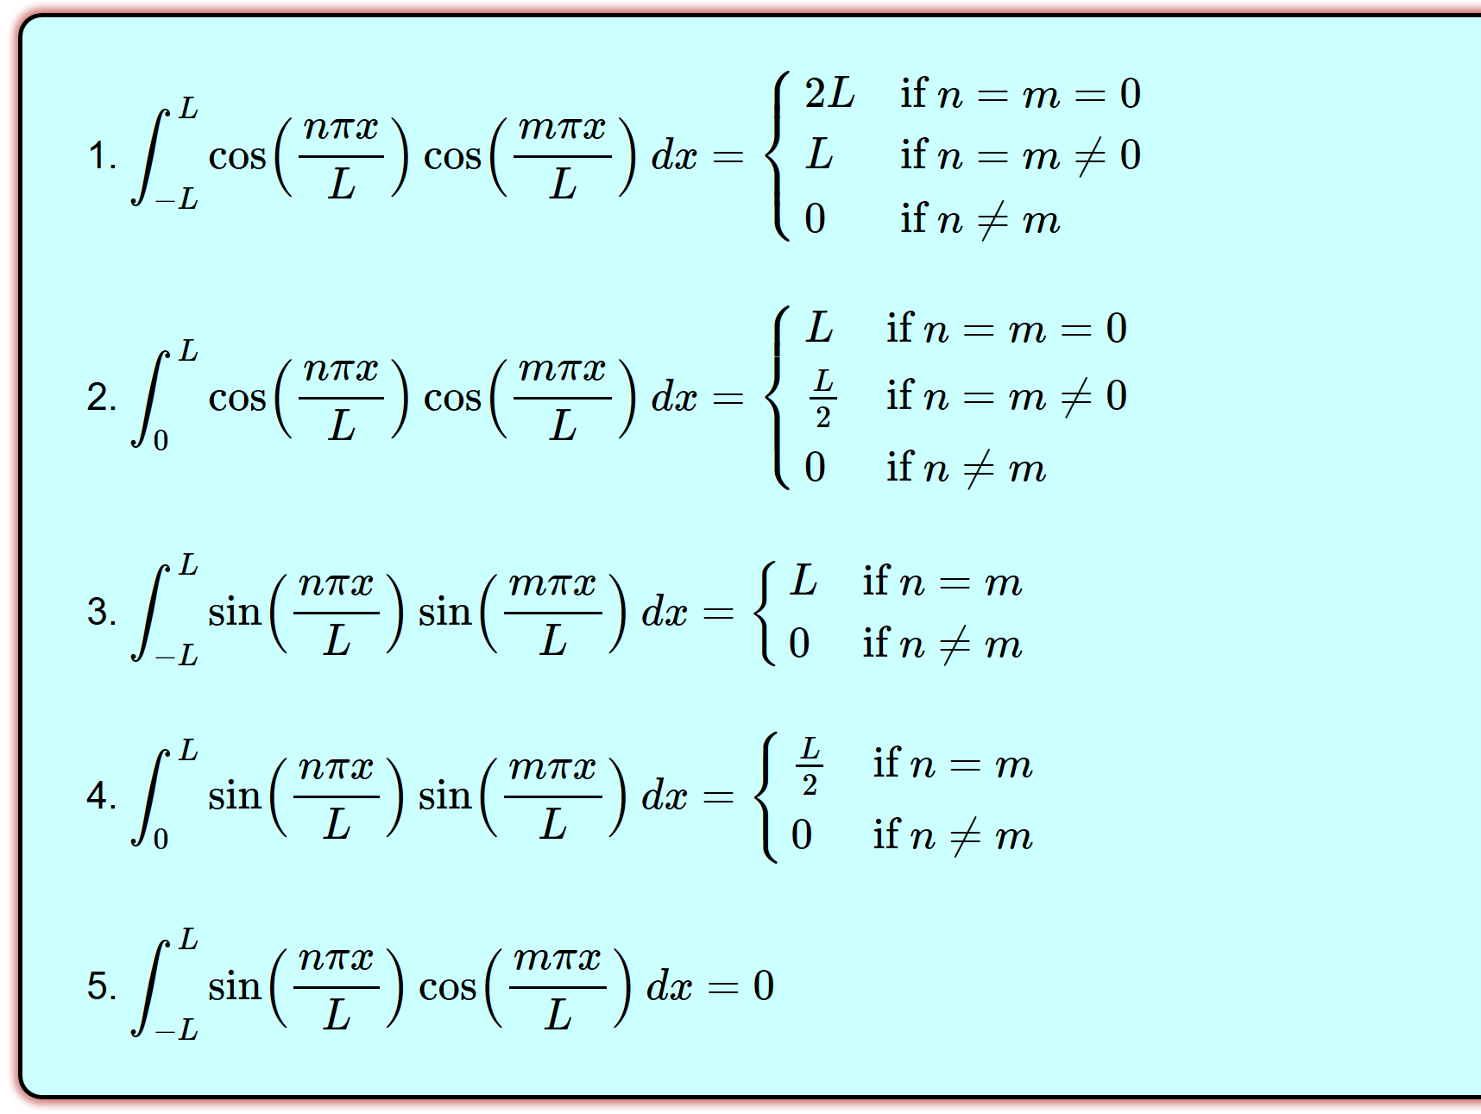
http://tutorial.math.lamar.edu/Classes/DE/PeriodicOrthogonal.aspx

Slide 45
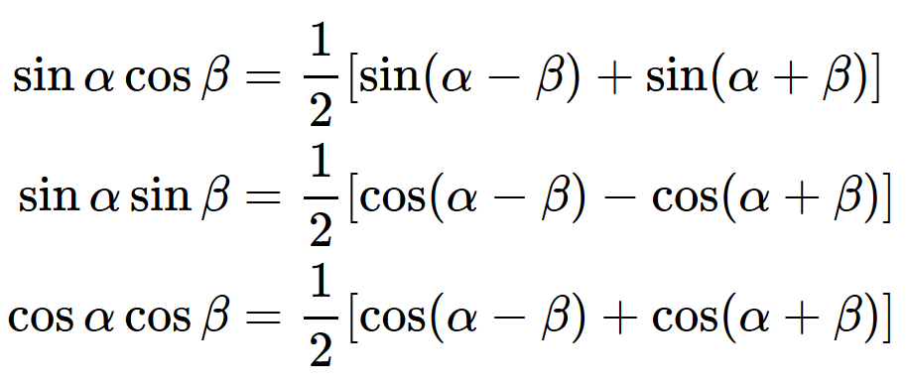
http://tutorial.math.lamar.edu/Classes/DE/PeriodicOrthogonal.aspx

Slide 46
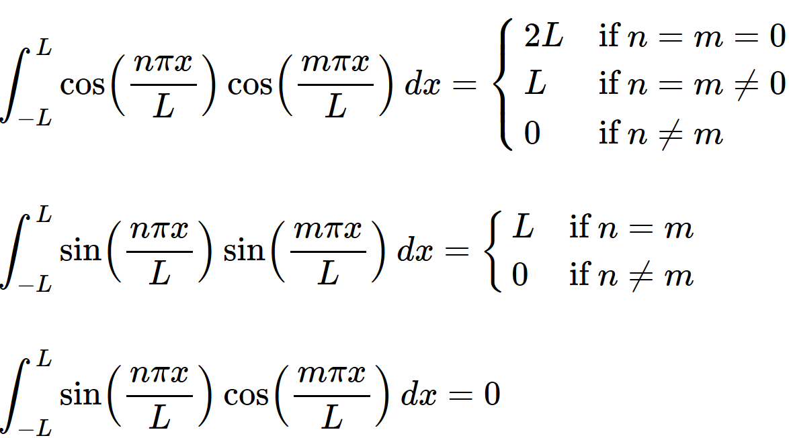
Find A_{n} and B_{n} if

Slide 47
Find A_{n} and B_{n} if

Slide 48
Find A_{n} and B_{n} if

