Slide 1
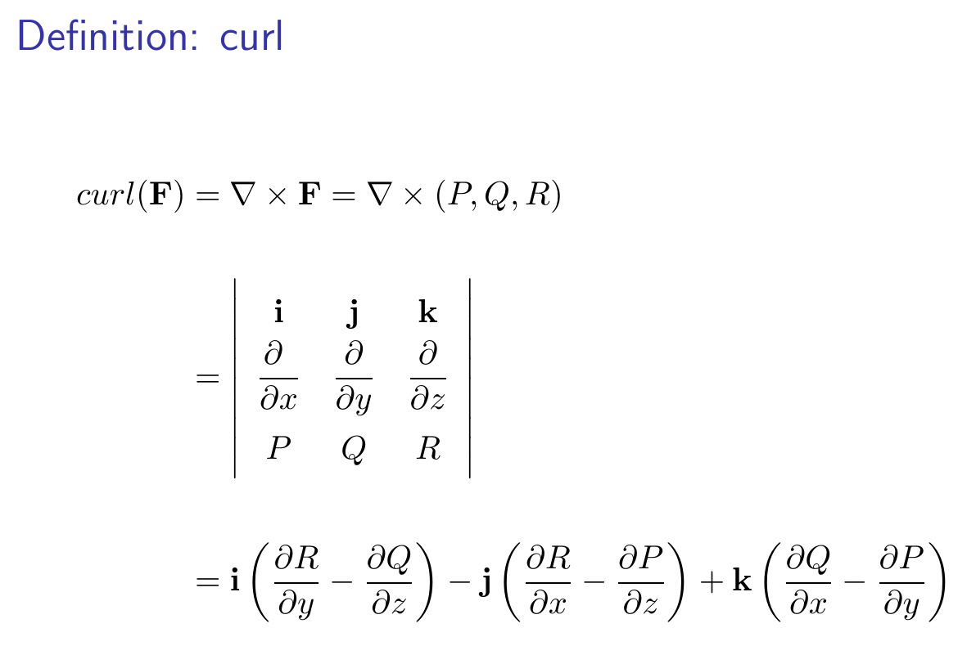
14.7 Stoke’s Theorem

Slide 2
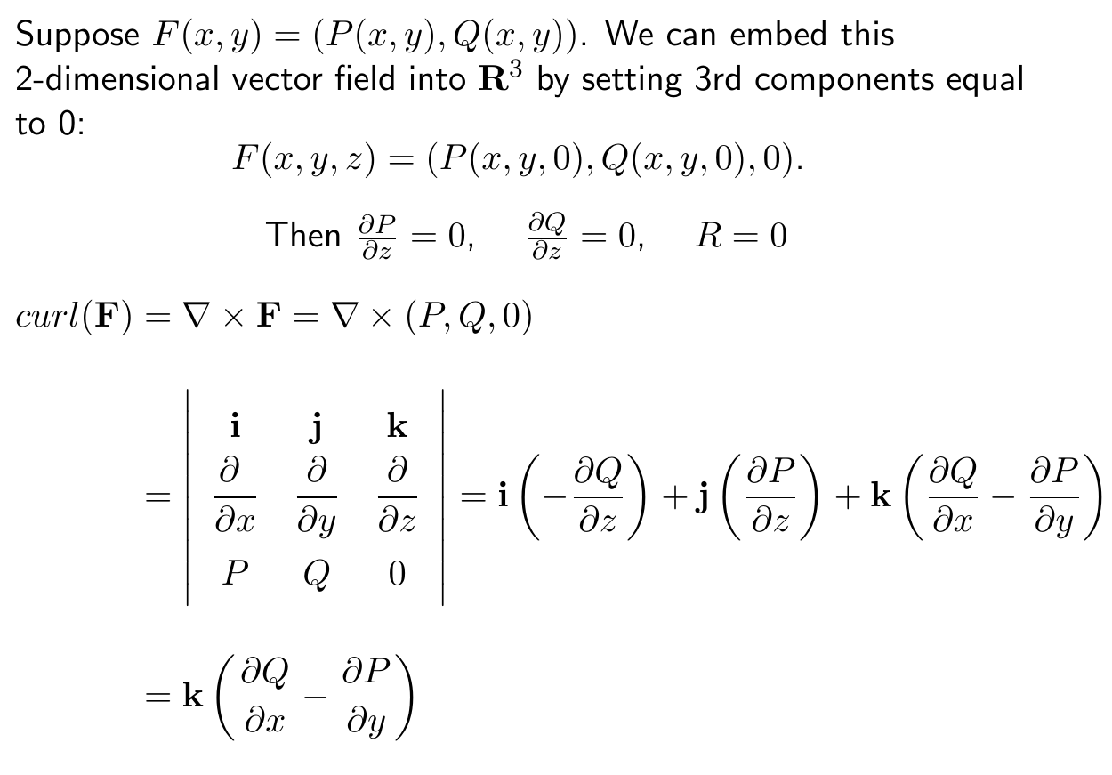

Slide 3
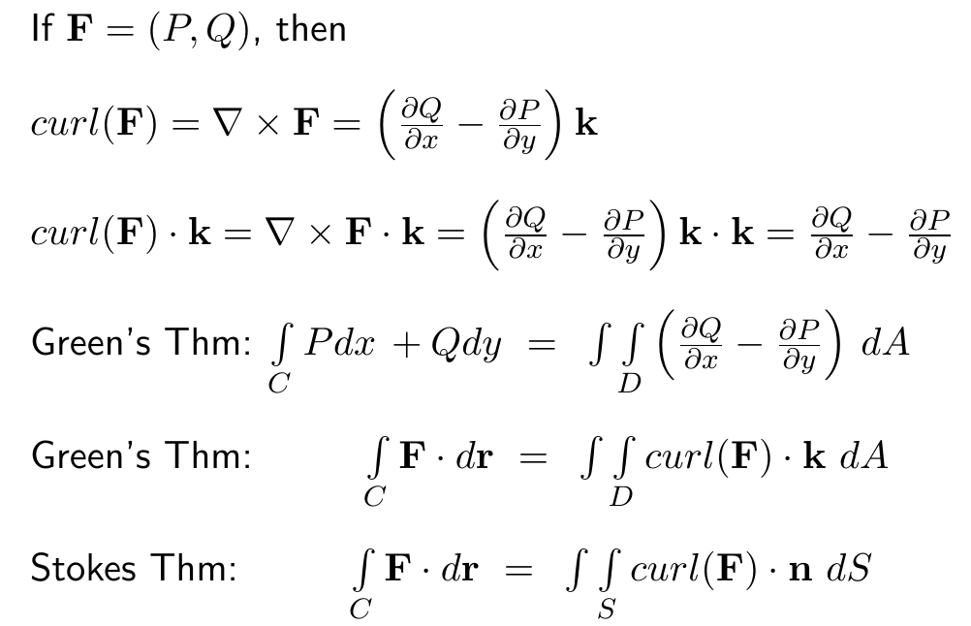

Slide 4
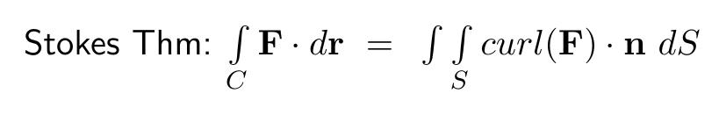
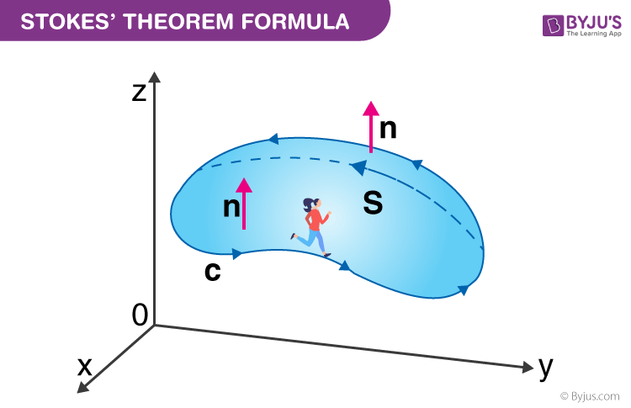
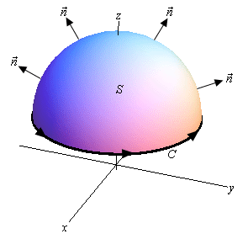
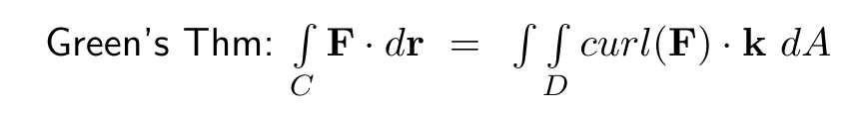
https://byjus.com/maths/stokes-theorem/
http://tutorial.math.lamar.edu/Classes/CalcIII/StokesTheorem.aspx
Green’s Theorem is a special case of Stoke’s theorem when your surface lies in the xy plane

Slide 5
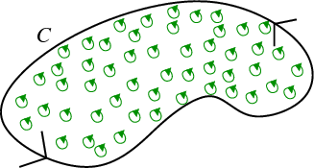
https://mathinsight.org/greens_theorem_idea

Slide 6
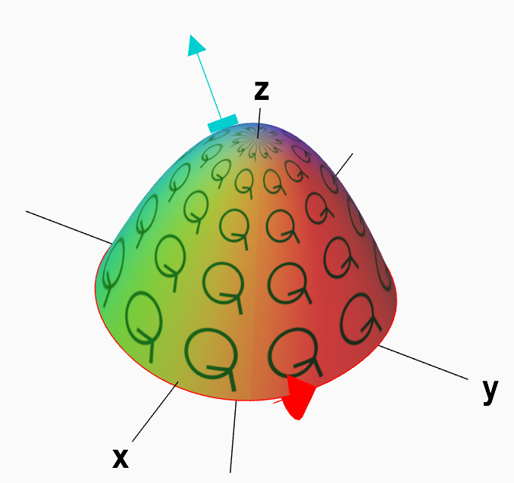
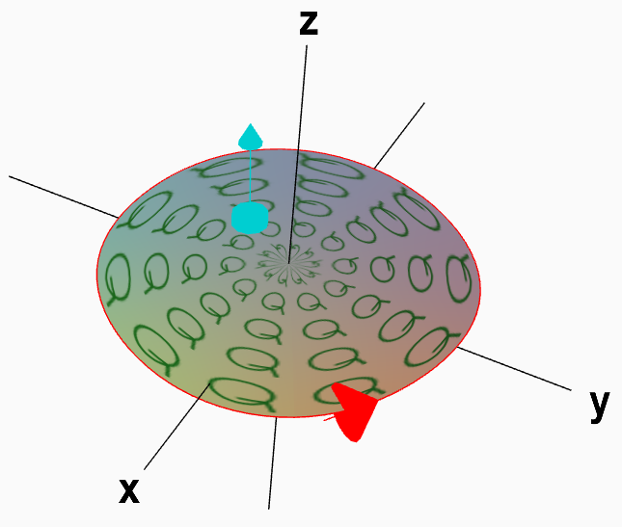
https://mathinsight.org/stokes_theorem_idea

Slide 7
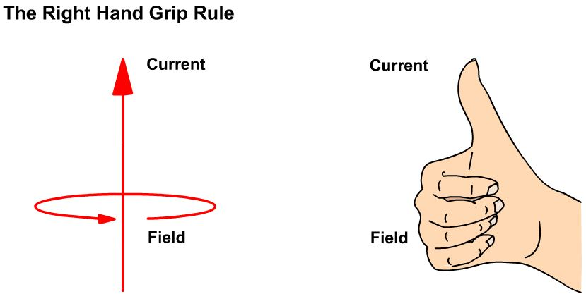
http://iamtechnical.com/right-hand-grip-rule
https://mathinsight.org/stokes_theorem_idea

Slide 8

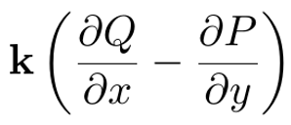

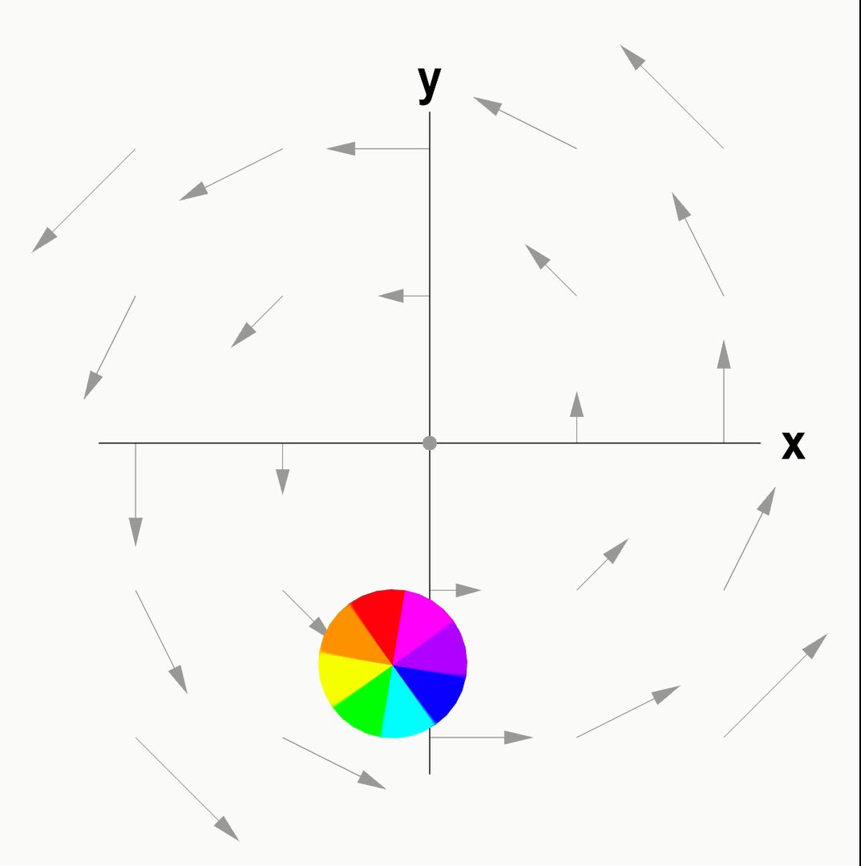
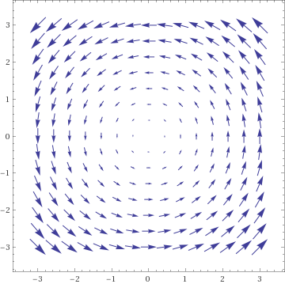


Slide 9
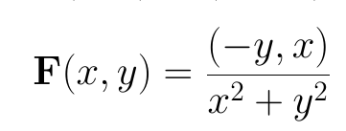
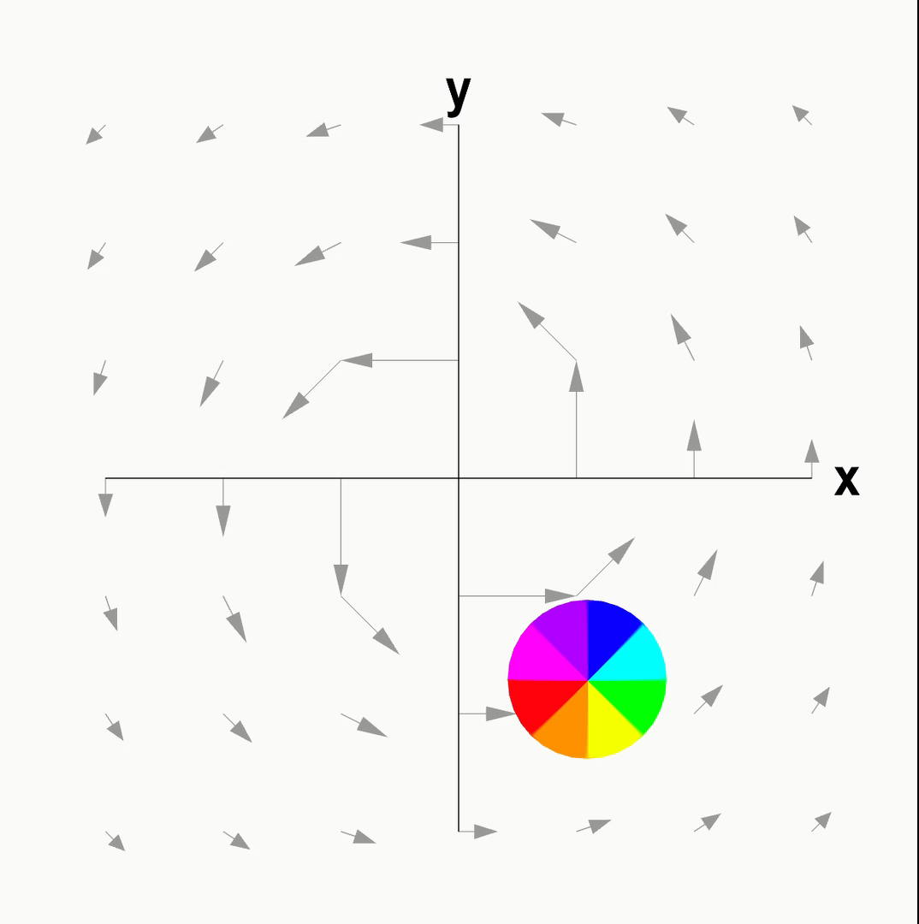
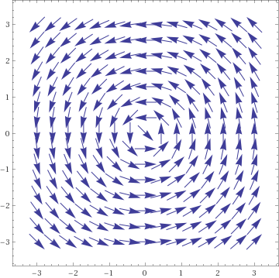

Slide 11
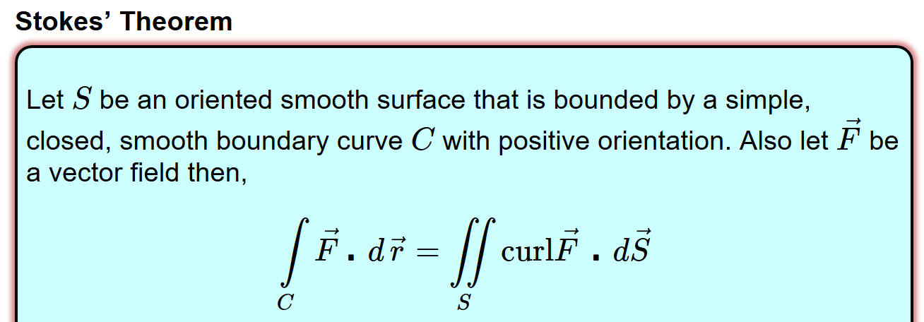
https://byjus.com/maths/stokes-theorem/
http://tutorial.math.lamar.edu/Classes/CalcIII/StokesTheorem.aspx
whose components have continuous first order partial derivatives.

Slide 12
https://mathinsight.org/stokes_theorem_idea

Slide 13
https://mathinsight.org/stokes_theorem_idea

Slide 14
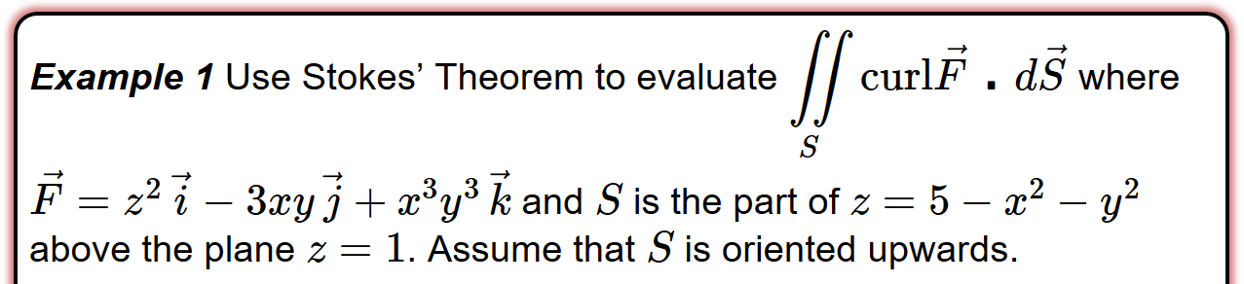
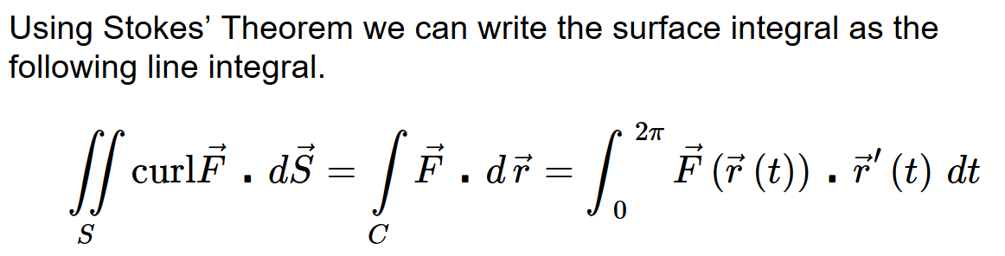
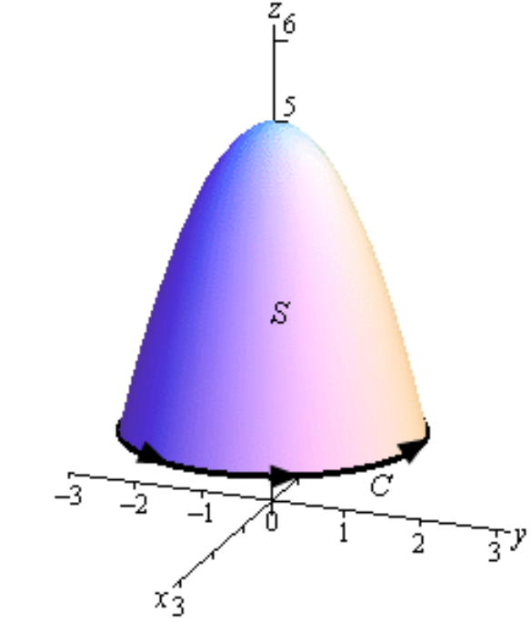
http://tutorial.math.lamar.edu/Classes/CalcIII/StokesTheorem.aspx
S = piecewise smooth positively oriented surface.
C = boundary of S
= simple closed positively oriented curve.
F = vector field whose components have continuous first order partial derivatives.

Slide 15
http://tutorial.math.lamar.edu/Classes/CalcIII/StokesTheorem.aspx
Find C:

Slide 16
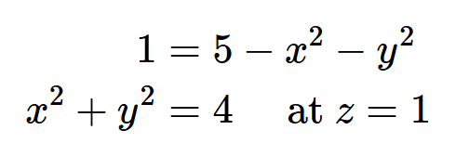
http://tutorial.math.lamar.edu/Classes/CalcIII/StokesTheorem.aspx
Find C:
Parametrize C:

Slide 17
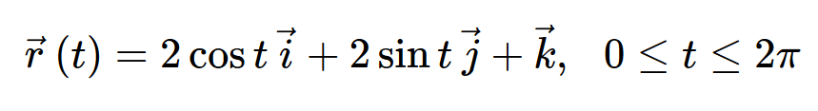
http://tutorial.math.lamar.edu/Classes/CalcIII/StokesTheorem.aspx
Parametrize C:

Slide 18
http://tutorial.math.lamar.edu/Classes/CalcIII/StokesTheorem.aspx

Slide 19
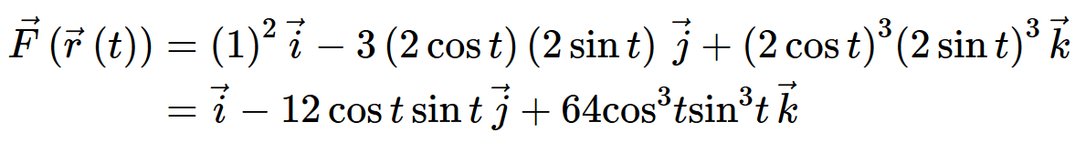
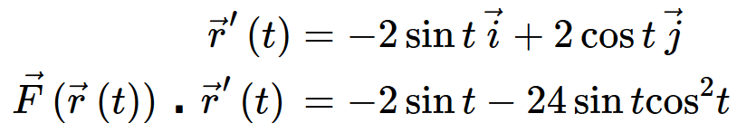
http://tutorial.math.lamar.edu/Classes/CalcIII/StokesTheorem.aspx

Slide 20
http://tutorial.math.lamar.edu/Classes/CalcIII/StokesTheorem.aspx

Slide 21
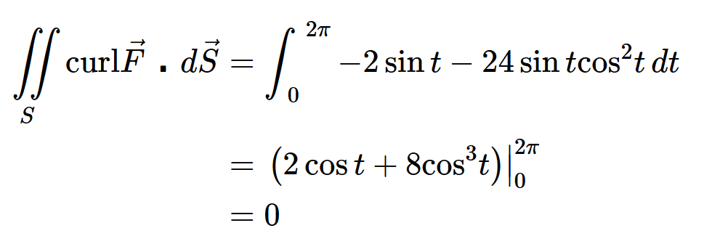
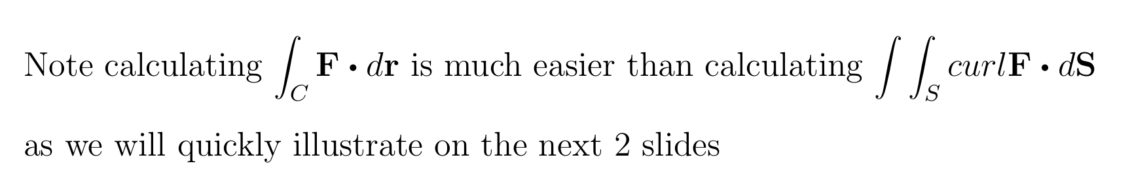
http://tutorial.math.lamar.edu/Classes/CalcIII/StokesTheorem.aspx

Slide 22
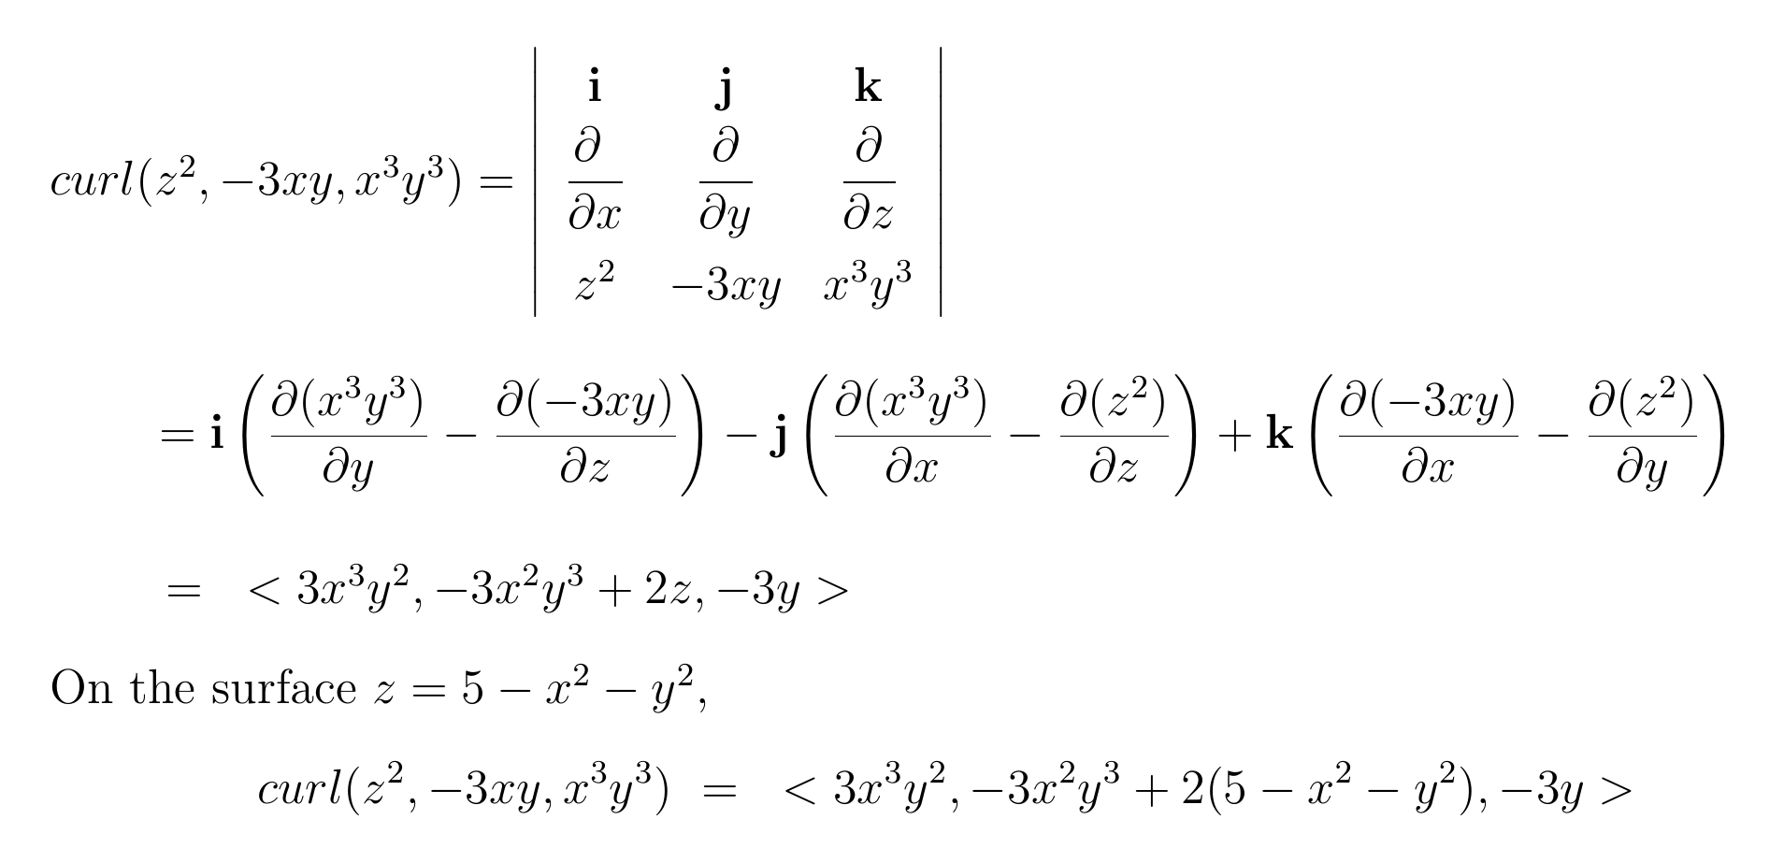

Slide 23
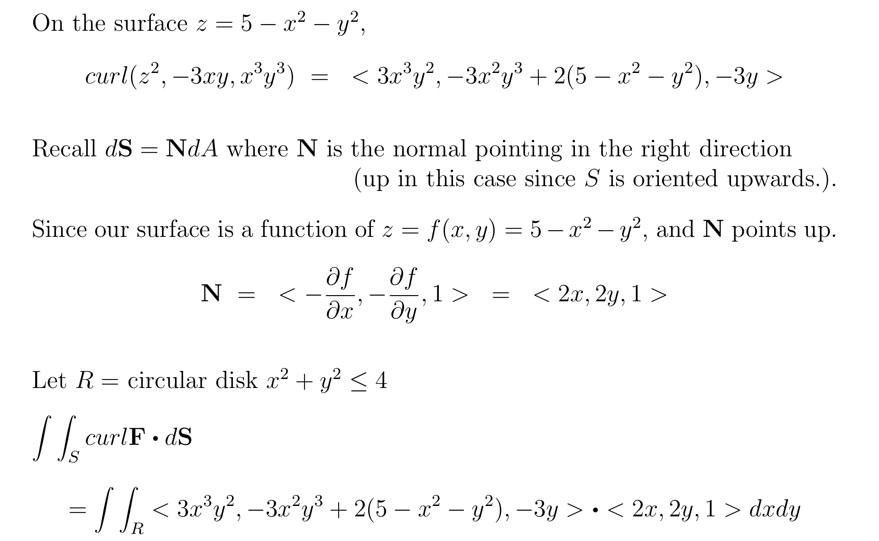

Slide 24
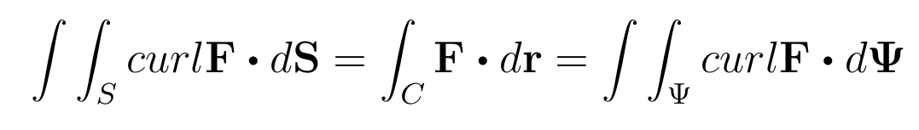
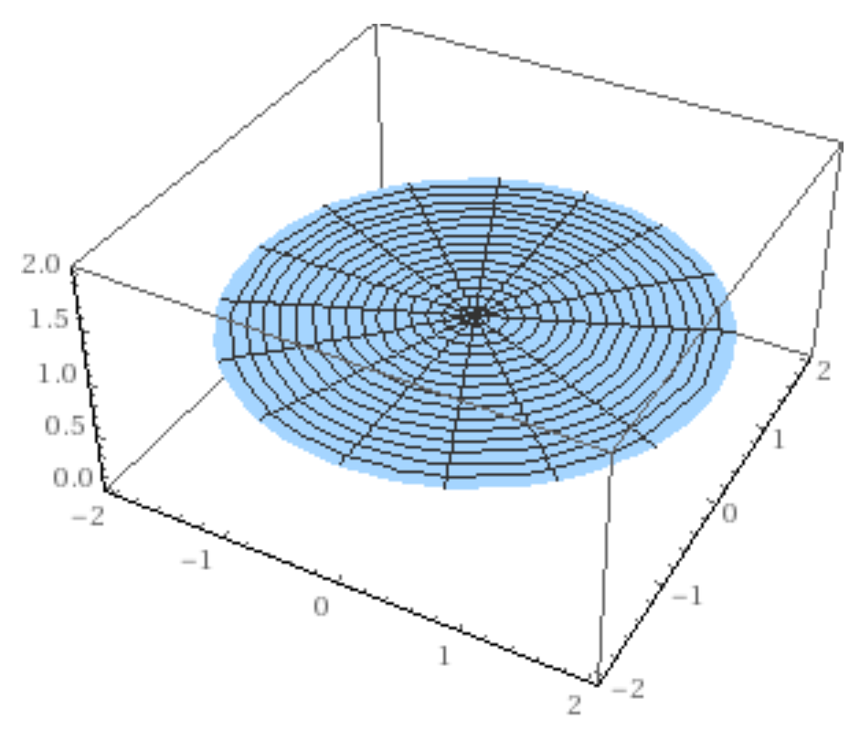

Slide 25
https://mathinsight.org/stokes_theorem_idea

Slide 26
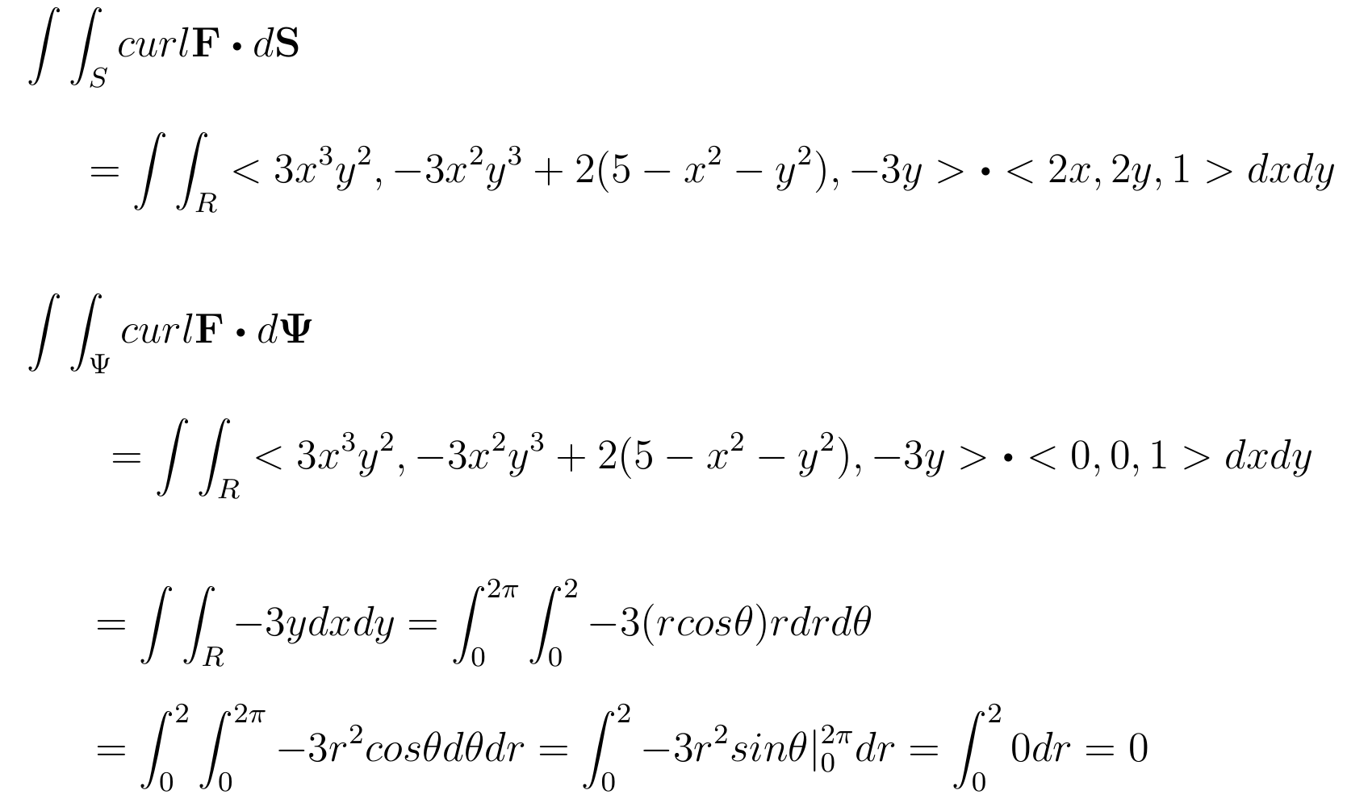

Slide 27
http://tutorial.math.lamar.edu/Classes/CalcIII/StokesTheorem.aspx

Slide 28
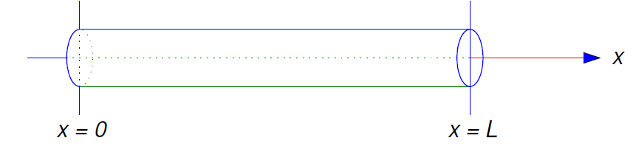
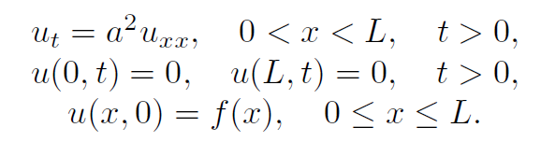
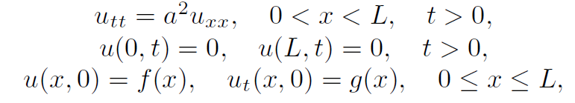

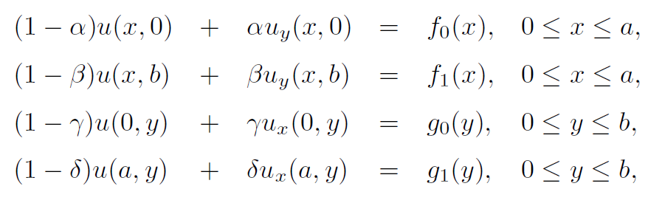
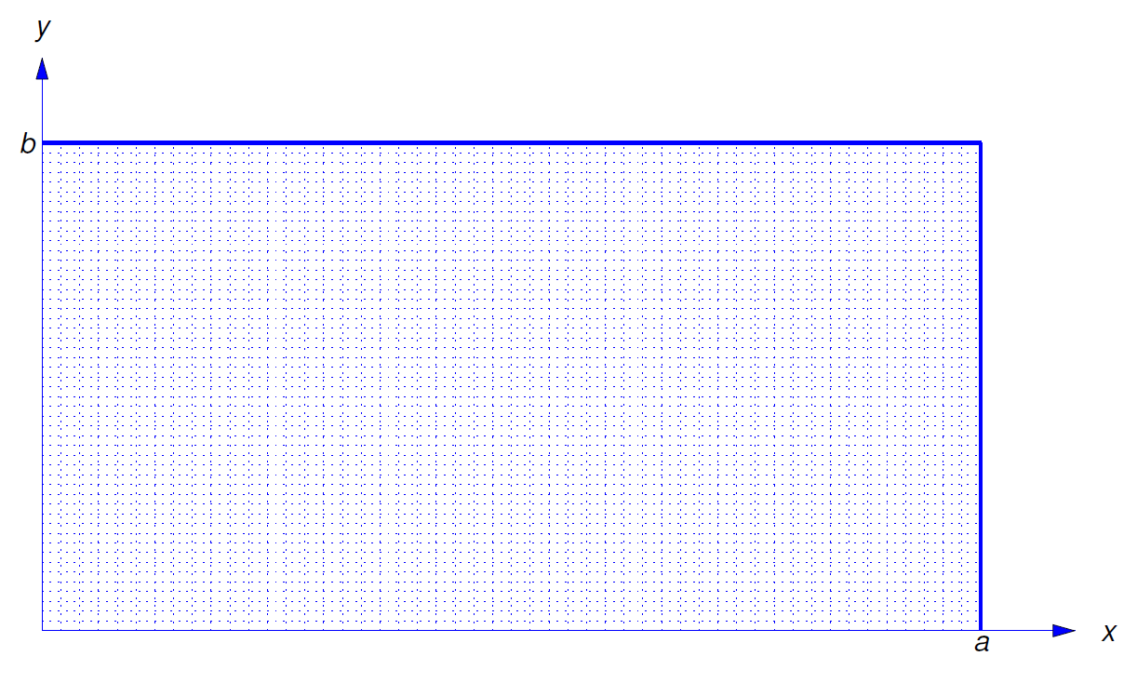
Ch 10 Boundary Value Problems
10.5 and 10.6 Heat Equation
10.7 Wave Equation
10.8 LaPlace Equation

Slide 29
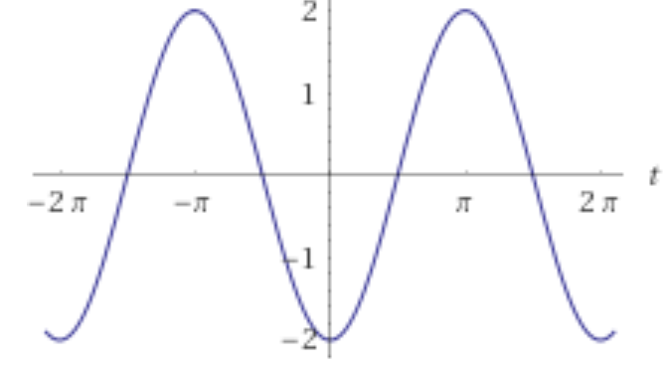
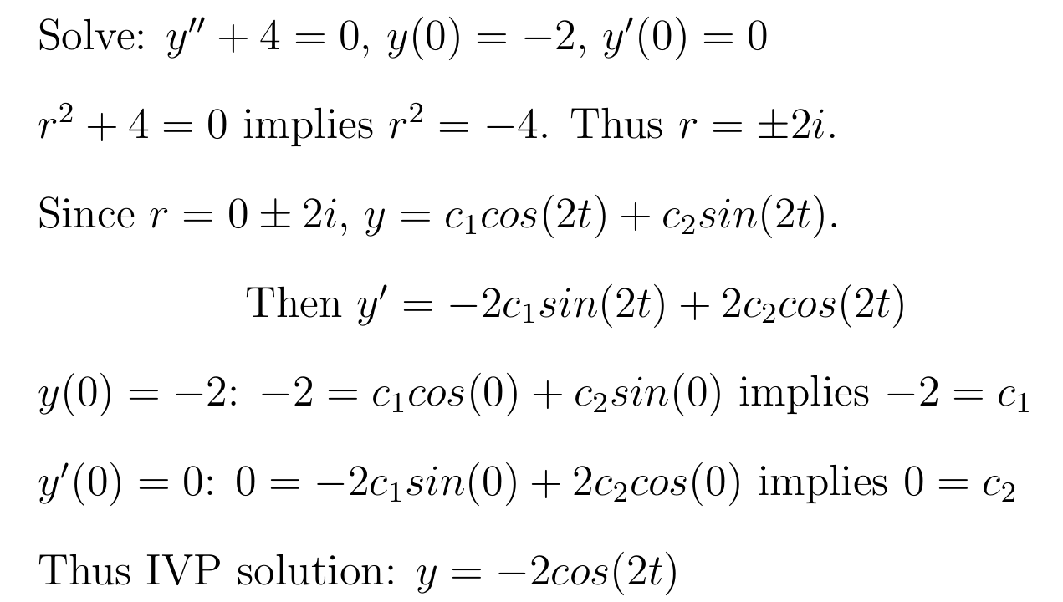
Boundary Value Problem vs Initial Value Problem
In Math IV, you solved DE equations involving initial values:

Slide 30
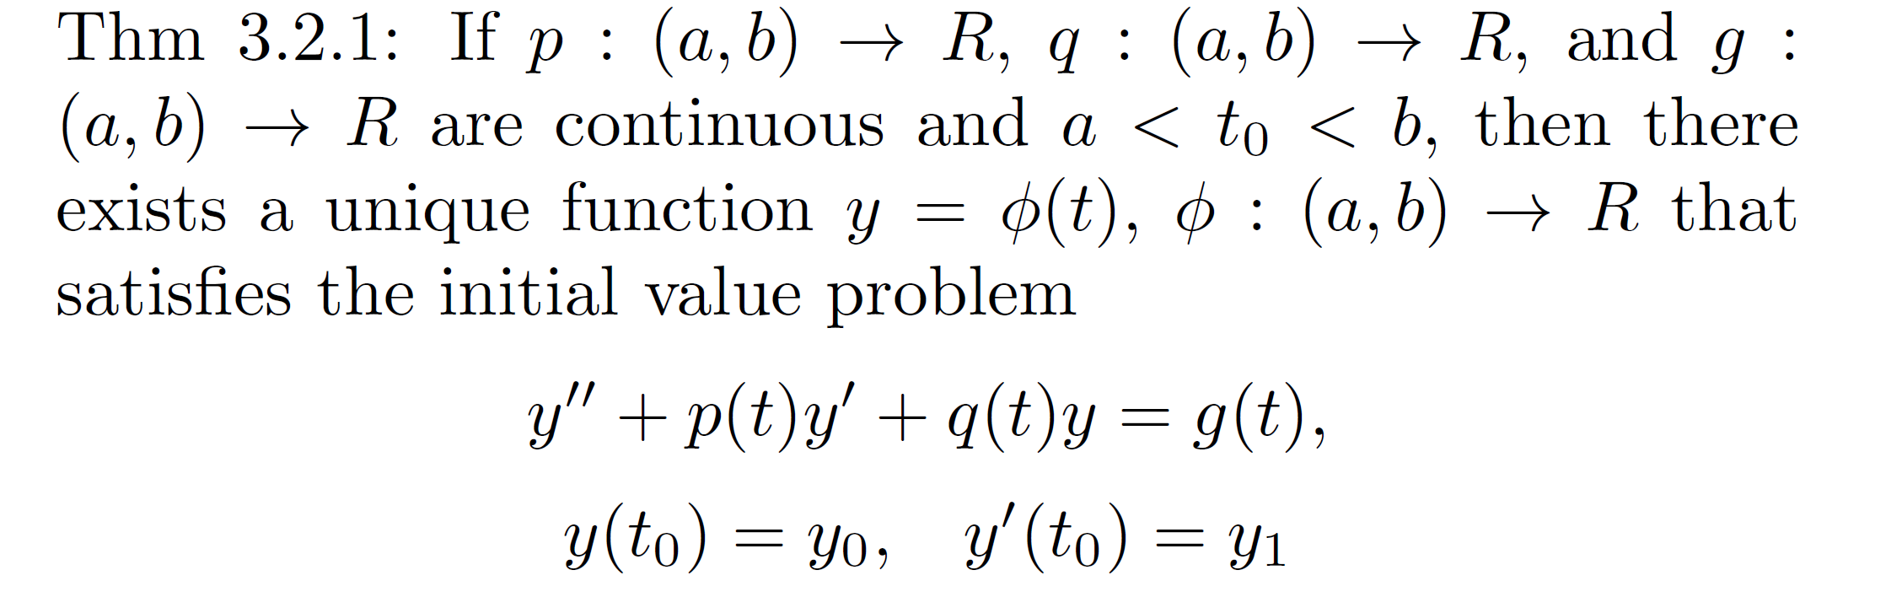

Boundary Value Problem vs Initial Value Problem
In Math IV, you solved DE equations involving initial values:

Slide 31
For boundary value problems:
Solutions may not be unique.
Solutions may not exist.

Slide 32
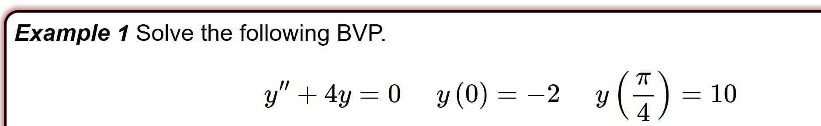
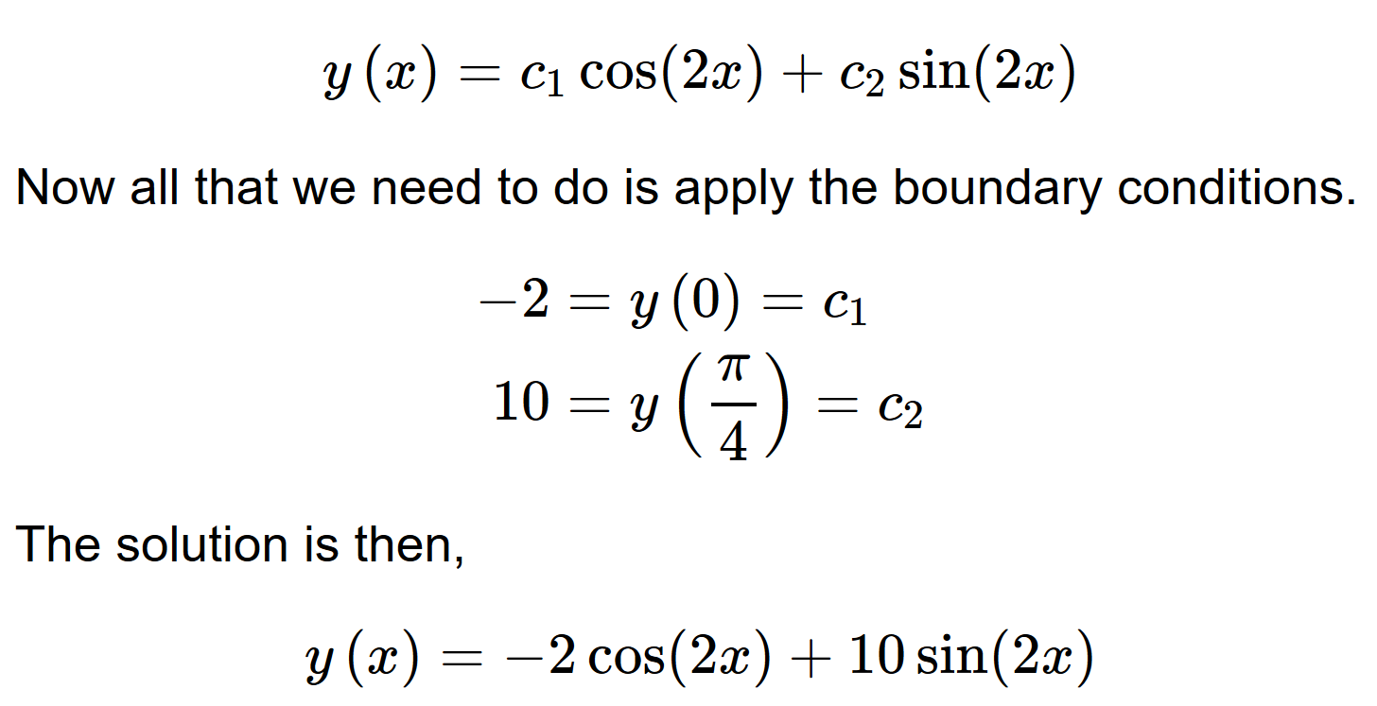
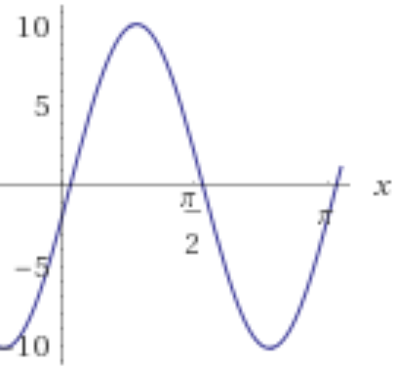
http://tutorial.math.lamar.edu/Classes/DE/BoundaryValueProblem.aspx

Slide 33
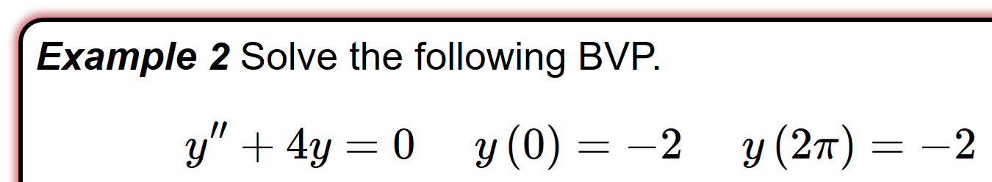
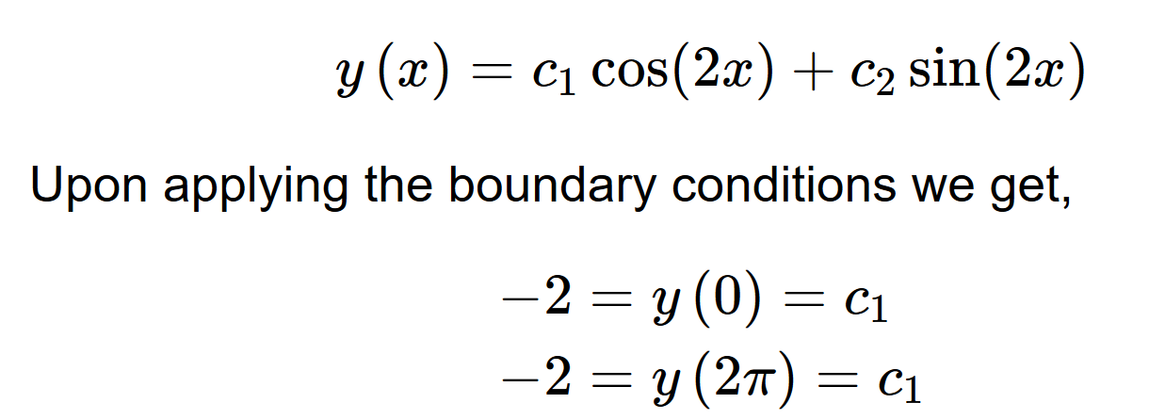
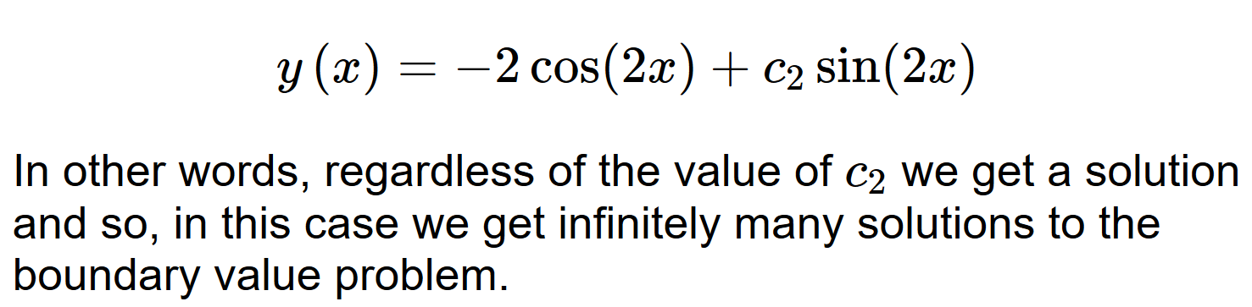
http://tutorial.math.lamar.edu/Classes/DE/BoundaryValueProblem.aspx

Slide 34
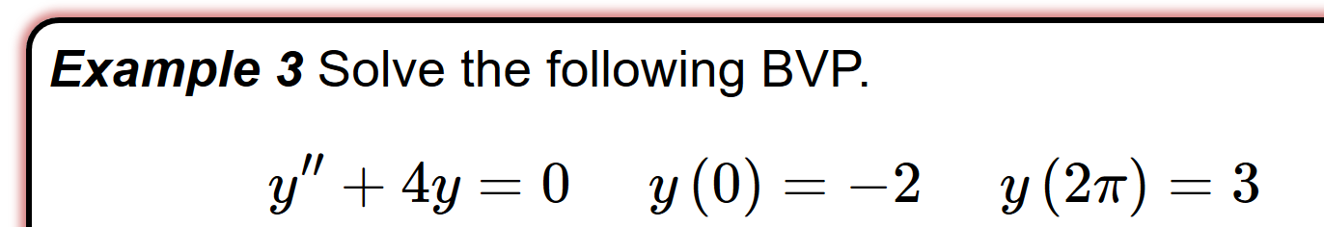
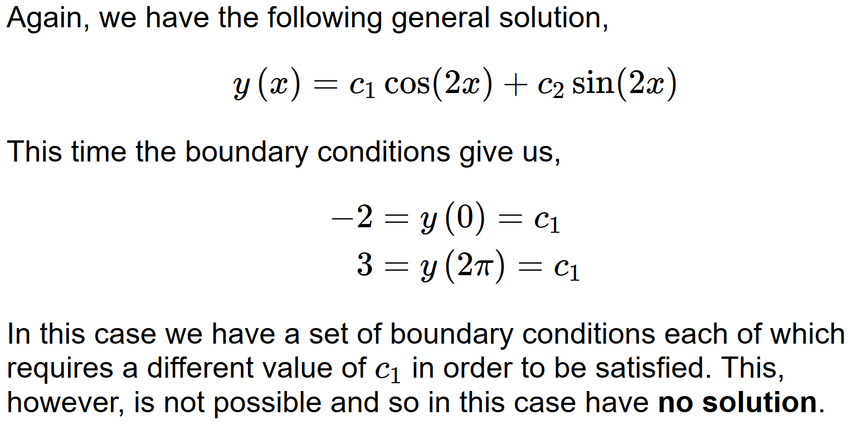
http://tutorial.math.lamar.edu/Classes/DE/BoundaryValueProblem.aspx

