Slide 1
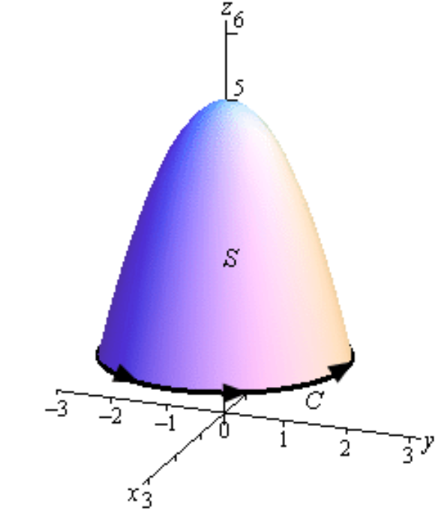
http://tutorial.math.lamar.edu/Classes/CalcIII/StokesTheorem.aspx
S = piecewise smooth positively oriented surface.
C = boundary of S
= simple closed positively oriented curve.
F = vector field whose components have continuous first order partial derivatives.

Slide 2
http://tutorial.math.lamar.edu/Classes/CalcIII/StokesTheorem.aspx

Slide 3
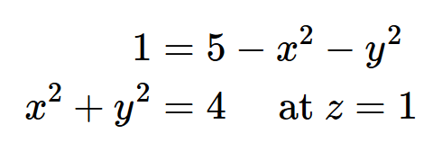
http://tutorial.math.lamar.edu/Classes/CalcIII/StokesTheorem.aspx

Slide 4
http://tutorial.math.lamar.edu/Classes/CalcIII/StokesTheorem.aspx

Slide 5
http://tutorial.math.lamar.edu/Classes/CalcIII/StokesTheorem.aspx

Slide 6
http://tutorial.math.lamar.edu/Classes/CalcIII/StokesTheorem.aspx

Slide 7
http://tutorial.math.lamar.edu/Classes/CalcIII/StokesTheorem.aspx

Slide 8
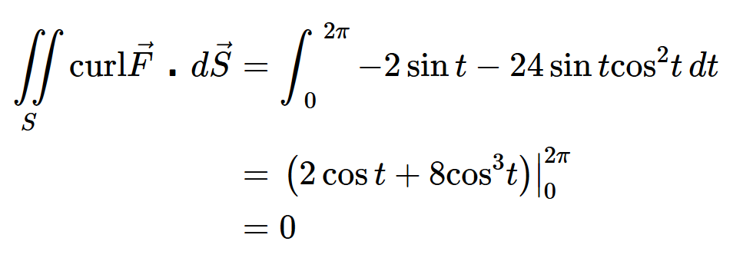
http://tutorial.math.lamar.edu/Classes/CalcIII/StokesTheorem.aspx

Slide 9
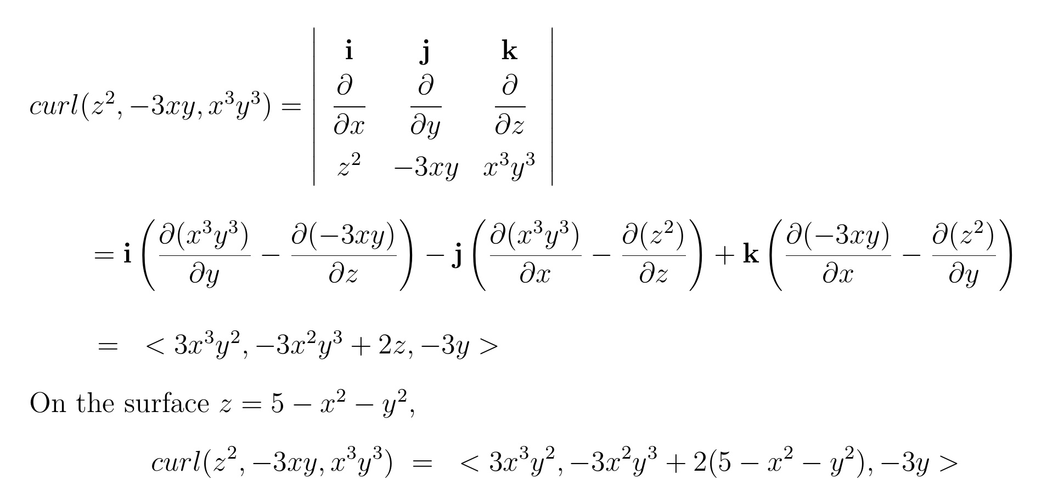

Slide 11
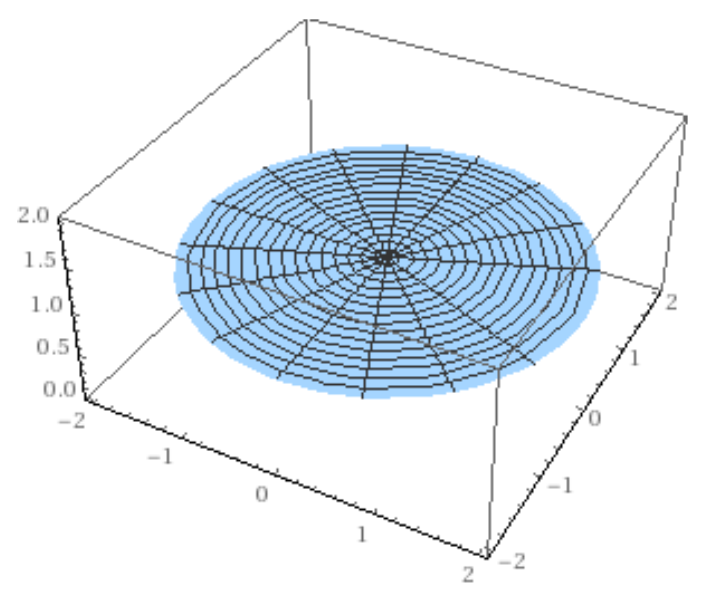

Slide 12
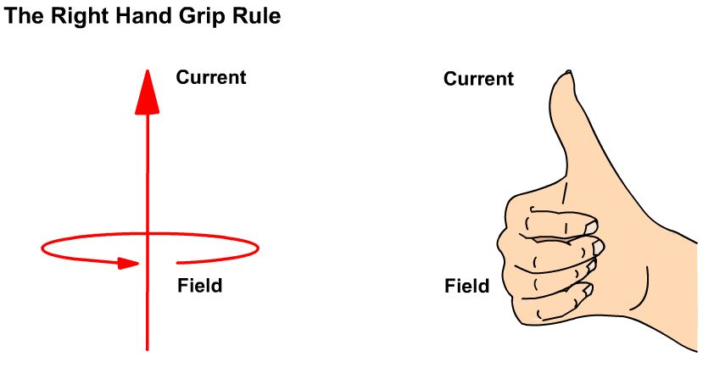
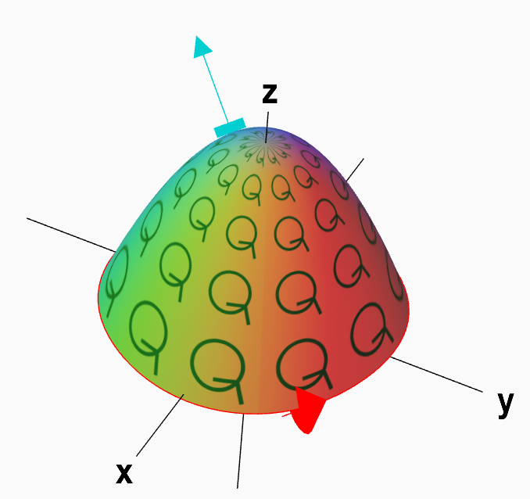
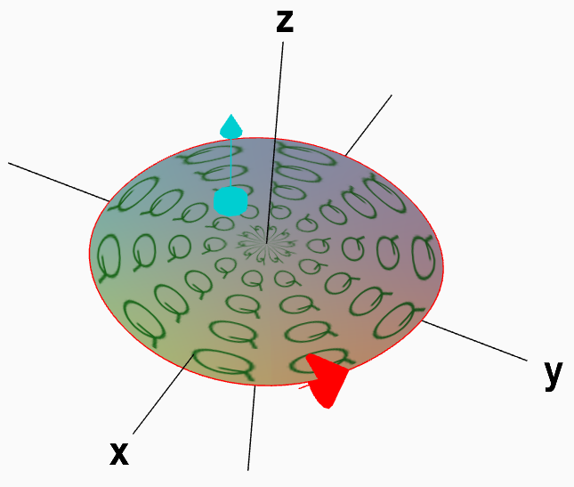
https://mathinsight.org/stokes_theorem_idea

Slide 13
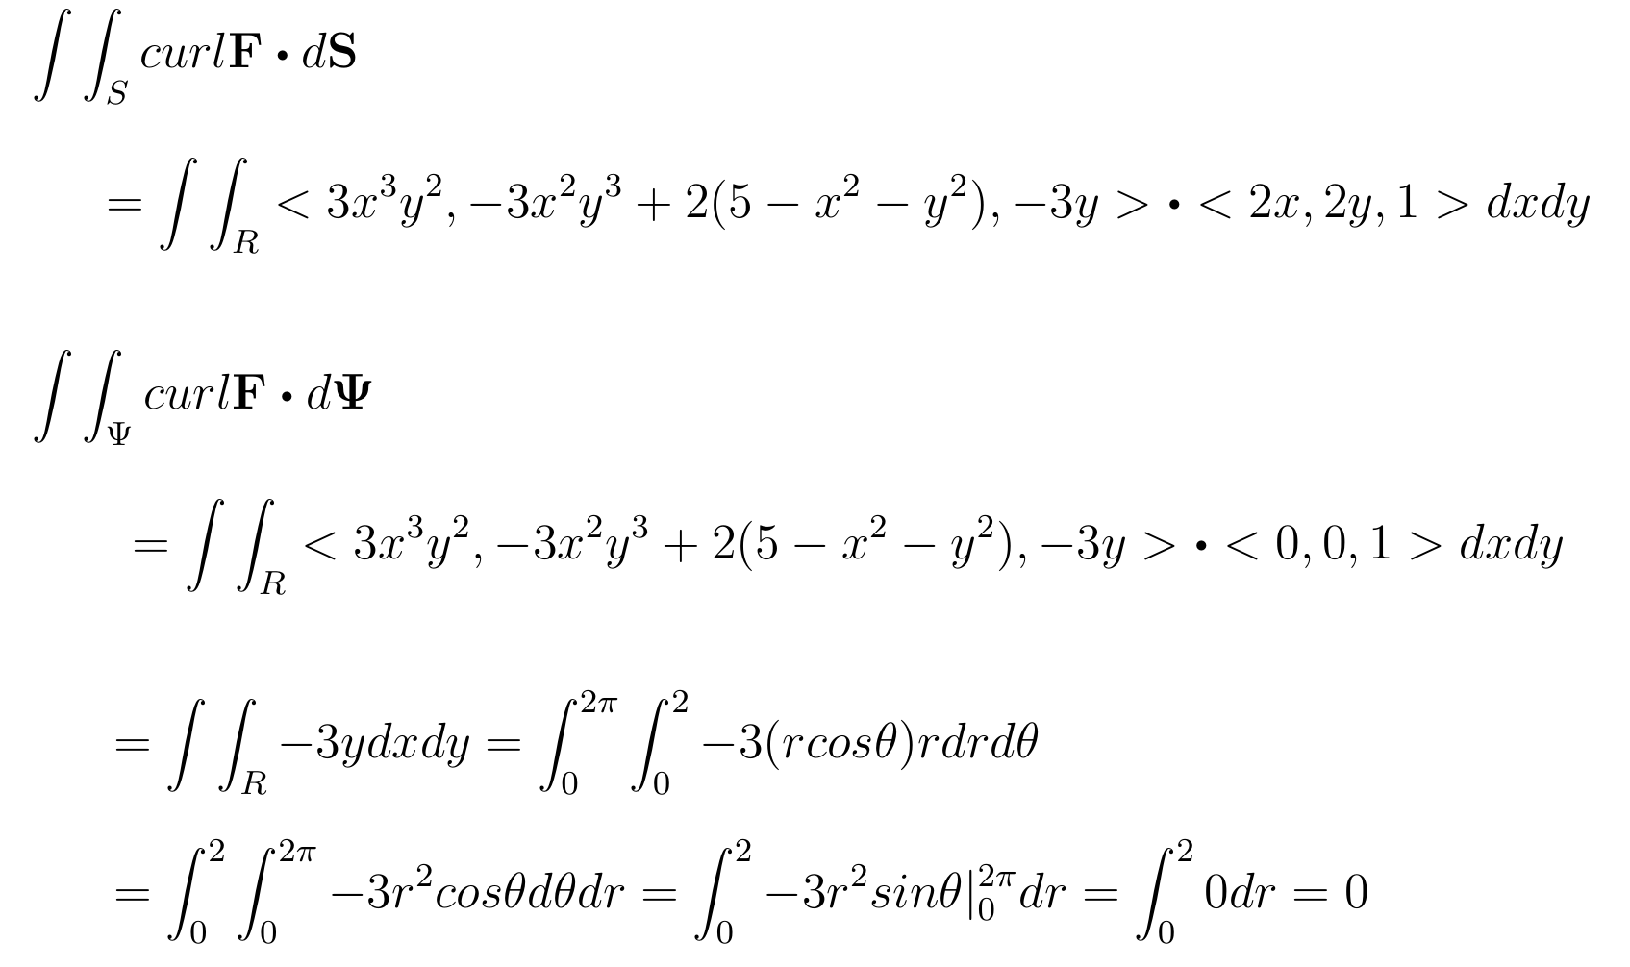

Slide 14
http://tutorial.math.lamar.edu/Classes/CalcIII/StokesTheorem.aspx

