Slide 1
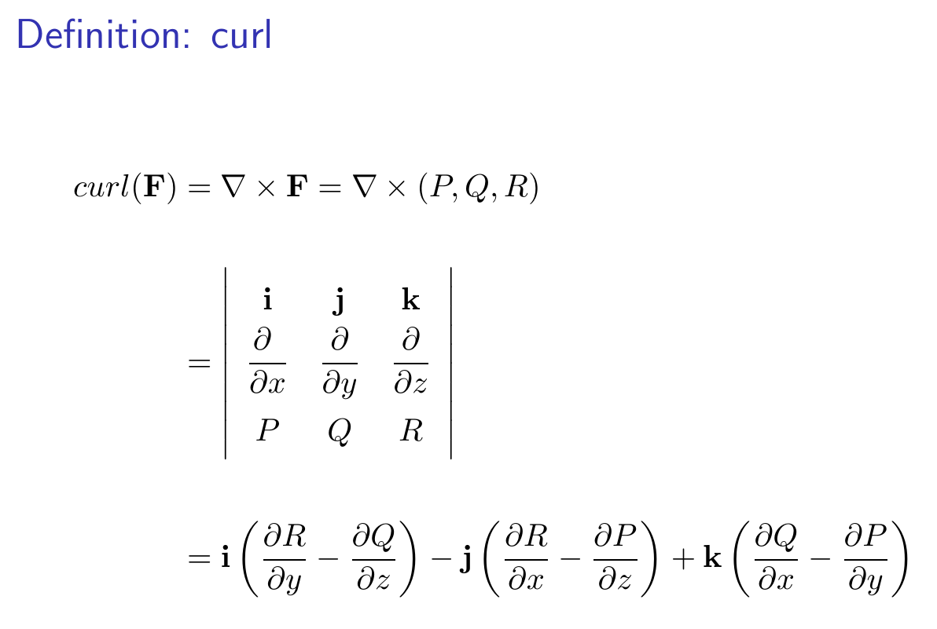
14.7 Stoke’s Theorem

Slide 2
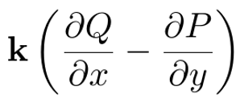
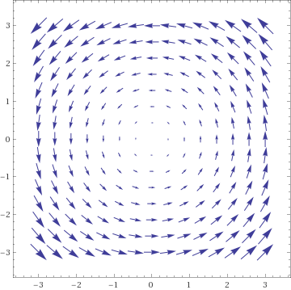

Slide 3
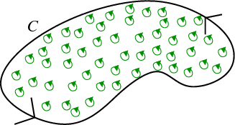
https://mathinsight.org/greens_theorem_idea

Slide 4
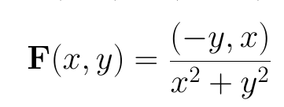
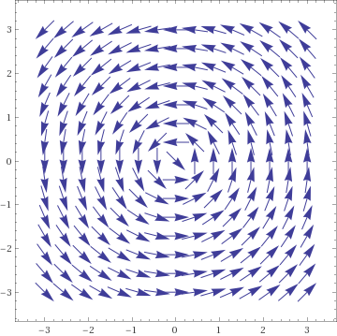

Slide 6
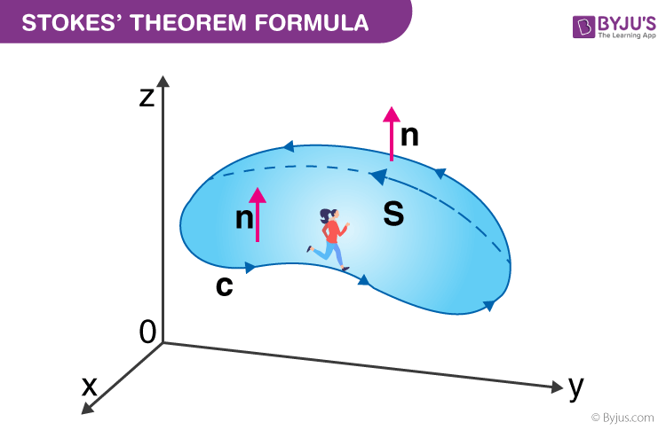
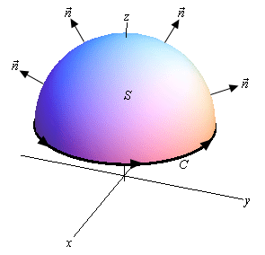
https://byjus.com/maths/stokes-theorem/
http://tutorial.math.lamar.edu/Classes/CalcIII/StokesTheorem.aspx
Green’s Theorem is a special case of Stoke’s theorem when your surface lies in the xy plane

Slide 7
https://byjus.com/maths/stokes-theorem/
http://tutorial.math.lamar.edu/Classes/CalcIII/StokesTheorem.aspx
whose components have continuous first order partial derivatives.

Slide 8
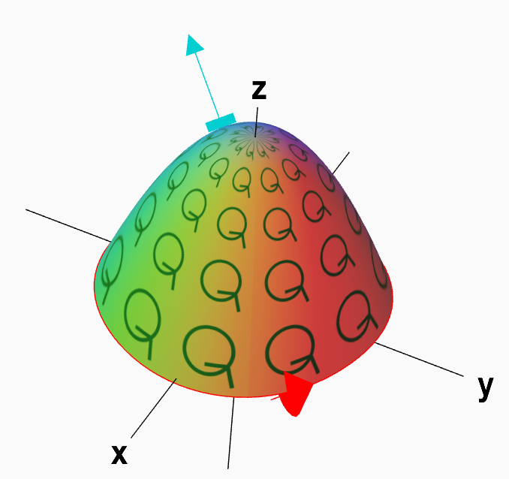
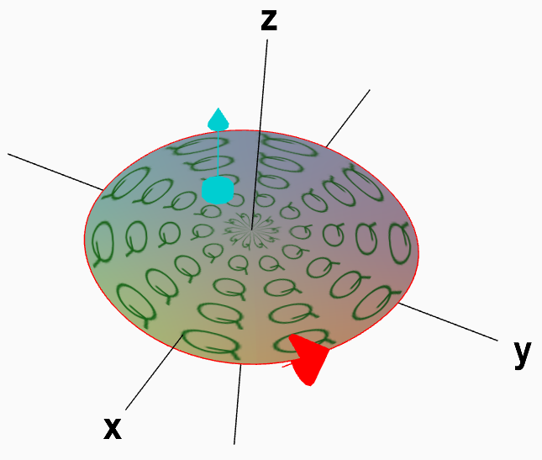

Slide 10
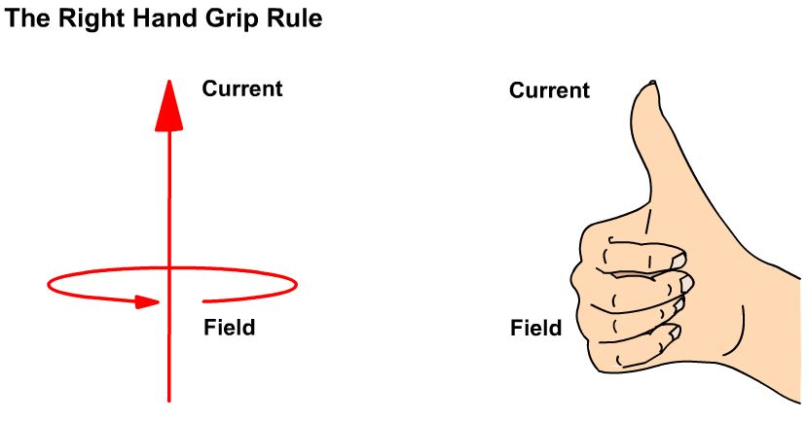

Slide 11
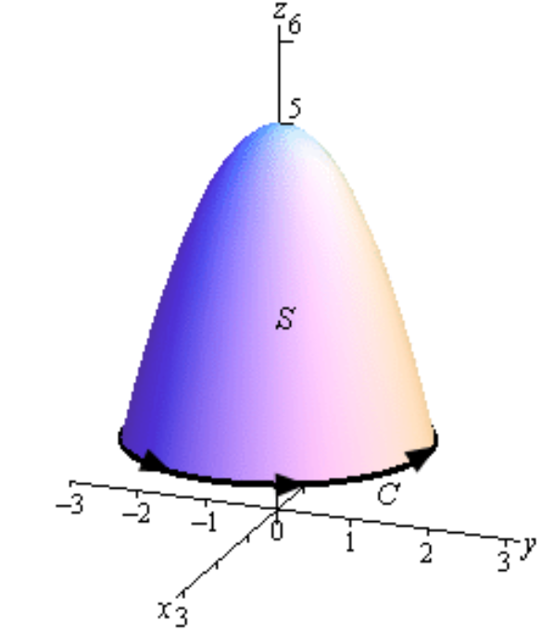

Slide 12
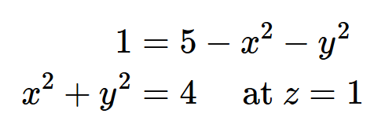

Slide 16
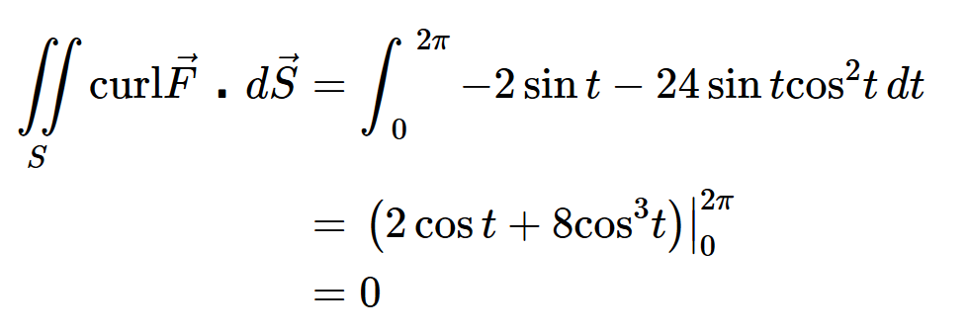

Slide 17
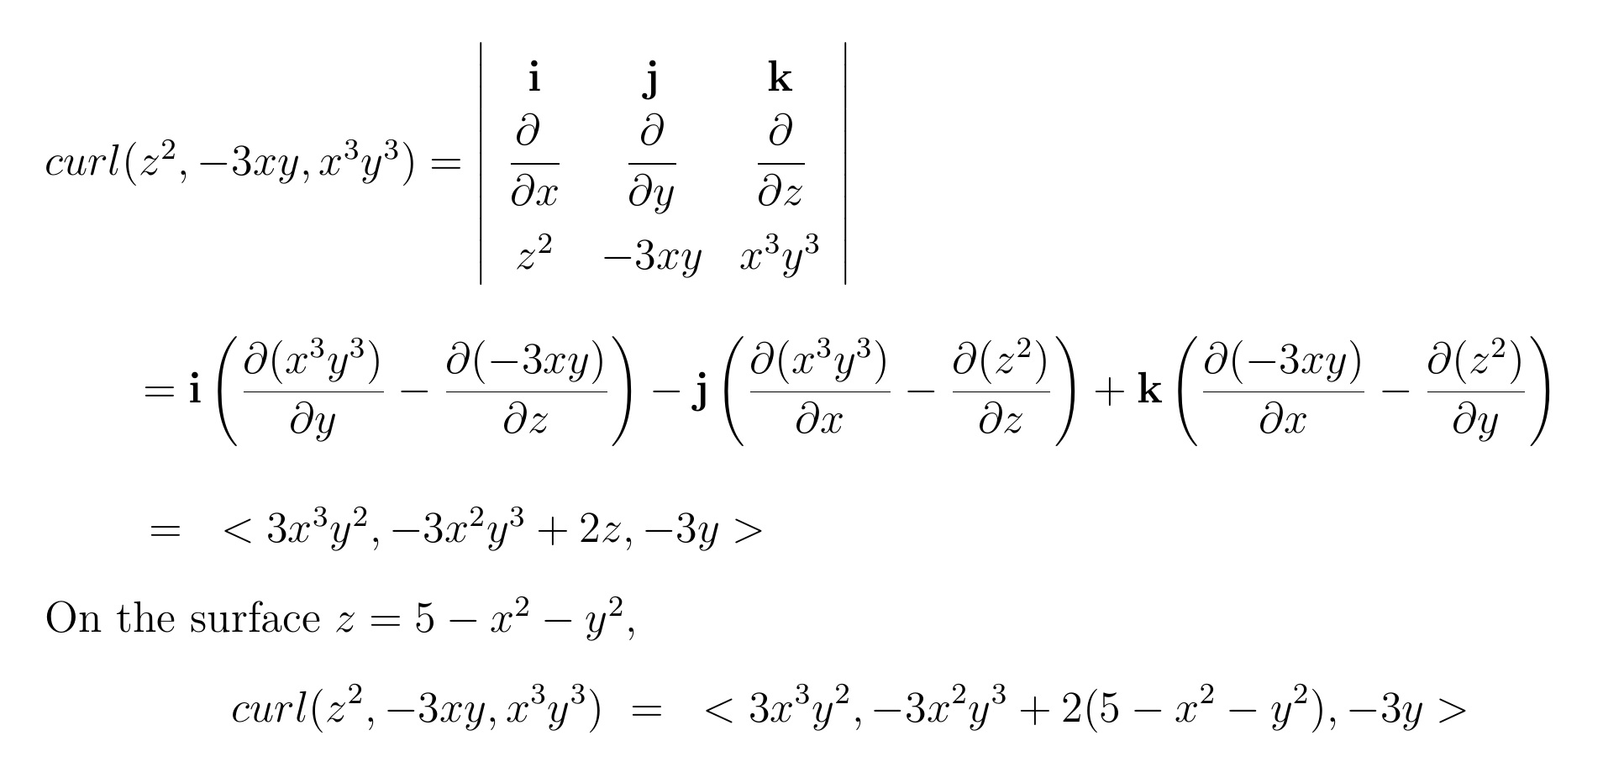

Slide 19
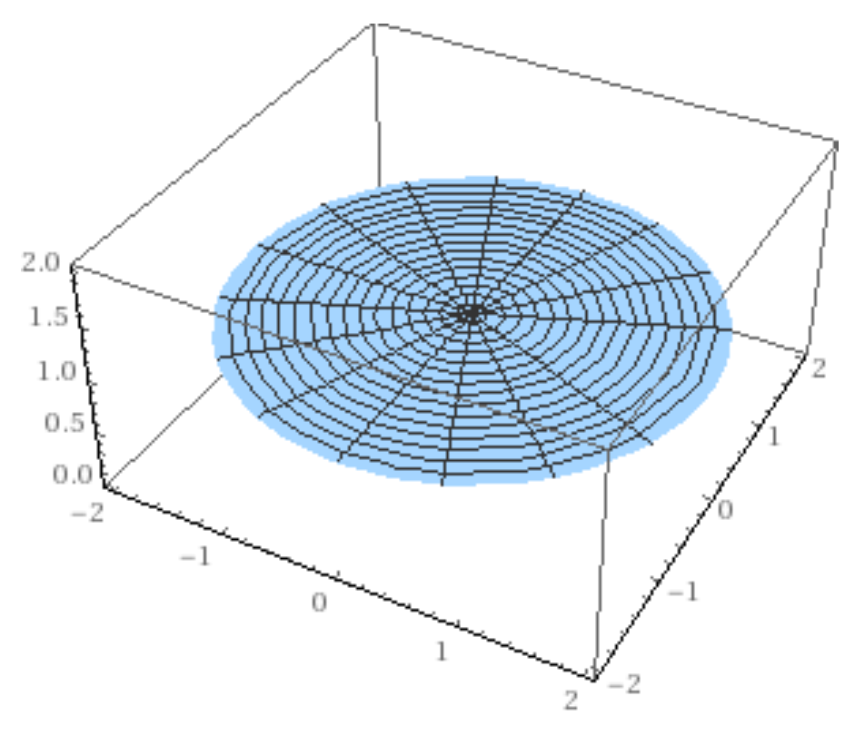

Slide 20
