Slide 1
Suppose water that is 1 meter high passes the blue line at 2 m/sec. If the height of this blue line is Δy, how much water passes thru in 1 second?

Slide 2
Suppose water that is 1 meter high passes the blue line at 2 m/sec. If the height of this blue line is Δy, how much water passes thru in 1 second?
(1 meter high)(Δy)(2 m/sec)(1 sec) = 2 Δy m^3.
Thus 2 Δy cubic meters of water pass thru the blue line segment with height Δy.

Slide 3
Suppose water that is 1 meter high passes the blue line at P(x) m/sec. If the height of this blue line is Δy, how much water passes thru in 1 second?
y
x
(1 meter high)(Δy)(P(x) m/sec)(1 sec) = P(x) Δy m^3.
Thus P(x) Δy cubic meters of water pass thru the blue line segment with height Δy.

Slide 4
Suppose water that is 1 meter high passes the blue line at P(x, y) m/sec. If the height of this blue line is Δy, how much water passes thru in 1 second?
y
x
(1 meter high)(Δy)(P(x, y*) m/sec)(1 sec) = P(x, y*) Δy m^3.
Thus approximately, P(x, y*) Δy cubic meters of water pass thru the blue line segment with height Δy.

Slide 5
Suppose vector field is F = < P(x), 0>. Suppose these vectors represent velocity vectors. Note the velocity increases as x increases.
y
x
Suppose this represents the velocity of water that is 1 meter high flowing over a 2D planar surface. Then more water exits the blue rectangle then enters this rectangle.

Slide 6
Suppose vector field is F = < P(x), 0>. Suppose dimensions of the blue rectangle are Δx by Δy.
y
x
In 1 second,
P(x) Δy cubic meters of water enters the blue box
P(x + Δx) Δy cubic meters of exits the blue box.
Thus P(x + Δx) Δy - P(x) Δy passes thru the blue box.

Slide 7
Suppose vector field is F = < P(x), 0>. Suppose dimensions of the blue rectangle are Δx by Δy.
y
x
In 1 second, [P(x + Δx) - P(x)] Δy passes thru the blue box.

Slide 8
Suppose vector field is F = < P(x), 0>. Suppose dimensions of the blue rectangle are Δx by Δy.
y
x
In 1 second, [P(x + Δx) - P(x)] Δy passes thru the blue box. Thus $\frac{\text{[}\text{P}\text{(}\text{x}\text{ +} \text{D}\text{x}\text{)}\text{ − }\text{P}\text{(}\text{x}\text{)]}\text{D}\text{x}\text{D}\text{y}}{\text{D}\text{x}}$ passes thru the blue box.

Slide 9
$\lim_{\text{D}\text{x}→0} \frac{\text{[}\text{P}\text{(}\text{x}\text{ +} \text{D}\text{x}\text{)}\text{ − }\text{P}\text{(}\text{x}\text{)]} }{\text{D}\text{x}}$ = $\frac{∂P}{∂x} \text{and} \text{D}\text{x}\text{D}\text{y}$ → dA
Thus $\frac{\text{[}\text{P}\text{(}\text{x}\text{ +} \text{D}\text{x}\text{)}\text{ − }\text{P}\text{(}\text{x}\text{)]}\text{D}\text{x}\text{D}\text{y}}{\text{D}\text{x}}$ → $\frac{∂P}{∂x}$ dA

Slide 10
Suppose vector field is F = < P(x, y), 0>. Suppose dimensions of the blue rectangle are Δx by Δy.
y
x
In 1 sec, [P(x + Δx, y*) - P(x, y*)] Δy passes thru the blue box. Thus $\frac{\text{[}\text{P}\text{(}\text{x}\text{ +} \text{D}\text{x}\text{, }\text{y}\text{*}\text{)}\text{ − }\text{P}\text{(}\text{x}\text{, }\text{y}\text{*}\text{)]}\text{D}\text{x}\text{D}\text{y}}{\text{D}\text{x}}$ passes thru the blue box.

Slide 11
$\lim_{\text{D}\text{x}→0} \frac{\text{[}\text{P}\text{(}\text{x}\text{ +} \text{D}\text{x}\text{, }\text{y}\text{)}\text{ − }\text{P}\text{(}\text{x}\text{, }\text{y}\text{)]} }{\text{D}\text{x}}$ = $\frac{∂P}{∂x} \text{and} \text{D}\text{x}\text{D}\text{y}$ → dA
Thus $\frac{\text{[}\text{P}\text{(}\text{x}\text{ +} \text{D}\text{x}\text{, }\text{y}\text{)}\text{ − }\text{P}\text{(}\text{x}\text{, }\text{y}\text{)]}\text{D}\text{x}\text{D}\text{y}}{\text{D}\text{x}}$ → $\frac{∂P}{∂x}$ dA

Slide 12
Suppose vector field is F = < 0, Q(x, y)>. Suppose dimensions of the blue rectangle are Δx by Δy.
y
x
In 1 sec, [Q(x, y + $\text{D}\text{y}$) - Q(x, y)] Δx passes thru the blue box. Thus $\frac{\text{[}\text{Q}\text{(}\text{x}\text{, }\text{y} \text{+} \text{D}\text{y}\text{)}\text{ − }\text{Q}\text{(}\text{x}\text{, }\text{y}\text{)]}\text{D}\text{x}\text{D}\text{y}}{\text{D}\text{y}}$ passes thru the blue box.

Slide 13
$\lim_{\text{D}y→0} \frac{\text{[}\text{Q}\text{(}\text{x}\text{, }\text{y} \text{+} \text{D}\text{y}\text{)}\text{ − }\text{Q}\text{(}\text{x}\text{, }\text{y}\text{)]} }{\text{D}\text{y}}$ = $\frac{∂Q}{∂y} \text{and} \text{D}\text{x}\text{D}\text{y}$ → dA
Thus $\frac{\text{[}\text{Q}\text{(}\text{x}\text{, }\text{y} \text{+} \text{D}\text{y}\text{)}\text{ − }\text{Q}\text{(}\text{x}\text{, }\text{y}\text{)]}\text{D}\text{x}\text{D}\text{y}}{\text{D}\text{y}}$ → $\frac{∂Q}{∂y}$ dA

Slide 14
Suppose vector field is F = < P(x, y), Q(x, y)>. Suppose dimensions of the blue rectangle are Δx by Δy.
y
x
In 1 second,
[P(x + Δx, y) - P(x, y)] Δy + [Q(x, y + $\text{D}\text{y}$) - Q(x, y)] Δx
passes thru the blue box.

Slide 15
Suppose vector field is F = < P(x, y), Q(x, y)>. Suppose dimensions of the blue rectangle are Δx by Δy.
y
x
In 1 second,
[P(x + Δx, y) - P(x, y)] Δy + [Q(x, y + $\text{D}\text{y}$) - Q(x, y)] Δx
passes thru the blue box.

Slide 16
Suppose vector field is F = < P(x, y), Q(x, y)>. Suppose dimensions of the blue rectangle are Δx by Δy.
y
x
In 1 second,
[P(x + Δx, y) - P(x, y)] Δx Δy + [Q(x, y + $\text{D}\text{y}$) - Q(x, y)] Δx Δy
Δx Δy
passes thru the blue box.

Slide 17
[P(x + Δx, y) - P(x, y)] Δx Δy + [Q(x, y + $\text{D}\text{y}$) - Q(x, y)] Δx Δy
Δx Δy
$\frac{∂P}{∂x}$ dA + $\frac{∂Q}{∂y}$dA = ( $\frac{∂P}{∂x}$ + $\frac{∂Q}{∂y}$ ) dA
passes thru the blue box.
Thus $\frac{∂P}{∂x}$($x,y$) + $\frac{∂Q}{∂y}(x,y)$ is the net rate per unit area at which fluid is flowing away (or “diverging”) from a point (x, y)

Slide 18
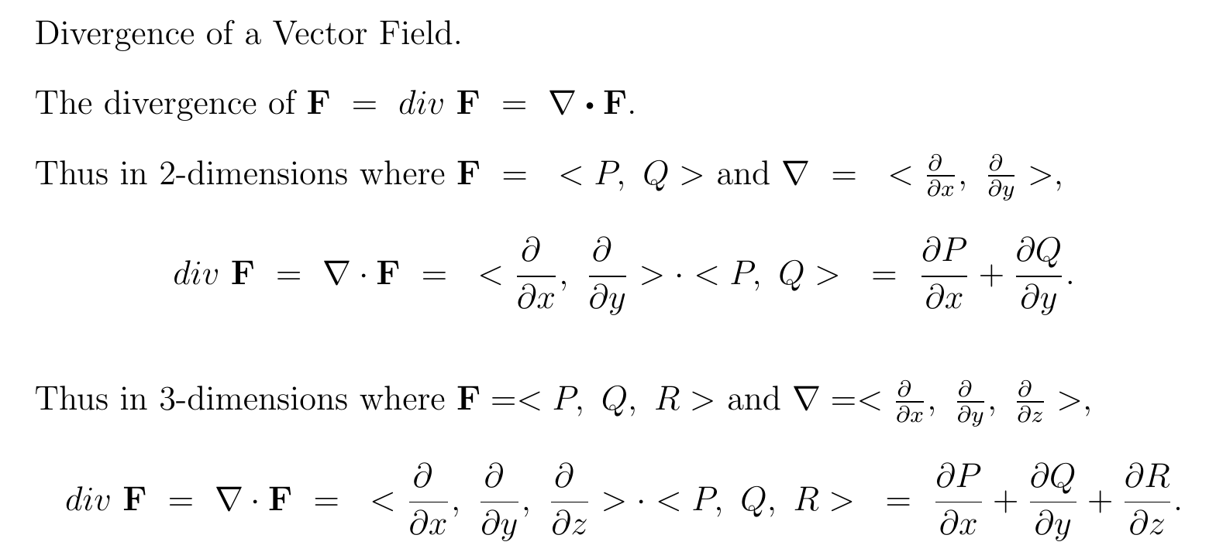

Slide 19
Suppose vector field is F = < P(x, y), Q(x, y)>.
$$\iint_{R}{∇⋅FⅆA}$$

Slide 20
[P(x + Δx, y) - P(x, y)] Δx Δy + [Q(x, y + $\text{D}\text{y}$) - Q(x, y)] Δx Δy
Δx Δy
$\frac{∂P}{∂x}$ dA + $\frac{∂Q}{∂y}$dA = ( $\frac{∂P}{∂x}$ + $\frac{∂Q}{∂y}$ ) dA
passes thru the blue box.
Thus $\frac{∂P}{∂x}$($x,y$) + $\frac{∂Q}{∂y}(x,y)$ is the net rate per unit area at which fluid is flowing away (or “diverging”) from a point (x, y)

Slide 21
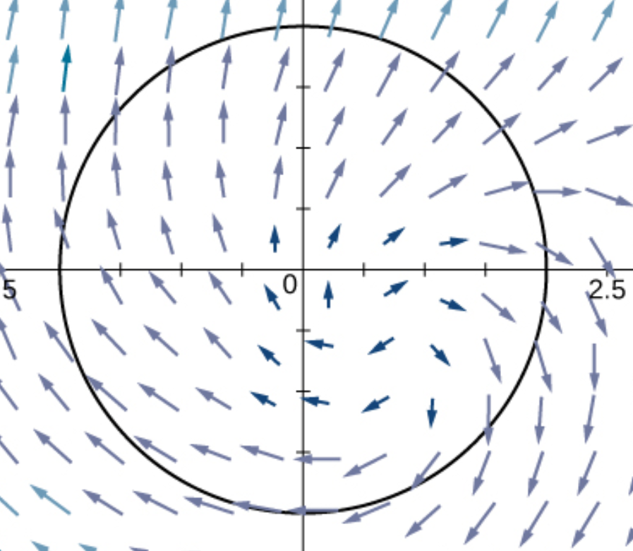
Suppose vector field is F = < P(x, y), Q(x, y)>.
$$\iint_{R}{∇⋅FⅆA=flux= }$$
$$\oint_{C}{F⋅nⅆs}$$

Slide 22
https://web.mst.edu/~vojtat/class_2135/lectures/lecture03/lecture03_part_3_electric_flux.ppt
We define A to be a vector having a magnitude equal to the area of the surface, in a direction normal to the surface.
A
θ
E
θ
The “amount of surface” perpendicular to the electric field is A cos θ.
Therefore, the amount of surface area effectively “cut through” by the electric field is A cos θ.
A_{Effective} = A cos θ so Φ_{E} = EA_{Effective} = EA cos θ.
Remember the dot product from Physics 1135?

Slide 23
https://web.mst.edu/~vojtat/class_2135/lectures/lecture03/lecture03_part_3_electric_flux.ppt
If the electric field is not uniform, or the surface is not flat…
divide the surface into infinitesimal surface elements and add the flux through each…
E
ΔA
dA
a surface integral, therefore a double integral
Remember, the direction of dA is normal to the surface.

Slide 24
Suppose vector field is F = < P(x, y), Q(x, y)>.
$$\iint_{R}{∇⋅FⅆA=flux= }$$
$$\oint_{C}{F⋅nⅆs}$$

Slide 26
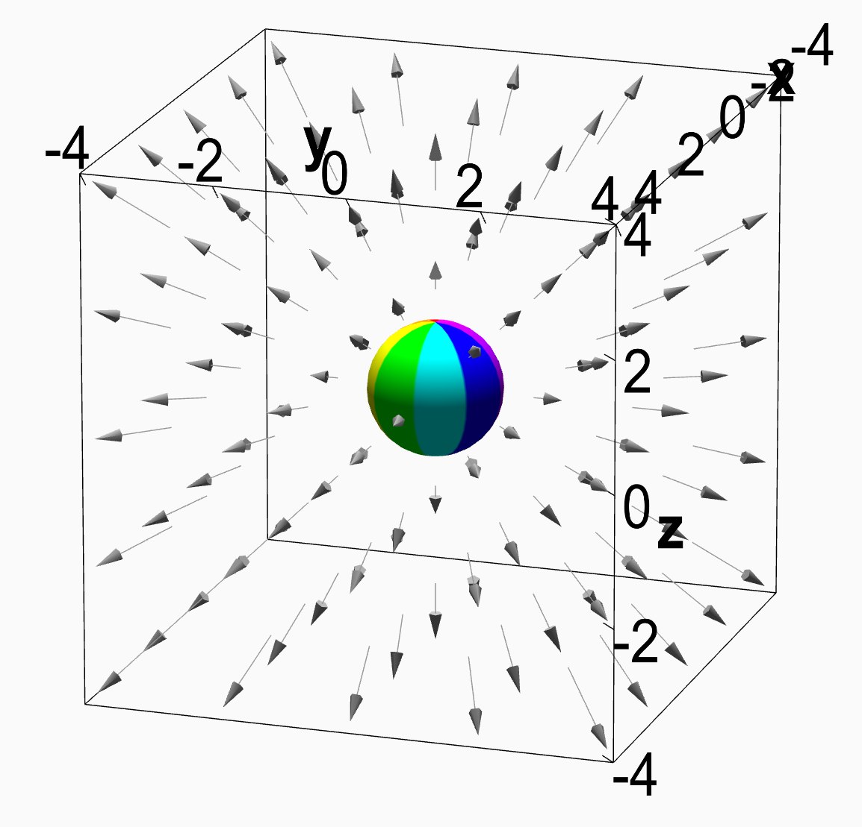

Slide 27
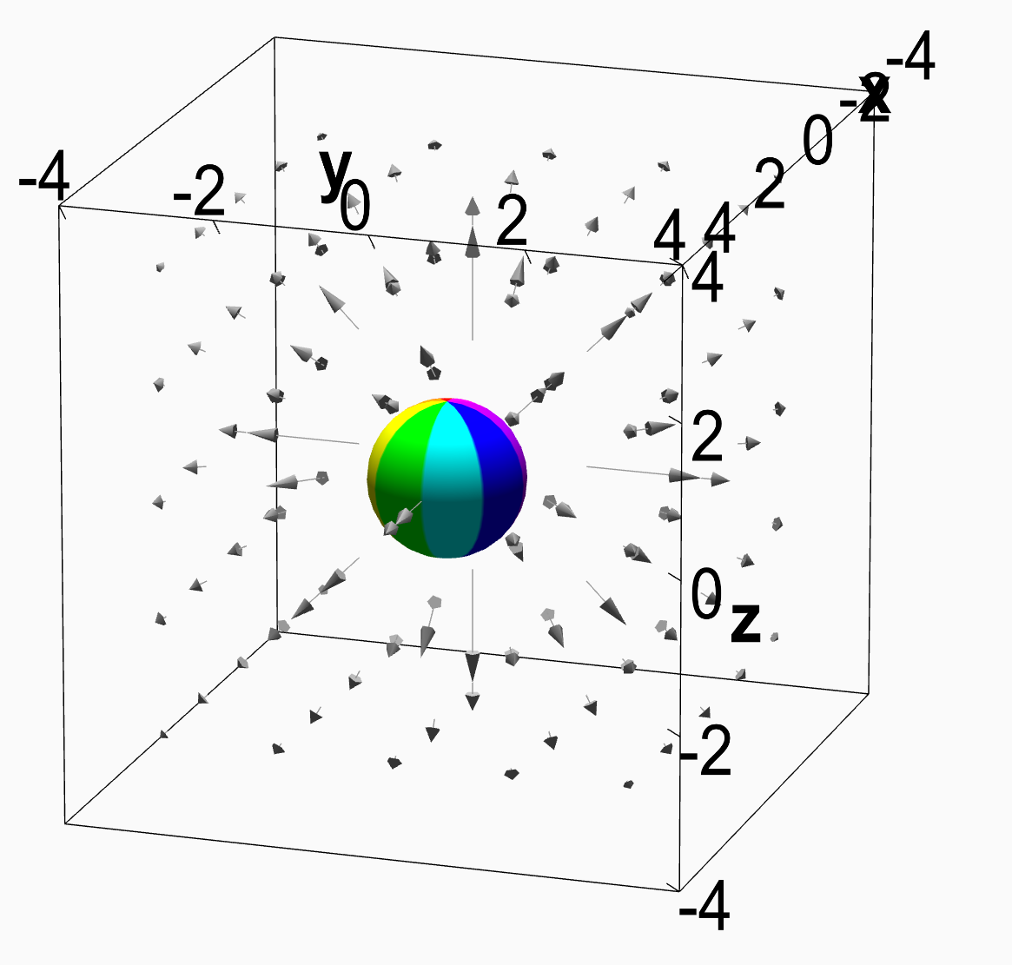

Slide 28
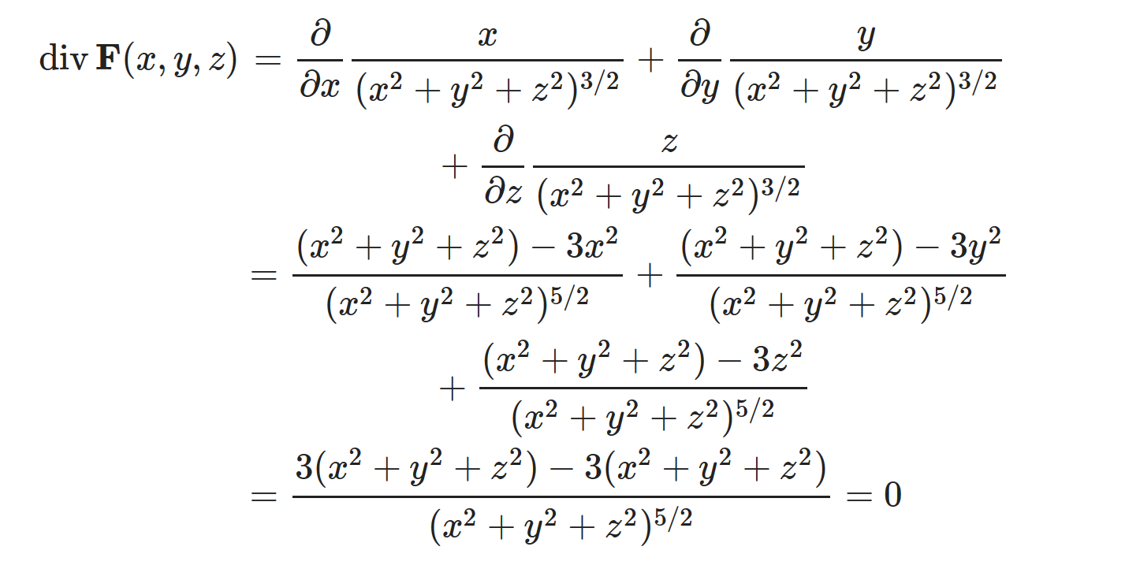

Slide 29
http://tutorial.math.lamar.edu/Classes/CalcIII/DivergenceTheorem.aspx

Slide 30
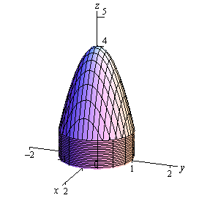
http://tutorial.math.lamar.edu/Classes/CalcIII/DivergenceTheorem.aspx

Slide 31
http://tutorial.math.lamar.edu/Classes/CalcIII/DivergenceTheorem.aspx

Slide 32
http://tutorial.math.lamar.edu/Classes/CalcIII/DivergenceTheorem.aspx

Slide 33
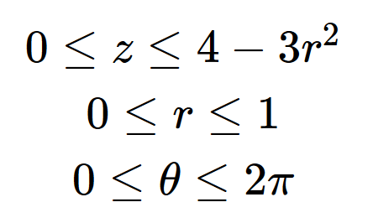
http://tutorial.math.lamar.edu/Classes/CalcIII/DivergenceTheorem.aspx

Slide 34
http://tutorial.math.lamar.edu/Classes/CalcIII/DivergenceTheorem.aspx

Slide 35
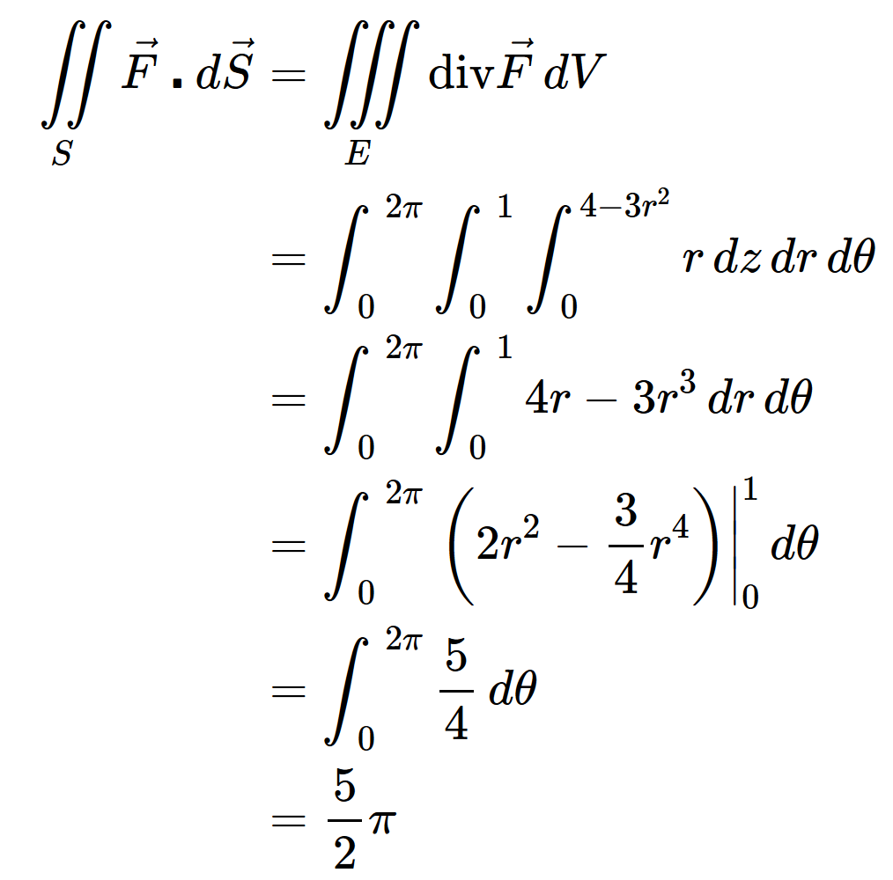
http://tutorial.math.lamar.edu/Classes/CalcIII/DivergenceTheorem.aspx

Slide 36
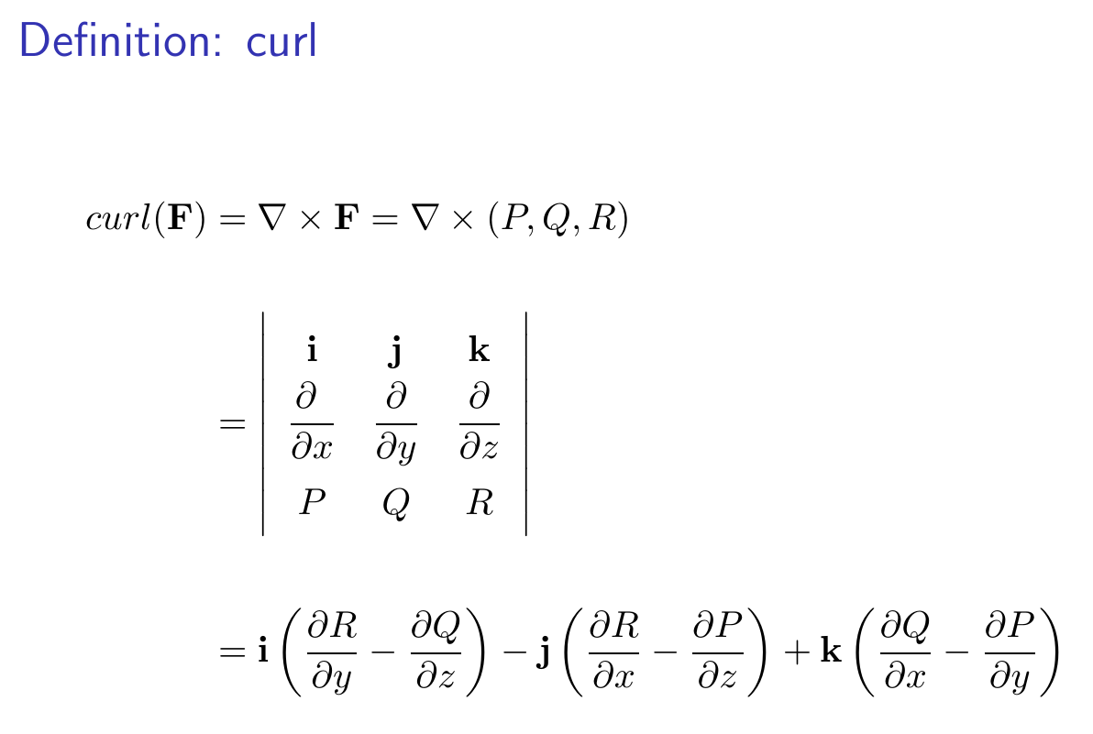
14.7 Stoke’s Theorem

Slide 37
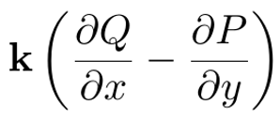
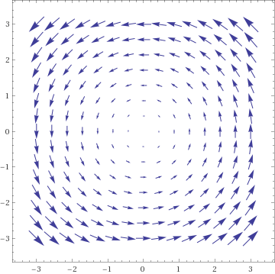

Slide 38
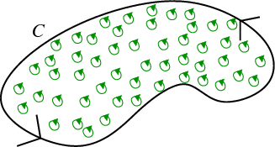
https://mathinsight.org/greens_theorem_idea

Slide 39
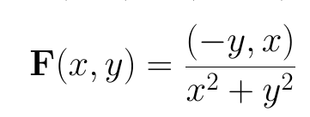
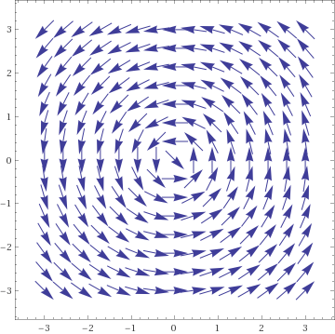

Slide 41
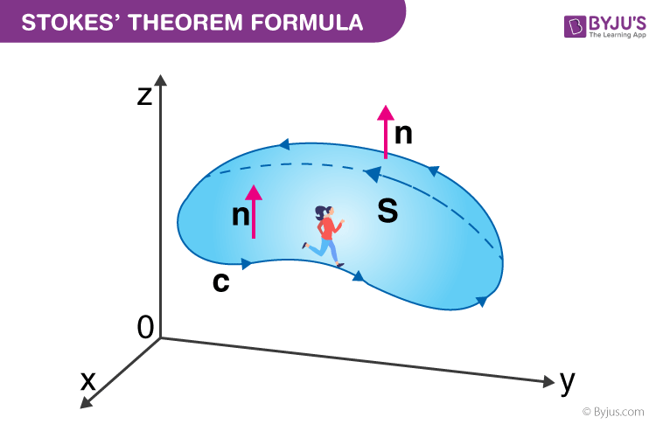
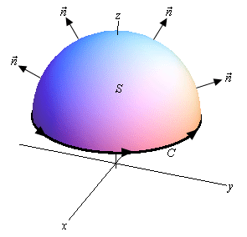
https://byjus.com/maths/stokes-theorem/
http://tutorial.math.lamar.edu/Classes/CalcIII/StokesTheorem.aspx

Slide 42
https://byjus.com/maths/stokes-theorem/
http://tutorial.math.lamar.edu/Classes/CalcIII/StokesTheorem.aspx
whose components have continuous first order partial derivatives.

Slide 43
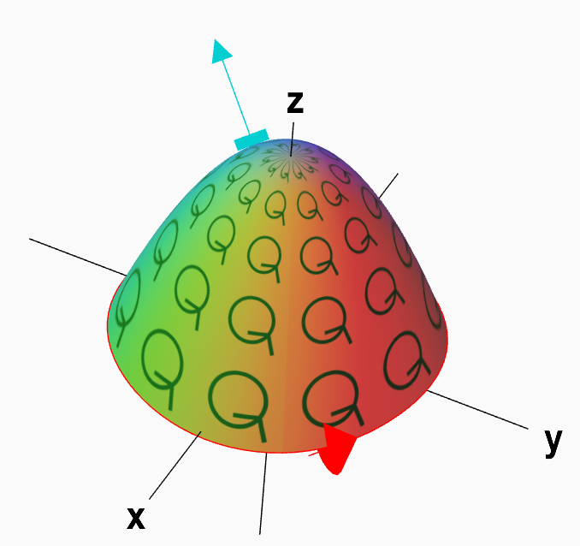
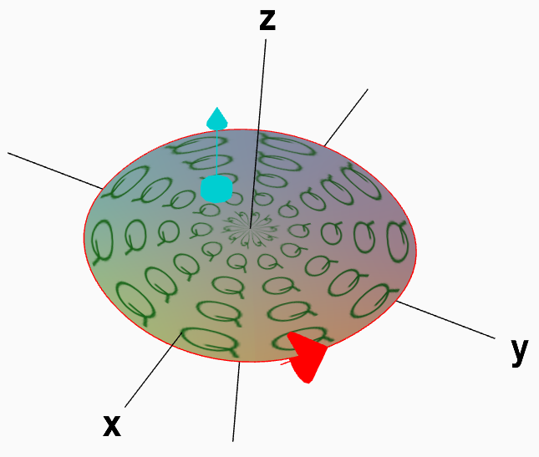

Slide 45
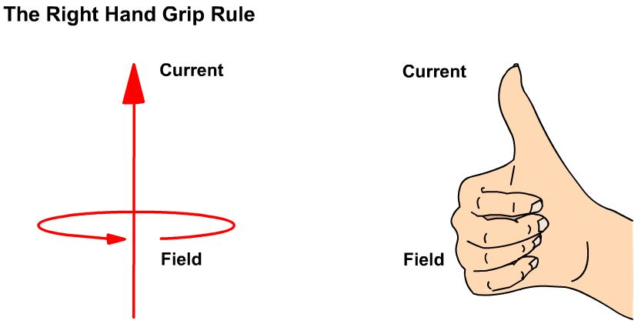

Slide 46
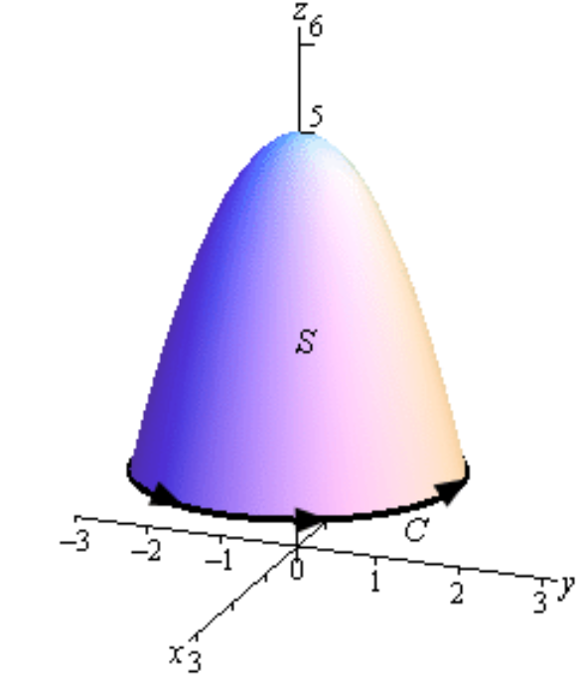

Slide 47
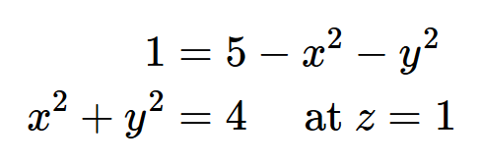

Slide 51
