Slide 1
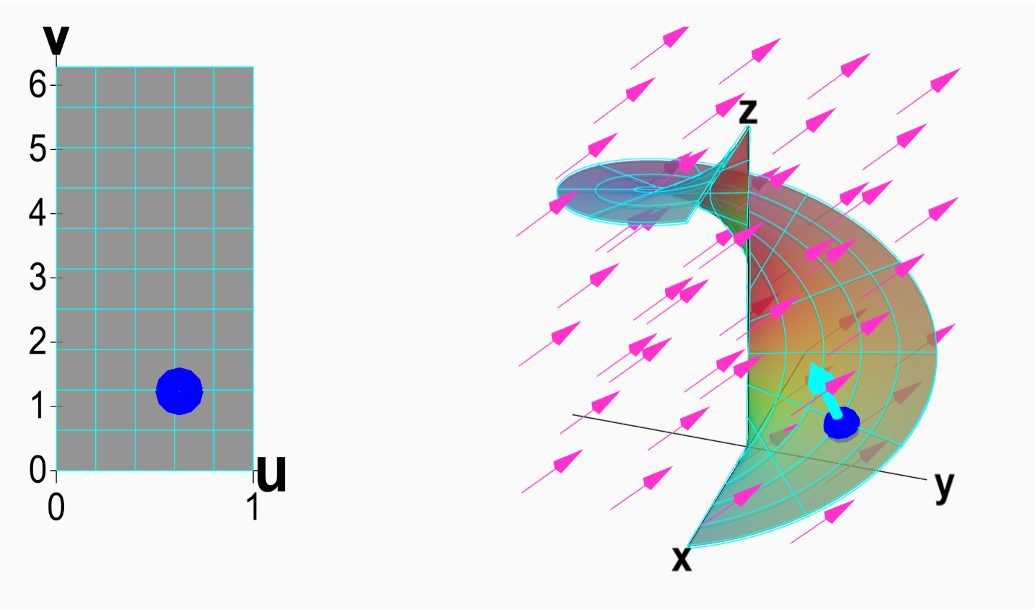
Vector surface integral
https://mathinsight.org/surface_integral_vector_field_introduction

Slide 2
Note the next slides are from Dr. Vojta’s Engineering Physics course:
https://web.mst.edu/~vojtat/class_2135/lectures/lecture03/lecture03_part_3_electric_flux.ppt

Slide 3
https://web.mst.edu/~vojtat/class_2135/lectures/lecture03/lecture03_part_3_electric_flux.ppt
Electric Flux
We have used electric field lines to visualize electric fields and indicate their strength.
We are now going to count* the number of electric field lines passing through a surface, and use this count to determine the electric field.
E
*There are 3 kinds of people in this world: those who can count, and those who can’t.

Slide 4
https://web.mst.edu/~vojtat/class_2135/lectures/lecture03/lecture03_part_3_electric_flux.ppt
The electric flux passing through a surface is the number of electric field lines that pass through it.
Because electric field lines are drawn arbitrarily, we quantify electric flux like this: Φ_{E}=EA,
…except that…
A
E
If the surface is tilted, fewer lines cut the surface.
E
θ
Later we’ll learn about magnetic flux, which is why I will use the subscript E on electric flux.
The green lines miss!

Slide 5
https://web.mst.edu/~vojtat/class_2135/lectures/lecture03/lecture03_part_3_electric_flux.ppt
We define A to be a vector having a magnitude equal to the area of the surface, in a direction normal to the surface.
A
θ
E
θ
The “amount of surface” perpendicular to the electric field is A cos θ.
Therefore, the amount of surface area effectively “cut through” by the electric field is A cos θ.
A_{Effective} = A cos θ so Φ_{E} = EA_{Effective} = EA cos θ.
Remember the dot product from Physics 1135?

Slide 6
https://web.mst.edu/~vojtat/class_2135/lectures/lecture03/lecture03_part_3_electric_flux.ppt
If the electric field is not uniform, or the surface is not flat…
divide the surface into infinitesimal surface elements and add the flux through each…
E
ΔA
dA
a surface integral, therefore a double integral
Remember, the direction of dA is normal to the surface.

Slide 7
https://web.mst.edu/~vojtat/class_2135/lectures/lecture03/lecture03_part_3_electric_flux.ppt
If the surface is closed (completely encloses a volume)…
…we count* lines going out as positive and lines going in as negative…
E
dA
a surface integral, therefore a double integral
For a closed surface, dA is normal to the surface and always points away from the inside.
*There are 10 kinds of people in this world: those who can count in binary, and those who can’t.

Slide 8
https://web.mst.edu/~vojtat/class_2135/lectures/lecture03/lecture03_part_3_electric_flux.ppt
What the *!@* is this thing?
Nothing to panic about!
The circle just reminds you to integrate over a closed surface.
∫
∫

Slide 9
https://web.mst.edu/~vojtat/class_2135/lectures/lecture03/lecture03_part_3_electric_flux.ppt
Question: you gave me five different equations for electric flux. Which one do I need to use?
Answer: use the simplest (easiest!) one that works.
Flat surface, E || A, E constant over surface. Easy!
Flat surface, E not || A, E constant over surface.
Flat surface, E not || A, E constant over surface.
Surface not flat, E not uniform. Avoid, if possible.
This is the definition of electric flux.
Closed surface.
The circle on the integral just reminds you to integrate over a closed surface.
If the surface is closed, you may be able to “break it up” into simple segments and still use Φ_{E}=E·A for each segment.

Slide 10
https://web.mst.edu/~vojtat/class_2135/lectures/lecture03/lecture03_part_3_electric_flux.ppt
Electric Flux Example: Calculate the electric flux through a cylinder with its axis parallel to the electric field direction.
E

Slide 11
https://web.mst.edu/~vojtat/class_2135/lectures/lecture03/lecture03_part_3_electric_flux.ppt
Electric Flux Example: Calculate the electric flux through a cylinder with its axis parallel to the electric field direction.
E
I see three parts to the cylinder:
E
The left end cap.
dA

Slide 12
https://web.mst.edu/~vojtat/class_2135/lectures/lecture03/lecture03_part_3_electric_flux.ppt
Electric Flux Example: Calculate the electric flux through a cylinder with its axis parallel to the electric field direction.
E
I see three parts to the cylinder:
The tube.
E

Slide 13
https://web.mst.edu/~vojtat/class_2135/lectures/lecture03/lecture03_part_3_electric_flux.ppt
Electric Flux Example: Calculate the electric flux through a cylinder with its axis parallel to the electric field direction.
E
I see three parts to the cylinder:
E
The right end cap.
dA

Slide 14
https://web.mst.edu/~vojtat/class_2135/lectures/lecture03/lecture03_part_3_electric_flux.ppt
Let’s separately calculate the contribution of each part to the flux, then add to get the total flux.
E
The left end cap.
dA
The tube.
E
E
The right end cap.
dA

Slide 15
https://web.mst.edu/~vojtat/class_2135/lectures/lecture03/lecture03_part_3_electric_flux.ppt
E
The left end cap.
dA
Every dA on the left end cap is antiparallel to E. The angle between the two vectors is 180°
E is uniform, so

Slide 16
https://web.mst.edu/~vojtat/class_2135/lectures/lecture03/lecture03_part_3_electric_flux.ppt
The tube.
E
E
Let’s look down the axis of the tube.
◉
dA
E is pointing at you.
Every dA is radial (perpendicular to the tube surface).
E
The angle between E and dA is 90°.
dA

Slide 17
https://web.mst.edu/~vojtat/class_2135/lectures/lecture03/lecture03_part_3_electric_flux.ppt
E
The angle between E and dA is 90°.
dA
The tube contributes nothing to the flux!

Slide 18
https://web.mst.edu/~vojtat/class_2135/lectures/lecture03/lecture03_part_3_electric_flux.ppt
E
The right end cap.
dA
Every dA on the right end cap is parallel to E. The angle between the two vectors is 0°
E is uniform, so

Slide 19
https://web.mst.edu/~vojtat/class_2135/lectures/lecture03/lecture03_part_3_electric_flux.ppt
The net (total) flux
Assuming a right circular cylinder.*
The flux is zero! Every electric field line that goes in also goes out.
*We will see in a bit that we don’t have to make this assumption.

Slide 20
https://web.mst.edu/~vojtat/class_2135/lectures/lecture03/lecture03_part_3_electric_flux.ppt
Electric Flux Example: Calculate the electric flux through a cylinder with its axis parallel to the electric field direction.
E

Slide 21
https://web.mst.edu/~vojtat/class_2135/lectures/lecture03/lecture03_part_3_electric_flux.ppt
If the electric field is not uniform, or the surface is not flat…
divide the surface into infinitesimal surface elements and add the flux through each…
E
ΔA
dA
a surface integral, therefore a double integral
Remember, the direction of dA is normal to the surface.

Slide 22
Vector surface integral
https://mathinsight.org/surface_integral_vector_field_introduction

Slide 23
Vector surface integral
https://mathinsight.org/surface_integral_vector_field_introduction

