Slide 1
https://web.mst.edu/~vojtat/class_2135/lectures/lecture03/lecture03_part_3_electric_flux.ppt
If the electric field is not uniform, or the surface is not flat…
divide the surface into infinitesimal surface elements and add the flux through each…
E
ΔA
dA
a surface integral, therefore a double integral
Remember, the direction of dA is normal to the surface.

Slide 2
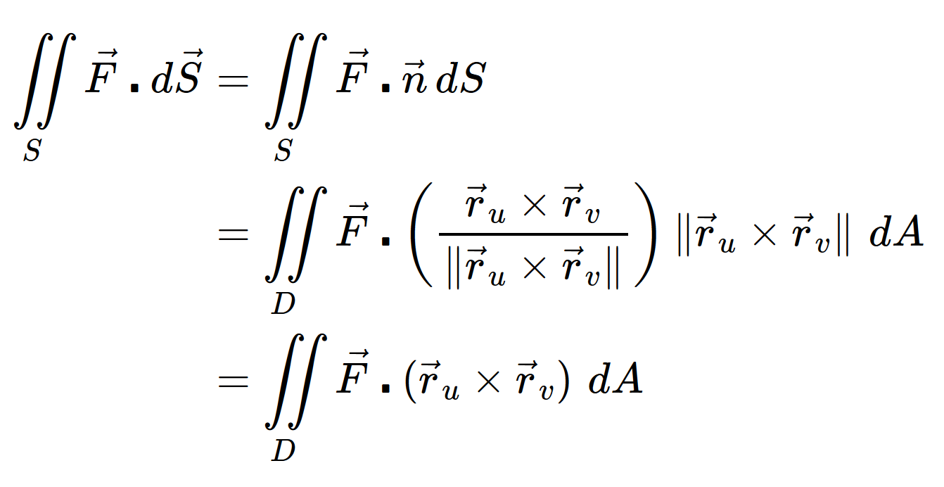
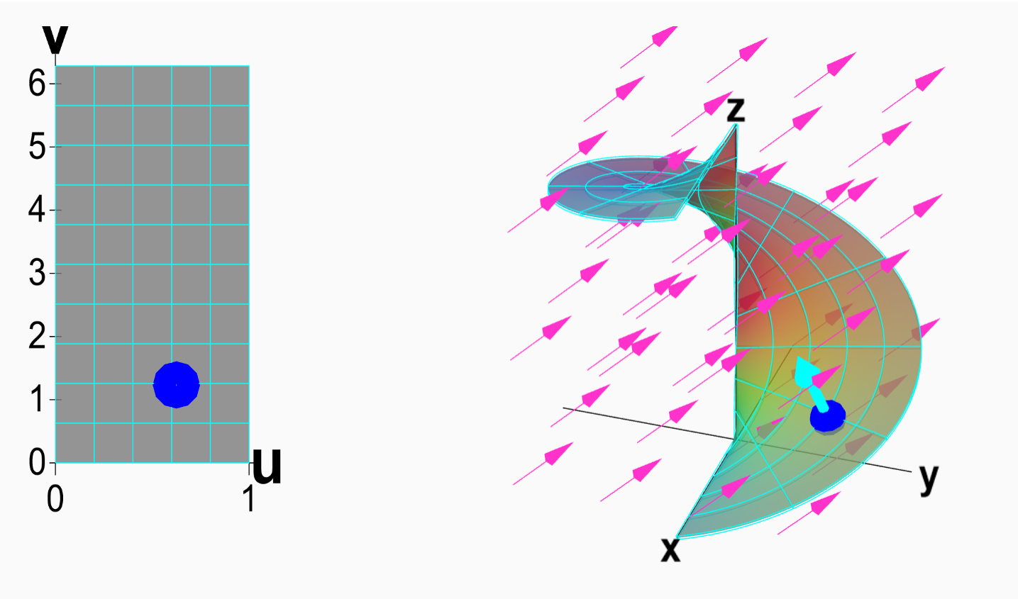
Vector surface integral
https://mathinsight.org/surface_integral_vector_field_introduction

Slide 3
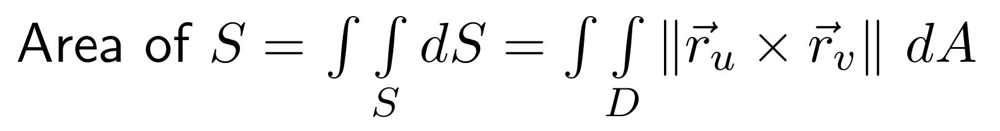
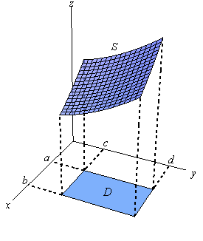
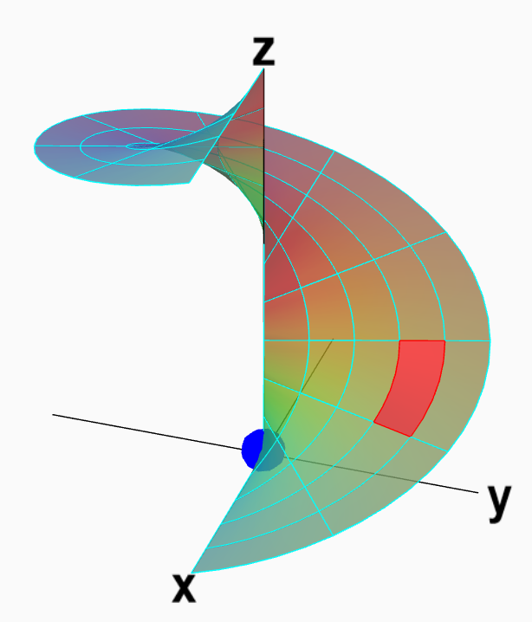
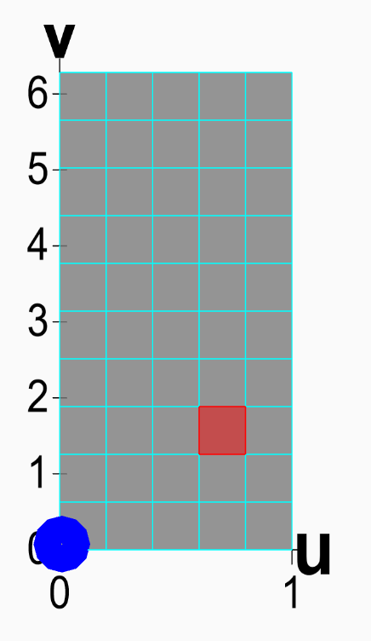
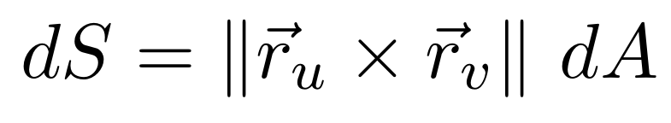
Section 13.8 Surface area
http://tutorial.math.lamar.edu/Classes/CalcIII/SurfaceIntegrals.aspx
http://tutorial.math.lamar.edu/Classes/CalcIII/SurfaceIntegrals.aspx
https://mathinsight.org/parametrized_surface_area

Slide 4
Vector surface integral

Slide 5
Vector surface integral
https://mathinsight.org/surface_integral_vector_field_introduction

Slide 6
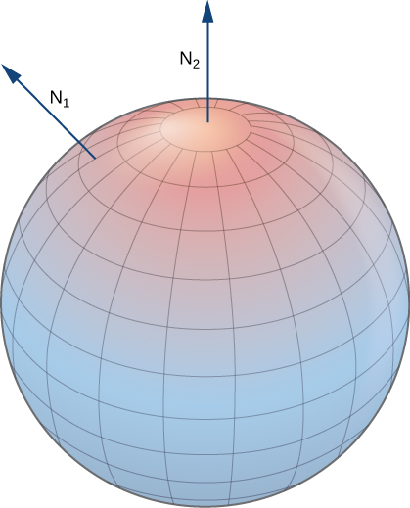
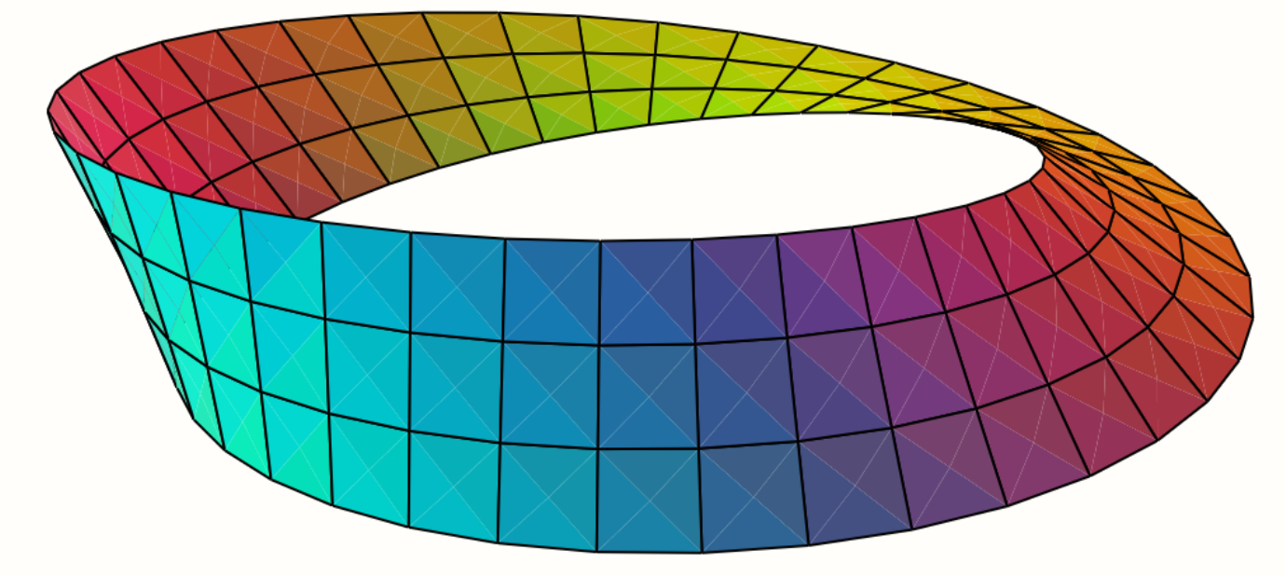
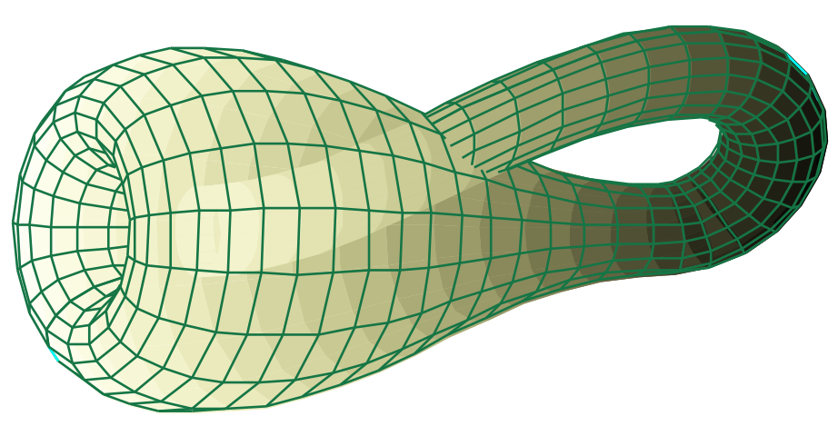
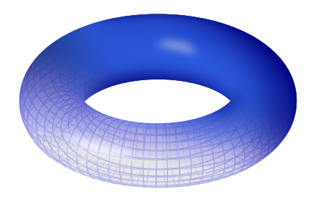
Note surface must be orientable: Surfaces must have 2 sides
Not orientable Orientable
Mobius band
Sphere
https://math.libretexts.org/Bookshelves/Calculus/Book%3A_Calculus_(Guichard)/16%3A_Vector_Calculus/16.07%3A_Surface_Integrals
Klein bottle
Torus
en.wikipedia.org
en.wikipedia.org

Slide 7
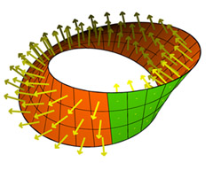
Not orientable
https://physics.stackexchange.com/questions/262362/what-is-the-direction-of-area-vector

Slide 8
Vector surface integral
https://mathinsight.org/surface_integral_vector_field_introduction

Slide 9
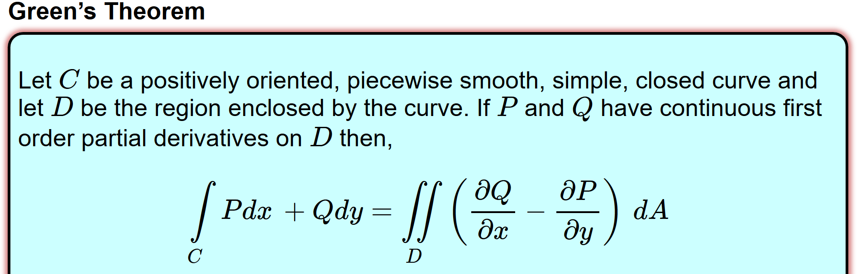
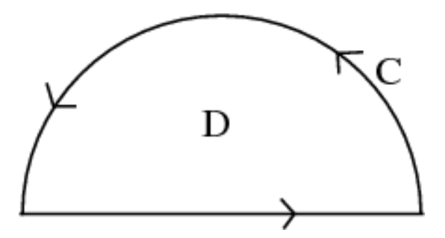
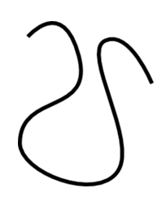
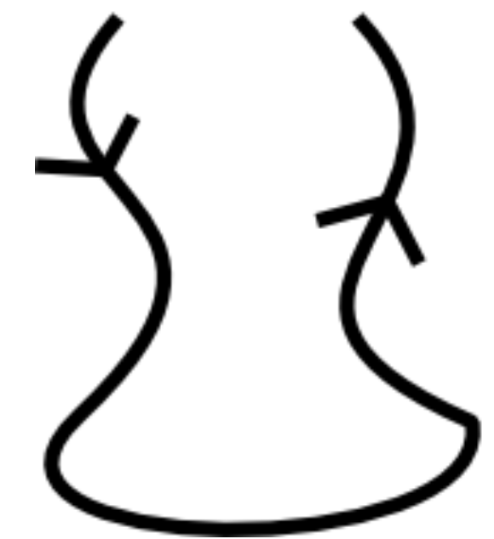
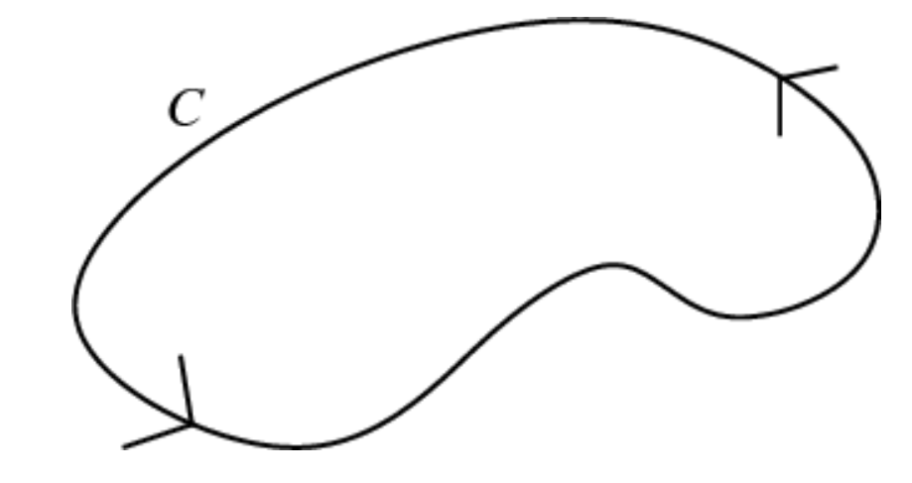

http://tutorial.math.lamar.edu/Classes/CalcIII/GreensTheorem.aspx
NOT closed
closed
https://mathinsight.org/
https://mathinsight.org/

Slide 10
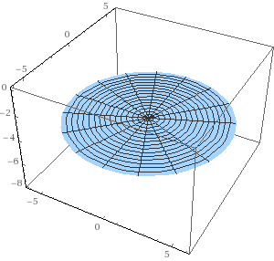
A surface is closed if it has no boundary
Not closed Closed surface
Sphere
Torus
The tube = cylinder
Cylinder with top and bottom
en.wikipedia.org

Slide 11
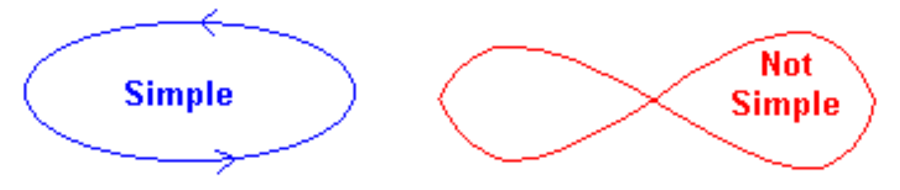
http://tutorial.math.lamar.edu/Classes/CalcIII/GreensTheorem.aspx
http://ltcconline.net/greenl/courses/202/vectorIntegration/greensTheorem.htm

Slide 12
For a closed surface, outward normal = positive orientation
en.wikipedia.org

Slide 13
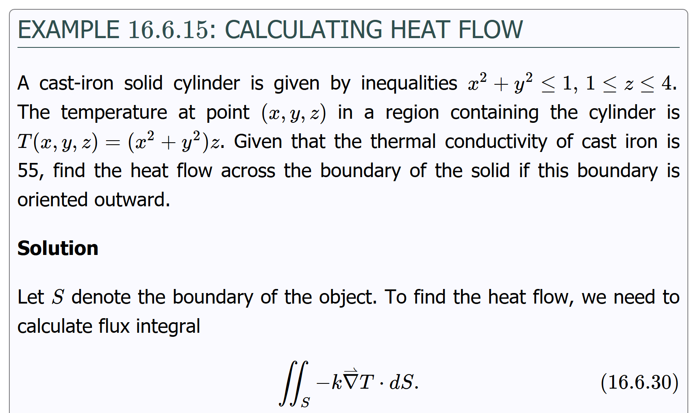
https://math.libretexts.org/Bookshelves/Calculus/Book%3A_Calculus_(OpenStax)/16%3A_Vector_Calculus/16.6%3A_Surface_Integrals

Slide 14
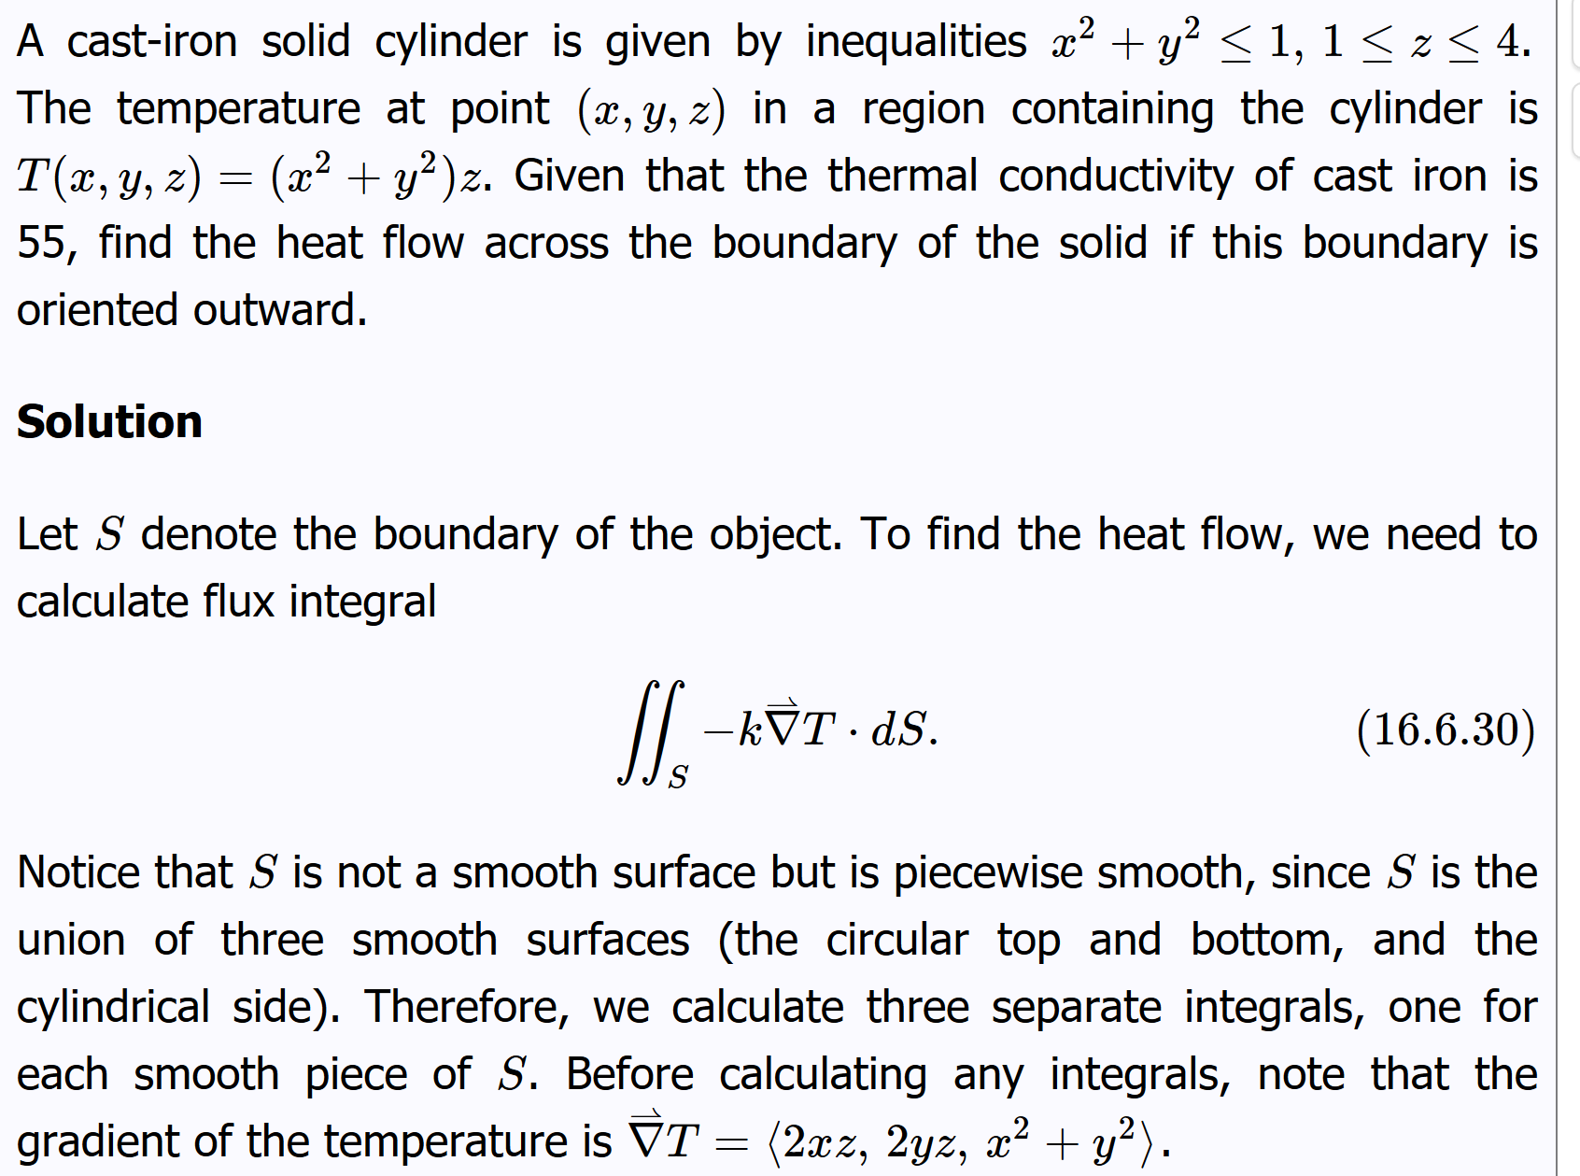

Slide 15
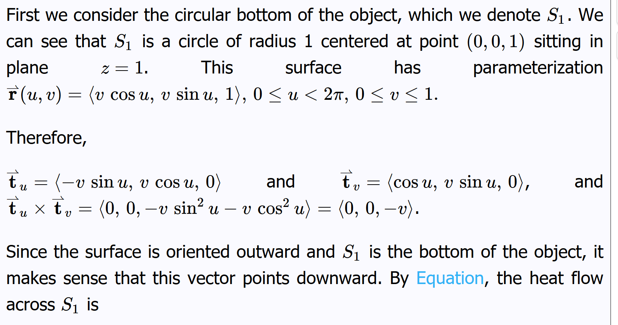
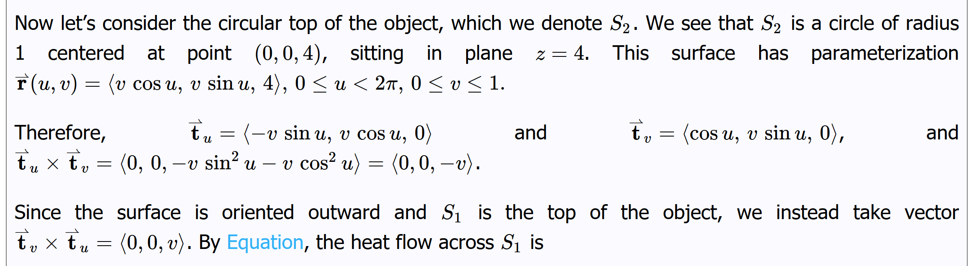

Slide 16
See example Example 16.6.15: Calculating Heat Flow at
Https://math.libretexts.org/Bookshelves/Calculus/Book%3A_Calculus_(OpenStax)/16%3A_Vector_Calculus/16.6%3A_Surface_Integrals

