Slide 1
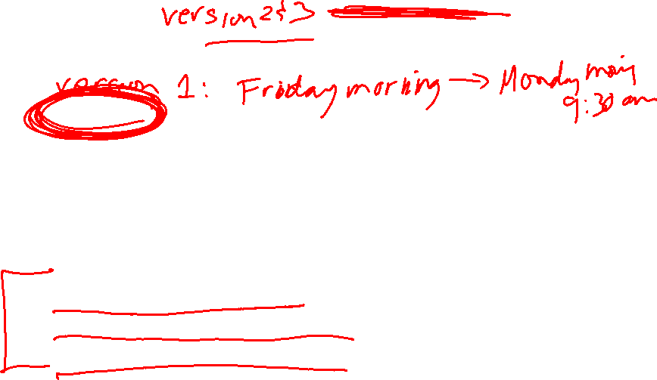
Midterm 2 will cover 13.6 – 14.5
Webassign portion will likely be available Friday afternoon April 17 and due Tuesday April 21 at 4pm.
3 different timed versions (45 minutes each).
Grade on webassign will be highest of your 3 attempts.
will include multiple part webassign problems
For written portion to be uploaded to ICON, choose ONE of the following times:
Tuesday April 21 at 6:30pm in the evening
Wednesday April 22 at 9:30am in the morning
Wednesday April 22 at 1:30pm in the afternoon
Log into zoom and upload to ICON. You will have 30 minutes for this written portion of the exam plus 20 minute to upload to ICON.

Slide 2
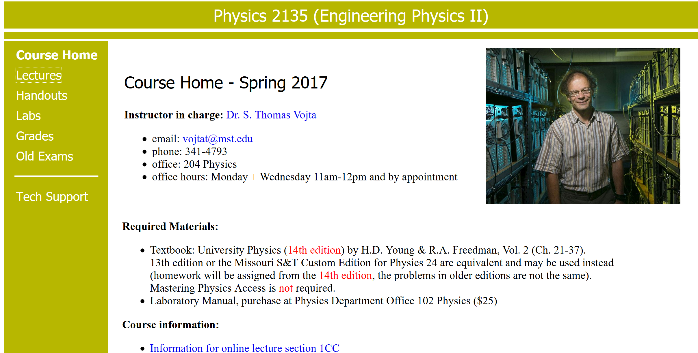

Note the next slides are from Dr. Vojta’s Engineering Physics course:
https://web.mst.edu/~vojtat/class_2135/lectures/lecture03/lecture03_part_3_electric_flux.ppt

Slide 3
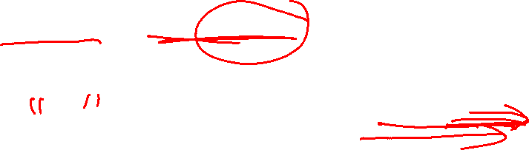
https://web.mst.edu/~vojtat/class_2135/lectures/lecture03/lecture03_part_3_electric_flux.ppt
Electric Flux
We have used electric field lines to visualize electric fields and indicate their strength.
We are now going to count* the number of electric field lines passing through a surface, and use this count to determine the electric field.
E
*There are 3 kinds of people in this world: those who can count, and those who can’t.

Slide 4
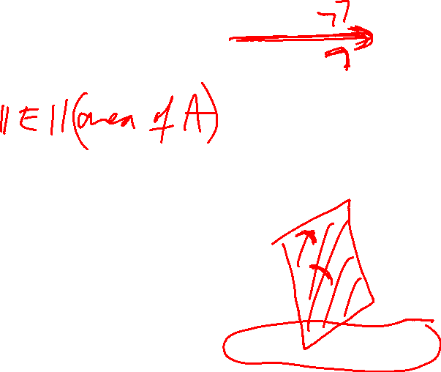
https://web.mst.edu/~vojtat/class_2135/lectures/lecture03/lecture03_part_3_electric_flux.ppt
The electric flux passing through a surface is the number of electric field lines that pass through it.
Because electric field lines are drawn arbitrarily, we quantify electric flux like this: Φ_{E}=EA,
…except that…
A
E
If the surface is tilted, fewer lines cut the surface.
E
θ
Later we’ll learn about magnetic flux, which is why I will use the subscript E on electric flux.
The green lines miss!

Slide 5
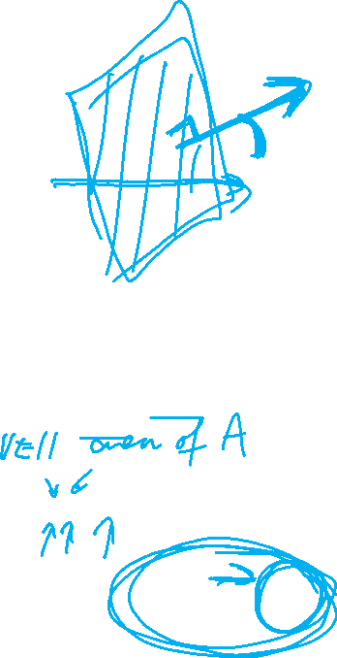
https://web.mst.edu/~vojtat/class_2135/lectures/lecture03/lecture03_part_3_electric_flux.ppt
We define A to be a vector having a magnitude equal to the area of the surface, in a direction normal to the surface.
A
θ
E
θ
The “amount of surface” perpendicular to the electric field is A cos θ.
Therefore, the amount of surface area effectively “cut through” by the electric field is A cos θ.
A_{Effective} = A cos θ so Φ_{E} = EA_{Effective} = EA cos θ.
Remember the dot product from Physics 1135?

Slide 6
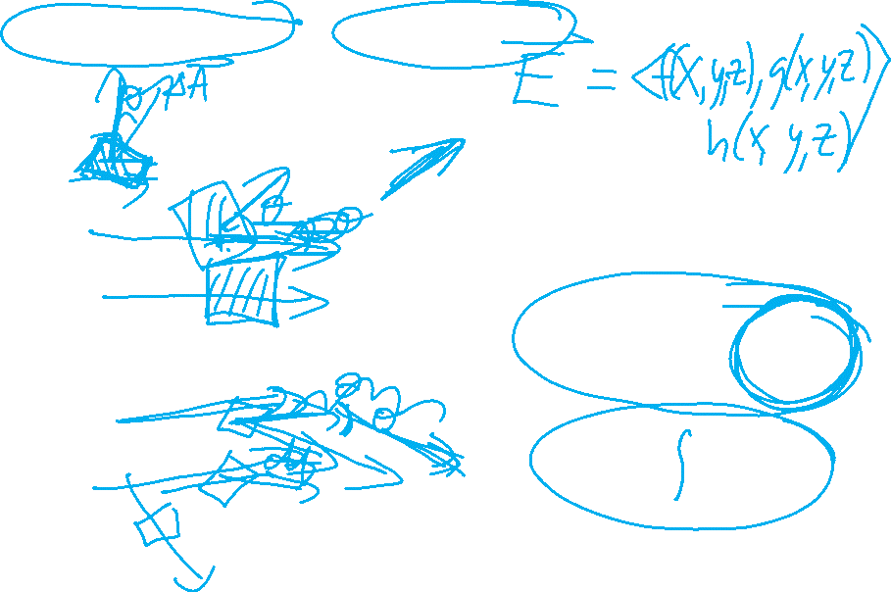
https://web.mst.edu/~vojtat/class_2135/lectures/lecture03/lecture03_part_3_electric_flux.ppt
If the electric field is not uniform, or the surface is not flat…
divide the surface into infinitesimal surface elements and add the flux through each…
E
ΔA
dA
a surface integral, therefore a double integral
Remember, the direction of dA is normal to the surface.

Slide 7
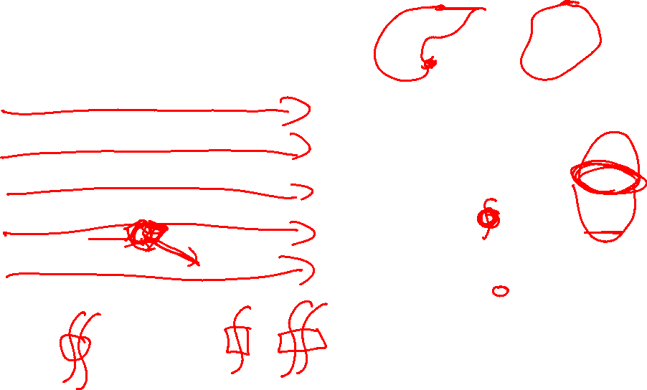
https://web.mst.edu/~vojtat/class_2135/lectures/lecture03/lecture03_part_3_electric_flux.ppt
If the surface is closed (completely encloses a volume)…
…we count* lines going out as positive and lines going in as negative…
E
dA
a surface integral, therefore a double integral
For a closed surface, dA is normal to the surface and always points away from the inside.
*There are 10 kinds of people in this world: those who can count in binary, and those who can’t.

Slide 8

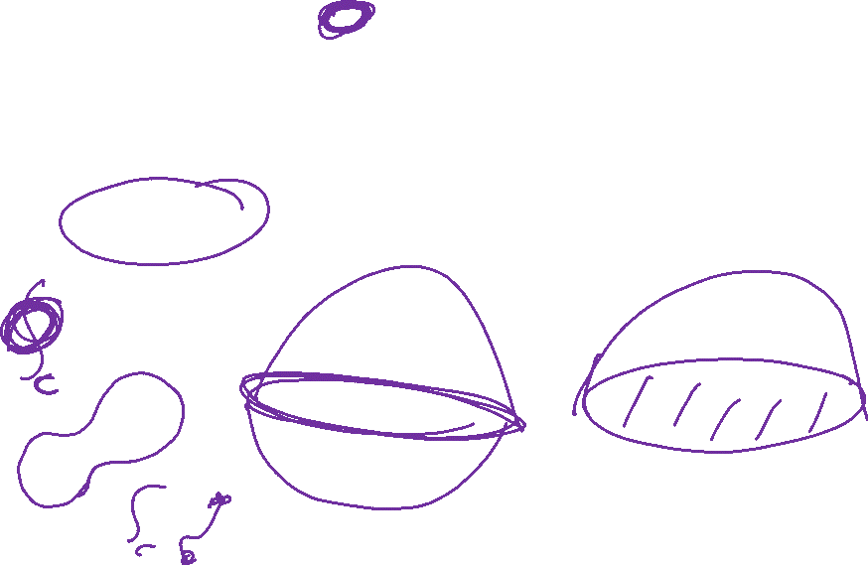
https://web.mst.edu/~vojtat/class_2135/lectures/lecture03/lecture03_part_3_electric_flux.ppt
What the *!@* is this thing?
Nothing to panic about!
The circle just reminds you to integrate over a closed surface.
∫
∫

Slide 9
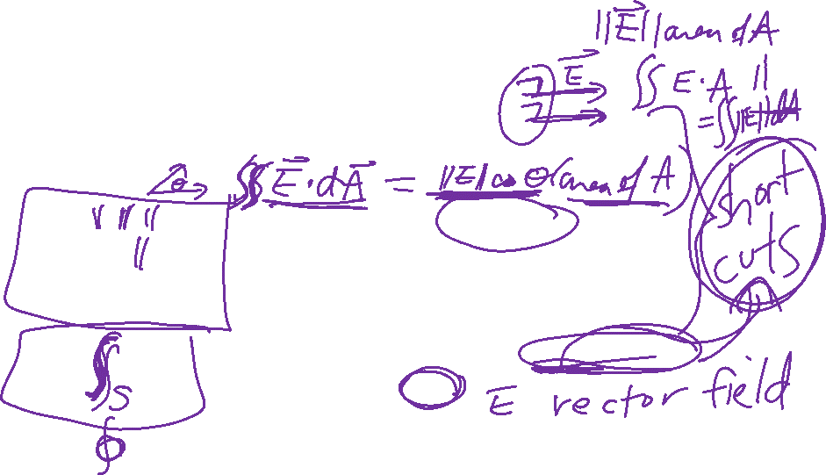
https://web.mst.edu/~vojtat/class_2135/lectures/lecture03/lecture03_part_3_electric_flux.ppt
Question: you gave me five different equations for electric flux. Which one do I need to use?
Answer: use the simplest (easiest!) one that works.
Flat surface, E || A, E constant over surface. Easy!
Flat surface, E not || A, E constant over surface.
Flat surface, E not || A, E constant over surface.
Surface not flat, E not uniform. Avoid, if possible.
This is the definition of electric flux.
Closed surface.
The circle on the integral just reminds you to integrate over a closed surface.
If the surface is closed, you may be able to “break it up” into simple segments and still use Φ_{E}=E·A for each segment.

Slide 10
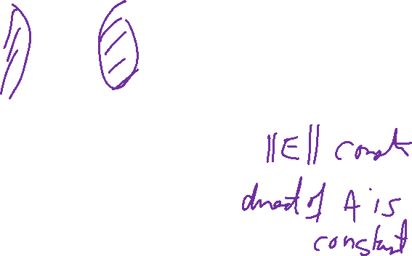
https://web.mst.edu/~vojtat/class_2135/lectures/lecture03/lecture03_part_3_electric_flux.ppt
Electric Flux Example: Calculate the electric flux through a cylinder with its axis parallel to the electric field direction.
E

Slide 11

https://web.mst.edu/~vojtat/class_2135/lectures/lecture03/lecture03_part_3_electric_flux.ppt
Electric Flux Example: Calculate the electric flux through a cylinder with its axis parallel to the electric field direction.
E
I see three parts to the cylinder:
E
The left end cap.
dA

Slide 12
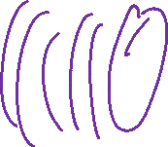
https://web.mst.edu/~vojtat/class_2135/lectures/lecture03/lecture03_part_3_electric_flux.ppt
Electric Flux Example: Calculate the electric flux through a cylinder with its axis parallel to the electric field direction.
E
I see three parts to the cylinder:
The tube.
E

Slide 13
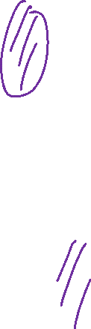
https://web.mst.edu/~vojtat/class_2135/lectures/lecture03/lecture03_part_3_electric_flux.ppt
Electric Flux Example: Calculate the electric flux through a cylinder with its axis parallel to the electric field direction.
E
I see three parts to the cylinder:
E
The right end cap.
dA

Slide 14
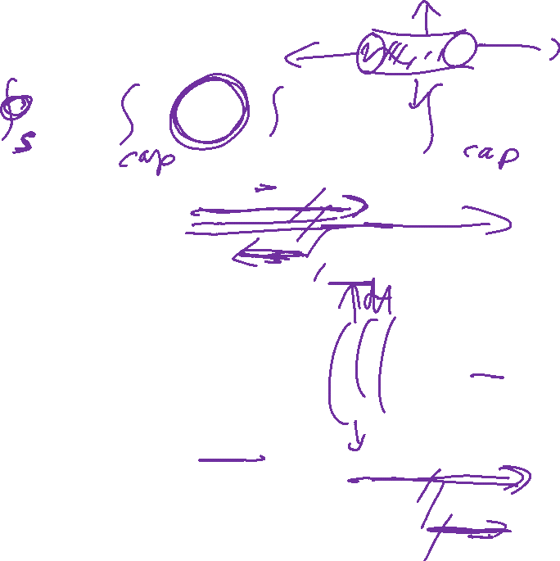
https://web.mst.edu/~vojtat/class_2135/lectures/lecture03/lecture03_part_3_electric_flux.ppt
Let’s separately calculate the contribution of each part to the flux, then add to get the total flux.
E
The left end cap.
dA
The tube.
E
E
The right end cap.
dA

Slide 15
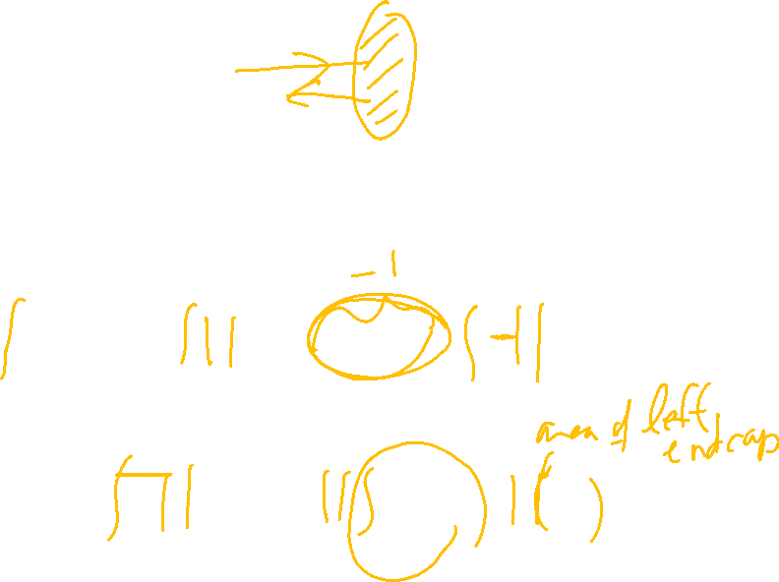
https://web.mst.edu/~vojtat/class_2135/lectures/lecture03/lecture03_part_3_electric_flux.ppt
E
The left end cap.
dA
Every dA on the left end cap is antiparallel to E. The angle between the two vectors is 180°
E is uniform, so

Slide 16
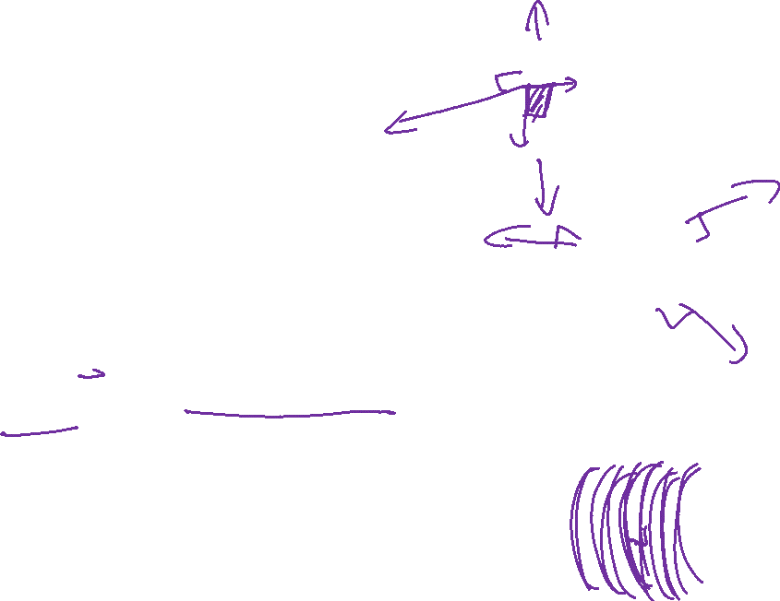
https://web.mst.edu/~vojtat/class_2135/lectures/lecture03/lecture03_part_3_electric_flux.ppt
The tube.
E
E
Let’s look down the axis of the tube.
◉
dA
E is pointing at you.
Every dA is radial (perpendicular to the tube surface).
E
The angle between E and dA is 90°.
dA

Slide 17
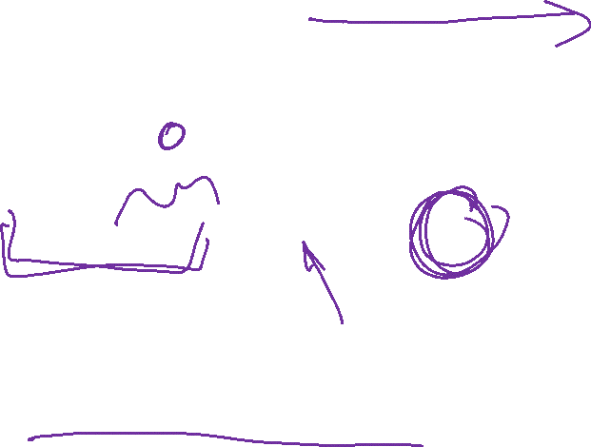
https://web.mst.edu/~vojtat/class_2135/lectures/lecture03/lecture03_part_3_electric_flux.ppt
E
The angle between E and dA is 90°.
dA
The tube contributes nothing to the flux!

Slide 18
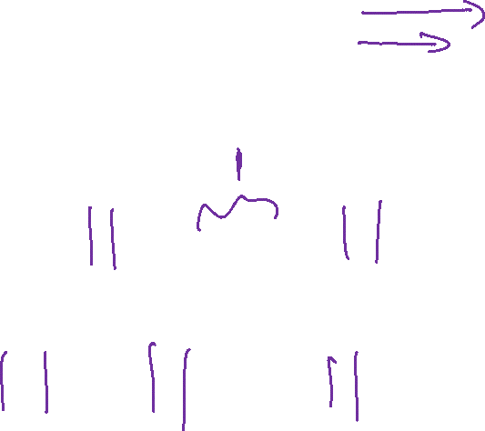
https://web.mst.edu/~vojtat/class_2135/lectures/lecture03/lecture03_part_3_electric_flux.ppt
E
The right end cap.
dA
Every dA on the right end cap is parallel to E. The angle between the two vectors is 0°
E is uniform, so

Slide 19
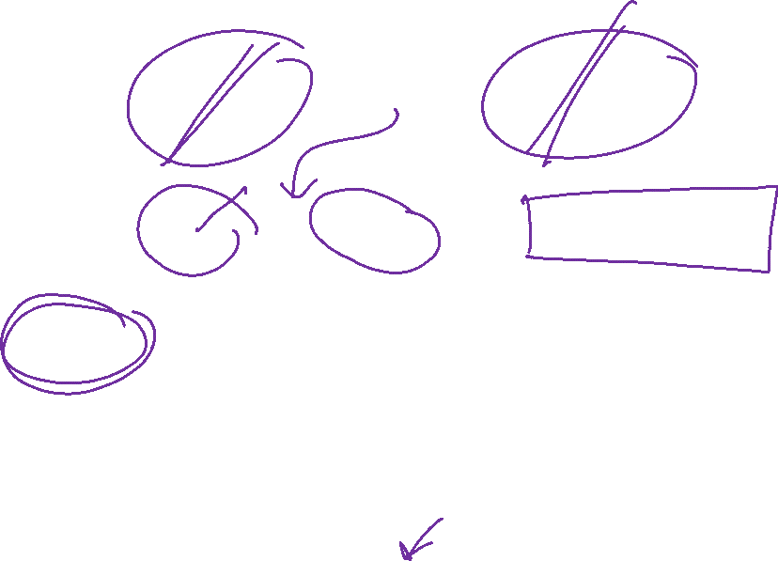
https://web.mst.edu/~vojtat/class_2135/lectures/lecture03/lecture03_part_3_electric_flux.ppt
The net (total) flux
Assuming a right circular cylinder.*
The flux is zero! Every electric field line that goes in also goes out.
*We will see in a bit that we don’t have to make this assumption.

Slide 20
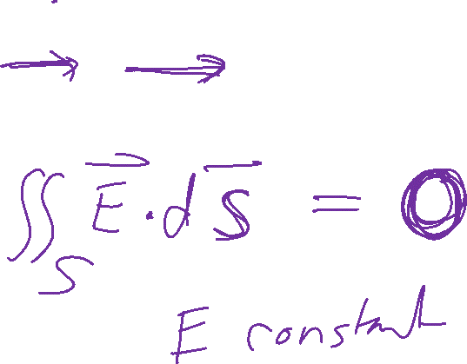
https://web.mst.edu/~vojtat/class_2135/lectures/lecture03/lecture03_part_3_electric_flux.ppt
Electric Flux Example: Calculate the electric flux through a cylinder with its axis parallel to the electric field direction.
E

Slide 21

https://web.mst.edu/~vojtat/class_2135/lectures/lecture03/lecture03_part_3_electric_flux.ppt
If the electric field is not uniform, or the surface is not flat…
divide the surface into infinitesimal surface elements and add the flux through each…
E
ΔA
dA
a surface integral, therefore a double integral
Remember, the direction of dA is normal to the surface.

Slide 22
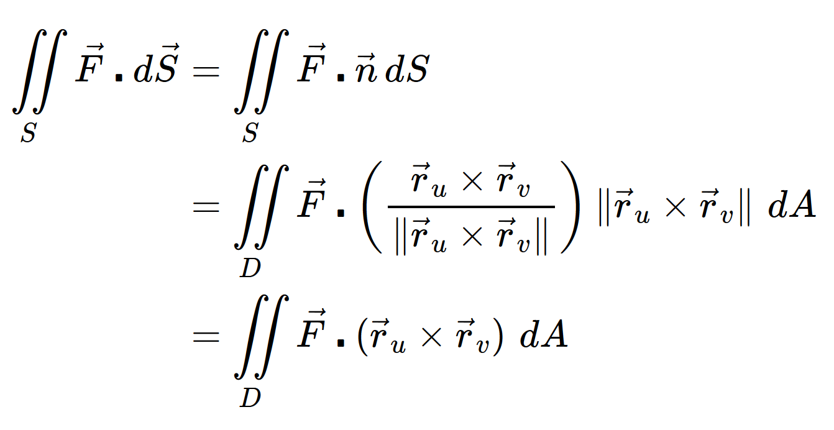
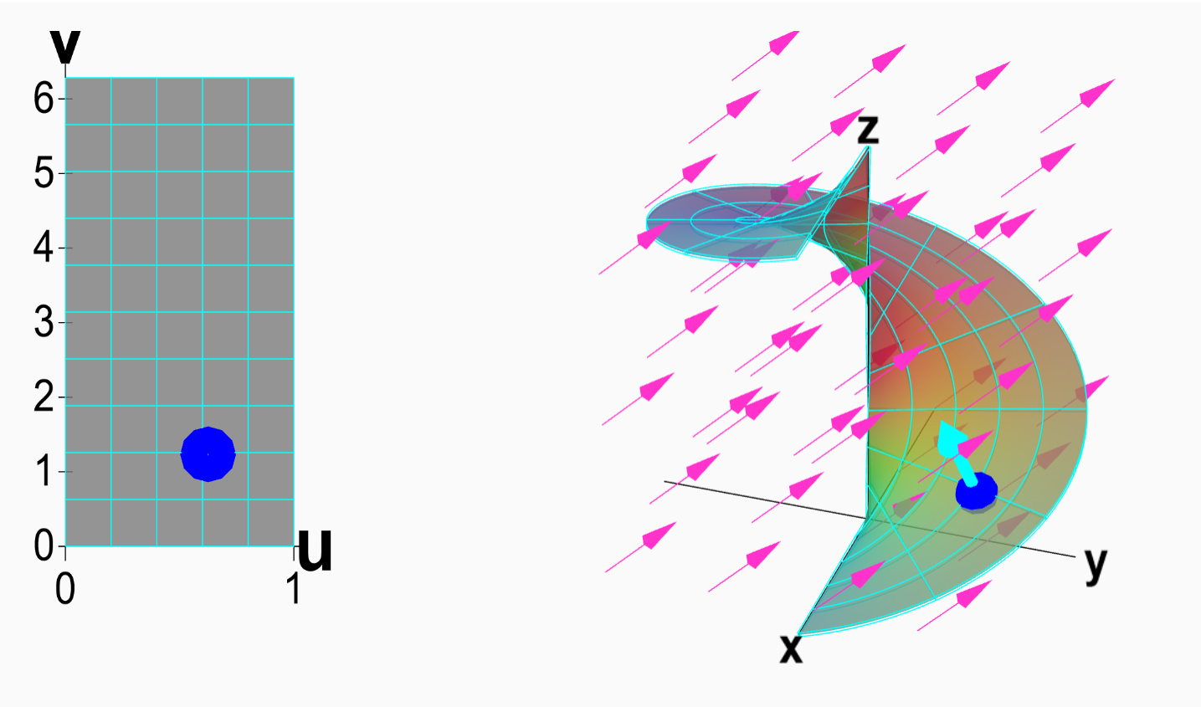
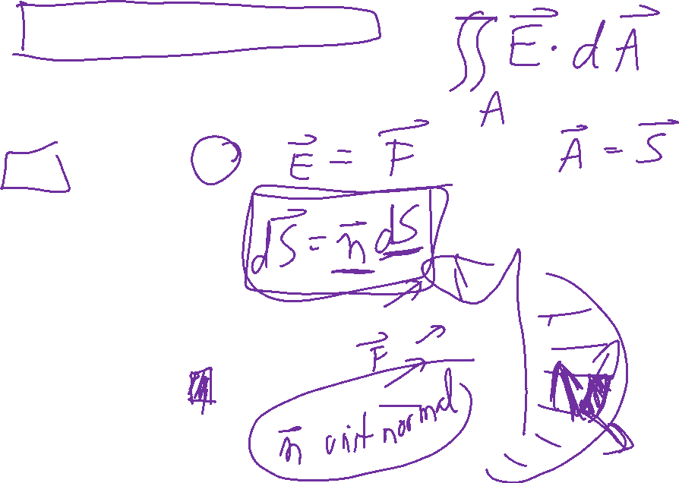
Vector surface integral
https://mathinsight.org/surface_integral_vector_field_introduction

Slide 23
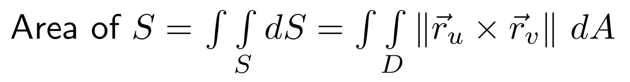
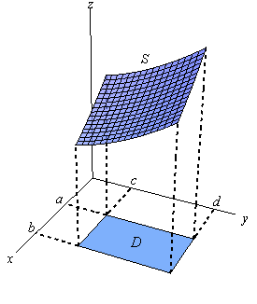
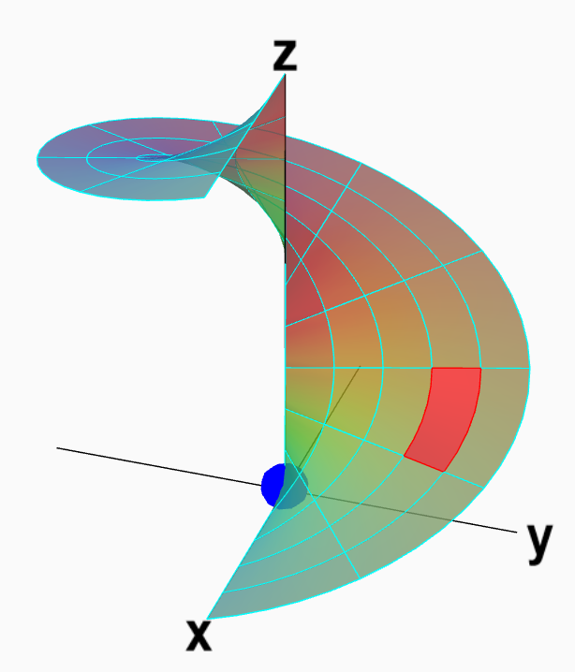
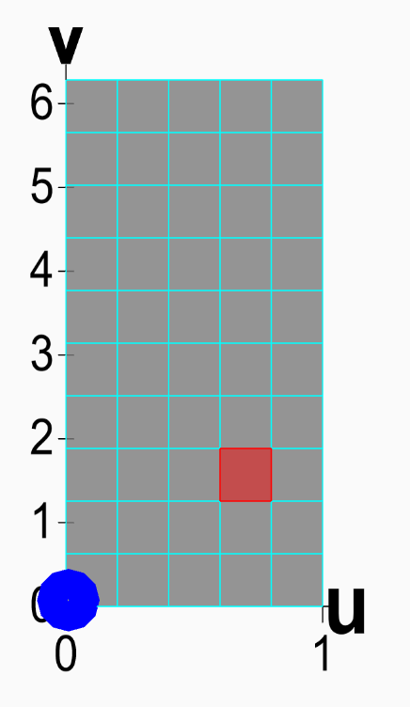
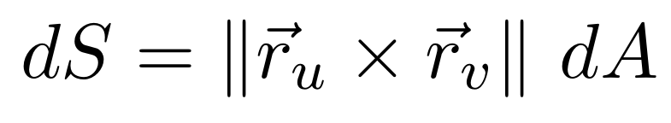
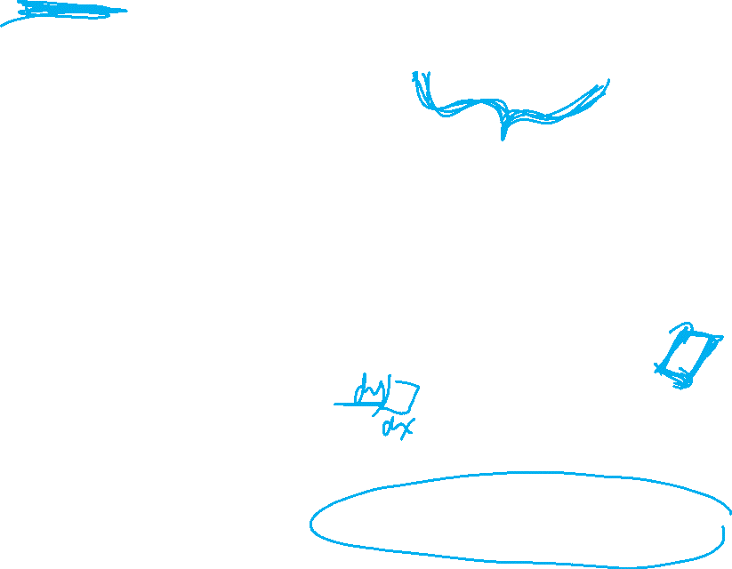
Section 13.8 Surface area
http://tutorial.math.lamar.edu/Classes/CalcIII/SurfaceIntegrals.aspx
http://tutorial.math.lamar.edu/Classes/CalcIII/SurfaceIntegrals.aspx
https://mathinsight.org/parametrized_surface_area

Slide 24
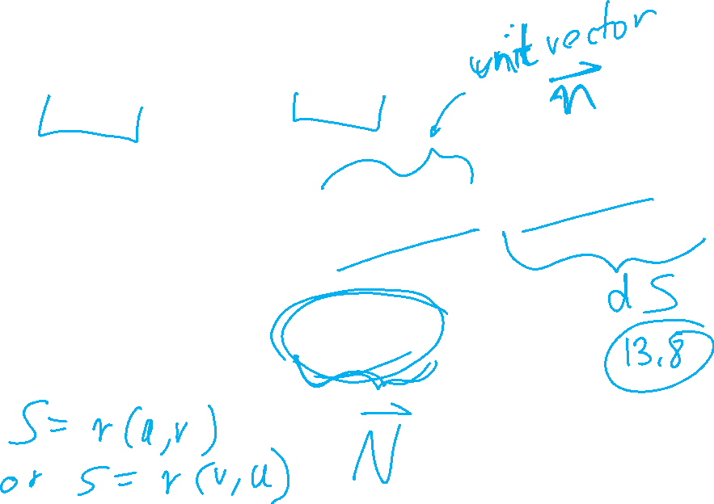
Vector surface integral

Slide 25
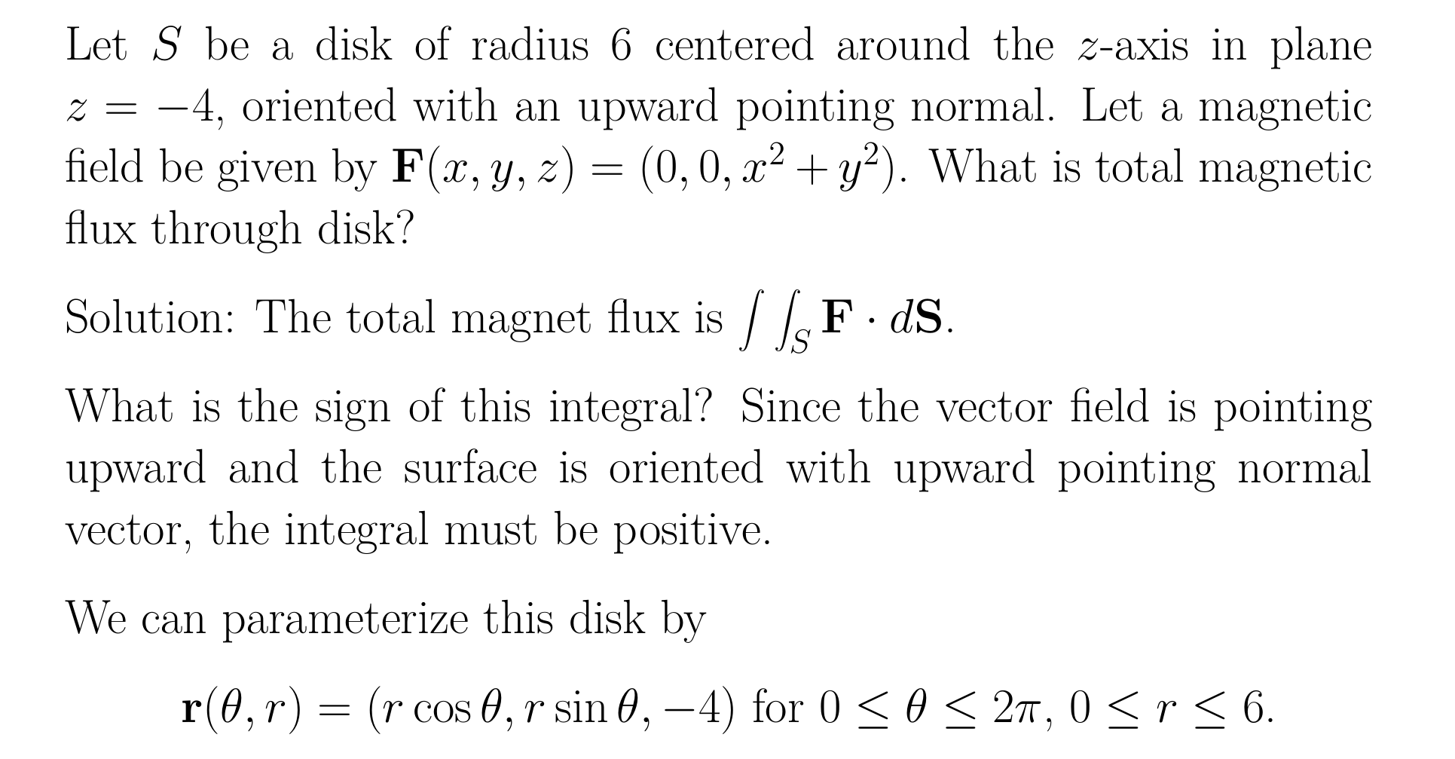
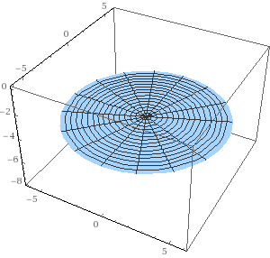
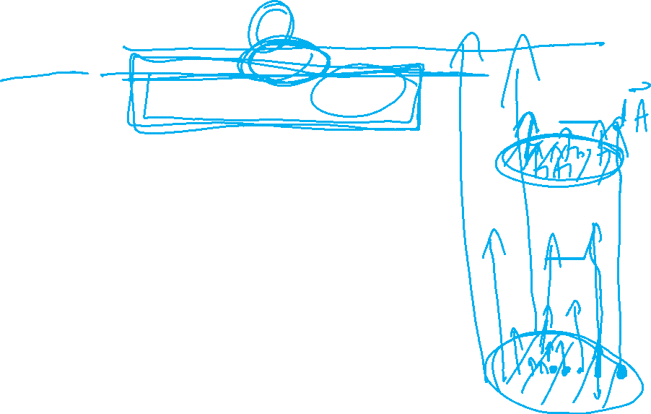
Example
https://mathinsight.org/surface_integral_vector_examples

Slide 26
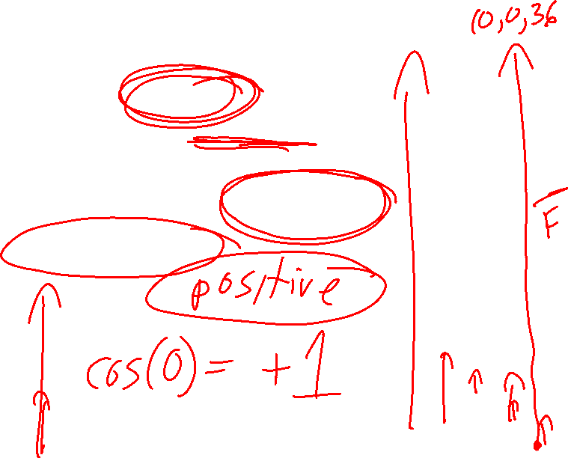
Example
https://mathinsight.org/surface_integral_vector_examples

Slide 27
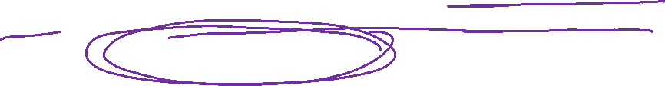
Example
https://mathinsight.org/surface_integral_vector_examples

Slide 28
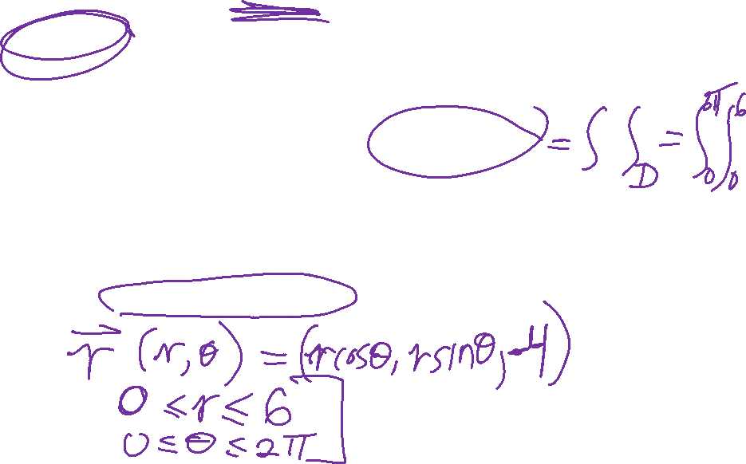
Example
https://mathinsight.org/surface_integral_vector_examples

Slide 29


Example
https://mathinsight.org/surface_integral_vector_examples

Slide 30
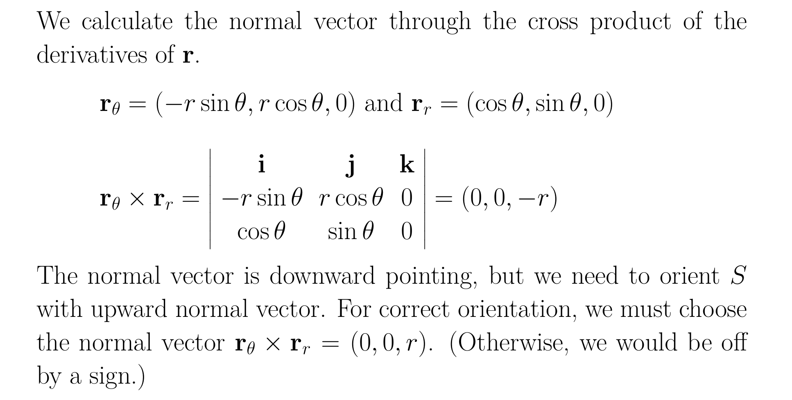
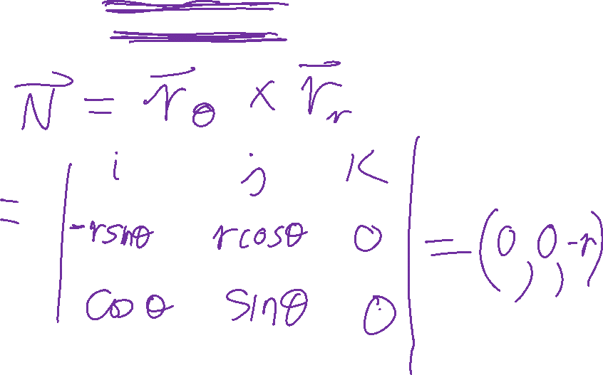

Slide 31
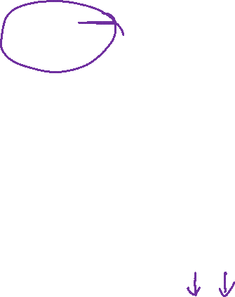

Slide 32
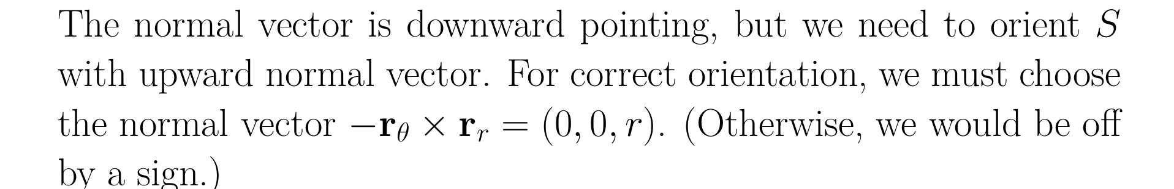
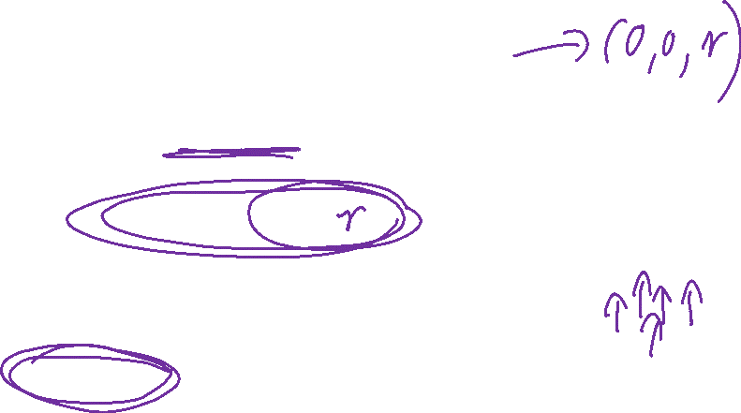
Let S be a disk of radius 6 centered around the z-axis in plane z=-4, oriented with an upward pointing normal.

Slide 33

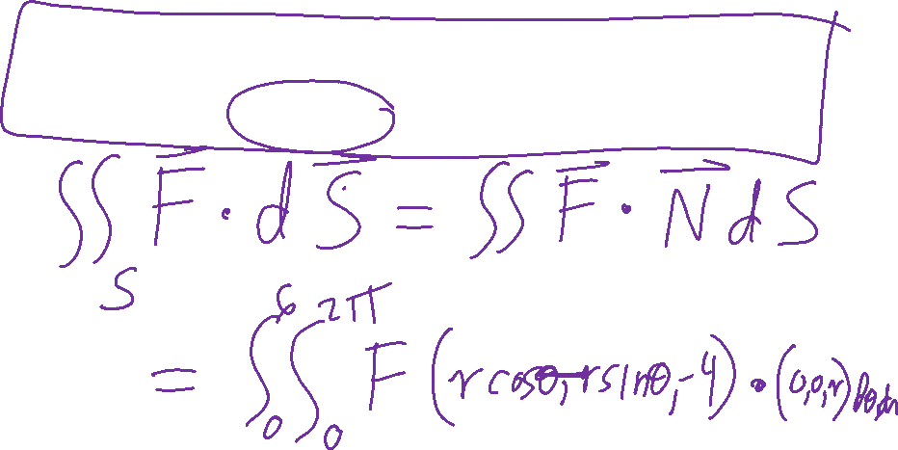
Surface S

Slide 34
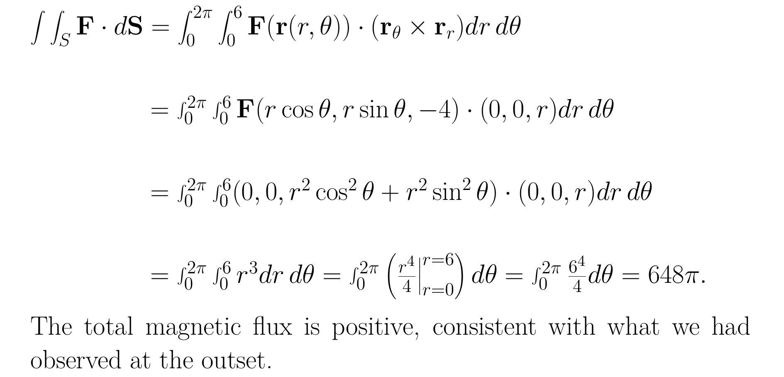
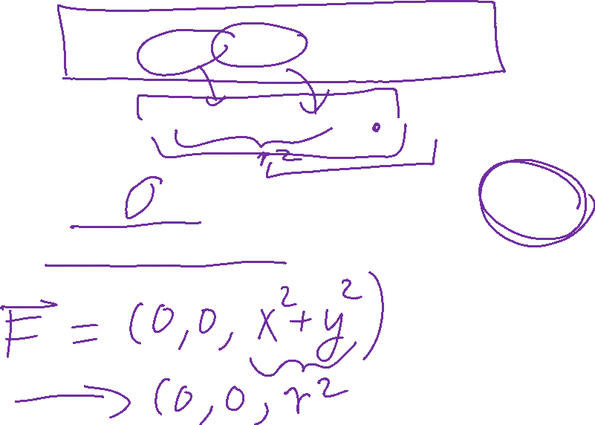

Slide 35
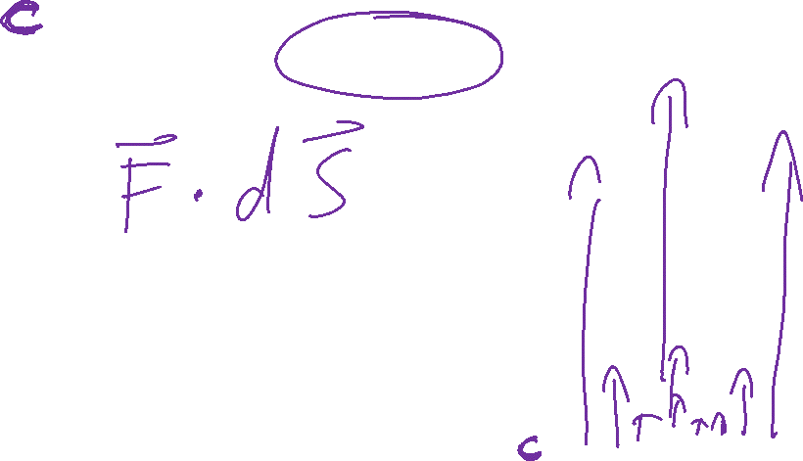
Example
https://mathinsight.org/surface_integral_vector_examples

Slide 36
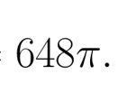
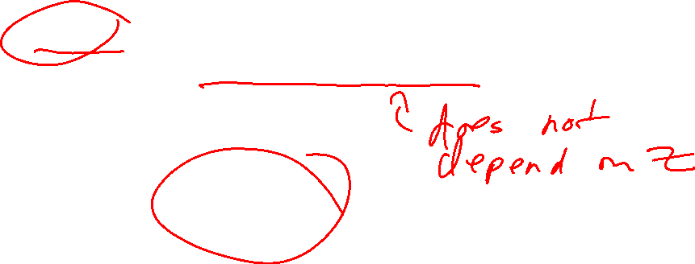
Example
c
https://mathinsight.org/surface_integral_vector_examples

Slide 37
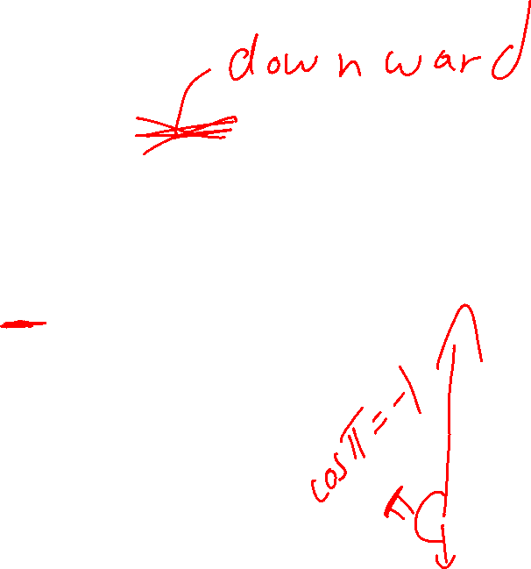
Example
c
https://mathinsight.org/surface_integral_vector_examples

Slide 38
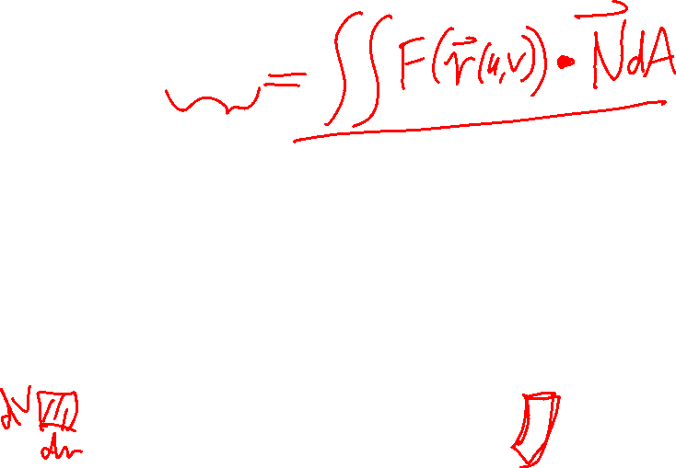
Vector surface integral
https://mathinsight.org/surface_integral_vector_field_introduction

Slide 39
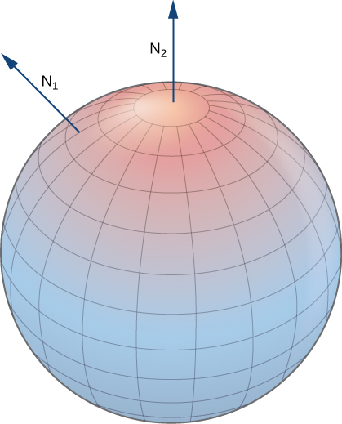
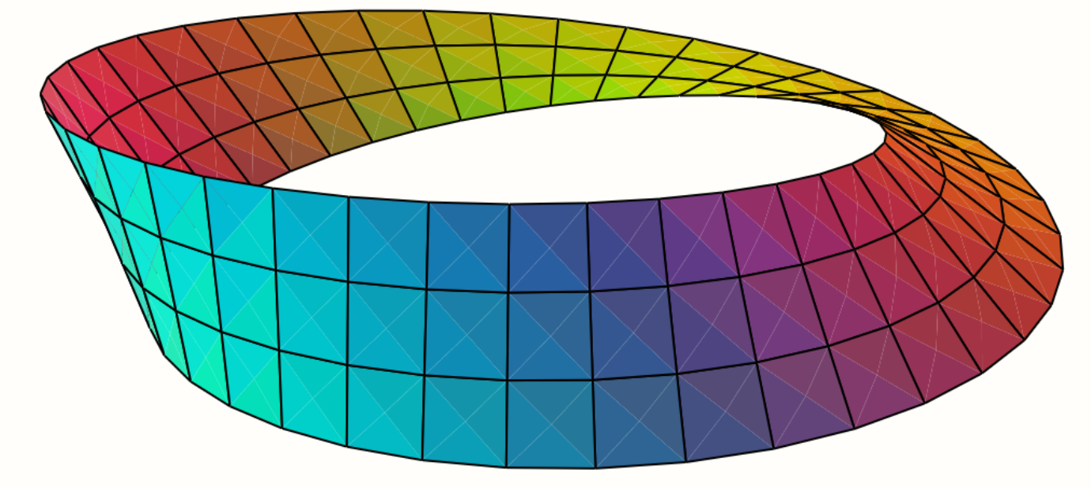



Note surface must be orientable: Surfaces must have 2 sides
Not orientable Orientable
Mobius band
Sphere
https://math.libretexts.org/Bookshelves/Calculus/Book%3A_Calculus_(Guichard)/16%3A_Vector_Calculus/16.07%3A_Surface_Integrals
Klein bottle
Torus
en.wikipedia.org
en.wikipedia.org

Slide 40


Not orientable
https://physics.stackexchange.com/questions/262362/what-is-the-direction-of-area-vector

Slide 41
Vector surface integral
https://mathinsight.org/surface_integral_vector_field_introduction

Slide 42






http://tutorial.math.lamar.edu/Classes/CalcIII/GreensTheorem.aspx
NOT closed
closed
https://mathinsight.org/
https://mathinsight.org/

Slide 43

A surface is closed if it has no boundary
Not closed Closed surface
Sphere
Torus
The tube = cylinder
Cylinder with top and bottom
en.wikipedia.org

Slide 44

http://tutorial.math.lamar.edu/Classes/CalcIII/GreensTheorem.aspx
http://ltcconline.net/greenl/courses/202/vectorIntegration/greensTheorem.htm

Slide 45
For a closed surface, outward normal = positive orientation
en.wikipedia.org

Slide 46


https://math.libretexts.org/Bookshelves/Calculus/Book%3A_Calculus_(OpenStax)/16%3A_Vector_Calculus/16.6%3A_Surface_Integrals

Slide 47


Slide 48



Slide 49
See example Example 16.6.15: Calculating Heat Flow at
Https://math.libretexts.org/Bookshelves/Calculus/Book%3A_Calculus_(OpenStax)/16%3A_Vector_Calculus/16.6%3A_Surface_Integrals

