Slide 1
Midterm 2 will cover 13.6 – 14.5
Webassign portion will likely be available Friday afternoon April 17 and due Tuesday April 21 at 4pm.
3 different timed versions (45 minutes each).
Grade on webassign will be highest of your 3 attempts.
will include multiple part webassign problems
For written portion to be uploaded to ICON, choose ONE of the following times:
Tuesday April 21 at 6:30pm in the evening
Wednesday April 22 at 9:30am in the morning
Wednesday April 22 at 1:30pm in the afternoon
Log into zoom and upload to ICON. You will have 30 minutes for this written portion of the exam plus 20 minute to upload to ICON.

Slide 2
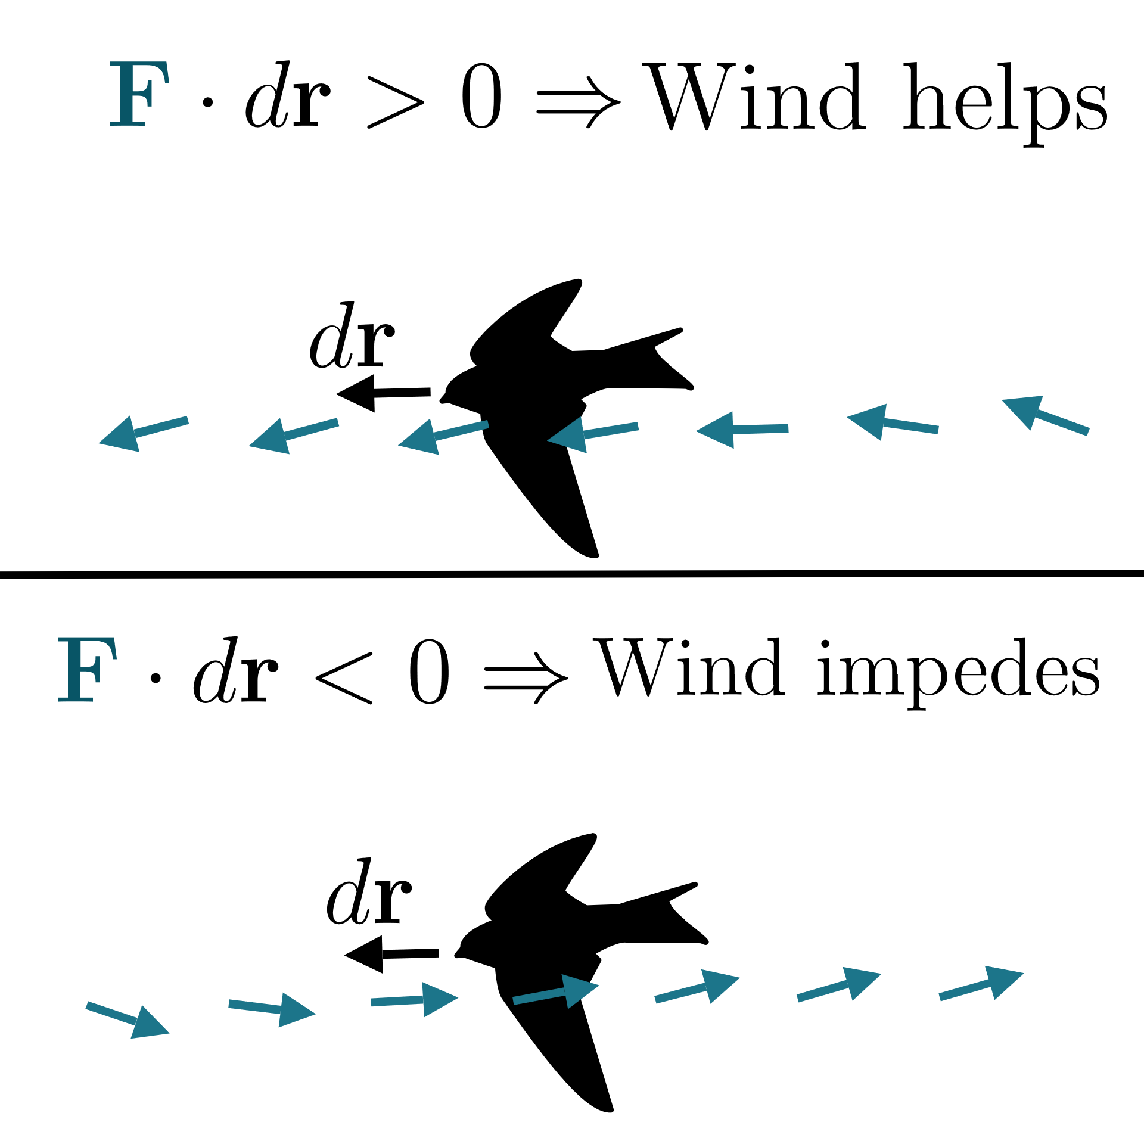
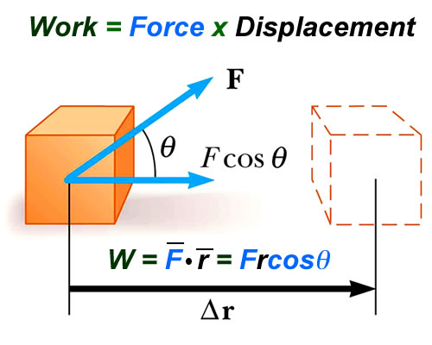
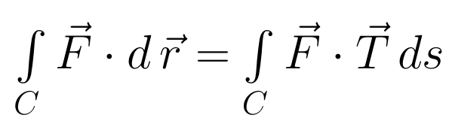
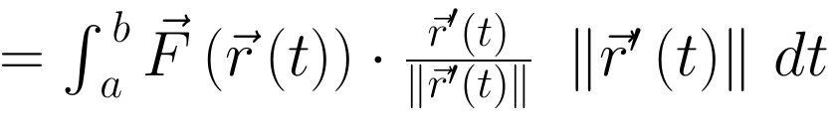
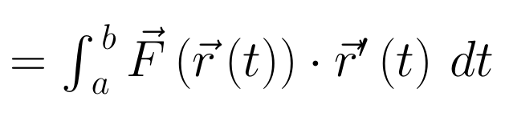
Vector Line Integral
= Work
https://www.khanacademy.org/math/multivariable-calculus/greens-theorem-and-stokes-theorem/stokes-theorem-articles/a/stokes-theorem

Slide 3

Application 2: If C is a closed curve,
Note we are adding up the tangential component of F along the curve C
Example: Let F = velocity field of a fluid.

Slide 4
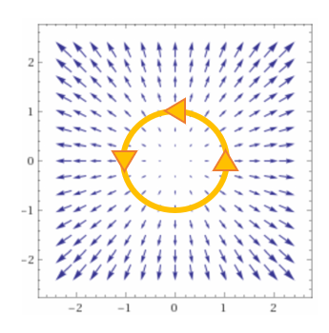
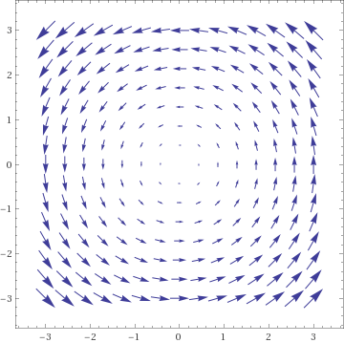

Application 2: If C is a closed curve,
Add up the tangential component of F along the curve C

Slide 5
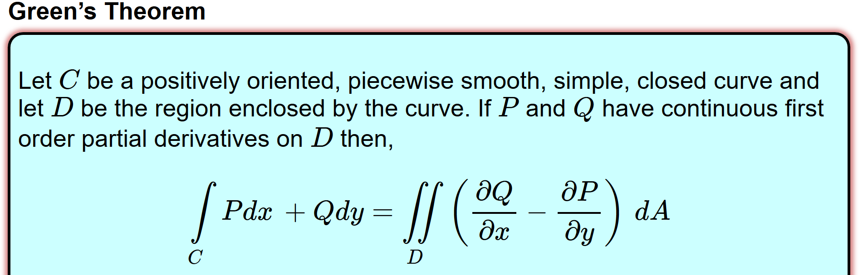
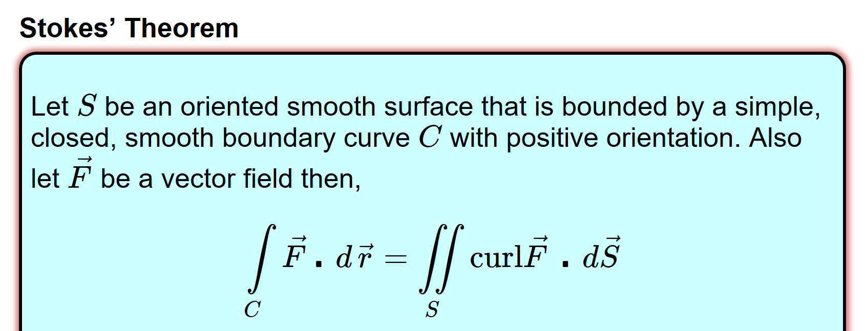
(Section 14.4)
http://tutorial.math.lamar.edu/Classes/CalcIII/GreensTheorem.aspx
(Section 14.7)

Slide 6


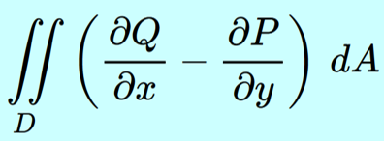
Application 2: If C is a closed curve,
Add up the tangential component of F along the curve C

Slide 7
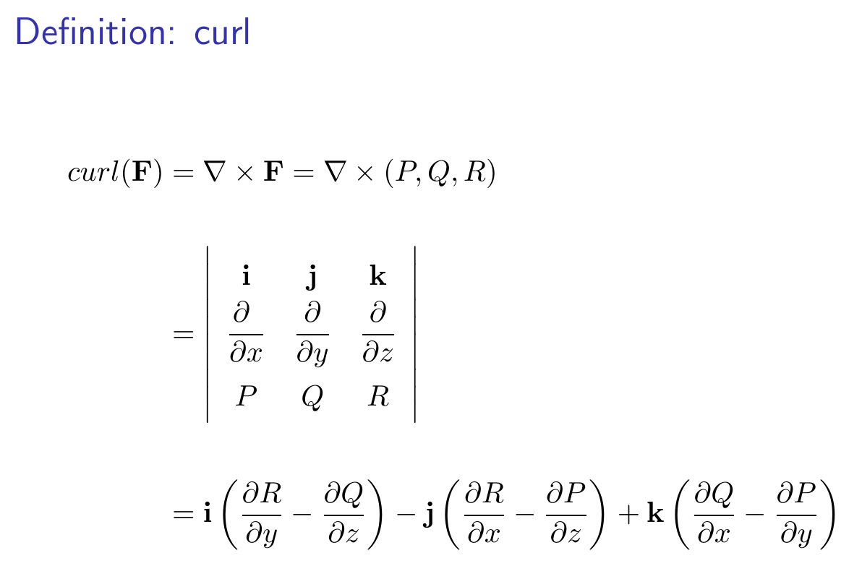

Slide 8
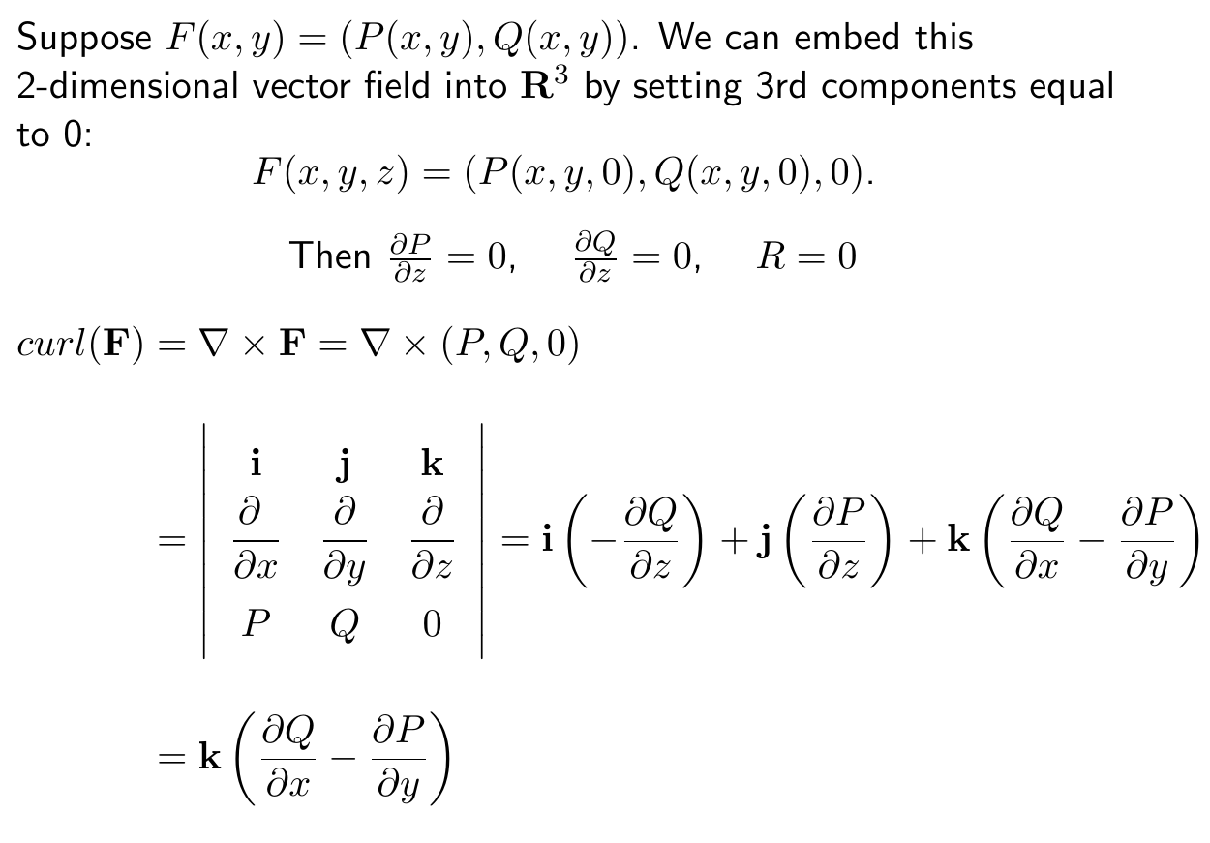

Slide 10
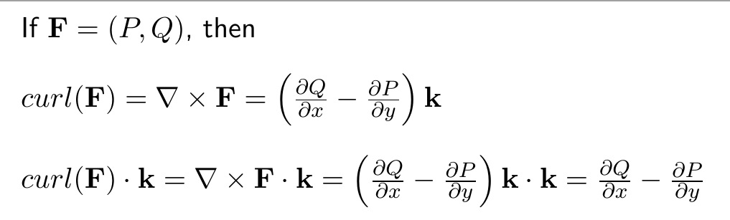
http://tutorial.math.lamar.edu/Classes/CalcIII/GreensTheorem.aspx

Slide 11
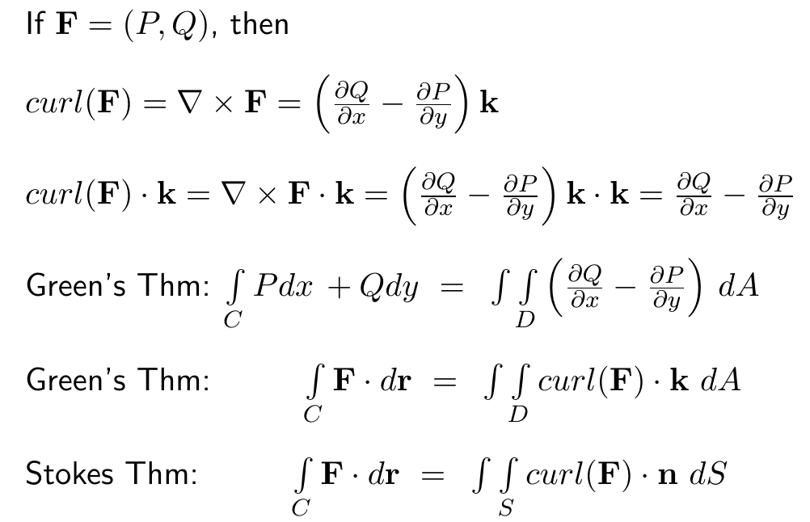

Slide 12
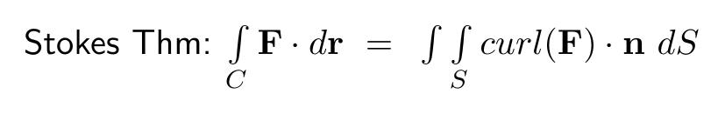
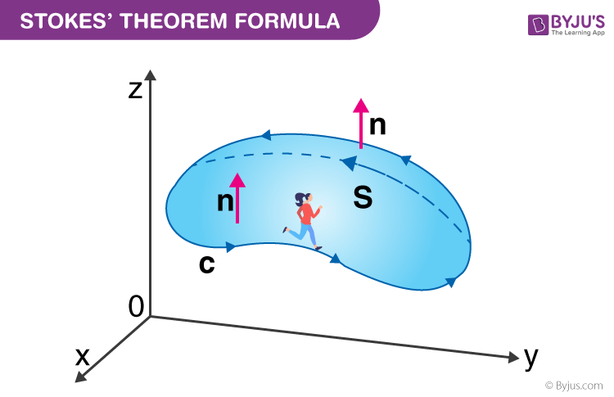
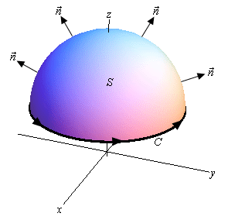
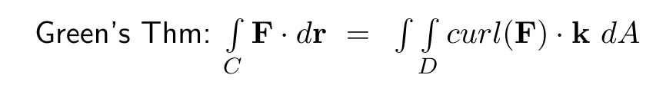
https://byjus.com/maths/stokes-theorem/
http://tutorial.math.lamar.edu/Classes/CalcIII/StokesTheorem.aspx

Slide 14
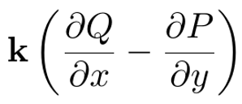

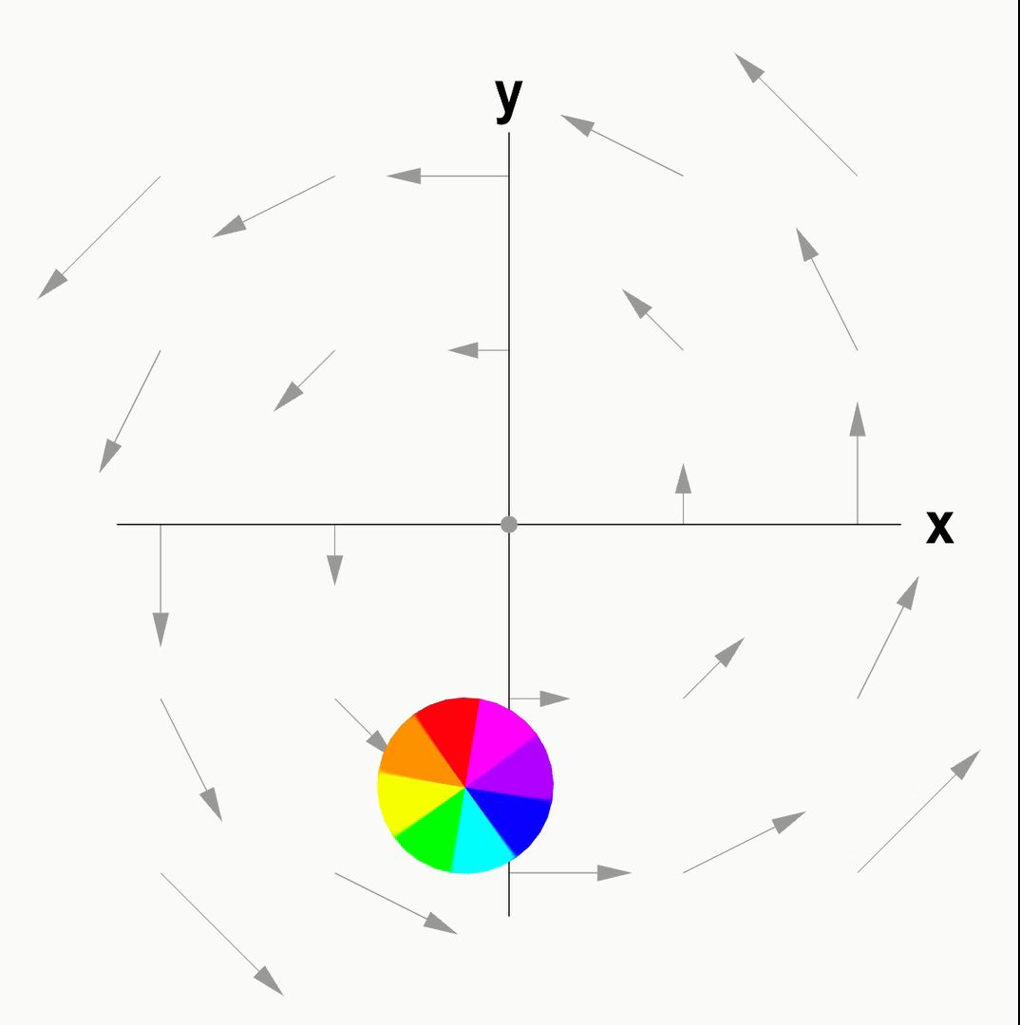


Slide 15
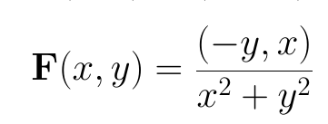
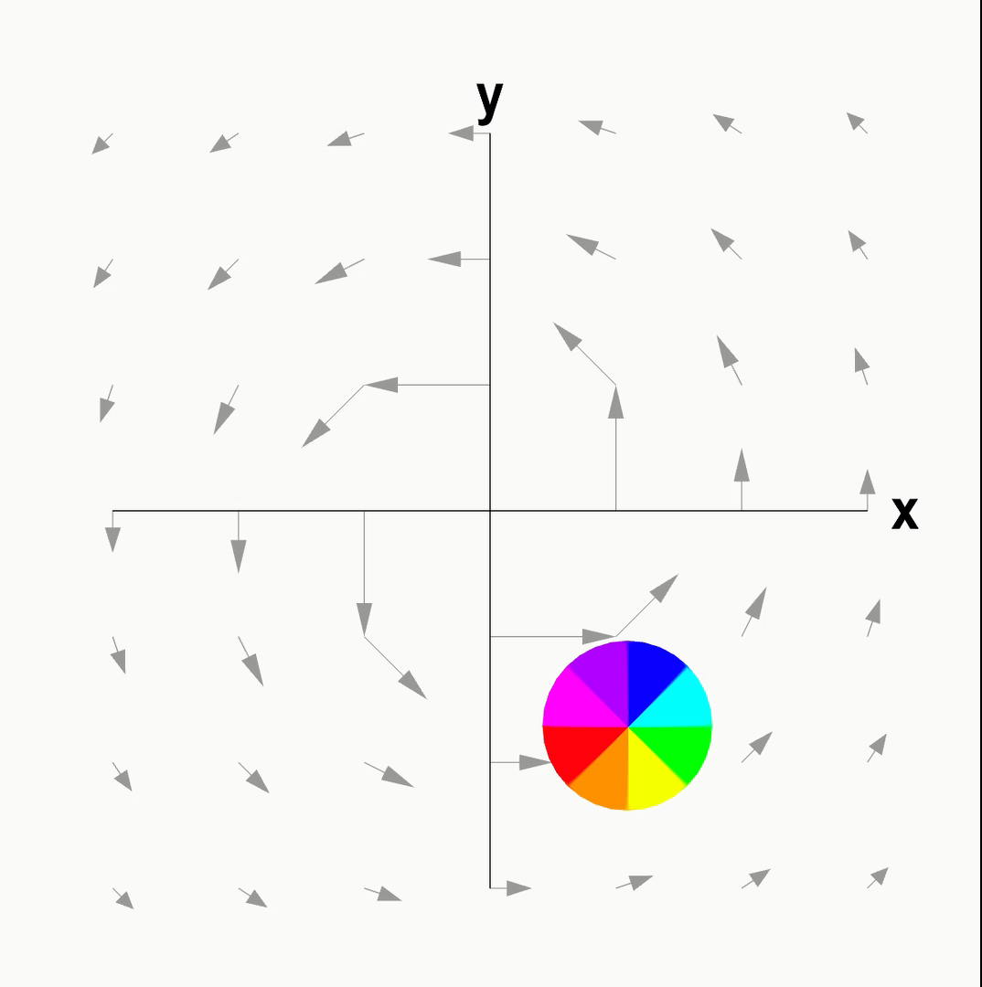
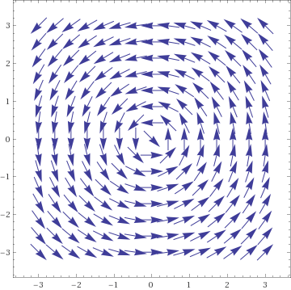

Slide 16
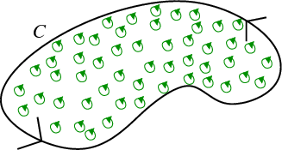
https://mathinsight.org/greens_theorem_idea

Slide 17
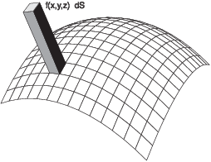
14.5: Surface Integrals
Part 1: Scalar surface integrals
http://sites.millersville.edu/bikenaga/calculus/surface-integrals/surface-integrals.html

Slide 18
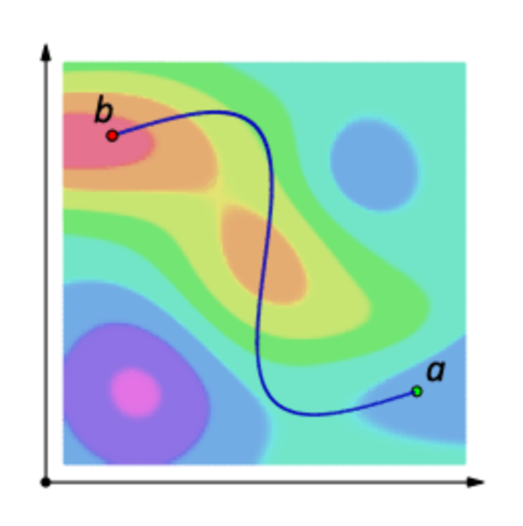
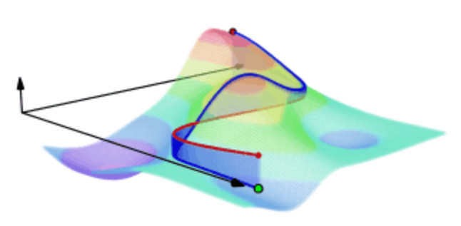
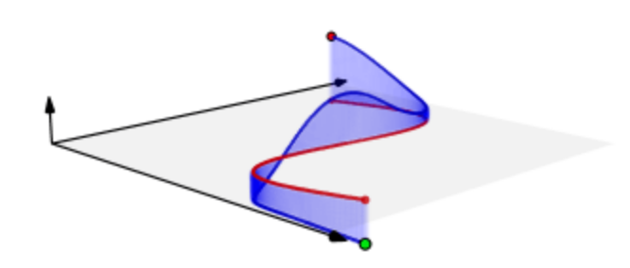
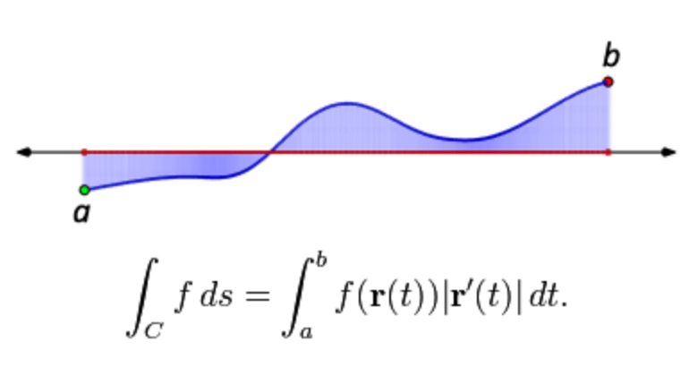
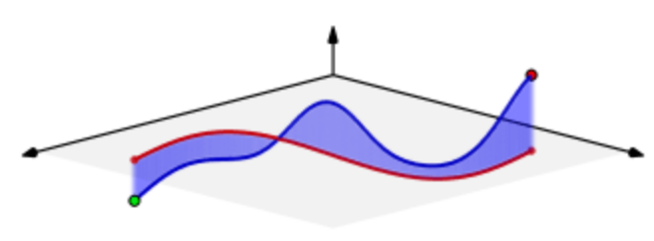
Scalar line integral of a function z = f(x, y) over a curve C
Note C = r([a, b])
https://en.wikipedia.org/wiki/Line_integral

Slide 19
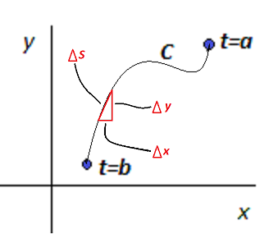
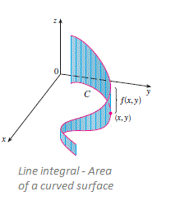
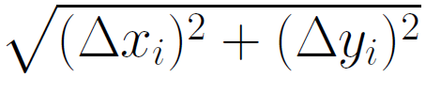
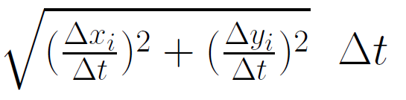
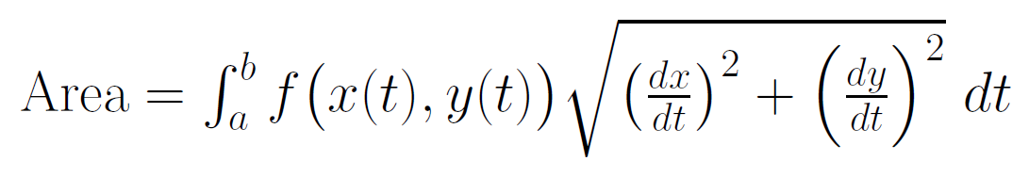
Scalar line integral of a function
z = f(x, y) over a curve C
Σ height * width = Σ f(x_{i}, y_{i}) Δ s_{i} = Σ f(x_{i}, y_{i})
= Σ f(x_{i}, y_{i})
Note C = r([a, b]) where r(t) = (x(t), y(t))
https://brilliant.org/wiki/line-integral/

Slide 20
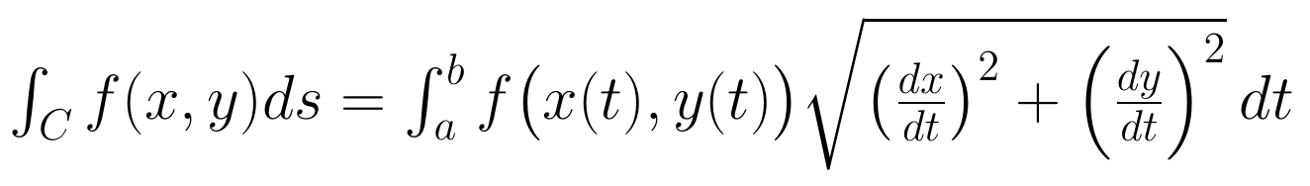
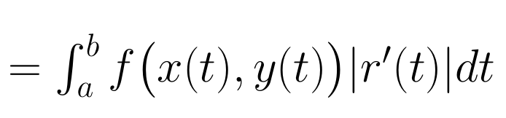
Scalar line integral of a function z = f(x, y) over a curve C
Note C = r([a, b])
https://brilliant.org/wiki/line-integral/

Slide 21
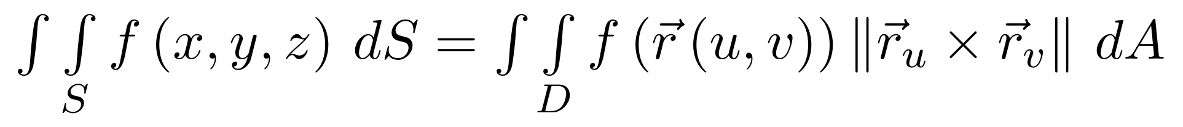
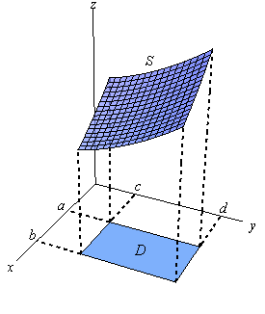
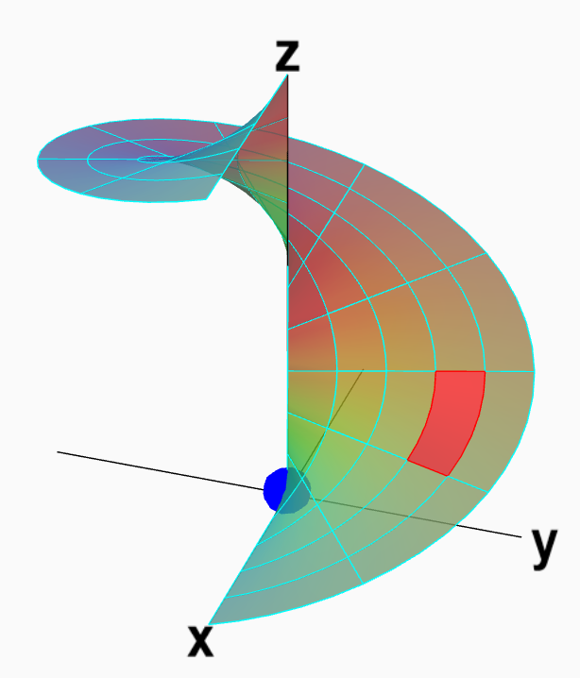
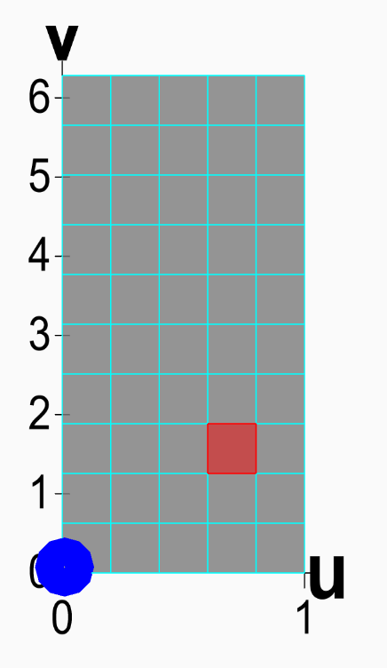
Scalar surface integral of a function z = f(x, y) over a surface S
http://tutorial.math.lamar.edu/Classes/CalcIII/SurfaceIntegrals.aspx
https://mathinsight.org/parametrized_surface_area

Slide 22
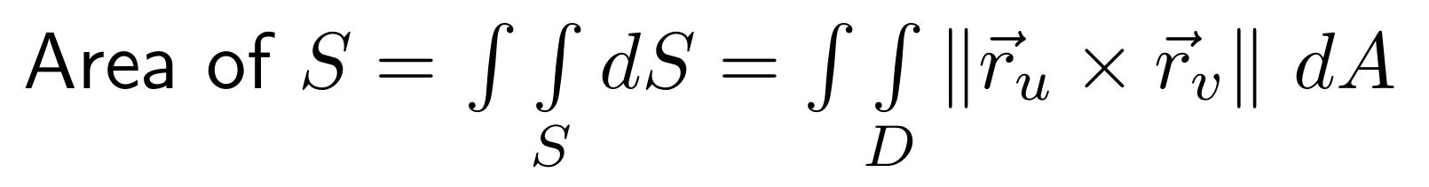
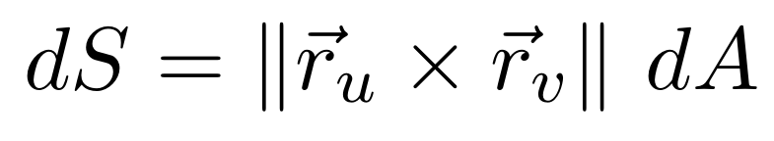
Section 13.8 Surface area
http://tutorial.math.lamar.edu/Classes/CalcIII/SurfaceIntegrals.aspx
http://tutorial.math.lamar.edu/Classes/CalcIII/SurfaceIntegrals.aspx
https://mathinsight.org/parametrized_surface_area

Slide 23
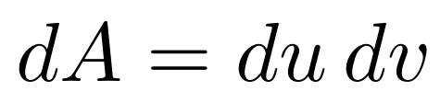
Section 13.8 Surface area
https://mathinsight.org/parametrized_surface_area

Slide 24
Scalar surface integral of a function z = f(x, y) over a surface S
http://sites.millersville.edu/bikenaga/calculus/surface-integrals/surface-integrals.html

Slide 25
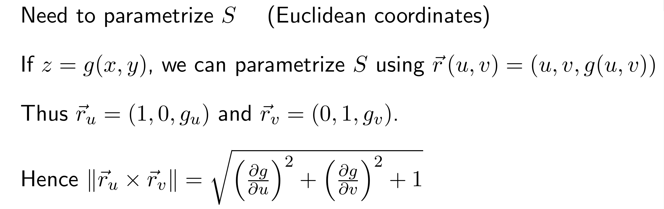
Scalar surface integral of a function z = f(x, y) over a surface S
http://sites.millersville.edu/bikenaga/calculus/surface-integrals/surface-integrals.html

Slide 26
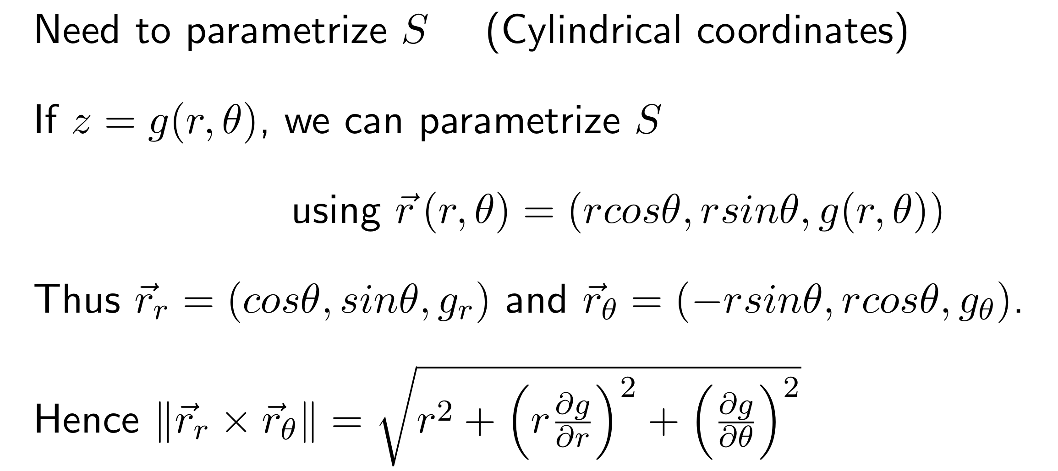
Scalar surface integral of a function z = f(x, y) over a surface S

Slide 27
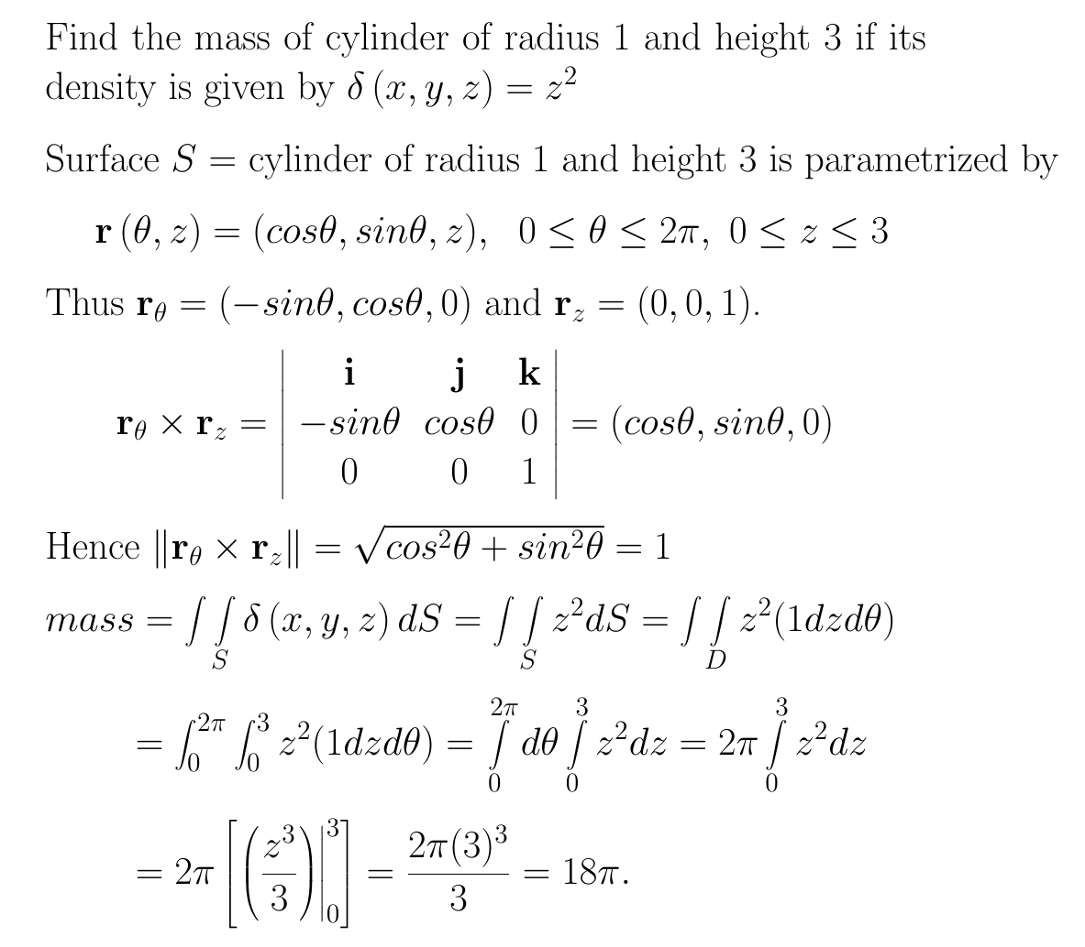
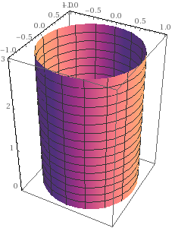
https://www.math24.net/physical-applications-surface-integrals
wolframalpha.com

Slide 28
https://www.math24.net/physical-applications-surface-integrals
wolframalpha.com

Slide 29
https://www.math24.net/physical-applications-surface-integrals
wolframalpha.com

Slide 30
https://www.math24.net/physical-applications-surface-integrals
wolframalpha.com

Slide 31
https://www.math24.net/physical-applications-surface-integrals
wolframalpha.com

Slide 32
https://www.math24.net/physical-applications-surface-integrals
wolframalpha.com

Slide 33
https://www.math24.net/physical-applications-surface-integrals
wolframalpha.com

Slide 34
wolframalpha.com
https://www.math24.net/physical-applications-surface-integrals

Slide 35
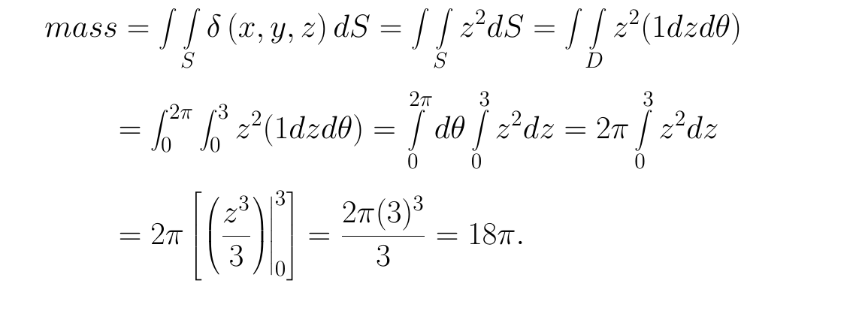
https://www.math24.net/physical-applications-surface-integrals
wolframalpha.com

Slide 36
https://www.math24.net/physical-applications-surface-integrals
wolframalpha.com

Slide 37
wolframalpha.com
https://www.math24.net/physical-applications-surface-integrals

Slide 38
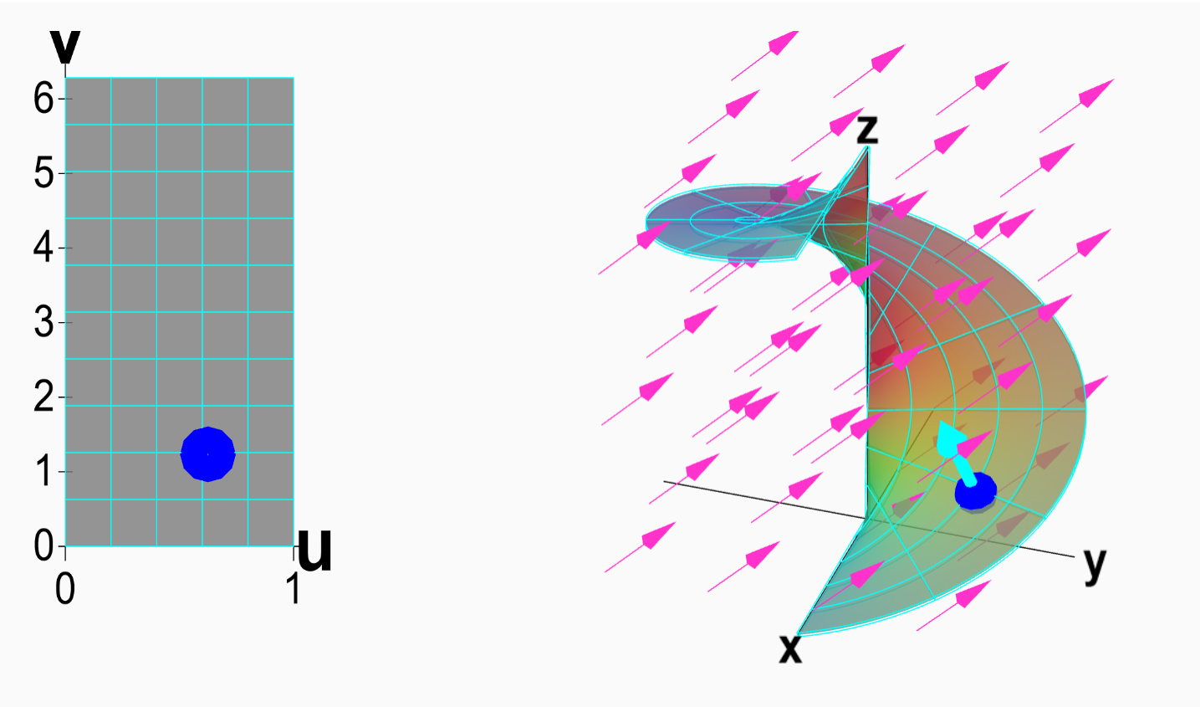
14.5: Surface Integrals
Part 2: Vector surface integrals
https://mathinsight.org/surface_integral_vector_field_introduction

Slide 39

F is a vector field.
Vector line integral

Slide 40

Vector surface integral

Slide 41




Note surface most be orientable: Surfaces must have 2 sides
Not orientable Orientable
Mobius band
Sphere
https://math.libretexts.org/Bookshelves/Calculus/Book%3A_Calculus_(Guichard)/16%3A_Vector_Calculus/16.07%3A_Surface_Integrals
Klein bottle
Torus
en.wikipedia.org
en.wikipedia.org

Slide 42

Not orientable
https://physics.stackexchange.com/questions/262362/what-is-the-direction-of-area-vector

