Slide 1
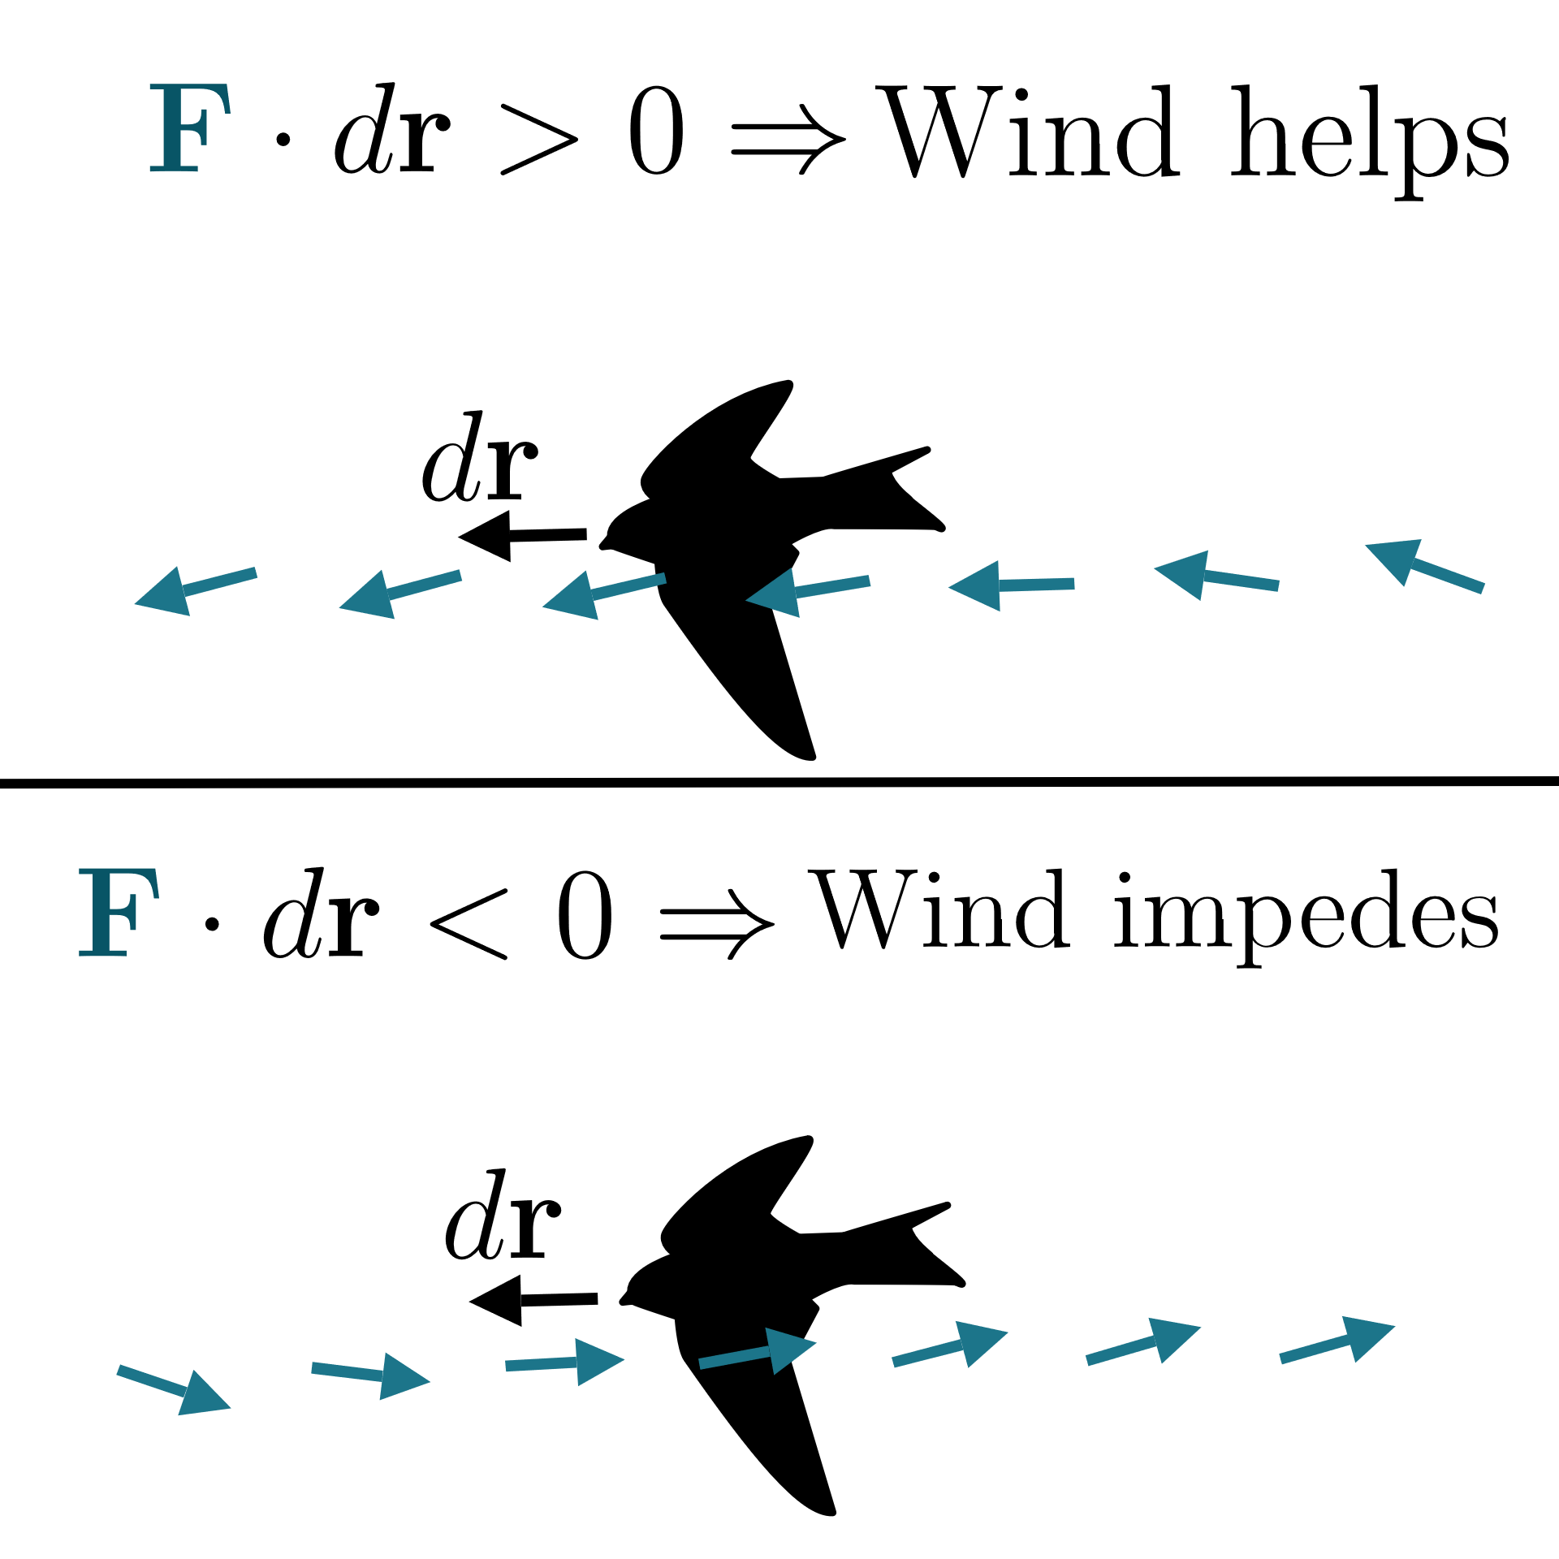
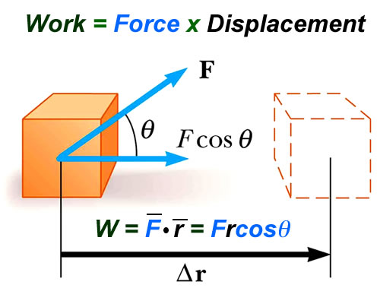
Vector Line Integral
= Work
https://www.khanacademy.org/math/multivariable-calculus/greens-theorem-and-stokes-theorem/stokes-theorem-articles/a/stokes-theorem

Slide 2
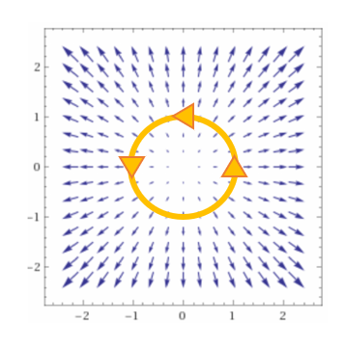
Application 2: If C is a closed curve,
Note we are adding up the tangential component of F along the curve C
Example: Let F = velocity field of a fluid.

Slide 3
Application 2: If C is a closed curve,
Note we are adding up the tangential component of F along the curve C
Example: Let F = velocity field of a fluid.

Slide 4
(Section 14.4)
http://tutorial.math.lamar.edu/Classes/CalcIII/GreensTheorem.aspx
(Section 14.7)

Slide 5
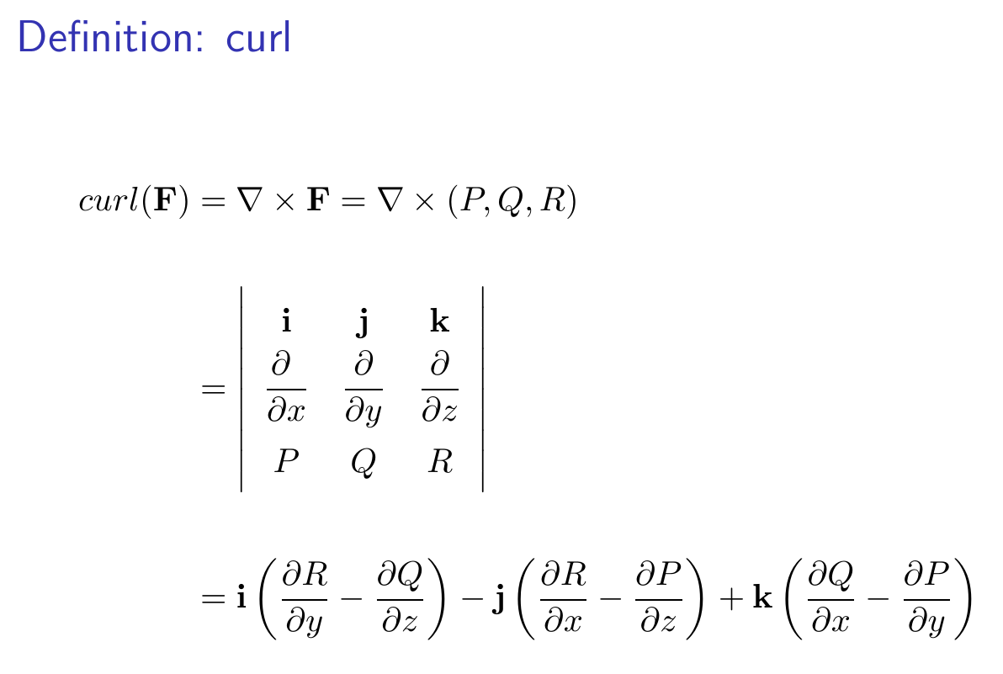

Slide 6
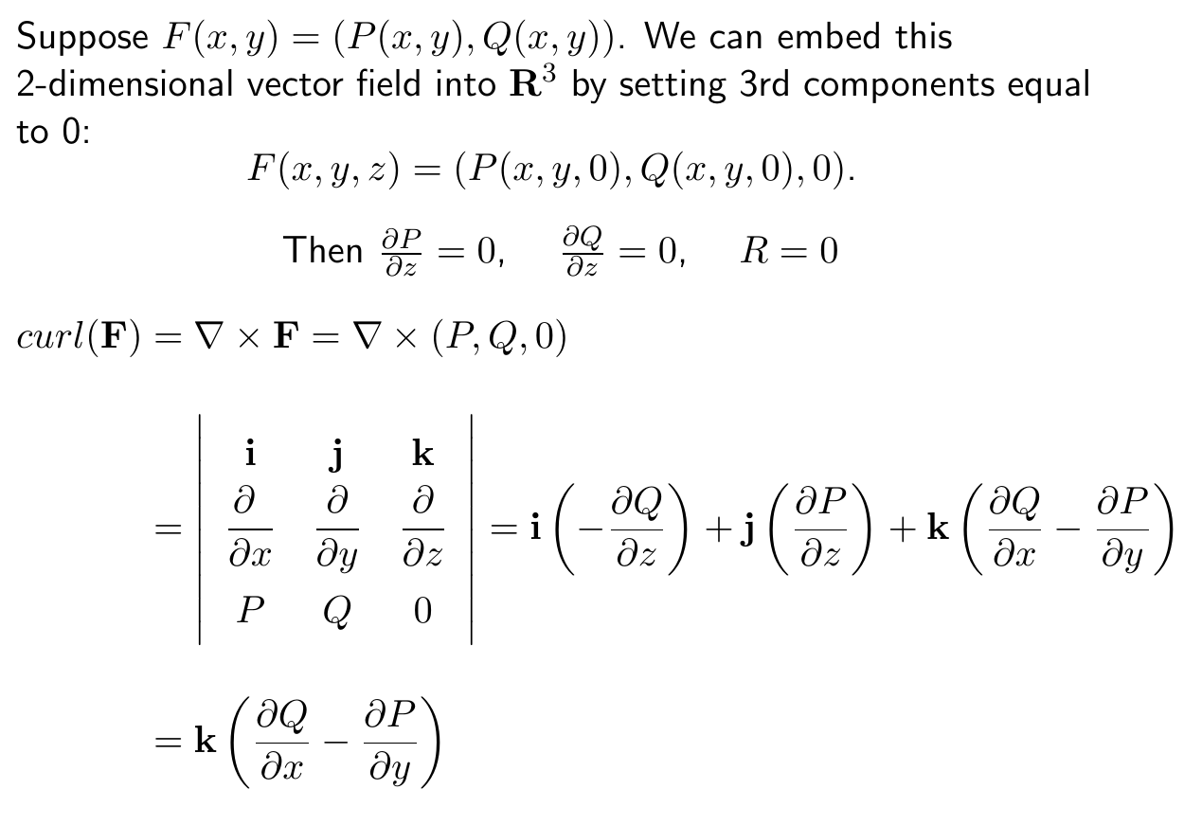

Slide 7
http://tutorial.math.lamar.edu/Classes/CalcIII/GreensTheorem.aspx

Slide 8
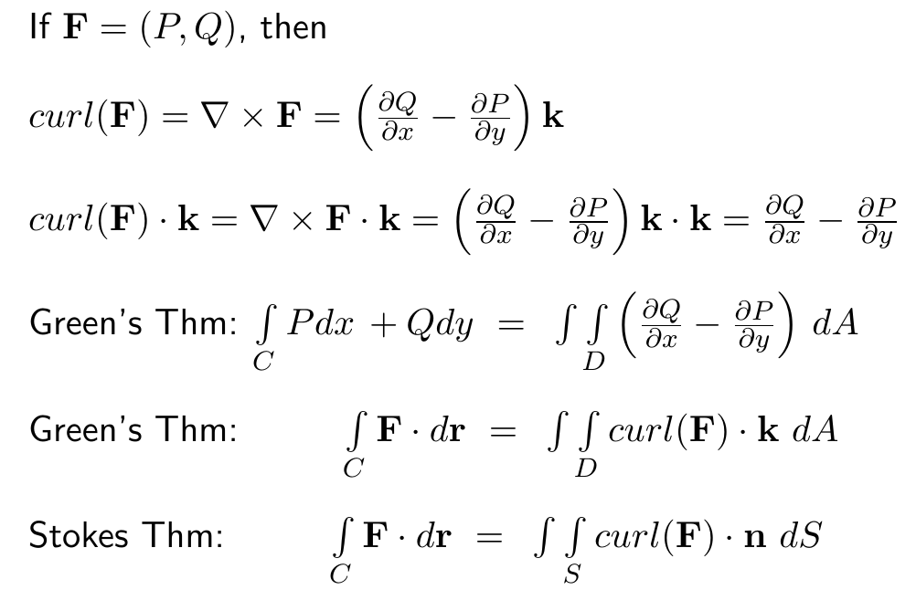

Slide 9
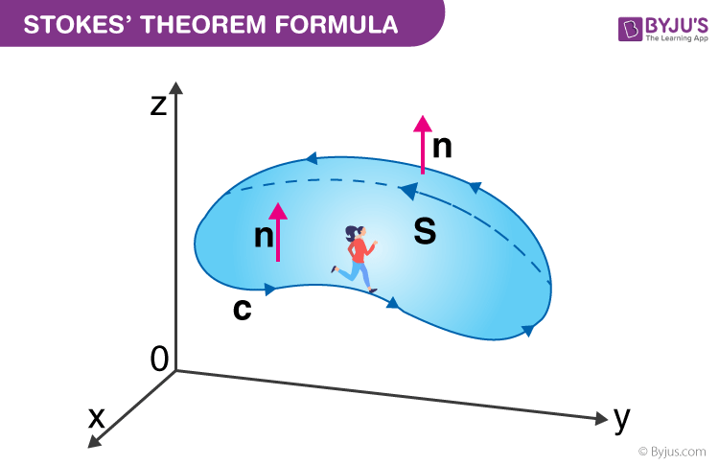
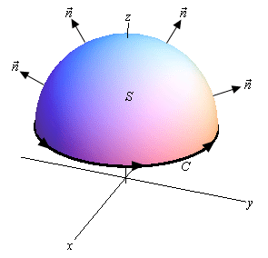
https://byjus.com/maths/stokes-theorem/
http://tutorial.math.lamar.edu/Classes/CalcIII/StokesTheorem.aspx

Slide 15
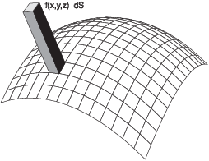
14.5: Surface Integrals
Part 1: Scalar surface integrals
http://sites.millersville.edu/bikenaga/calculus/surface-integrals/surface-integrals.html

Slide 16
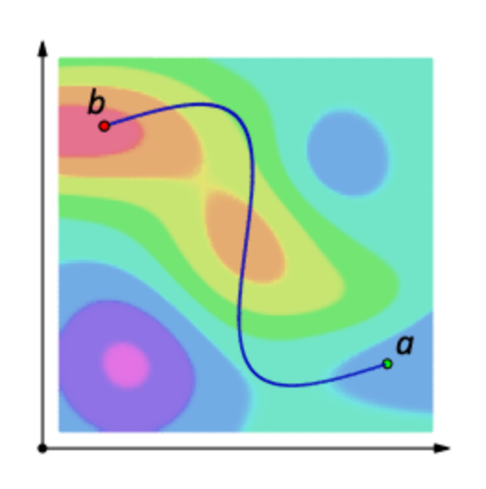
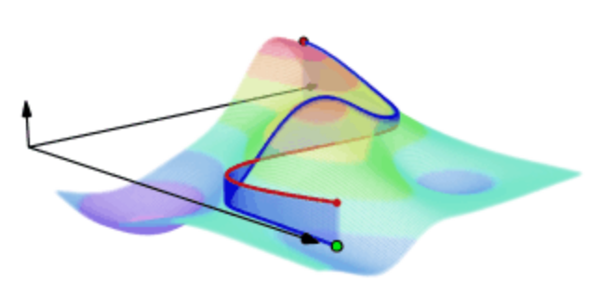
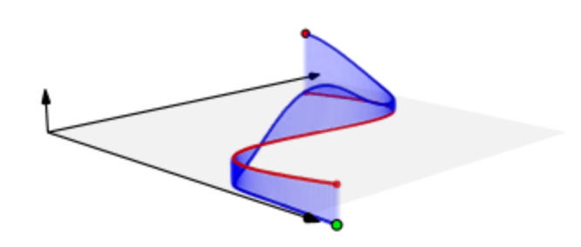
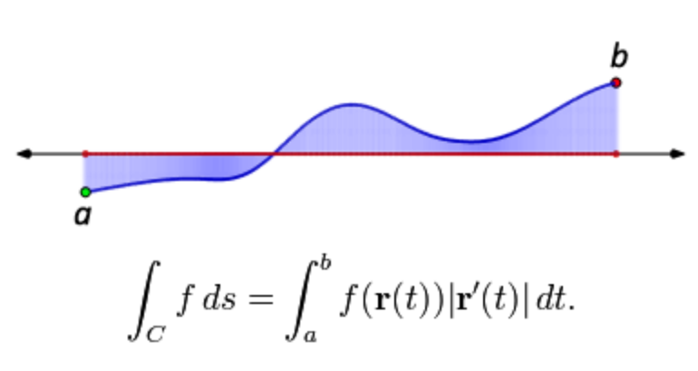
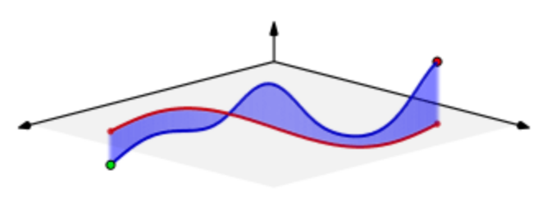
Scalar line integral of a function z = f(x, y) over a curve C
Note C = r([a, b])
https://en.wikipedia.org/wiki/Line_integral

Slide 17
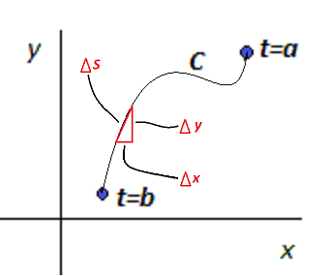
Scalar line integral of a function
z = f(x, y) over a curve C
Σ height * width = Σ f(x_{i}, y_{i}) Δ s_{i} = Σ f(x_{i}, y_{i})
= Σ f(x_{i}, y_{i})
Note C = r([a, b]) where r(t) = (x(t), y(t))
https://brilliant.org/wiki/line-integral/

Slide 18
Scalar line integral of a function z = f(x, y) over a curve C
Note C = r([a, b])
https://brilliant.org/wiki/line-integral/

Slide 19
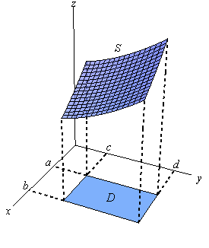
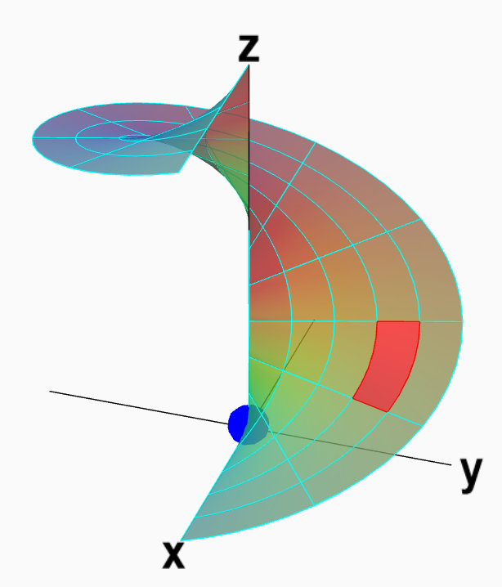
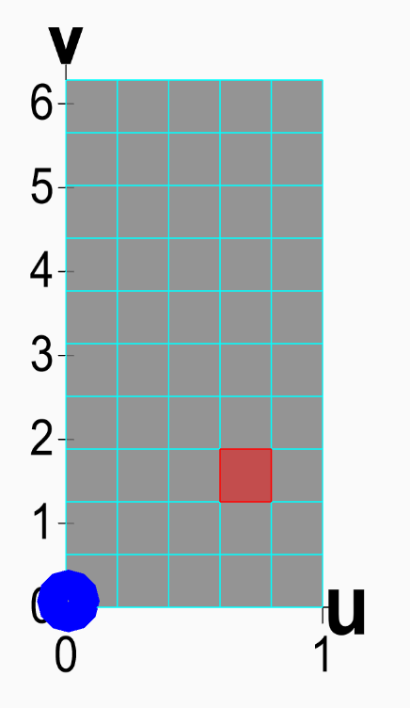
Scalar surface integral of a function z = f(x, y) over a surface S
http://tutorial.math.lamar.edu/Classes/CalcIII/SurfaceIntegrals.aspx
https://mathinsight.org/parametrized_surface_area

Slide 20
Section 13.8 Surface area
http://tutorial.math.lamar.edu/Classes/CalcIII/SurfaceIntegrals.aspx
http://tutorial.math.lamar.edu/Classes/CalcIII/SurfaceIntegrals.aspx
https://mathinsight.org/parametrized_surface_area

Slide 21
Section 13.8 Surface area
https://mathinsight.org/parametrized_surface_area

Slide 22
Scalar surface integral of a function z = f(x, y) over a surface S
http://sites.millersville.edu/bikenaga/calculus/surface-integrals/surface-integrals.html

Slide 23
Scalar surface integral of a function z = f(x, y) over a surface S
http://sites.millersville.edu/bikenaga/calculus/surface-integrals/surface-integrals.html

Slide 24
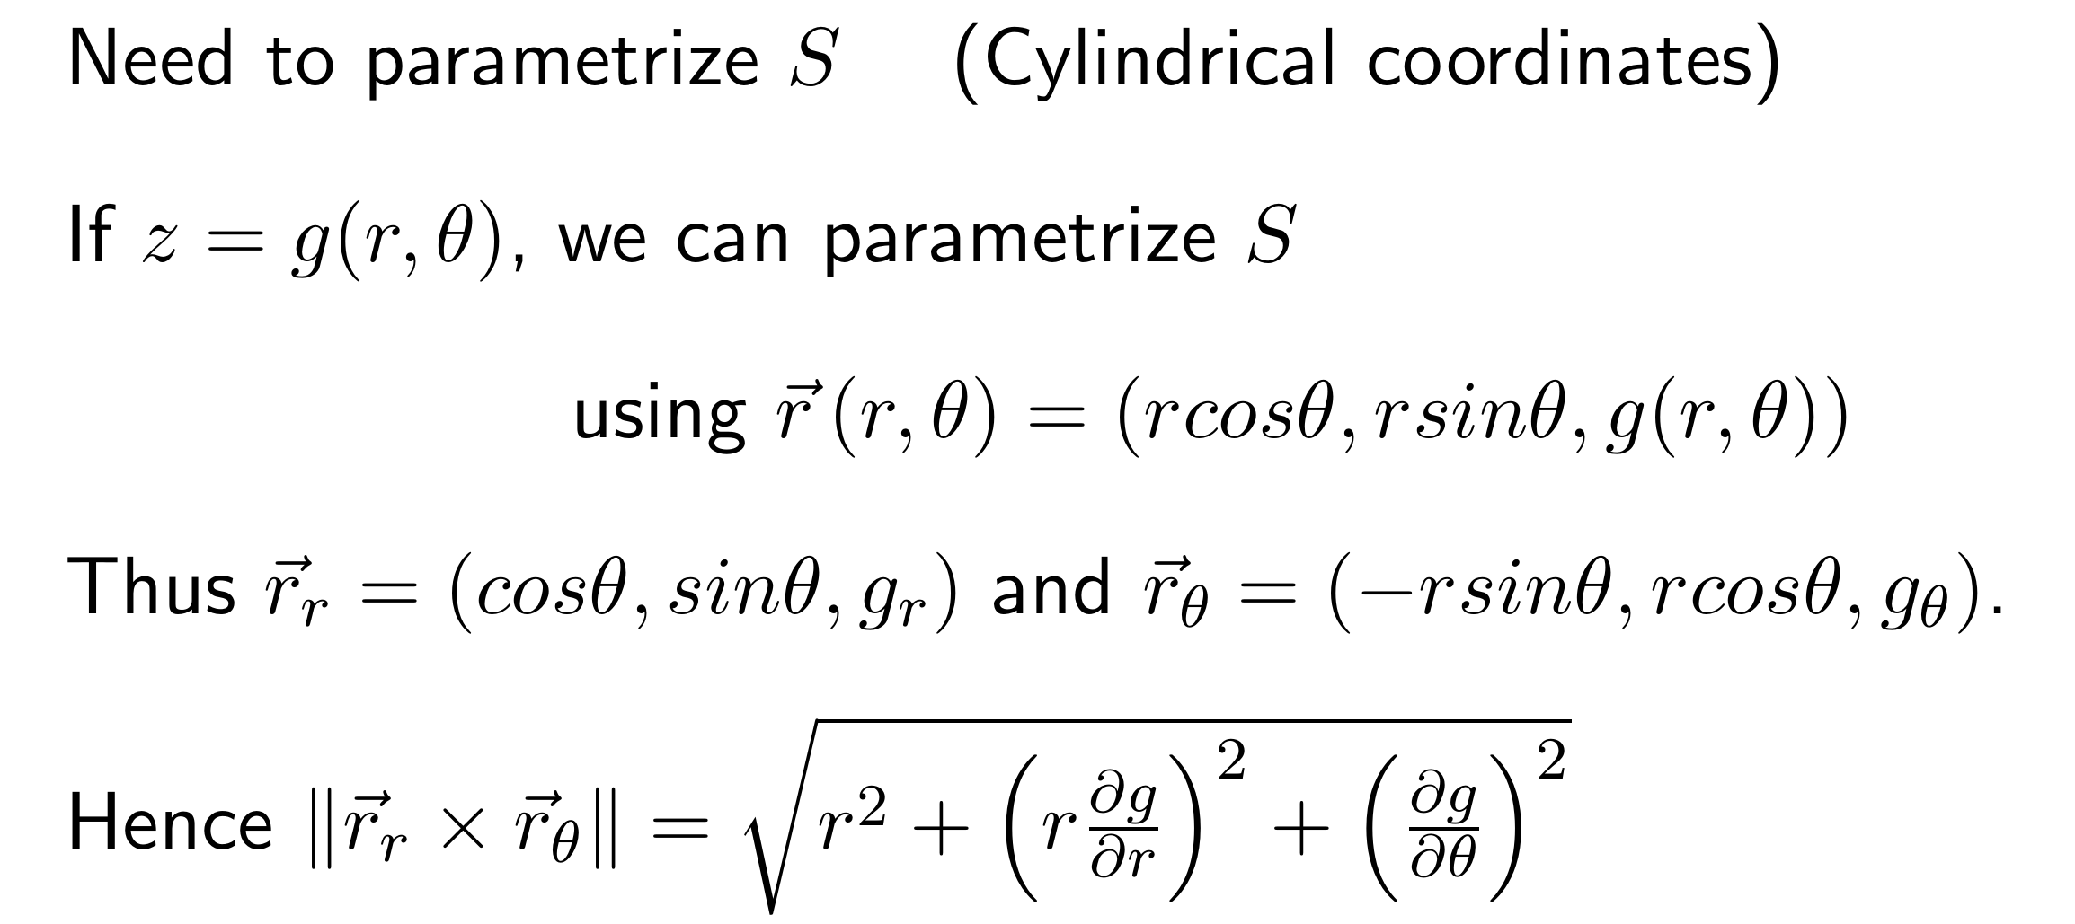
Scalar surface integral of a function z = f(x, y) over a surface S

Slide 25
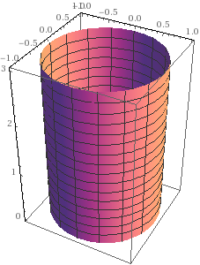
https://www.math24.net/physical-applications-surface-integrals
wolframalpha.com

Slide 26
https://www.math24.net/physical-applications-surface-integrals
wolframalpha.com

Slide 27
https://www.math24.net/physical-applications-surface-integrals
wolframalpha.com

Slide 28
https://www.math24.net/physical-applications-surface-integrals
wolframalpha.com

Slide 29
wolframalpha.com
https://www.math24.net/physical-applications-surface-integrals

Slide 30
https://www.math24.net/physical-applications-surface-integrals
wolframalpha.com

Slide 31
https://www.math24.net/physical-applications-surface-integrals
wolframalpha.com

Slide 32
wolframalpha.com
https://www.math24.net/physical-applications-surface-integrals

Slide 33
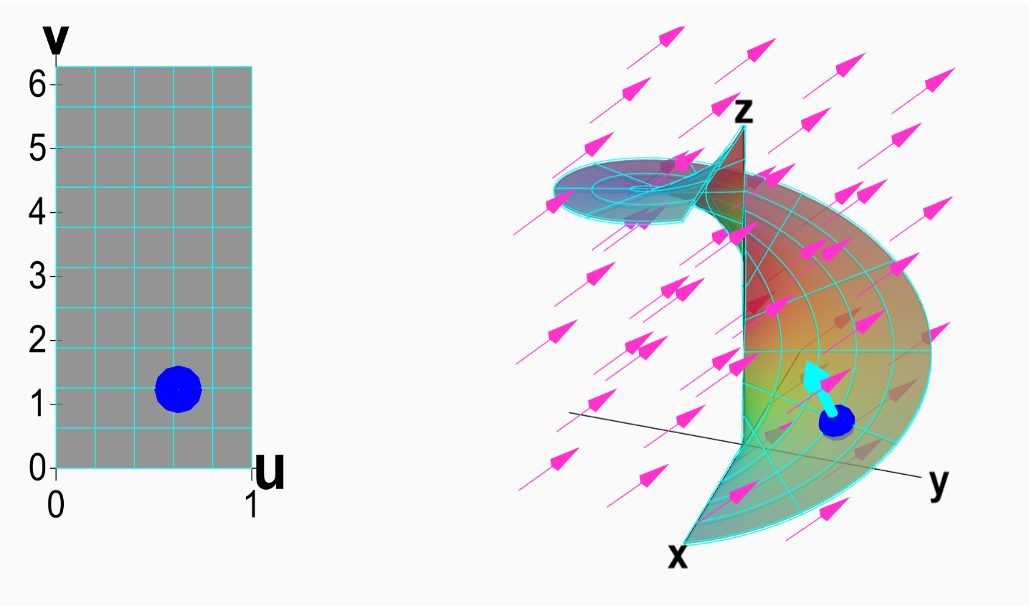
14.5: Surface Integrals
Part 2: Vector surface integrals
https://mathinsight.org/surface_integral_vector_field_introduction

Slide 34
F is a vector field.
Vector line integral

