Slide 1

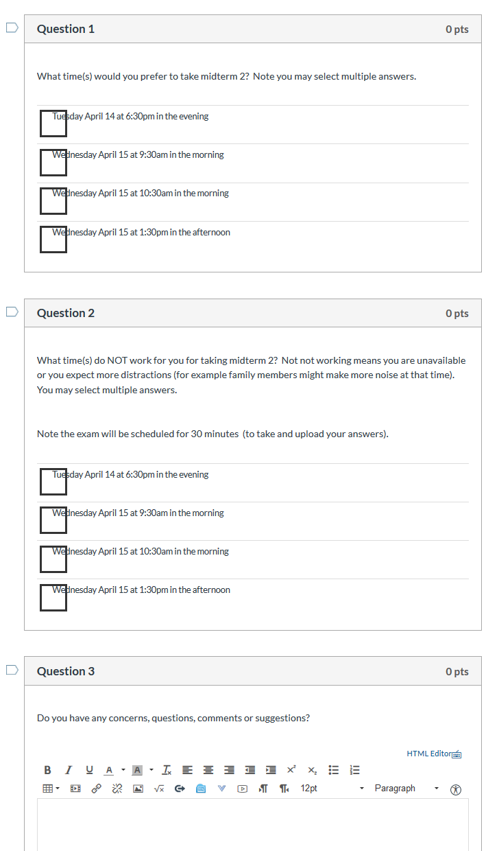
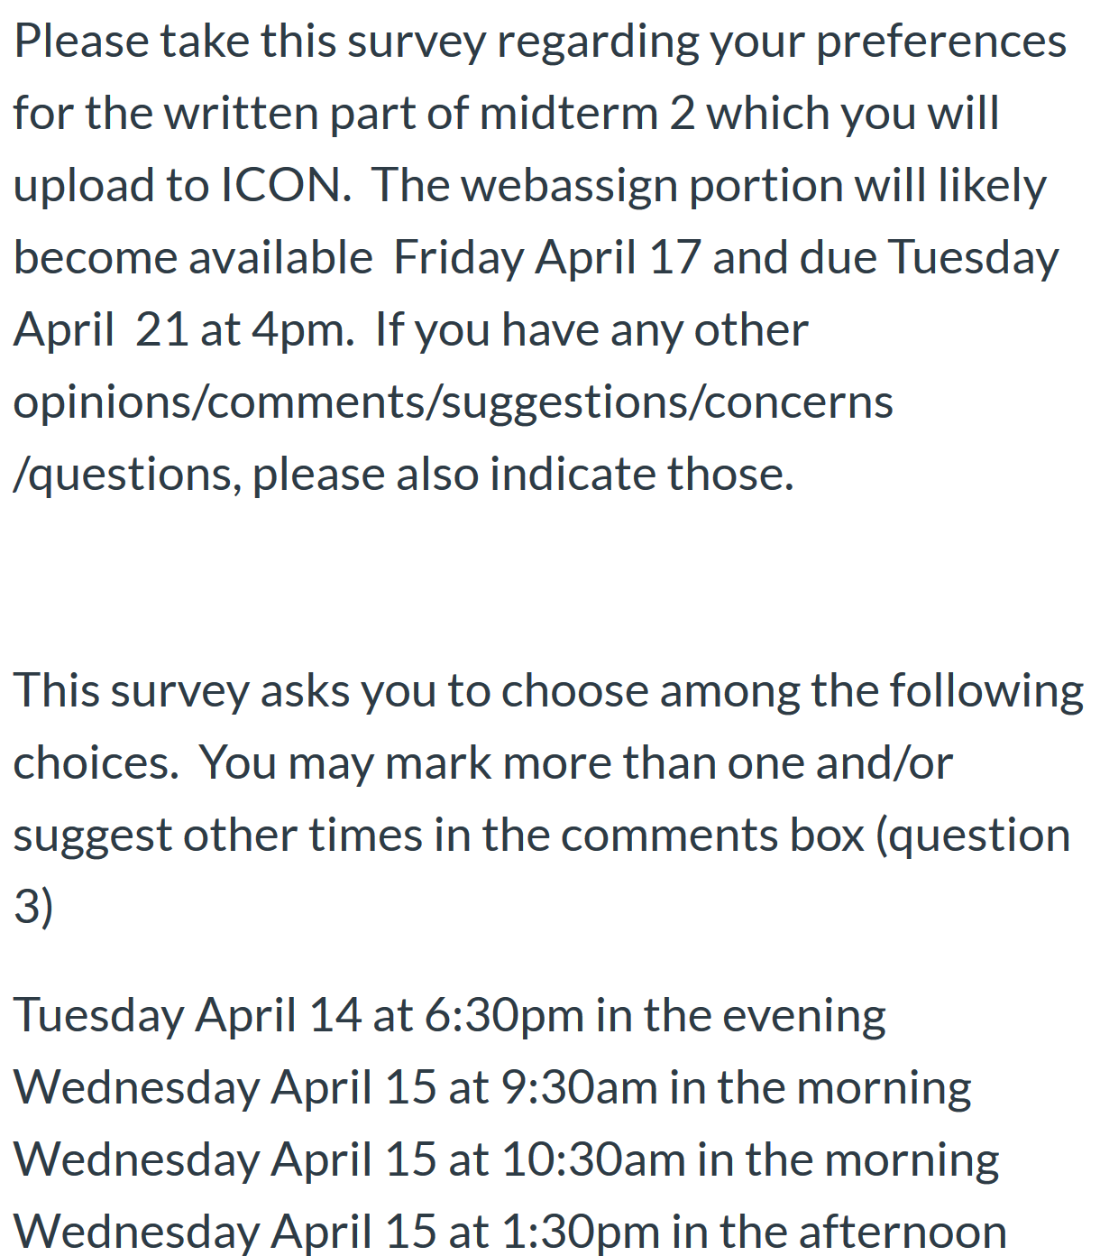
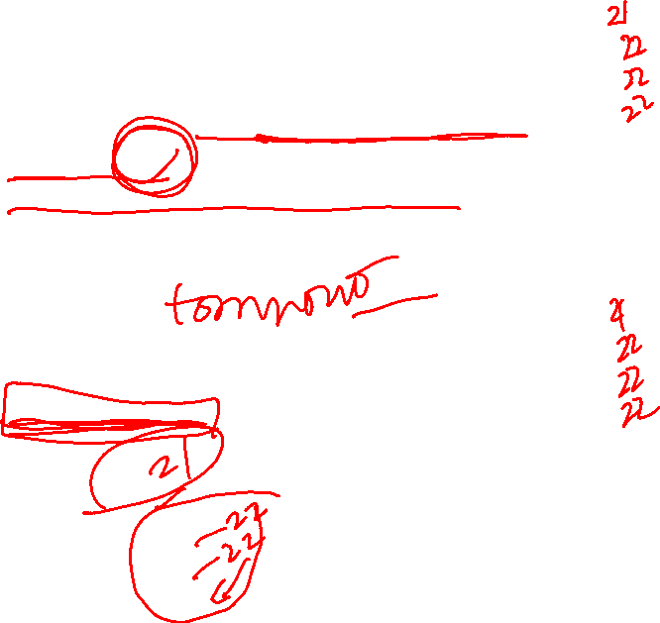
Survey due today at 5pm

Slide 2
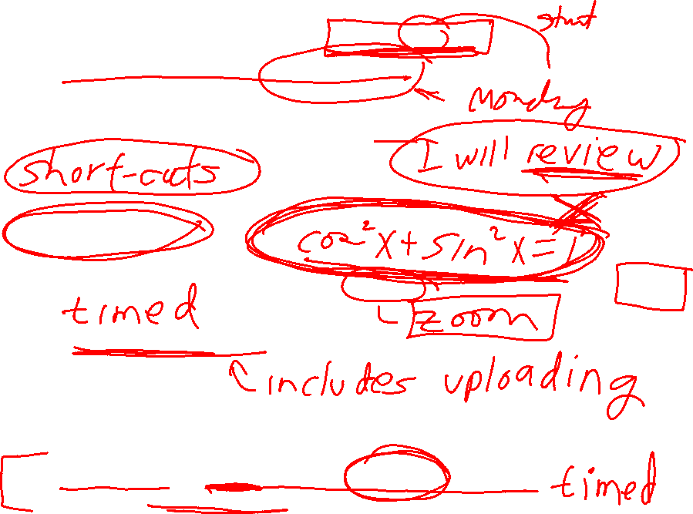
What sections will the test cover? 13.6 – 14.5, 7
Most likely will only cover curl from 14.7 for exam 2.
On the last test you hinted at what sections would be covered most heavily, could you do the same for this one? Yes
Will we need to know and use trig identities on the exam? No, but exam is open book/notes
How much time will we have for thewritten portion of the test? 30 min
Is it a hard 30 minute time limit or will some time be allotted to upload our work? I hope so.
How many questions will be on the written portion? 1 or 2
For webassign part: three separate 45 minute attempts.
will include multiple part webassign problems

Slide 3
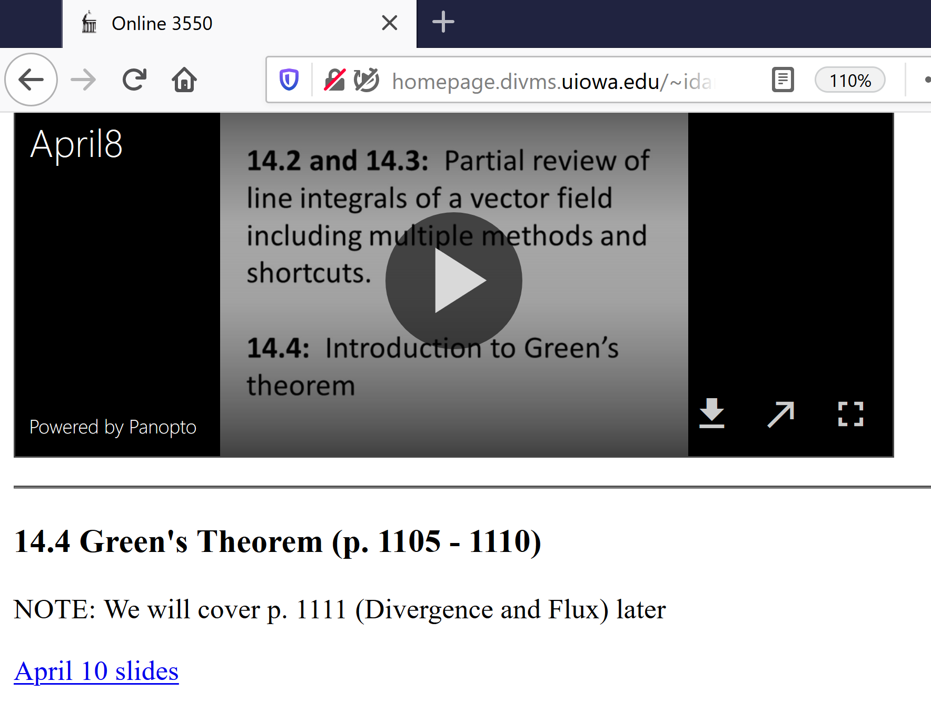
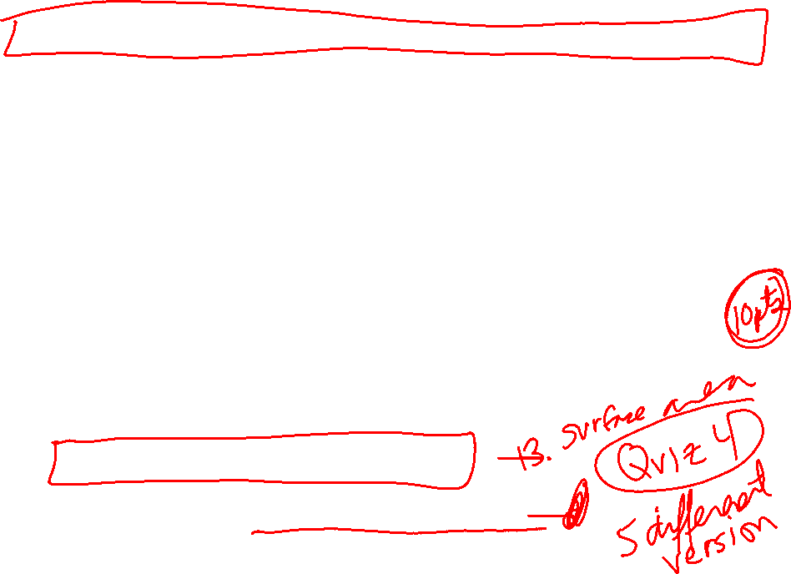
http://homepage.divms.uiowa.edu/~idarcy/COURSES/3550/Spring20/online.html

Slide 4
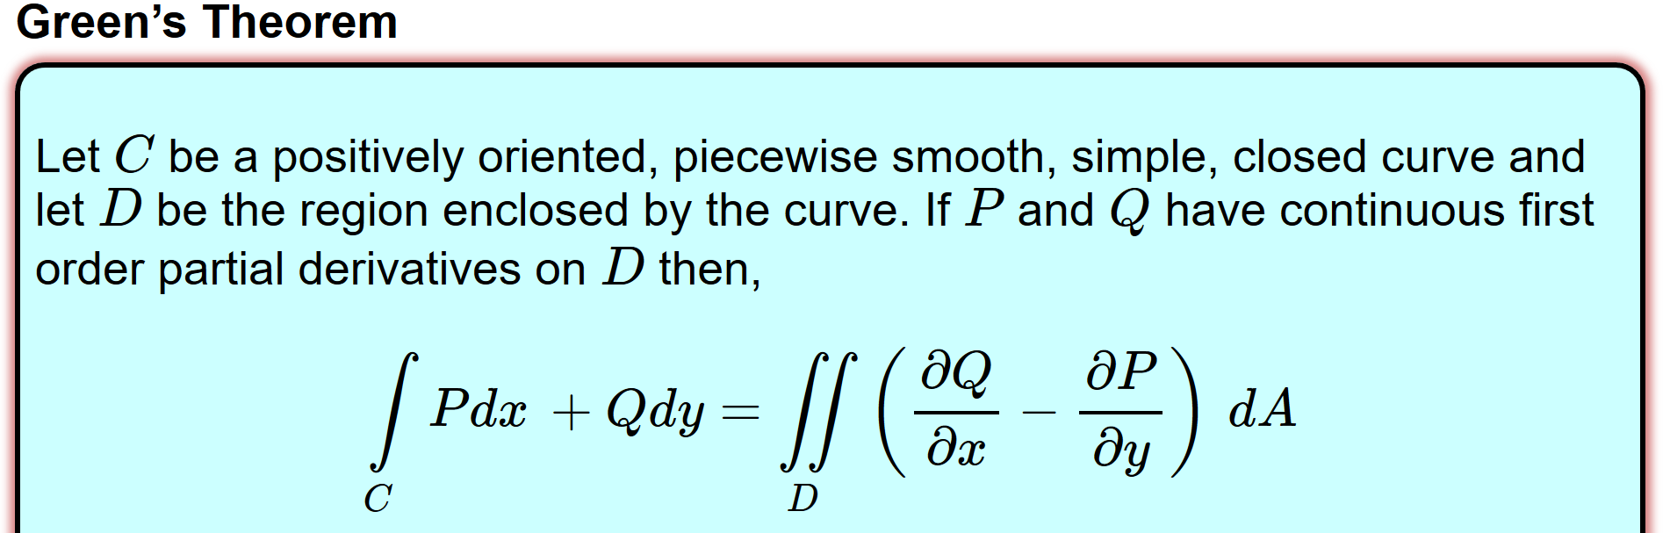
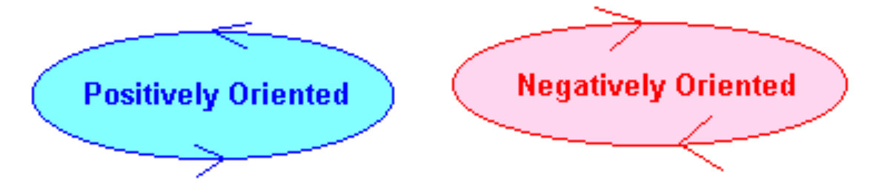
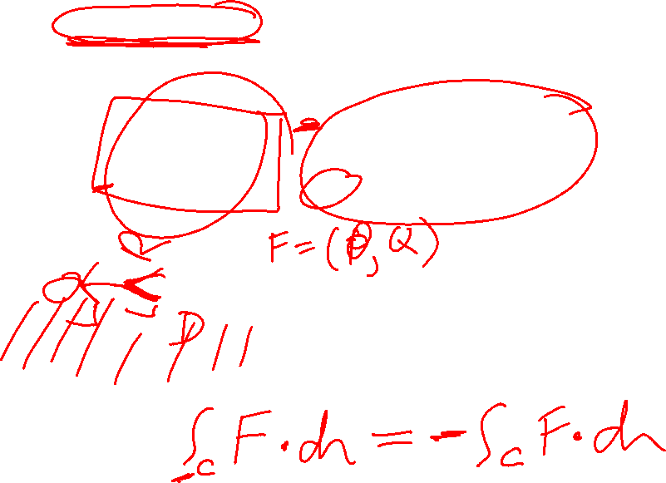
http://tutorial.math.lamar.edu/Classes/CalcIII/GreensTheorem.aspx
http://ltcconline.net/greenl/courses/202/vectorIntegration/greensTheorem.htm

Slide 5
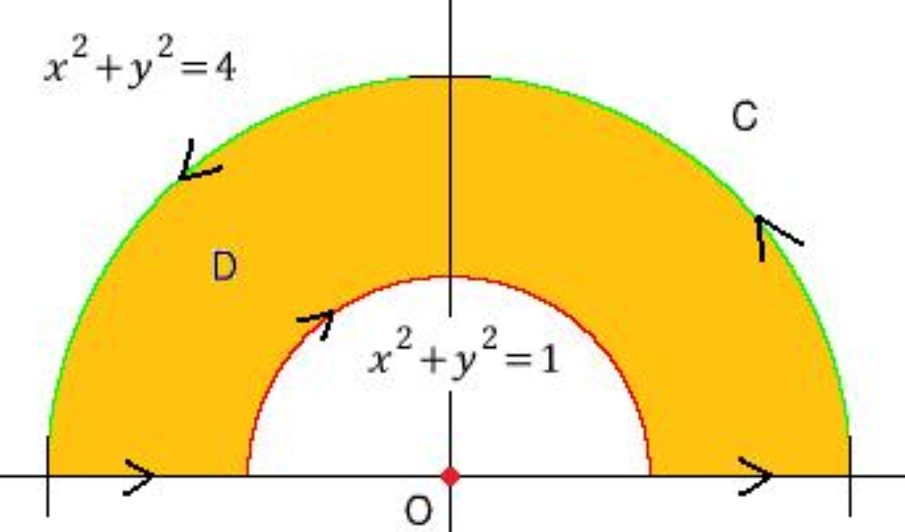
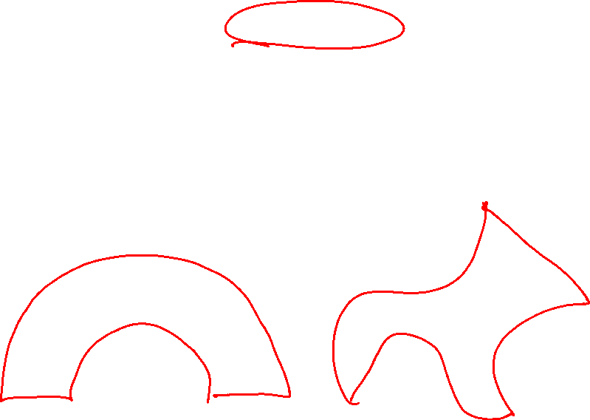
http://tutorial.math.lamar.edu/Classes/CalcIII/GreensTheorem.aspx
http://blog.naver.com/PostView.nhn?blogId=mindo1103&logNo=90179767504&parentCategoryNo=35&categoryNo=&viewDate=&isShowPopularPosts=true&from=search

Slide 6

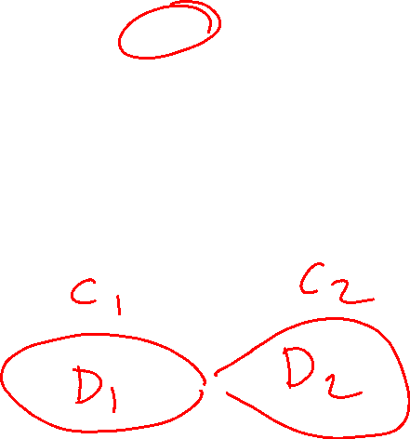
http://tutorial.math.lamar.edu/Classes/CalcIII/GreensTheorem.aspx
http://ltcconline.net/greenl/courses/202/vectorIntegration/greensTheorem.htm

Slide 7


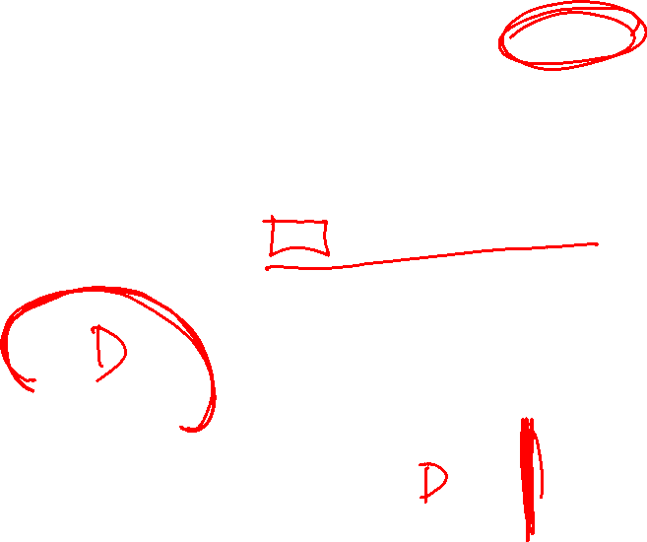
http://tutorial.math.lamar.edu/Classes/CalcIII/GreensTheorem.aspx
NOT closed
https://mathinsight.org/

Slide 8
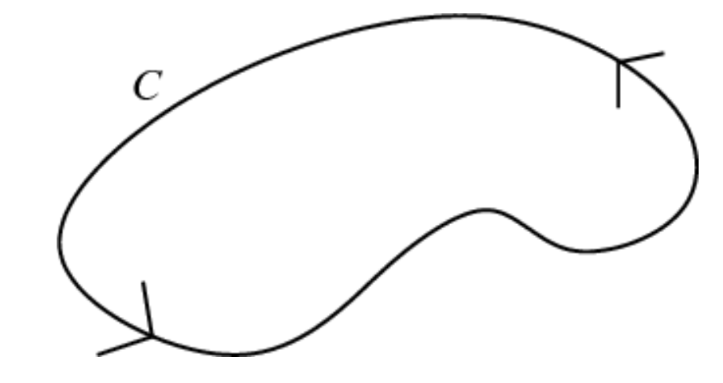
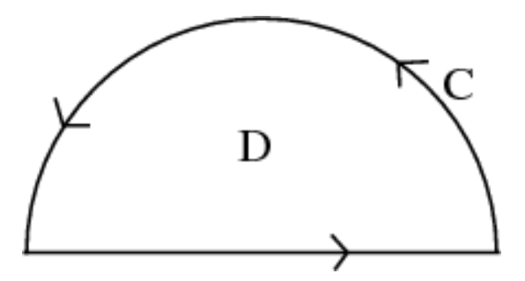
http://tutorial.math.lamar.edu/Classes/CalcIII/GreensTheorem.aspx
closed
https://mathinsight.org/

Slide 9

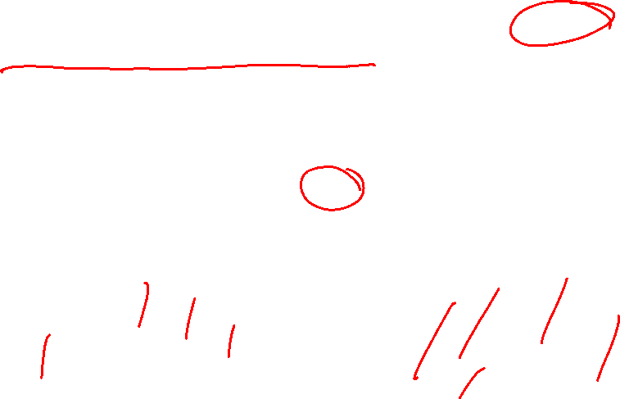
http://tutorial.math.lamar.edu/Classes/CalcIII/GreensTheorem.aspx
closed
https://mathinsight.org/

Slide 10
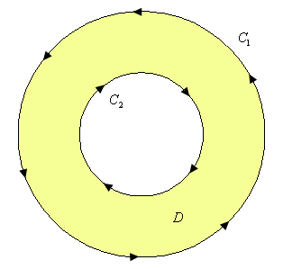

http://tutorial.math.lamar.edu/Classes/CalcIII/GreensTheorem.aspx
http://tutorial.math.lamar.edu/Classes/CalcIII/GreensTheorem.aspx

Slide 11
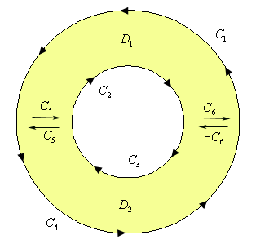
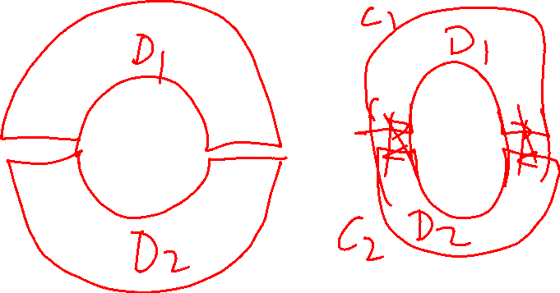
http://tutorial.math.lamar.edu/Classes/CalcIII/GreensTheorem.aspx
http://tutorial.math.lamar.edu/Classes/CalcIII/GreensTheorem.aspx

Slide 12
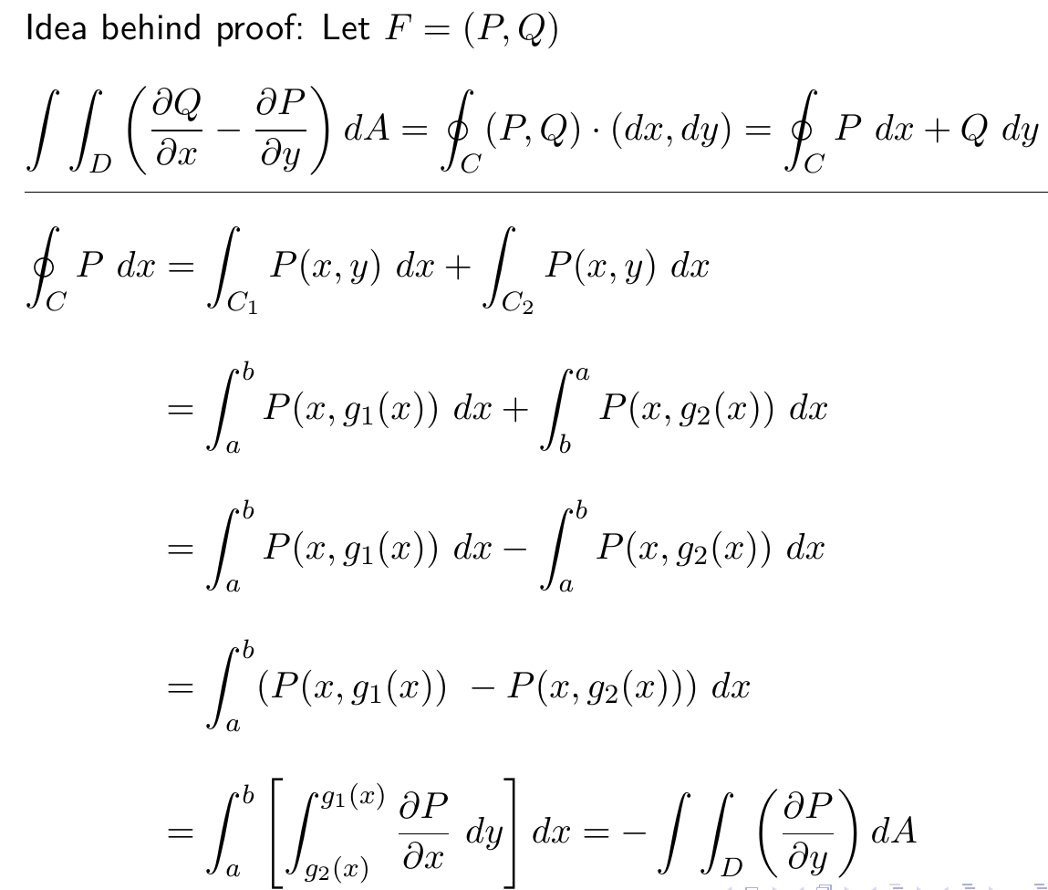
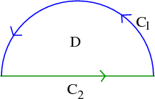
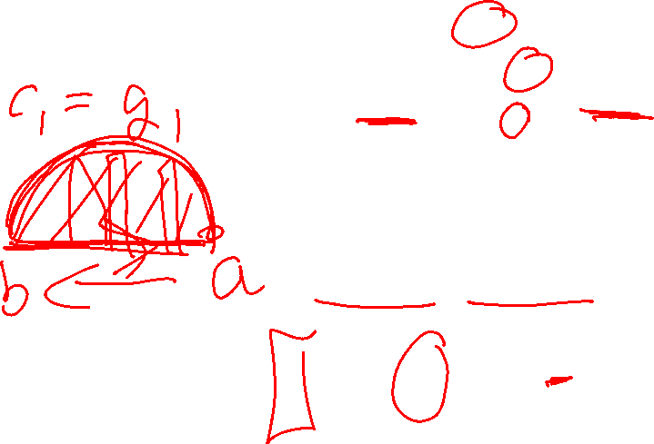
http://tutorial.math.lamar.edu/Classes/CalcIII/GreensTheorem.aspx

Slide 13
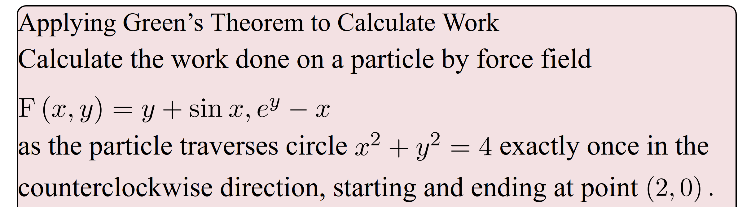
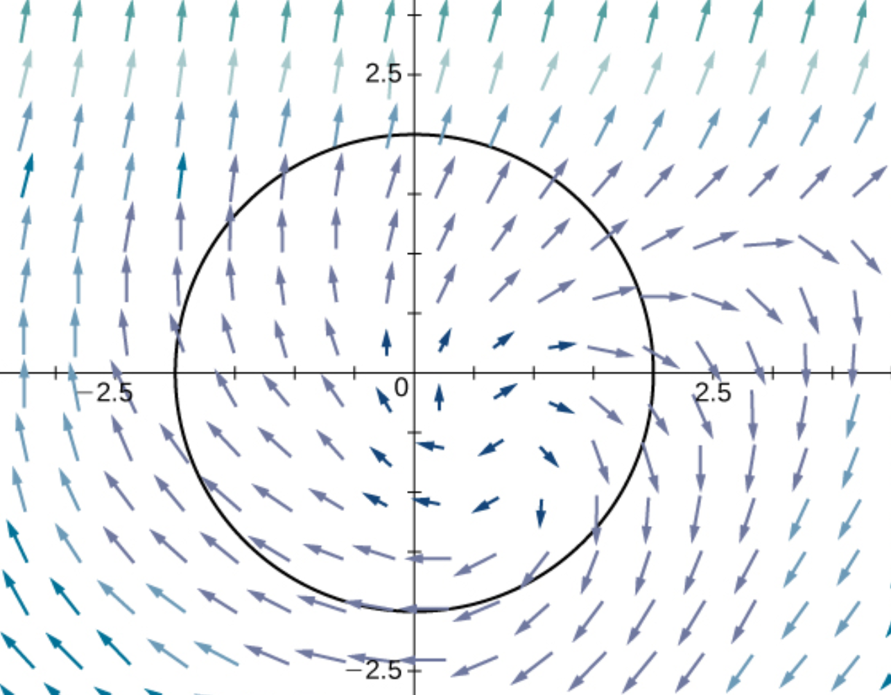
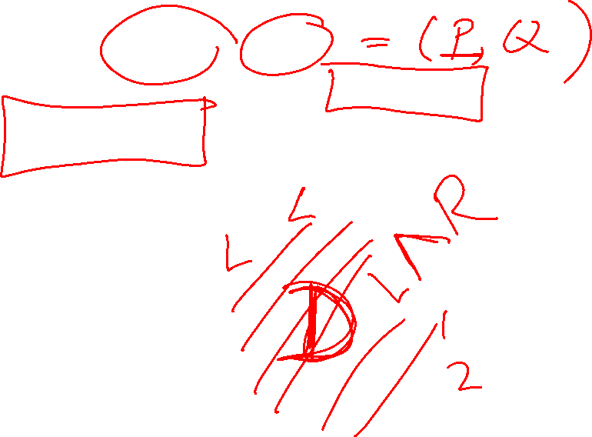
(
)
https://opentextbc.ca/calculusv3openstax/chapter/greens-theorem/

Slide 14
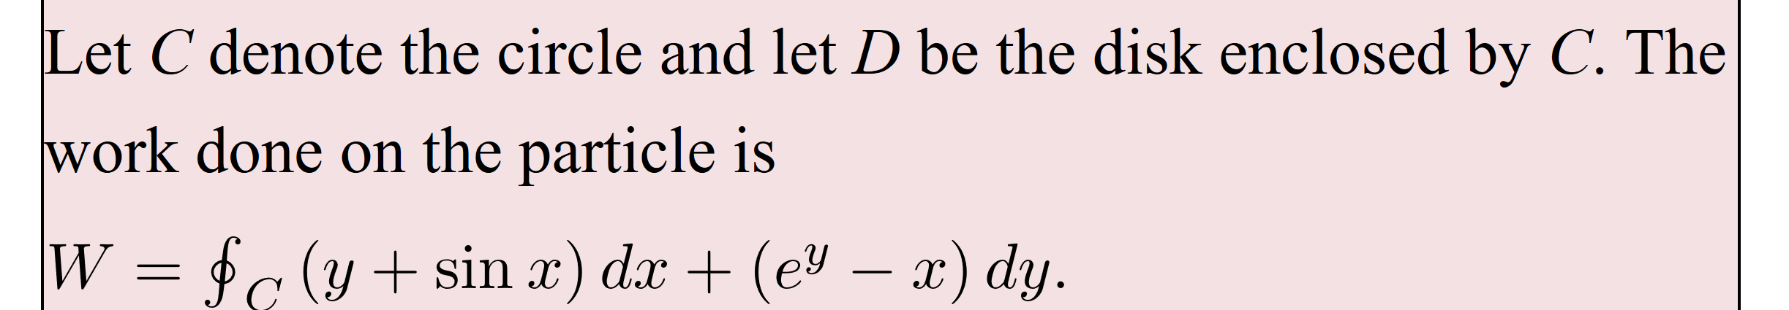
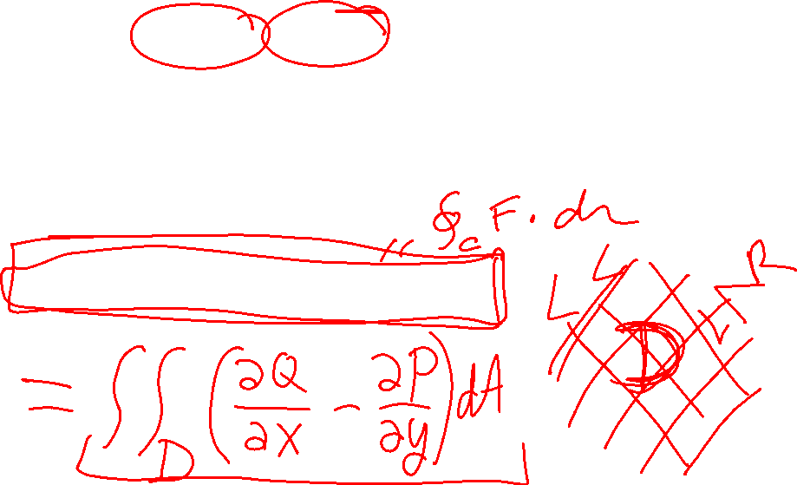
(
)
https://opentextbc.ca/calculusv3openstax/chapter/greens-theorem/

Slide 15
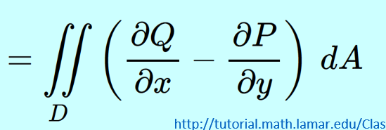
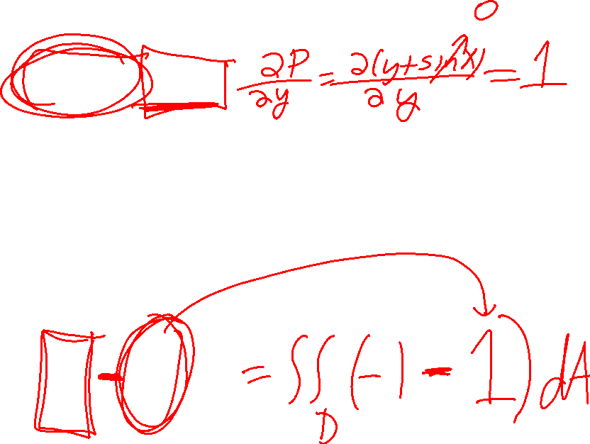
(
)
https://opentextbc.ca/calculusv3openstax/chapter/greens-theorem/

Slide 16
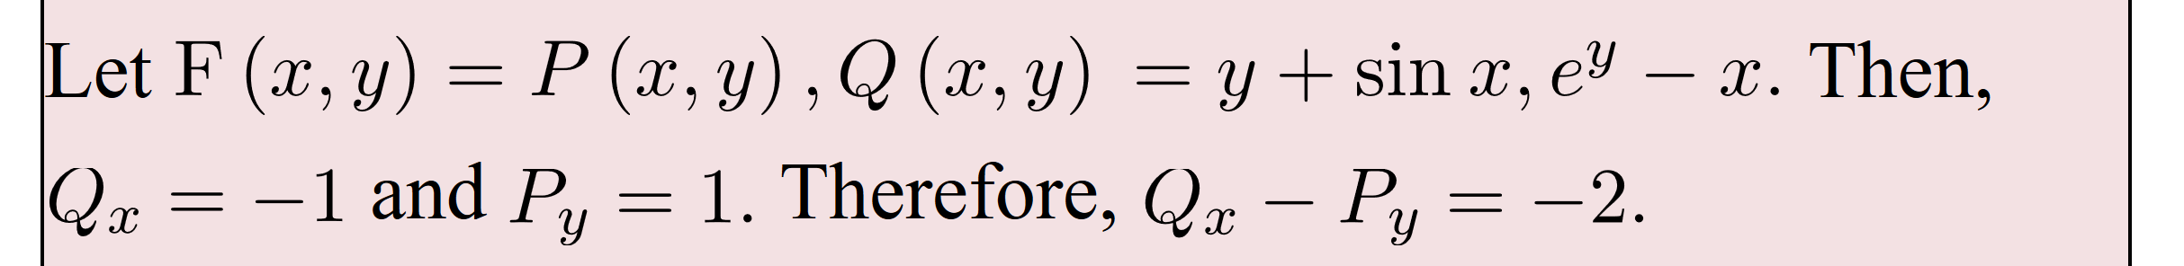
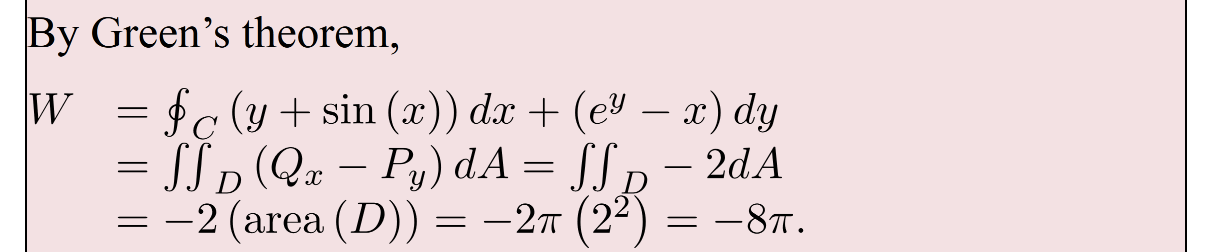
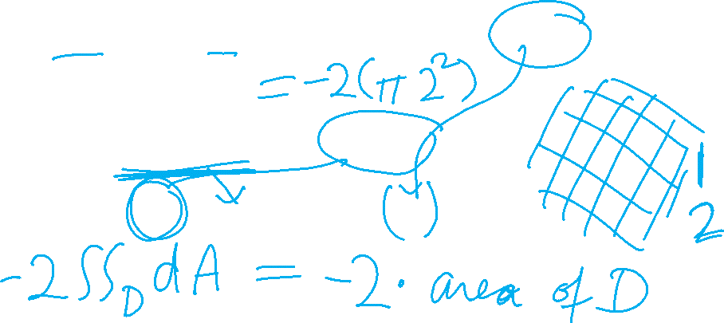
(
)
(
)
https://opentextbc.ca/calculusv3openstax/chapter/greens-theorem/

Slide 17
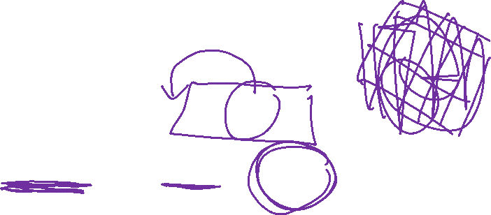
(
)
(
)
https://opentextbc.ca/calculusv3openstax/chapter/greens-theorem/

Slide 18

(
)
https://opentextbc.ca/calculusv3openstax/chapter/greens-theorem/

Slide 19
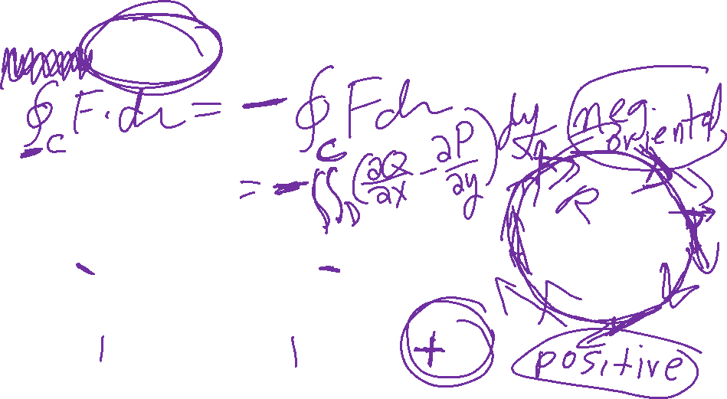
(
)
https://opentextbc.ca/calculusv3openstax/chapter/greens-theorem/

Slide 20
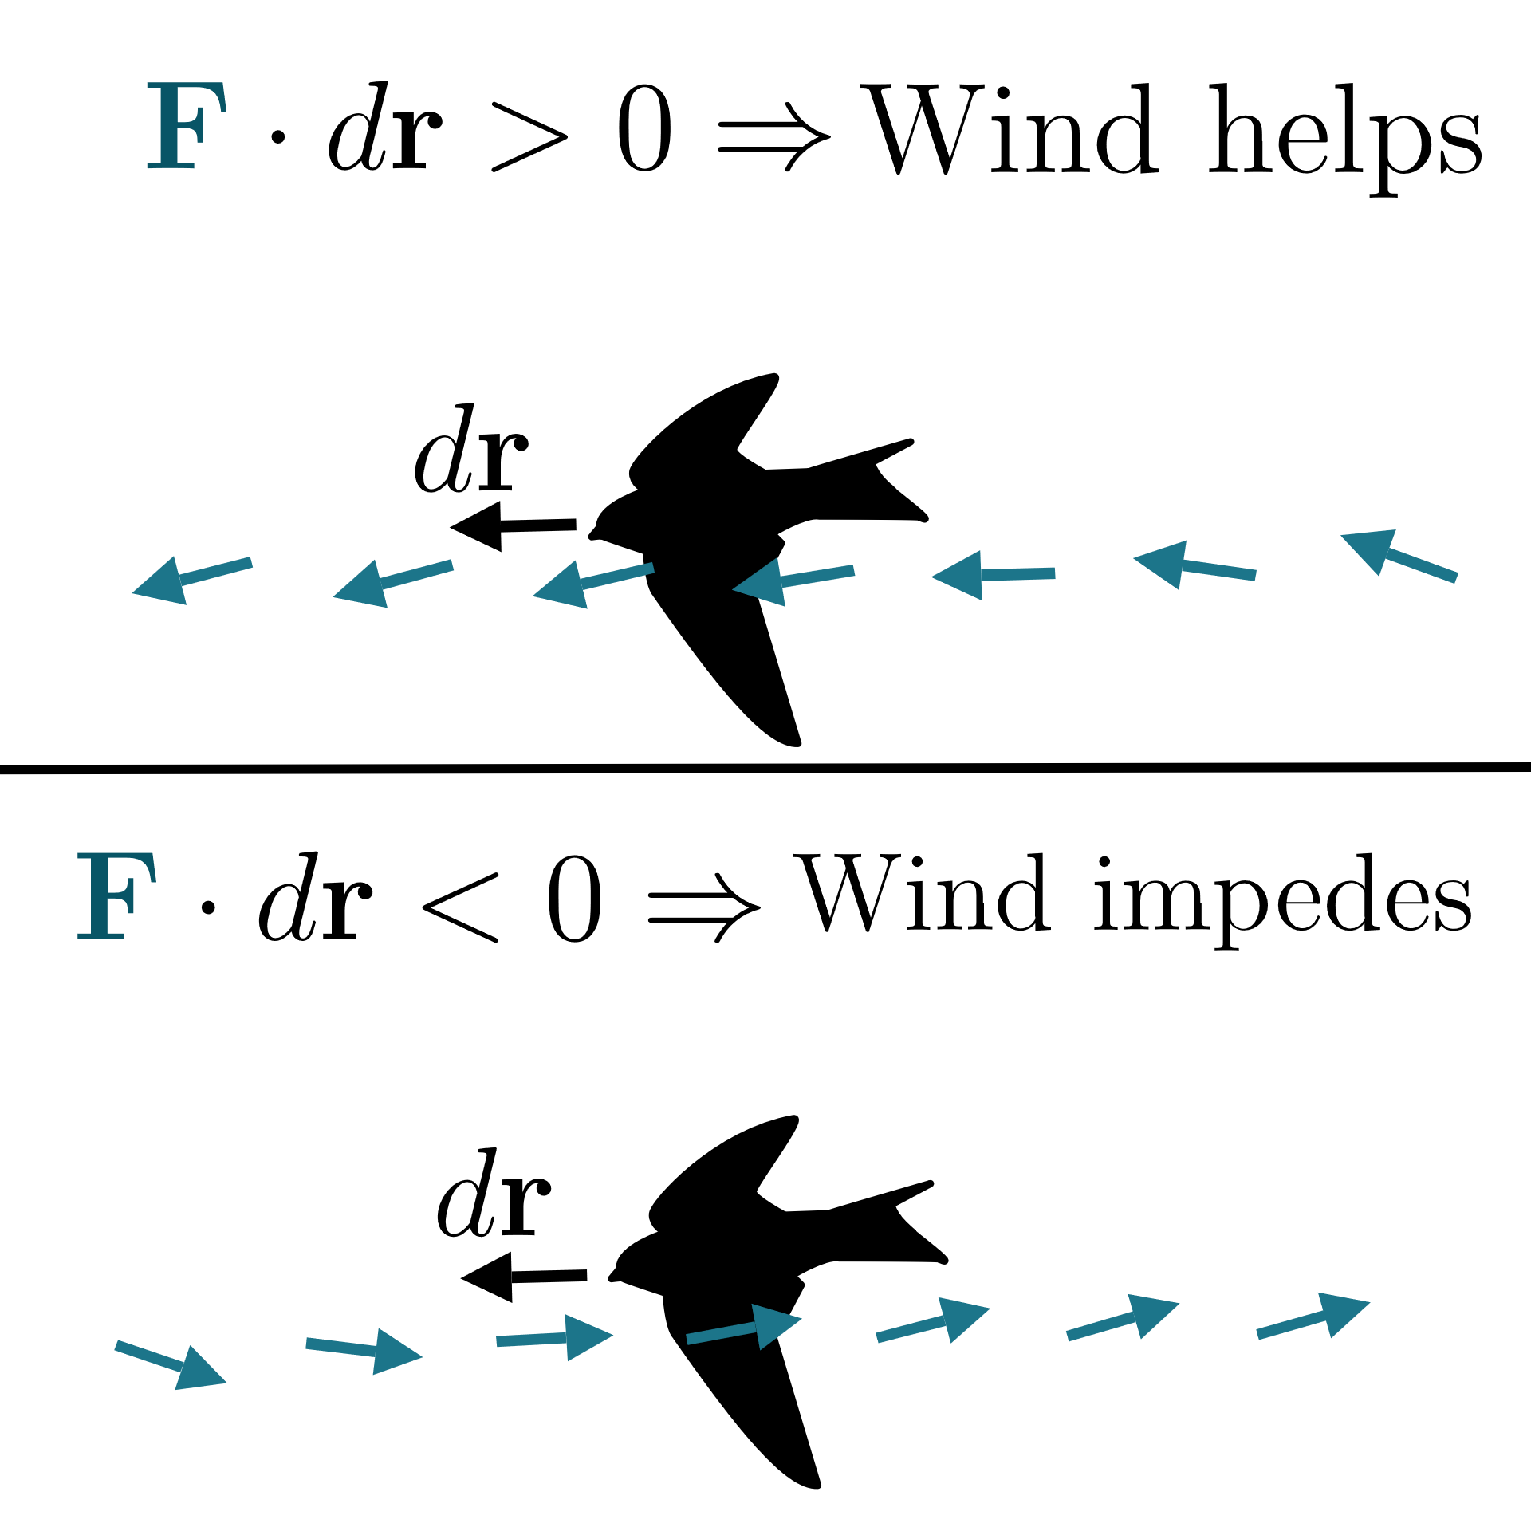
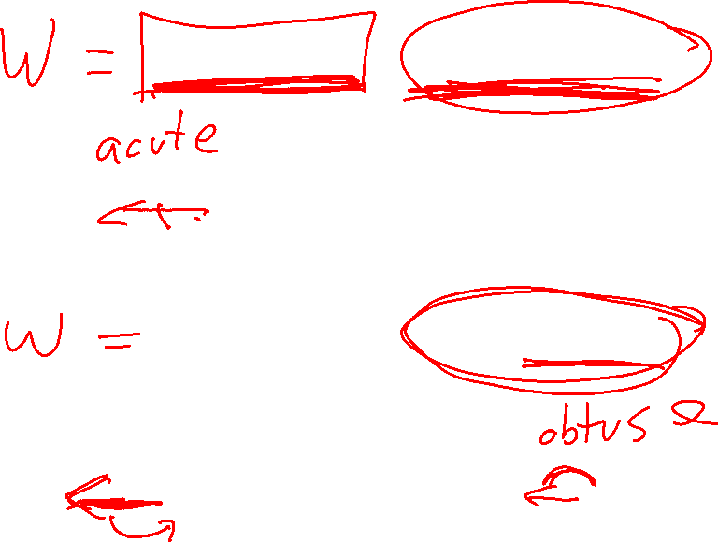
https://www.khanacademy.org/math/multivariable-calculus/greens-theorem-and-stokes-theorem/stokes-theorem-articles/a/stokes-theorem

Slide 21
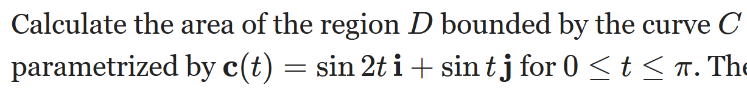
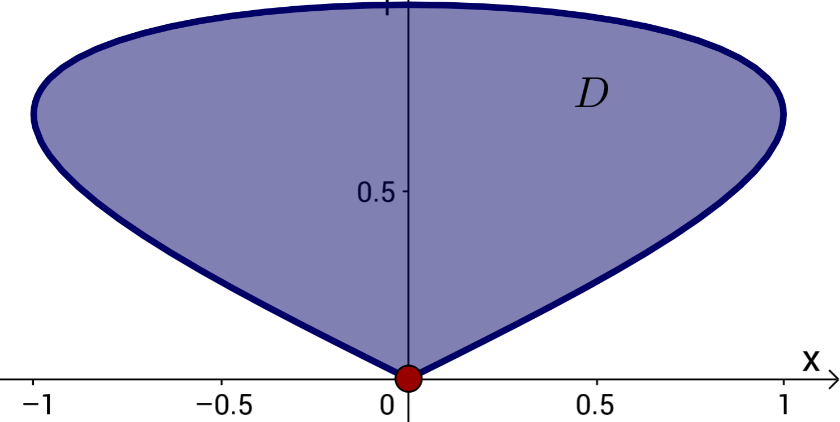
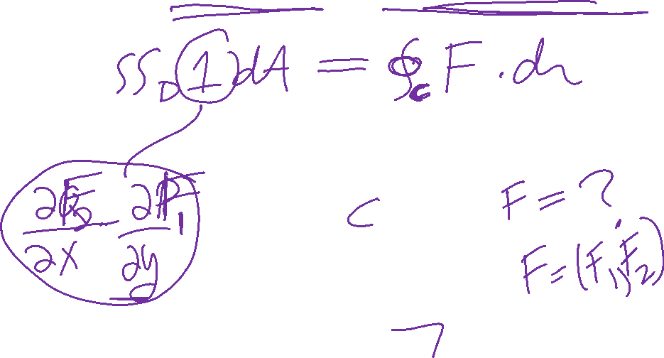
Can also use Green’s theorem to calculate double integrals.
Example: Find area of a region.
https://mathinsight.org/greens_theorem_find_area

Slide 22
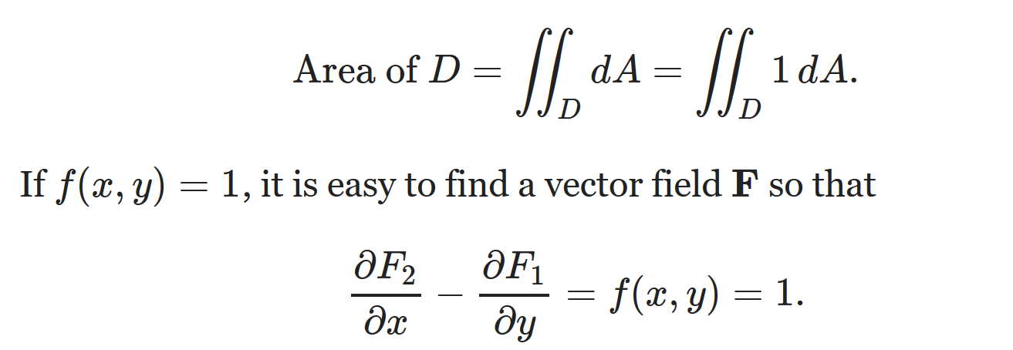
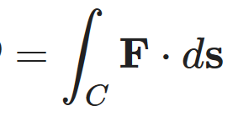
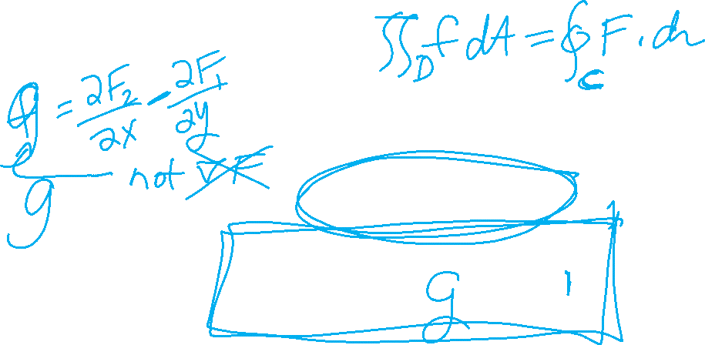
Can also use Green’s theorem to calculate double integrals.
Example: Find area of a region.

Slide 23
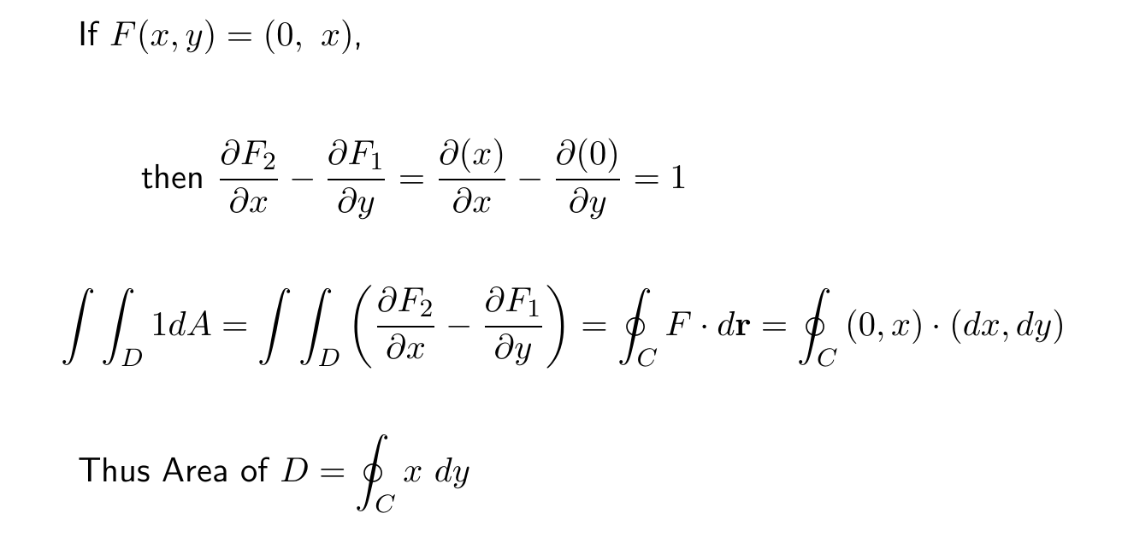
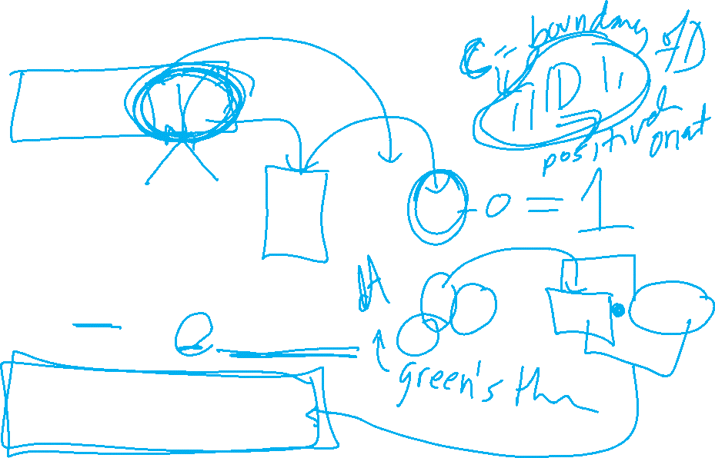
Can also use Green’s theorem to calculate double integrals.
Example: Find area of a region.

Slide 24
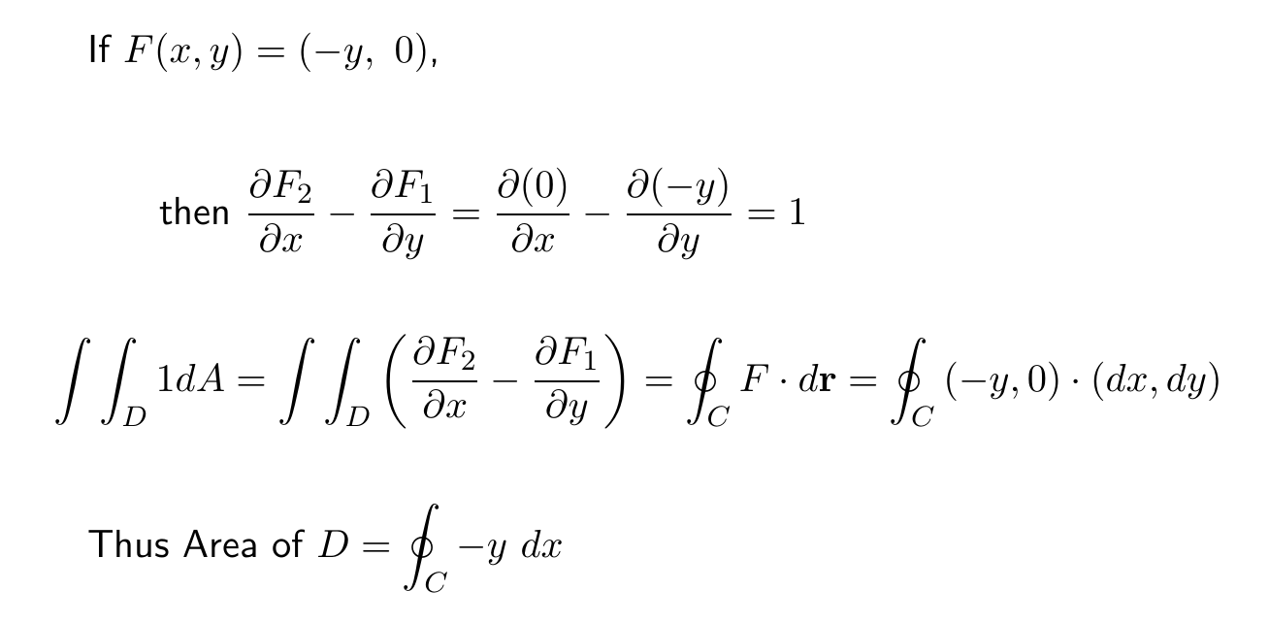
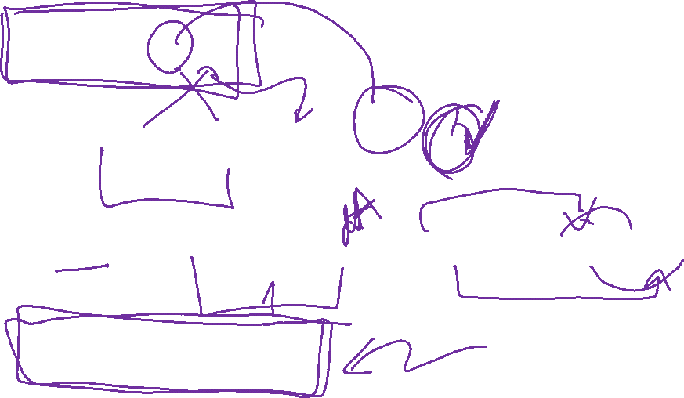
Can also use Green’s theorem to calculate double integrals.
Example: Find area of a region.

Slide 25
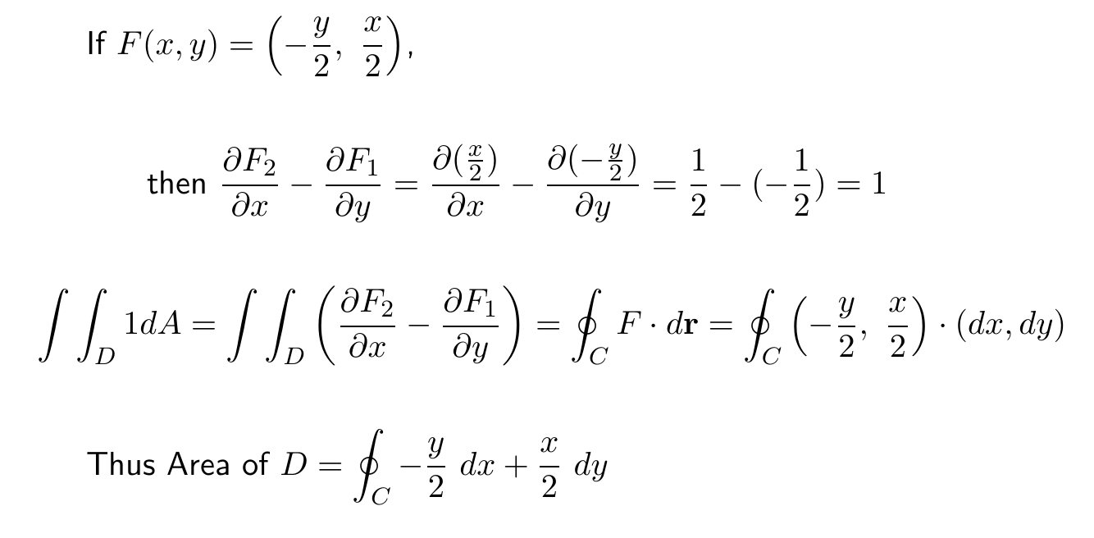
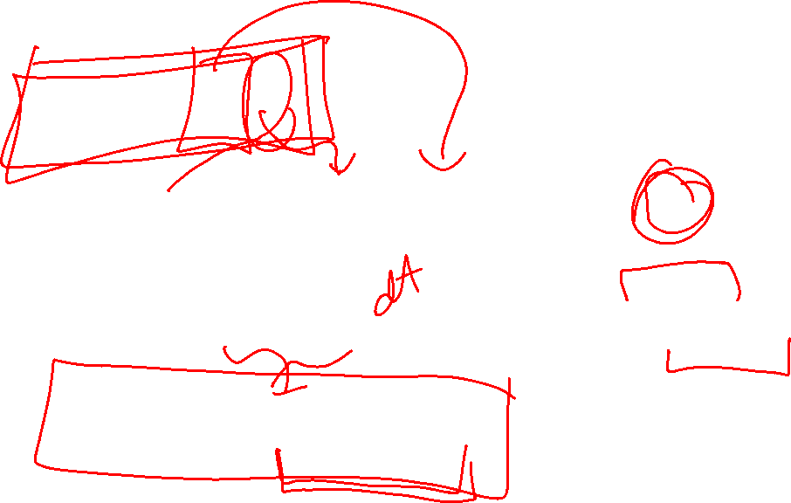
Can also use Green’s theorem to calculate double integrals.
Example: Find area of a region.

Slide 26
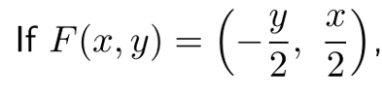
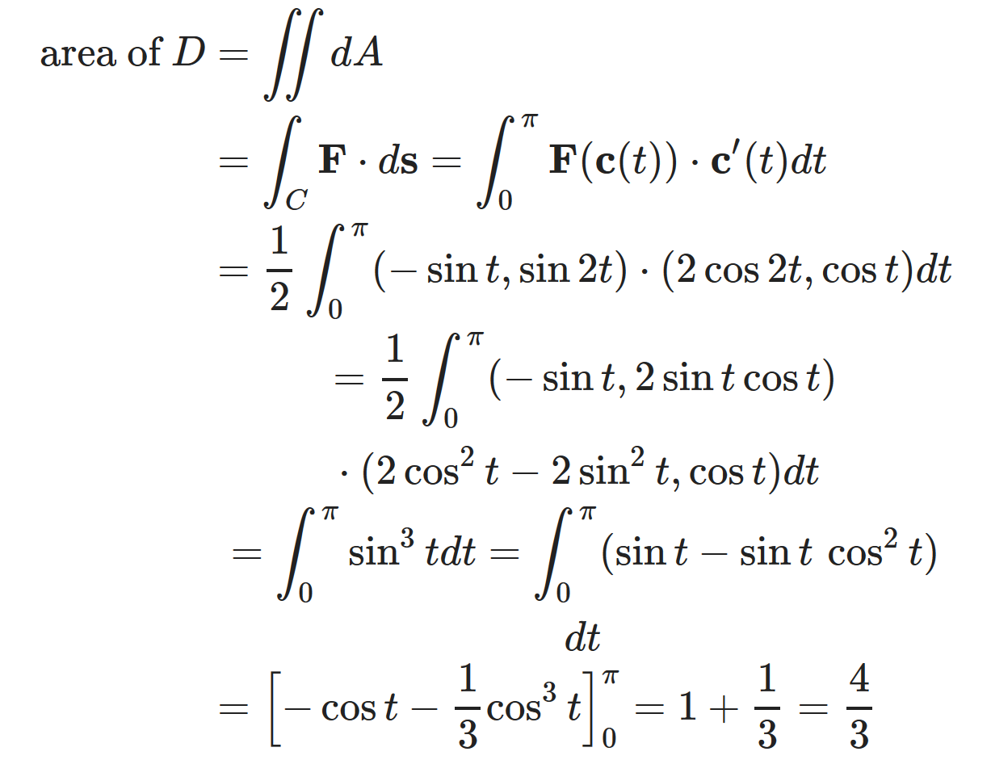

https://mathinsight.org/greens_theorem_find_area

Slide 27

https://mathinsight.org/greens_theorem_find_area

Slide 28

https://mathinsight.org/greens_theorem_find_area

Slide 29


(Section 14.4)
http://tutorial.math.lamar.edu/Classes/CalcIII/GreensTheorem.aspx
(Section 14.7)

Slide 30



Slide 31



Slide 32

http://tutorial.math.lamar.edu/Classes/CalcIII/GreensTheorem.aspx

Slide 33


Slide 34




https://byjus.com/maths/stokes-theorem/
http://tutorial.math.lamar.edu/Classes/CalcIII/StokesTheorem.aspx

