Slide 1
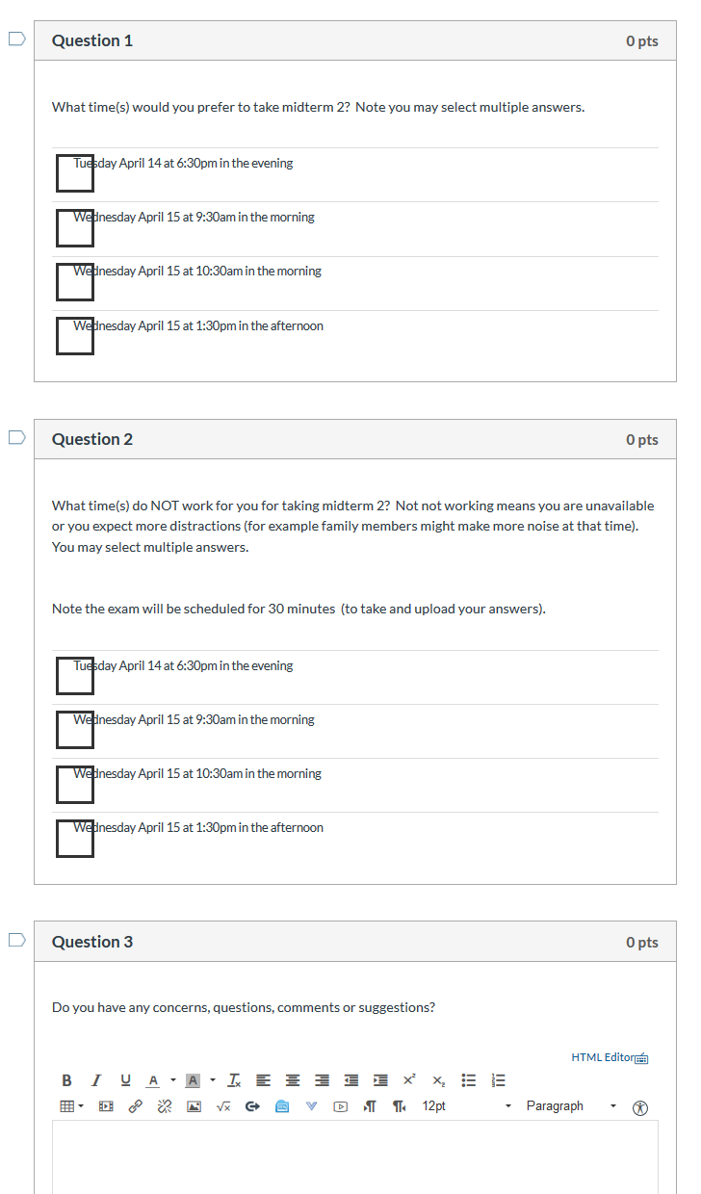
Survey due today at 5pm

Slide 2
http://homepage.divms.uiowa.edu/~idarcy/COURSES/3550/Spring20/online.html

Slide 3
http://tutorial.math.lamar.edu/Classes/CalcIII/GreensTheorem.aspx
http://ltcconline.net/greenl/courses/202/vectorIntegration/greensTheorem.htm

Slide 4
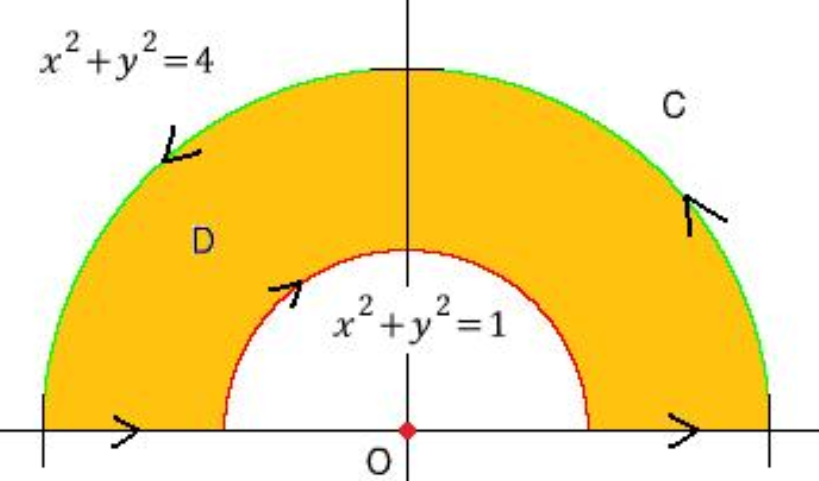
http://tutorial.math.lamar.edu/Classes/CalcIII/GreensTheorem.aspx
http://blog.naver.com/PostView.nhn?blogId=mindo1103&logNo=90179767504&parentCategoryNo=35&categoryNo=&viewDate=&isShowPopularPosts=true&from=search

Slide 5
http://tutorial.math.lamar.edu/Classes/CalcIII/GreensTheorem.aspx
http://ltcconline.net/greenl/courses/202/vectorIntegration/greensTheorem.htm

Slide 6
http://tutorial.math.lamar.edu/Classes/CalcIII/GreensTheorem.aspx
NOT closed
https://mathinsight.org/

Slide 7
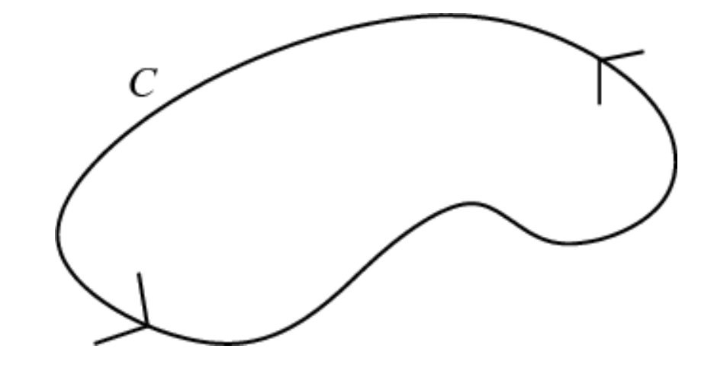
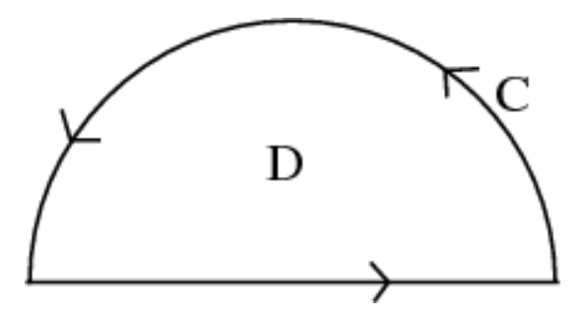
http://tutorial.math.lamar.edu/Classes/CalcIII/GreensTheorem.aspx
closed
https://mathinsight.org/

Slide 8
http://tutorial.math.lamar.edu/Classes/CalcIII/GreensTheorem.aspx
closed
https://mathinsight.org/

Slide 9
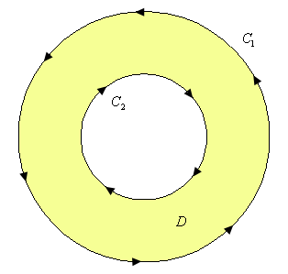
http://tutorial.math.lamar.edu/Classes/CalcIII/GreensTheorem.aspx
http://tutorial.math.lamar.edu/Classes/CalcIII/GreensTheorem.aspx

Slide 10
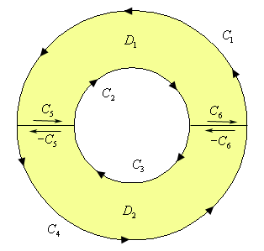
http://tutorial.math.lamar.edu/Classes/CalcIII/GreensTheorem.aspx
http://tutorial.math.lamar.edu/Classes/CalcIII/GreensTheorem.aspx

Slide 11
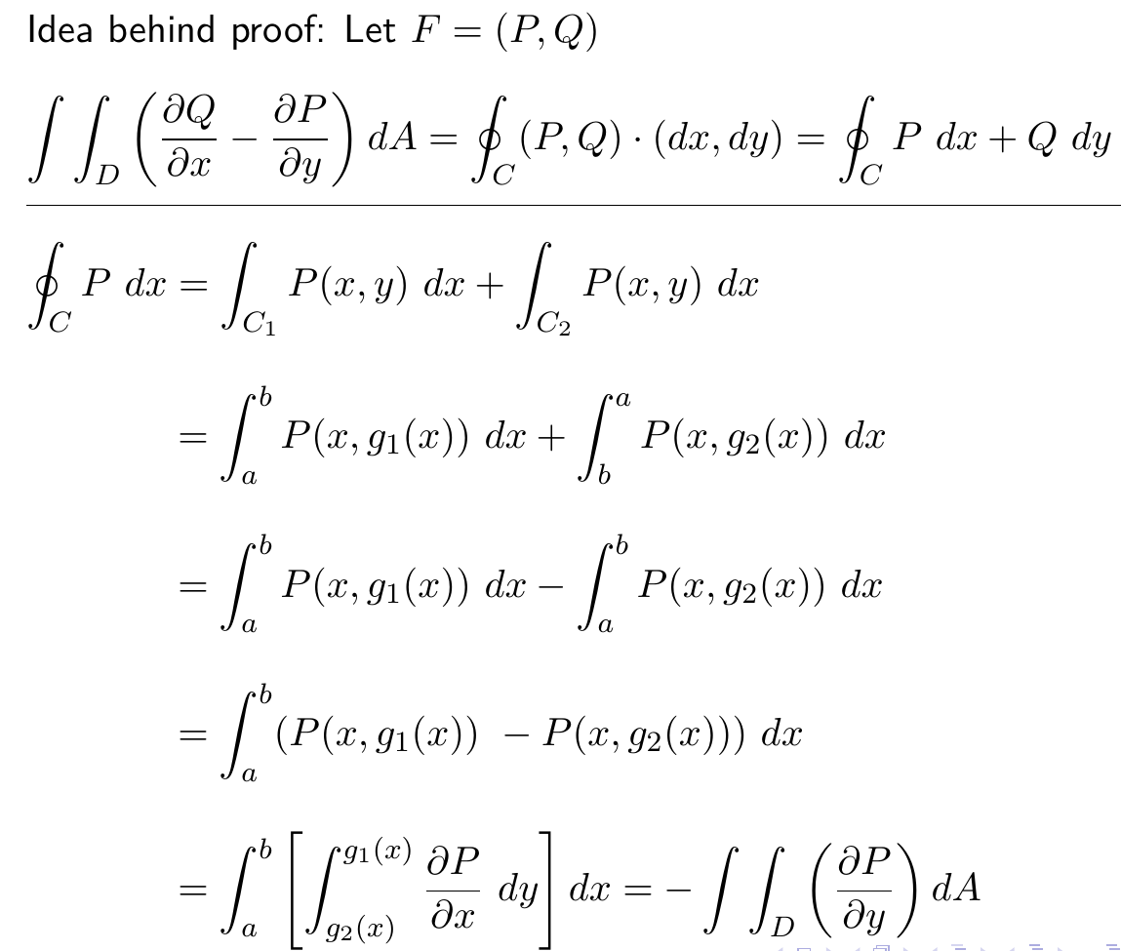
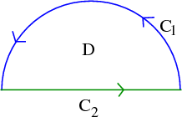
http://tutorial.math.lamar.edu/Classes/CalcIII/GreensTheorem.aspx

Slide 12
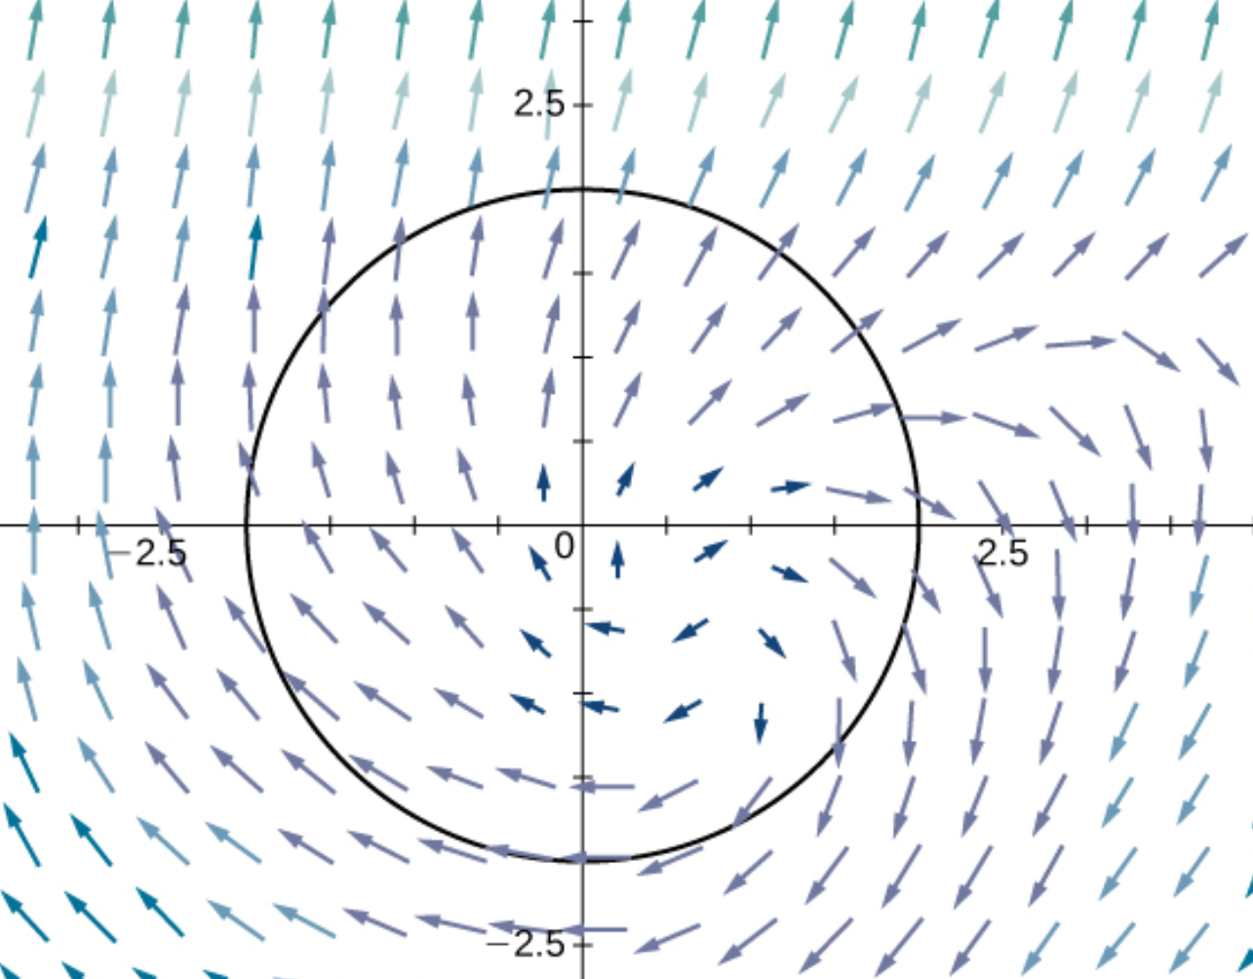
(
)
https://opentextbc.ca/calculusv3openstax/chapter/greens-theorem/

Slide 13
(
)
https://opentextbc.ca/calculusv3openstax/chapter/greens-theorem/

Slide 14
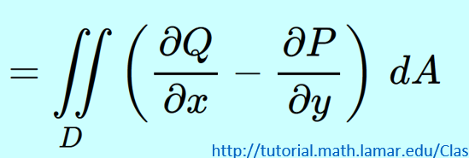
(
)
https://opentextbc.ca/calculusv3openstax/chapter/greens-theorem/

Slide 15
(
)
(
)
https://opentextbc.ca/calculusv3openstax/chapter/greens-theorem/

Slide 16
(
)
(
)
https://opentextbc.ca/calculusv3openstax/chapter/greens-theorem/

Slide 17
(
)
https://opentextbc.ca/calculusv3openstax/chapter/greens-theorem/

Slide 18
(
)
https://opentextbc.ca/calculusv3openstax/chapter/greens-theorem/

Slide 19
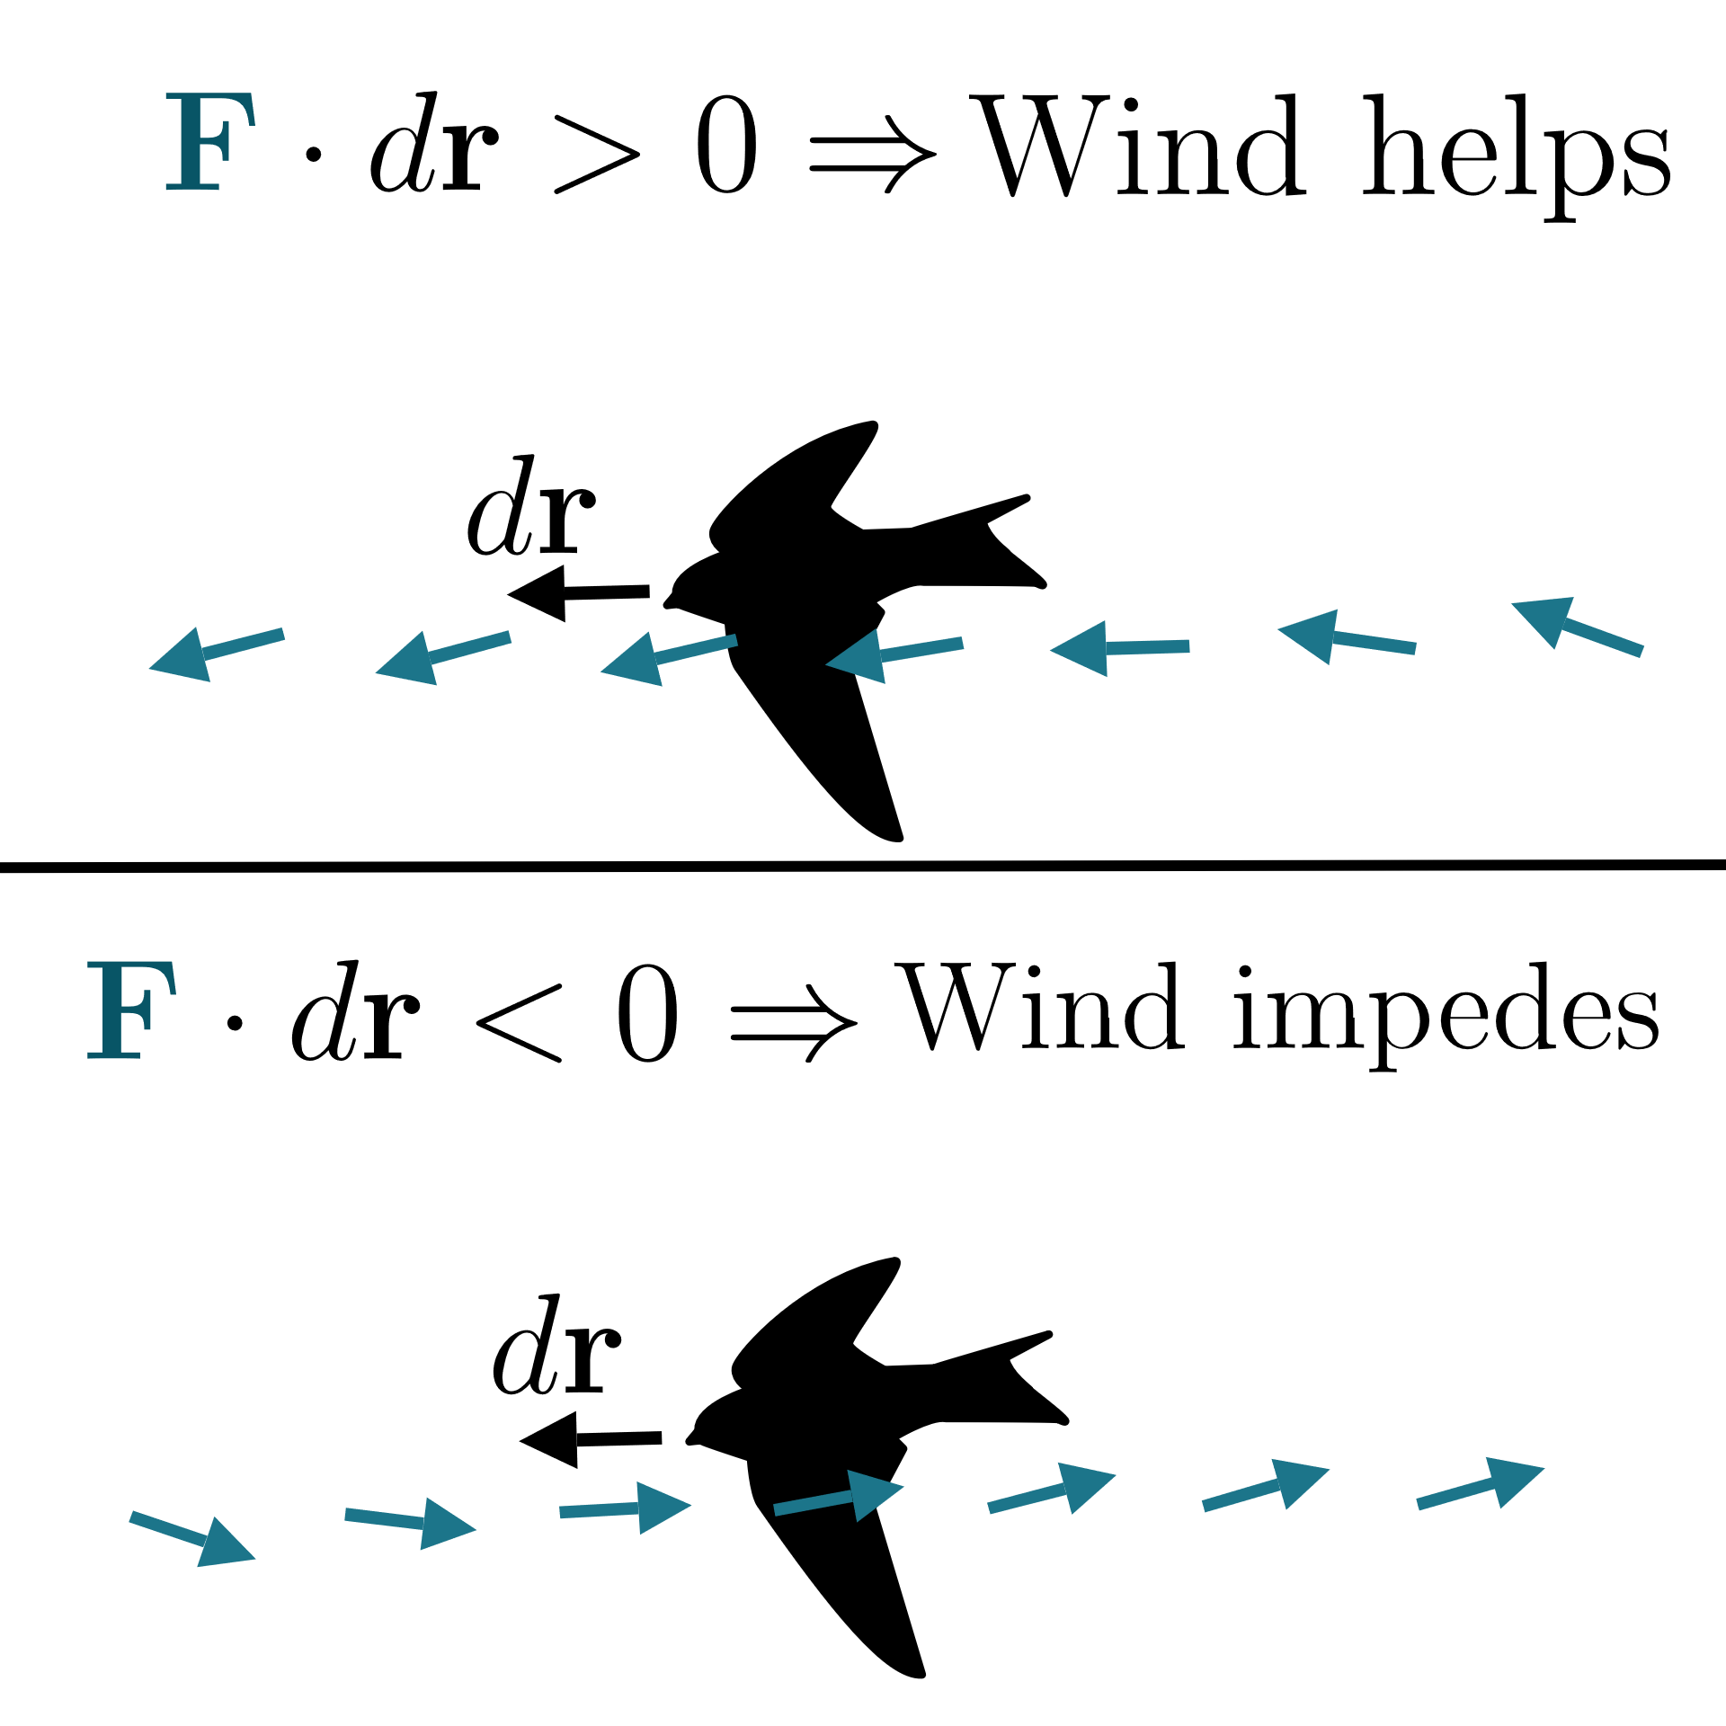
https://www.khanacademy.org/math/multivariable-calculus/greens-theorem-and-stokes-theorem/stokes-theorem-articles/a/stokes-theorem

Slide 20
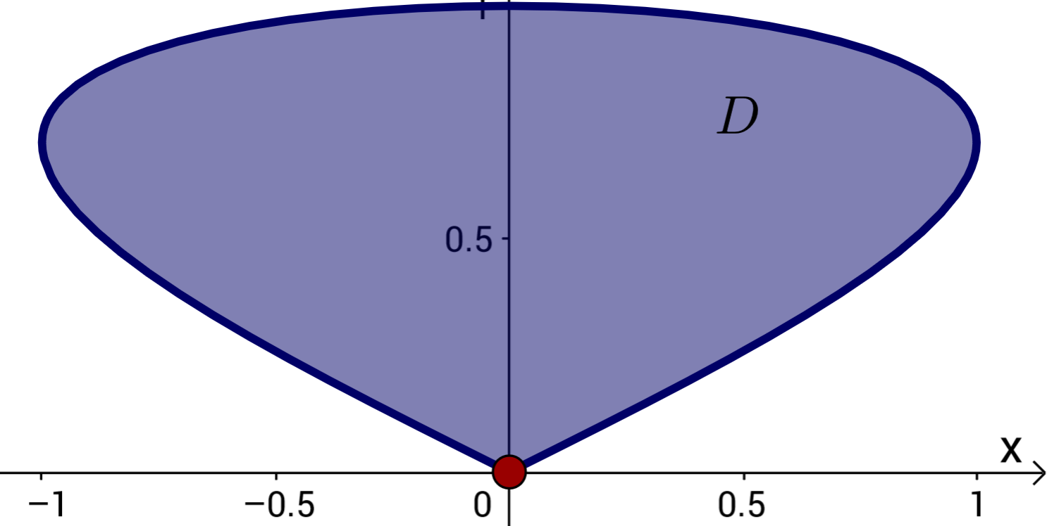
Can also use Green’s theorem to calculate double integrals.
Example: Find area of a region.
https://mathinsight.org/greens_theorem_find_area

Slide 21
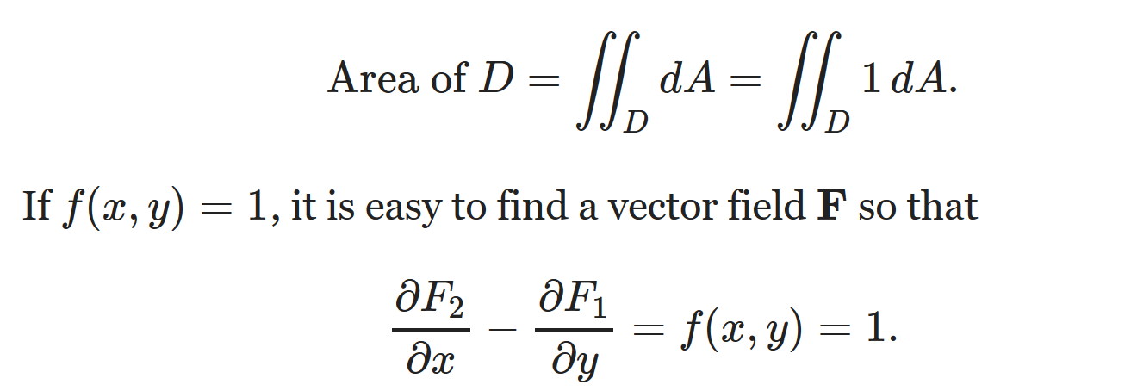
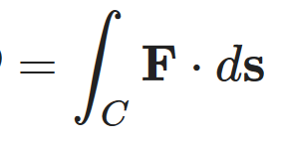
Can also use Green’s theorem to calculate double integrals.
Example: Find area of a region.

Slide 22
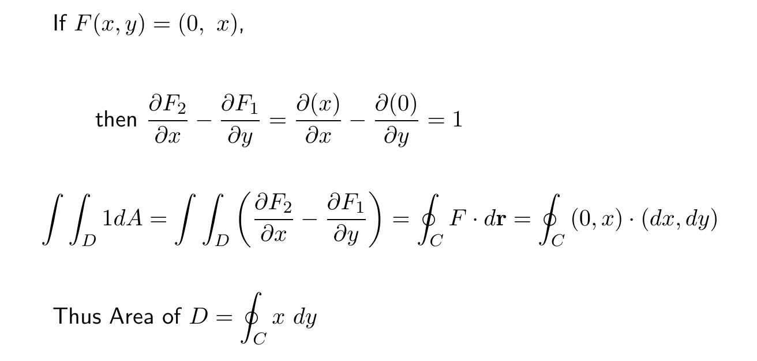
Can also use Green’s theorem to calculate double integrals.
Example: Find area of a region.

Slide 23
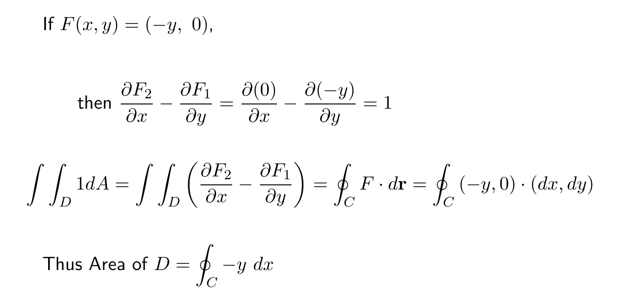
Can also use Green’s theorem to calculate double integrals.
Example: Find area of a region.

Slide 24
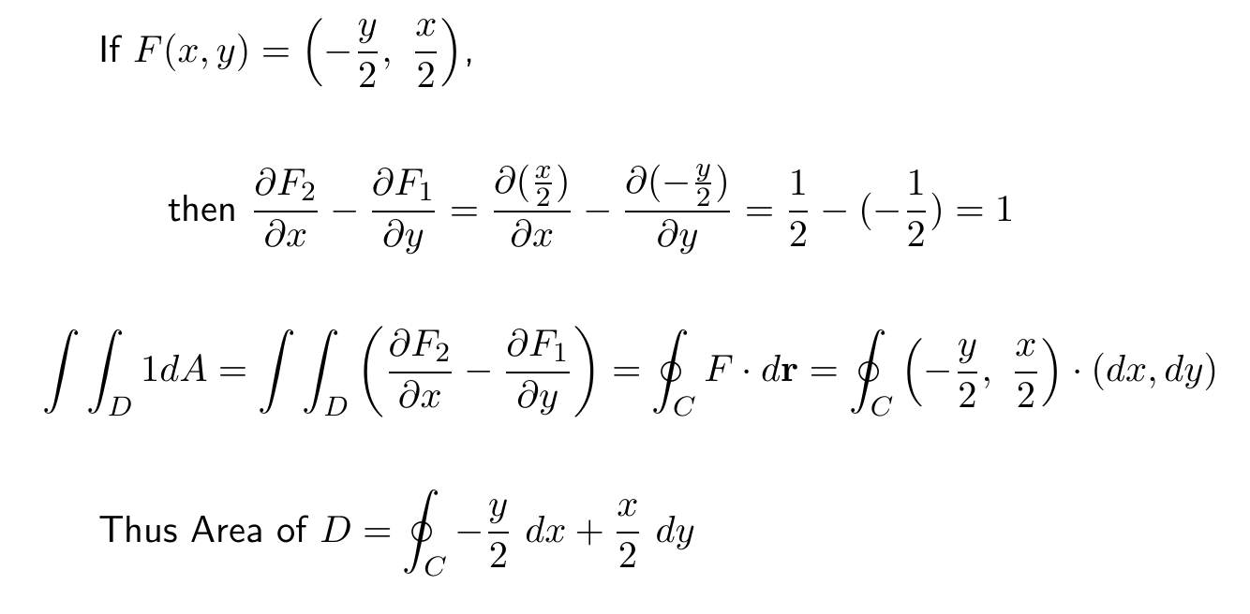
Can also use Green’s theorem to calculate double integrals.
Example: Find area of a region.

Slide 25
https://mathinsight.org/greens_theorem_find_area

Slide 26
https://mathinsight.org/greens_theorem_find_area

Slide 27
https://mathinsight.org/greens_theorem_find_area

Slide 28
(Section 14.4)
http://tutorial.math.lamar.edu/Classes/CalcIII/GreensTheorem.aspx
(Section 14.7)

Slide 29
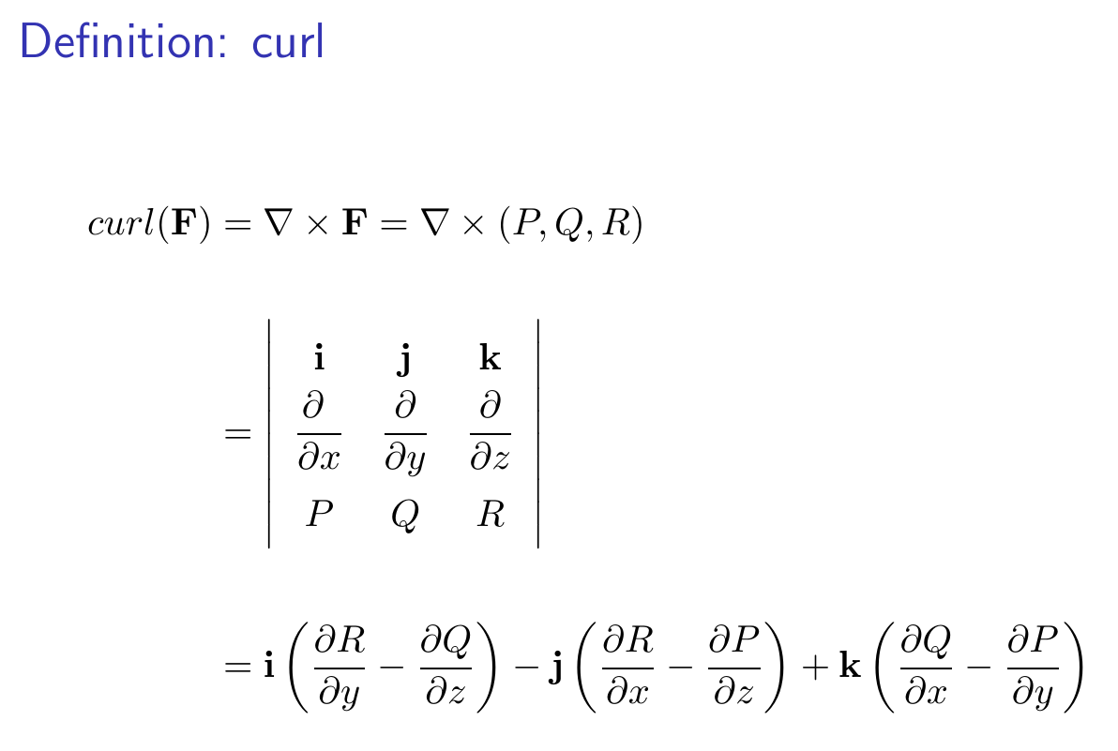

Slide 30
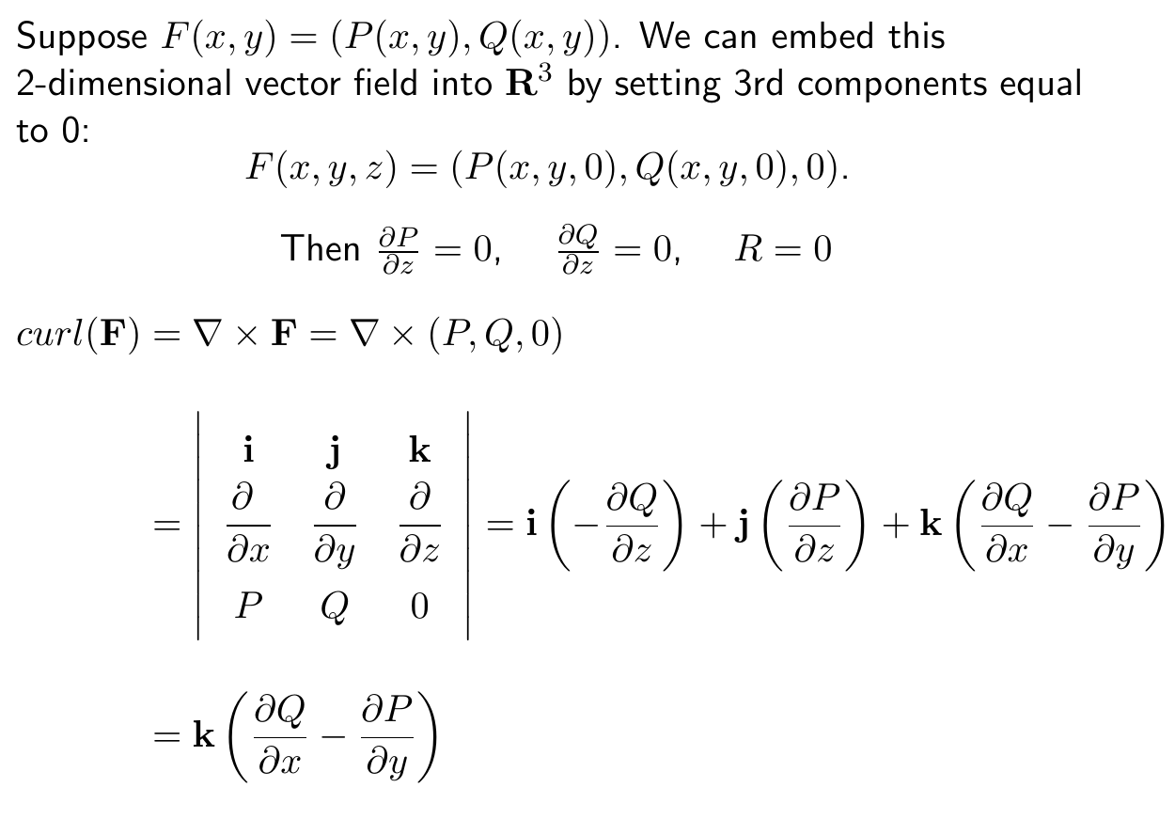

Slide 31
http://tutorial.math.lamar.edu/Classes/CalcIII/GreensTheorem.aspx

Slide 32
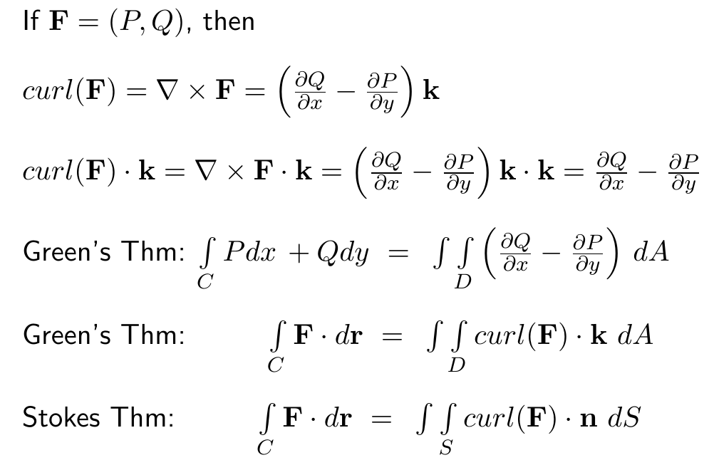

Slide 33
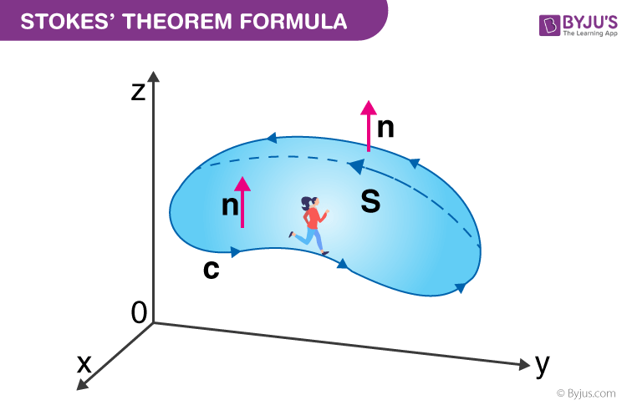
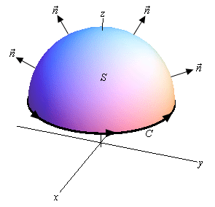
https://byjus.com/maths/stokes-theorem/
http://tutorial.math.lamar.edu/Classes/CalcIII/StokesTheorem.aspx

