Slide 1
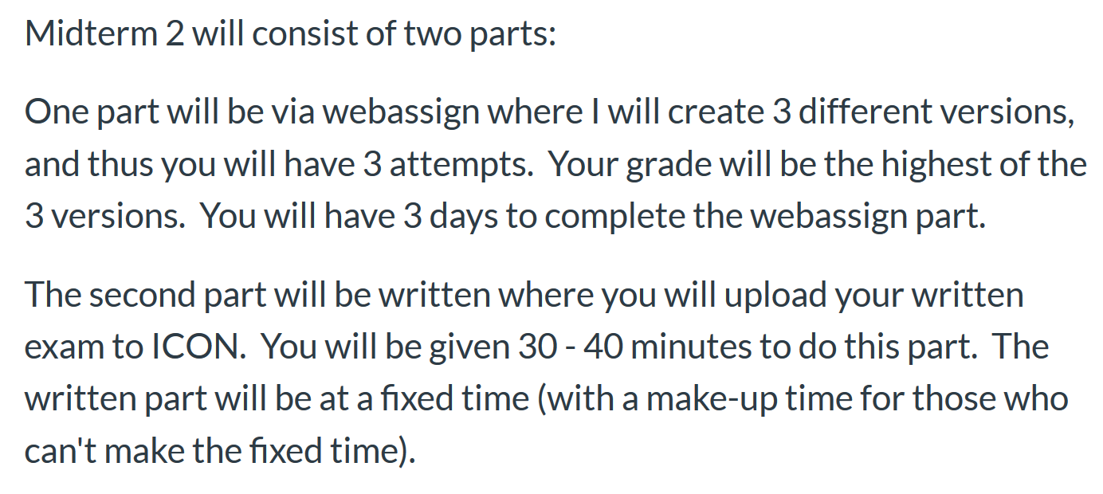
Please take ICON survey today

Slide 2
Quiz 3 due today
Quiz 4 over 13.8 and ?
If you need an extension for quiz 3 or HW 8, e-mail me.
Videos are posted under UICapture

Slide 3
Section 14.3: Path Independence

Slide 5
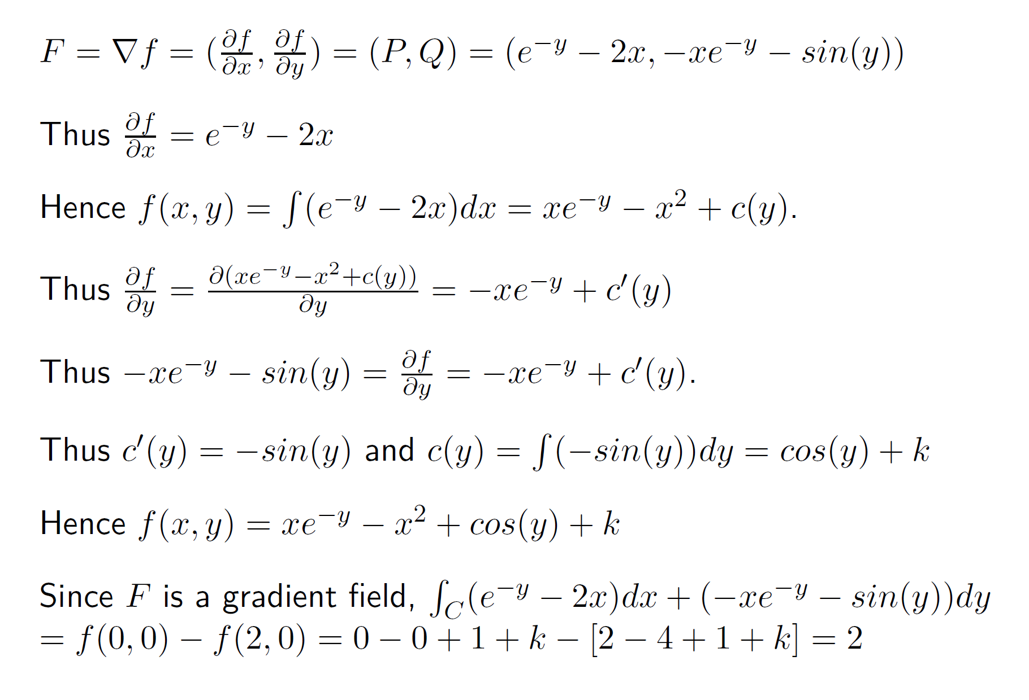

Slide 7
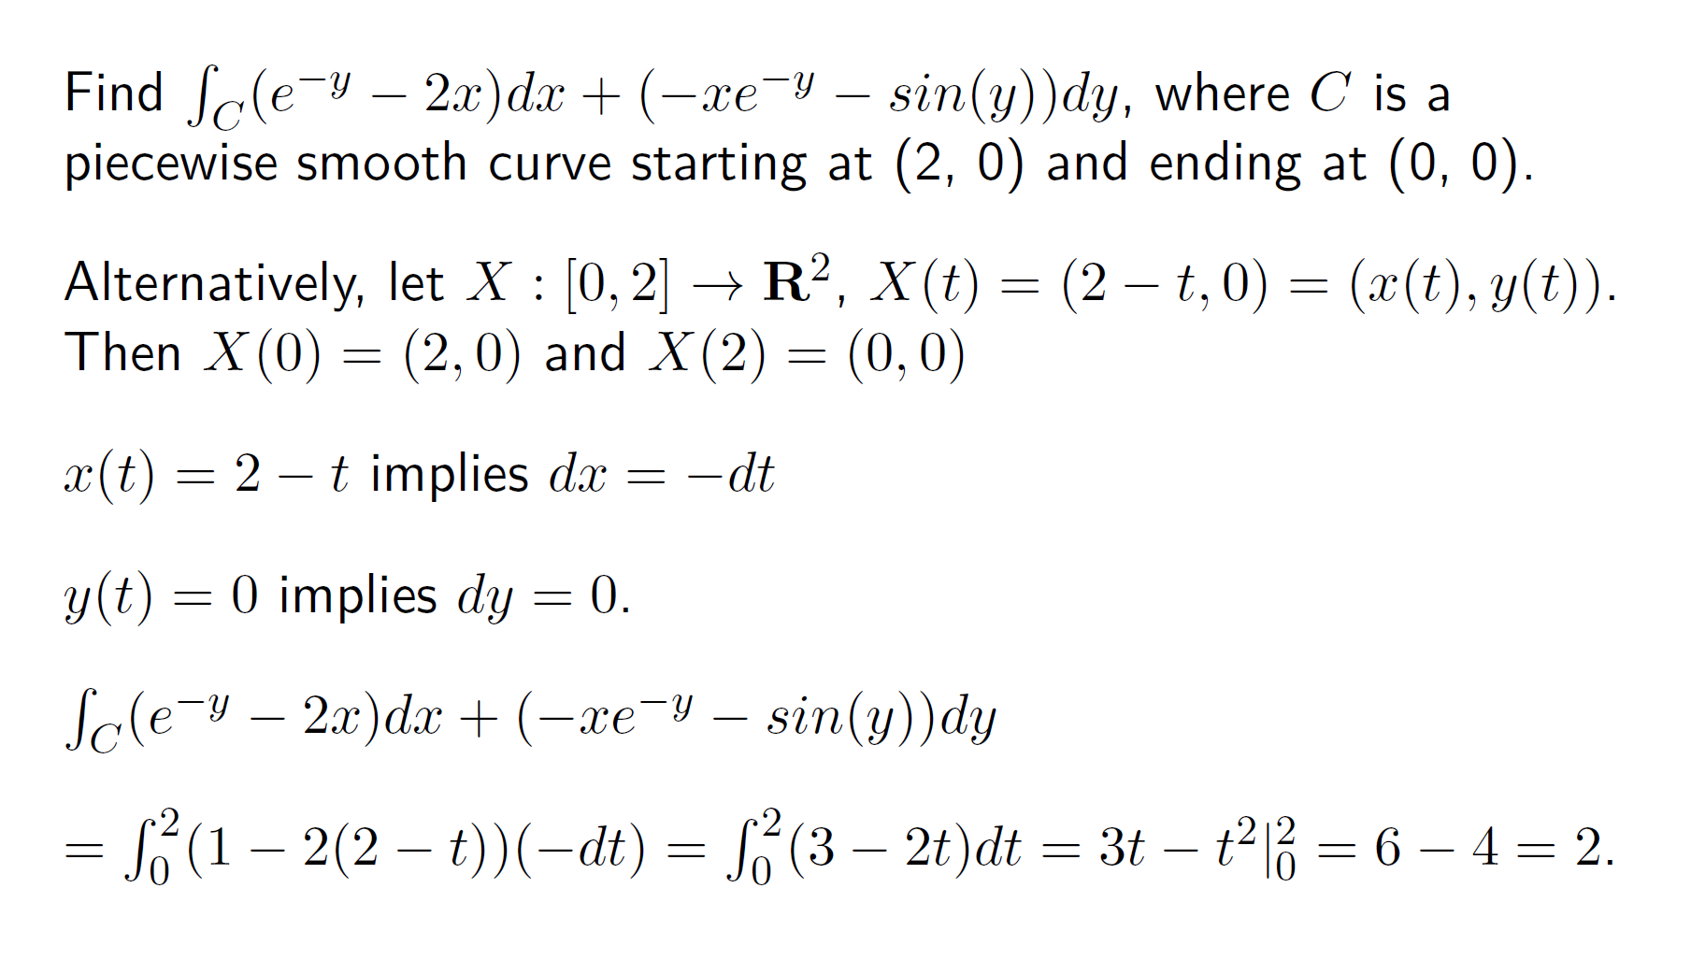

Slide 8
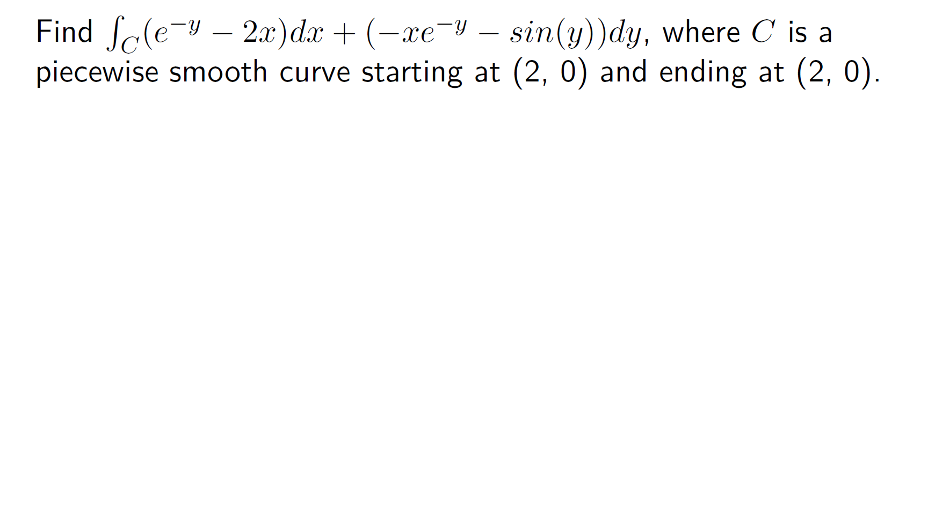

Slide 10
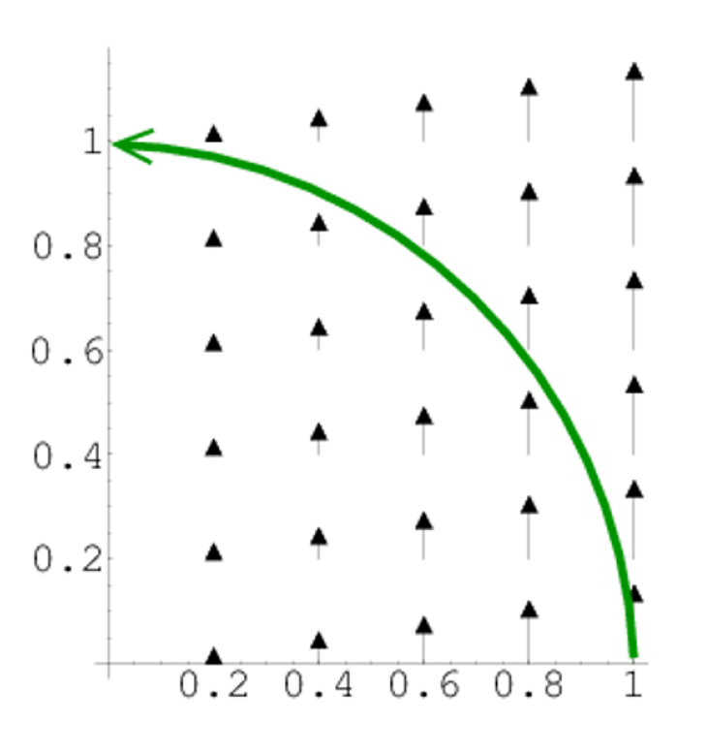

Slide 12
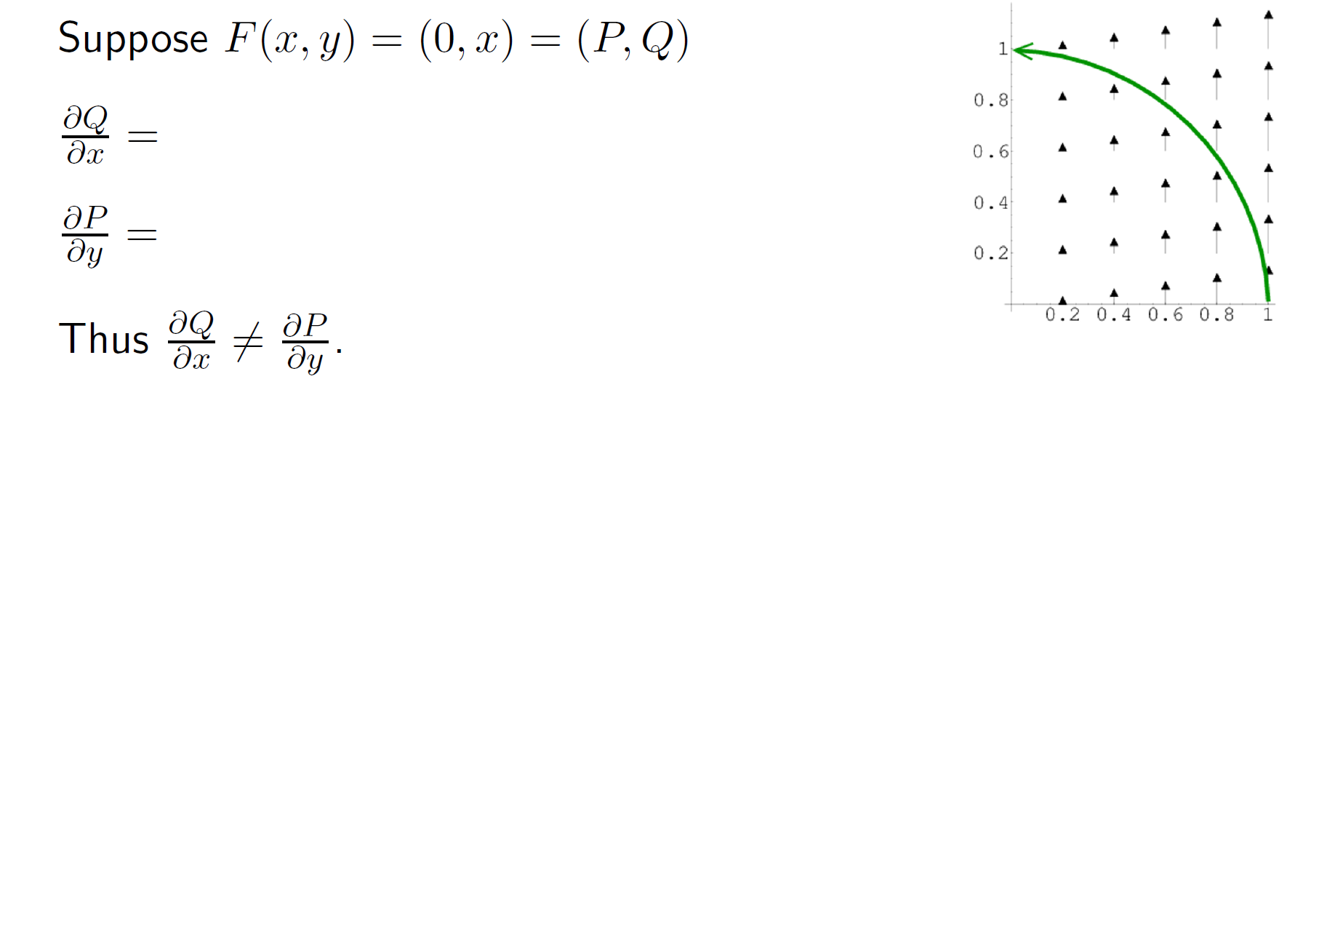

Slide 21
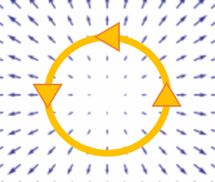
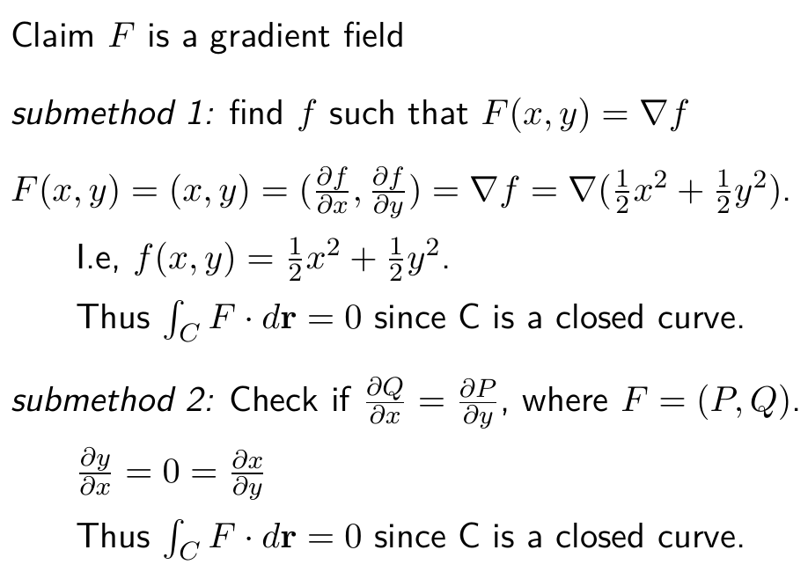

Slide 22
http://tutorial.math.lamar.edu/Classes/CalcIII/GreensTheorem.aspx

Slide 23
http://tutorial.math.lamar.edu/Classes/CalcIII/GreensTheorem.aspx
http://ltcconline.net/greenl/courses/202/vectorIntegration/greensTheorem.htm

Slide 24
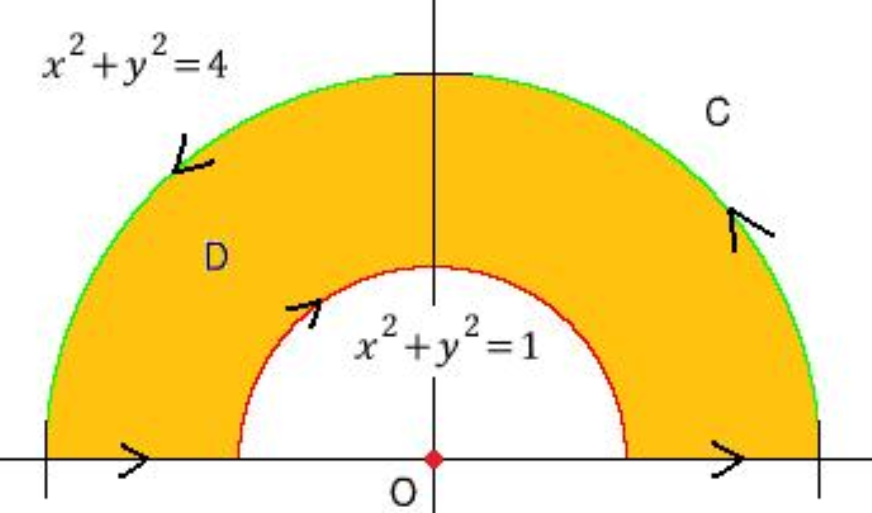
http://tutorial.math.lamar.edu/Classes/CalcIII/GreensTheorem.aspx
http://blog.naver.com/PostView.nhn?blogId=mindo1103&logNo=90179767504&parentCategoryNo=35&categoryNo=&viewDate=&isShowPopularPosts=true&from=search

Slide 25
http://tutorial.math.lamar.edu/Classes/CalcIII/GreensTheorem.aspx
http://ltcconline.net/greenl/courses/202/vectorIntegration/greensTheorem.htm

Slide 26
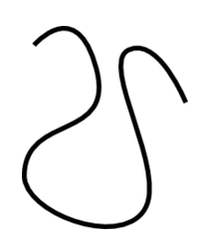
http://tutorial.math.lamar.edu/Classes/CalcIII/GreensTheorem.aspx
NOT closed
https://mathinsight.org/

Slide 27
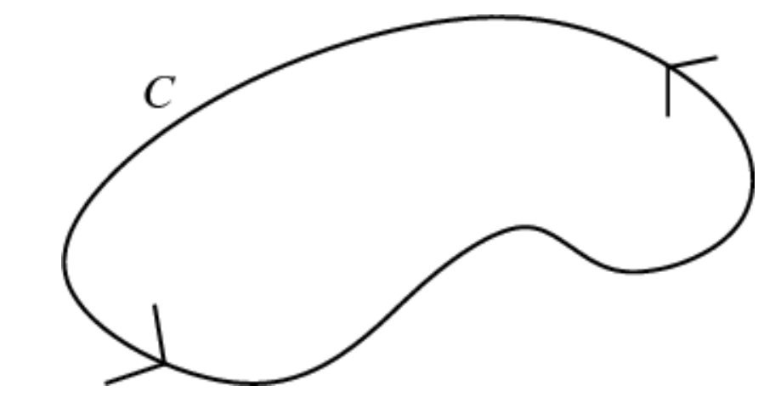
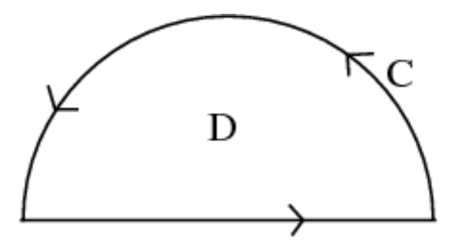
http://tutorial.math.lamar.edu/Classes/CalcIII/GreensTheorem.aspx
closed
https://mathinsight.org/

Slide 28
http://tutorial.math.lamar.edu/Classes/CalcIII/GreensTheorem.aspx
closed
https://mathinsight.org/

Slide 29
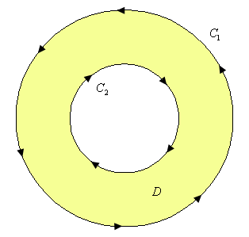
http://tutorial.math.lamar.edu/Classes/CalcIII/GreensTheorem.aspx
http://tutorial.math.lamar.edu/Classes/CalcIII/GreensTheorem.aspx

Slide 30
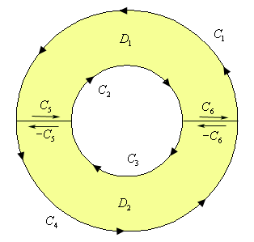
http://tutorial.math.lamar.edu/Classes/CalcIII/GreensTheorem.aspx
http://tutorial.math.lamar.edu/Classes/CalcIII/GreensTheorem.aspx

Slide 31
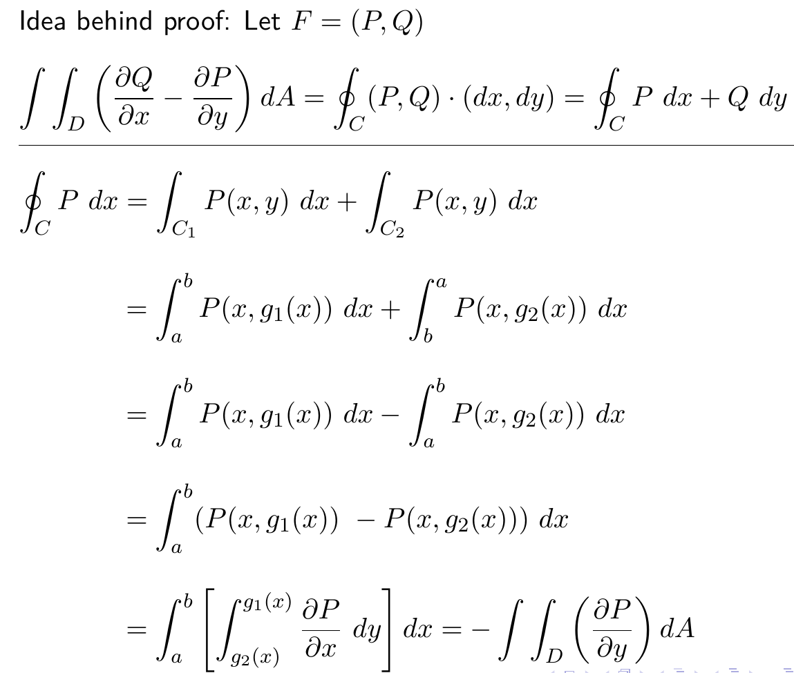
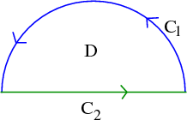
http://tutorial.math.lamar.edu/Classes/CalcIII/GreensTheorem.aspx

Slide 32
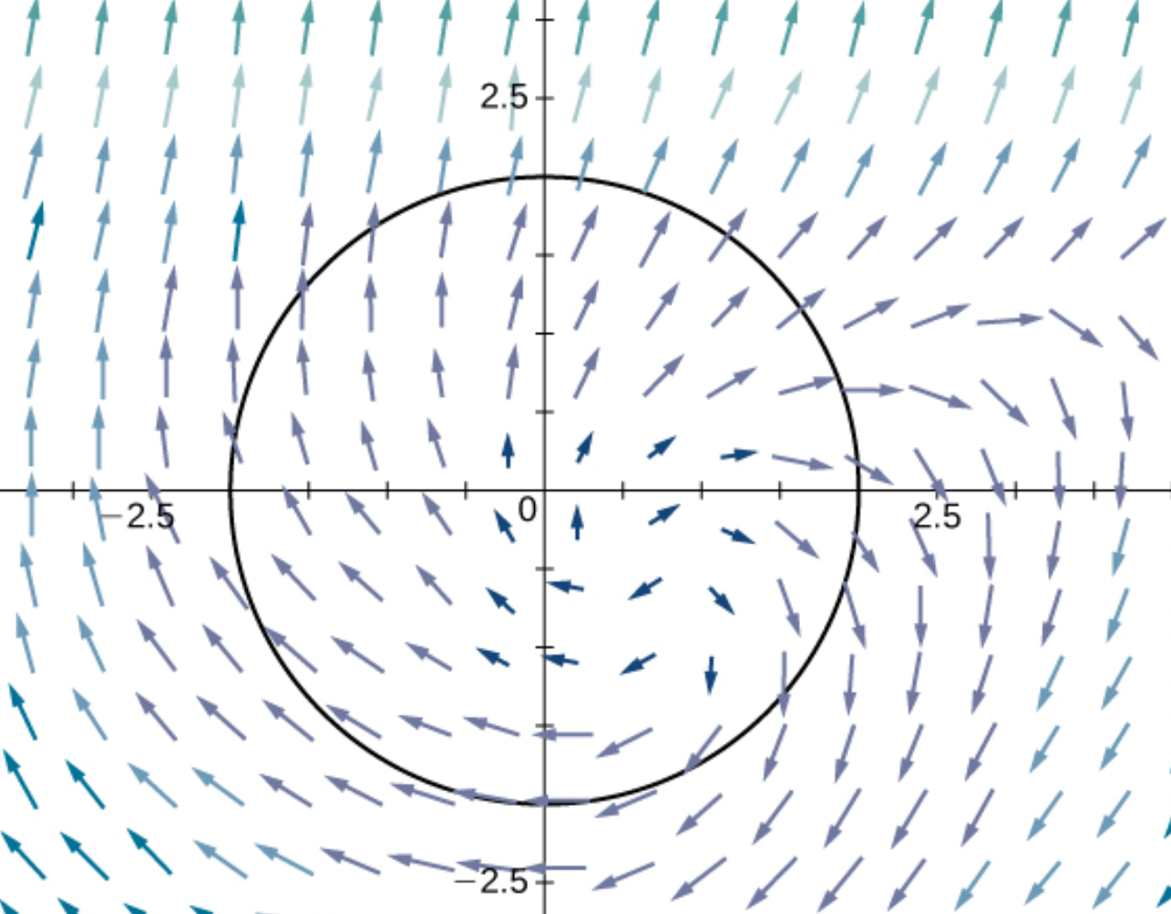
(
)
https://opentextbc.ca/calculusv3openstax/chapter/greens-theorem/

Slide 33
(
)
https://opentextbc.ca/calculusv3openstax/chapter/greens-theorem/

Slide 34
https://opentextbc.ca/calculusv3openstax/chapter/greens-theorem/

Slide 35
https://opentextbc.ca/calculusv3openstax/chapter/greens-theorem/

Slide 36
https://opentextbc.ca/calculusv3openstax/chapter/greens-theorem/

Slide 37
(
)
https://opentextbc.ca/calculusv3openstax/chapter/greens-theorem/

Slide 38
(
)
https://opentextbc.ca/calculusv3openstax/chapter/greens-theorem/

