Slide 1
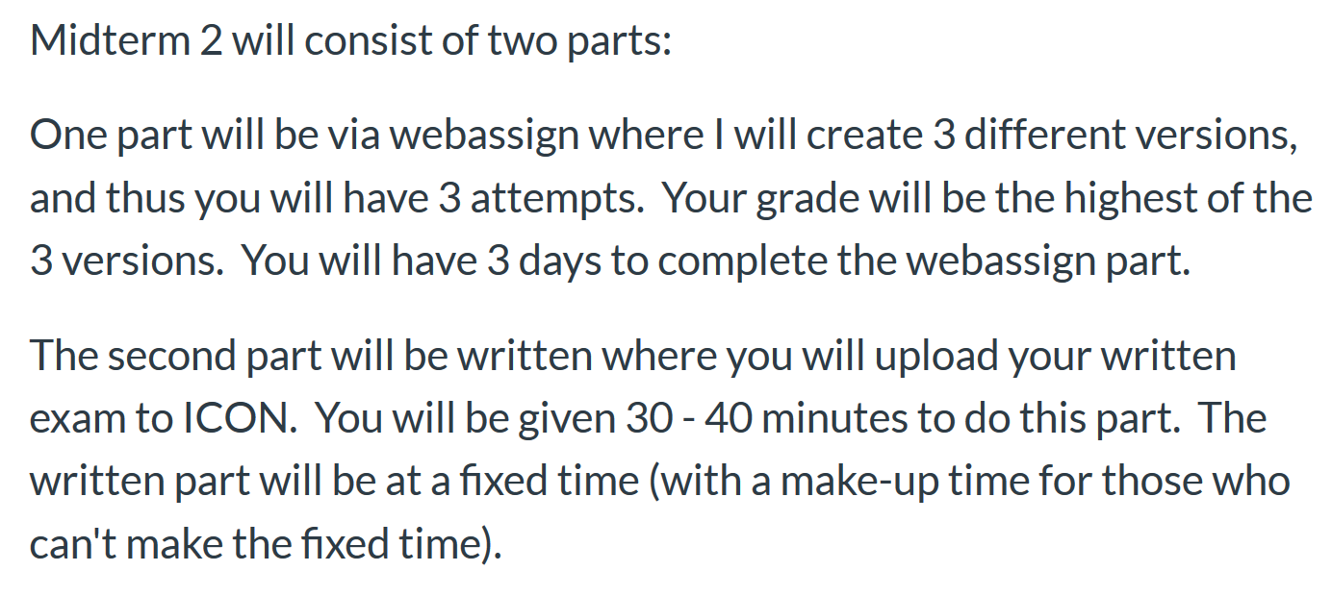
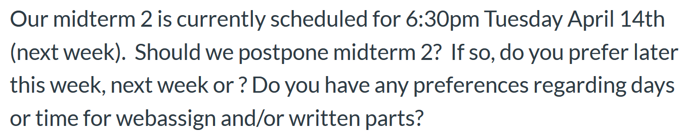
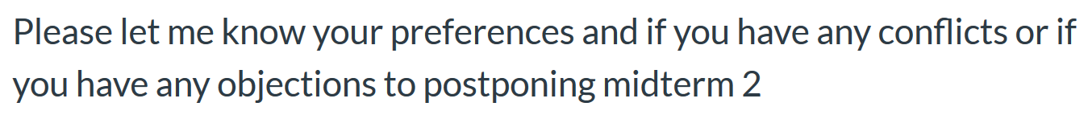
Please take ICON survey today

Slide 2
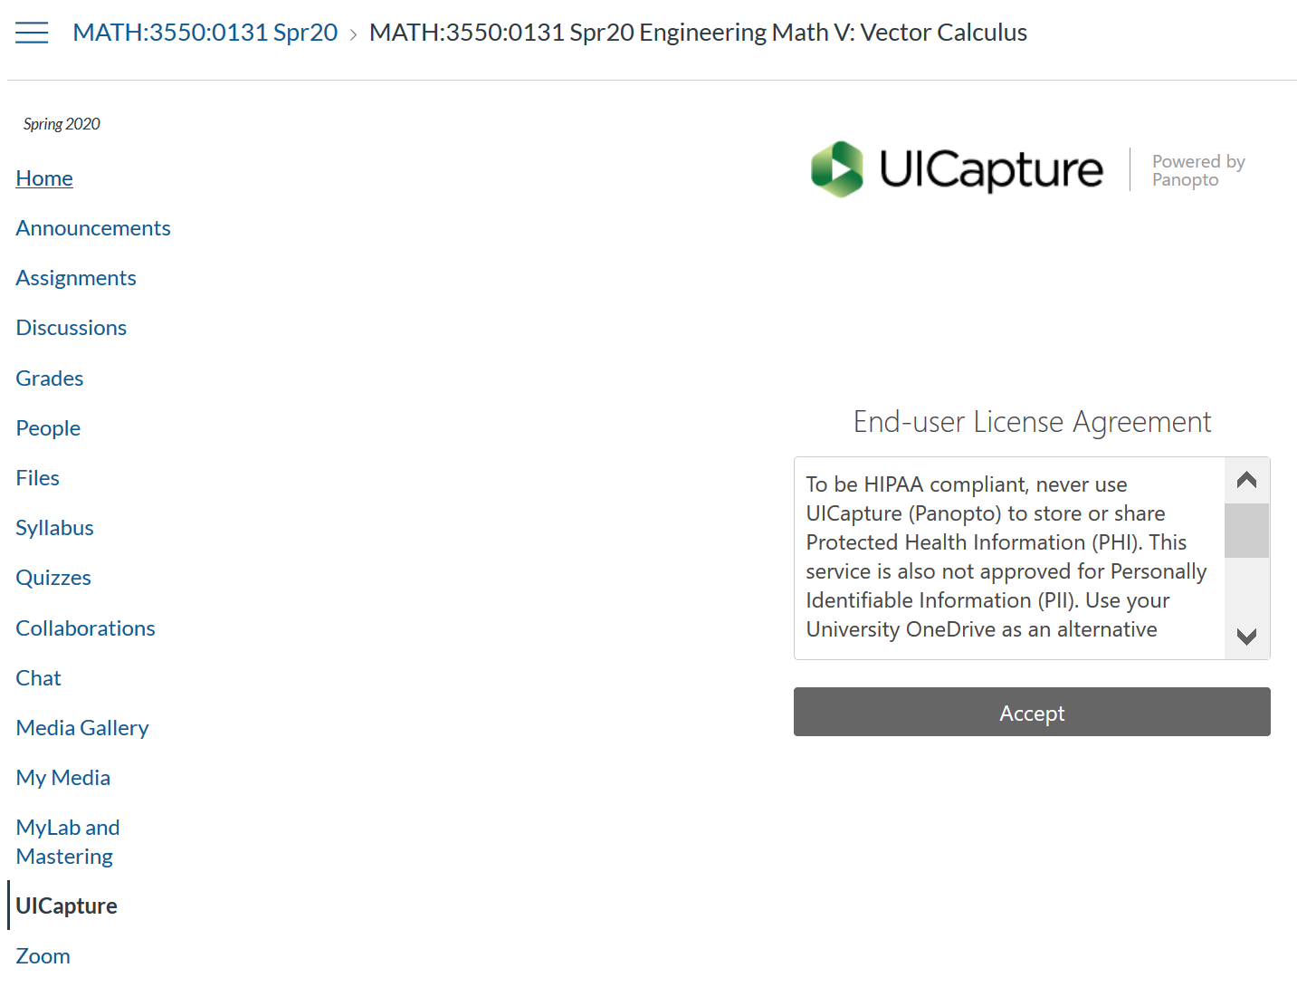
Quiz 3 due today
Quiz 4 over 13.8 and ?
If you need an extension for quiz 3 or HW 8, e-mail me.
Videos are posted under UICapture

Slide 3
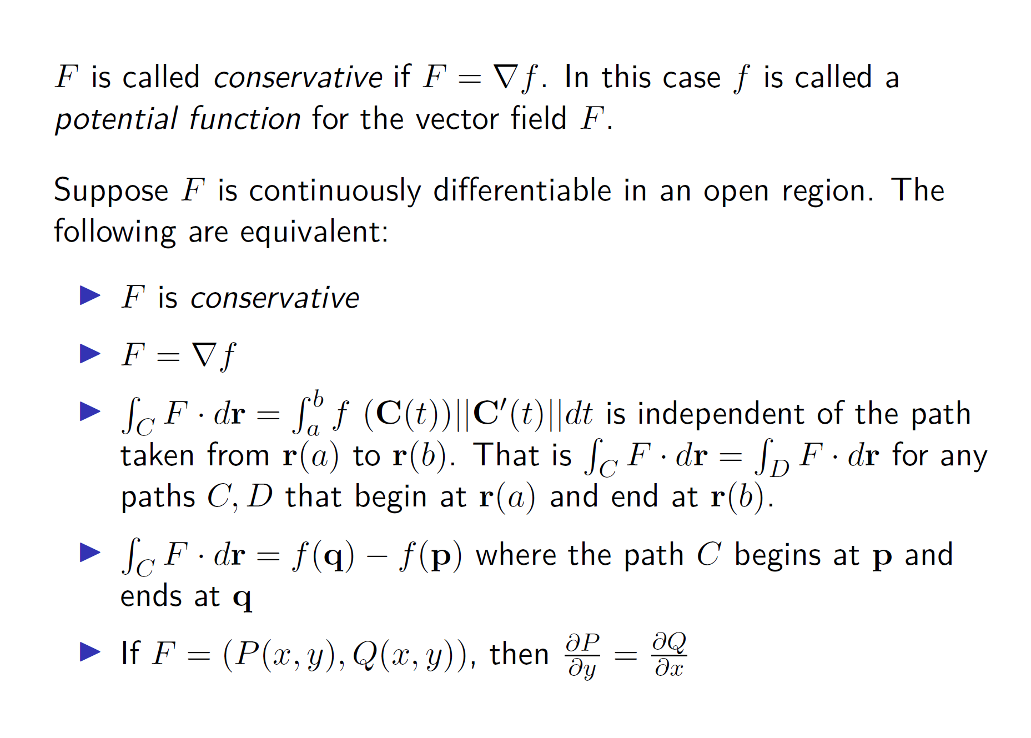
Section 14.3: Path Independence

Slide 4
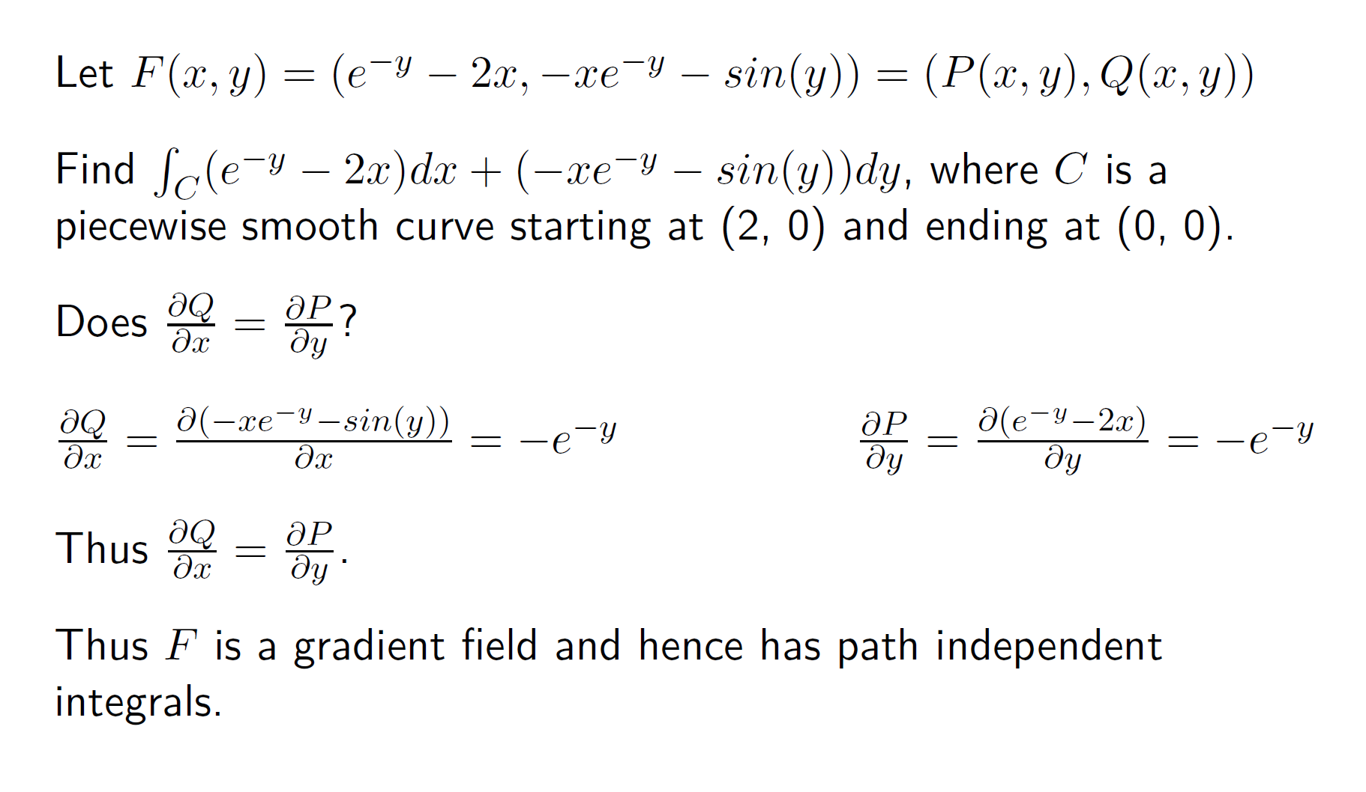

Slide 5
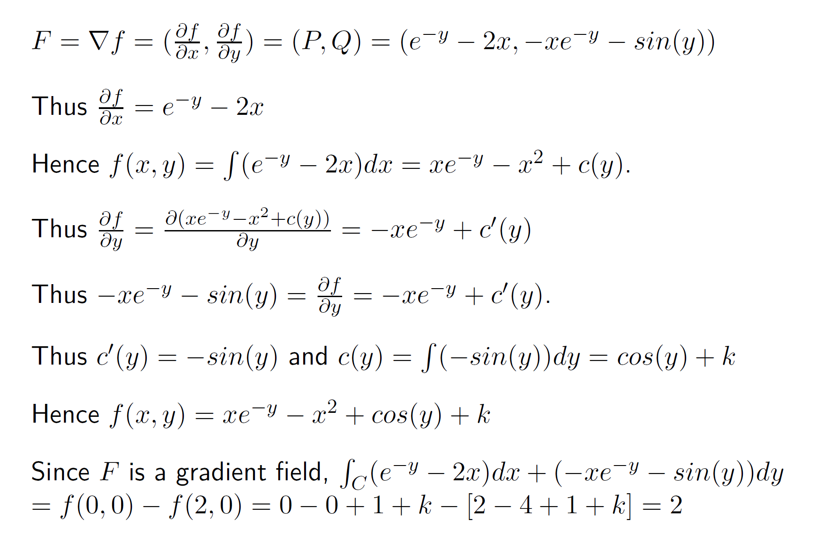

Slide 6
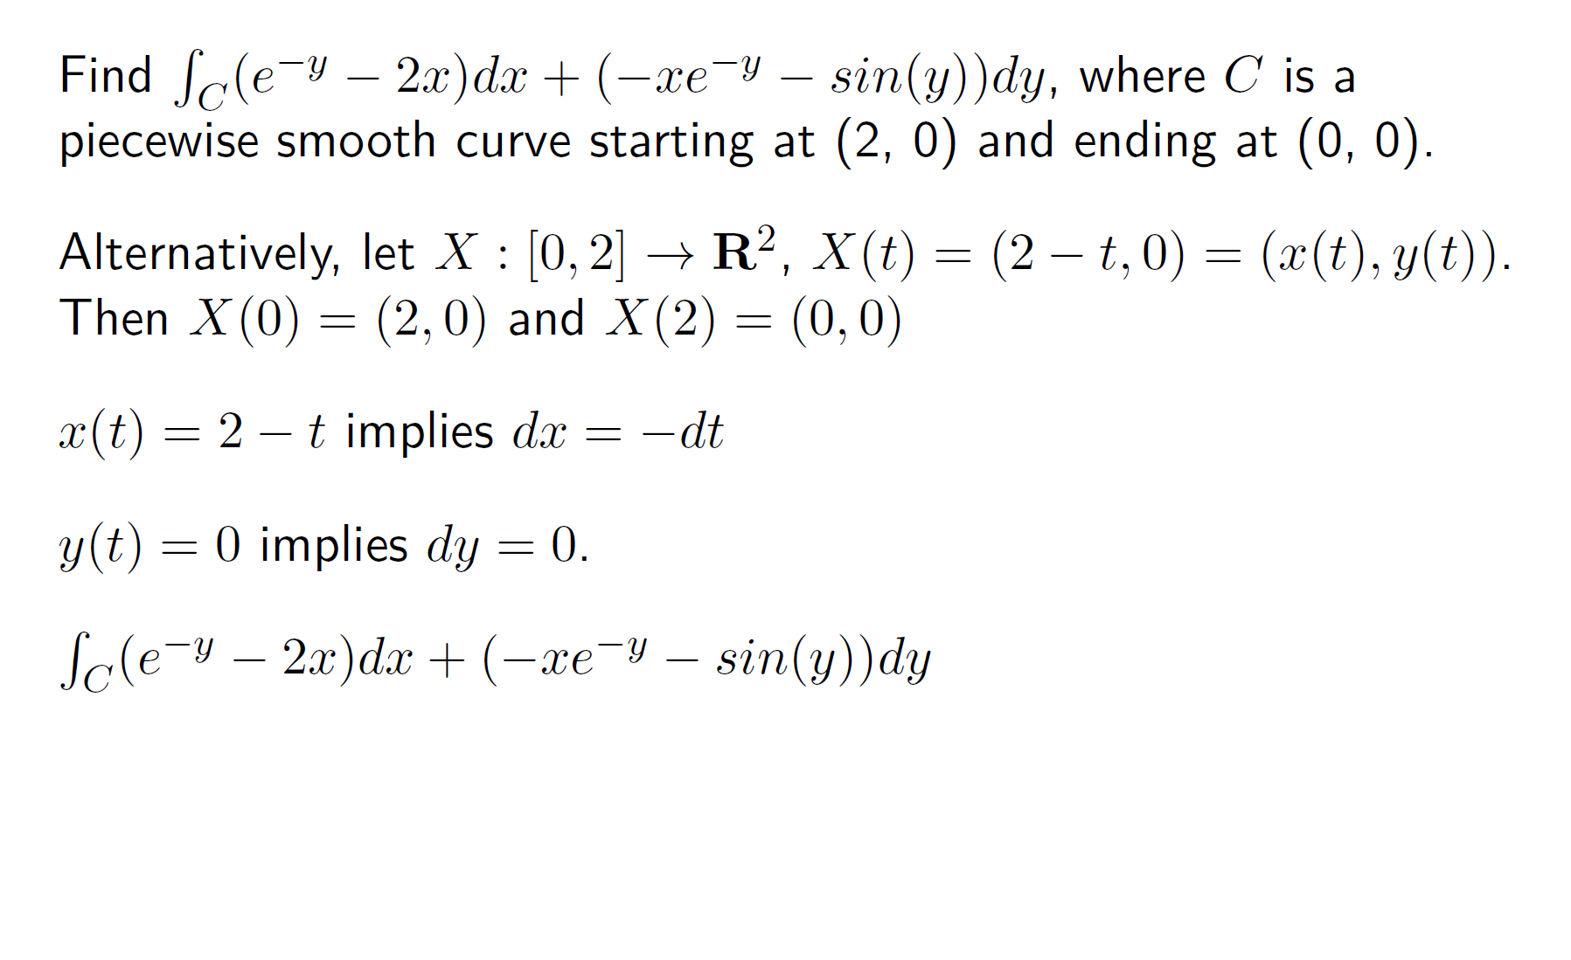

Slide 7
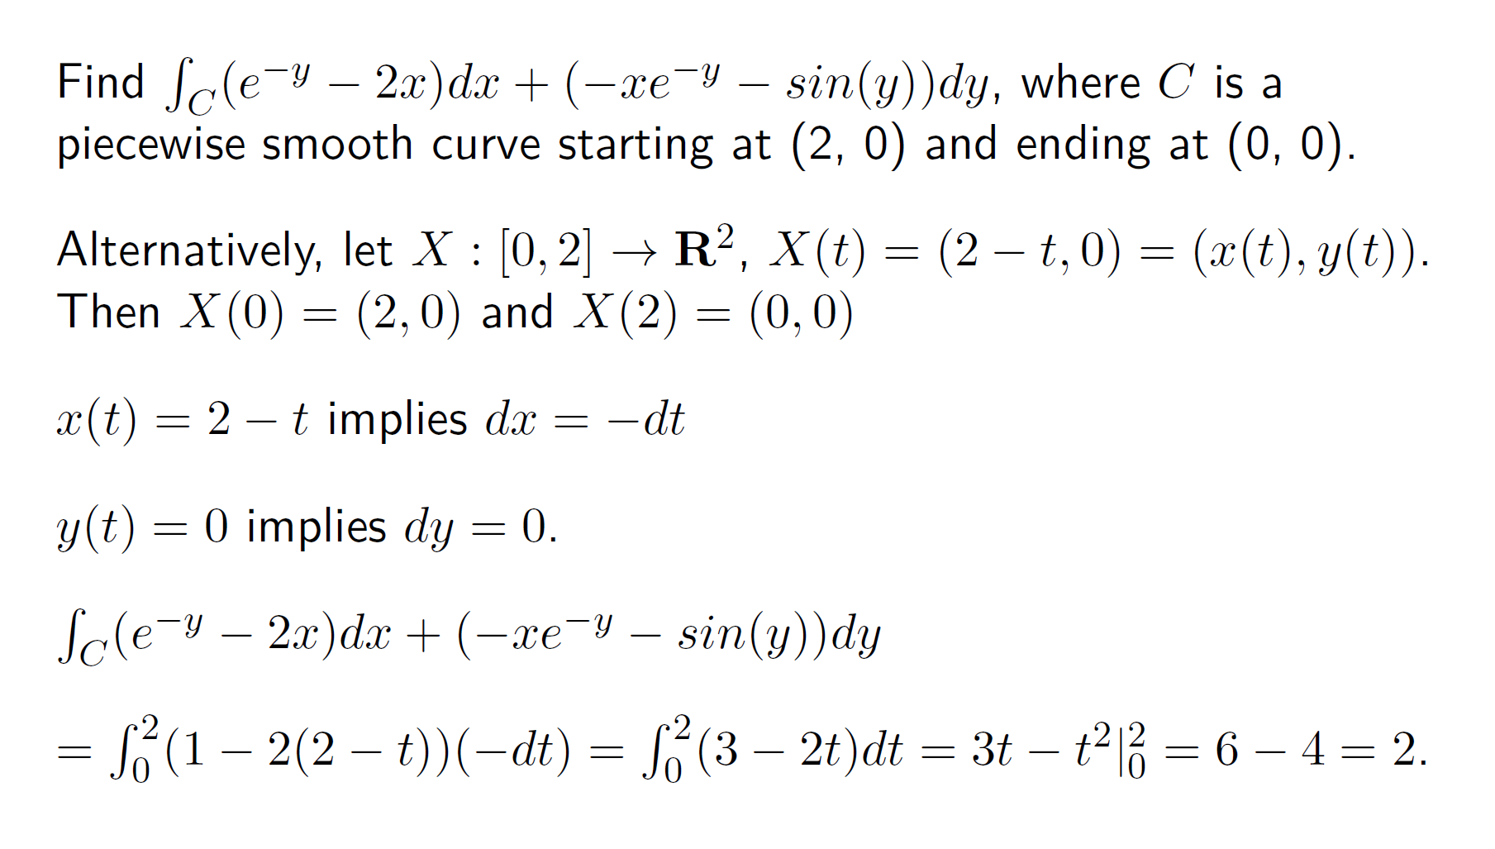

Slide 8
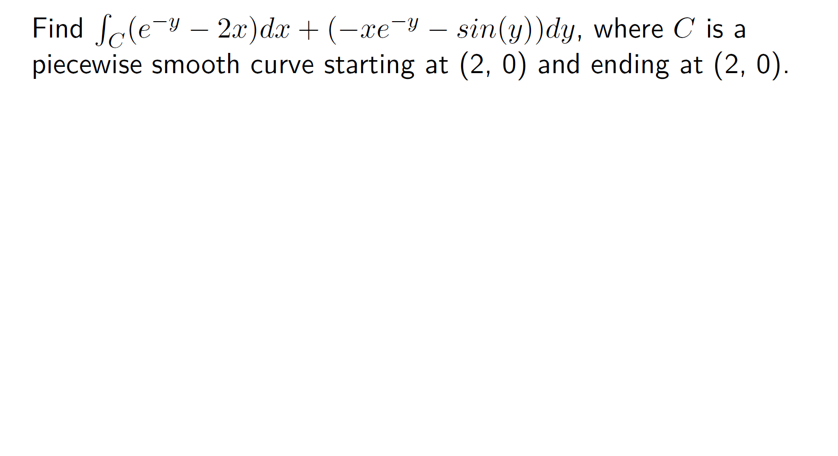

Slide 9
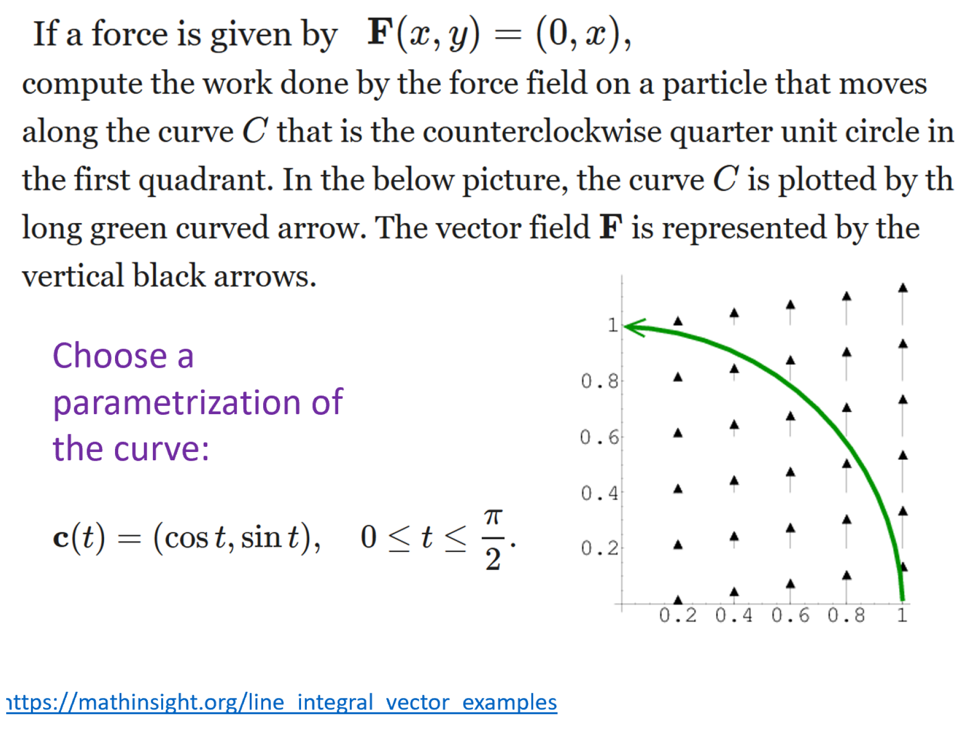

Slide 10
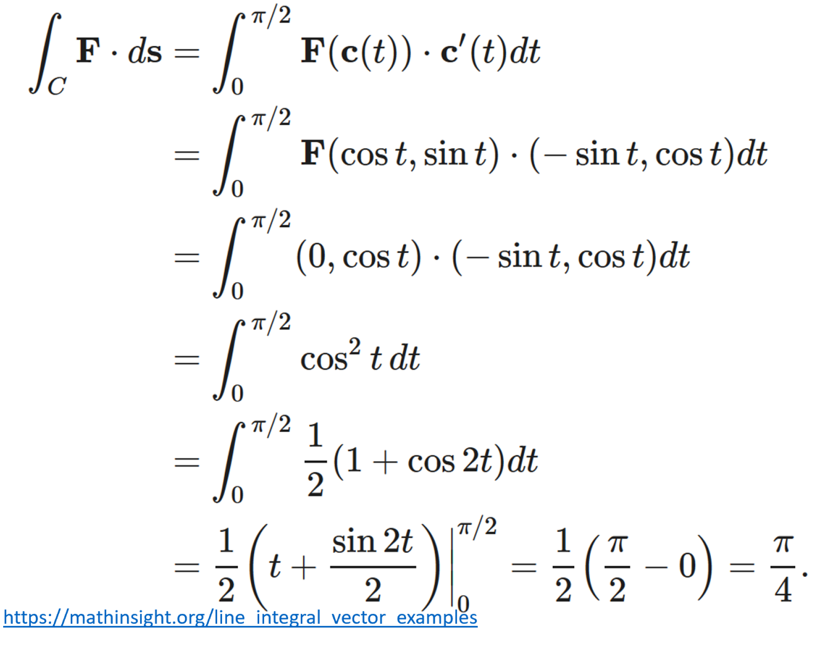
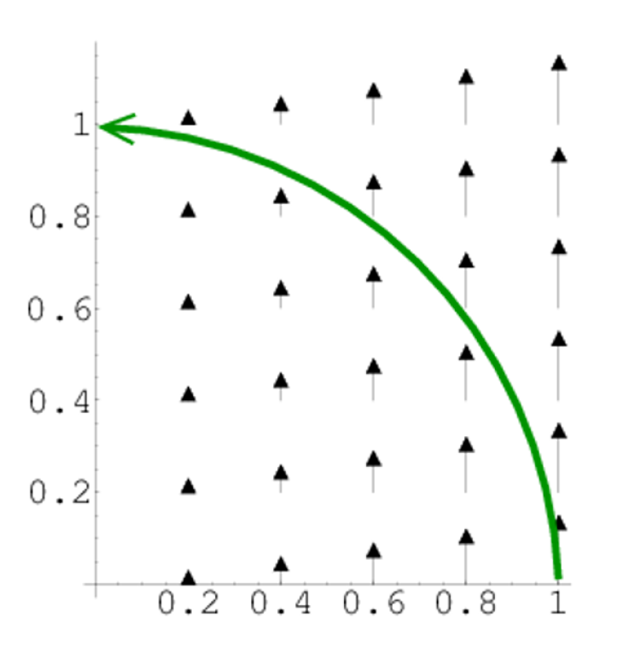

Slide 11
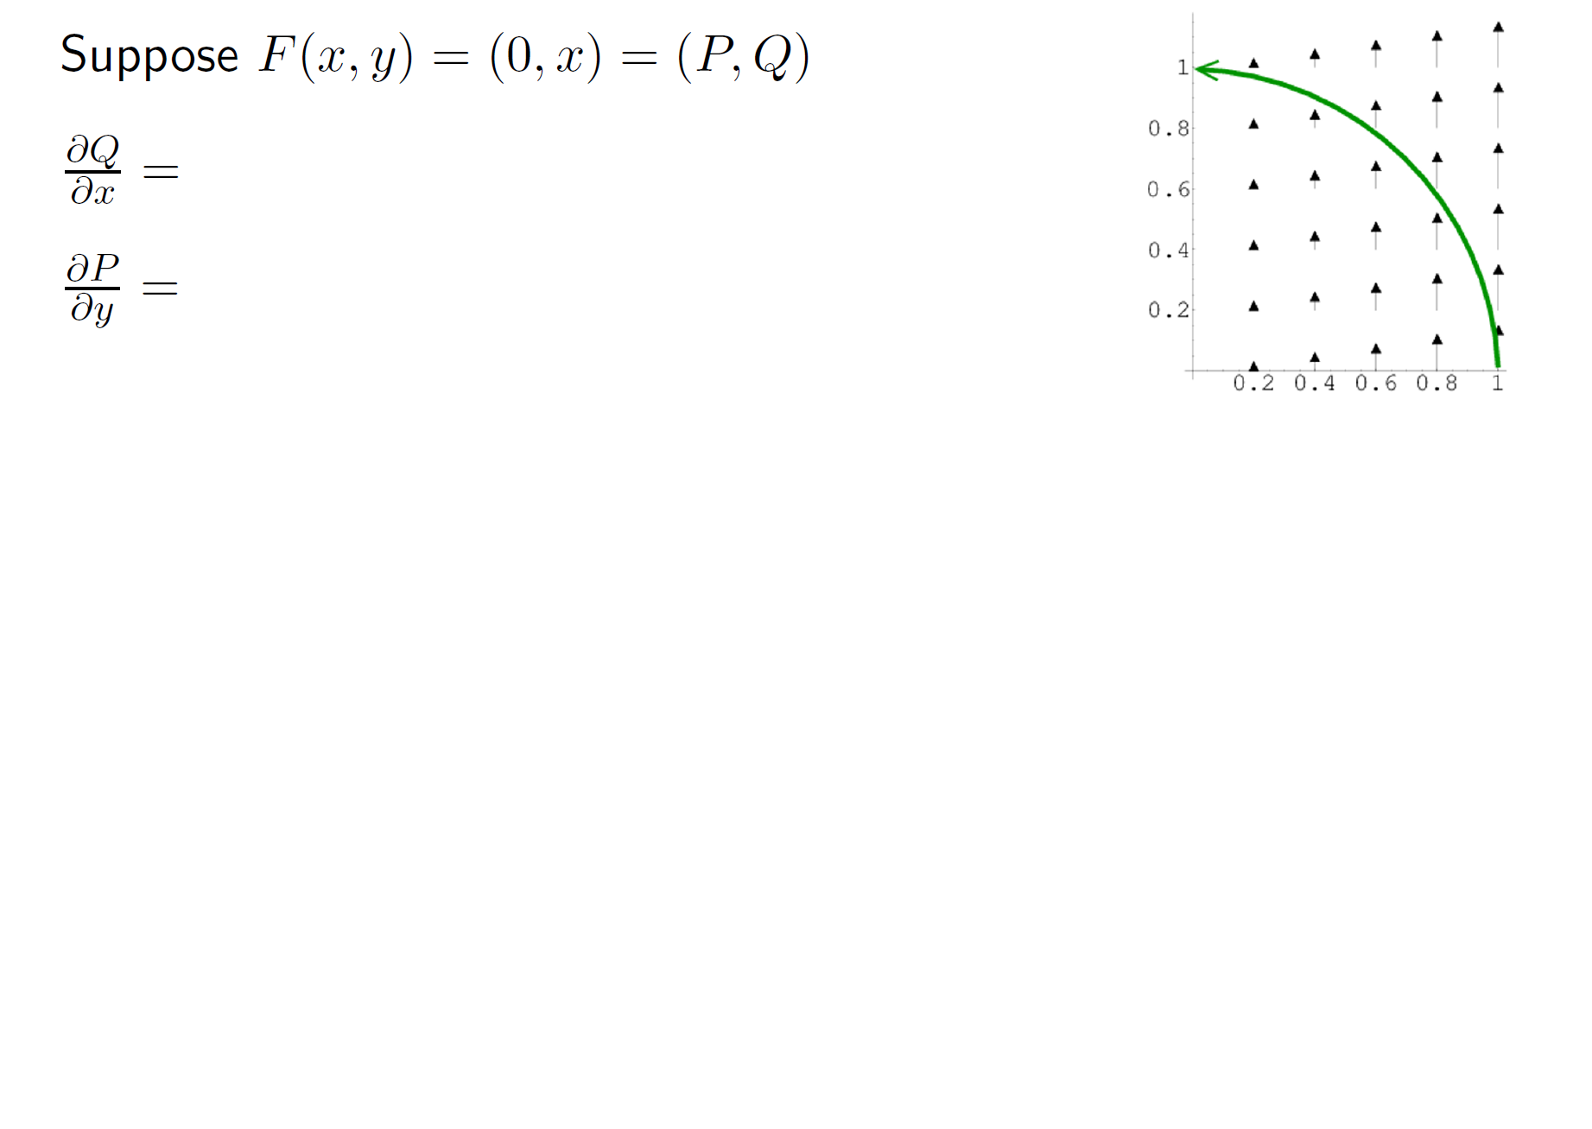

Slide 12
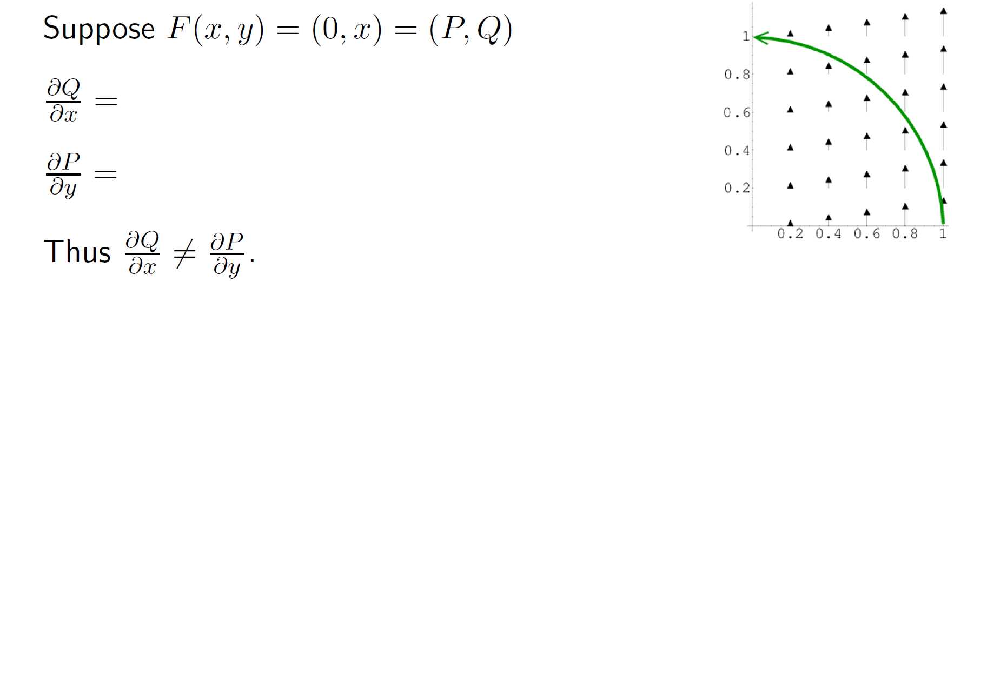

Slide 13
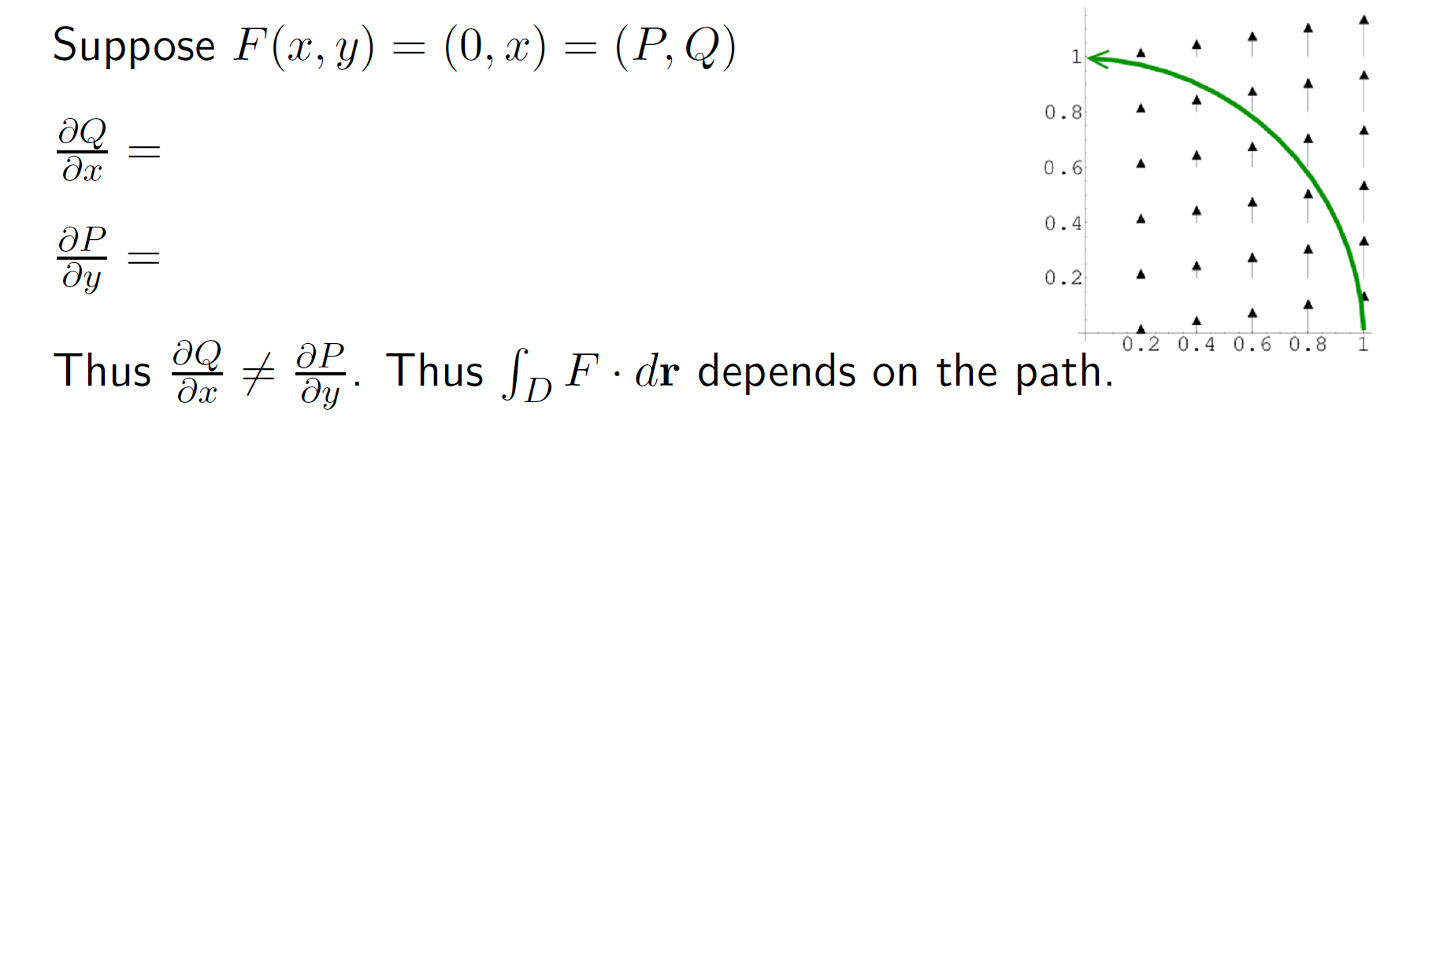

Slide 14
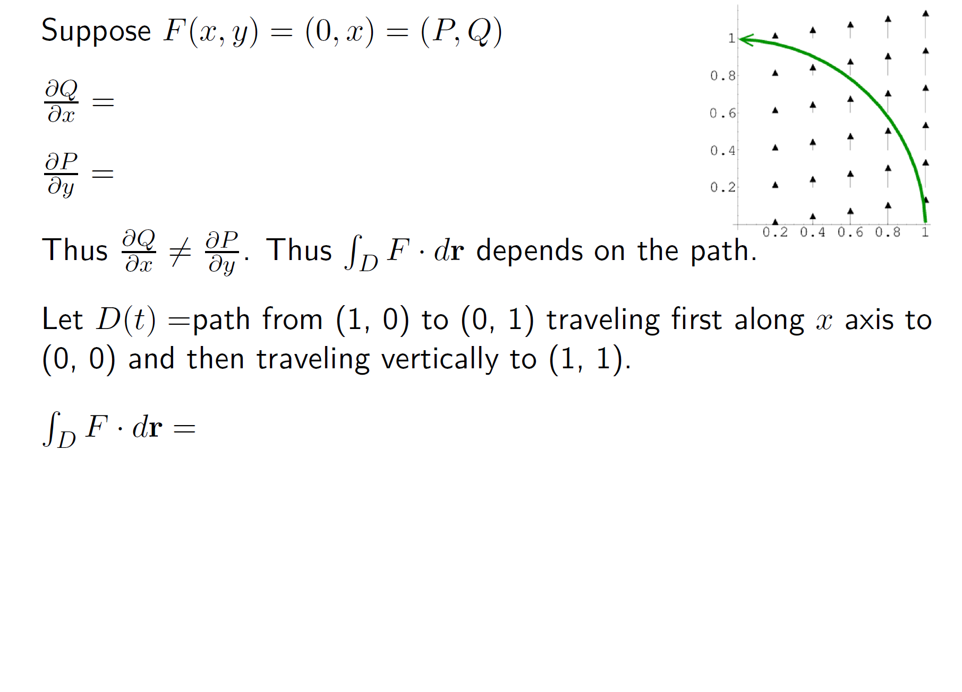


Slide 15
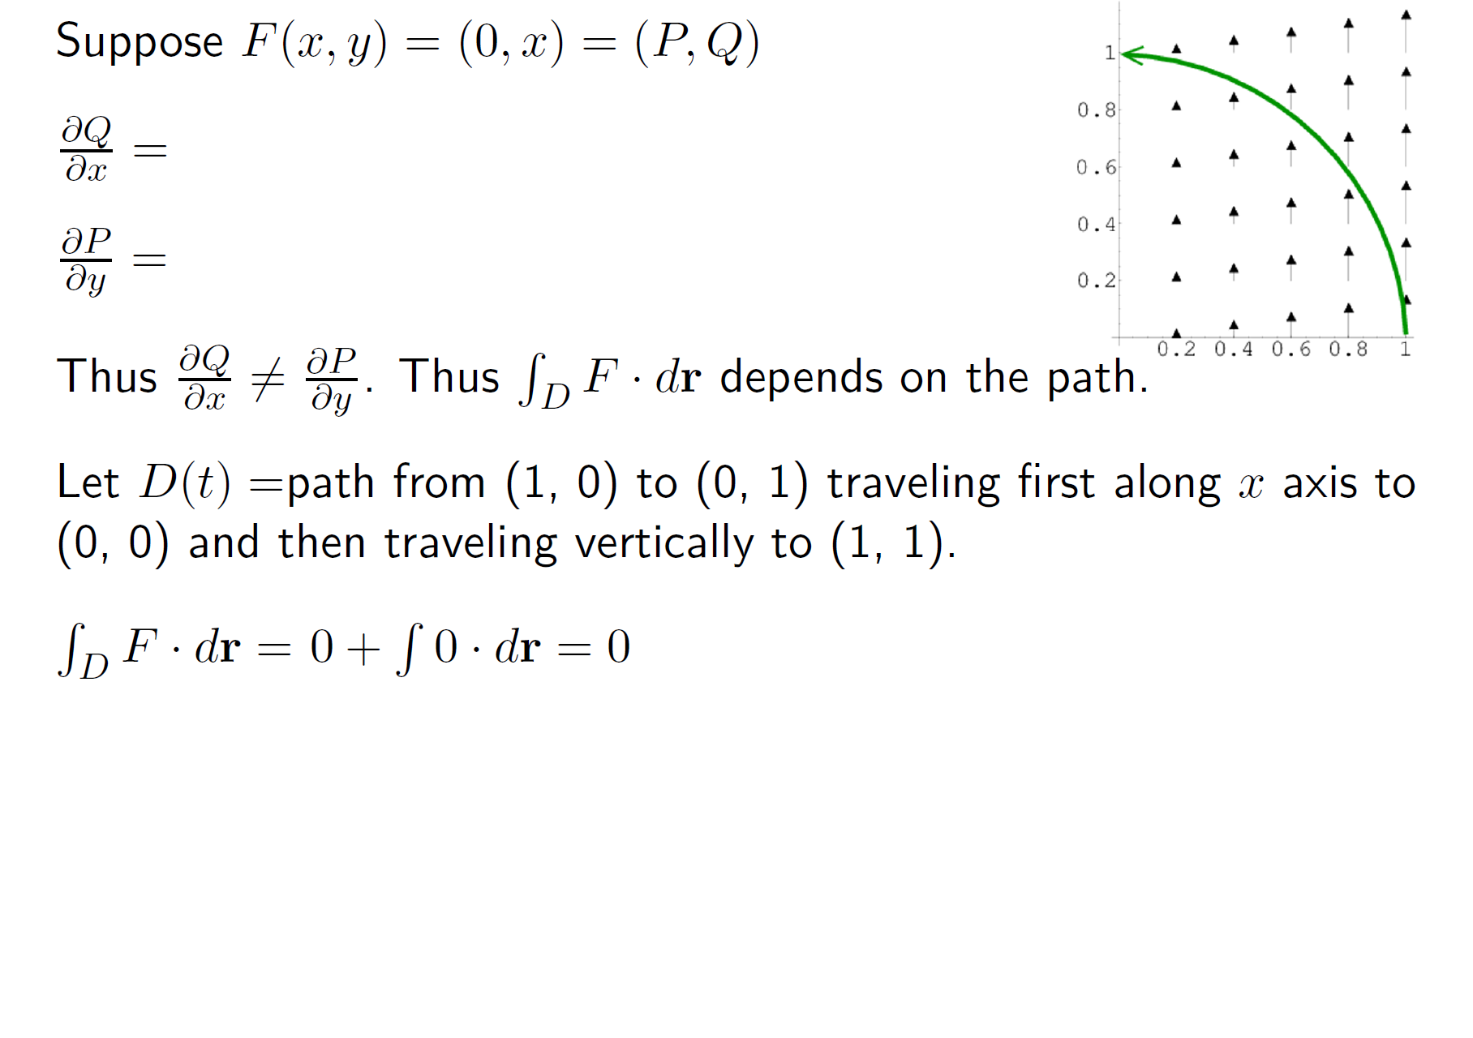

Slide 16
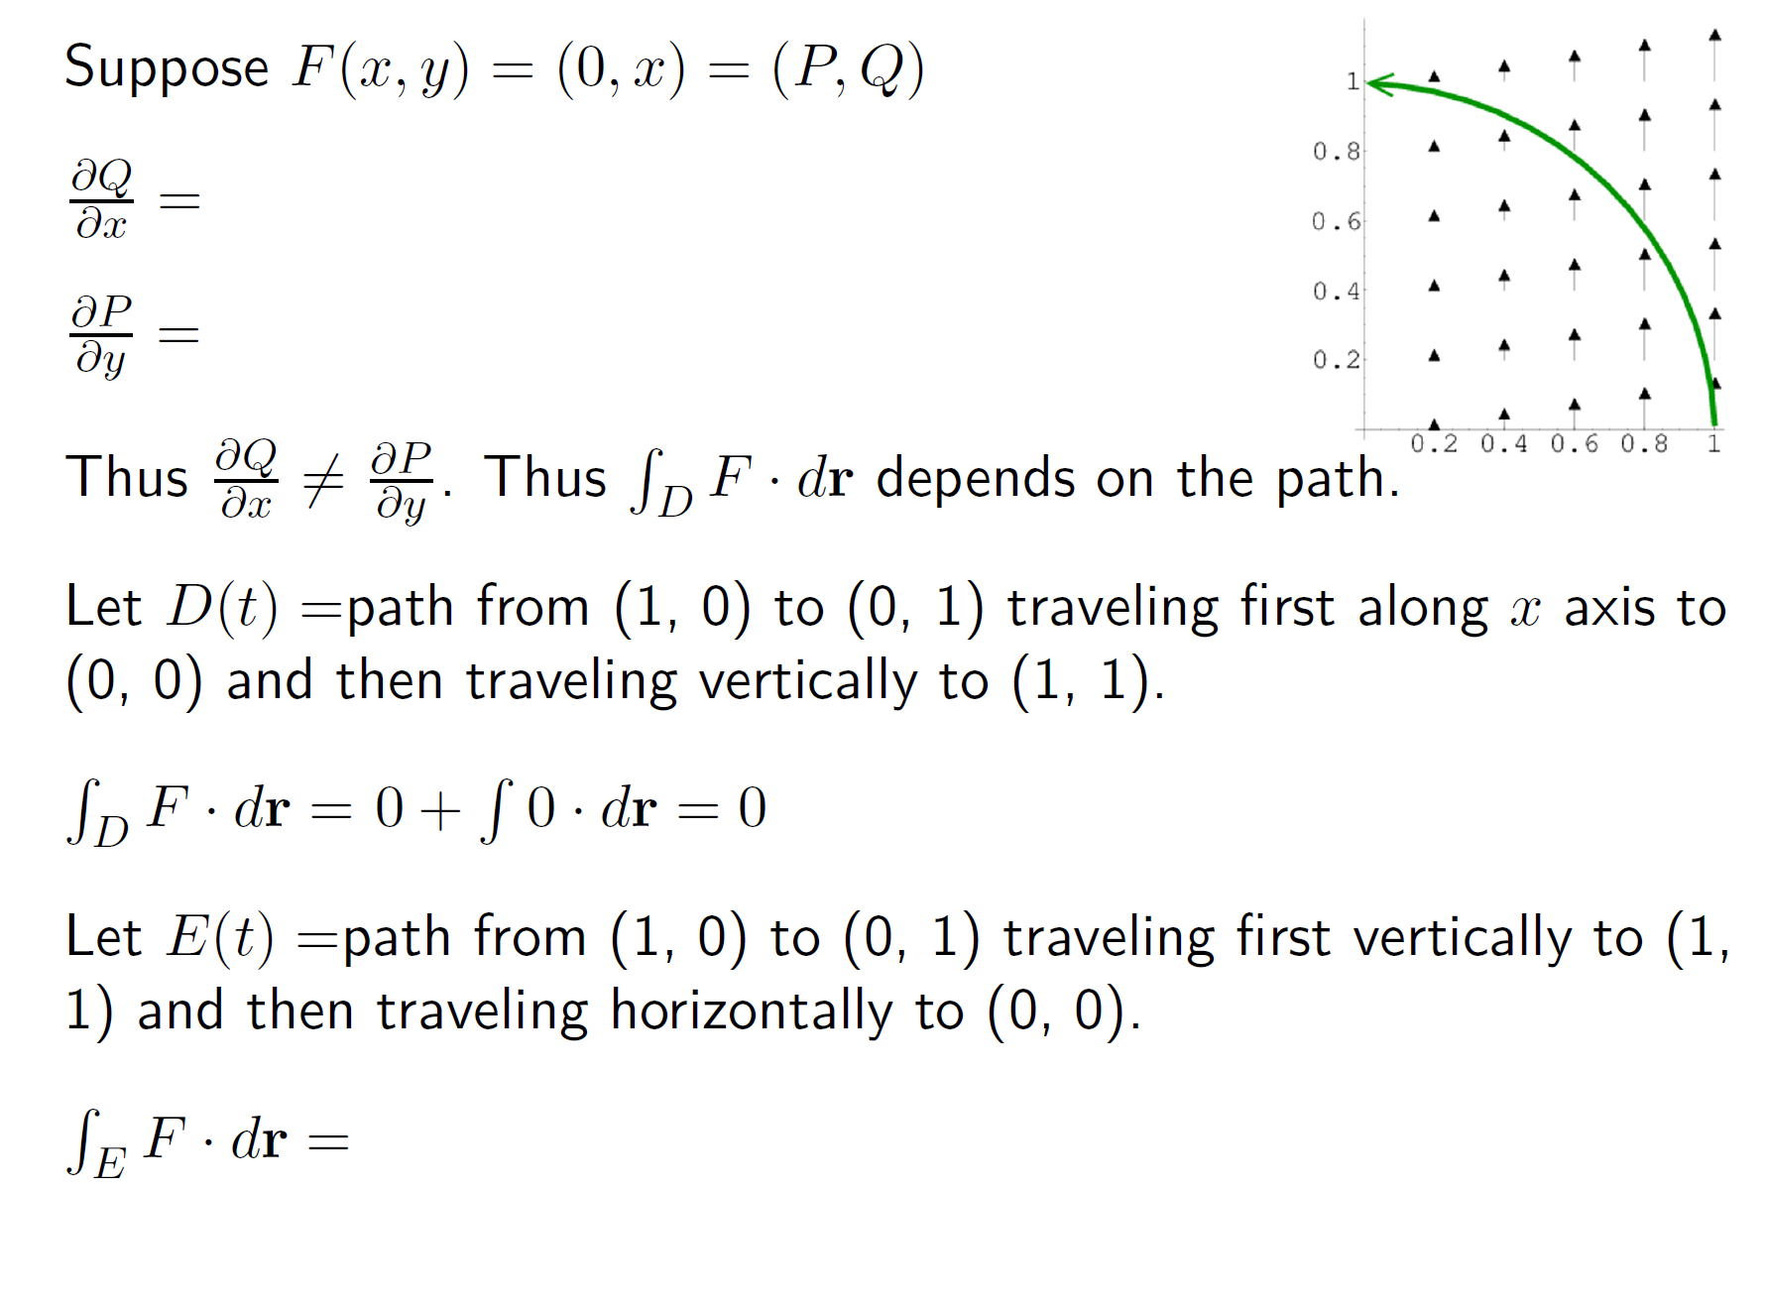

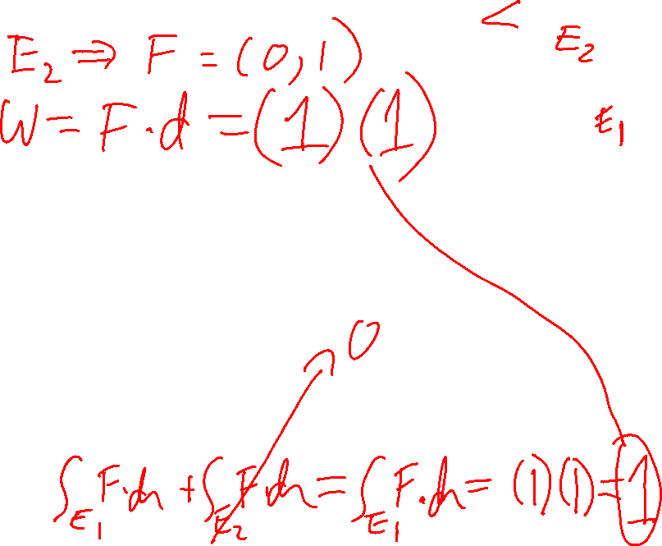


Slide 17
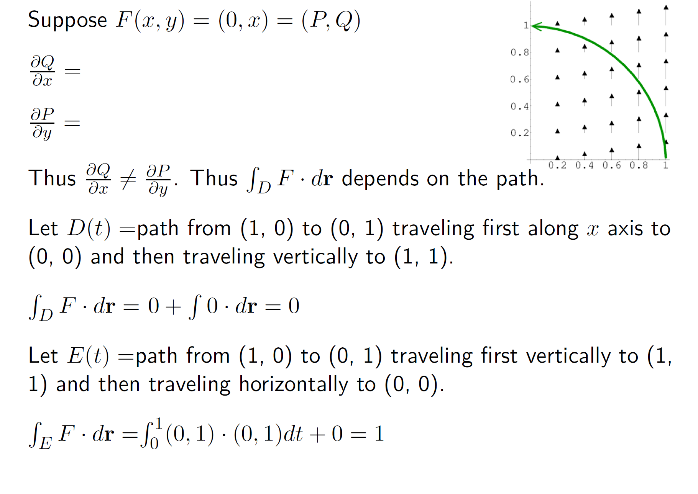
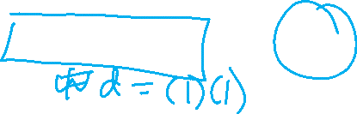

Slide 18
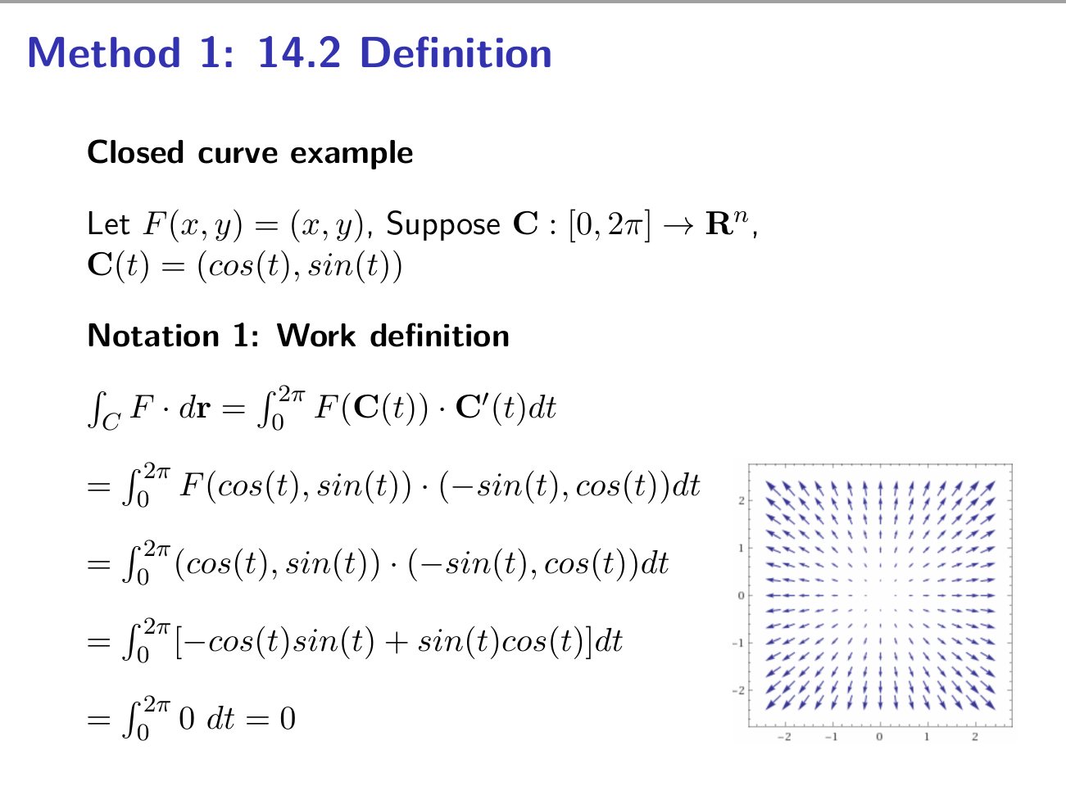


Slide 19

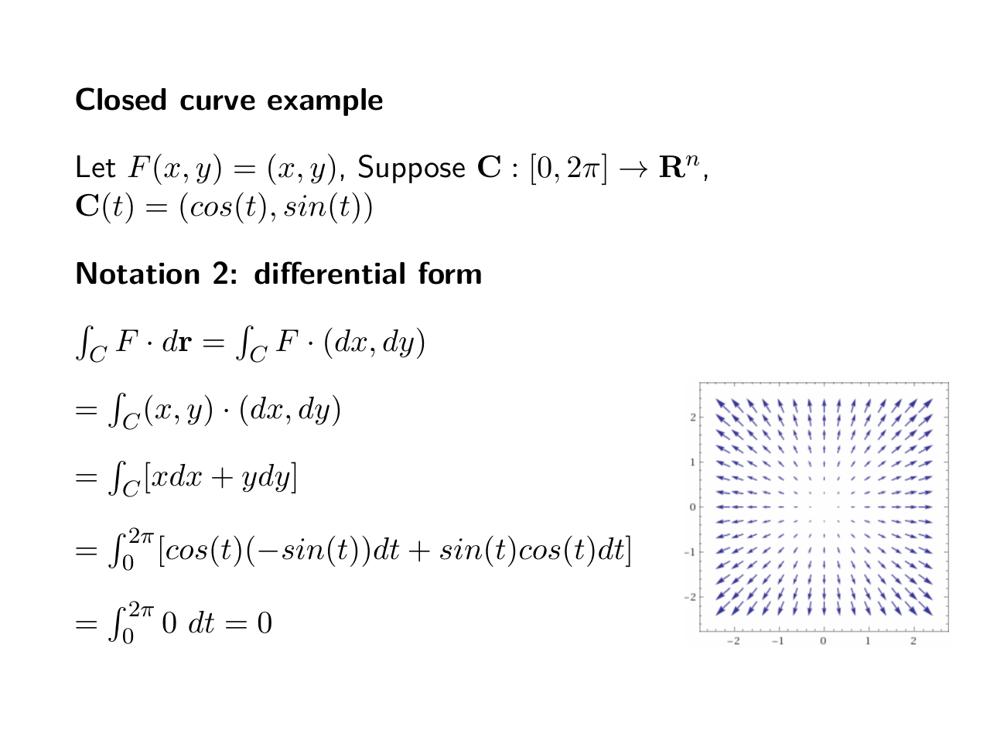


Slide 20
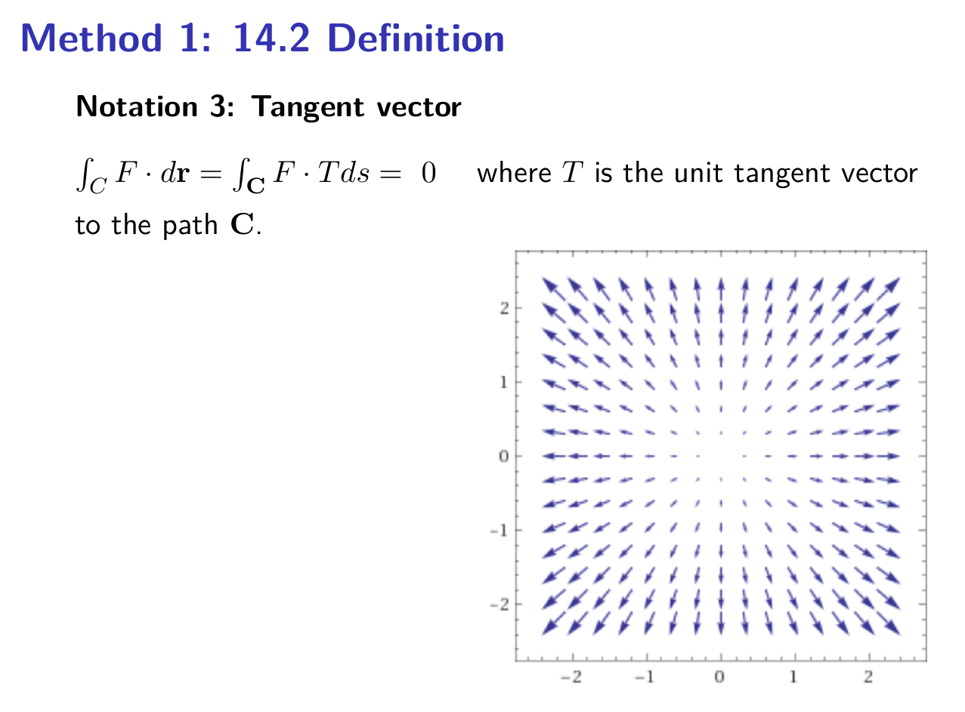
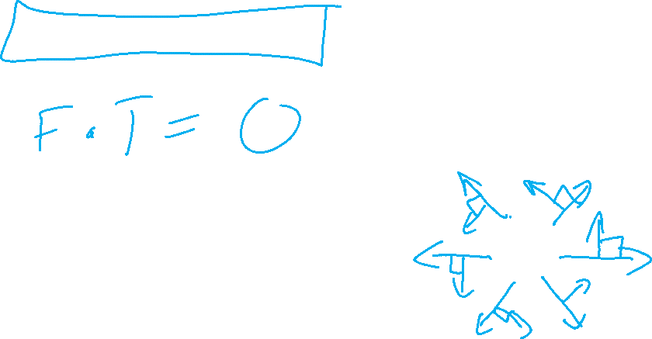

Slide 21

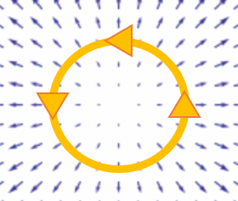
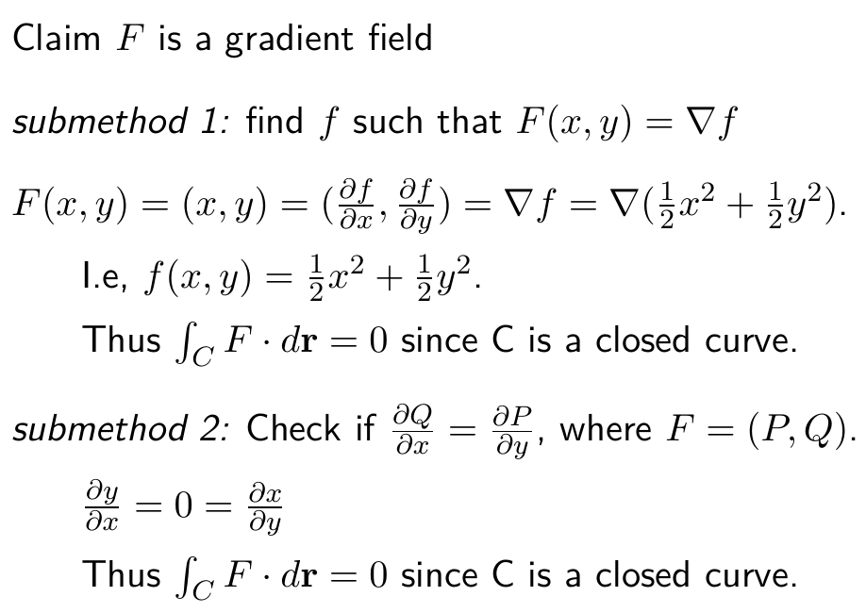
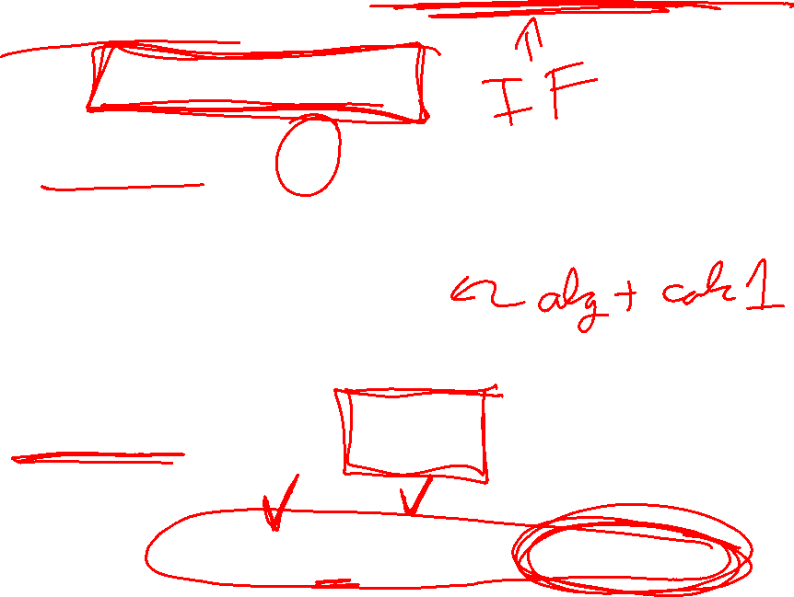

Slide 22
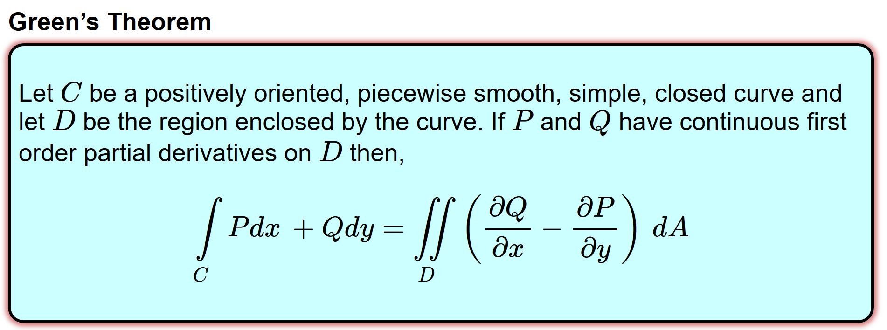
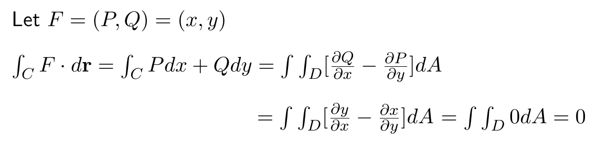
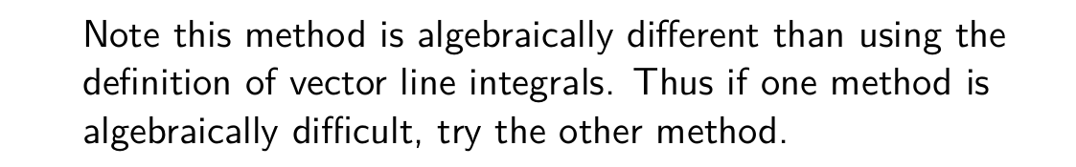
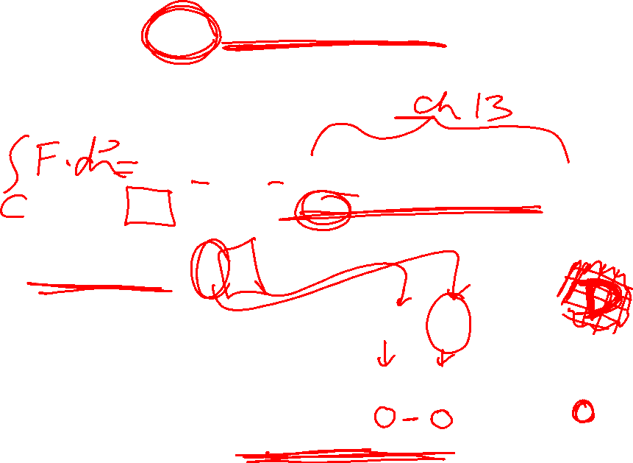
http://tutorial.math.lamar.edu/Classes/CalcIII/GreensTheorem.aspx

Slide 23
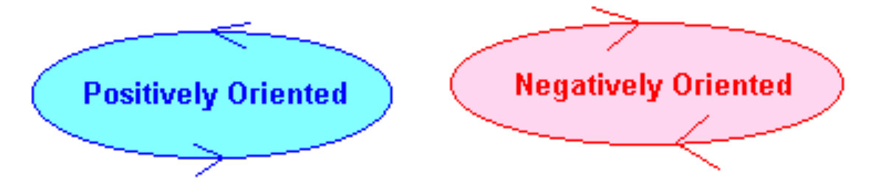
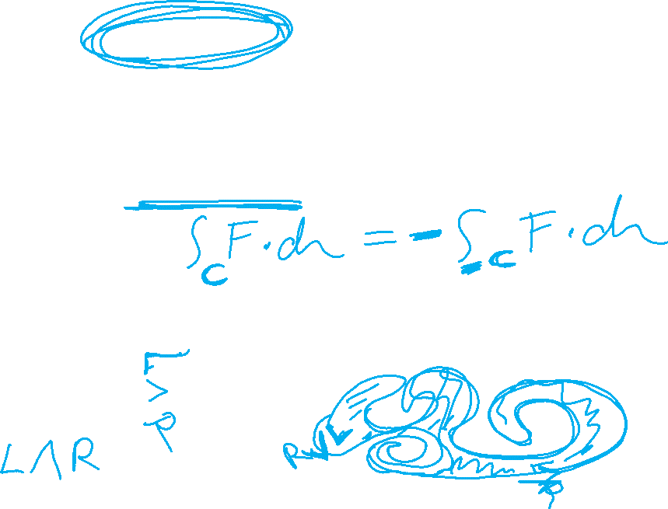
http://tutorial.math.lamar.edu/Classes/CalcIII/GreensTheorem.aspx
http://ltcconline.net/greenl/courses/202/vectorIntegration/greensTheorem.htm

Slide 24
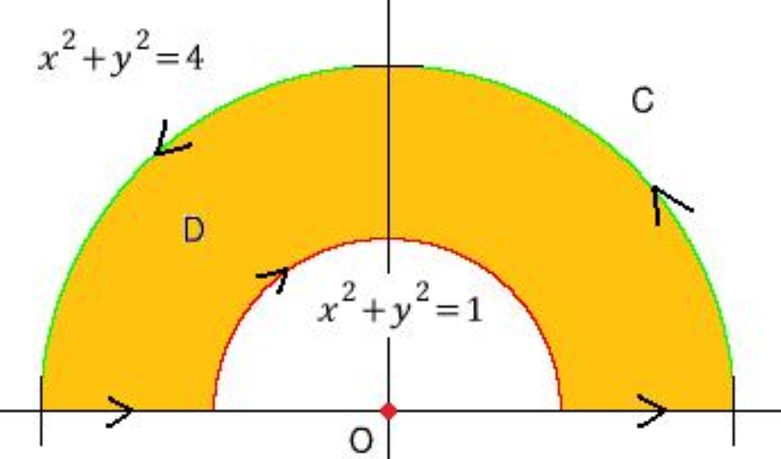
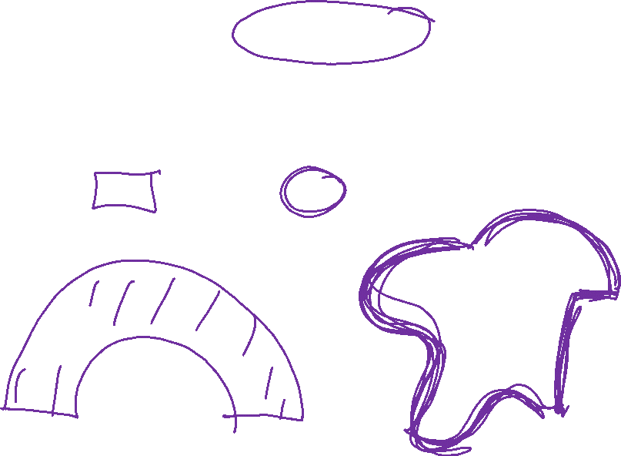
http://tutorial.math.lamar.edu/Classes/CalcIII/GreensTheorem.aspx
http://blog.naver.com/PostView.nhn?blogId=mindo1103&logNo=90179767504&parentCategoryNo=35&categoryNo=&viewDate=&isShowPopularPosts=true&from=search

Slide 25

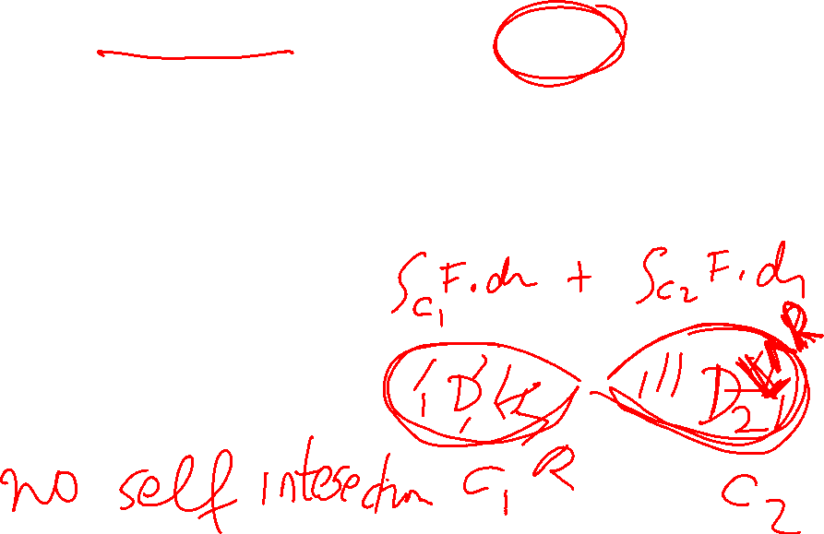
http://tutorial.math.lamar.edu/Classes/CalcIII/GreensTheorem.aspx
http://ltcconline.net/greenl/courses/202/vectorIntegration/greensTheorem.htm

Slide 26


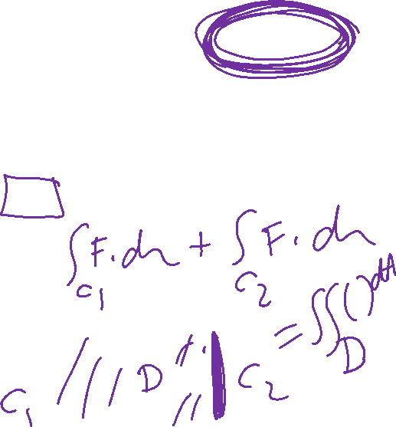
http://tutorial.math.lamar.edu/Classes/CalcIII/GreensTheorem.aspx
NOT closed
https://mathinsight.org/

Slide 27
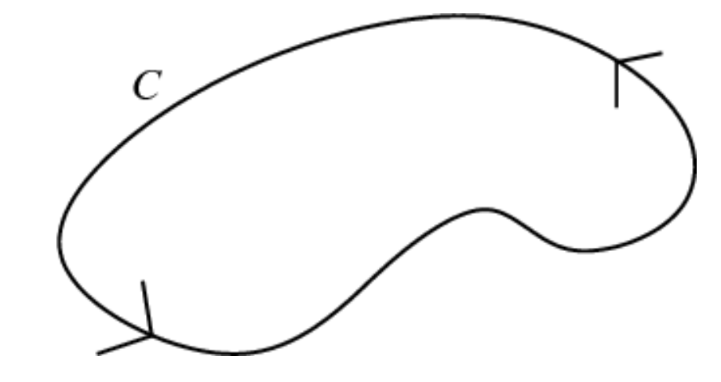
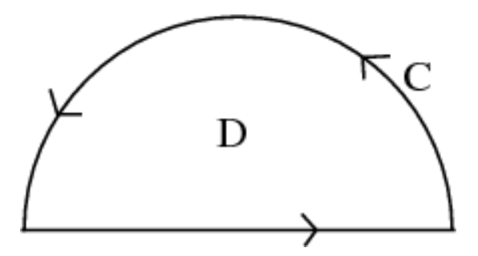

http://tutorial.math.lamar.edu/Classes/CalcIII/GreensTheorem.aspx
closed
https://mathinsight.org/

Slide 28

http://tutorial.math.lamar.edu/Classes/CalcIII/GreensTheorem.aspx
closed
https://mathinsight.org/

Slide 29
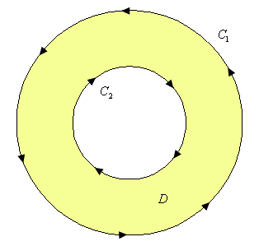
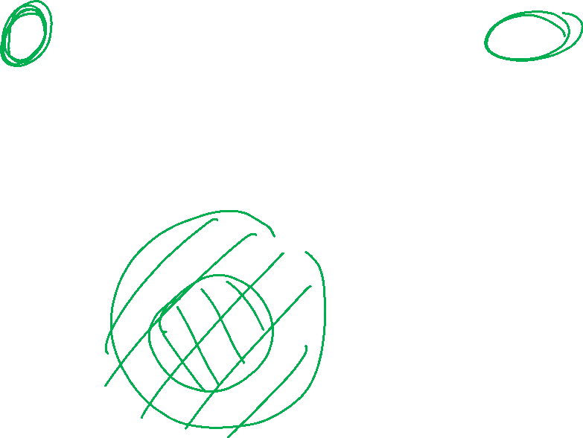
http://tutorial.math.lamar.edu/Classes/CalcIII/GreensTheorem.aspx
http://tutorial.math.lamar.edu/Classes/CalcIII/GreensTheorem.aspx

Slide 30
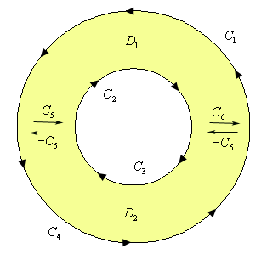
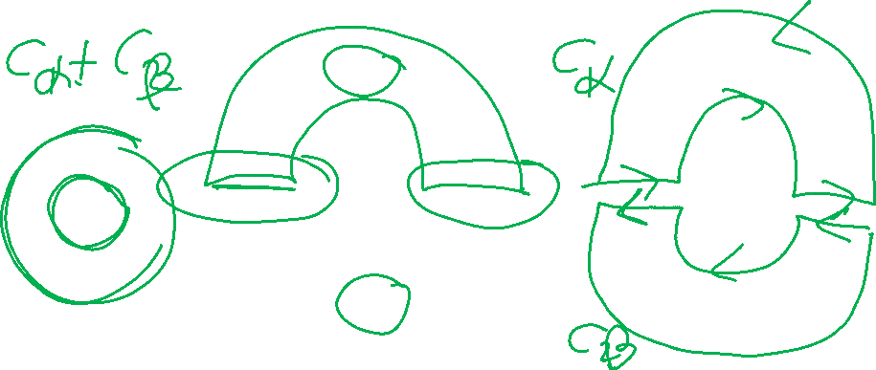
http://tutorial.math.lamar.edu/Classes/CalcIII/GreensTheorem.aspx
http://tutorial.math.lamar.edu/Classes/CalcIII/GreensTheorem.aspx

Slide 31
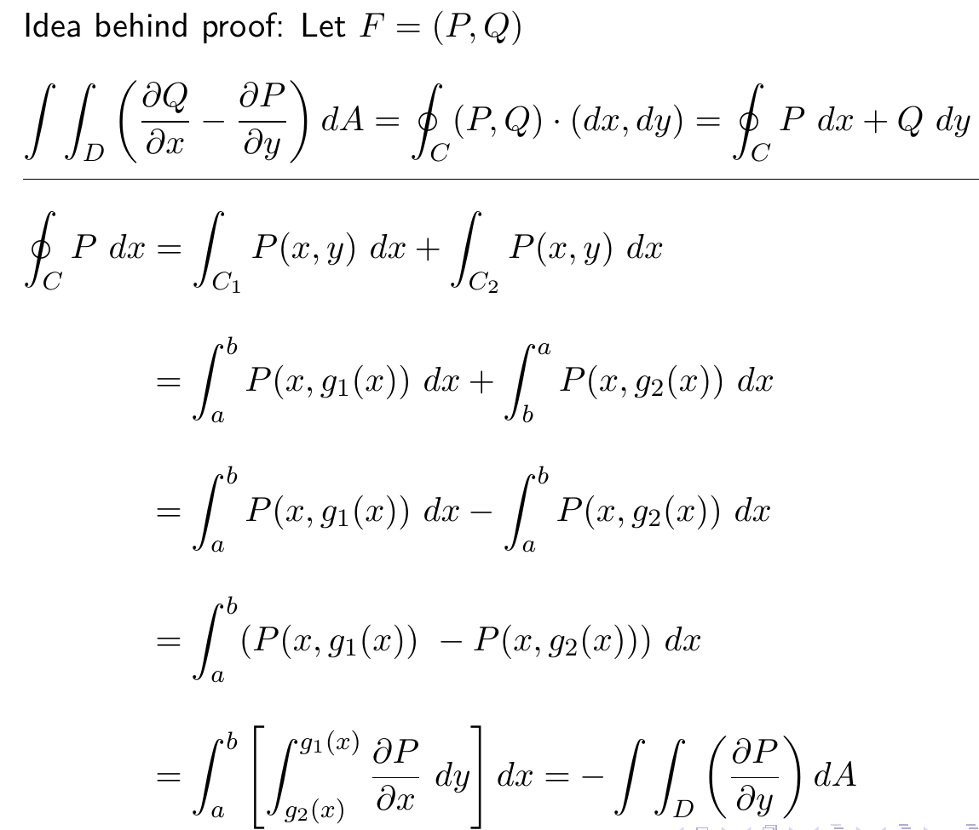
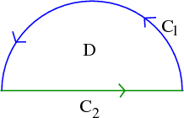
http://tutorial.math.lamar.edu/Classes/CalcIII/GreensTheorem.aspx

Slide 32
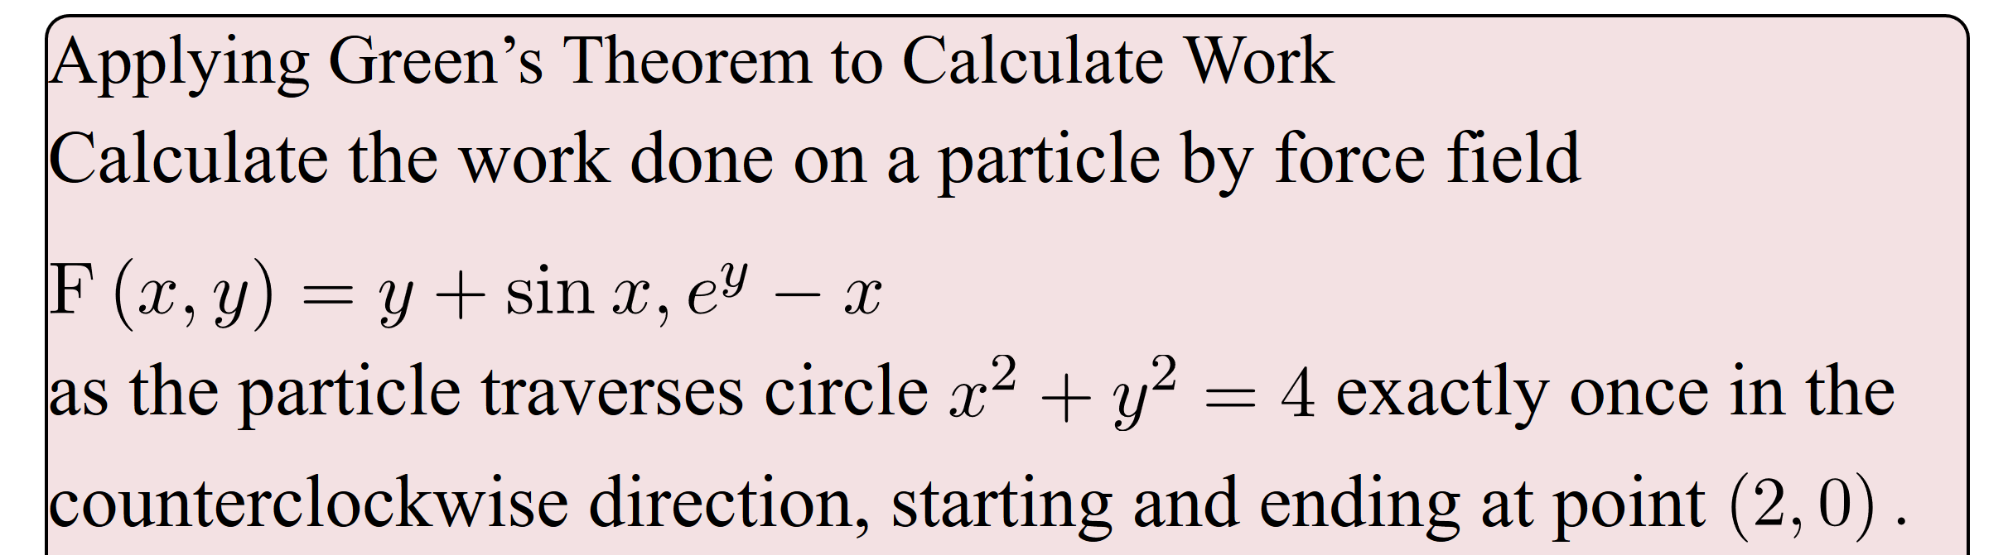
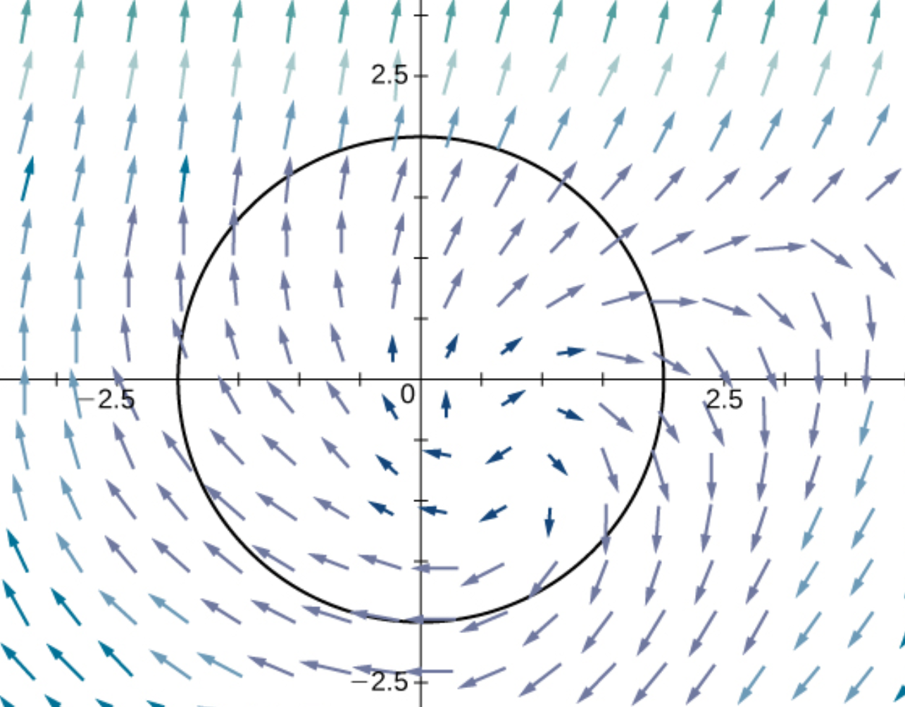
(
)
https://opentextbc.ca/calculusv3openstax/chapter/greens-theorem/

Slide 33
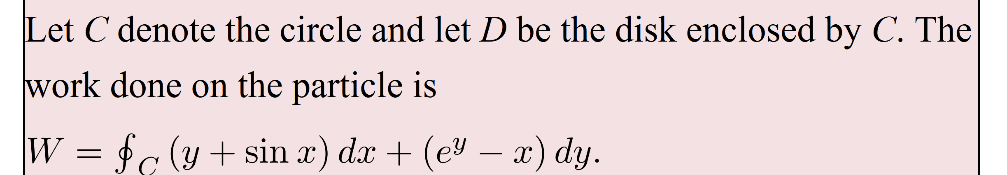
(
)
https://opentextbc.ca/calculusv3openstax/chapter/greens-theorem/

Slide 34

https://opentextbc.ca/calculusv3openstax/chapter/greens-theorem/

Slide 35

https://opentextbc.ca/calculusv3openstax/chapter/greens-theorem/

Slide 36
https://opentextbc.ca/calculusv3openstax/chapter/greens-theorem/

Slide 37
(
)
https://opentextbc.ca/calculusv3openstax/chapter/greens-theorem/

Slide 38
(
)
https://opentextbc.ca/calculusv3openstax/chapter/greens-theorem/

Slide 39


Can also use Green’s theorem to calculate double integrals.
Example: Find area of a region.
https://mathinsight.org/greens_theorem_find_area

Slide 40


Can also use Green’s theorem to calculate double integrals.
Example: Find area of a region.

Slide 41

Can also use Green’s theorem to calculate double integrals.
Example: Find area of a region.

Slide 42

Can also use Green’s theorem to calculate double integrals.
Example: Find area of a region.

Slide 43

Can also use Green’s theorem to calculate double integrals.
Example: Find area of a region.

Slide 44


https://mathinsight.org/greens_theorem_find_area

Slide 45
https://mathinsight.org/greens_theorem_find_area

Slide 46

https://mathinsight.org/greens_theorem_find_area

