Slide 1
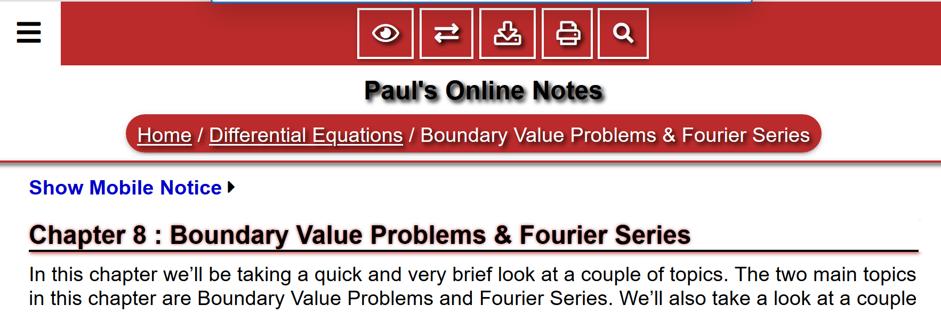
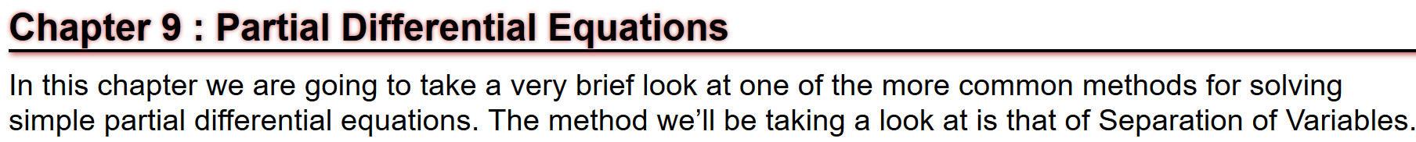
Note: Most of the slides for our ch 10 lectures will be based on Paul’s online notes often via cut and paste.
http://tutorial.math.lamar.edu/Classes/DE/IntroBVP.aspx

Slide 2

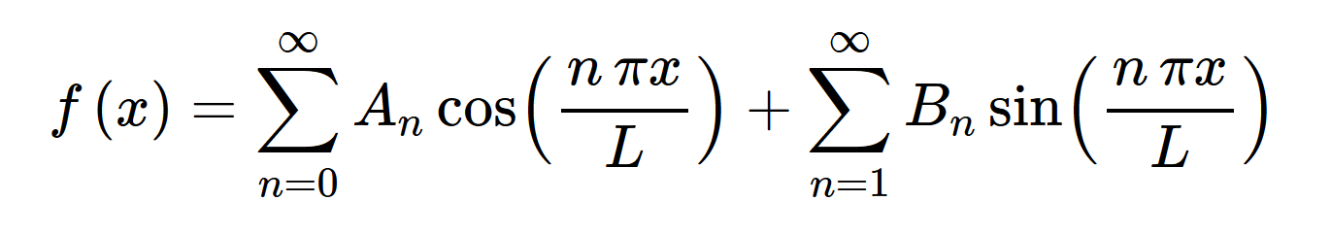
http://tutorial.math.lamar.edu/Classes/DE/FourierSeries.aspx
10.2

Slide 3
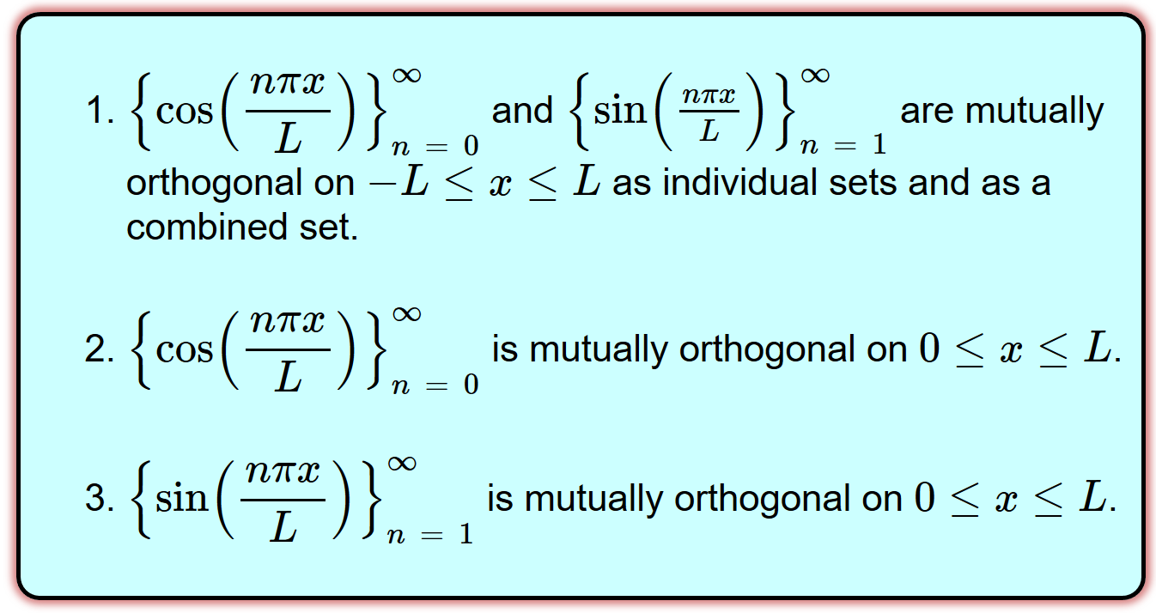
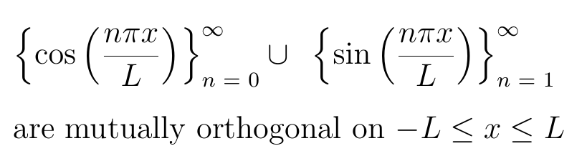
http://tutorial.math.lamar.edu/Classes/DE/PeriodicOrthogonal.aspx

Slide 4
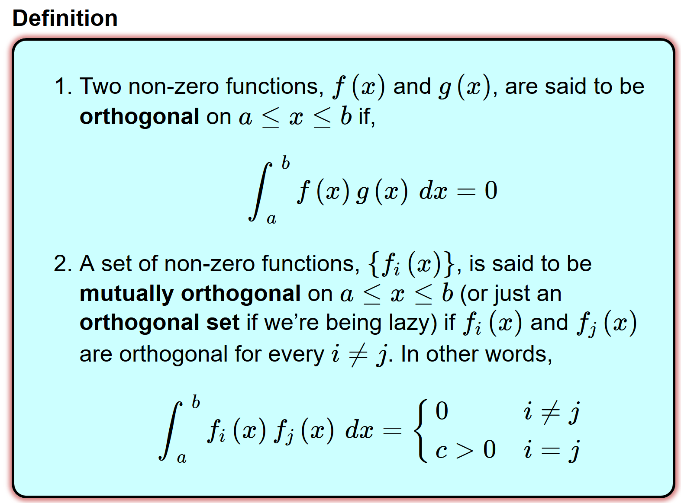
http://tutorial.math.lamar.edu/Classes/DE/PeriodicOrthogonal.aspx

Slide 5
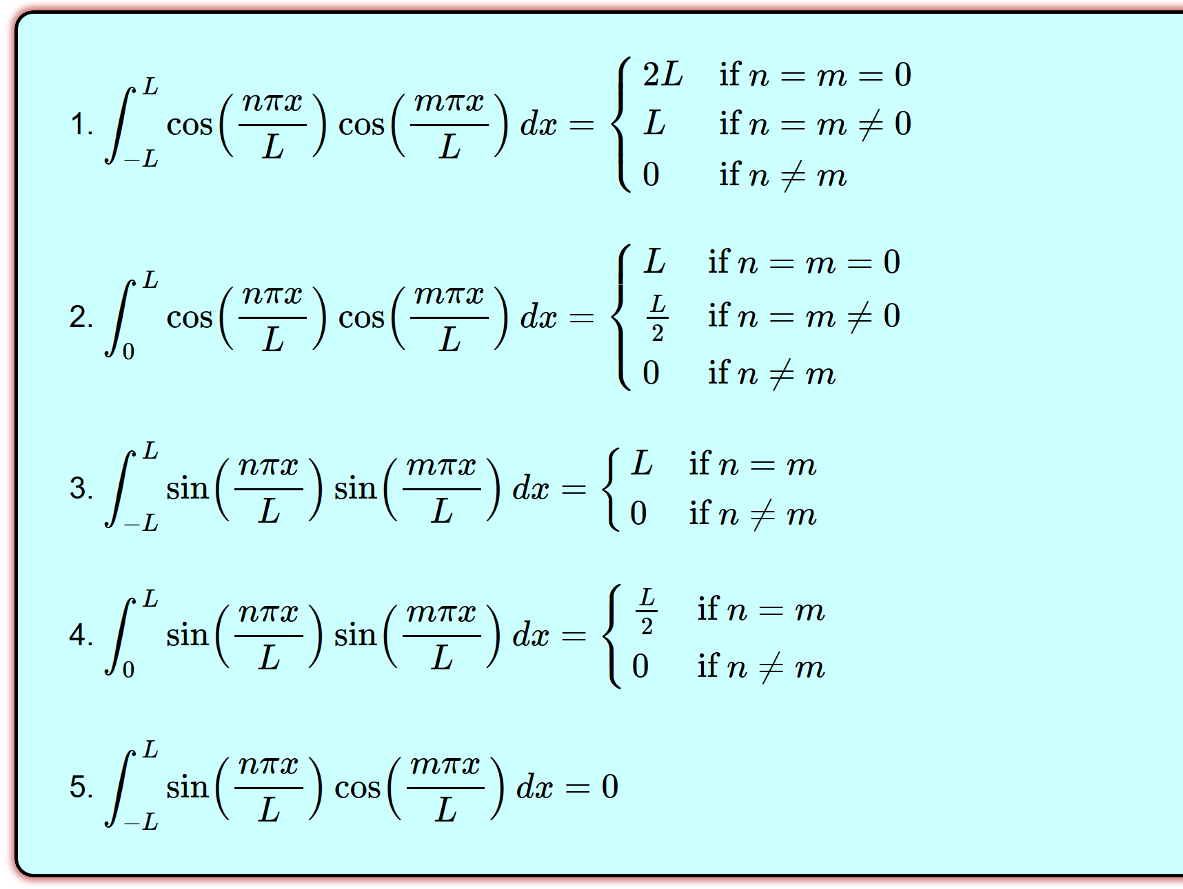
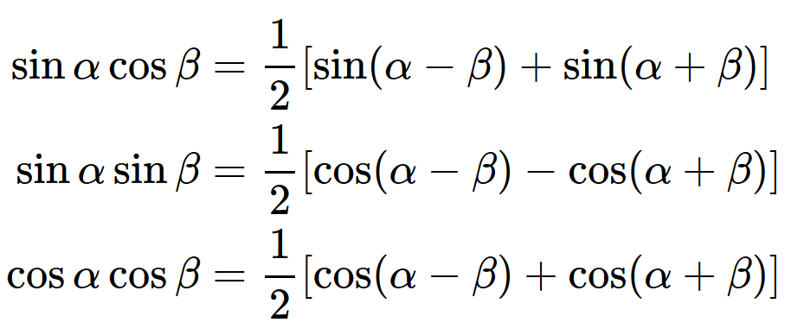
http://tutorial.math.lamar.edu/Classes/DE/PeriodicOrthogonal.aspx

Slide 6
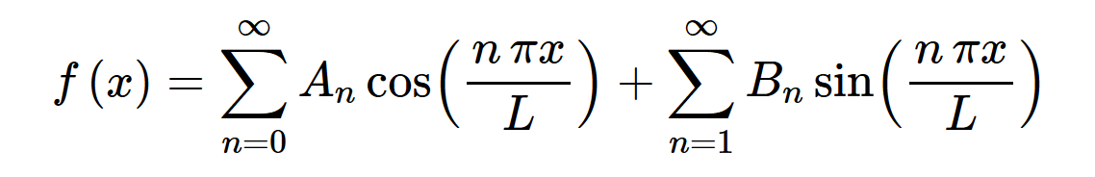
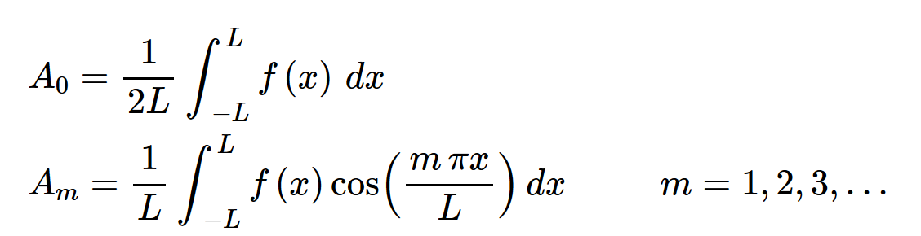
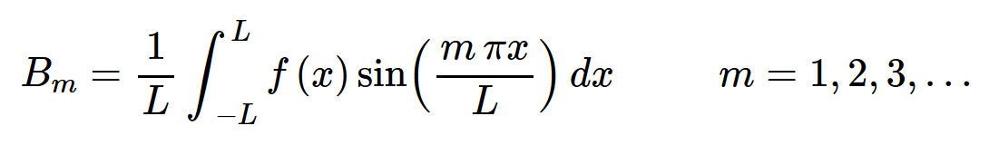
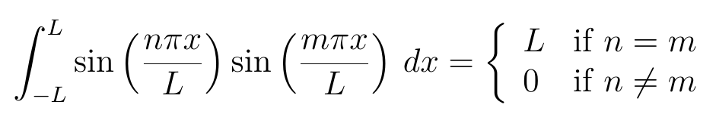
If , then

Slide 7
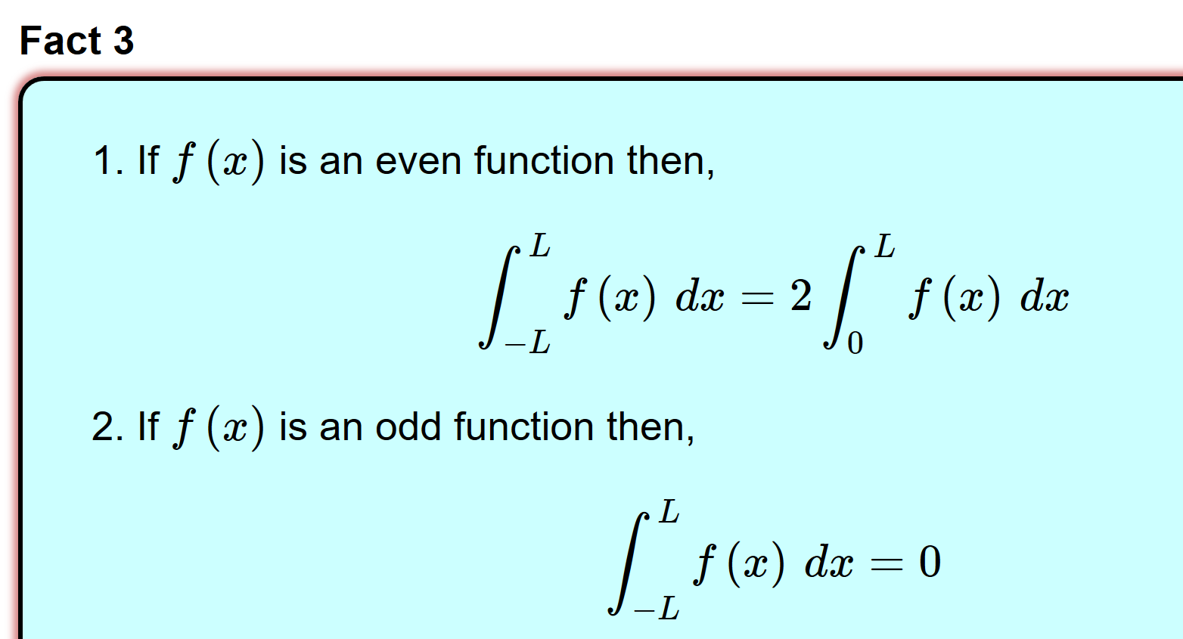
http://tutorial.math.lamar.edu/Classes/DE/PeriodicOrthogonal.aspx
A function is said to be even if f(−x) = f(x)
A function is said to be odd if f(−x) = −f(x)

Slide 8
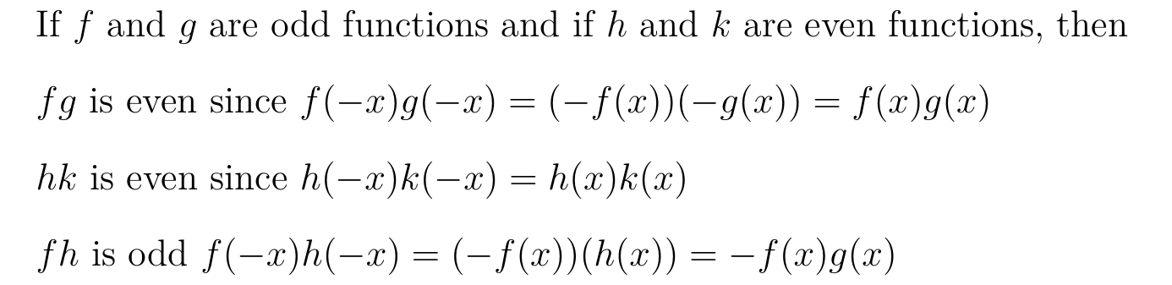
http://tutorial.math.lamar.edu/Classes/DE/PeriodicOrthogonal.aspx
A function is said to be even if f(−x) = f(x)
A function is said to be odd if f(−x) = −f(x)

Slide 9
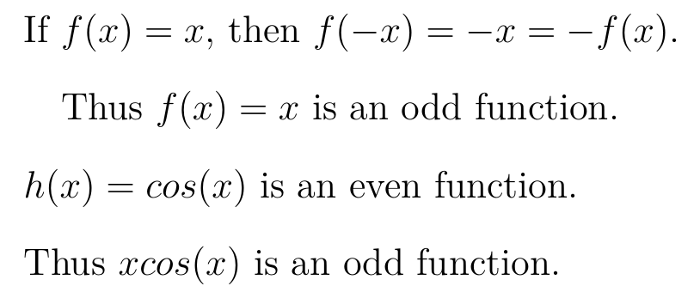
http://tutorial.math.lamar.edu/Classes/DE/PeriodicOrthogonal.aspx
A function is said to be even if f(−x) = f(x)
A function is said to be odd if f(−x) = −f(x)

Slide 10
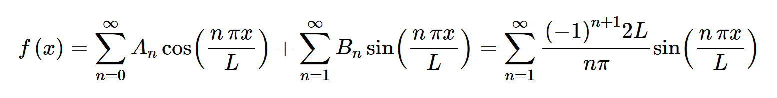
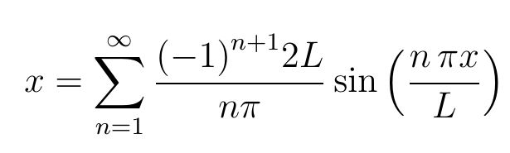

http://tutorial.math.lamar.edu/Classes/DE/FourierSeries.aspx

Slide 11
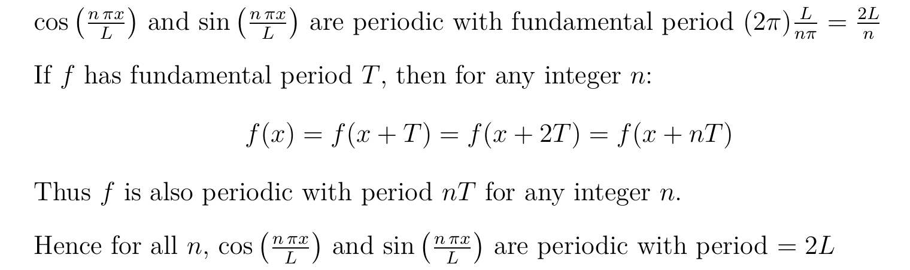
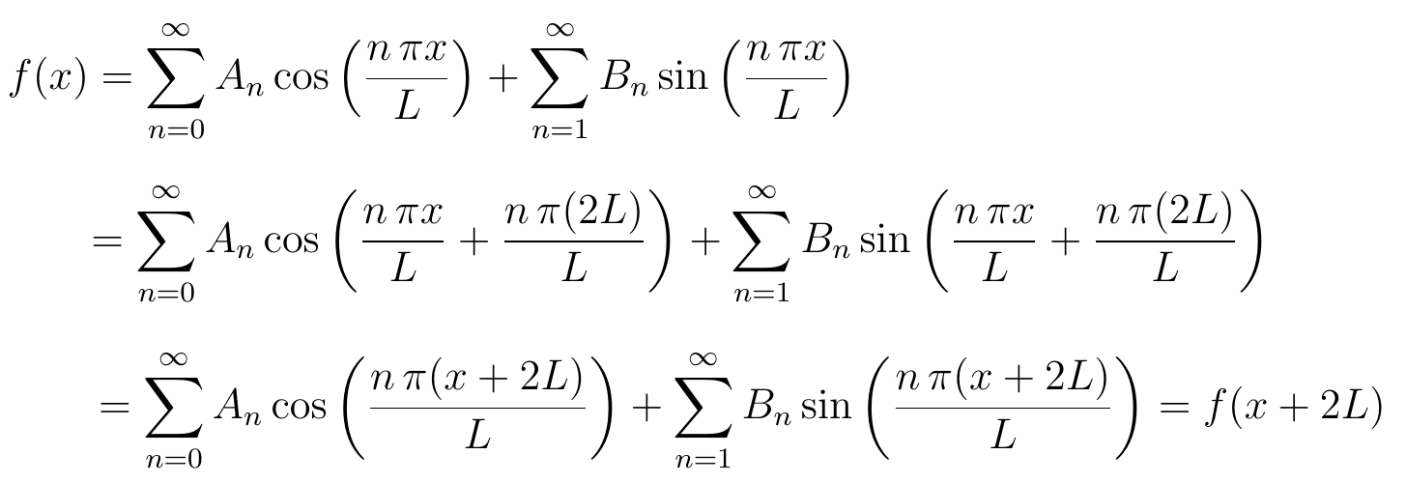


Slide 12
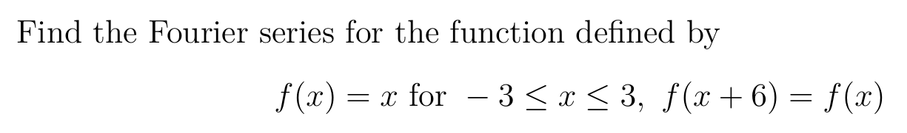

Slide 13
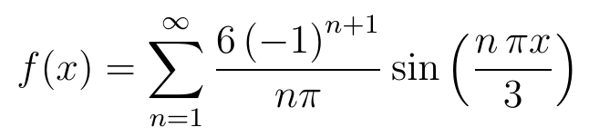
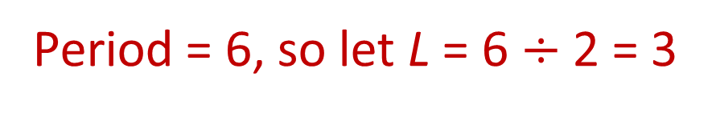
Period = 6, so let L = 6 $÷$2 = 3

Slide 14
Period = 6, so let L = 6 $÷$2 = 3

Slide 15
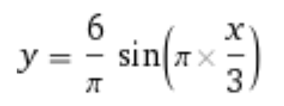
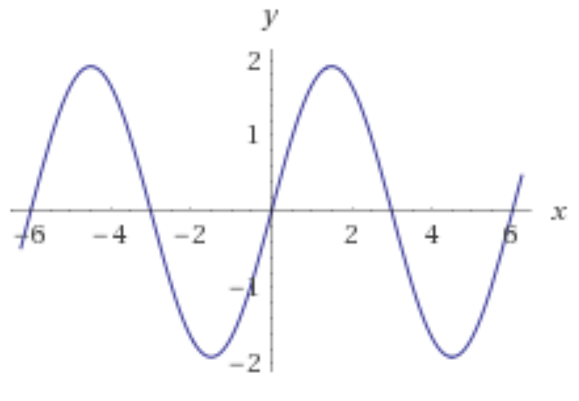

Slide 16
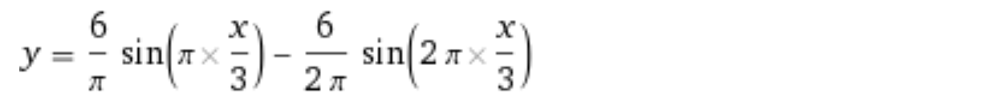
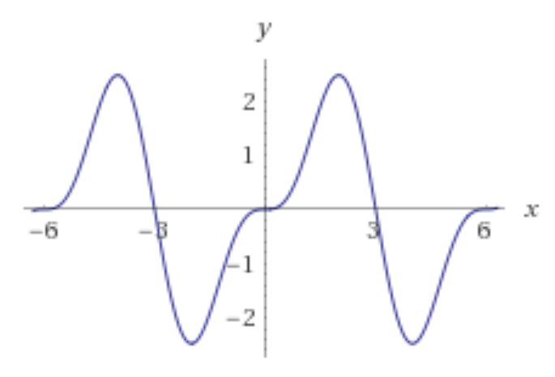

Slide 17
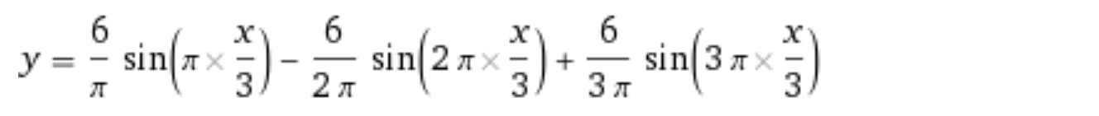
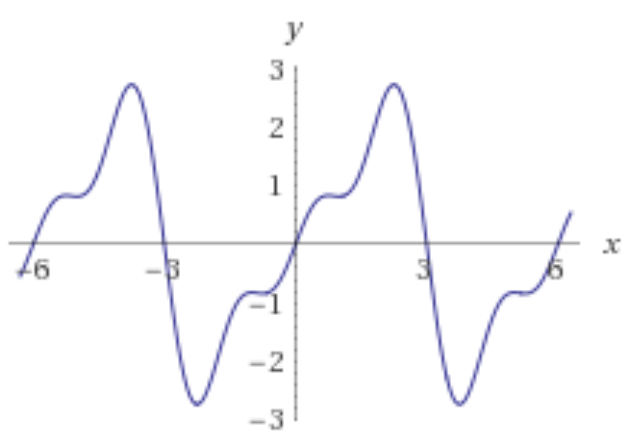

Slide 18
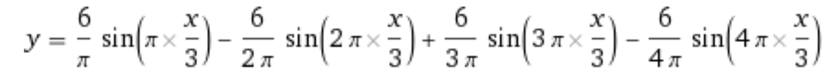
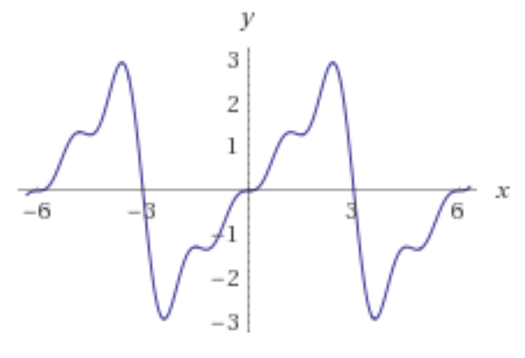

Slide 19
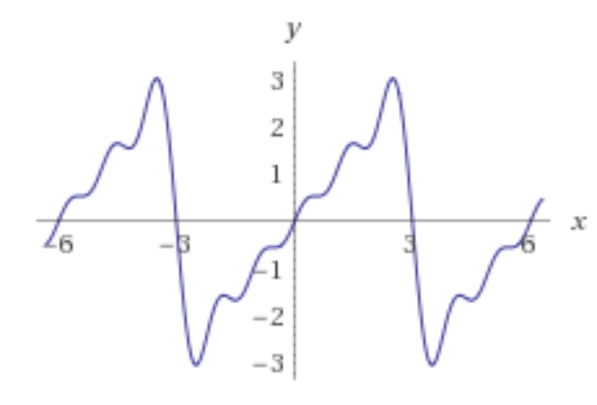

Slide 20
