Slide 1

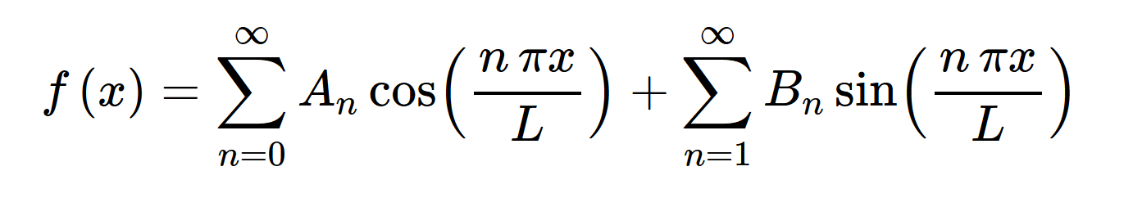
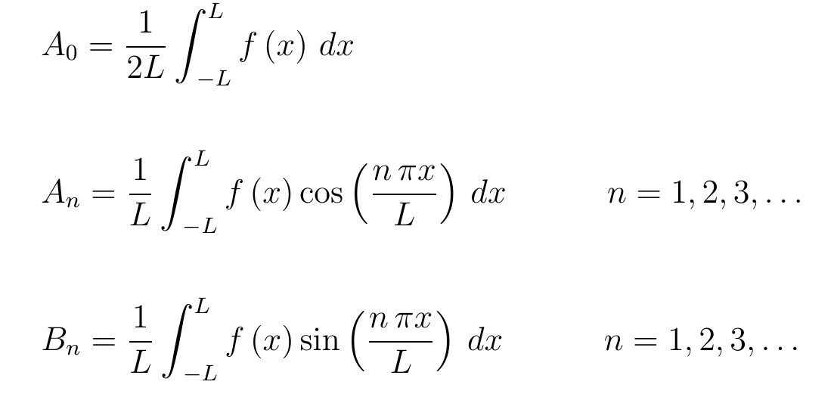
10.2

Slide 2
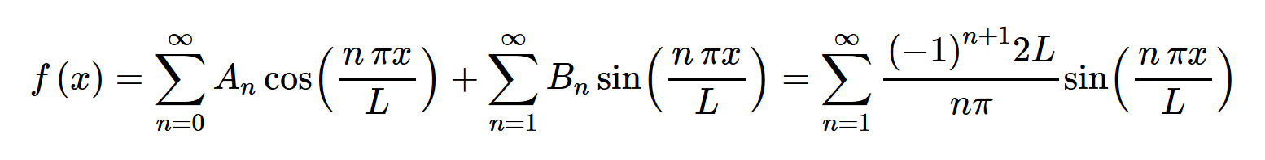
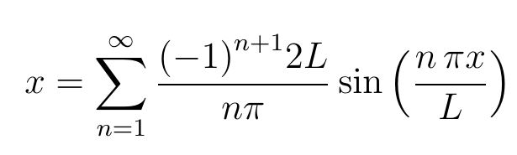

http://tutorial.math.lamar.edu/Classes/DE/FourierSeries.aspx

Slide 3
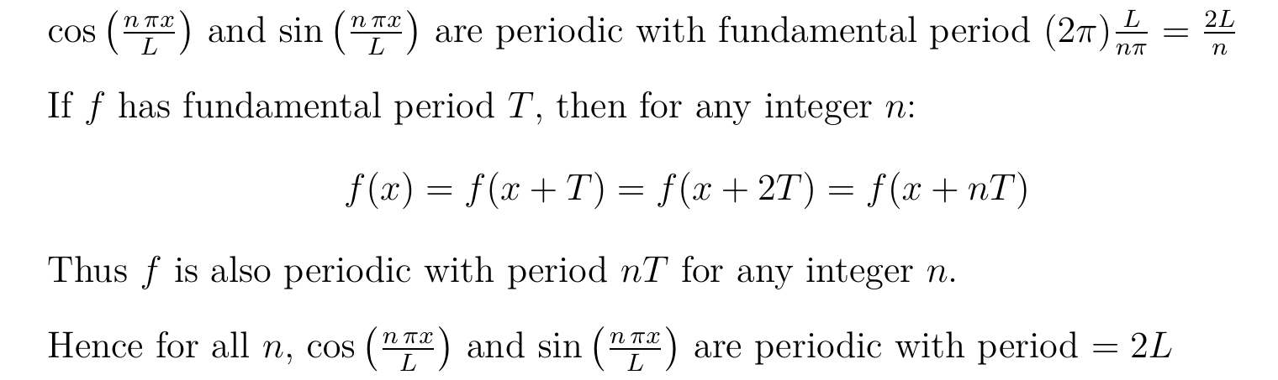
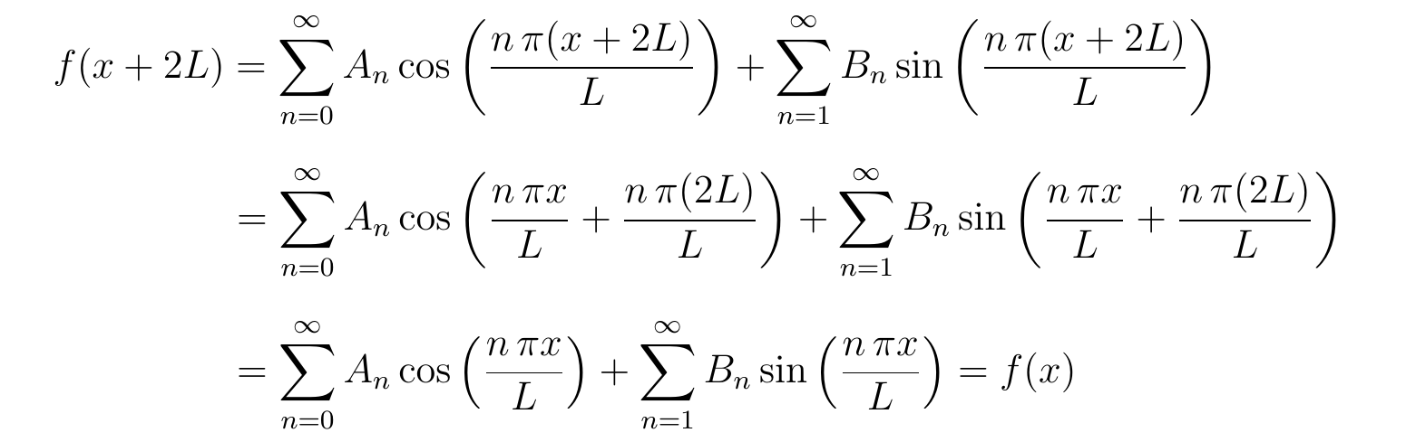


Slide 4
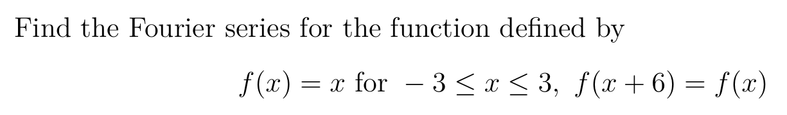

Slide 5
Recall:

Slide 6
Recall:
If f(x + 6) = f(x), then period = , let L =

Slide 7
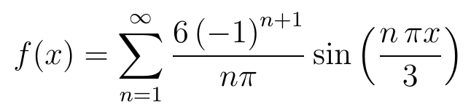
Recall:
If f(x + 6) = f(x), then period = 6, so let L = 6 $÷$2 = 3

Slide 8
Recall:
If f(x + 6) = f(x), then period = 6, so let L = 6 $÷$2 = 3

Slide 9
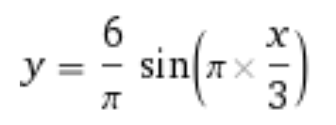
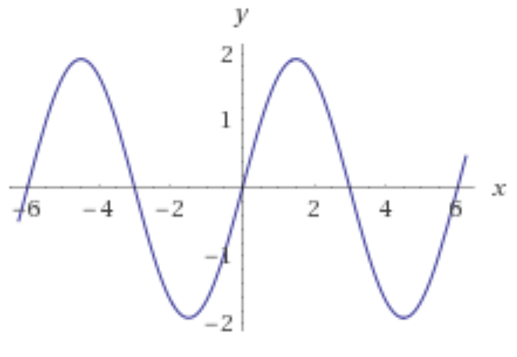

Slide 10
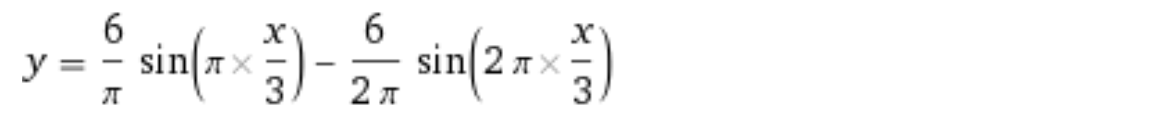
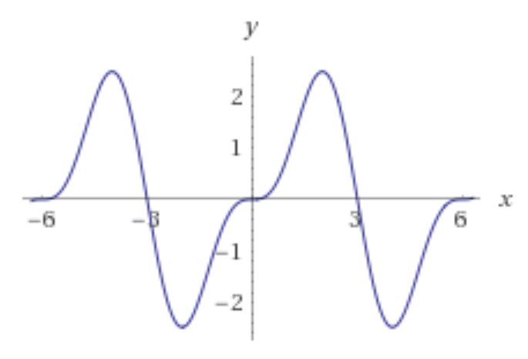

Slide 11
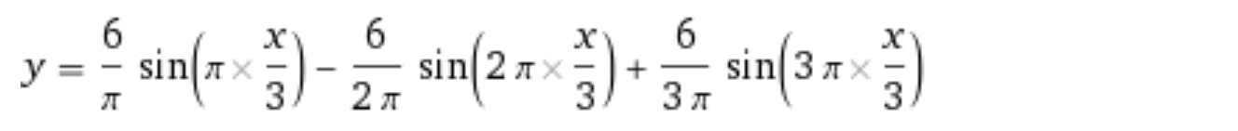
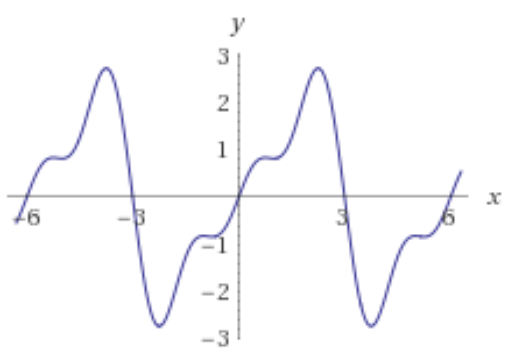

Slide 12
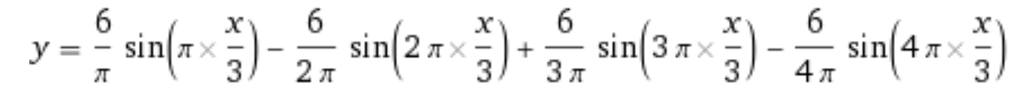
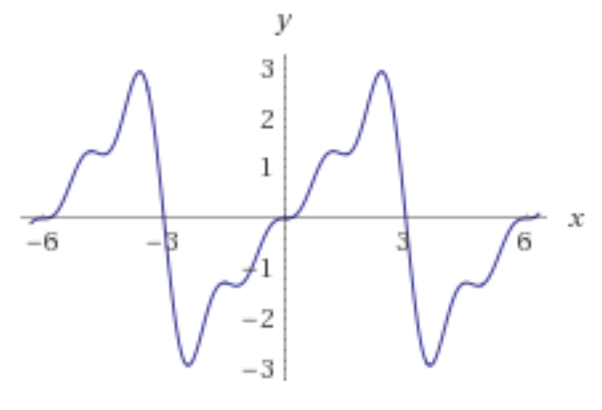

Slide 13
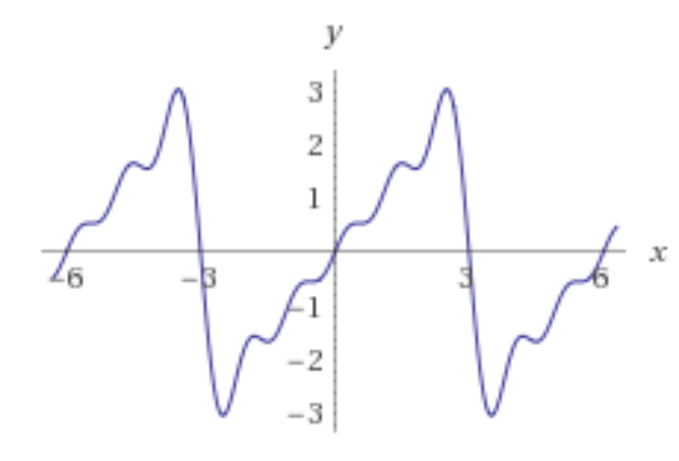

Slide 14
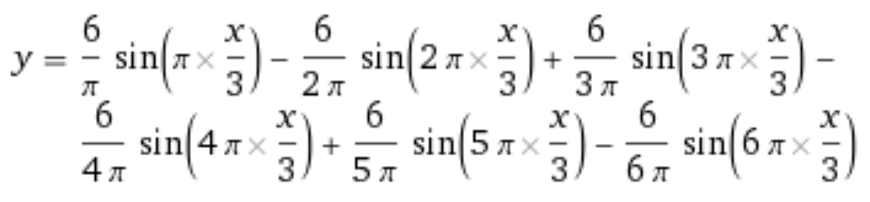
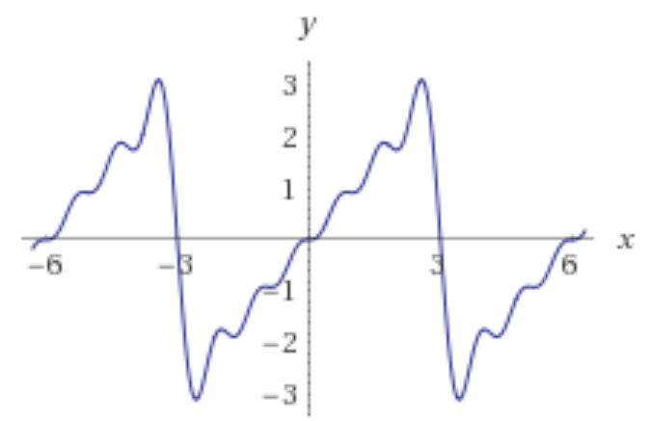

Slide 16
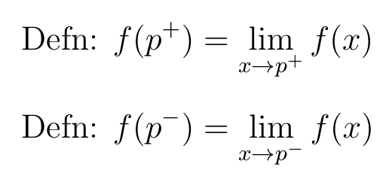
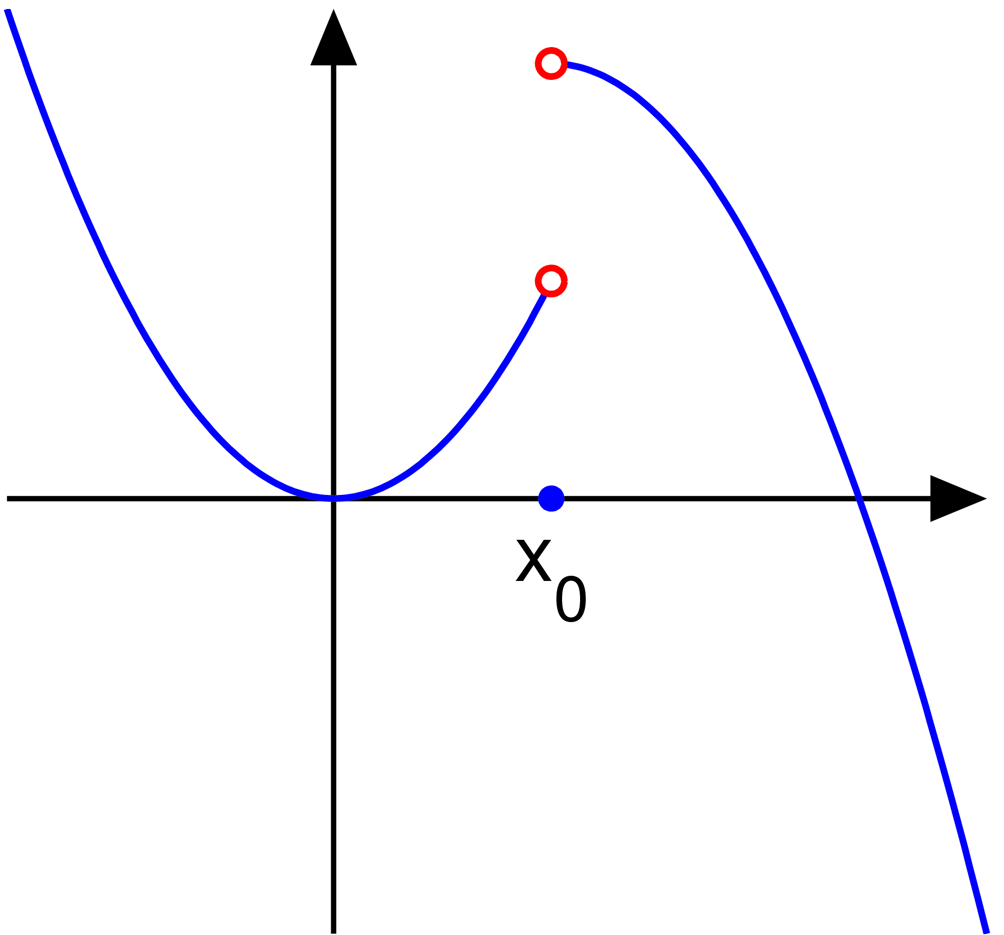
f is piecewise continuous
d
c
p
10.3 Convergence

Slide 17
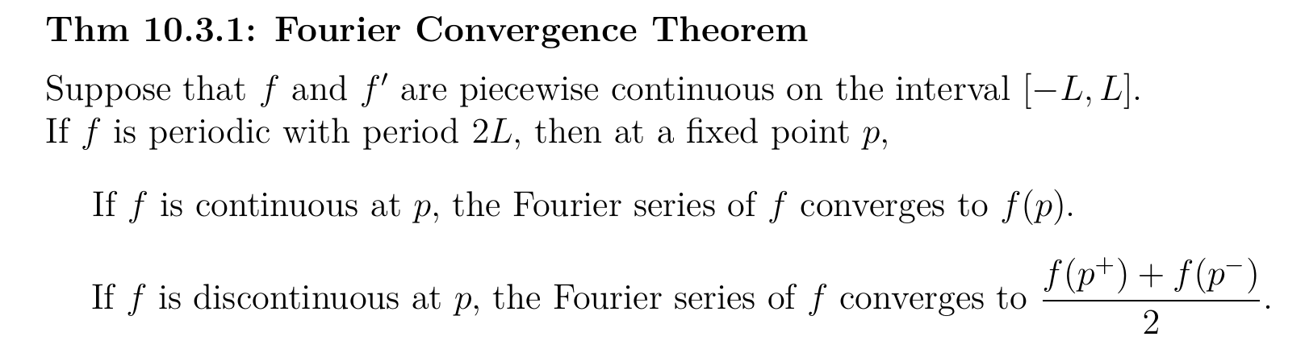

Slide 27
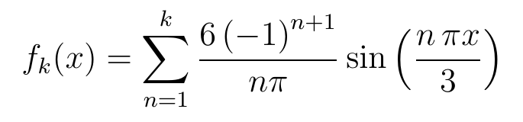
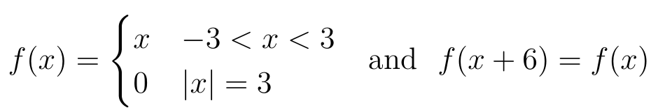

Slide 28
Gibbs phenomenon:
Larger error near discontinuities.
Overshot.

Slide 29
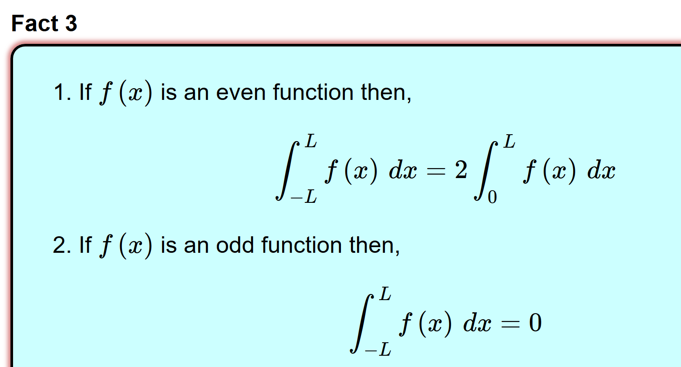
10.4 Even and Odd Functions:
A function is said to be even if f(−x) = f(x)
A function is said to be odd if f(−x) = −f(x)
http://tutorial.math.lamar.edu/Classes/DE/PeriodicOrthogonal.aspx

Slide 30
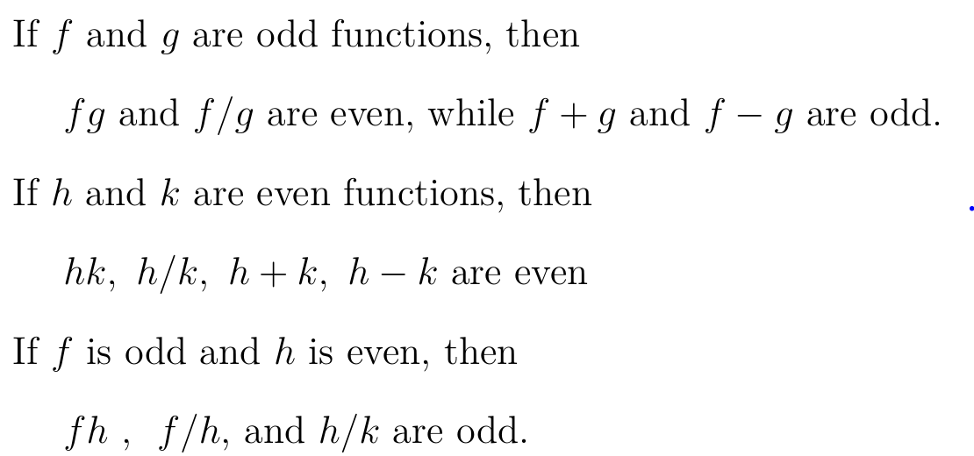
A function is said to be even if f(−x) = f(x)
A function is said to be odd if f(−x) = −f(x)

Slide 31
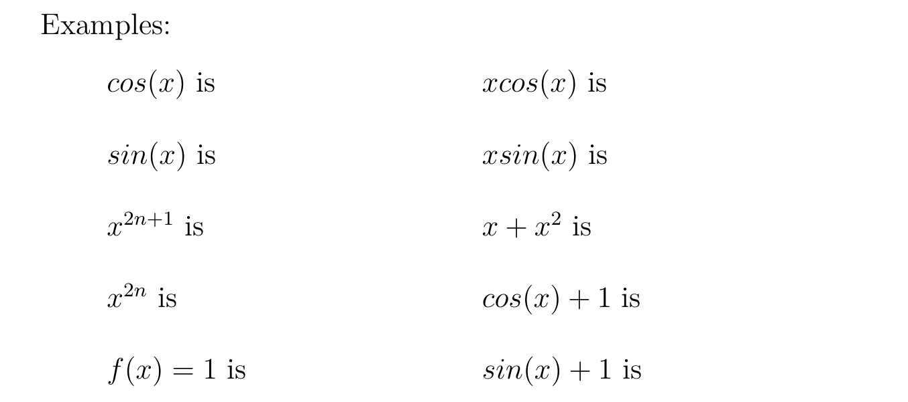
A function is said to be even if f(−x) = f(x)
A function is said to be odd if f(−x) = −f(x)

Slide 32
10.4 If f(x) is an odd function:

Slide 33
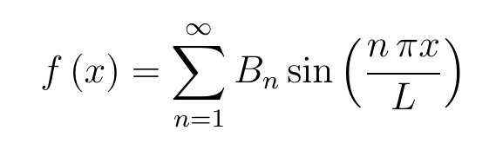
10.4 If f(x) is an odd function:
Fourier sine series

Slide 34
10.4 If f(x) is an even function:

Slide 35
10.4 If f(x) is an even function:
Fourier cosine series

Slide 36
Even and Odd Extensions

Slide 37
http://tutorial.math.lamar.edu/Classes/DE/FourierSeries.aspx

Slide 38
Periodic extension:
Extend function f(x) = x, -3 < x < 3, via a periodic function.

Slide 39
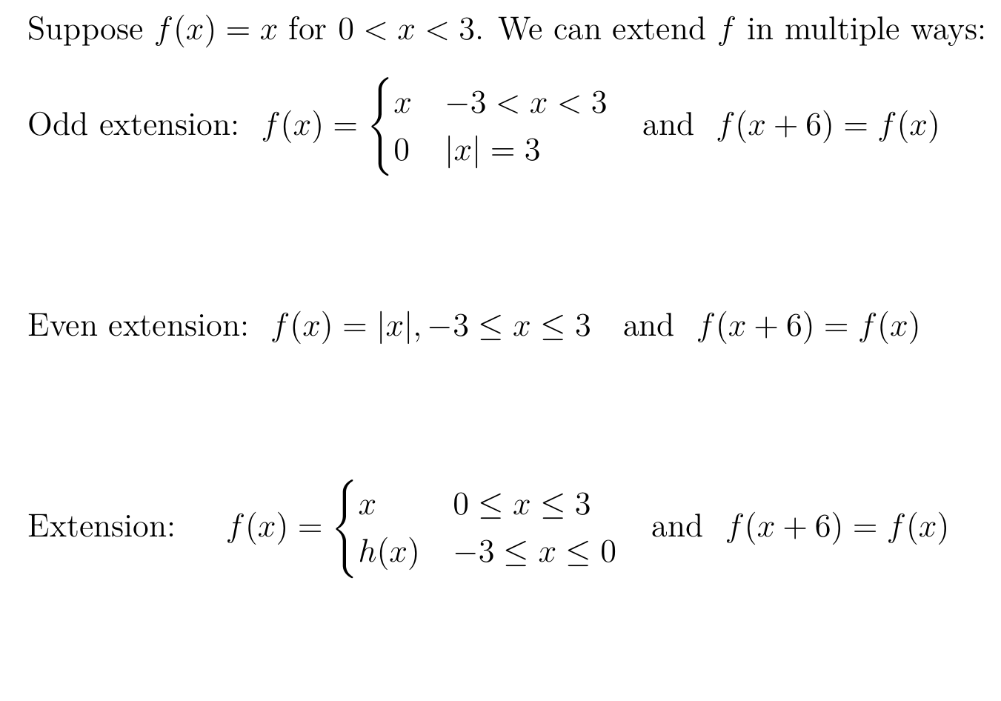

Slide 41
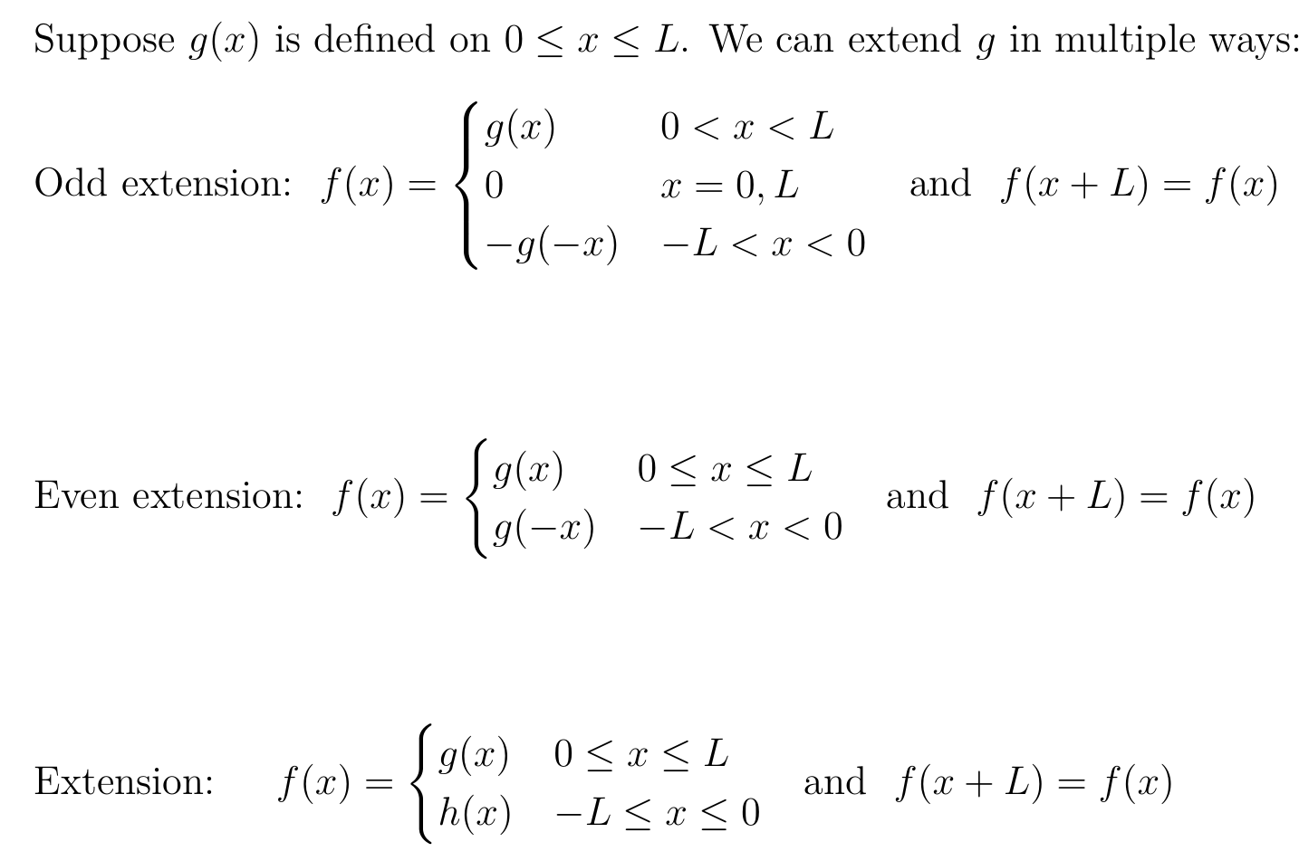

Slide 43
http://tutorial.math.lamar.edu/Classes/DE/FourierSeries.aspx
10.2

Slide 44
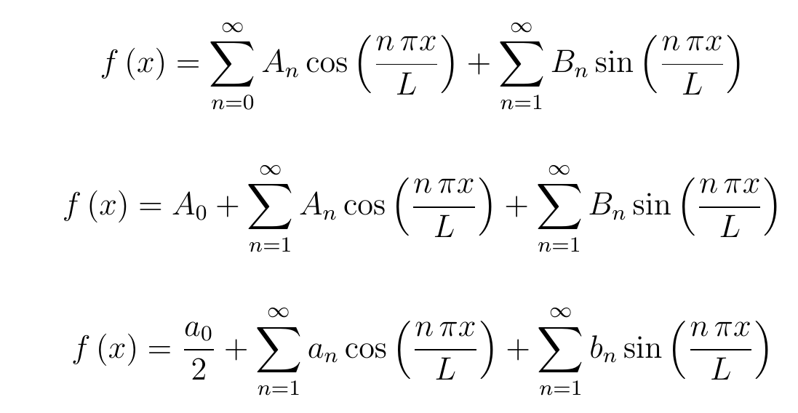
The following are all equivalent:

Slide 45
10.2

Slide 46
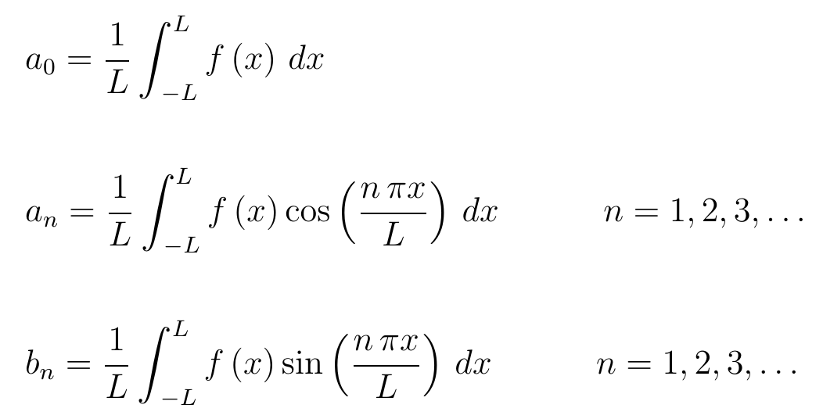
10.2

