Slide 1
Note: Most of the slides for our ch 10 problems will be based on Paul’s online notes often via cut and paste.
http://tutorial.math.lamar.edu/Classes/DE/IntroBVP.aspx

Slide 2
http://tutorial.math.lamar.edu/Classes/DE/FourierSeries.aspx
10.2

Slide 3
http://tutorial.math.lamar.edu/Classes/DE/PeriodicOrthogonal.aspx
Periodic Function
A function is said to be periodic with period T if f(x+T) = f(x) for all x
The smallest value of T satisfying the above is called the fundamental period.

Slide 4
http://tutorial.math.lamar.edu/Classes/DE/PeriodicOrthogonal.aspx
A function is said to be even if f(−x) = f(x)
A function is said to be odd if f(−x) = −f(x)

Slide 5
http://tutorial.math.lamar.edu/Classes/DE/PeriodicOrthogonal.aspx

Slide 6
http://tutorial.math.lamar.edu/Classes/DE/PeriodicOrthogonal.aspx

Slide 7
http://tutorial.math.lamar.edu/Classes/DE/PeriodicOrthogonal.aspx

Slide 8
http://tutorial.math.lamar.edu/Classes/DE/PeriodicOrthogonal.aspx

Slide 9
http://tutorial.math.lamar.edu/Classes/DE/PeriodicOrthogonal.aspx

Slide 10
http://tutorial.math.lamar.edu/Classes/DE/PeriodicOrthogonal.aspx

Slide 11
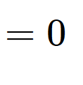
http://tutorial.math.lamar.edu/Classes/DE/PeriodicOrthogonal.aspx
Since

Slide 12
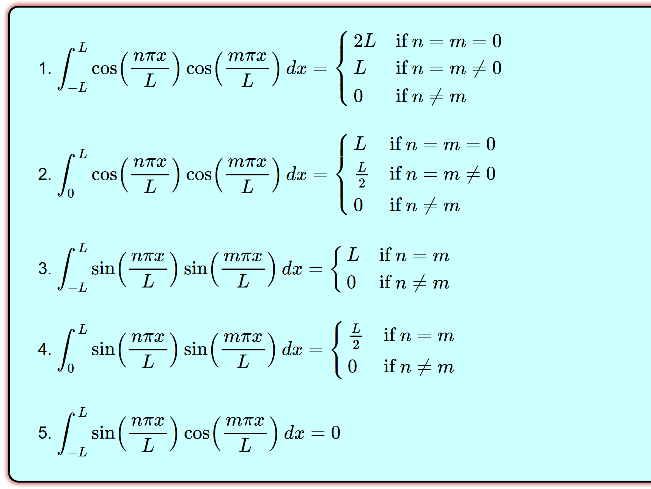
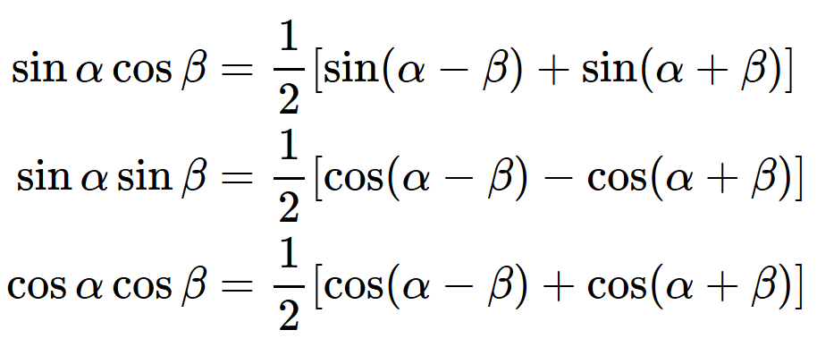
http://tutorial.math.lamar.edu/Classes/DE/PeriodicOrthogonal.aspx

Slide 13
http://tutorial.math.lamar.edu/Classes/DE/PeriodicOrthogonal.aspx

Slide 14
Find A_{n} and B_{n} if
To find A_{m}:

Slide 15
Find A_{n} and B_{n} if

Slide 16
Find A_{n} and B_{n} if

Slide 17
Find A_{n} and B_{n} if

Slide 18
Find A_{n} and B_{n} if

Slide 19
Find A_{n} and B_{n} if

Slide 20
Find A_{n} and B_{n} if

Slide 21
Find A_{n} and B_{n} if

Slide 22
Find A_{n} and B_{n} if

Slide 23
Find A_{n} and B_{n} if

Slide 24
http://tutorial.math.lamar.edu/Classes/DE/PeriodicOrthogonal.aspx
A function is said to be even if f(−x) = f(x)
A function is said to be odd if f(−x) = −f(x)

Slide 25
http://tutorial.math.lamar.edu/Classes/DE/PeriodicOrthogonal.aspx
A function is said to be even if f(−x) = f(x)
A function is said to be odd if f(−x) = −f(x)

Slide 26
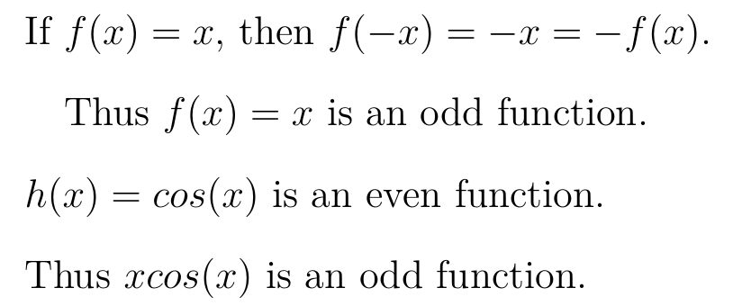
http://tutorial.math.lamar.edu/Classes/DE/PeriodicOrthogonal.aspx
A function is said to be even if f(−x) = f(x)
A function is said to be odd if f(−x) = −f(x)

Slide 27
http://tutorial.math.lamar.edu/Classes/DE/FourierSeries.aspx
Find A_{n} and B_{n} if

Slide 28
http://tutorial.math.lamar.edu/Classes/DE/FourierSeries.aspx
Find A_{n} and B_{n} if

Slide 29
http://tutorial.math.lamar.edu/Classes/DE/FourierSeries.aspx
Find A_{n} and B_{n} if

Slide 30
http://tutorial.math.lamar.edu/Classes/DE/FourierSeries.aspx

Slide 31
http://tutorial.math.lamar.edu/Classes/DE/FourierSeries.aspx

Slide 32
http://tutorial.math.lamar.edu/Classes/DE/FourierSeries.aspx

Slide 33
http://tutorial.math.lamar.edu/Classes/DE/FourierSeries.aspx

Slide 34
http://tutorial.math.lamar.edu/Classes/DE/FourierSeries.aspx

Slide 35
http://tutorial.math.lamar.edu/Classes/DE/FourierSeries.aspx

