Slide 1





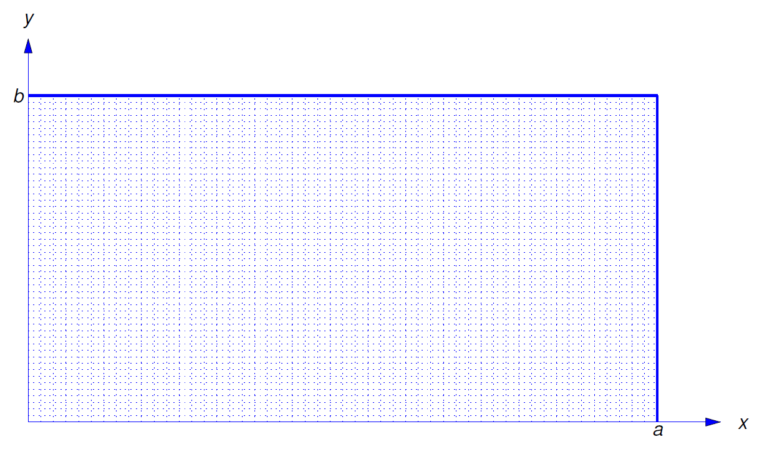
Ch 10 Boundary Value Problems
10.5 and 10.6 Heat Equation
10.7 Wave Equation
10.8 LaPlace Equation

Slide 2
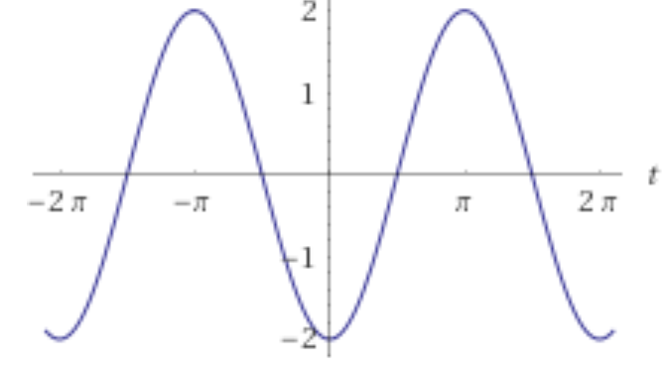
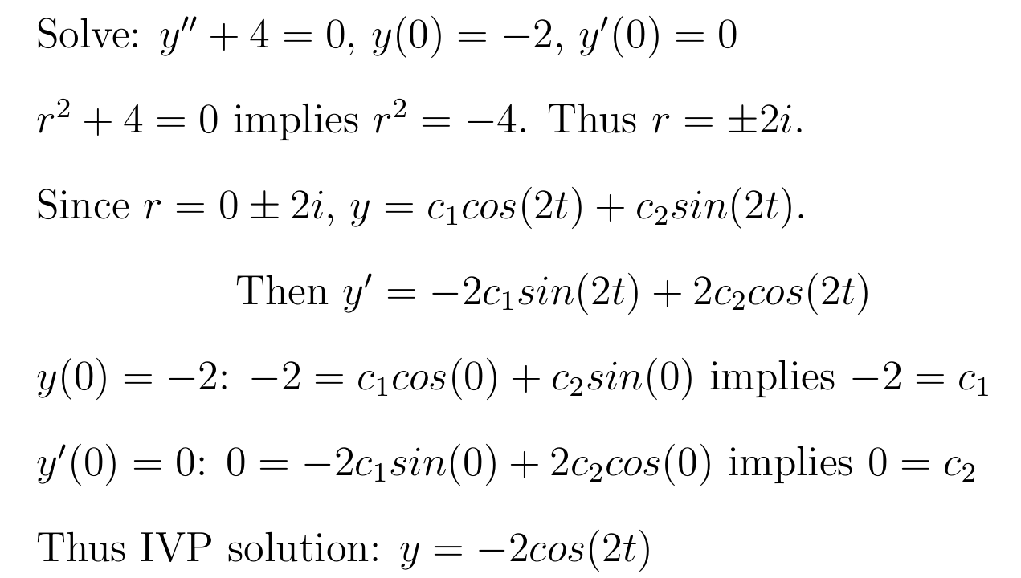
Boundary Value Problem vs Initial Value Problem
In Math IV, you solved DE equations involving initial values:

Slide 3

Boundary Value Problem vs Initial Value Problem
In Math IV, you solved DE equations involving initial values:

Slide 4

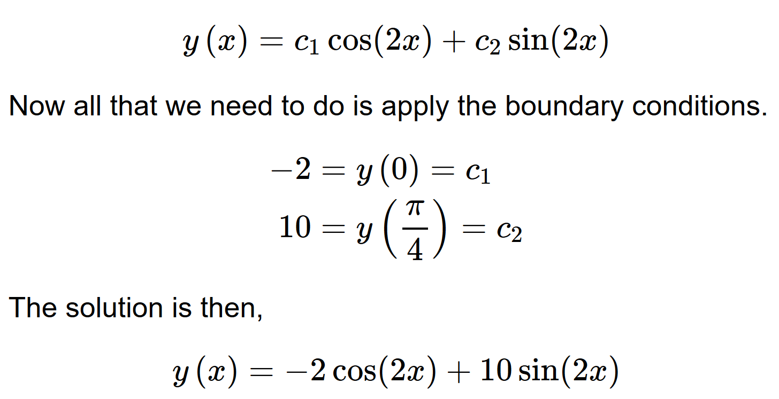
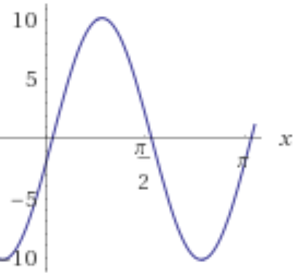
http://tutorial.math.lamar.edu/Classes/DE/BoundaryValueProblem.aspx

Slide 5

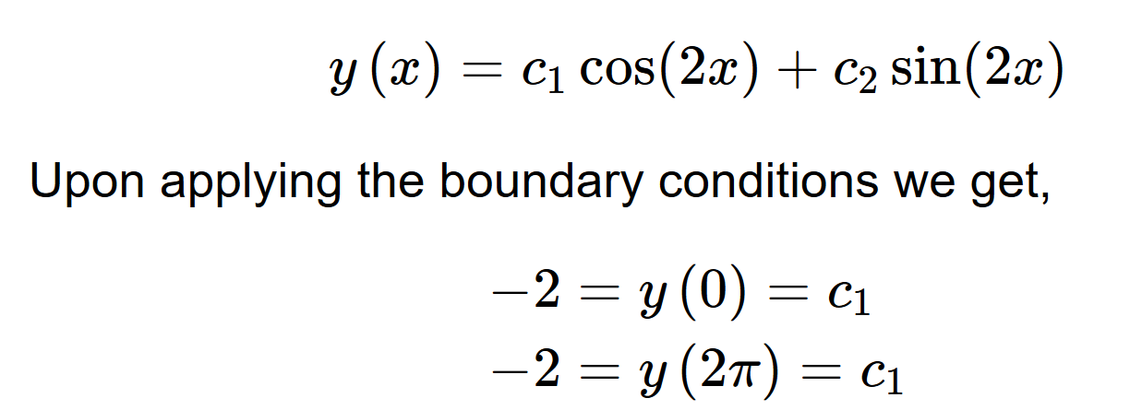


Slide 6

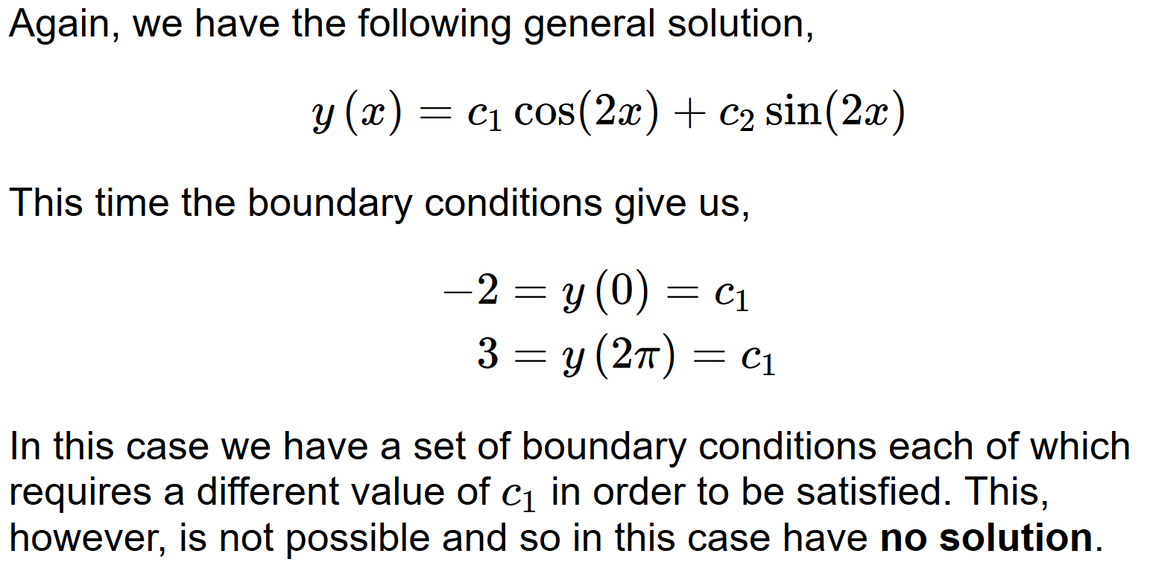

Slide 7




Slide 8



Periodic Function
A function is said to be periodic with period T if f(x+T) = f(x) for all x

Slide 9
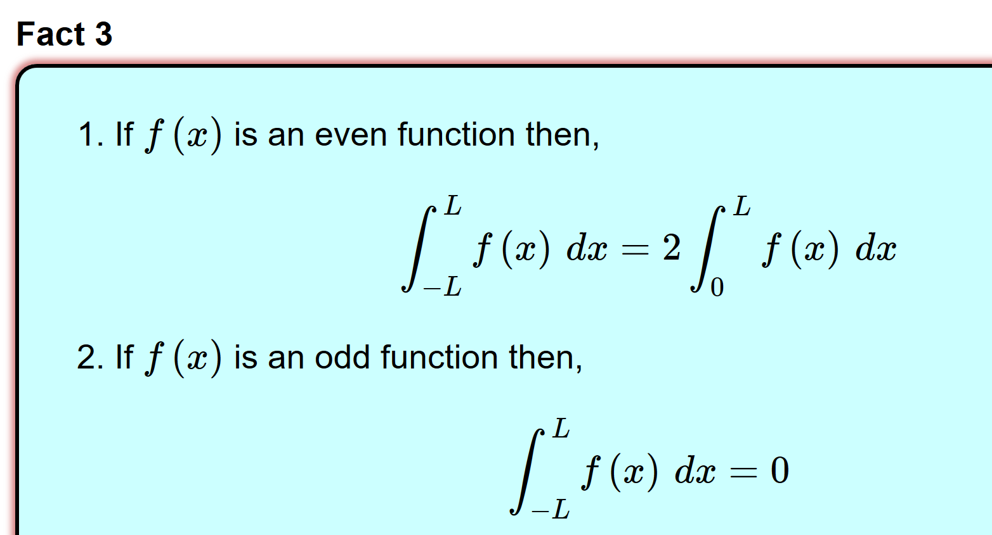
A function is said to be even if f(−x) = f(x)
A function is said to be odd if f(−x) = −f(x)

Slide 10
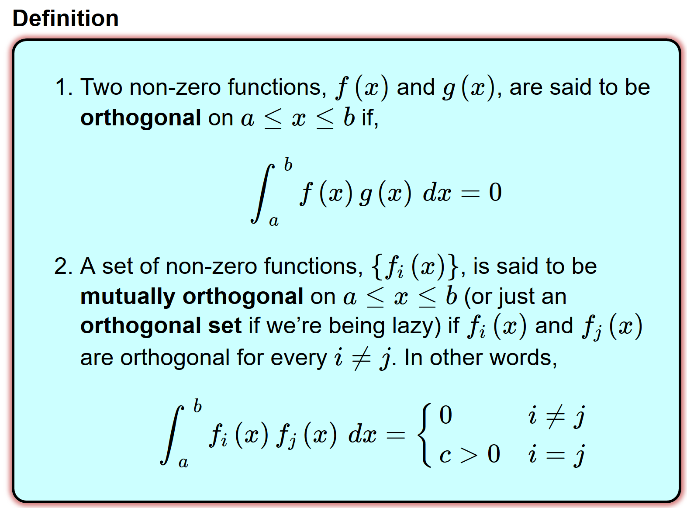

Slide 11


