Slide 1
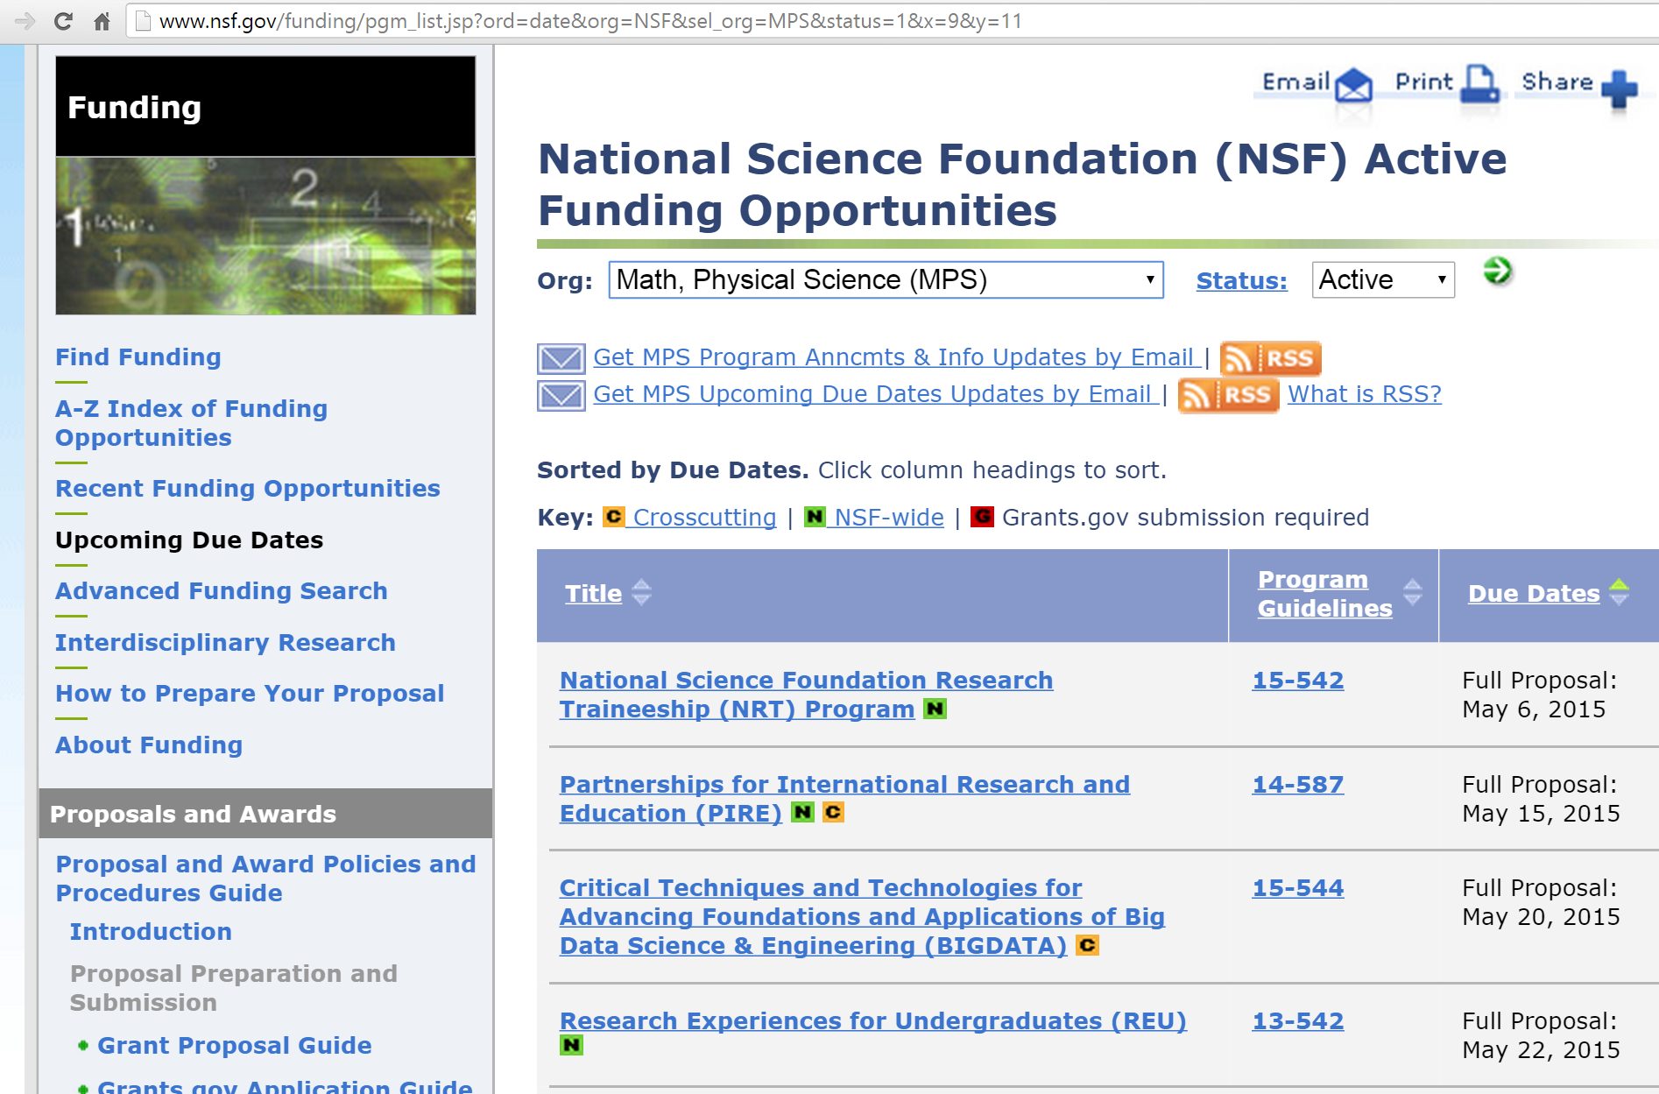
http://www.nsf.gov/funding/pgm_list.jsp?ord=date&org=NSF&sel_org=MPS&status=1&x=9&y=11

Slide 2
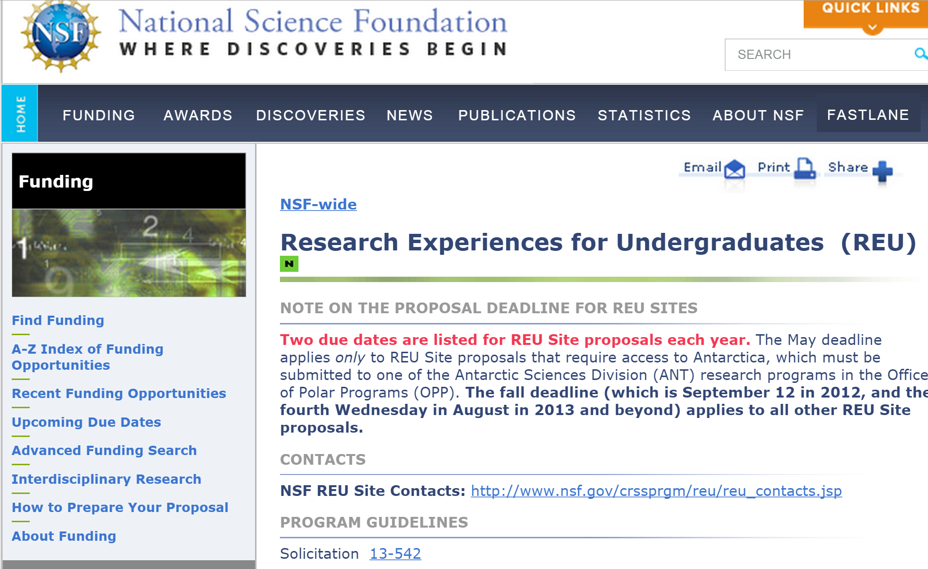
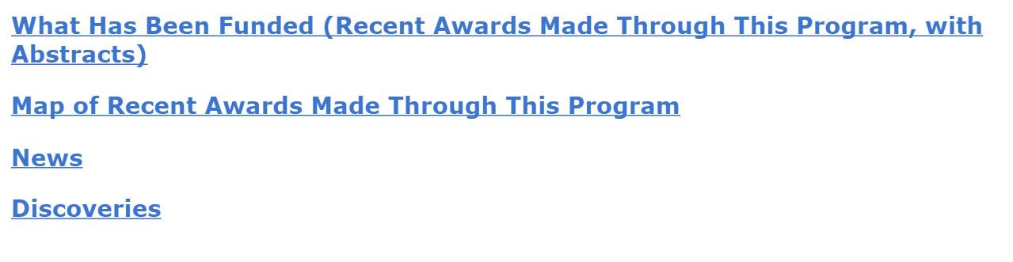
http://www.nsf.gov/funding/pgm_summ.jsp?pims_id=5517&org=NSF&sel_org=MPS&from=fund
At bottom of page

Slide 3
http://www.nsf.gov/funding/pgm_summ.jsp?pims_id=5517&org=NSF&sel_org=MPS&from=fund

Slide 4
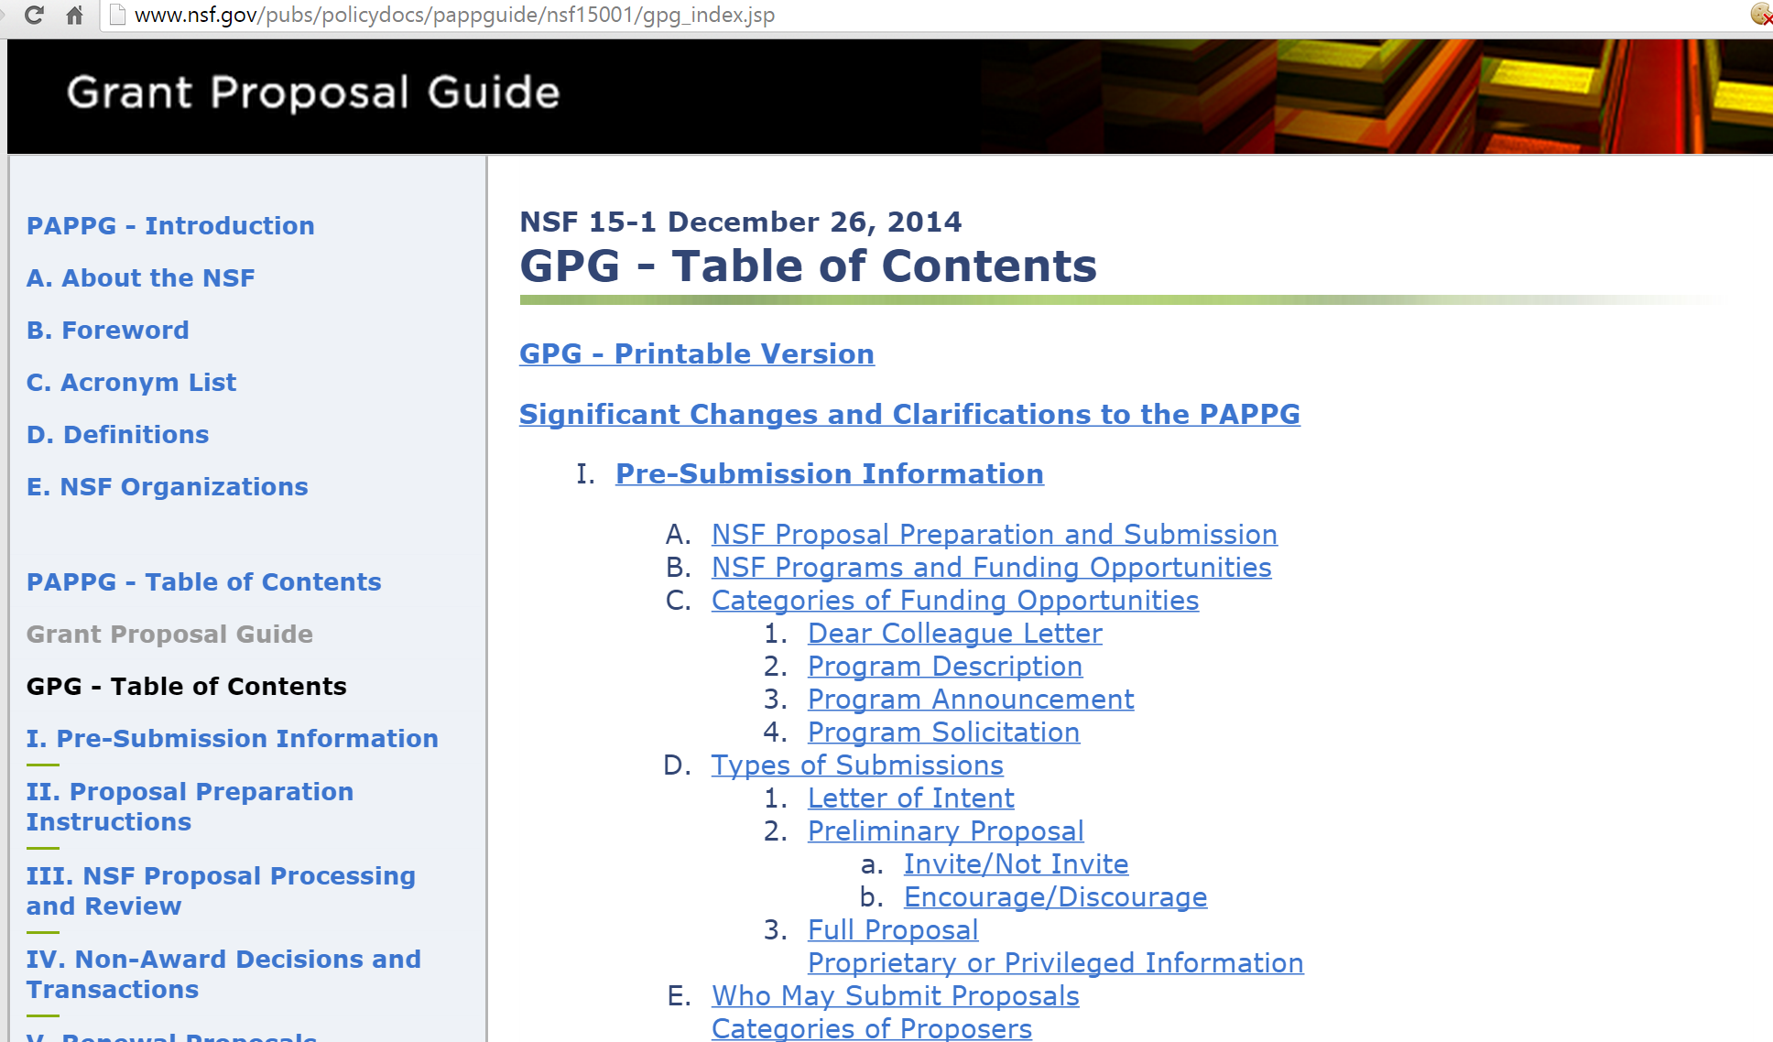
http://www.nsf.gov/pubs/policydocs/pappguide/nsf15001/gpg_index.jsp

Slide 5
Parts of an NSF proposal:
a. Cover Sheet
b. Project Summary
c. Table of Contents
d. Project Description
e. References Cited
f. Biographical Sketch(es)
g. Budget and Budget Justification
h. Current and Pending Support
i. Facilities, Equipment and Other Resources
j. Special Information and Supplementary Documentation
        Data Management Plan
        Postdoctoral Mentoring Plan (if applicable)

Slide 6
Parts of an NSF proposal:
Cover Pages
List of suggested Reviewers
Project Summary (limited to one page)
Project Description (must not exceed 15 pages).
References Cited – no page limit.
Biographical Sketches (limited to two pages, usually)
Budget (include Budget Justification).
When preparing proposals, PIs are encouraged to contact the appropriate disciplinary REU program officer (see
http://www.nsf.gov/crssprgm/reu/reu_contacts.jsp) with any questions about the budget or the appropriateness of charges in it.
Current and Pending Support.
Facilities, Equipment, and Other Resources.
Supplementary Documentation.
E.g. Data Management, Post-doc Mentoring, Letters of collaboration.
Program specific requirements

Slide 7
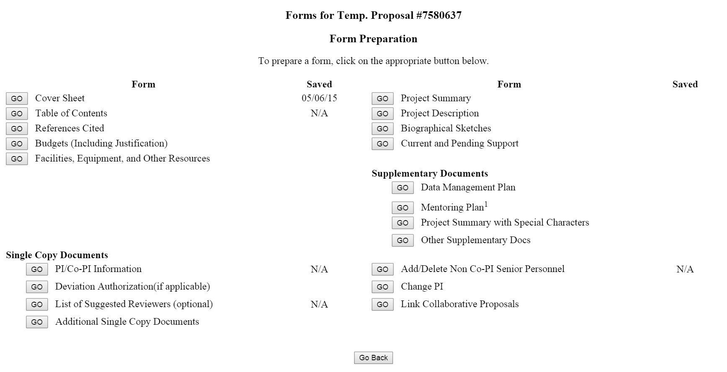
https://www.fastlane.nsf.gov/servlet/FastLane.A1FormSel

Slide 8
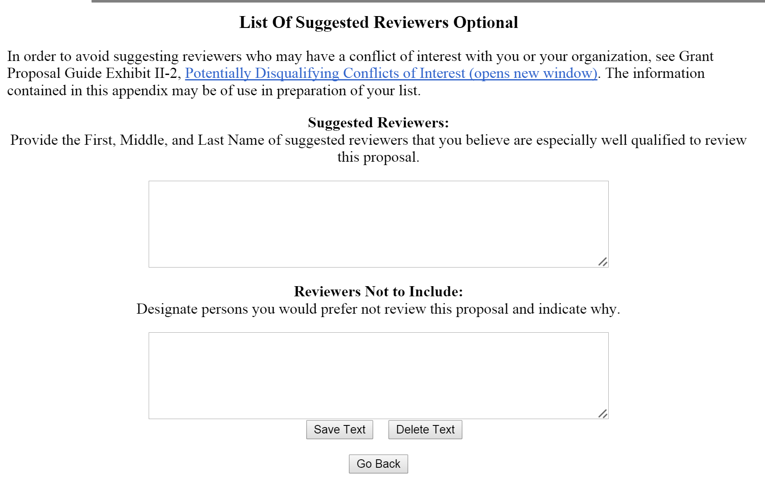
Including a list of suggested reviewers may help program officers to determine possible reviewers for your proposal. Having an expert in your field advocating for your proposal can be very helpful

Slide 9
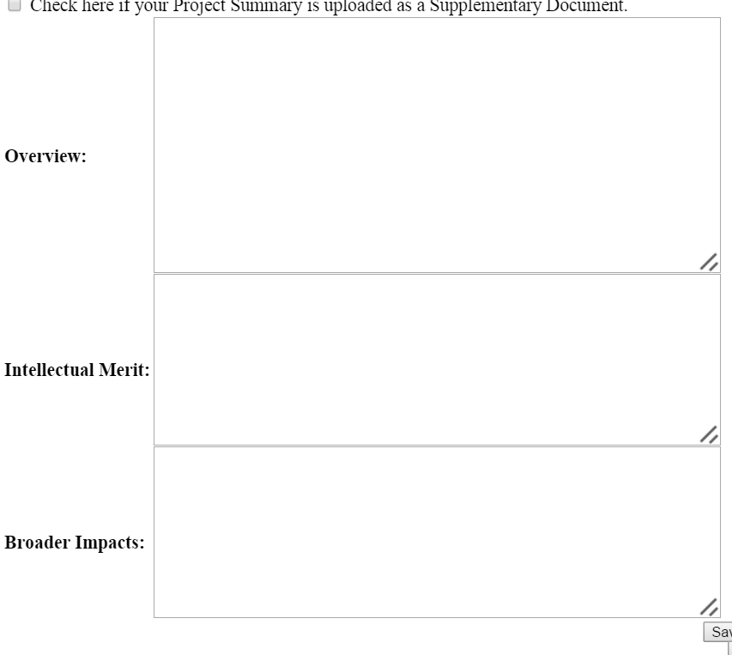
Project Summary
Limited to one page,
character limit is 4,600 characters
Audience: General, not specialized.
Must include
Overview,
Intellectual merit, and
broader impact.
Samples:
http://www.uww.edu/Documents/urp/rui/ProjectSummaryfromRUI2101-MW.pdf
http://www.uww.edu/Documents/urp/rui/ProjectSummary-KC.pdf

Slide 10
References Cited – no page limit.
If your references (or lack of) show that you aren’t sufficiently
familiar with the field, you are unlikely to be funded.

Slide 11
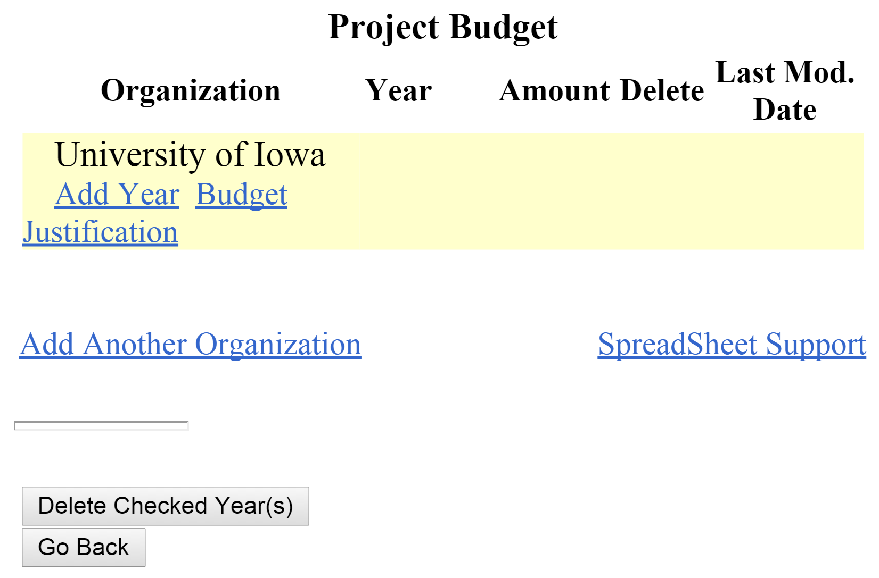

Slide 12
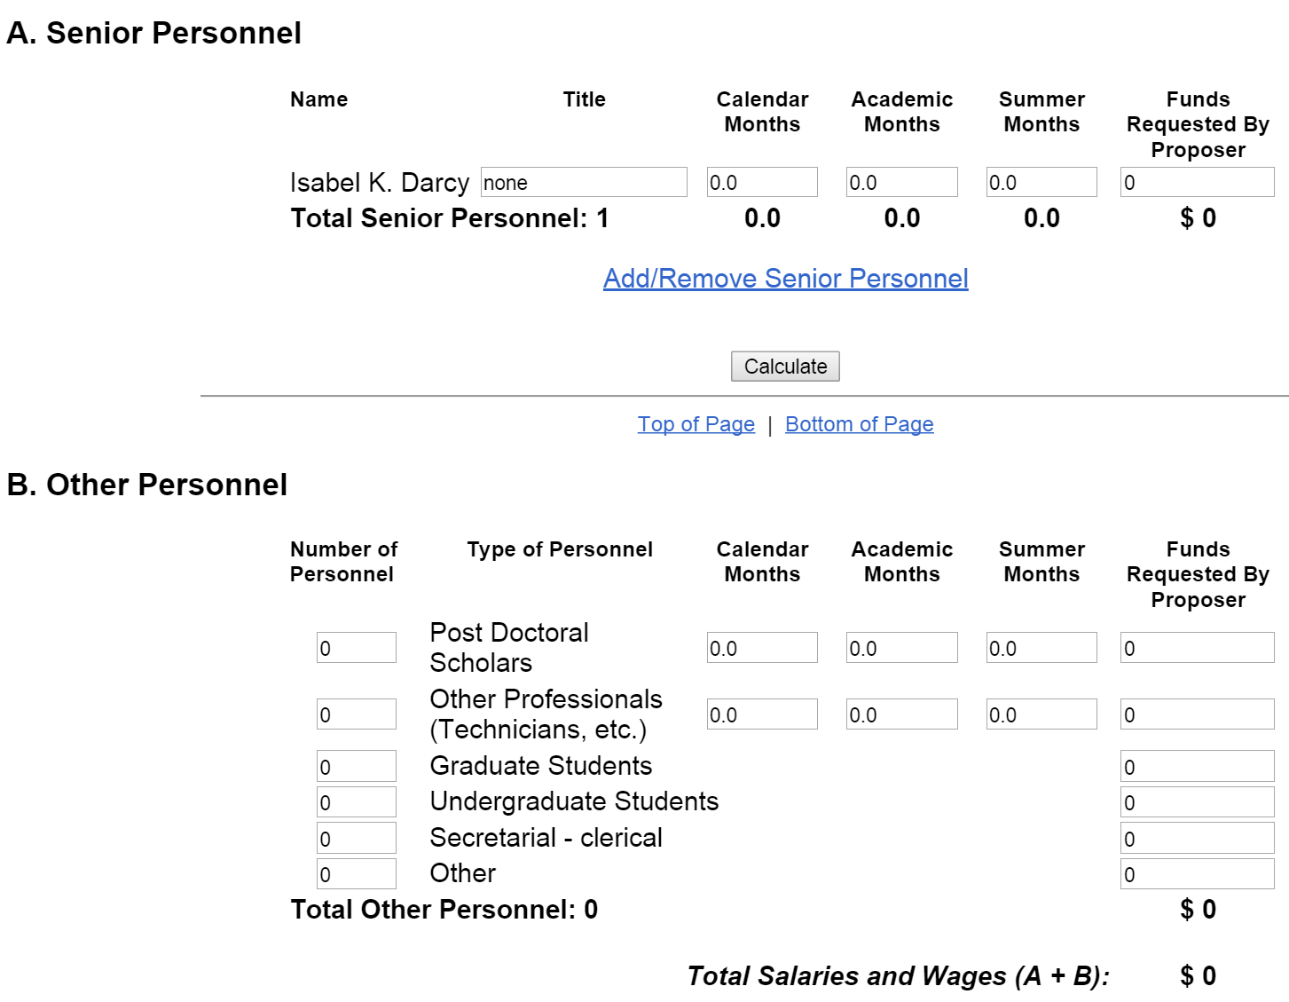

Slide 13
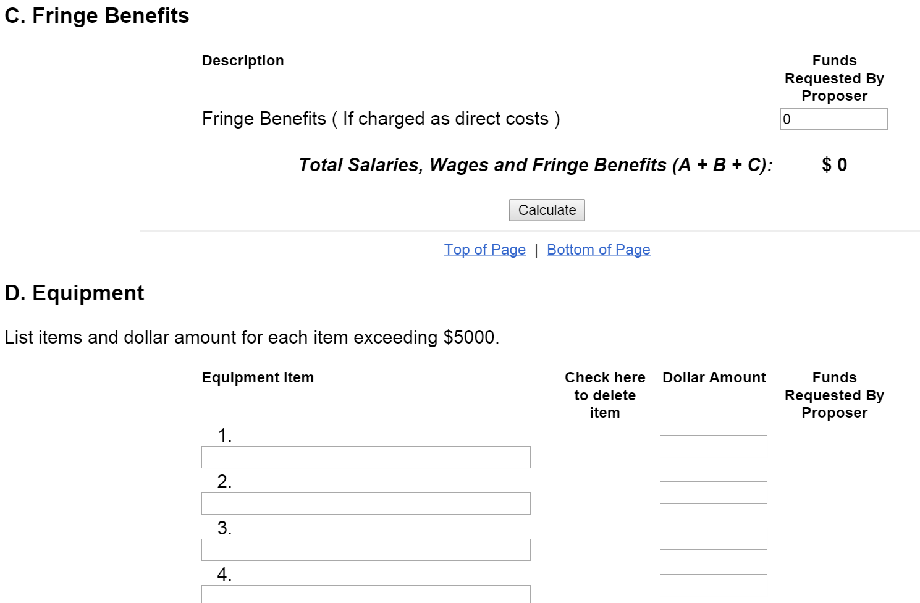

Slide 14
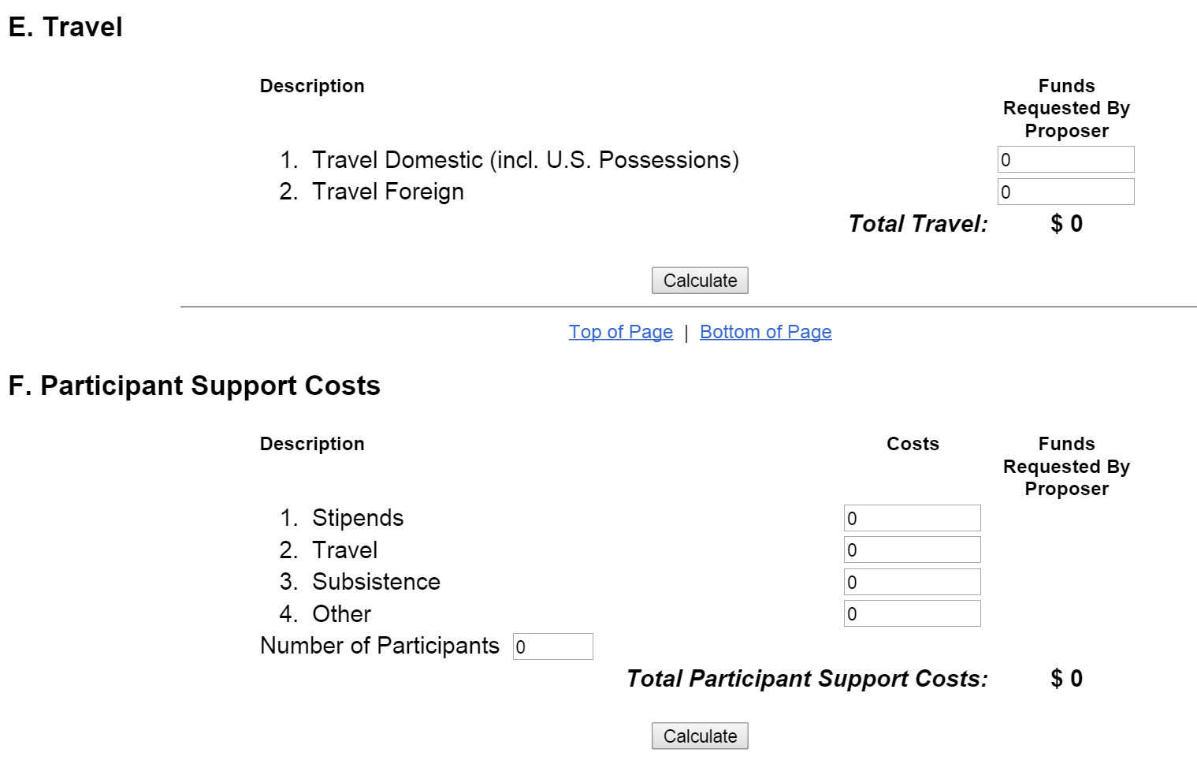

Slide 15
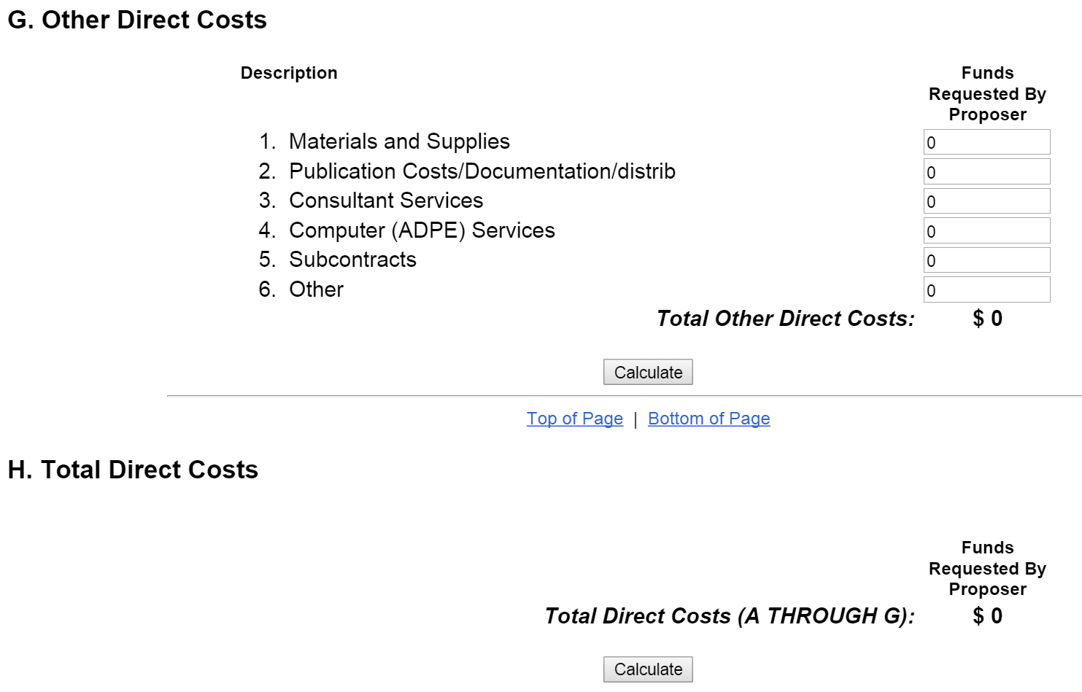

Slide 16
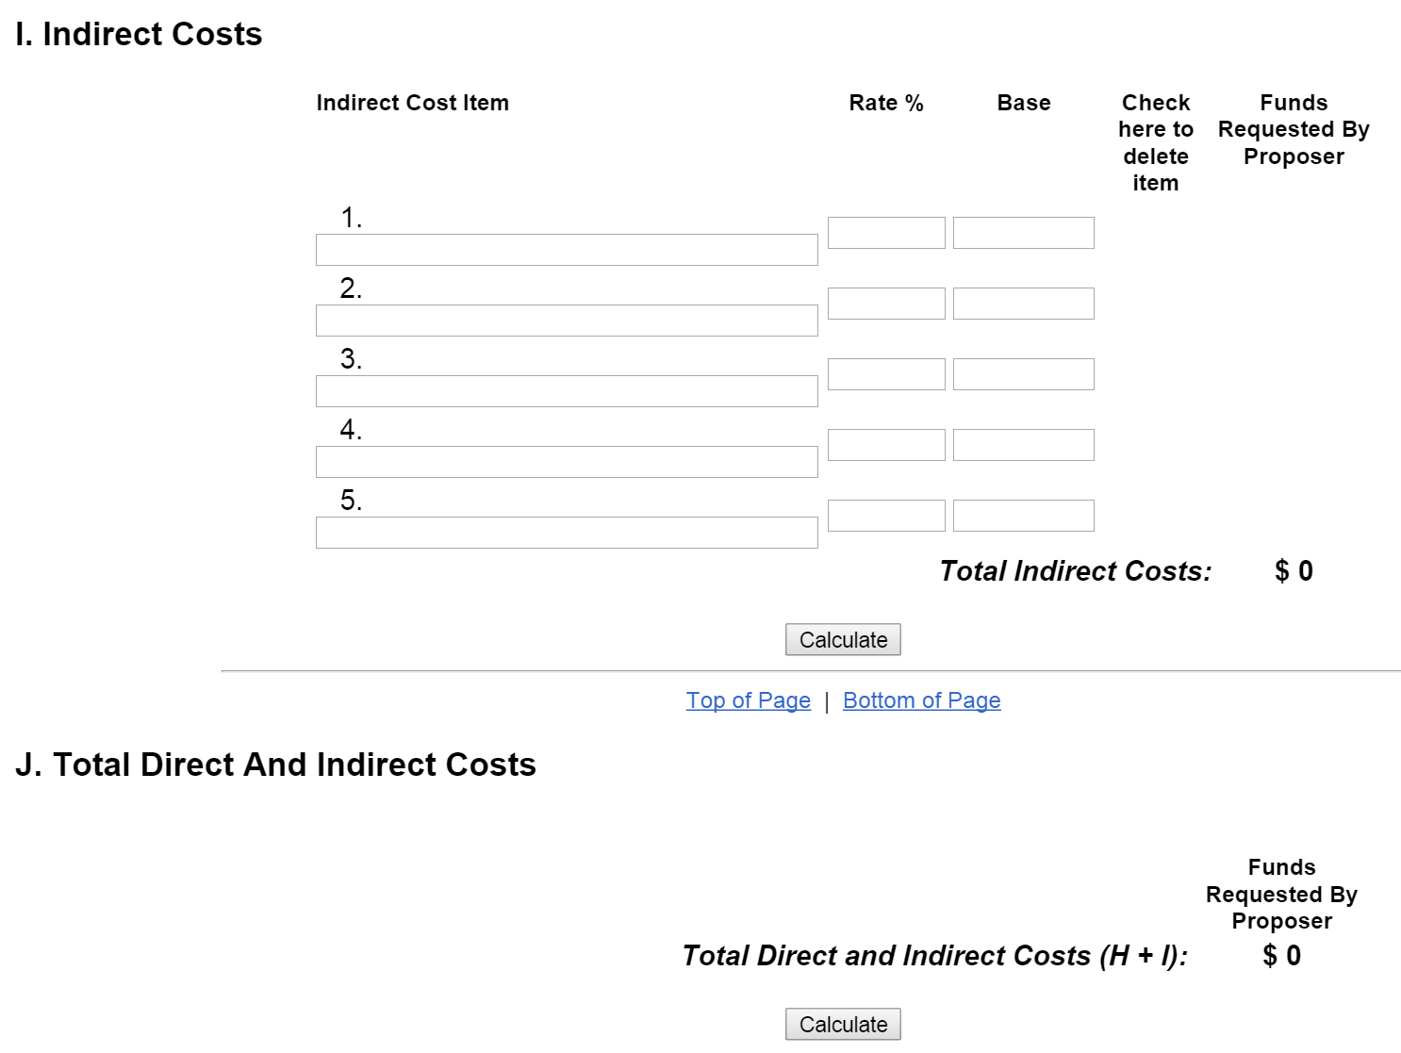

Slide 17
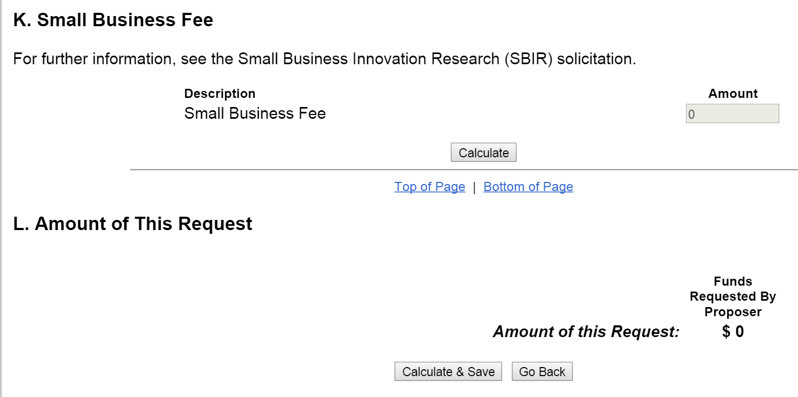

Slide 18
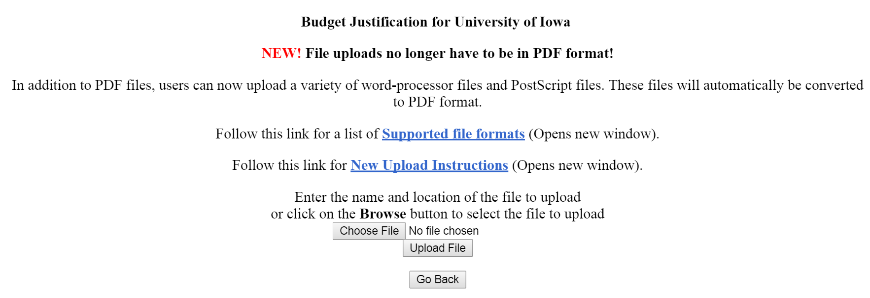

Slide 19
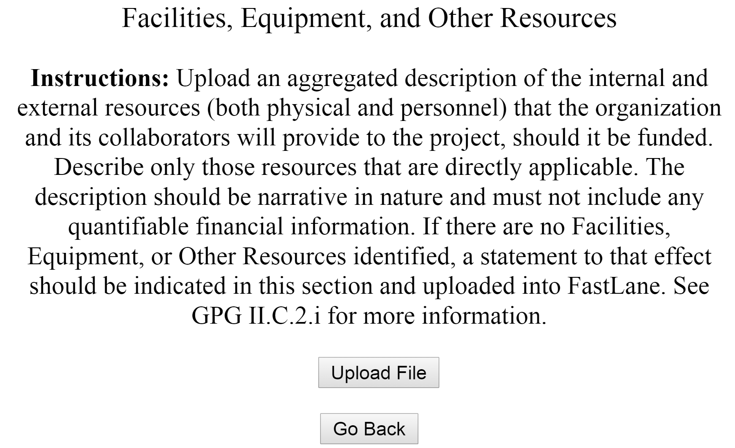
Examples: Computational, Office, Teaching, …

Slide 20
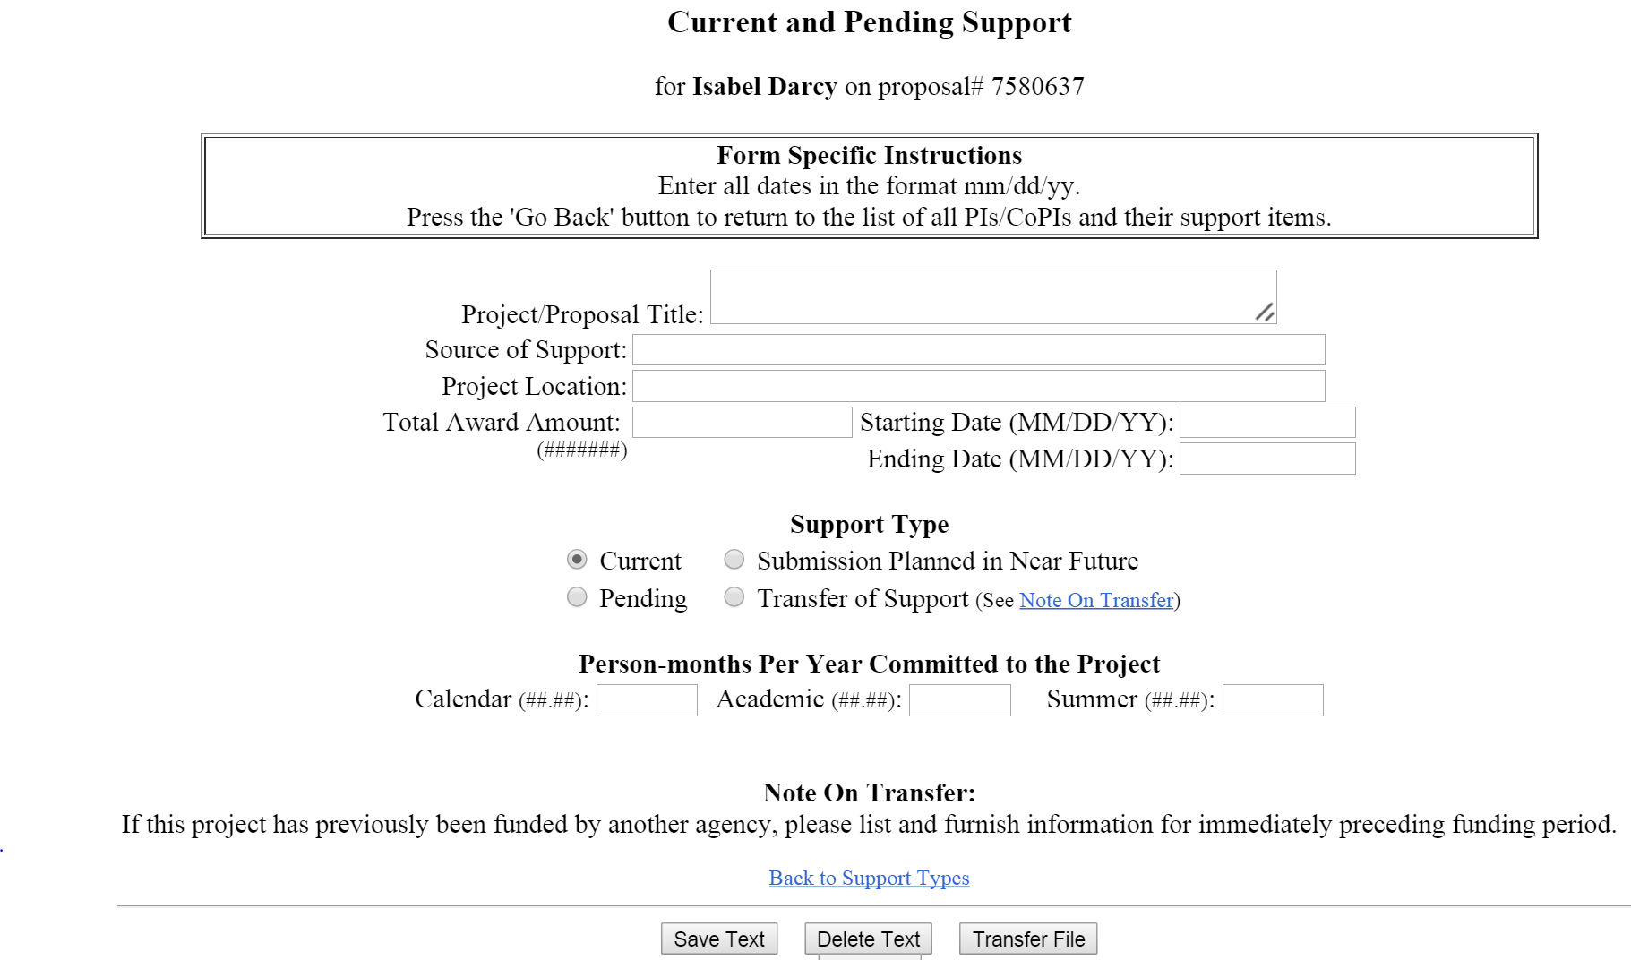

Slide 21
Biographical Sketch
(2 pages max, usually)
(a) Professional Preparation
A list of the individual’s undergraduate and graduate education and postdoctoral training (including location) as indicated below:
Undergraduate Institution(s) Location Major Degree & Year
Graduate Institution(s) Location Major Degree & Year
Postdoctoral Institution(s) Location Area Inclusive Dates (years)
(b) Appointments
A list, in reverse chronological order, of all the individual's academic/professional appointments beginning with the current appointment.
Products
  up to five products most closely related to the proposed project; and
  up to five other significant products, whether or not related to the proposed project.
Acceptable products must be citable and accessible including but not limited to publications, data sets, software, patents, and copyrights.

Slide 22
d) Synergistic Activities
A list of up to five examples that demonstrate the broader impact of the individual’s professional and scholarly activities that focuses on the integration and transfer of knowledge as well as its creation. Examples could include, among others: innovations in teaching and training (e.g., development of curricular materials and pedagogical methods); contributions to the science of learning; development and/or refinement of research tools; computation methodologies, and algorithms for problem-solving; development of databases to support research and education; broadening the participation of groups underrepresented in STEM; and service to the scientific and engineering community outside of the individual’s immediate organization.
(e) Collaborators & Other Affiliations
  Collaborators and Co-Editors
  Graduate Advisors and Postdoctoral Sponsors.
  Thesis Advisor and Postgraduate-Scholar Sponsor.

Slide 23
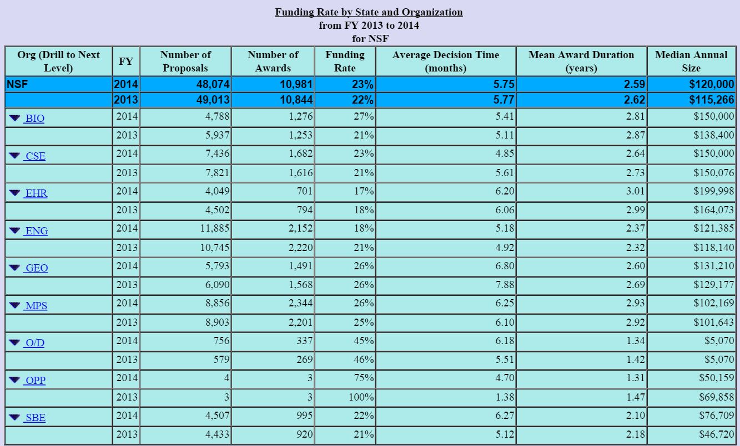

Slide 24
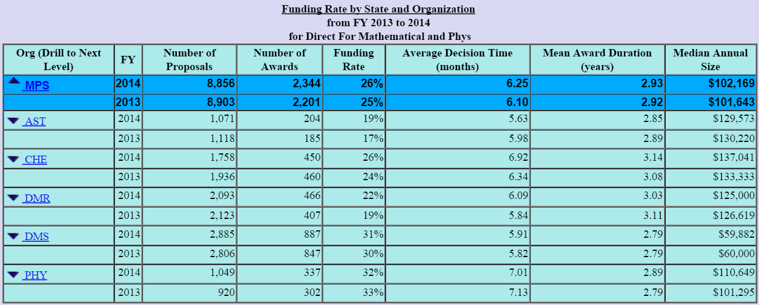

Slide 25
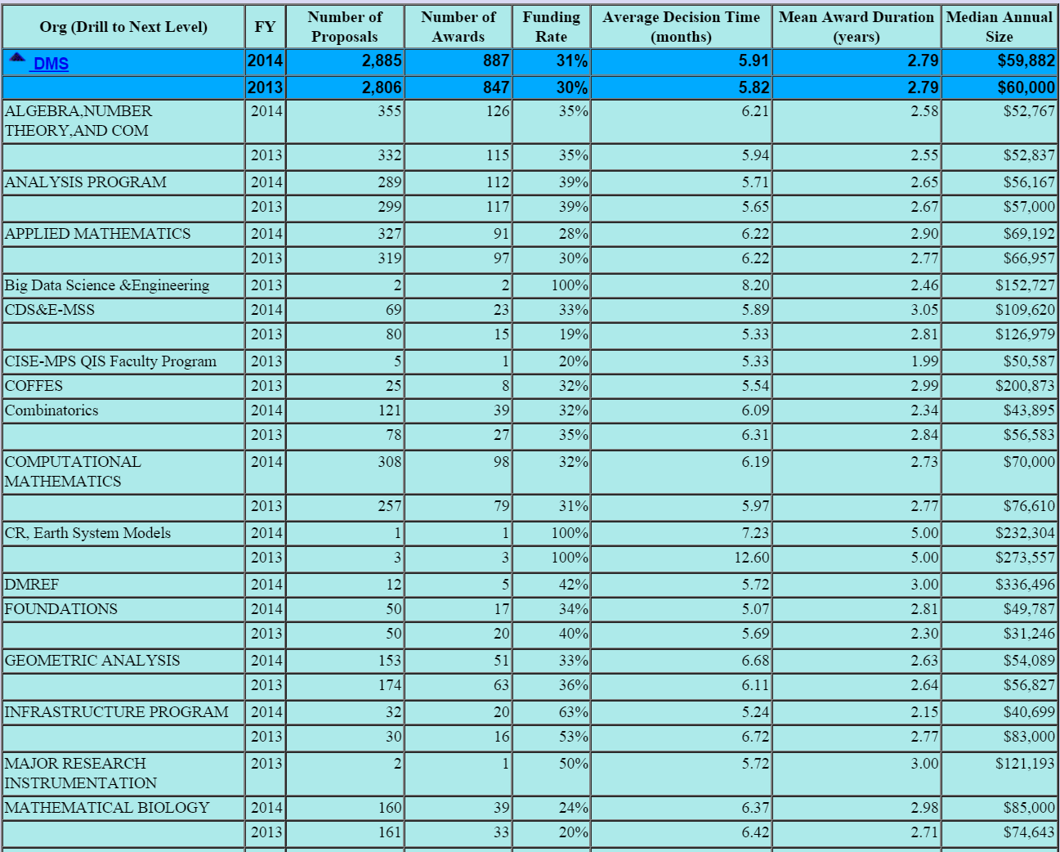

Slide 26
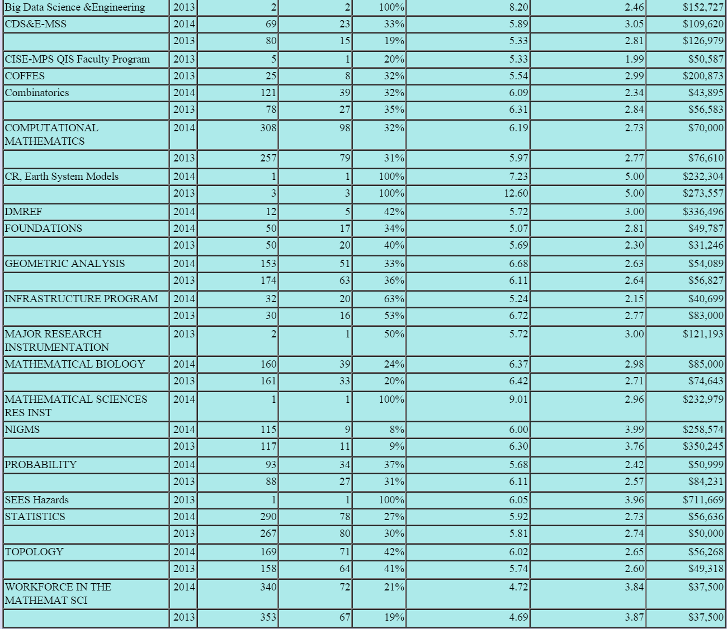

Slide 27
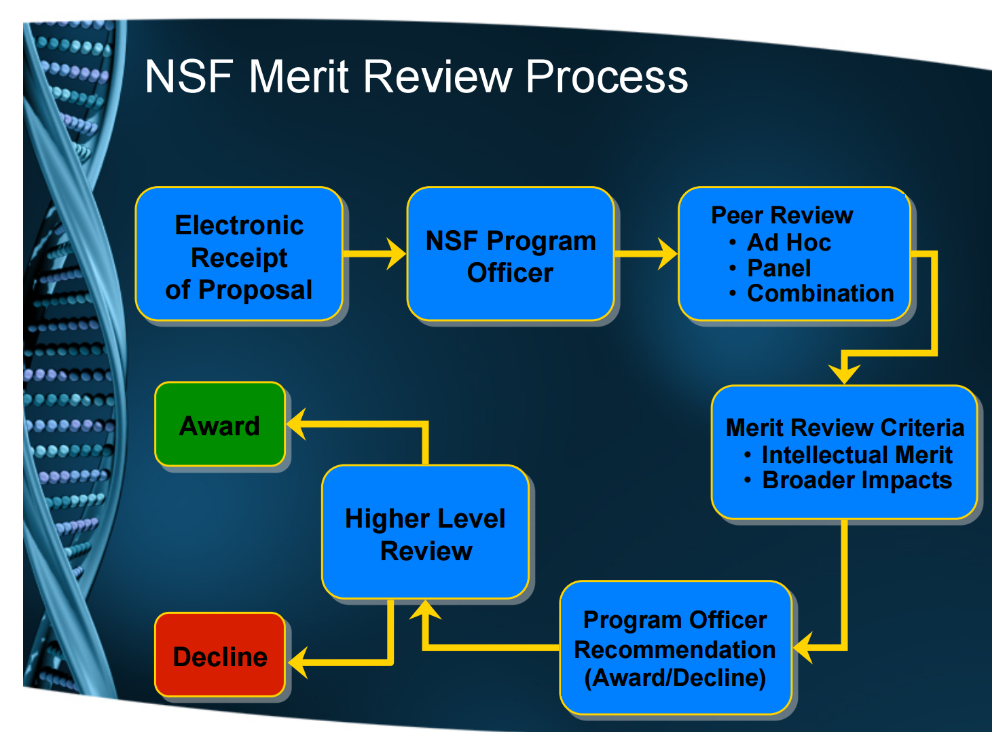
http://www.uww.edu/Documents/urp/rui/cameron.pdf Vicki Cameron August 2009

Slide 28
When reviewing 15 proposals, which are read first:
Those most related to reviewers research area.
Those with interesting titles.
Nicely formatted with good size font, section heading, lots of figures with good figure captions.
Well written.
Those that are read last:
Small font, overly technical, no figures, no figure captions, poor formatting, small font, small font, small font, …
Note that your proposal will be read by both experts in your field as well as non-experts. You must satisfy both audiences.

